Slide 1
Diagram Presentation PowerPoint
Presented by No Magic

Slide 2
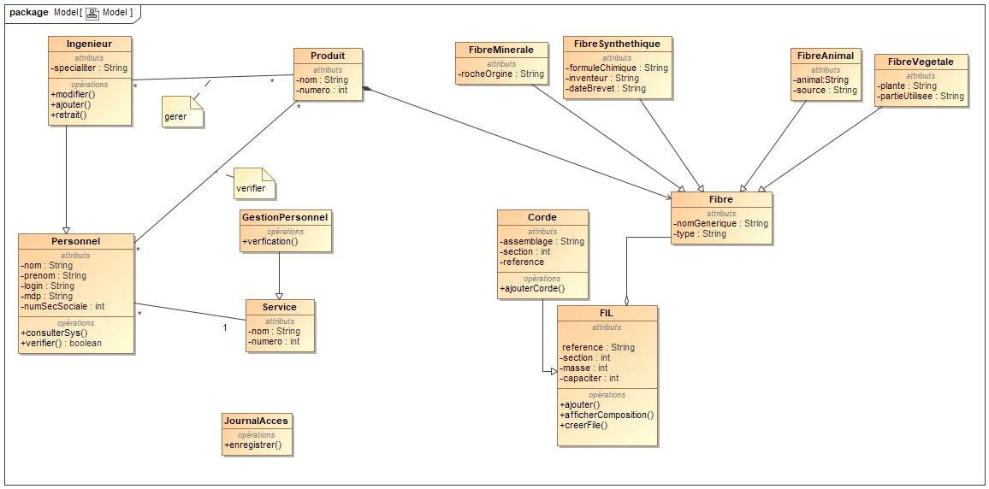
Model

Slide 3
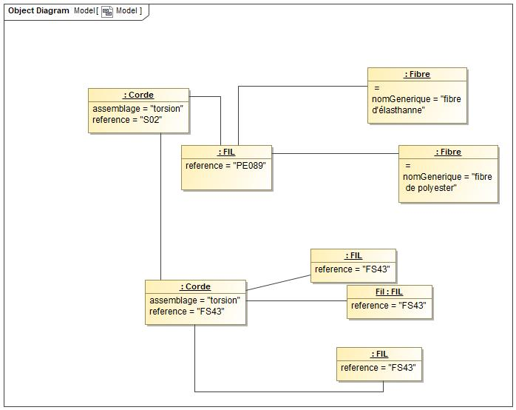
Model

Slide 4
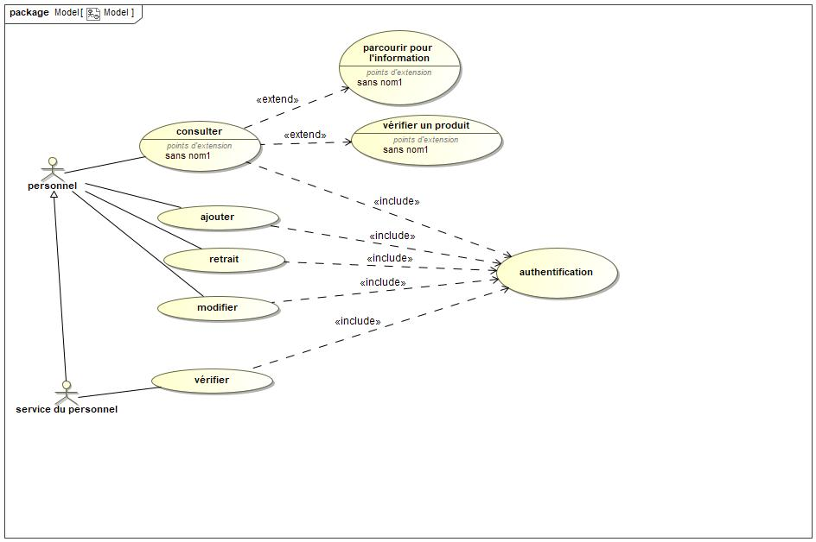
Model

