Slide 1
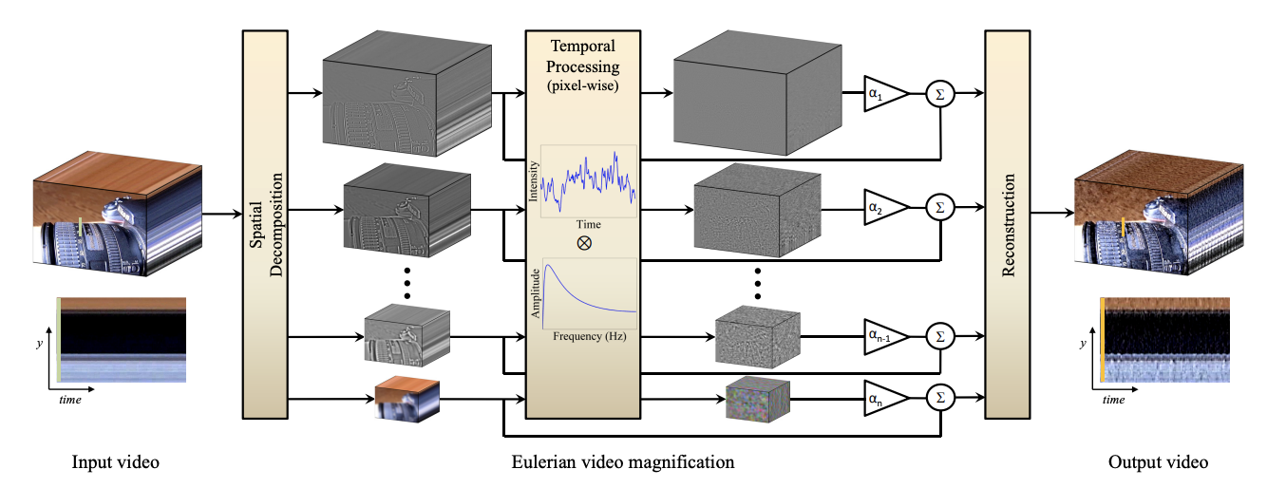
Eulerian Video Magnification
Construct the Laplacian pyramid

Slide 2
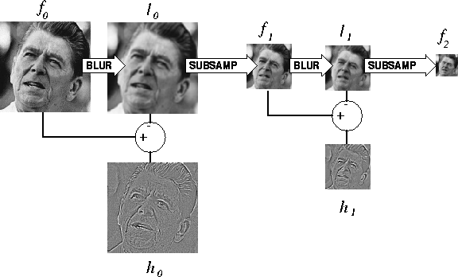
Eulerian Video Magnification
Construct the Laplacian pyramid
For face and my video, 4 levels
baby2 video, 6 levels
are used.

Slide 3
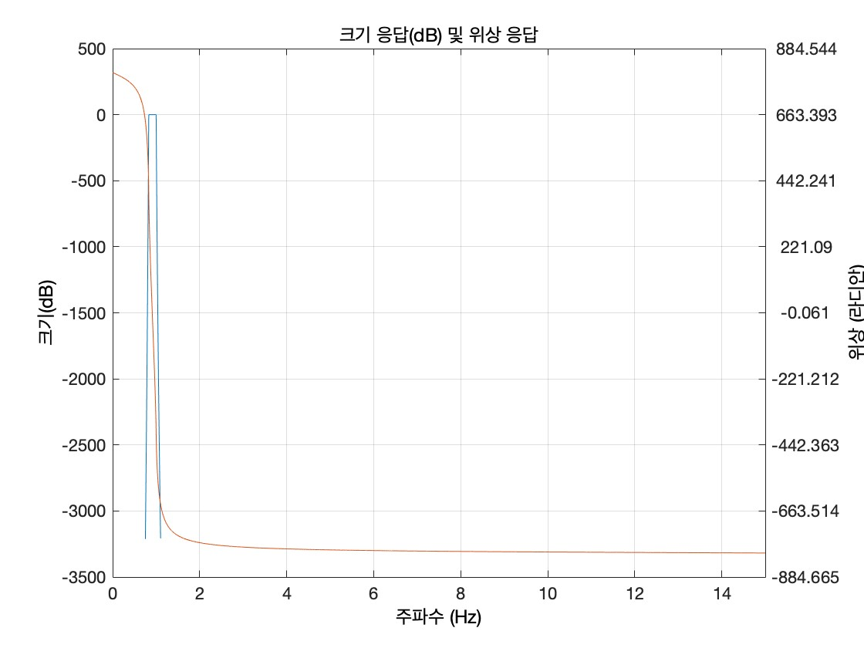
Eulerian Video Magnification
0.83-1
Construct the filter
Refer the EVM paper

Slide 4
Eulerian Video Magnification
Apply temporal filters to the signals
on the frequency domain

Slide 5
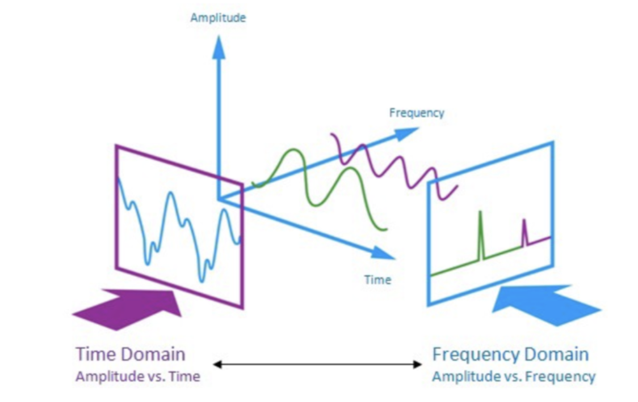
Eulerian Video Magnification
Apply temporal filters to the signals
on the frequency domain

Slide 6
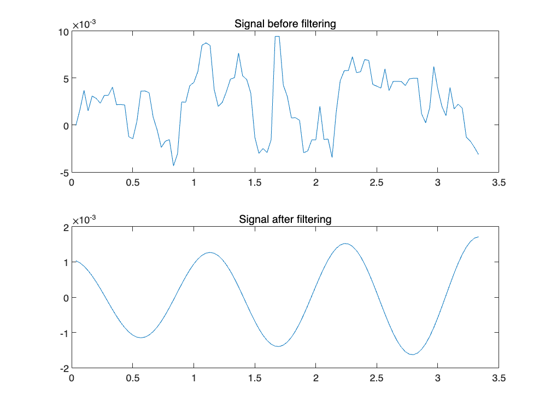
Eulerian Video Magnification
Ex) Face video
Apply temporal filters to the signals
on the frequency domain

Slide 7
Eulerian Video Magnification
Choose which levels of information
should be extracted

Slide 8
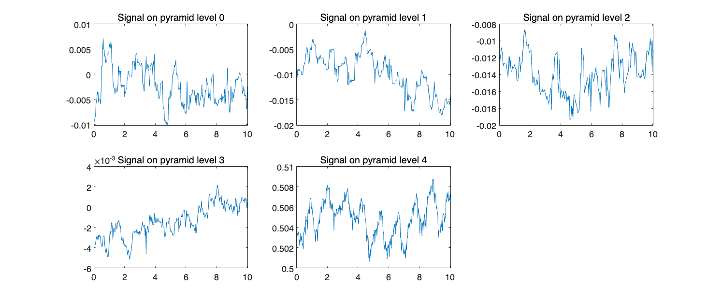
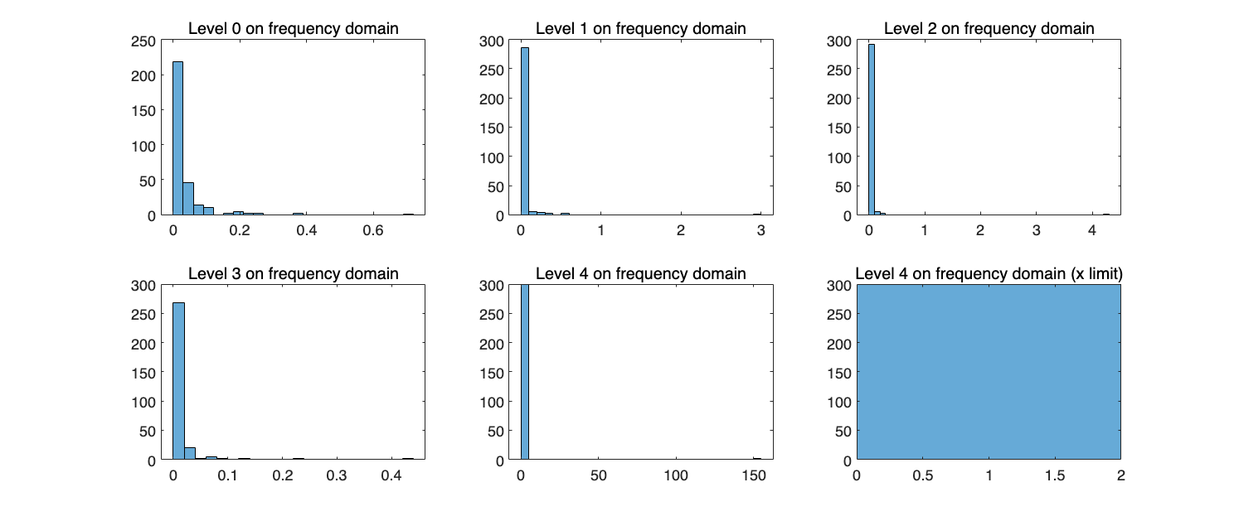
Eulerian Video Magnification
Choose which levels of information
should be extracted
Ex) Face video

Slide 9
Eulerian Video Magnification

