Slide 1
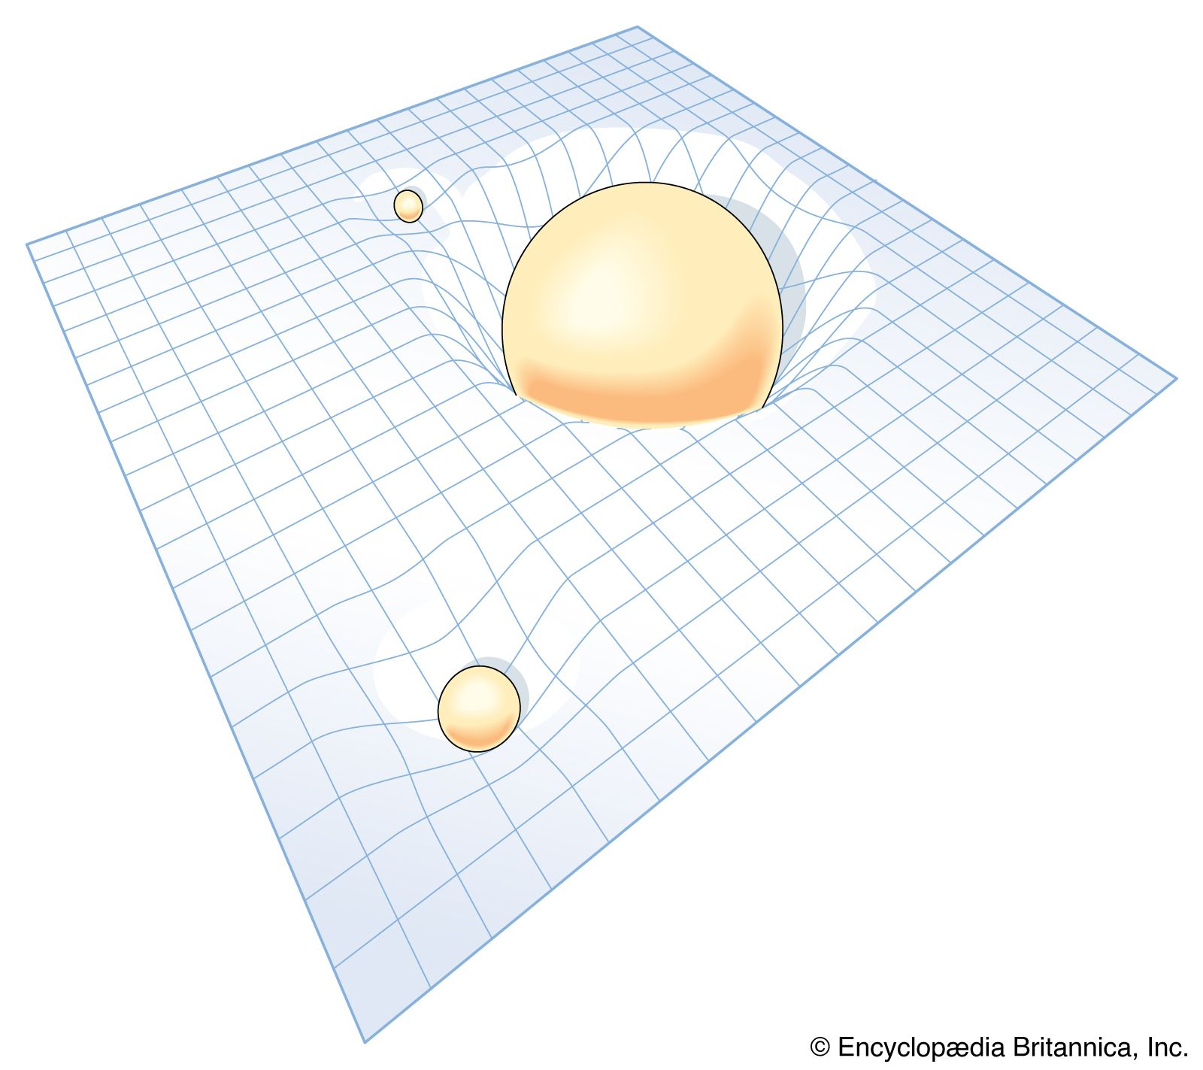
An Introduction to General Relativity: From Principles to Predictions
Daniel Alejandro Hinojosa -- Universidad Tecmilenio

Slide 2
