Slide 1

Parallel Computing Simulating the “Sharks and Fishes” problem in a Parallel Computing Environment
Dahir Mussa B00107811
Michael Dillon B00120328
Thomas Fokas B00121134
Shannon Dunne B00095740

Slide 2
Overview
Introduction
Aims
Objectives
Serial Computing
Parallel Computing
C programming
Scope
Methodology
Conclusions
References
Project Gantt Chart

Slide 3
Introduction
The ‘Sharks and Fishes’ problem is an example of a ‘Cellular Automata’, and the ‘Predator-Prey Model’.
Each cell is placed in a state.
States change, according to the rules.
States simultaneously change each generation.

Slide 4
Serial Computing
Serial computing is when a computer program is broken up into several different instructions, and then processed and executed (by a single processor) one at a time.
In comparison to parallel computing, serial is slower, and less cost-efficient.

Slide 5
Parallel Computing
Unlike serial computing, parallel computing is when a program is broken up into separate sections, and then each section is broken up into a set of instructions, which are executed at the same time on multiple processors.

Slide 6
C programming
C is a general-purpose programming language developed for operating systems such as Unix. c was first developed in the early 1970s by Ken Thompson and Dennis Ritchie at bell labs
C programming is a compiled language that is extremely popular and widely used programming language in the world. It is a powerful language and can be used for multitude of application..

Slide 7
Aims
Show the differences between using serial program and the parallel program.
Show parallel computing can speed up intensive calculations.
Show that executing multiply computations at the same is faster than executing one at a time.

Slide 8
Objectives
Write a serial and parallel C program to mimic the changing population of the sharks and fishes.
Create a visualisation for serial and parallel C programming.
Make predictions about the change of populations using the test results from the programs.
Test all programs to make sure there are no bugs and they are operating correctly.
Compare the difference between the computational performance of serial and parallel programming.

Slide 9
Methodology
C Programming
We plan to use the C programming language, on a 64-bit version of a Linux (Mageia) virtual machine, to write both: the serial (single processor) program, and on the parallel program with Pthreads (POSIX Threads)
POSIX Threads
POSIX Threads are commonly abbreviated as ’Pthreads’. We will use Pthreads to assist with the implementation of the parallel programs. Pthreads is an implementation and execution model that exists independently from a language, as well as a parallel execution model.
Java
We also plan to use the Java programming language to write a program to visualise the results of the evolution of sharks and fishes across the geographical area of study; over several generations

Slide 10
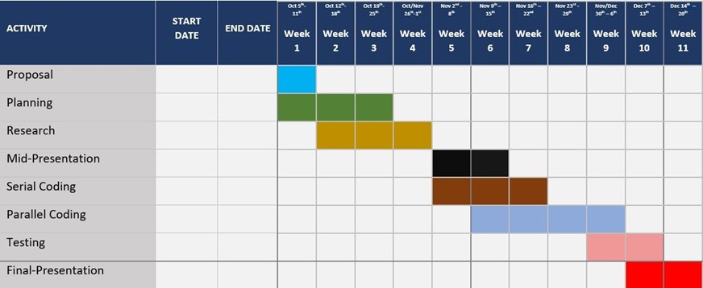
Project Gantt Chart

Slide 11
Conclusions
We are ready to start this project however, there are some parts we may still have to change ,the next stage of this project is to start writing pseudo-code for the serial program. the project is scheduled to be delivered on December at the end of the semester

Slide 12
References
1.Guru99.com. 2020. What Is C Programming Language? Basics, Introduction And History. [online] Available at: ¡https://www.guru99.com/c-programming-language.html¿ [Accessed 2 October 2020].
2. Techopedia.com. 2020.What Is C (Programming Language)? – Definition From Techopedia. [online] Available at: ¡https://www.techopedia.com/definition/24068/c-programminglanguagec¿ [Accessed 2 October 2020].
3. Abhay B. Rathod, Rajratna Khadse, M Faruk Bagwan, initial. (2014) ‘SERIAL COMPUTING vs. PARALLEL COMPUTING: A COMPARATIVE STUDY USING MATLAB’ International Journal of Computer Science and Mobile Computing, Vol. 3, Issue 5, pg.815-820

