Slide 1

Walmart Sales Analysis & Prediction
Yogita Dahiya
Hindu Girls College, Sonipat

Slide 2

Project Objective
Analyze Walmart sales data and predict future sales using machine learning.

Slide 3
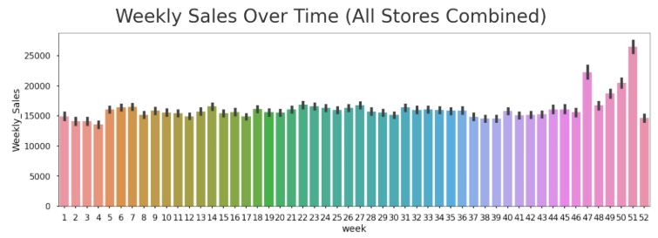
Dataset Overview
Dataset includes weekly sales of 45 stores with features like fuel price, CPI, unemployment, and holidays.

Slide 4
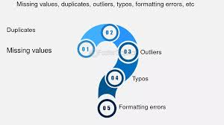
Data Cleaning
Handled missing values, removed duplicates, corrected date format, and ensured data consistency.

Slide 5

Feature Engineering
Extracted Month and Year from Date and created meaningful features for analysis.

Slide 6
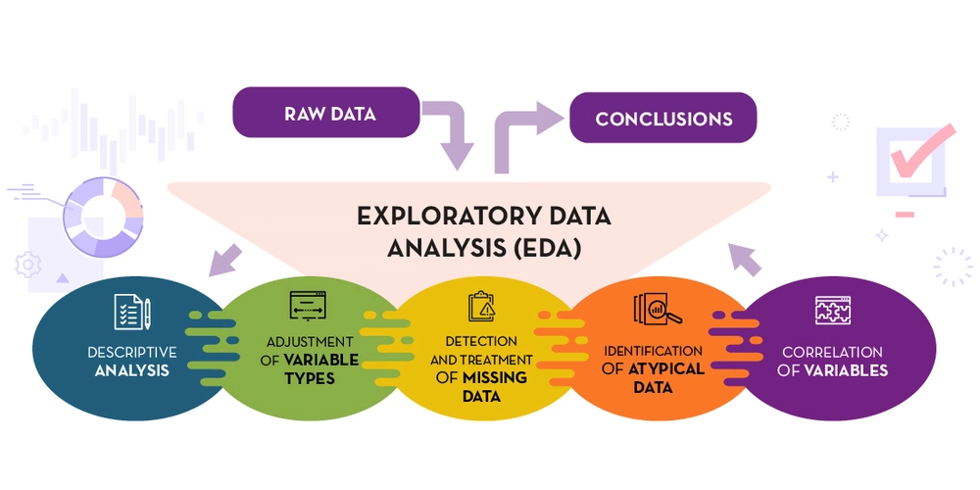
EDA (Exploratory Data Analysis)
Analyzed trends by store, month, and holidays to understand sales behavior.

Slide 7
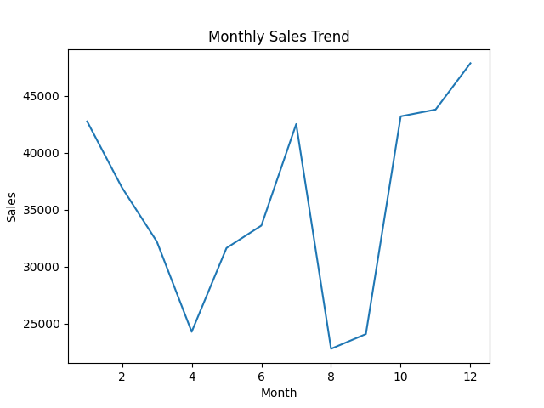
Sales Trend Analysis

Slide 8
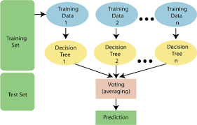
Machine Learning Models
Applied Linear Regression and Random Forest for sales prediction.

Slide 9
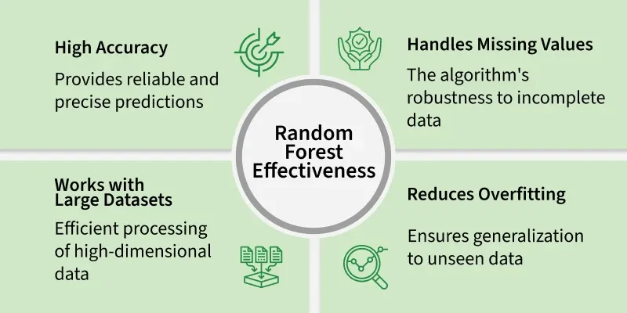
Model Performance
Random Forest provided better accuracy compared to Linear Regression.

Slide 10
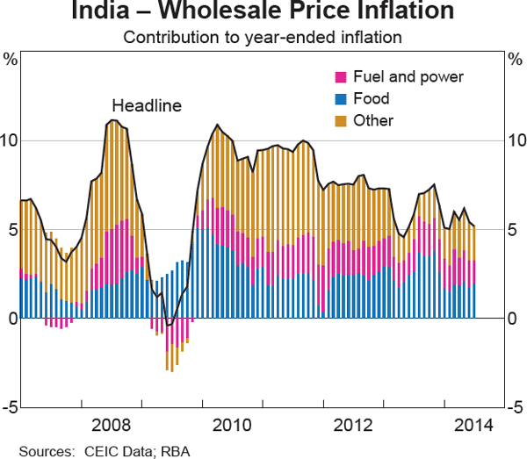
Key Insights
Sales vary by season and store. Economic factors like CPI and unemployment influence sales.

Slide 11

Conclusion
Data analysis and ML help businesses make better decisions and predict future sales.

Slide 12
Thank You
Thank you!
Questions?

