Slide 1
When Learning Stops: Recovering from an Expert Beginner
@ZacHarlan
@dahlbyk

Slide 2
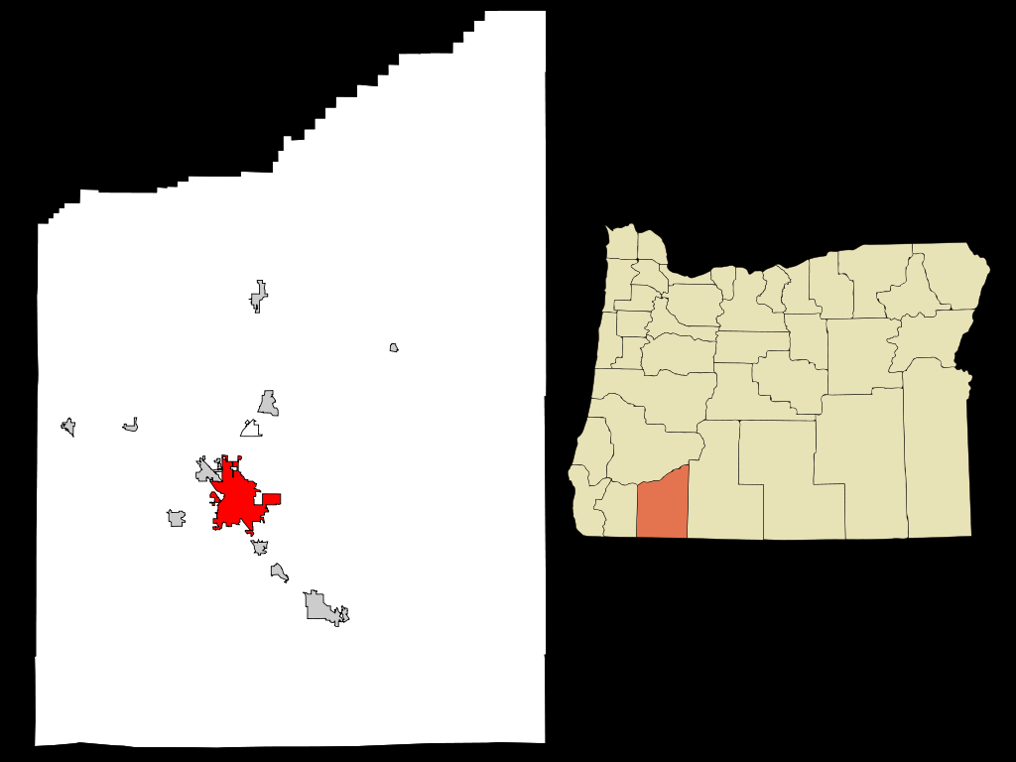
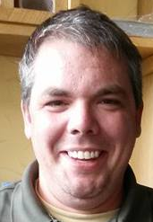

Slide 3














Motorsport Aftermarket Group

Slide 4
A Look Back
2008 – Tim Barcz joins J&P Cycles
2009 – MVC site ships; Keith joins
2010 – Record growth; Zac joins
2011 – Replace ERP system; record growth
2012 – Record growth; merger/restructuring; Keith quits
2013 – Army of One; Tim quits

Slide 5
Meet the VP
VP: “A strict scrum based process is not going to be successful in this larger project / work environment. We are going to have to come up with something that works with the quicker task based method SS currently uses along with the ability to quickly reassign resources and projects.”

Slide 6
Meet the VP
Keith: “If the structured sprints of Scrum won’t work, I would advocate for a Kanban approach: limit work in progress, select new work from a prioritized backlog. [PM] can track progress on the work that’s been started, and we can easily pull in in something of higher priority as necessary. … I strongly believe that allowing developers to self-direct within a process yields better results with less management overhead.”
VP: “It doesn’t really matter what we call it we just need to agree to a method and get to work. I don’t like getting tunnel vision on the next greatest way to write code and not actually get any code written. Having done this for so long the system we have now with [PM] running the projects and the EOD tracking is the most efficient way to get projects out.”

Slide 7
Meet the VP
VP: “Team Foundation is a complete source control development product with defect/bug tracking, task management and efficient integration into Visual studio and our agile project development methods (ect,ect). I know you have a lot of personal investment into GitHub but that open source type method of developing a product isn’t going to work for us going forward.”

Slide 8
Meet the VP
Keith: “Team Foundation works well for task/project management, and I’d suggest we continue using it for that. For source control specifically, I’d direct you to [MSDN post announcing git-tf]. The existence of a Microsoft-sponsored bridge to Git is a pretty clear admission to me that Git is the future. That’s even more true for a distributed team.”
VP: “No offense I used Git – installed it and played with it. In our environment there is nothing it does that we don’t already do with TF and in a quicker fashion. I want people writing code not worrying about checking in and branching methods.”

Slide 9
Meet the VP
VP: “Should the new web front end use MVC or .NET 4. 5 webforms? This I don’t have a 100% complete answer for. There is still a lot of debate to be had. However the two biggest negatives to each approach are – webforms uses viewstate and MVC requires a monolithic (project) type build so you have to push the whole website to make many backend changes where a webform we can push backend code for a specific page. Which in our fast paced development environment is something we do quite often. We also need to determine if MVC will work with our CMS and Faceted search functionality that is already built.”

Slide 10
Meet the VP
Keith: “I’m confident we can get MVC to do anything SS needs; I can’t say the same for WebForms and what J&P needs. The advantages of WebForms (data binding, forms) simply don’t come into play for public-facing sites, where we need specific control over markup and performance. And as a proponent of testing (on this I will not compromise), advocating logic in views because it allows the view to be pushed without a full site update just doesn’t resonate with me. A manual full-site update takes me perhaps 10 minutes, including build and 8000+ non-integration tests. And that process could be automated (so-called continuous deployment). Is that not fast enough?”

Slide 11
Meet the VP
VP: “When did you last work with web forms in a production environment? I realize that MVC is the big buzz word right now and I like the separation of code – but it does overly complicated some simple processes in many areas. The fact that you could do a manual full site update in 10 minutes is not the issues – it’s that we have 20 people working on the project and in various stages of work. Sometimes those features are not ready to go live yet or require other work to finish and we cannot always do a complete site push.”

Slide 12
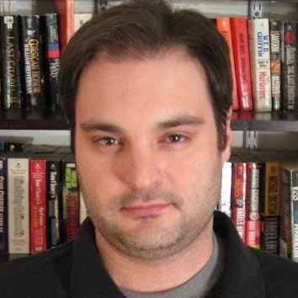
How Developers Stop Learning: Rise of the Expert Beginner
Erik Dietrich
http://www.daedtech.com/how-developers-stop-learning-rise-of-the-expert-beginner

Slide 13
The Dead Sea Effect
“All things being equal, the general competency of the IT department should have roughly the same distribution as the incoming hires.
“But in my experience, that’s not what happens. Instead, what happens is that the more talented and effective IT engineers are the ones most likely to leave — to evaporate, if you will. They are the ones least likely to put up with the frequent stupidities and workplace problems that plague large organizations; they are also the ones most likely to have other opportunities that they can readily move to.
http://brucefwebster.com/2008/04/11/the-wetware-crisis-the-dead-sea-effect/

Slide 14
The Dead Sea Effect
“What tends to remain behind is the ‘residue’ — the least talented and effective IT engineers. They tend to be grateful they have a job and make fewer demands on management; even if they find the workplace unpleasant, they are the least likely to be able to find a job elsewhere. They tend to entrench themselves, becoming maintenance experts on critical systems, assuming responsibilities that no one else wants so that the organization can’t afford to let them go.”
http://brucefwebster.com/2008/04/11/the-wetware-crisis-the-dead-sea-effect/

Slide 15
Dreyfus Model of Skill Acquisition
Expert
Advanced Beginner
Novice
Proficient
Competent
http://en.wikipedia.org/wiki/Dreyfus_model_of_skill_acquisition

Slide 16
Dunning-Kruger effect
A cognitive bias manifesting in two principal ways:
Unskilled individuals suffer from illusory superiority, mistakenly rating their ability much higher than is accurate. This bias is attributed to a metacognitive inability of the unskilled to recognize their ineptitude.
Those persons to whom a skill or skills come easily may find themselves with weak self-confidence, as they may falsely assume that others have an equivalent understanding. See Impostor syndrome.
http://en.wikipedia.org/wiki/Dunning%E2%80%93Kruger_effect

Slide 17
Dreyfus Model of Skill Acquisition
Novice
Adv Beginner
Competent
Proficient
Expert
DK
Imposter

Slide 18
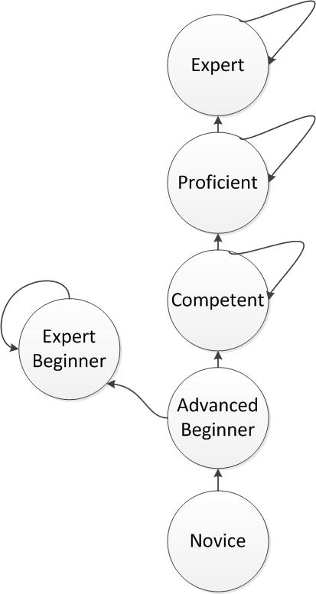
The Expert Beginner
“The Advanced Beginner stage is the last one in which the skill acquirer has no understanding of the big picture. As such, it’s the last phase in which the acquirer might confuse himself with an Expert.”
http://www.daedtech.com/how-developers-stop-learning-rise-of-the-expert-beginner

Slide 19
Expert Beginner Skill Acquisition
Novice
Adv Beginner
Competent
Proficient
Expert
DK
DK
DK
DK

Slide 20
The Expert Beginner
“The Expert Beginner has nowhere to go because progression requires an understanding that he has a lot of work to do, and that is not a readily available conclusion. You’ll notice that the Expert Beginner is positioned slightly above Advanced Beginner but not on the level of Competence. This is because he is not competent enough to grasp the big picture and recognize the irony of his situation, but he is slightly more competent than the Advanced Beginner due mainly to, well, extensive practice being a Beginner. If you’ve ever heard the aphorism about “ten years of experience or the same year of experience ten times,” the Expert Beginner is the epitome of the latter.”
http://www.daedtech.com/how-developers-stop-learning-rise-of-the-expert-beginner

Slide 21
Additional Reading
How Software Groups Rot: Legacy of the Expert Beginner
How Stagnation is Justified: Language of the Expert Beginner
False Tradeoffs and Empty Valuations
Condescension and Devaluations
The Angry Driver Effect
Experts are Wrong
Up or Not: Ambition of the Expert Beginner
Self-Correcting Organizations: Fall of the Expert Beginner
Wasted Talent: The Tragedy of the Expert Beginner
“a voluntary cessation of meaningful improvement.”
http://www.daedtech.com/tag/expert-beginner

Slide 22
So The VP Failed… Now What?

Slide 23
Assessing the Damage…
Personnel
Technical
Business

Slide 24
Planning a recovery…
Personnel
Who can get on board?
Expert Beginners train Expert Beginners; Competent+ leave
Technical
Values & Principles
Practices
Business
Setting Expectations
Rebuilding Relationships

Slide 25
Recovery Begins
2008 – Tim Barcz joins J&P Cycles
2009 – MVC site ships; Keith joins
2010 – Record growth; Zac joins
2011 – Replace ERP system; record growth
2012 – Record growth; merger/restructuring; Keith quits
2013 – Army of One; Tim quits
2014 – Recovery; Keith & Tim rejoin MAG

Slide 26
Executing a recovery…
90-day Rollout Plan
Transparency
Measure Progress
Celebrate Successes

Slide 27
How is it going?
Technical
Slower than planned
Much easier to learn by example
Personnel
Values are easier said than felt
Difficult to transition from top-down to self-organizing
Business
Stakeholder confidence/feedback steadily improving
But past dev experience still frames some interactions

Slide 28
Epilogue

Slide 29
A Look Ahead
2008 – Tim Barcz joins J&P Cycles
2009 – MVC site ships; Keith joins
2010 – Record growth; Zac joins
2011 – Replace ERP system; record growth
2012 – Record growth; merger/restructuring; Keith quits
2013 – Army of One; Tim quits
2014 – Recovery; Keith & Tim rejoin MAG
2015 – Record growth; make up for lost time
Questions? Also: jobs.jpcycles.com

