Slide 1
All teams are distributed
Keith Dahlby
@dahlbyk

Slide 2
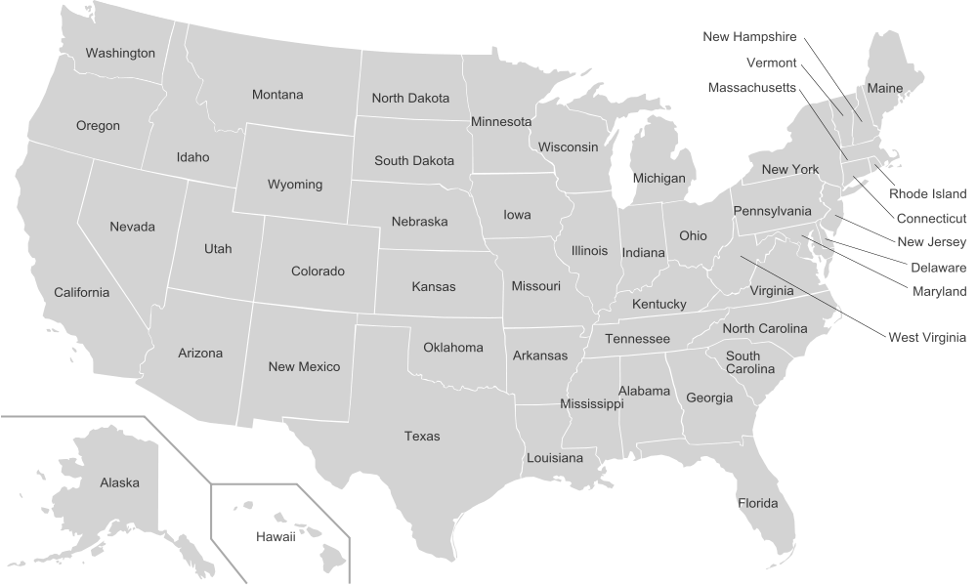





Slide 3
The most efficient and effective method of conveying information to and within a development team is face-to-face conversation.
Principles behind the Agile Manifesto
http://agilemanifesto.org/principles.html

Slide 4
Programmers work side by side in pairs, continually seeing and discussing each other’s code.
Extreme Programming Core Practice #7
http://www.computerworld.com/article/2585634/app-development/extreme-programming.html

Slide 5
Teams of workers that labored together for several months in specially designed "war rooms" were twice as productive as their counterparts working in traditional office arrangements
University Of Michigan study
https://www.sciencedaily.com/releases/2000/12/001206144705.htm

Slide 6
Is your team co-located?

Slide 7
Has anyone joined?

Slide 8
Will anyone join?

Slide 9
Has anyone left?

Slide 10
Will anyone leave?

Slide 11
The whole organization?

Slide 12
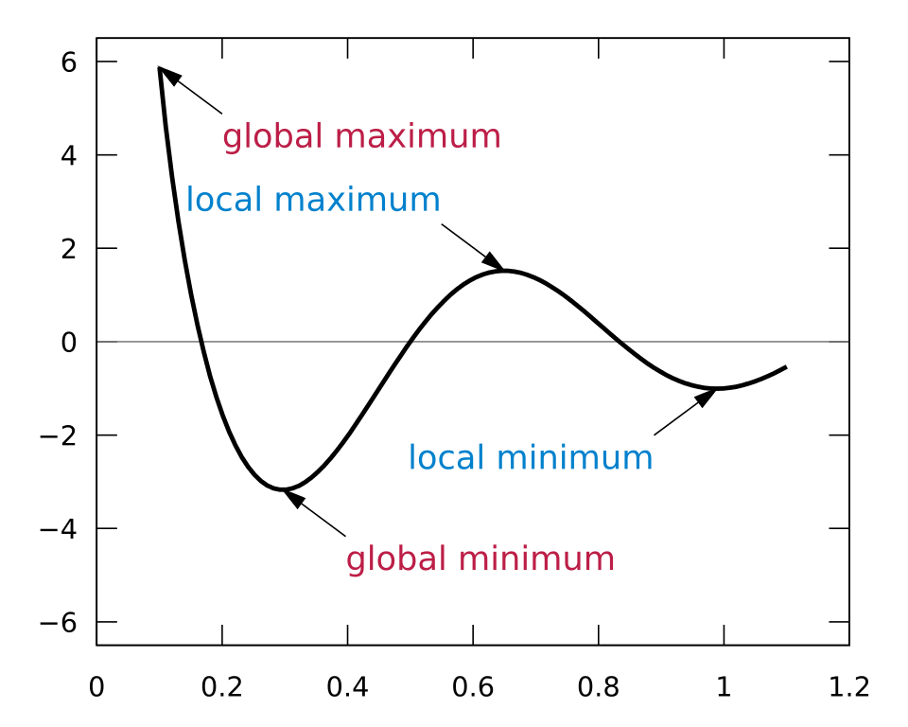
Face-to-face is a Local Maximum
https://en.wikipedia.org/wiki/Maxima_and_minima

Slide 13
Face-to-face is ephemeral

Slide 14
Meetings are ephemeral

Slide 15
Writing is forever

Slide 16
Rule 1: Be Deliberate

Slide 17
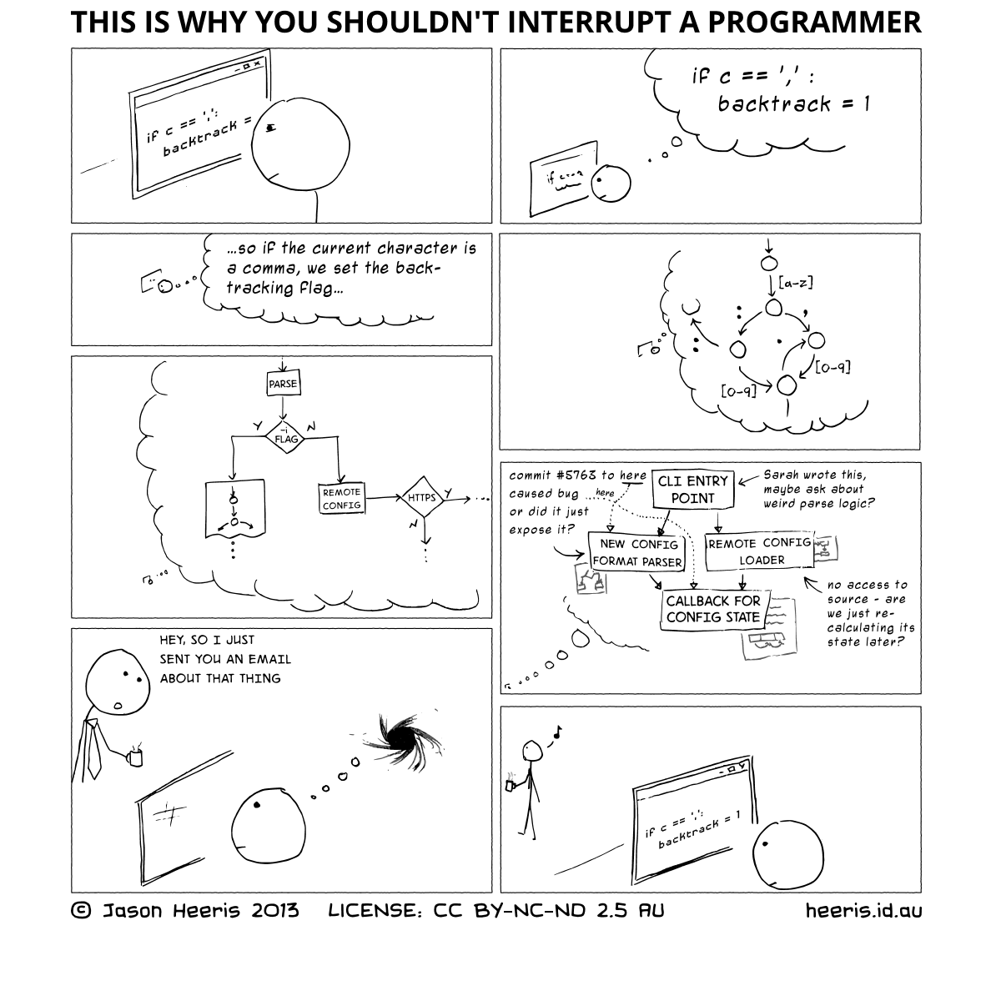
http://heeris.id.au/2013/this-is-why-you-shouldnt-interrupt-a-programmer/

Slide 18
Rule 2: Assume Asynchronous

Slide 19
Rule 3: Public over Private

Slide 20
Rule 4: Avoid Assumptions

Slide 21
Rule 5: Seek Clarification

Slide 22
Rule 6: Everything Gets a Link

Slide 23
Rule 7: Create a Web

Slide 24
Rule 8: Version Control Matters

Slide 25
Rule 9: Continuous Deployment

Slide 26
Rule 10: Have Fun

Slide 27
Questions?
@dahlbyk
github.com/dahlbyk/Presentations
HuBoard.com
NewBo.Co

