Slide 1
Stop Wasting Your Time With TypeScript
Keith Dahlby
@dahlbyk
Notes:
TypeScript has taken over the JavaScript ecosystem at an incredible pace, and not everyone is happy about it. In this session we'll review some of the reasons teams say they have moved away from TypeScript, so we can evaluate their conclusions and come up with some guidance for your own projects. More importantly, we'll focus on tips to make the TypeScript you write as productive as possible, working _with_ the type system instead of against it.

Slide 2

Notes:
https://thatconference.com/wi/2024/sponsors/

Slide 3
Big projects are ditching TypeScript… why?
Fireship
3.2 million subscribers
1.3 million views since Sep 7, 2023

Slide 4
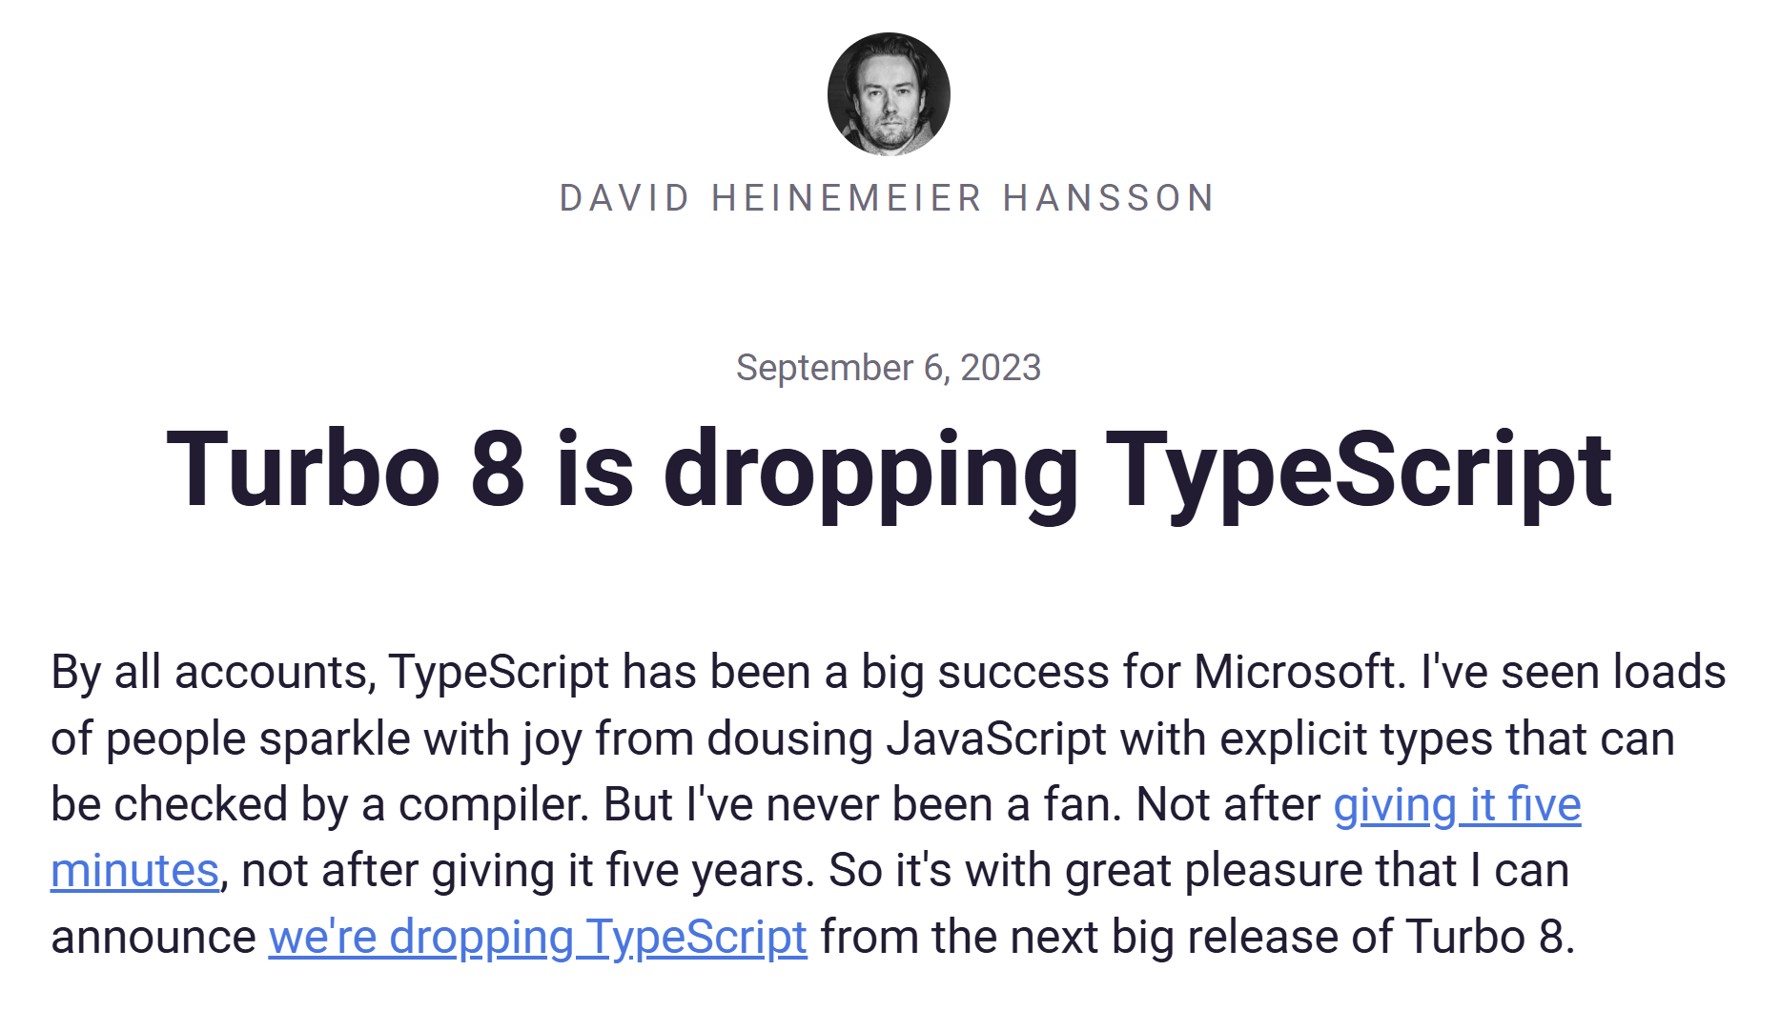
Notes:
https://world.hey.com/dhh/turbo-8-is-dropping-typescript-70165c01

Slide 5
Turbo 8 is dropping TypeScript
“The fact is that I actually rather like JavaScript… This wasn't always the case. But… it's become a real joy to write.
“TypeScript just gets in the way of that for me… because it pollutes the code with type… Things that should be easy become hard, and things that are hard become `any`. No thanks!”

Slide 6
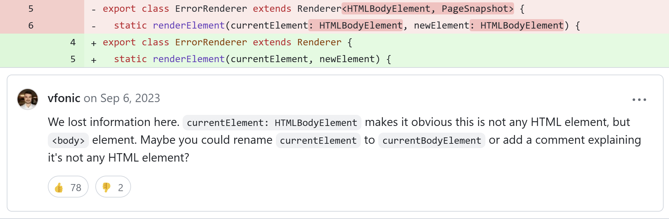
Pollution?
Notes:
https://github.com/hotwired/turbo/pull/971

Slide 7
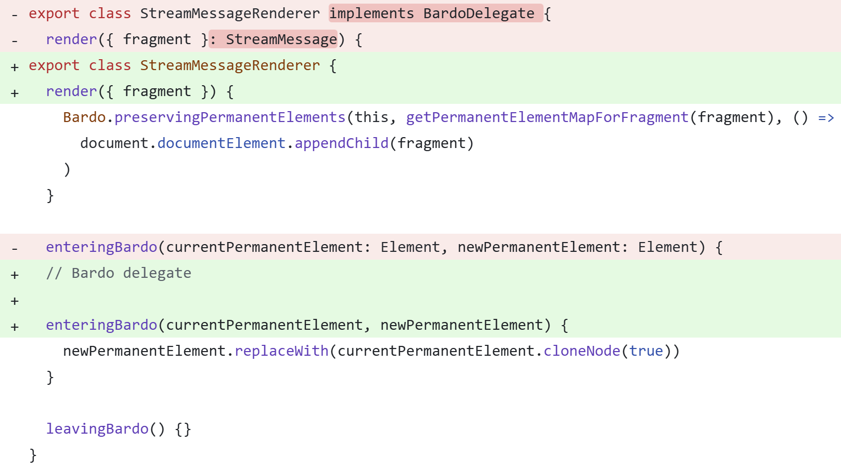
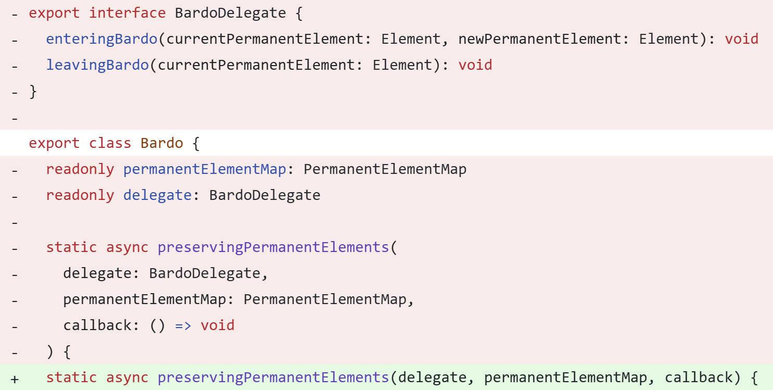
Pollution?
What is delegate?
Is this a delegate?
Notes:
https://github.com/hotwired/turbo/pull/971

Slide 8
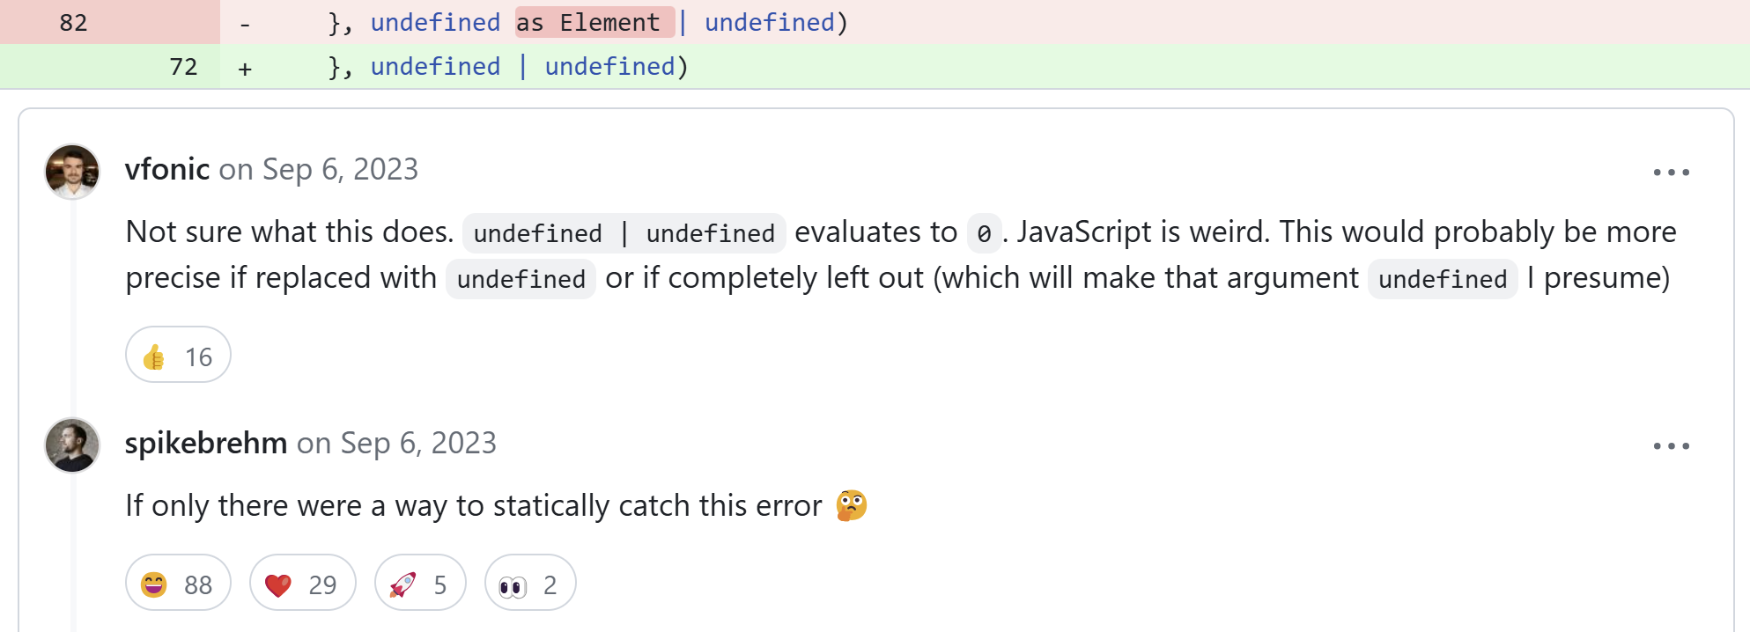
Pollution?
Notes:
https://github.com/hotwired/turbo/pull/971

Slide 9
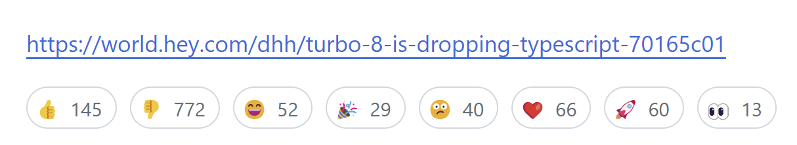
And there was much rejoicing?
Notes:
https://github.com/hotwired/turbo/pull/971

Slide 10
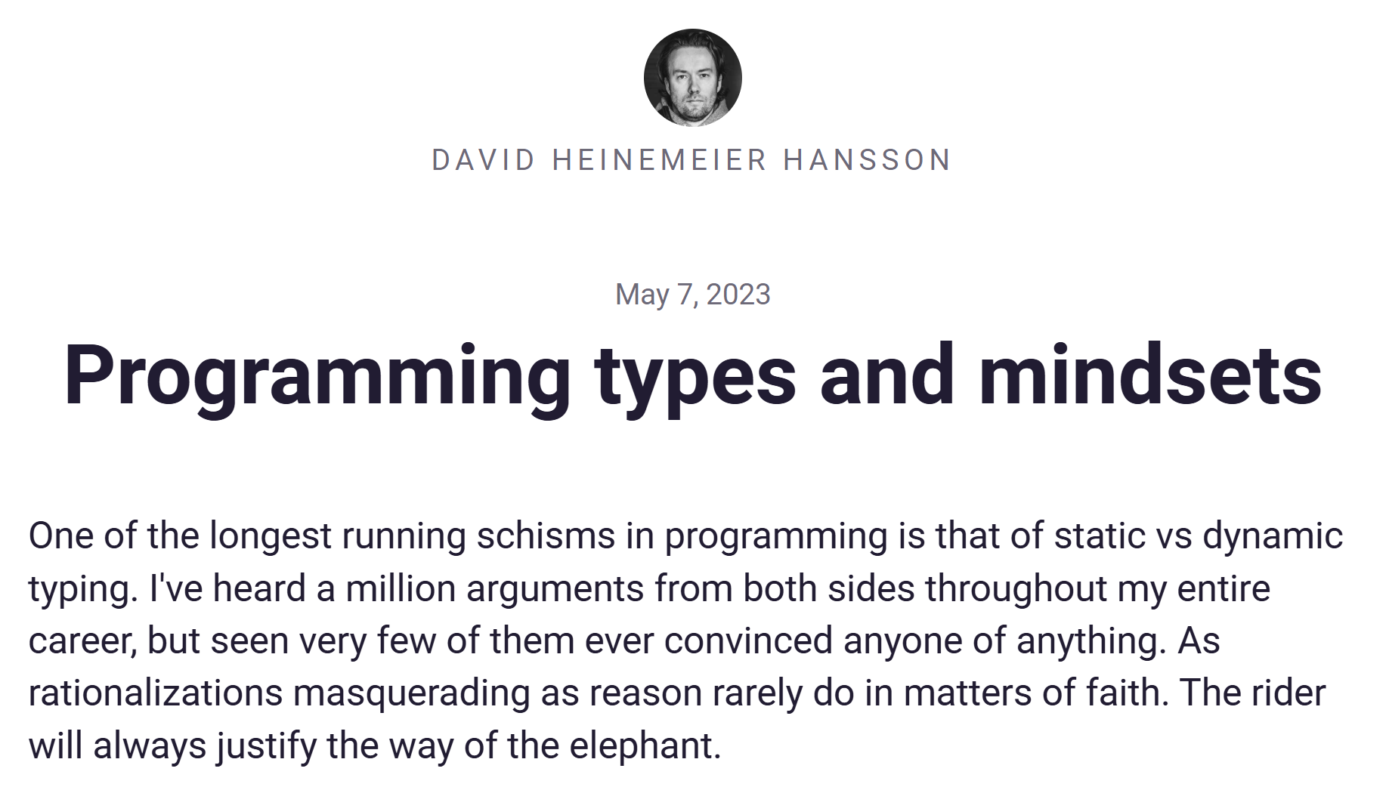
Notes:
https://world.hey.com/dhh/programming-types-and-mindsets-5b8490bc

Slide 11
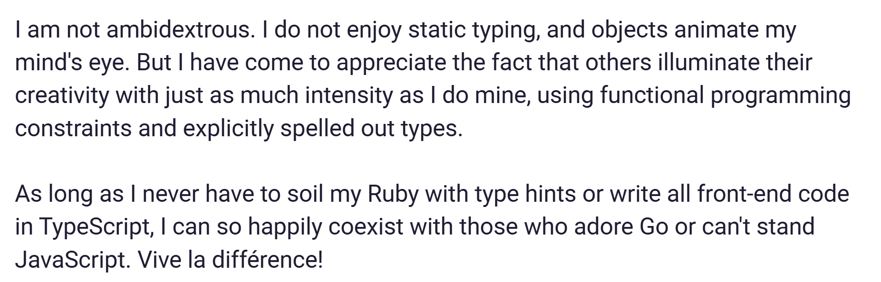
Stop wasting your time.

Slide 12
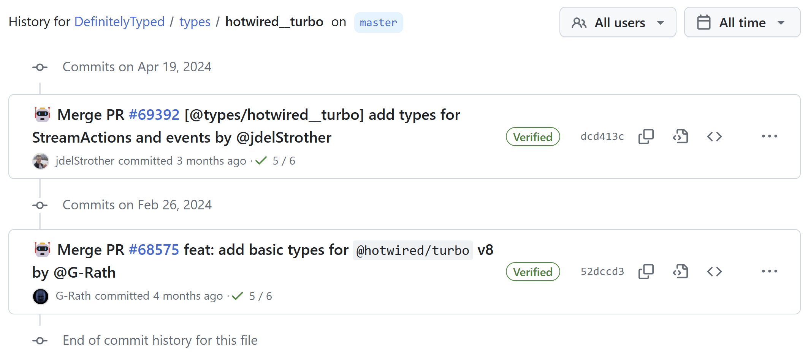
Waste someone else’s!
Notes:
https://github.com/DefinitelyTyped/DefinitelyTyped/commits/dcd413c4a6e7b5e0bf34a1c2841e24fc40118083/types/hotwired__turbo

Slide 13
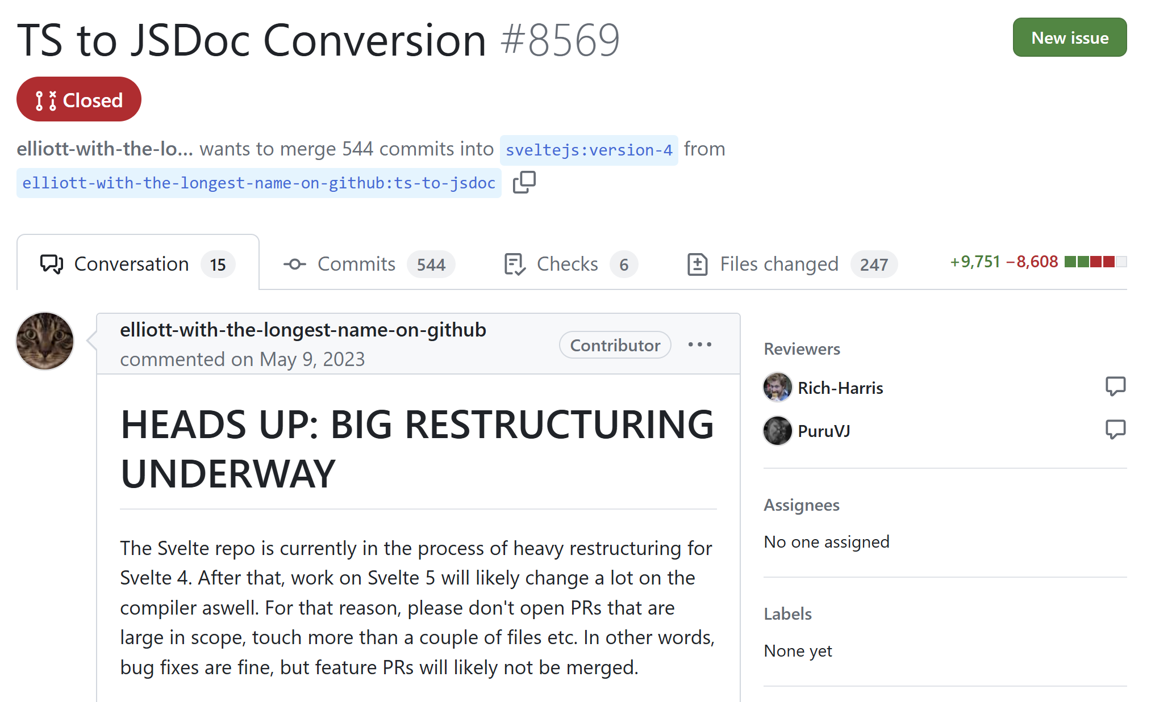
Svelte drops TS
Notes:
https://github.com/sveltejs/svelte/pull/8569

Slide 14
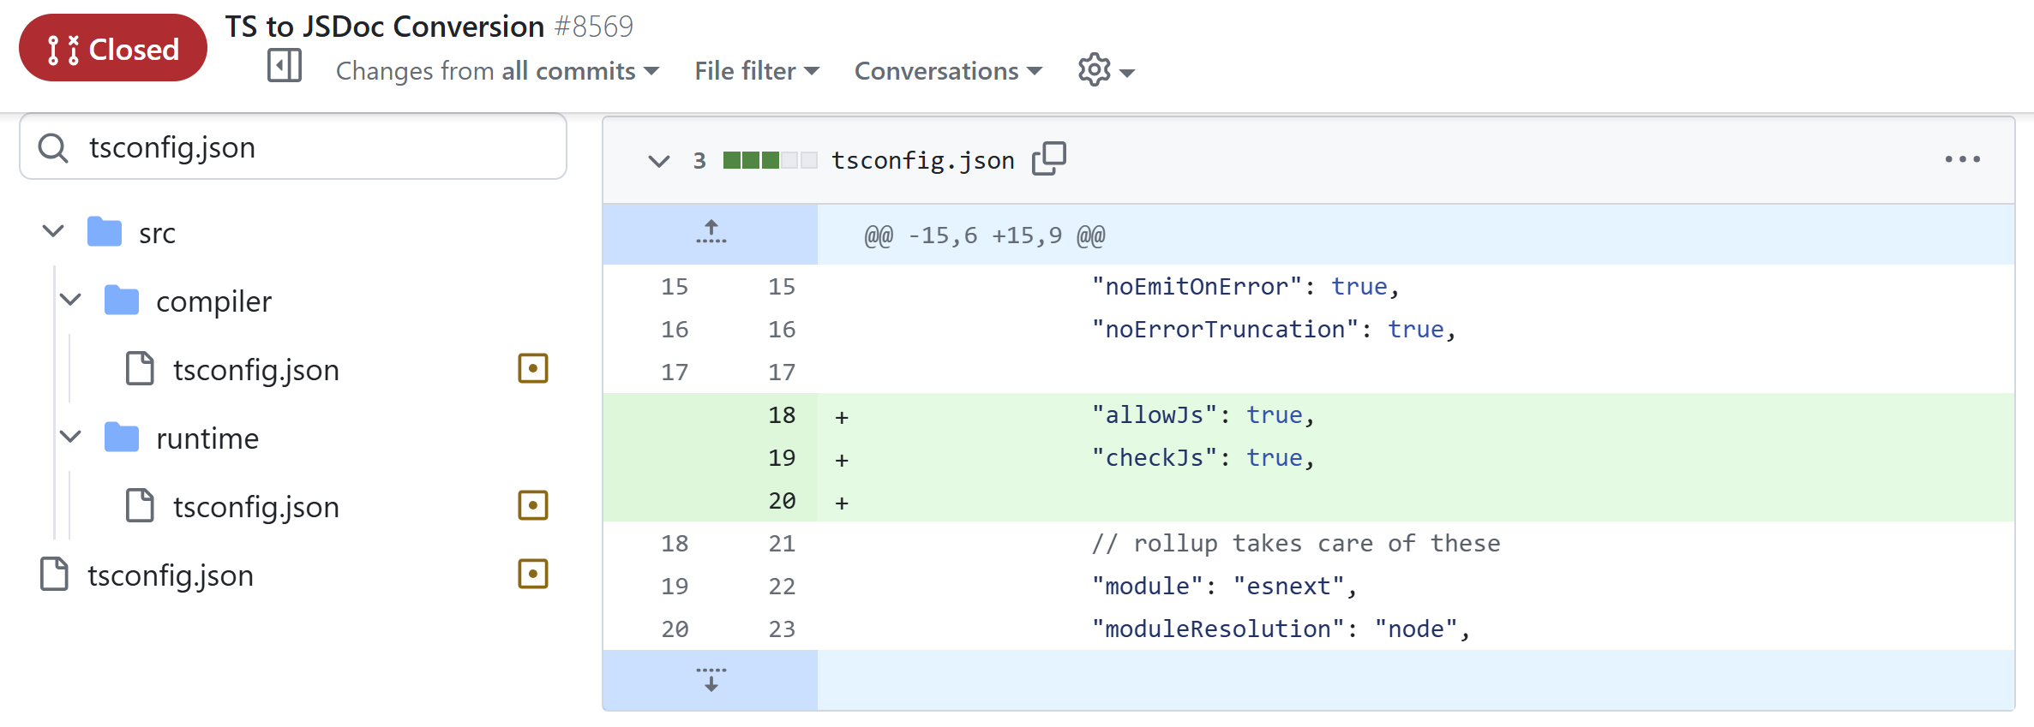
Svelte…keeps TS?
Notes:
https://github.com/sveltejs/svelte/pull/8569

Slide 15
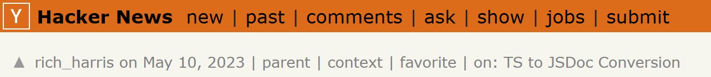
“If you're rabidly anti-TypeScript…I'm about to disappoint you. If you're rabidly pro-TypeScript…I'm about to disappoint you as well.
“Firstly: we are not abandoning type safety or anything daft like that… Our commitment to TypeScript is stronger than ever…
“We're doing this for practical reasons, not ideological ones — we've been building SvelteKit (as opposed to Svelte) this way for a long time and it's been miraculous for productivity.”
Notes:
https://news.ycombinator.com/item?id=35892250

Slide 16
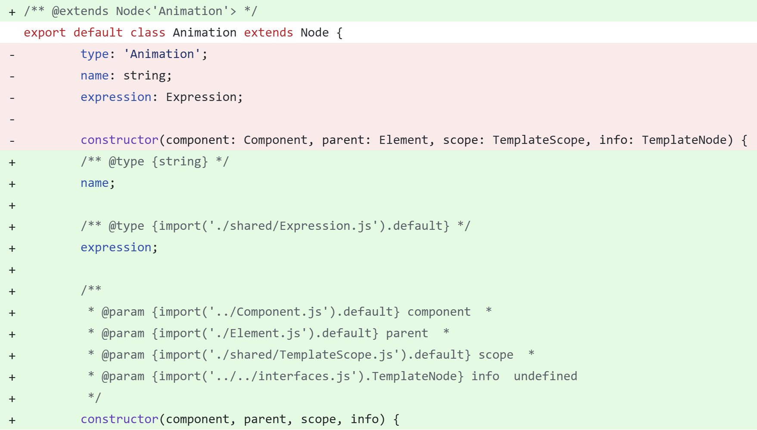
Types via JSDoc
Notes:
https://www.typescriptlang.org/docs/handbook/jsdoc-supported-types.html

Slide 17
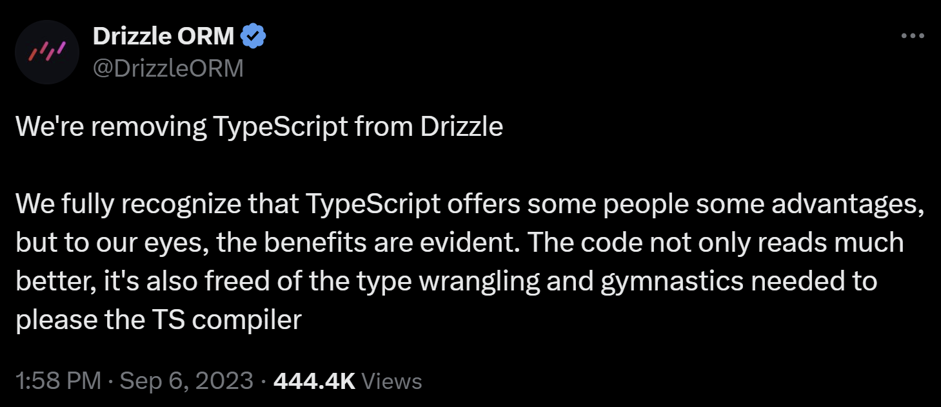
Drizzle drops TS
Notes:
https://x.com/DrizzleORM/status/1699497381824201074

Slide 18
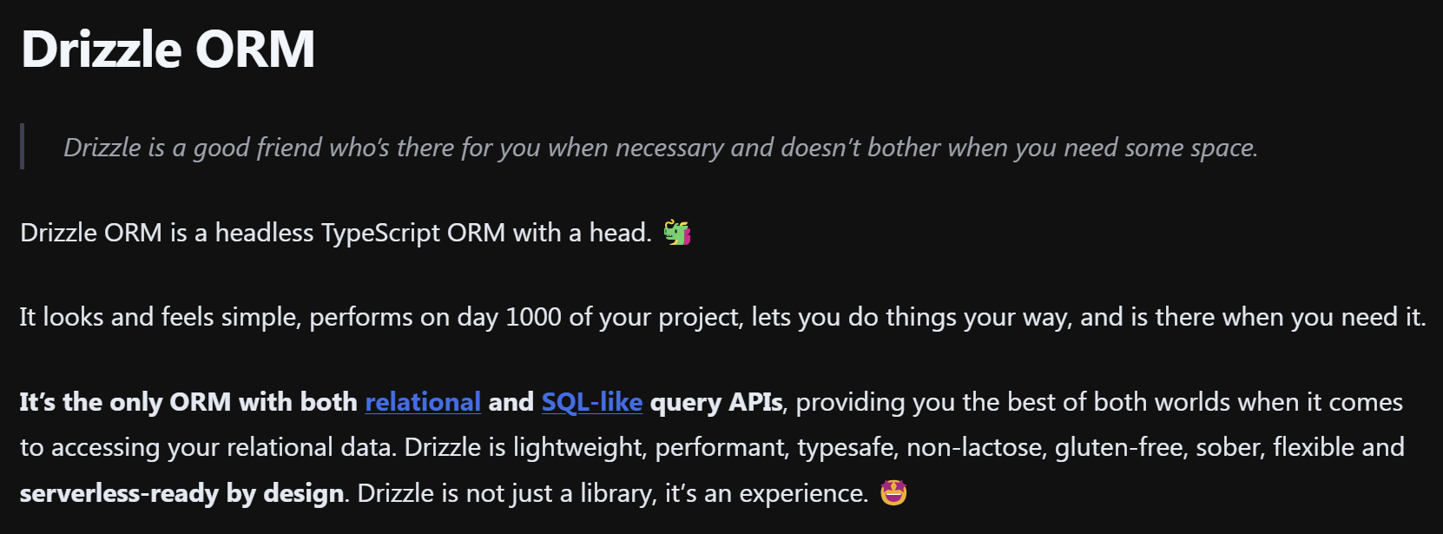
Drizzle marketing
Notes:
https://orm.drizzle.team/docs/overview

Slide 19
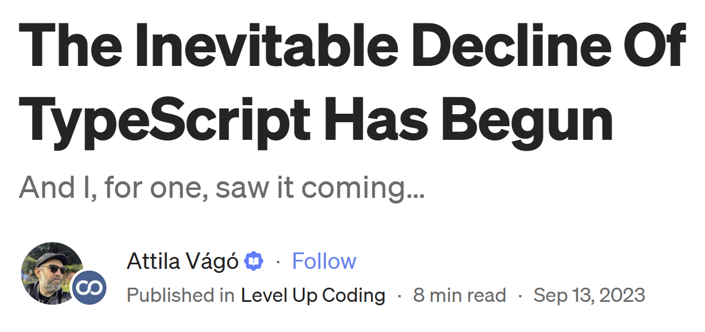
Notes:
https://levelup.gitconnected.com/the-inevitable-decline-of-typescript-has-begun-22e4899d0ae1

Slide 20
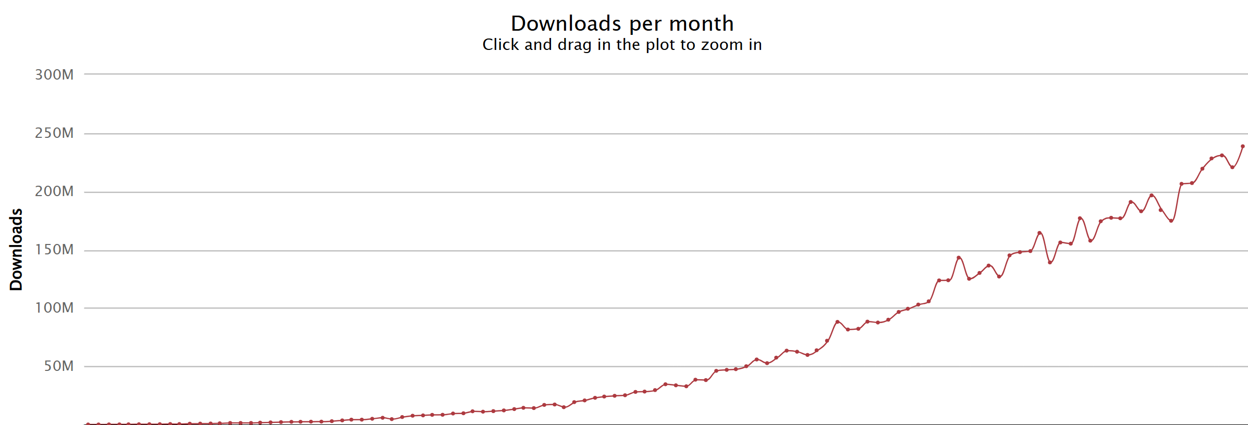
The Inevitable Decline of TS Has Begun
Notes:
https://npm-stat.com/charts.html?package=typescript&from=2015-01-01&to=2024-07-31

Slide 21
A big Ruby-affiliated project ditched TypeScript…
Fireship
3.2 million subscribers
0 million views since Sep 7, 2023

Slide 22
Stop Wasting Your Time With TypeScript
Keith Dahlby
@dahlbyk
Notes:
TypeScript has taken over the JavaScript ecosystem at an incredible pace, and not everyone is happy about it. In this session we'll review some of the reasons teams say they have moved away from TypeScript, so we can evaluate their conclusions and come up with some guidance for your own projects. More importantly, we'll focus on tips to make the TypeScript you write as productive as possible, working _with_ the type system instead of against it.

Slide 23
Notes:
https://thatconference.com/wi/2024/sponsors/

Slide 24
Stop Using any
Thank you for coming!
Questions?

Slide 25
Stop using any. Instead…
Define a type
interface Foo { … }
type Bar = { … }
Extend a type
interface Food extends Foo { … }
type Baz = Bar & { … }
interface Window { myGlobal: … }

Slide 26
Type vs Interface
Interfaces can only describe object shapes
Interfaces can be extended by declaring it multiple times
In performance critical types, interface comparison checks can be faster
“Think of Types like Variables”
Notes:
https://www.typescriptlang.org/cheatsheets/

Slide 27
Stop using any. Instead…
Derive the type
Union: type Quux = Foo | Bar
Keywords: typeof, keyof
Utility Type | Purpose
Partial<Type> | All properties optional
Record<Keys, Type> | Key-value pairs (can be exhaustive!)
Pick<Type, Keys> | Type with subset of properties (union of strings)
Omit<Type, Keys> | Type without subset of properties
Exclude<UnionType, ExcludedMembers> | UnionType without types assignable to ExcludedMembers
NonNullable<Type> | Exclude<Type, null | undefined>
ReturnType<Type> | Return type of function
Notes:
https://www.typescriptlang.org/docs/handbook/utility-types.html

Slide 28
Stop using any. Instead…
Use generics
Array<T>.prototype.map<R>((t: T) => R)
Use unknown
Use an index signature: { …, [key: string]: unknown }
Use Record<string, V>
Use any because you don’t own the code
OSS? Fix it!
Use any because you must
Leave comment with rationale!

Slide 29
Stop Using as
This is not C#!
Notes:
https://www.typescriptlang.org/docs/handbook/2/everyday-types.html#type-assertions
https://learn.microsoft.com/en-us/dotnet/csharp/language-reference/operators/type-testing-and-cast#as-operator

Slide 30
Stop using as. Instead…
Annotate variable types
interface Person { name: string; age: number } // Avoid const p = { name: 'Keith' } as Person;
// Prefer const p: Person = { name: 'Keith’ }; // Property 'age' is missing in type '{ name: string; }’ // but required in type 'Person'.

Slide 31
Stop using as. Instead…
Annotate return types
interface Person { name: string; age: number } // Avoid const f = name => ({ name }) as Person;
// Prefer const f = (name: string): Person => ({ name }); // Property 'age' is missing in type '{ name: string; }’ // but required in type 'Person'.

Slide 32
Aside: Recommended tsconfig
noImplicitAny
const f = name => ({ name }) as Person; // Parameter 'name' implicitly has an 'any' type.
Included in strict
Enable ASAP!
https://www.totaltypescript.com/tsconfig-cheat-sheet
Notes:
https://www.typescriptlang.org/tsconfig

Slide 33
Stop using as. Instead…
Use explicit generic type
// Avoid [...this.formData].reduce((entries, [name, value]) => { return entries.concat(typeof value == "string" ? [[name, value]] : []) }, [] as [string, string][])
// Prefer [...this.formData].reduce<[string, string][]>((entries, [name, value]) => { return entries.concat(typeof value == "string" ? [[name, value]] : []) }, [])

Slide 34
Stop using as. Instead…
Actually check the type
// Avoid const form = document.getElementById(id) as HTMLFormElement
// Prefer const form = document.getElementById(id) if (!(form instanceof HTMLFormElement)) { throw new Error(`Expected '${id}' to be a <form>`) } // form is HTMLFormElement

Slide 35
Lean on Narrowing
Check typeof and/or instanceof
“Control Flow Analysis”
Truthiness (not 0, NaN, "", null, undefined, etc)
if (arr?.length) { … }
Bonus: ?? vs ||
'prop' in obj ? obj.prop : …
Type predicates
function isFish(pet: Fish | Bird): pet is Fish { return 'swim' in pet; }

Slide 36
Sometimes say never
The never type is assignable to every type; however, no type is assignable to never (except never itself).
function getArea(shape: Shape) {
switch (shape.kind) {
case "circle":
return Math.PI * shape.radius ** 2;
case "square":
return shape.sideLength ** 2;
default:
const _exhaustiveCheck: never = shape;
return _exhaustiveCheck;
}
}

Slide 37
Exhaustiveness with Record<K,V>
type Dir = 'n' | 's' | 'e' | 'w';
const DirLabels: Readonly<Record<Dir, string>> = { n: 'North’, s: 'South’, e: 'East',
};
// Property 'w' is missing in type '…' but // required in type 'Readonly<Record<Dir, string>>'.

Slide 38
Other tips? Questions?
Keith Dahlby
@dahlbyk
Notes:
TypeScript has taken over the JavaScript ecosystem at an incredible pace, and not everyone is happy about it. In this session we'll review some of the reasons teams say they have moved away from TypeScript, so we can evaluate their conclusions and come up with some guidance for your own projects. More importantly, we'll focus on tips to make the TypeScript you write as productive as possible, working _with_ the type system instead of against it.

