Slide 1


Can You Relate?
Why Git?
Command line tool! AHHHHH! What is WRONG with them!? ZOMBIES!
$ git branch
Get it? branch!
HAHA HA!
GUI
$ git reset hand –HARD
Get it? Instead of head!
HA HA HA!
THIS TALK IS FOR YOU
Patient Zero: Infect Your Own Zombie Git Army

Slide 2








Platinum Sponsors
Gold Sponsors

Slide 3
Who Are We?
Cori Drew - @coridrew
Keith Dahlby - @dahlbyk
Dallas
Improving Enterprises
Tech Community Enthusiast
No command line bg
“Git Infected” 2012
Cedar Rapids, IA
Microsoft MVP
posh-git
Accepts pull requests
“Git Infected” 2009

Slide 4
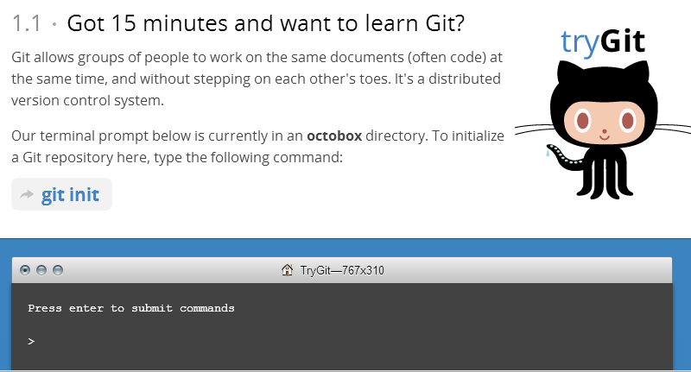
http://try.github.io
Notes:
If, after this talk, you decide to Try Git, there are amazing resources to go deeper, but we’ll be focusing on, “Why Git is Different” & concepts to get started

Slide 5


Slide 6
Cori’s Version Control History
VSS
→
SurroundSCM
→
TFS
Devs Unable to Create Branches
Pessimistic Locking

Slide 7

Centralized Version Control System (VCS)
Examples: TFS, Subversion (SVN), CVS, Perforce
Single point of failure
ADMIN CONTROL: Dev can’t make changes to changed file without pulling changes.
CONNECTED: Can’t work on a plane

Slide 8
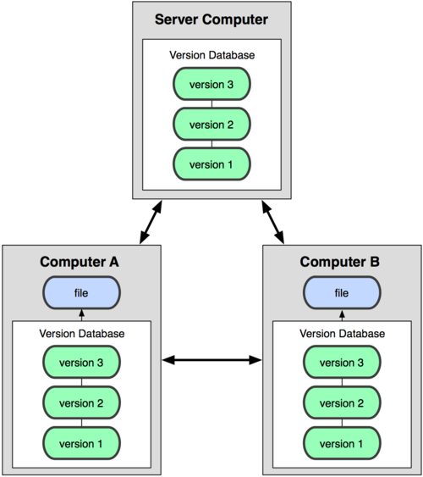
Distributed Version Control System (VCS)
Examples: Git, Mercurial, Bazaar
SAFER: Every developer has a copy of the entire repo on their hard drive.
DEVELOPER CONTROL: “push” instead of “checkout”

Slide 9
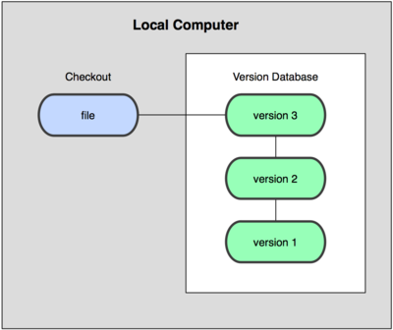
Git: Also a Local VCS (Version Control System)
BRIDGES: Enable the best of both worlds.
SAFETY NET: FREE branching enables more “let me try this” rabbit holes with less risk & fear
Notes:
The beauty of git is it doesn’t NEED a single central repo.
I think what causes a lot of the confusion is the muddy waters that happen because of the POWER of git to act as a local & distributed AND take the place of a central repo.
This power is what leads to sentences like… [click]

Slide 10
“I should ‘learn GitHub’”
GitHub = Git + Hub
Learn Git. Use GitHub.
Notes:
A lot of times, I’ve heard people ask someone to teach them GitHub, when they really meant teach them Git.
This isn’t a BAD question, but it’s easily addressable.
You learn git. You use github (although, you CAN learn git ON GitHub).

Slide 11
A few “hubs” that support Git
GitHub
Bitbucket
TFS Online
Infinite free PUBLIC repo’s
No free PRIVATE repo’s
5 free PRIVATE repo’s
Free private repo’s w up to 5 users
All free for now
Now supports TFS & git

Slide 12
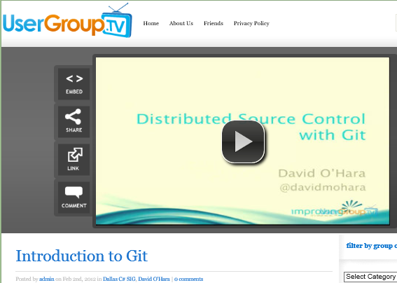
My Git Zombie Infection Day
Feb 2, 2012 @DavidMOhara Dallas C# Sig
Decided to give it 2 weeks
http://usergroup.tv/videos/introduction-to-git
Notes:
I won’t lie. That was a PAINFUL 2 WEEKS. Heck, that was a painful 3 months. Heck, it’s STILL painful sometimes. (None of my coworkers knew git, OR powershell.)

Slide 13
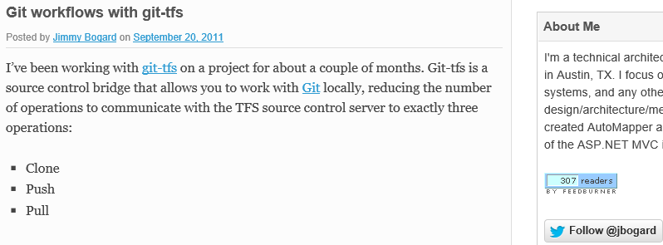

My 1st Two Weeks
Notes:
If it hadn’t been for this “Git Workflows With Git-TFS” post by Jimmy Bogard (& for help from people like Keith, helping me on Twitter), I would have been overwhelmed & given up.

Slide 14
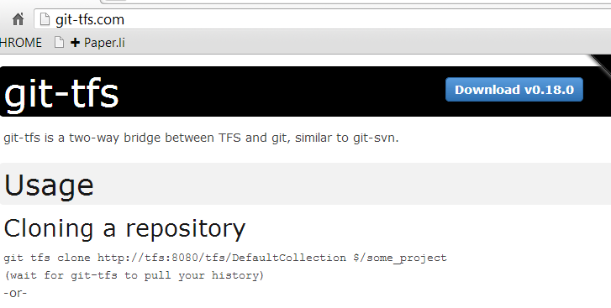
git-tfs Bridge

Slide 15
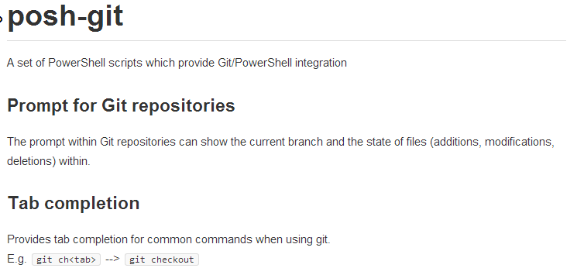
posh-git

Slide 16
4 TFS Problems GIT-TFS Solved
No file locking!
Disconnected!
Developer freedom
No workspaces = No directory REMAPPING All branches in same location!
Notes:
When you connect directly to a TFS repository, all of the files come down as read-only. Git-Tfs doesn’t do that, so when you try to edit a file, you don’t get the “file is readonly-would you like to check it out?” message
I had never been able to work without being connected to the VPN before. With git, commiting & working is local, so you only need to be connected when you are ready to push your changes to TFS.
Developer Freedom: ………this one really surprised me. Git enabled me be less afraid to experiment. I had no idea how afraid I was to try something I might not want my coworkers to see, or something that might affect more than a few files. Especially during biz hours.
No TFS Workspaces. Branching in TFS meant pulling an additional copy of the SAME FILES to a different location on your machine. I worked for a marketing firm. Pulling down a site with videos could take a couple of gigs of space. We also had sites that used Content Management systems, that weren’t built to use Cassini or IISExpress and HAD TO point to localhost. It has gotten Remapping separate branches to localhost was PAINFUL. Git solves this because all branches live in the git directory.

Slide 17
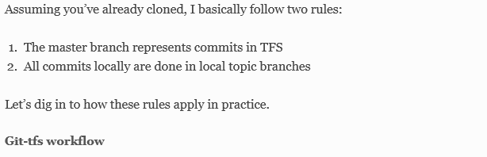
Git-Tfs Workflow
Notes:
In the blog post, Jimmie makes the rules simple:
Number one: NEVER WORK ON MASTER. What’s on master reflects what’s been committed to TFS, ONLY.
Number two: Only commit local work-in-progress to local branches.

Slide 18
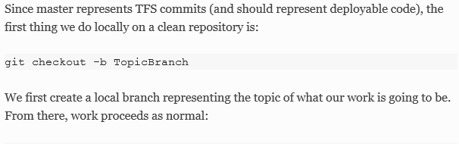
Git-Tfs Workflow
Notes:
He also gives all the commands for all the steps needed in the “perfect world” git tfs workflow scenario, and there are only about 6.
(showing because simplification & steps really helped me.)
After creating & checking out a branch, (click)

Slide 19
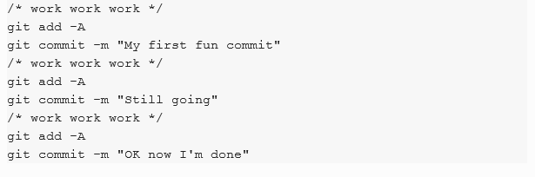
3 Local Steps
Notes:
He shows the workflow. Just (a) work (b) stage your changes & (c) commit.
Rinse & repeat. 3 steps. That’s it.
Let’s talk about the “git add –A” command (click)

Slide 20
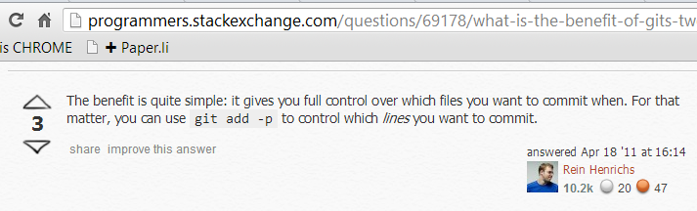
Staging in git

Slide 21
3 Local Steps

Slide 22
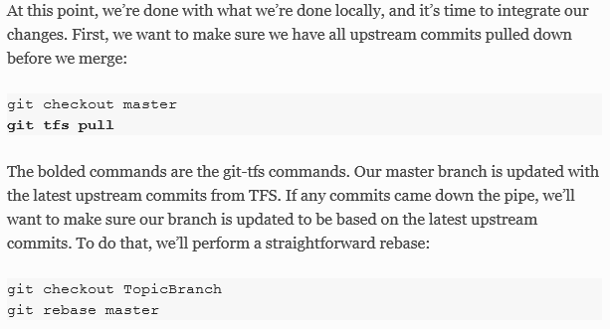

TFS Integration
*
=

Slide 23
Rebase Branch from Master

Slide 24
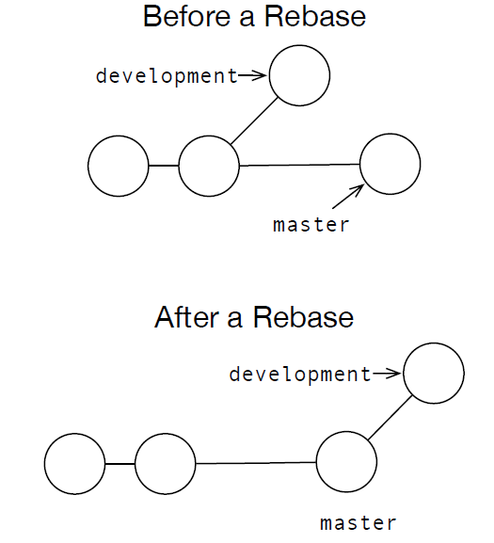
Rebase
C
Jan 3
Rewrite History INJECTS
Central Repo Commits = new local STARTING point
A
Jan 1
B
Jan 2
D
Jan 4
C
Jan 3
Jan 4
D
A
Jan 1
B
Jan 2
Notes:
I commonly hear people define Rebasing as “rewriting history.”
I like to think of it more like “Injecting history,” & this is why:
With git, nothing is “history” before it’s public (pushed). …so If you’re “rewriting history,” you’re doing it wrong.
In the diagram, A,B & D represent commits pushed to TFS. C represents a commit on your local working branch.
The date on C DOESN’T MATTER. What matters is that D was pushed before C. Therefore, D needs to become the new “starting point” for the changes in C.
In my head, Rebasing INJECTS history that should NEVER be rewritten.
Now let’s look at how Jimmy explained it again.

Slide 25
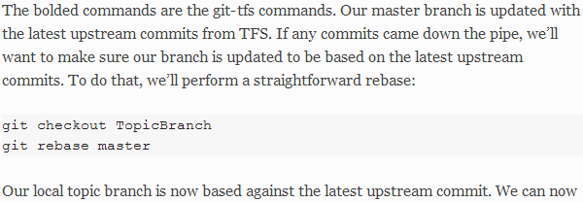
Rebase Branch from Master
Rebase = re + BASE

Slide 26
“Feature-Driven Development”
101: Add callout to About page
102: Add new blurb & pdf to Case Study page
103: Update copyright in footer
104: Update “What’s New” callout on home page
105: Add new video to Webinars section
Notes:
By “Feature-Driven-Development,” I mean Concurrent Work with Separate Approvals per Feature

Slide 27
“Feature-Driven Development”
101: Add callout to About page – APPROVED!
102: Add new blurb & pdf to Case Study page
103: Update copyright in footer – APPROVED!
104: Update “What’s New” callout on home page – APPROVED!
105: Add new video to Webinars section

Slide 28
“Feature-Driven Development”
101: Add callout to About page – APPROVED!
102: Add new blurb & pdf to Case Study page
103: Update copyright in footer – APPROVED!
104: Update “What’s New” callout on home page – APPROVED!
105: Add new video to Webinars section
HOW?
Notes:
The way prior devs handled this account was to go into a holding pattern (stop developing) until they can push {x} changes through.

Slide 29
How Git Solved This
Notes:
This is how git solved this for me.
In this diagram, All started w “Commit B” base.
Remember: Master Commits match what’s in TFS

Slide 30
How Git Solved This
Notes:
(I learned about Octomerge after creating this)

Slide 31
How Git Solved This

Slide 32
How Git Solved This
Notes:
Then I could compile & deploy just the TempMerge branch with those changes.

Slide 33
How Git Solved This
X
Notes:
I just deleted the TempMerge branch when I was done with it.

Slide 34
How Git Solved This

Slide 35
How Git Solved This

Slide 36
How Git Solved This
Notes:
After that, I rebased each working branch.

Slide 37
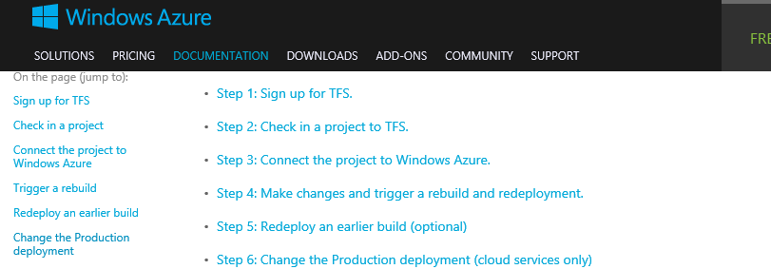
Continuous Delivery to Azure w TFS
Notes:
Aside: Azure has a really cool feature, that enables you to tie an Azure web site to a TFS branch. When you push to that branch, the azure site automatically deploys.

Slide 38
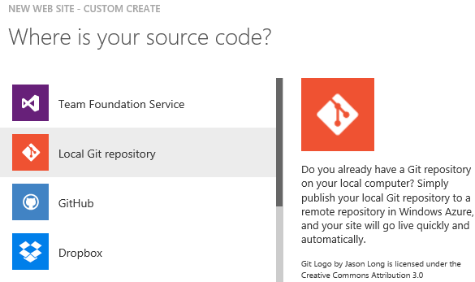
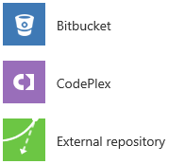
Notes:
Azure “Publish from source control” options let you tie it to a github branch, a bitbucket branch.. Even a dropbox location(!)
Also GitHub,
Dropbox
Bitbucket,
CodePlex,
etc!!!

Slide 39
Git: What Made it Click (for ME)
Git is NOT all or nothing
“Free” branching = SAFETY NET
No file dupes or IIS Remapping
Enabled Feature-Driven Development

Slide 40
DEMO

Slide 41
Resources
Introduction to Git – David M Ohara (@davemohara) http://usergroup.tv/videos/introduction-to-git
Git in 5 Minutes – Scott Paul Robertson http://scottr.org/presentations/git-in-5-minutes/
Pro Git – Scott Chacon (@chacon) http://git-scm.com/book
Git Workflows With Git-Tfs – Jimmy Bogard (@jbogard) http://lostechies.com/jimmybogard/2011/09/20/git-workflows-with-git-tfs
Twitter (@dahlbyk & @coridrew)

Slide 42

August 11th – 13th 2014
Same Place, Same Time

