Slide 1
Git More Done
Keith Dahlby
@dahlbyk

Slide 2


Slide 3






Who am I?

Slide 4
Who are you?

Slide 5
Git More Done
This talk is not about:
This talk is about:
Getting started
Remotes (push/pull)
Team workflow
Internals
Lots of neat stuff…
Worktrees
Hooks
Submodules
Subtree merging
filter-branch
Config
Naming Commits
Local workflow
Fixing “oops”
Finding bugs

Slide 6
Config

Slide 7
git config
git help config
git config -l
Scope | Switch | Location
Repository |  | .git/config
User | --global | ~/.gitconfig
System | --system | {install dir}/etc/gitconfig

Slide 8
git config
git config --edit --global
# git config core.autocrlf false
[core]
autocrlf = false
# git config branch.main.rebase true
[branch "main"]
remote = origin
merge = refs/heads/main
rebase = true

Slide 9
git help config
Setting | Values
core.editor | Path to preferred editor
diff.renames | false = don’t detect renames (default) true = detect renames copies = detect renames & copies
difftool.prompt | true (default), false
mergetool.prompt | true (default), false
mergetool.keepBackup | true (default), false After merge, original file with conflict markers saved with .orig extension
help.autocorrect | 0 = show but don’t execute (default) N = execute correction after N tenths of a second -N = execute correction immediately
log.date | default, relative, local, iso, rfc short

Slide 10
git help config
Setting | Values
commit.verbose | false or 1 (default) = do not show patch true or 1 = show staged changes 2 = show unstaged changes to tracked files, too
merge.autoStash rebase.autoStash | false (default), true Stash changes and new files before performing a merge/rebase, then restore when the rebase has completed or is aborted
init.defaultbranch | Change default branch from master to something else, e.g. main
format.pretty | oneline, short, medium (default), full, fuller, reference, email, raw, format:<string> and tformat:<string> See “PRETTY FORMATS” on git help log
log.abbrevCommit | false (default), true
push.autoSetupRemote | Assume --set-upstream on default push, if not already tracking

Slide 11
Aliases
Wrap git command + arguments
git config alias.ds "diff --stat"
git ds → git diff --stat
git ds dev → git diff --stat dev
Wrap shell commands
alias.gitka = !gitk --all
alias.call = !git add -A && git commit

Slide 12
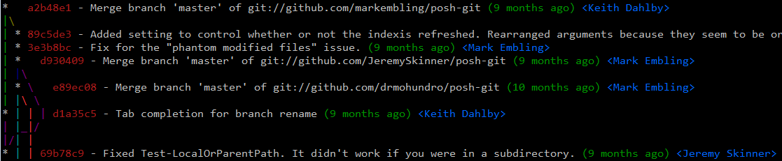
Aliases
alias.di = diff --staged
alias.new = log origin.. --reverse
alias.rbc = rebase --continue
http://bit.ly/better-git-svn
http://bit.ly/git-lg

Slide 13
Naming Commits

Slide 14
Naming Commits
SHA1
Or unique initial substring (6 often sufficient; abbrevCommit)
Symbolic references
Branch: refs/heads/dev = dev
Tag: refs/tags/v0.1 = v0.1
Remote references
refs/remotes/origin/dev = origin/dev

Slide 15
Naming Commits
HEAD = what’s checked out
Reference to branch
On commit, reference set to new SHA1
Arbitrary commit (detached HEAD)
On commit, no branch to update
<remote>/HEAD, e.g. origin/HEAD
Default branch on remote, e.g. main
git remote set-head <remote> -a

Slide 16
Naming Commits
ORIG_HEAD = “undo” for big HEAD changes
Saved before reset, merge, pull, etc
FETCH_HEAD = last fetched from remote
git fetch <url> <branch>
MERGE_HEAD = incoming merge commit(s)
CHERRY_PICK_HEAD = commit being cherry-picked
REVERT_HEAD = commit being reverted

Slide 17
Relatively Naming Commits
Suffixes
~ = parent; ~n = nth-generation grandparent
^ = first parent; ^n = nth merge parent
3 commits ago = HEAD~3 = HEAD^^^
@{n} = nth prior value for that ref
Undo last commit = git reset HEAD@{1}
git help revisions

Slide 18
Local Workflow

Slide 19
Branching
Ridiculously cheap – use liberally
Write SHA to file in refs/heads
Branches to clean up
git branch --merged

Slide 20
My Workflow
Keep main clean!
New topic branch from main
git checkout main -b topic
“Switch to <commit> as new branch <name>”
Commit more than feels natural

Slide 21
git stash
Stash away work in progress
Typical workflow
Working on topic branch
git stash save "have test, need impl"
Switch to other branch, hack away, switch back
git stash pop

Slide 22
git stash
Other useful operations
git stash save --include-untracked
git stash list
git stash show –p stash@{1}
git stash drop stash@{1}
git stash branch <name>

Slide 23
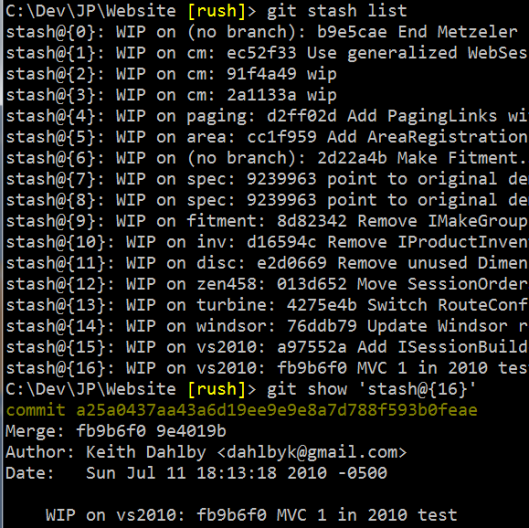
Use with care…

Slide 24
Temporary Commits
Advantage: WIP lives in branch
Typical workflow
Working on topic branch
git commit -m "WIP: Need impl"
Switch to other branch, hack away, switch back
git reset HEAD~
Pretend WIP commit never happened

Slide 25


git reset
Reset HEAD reference to commit:
git reset [--<mode>] commit
git reset HEAD~
Make HEAD look like remote branch:
git reset --hard origin/main

Slide 26
git reset [--<mode>]
soft = move HEAD; don’t reset index/work tree
Uncommit
mixed = reset index but not work tree (default)
Unstage all
hard = reset index and work tree
Discard changes (ignores untracked files)
Destructive – use with caution

Slide 27
git reset
Reset paths in index to match commit:
git reset commit -- <paths>…
Unstage a file:
git reset HEAD -- staged-file.txt
git reset HEAD staged-file.txt
git reset -- staged-file.txt

Slide 28
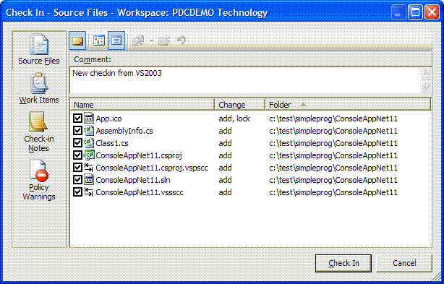
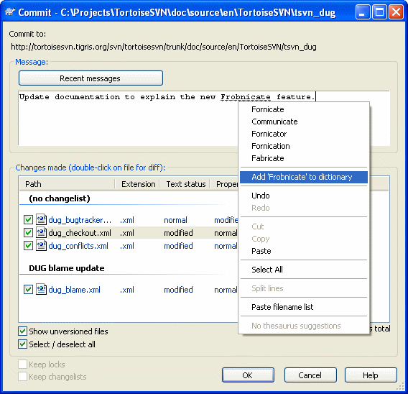
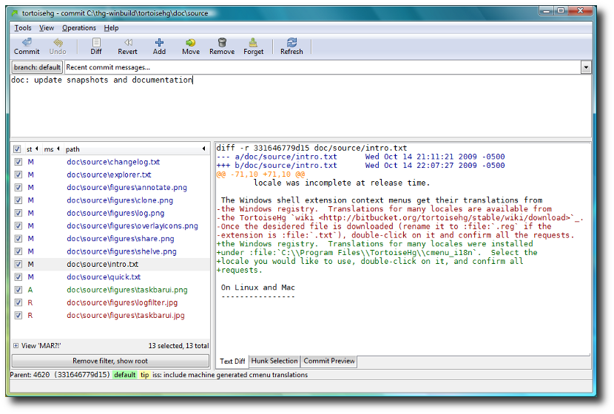
The Others

Slide 29
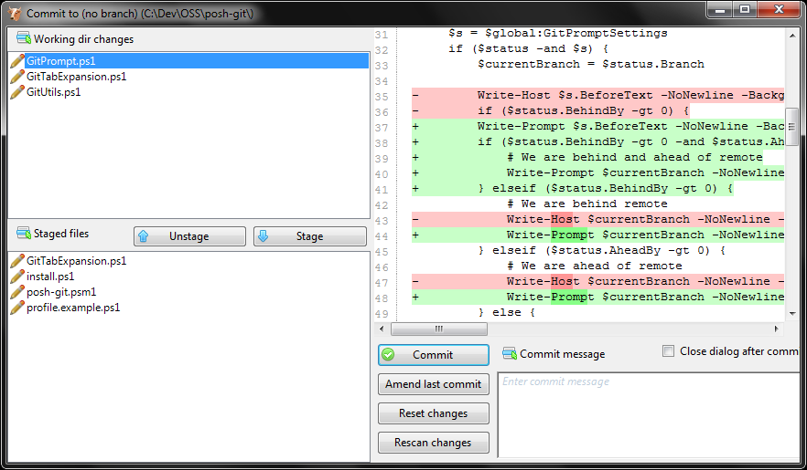
Git Staging Area (Index)
reset
add
add -p

Slide 30
git add --patch
Overlapping logical changes to one file
Reformatting
Refactoring
Changing functionality

Slide 31
git add --patch
Pick “hunks” (sections of diff) to stage
Key operations: y/n, a/d, s (split), e (edit)
Also:
git reset -p
git checkout –p
git stash save -p

Slide 32
Rewriting History
Permanent when pushed
Until then, pretend you were perfect
Simple case: messed up last commit
git commit --amend
alias.cia = commit --amend --no-edit
git cia -a --reset-author

Slide 33
git cherry-pick
Applies changeset(s) elsewhere
Commit to wrong branch?
… working on wrong-branch…
git checkout correct-branch
git cherry-pick wrong-branch
git checkout wrong-branch
git reset --hard HEAD~

Slide 34
merge vs rebase
Merge without rebase
A---B---C topic
/ \
D---E---F---B'--M main
Merge after rebase
D---E---F---B'--A'--C' main, topic
Deck of cards: shuffle vs cut

Slide 35

merge vs rebase

Slide 36
git rebase
Replay commits
A---B---C topic
/
D---E---F---B' main, HEAD
git rebase main topic
A'--C' topic, HEAD
/
D---E---F---B' main

Slide 37
git rebase --interactive
Replay commits with modifications
A---B---C topic, HEAD
/
D---E main
git rebase -i main
C'---(A+B)' topic, HEAD
/
D---E main

Slide 38
git rwi (rewrite interactive)
alias.rwi = !git rebase $(git merge-base origin HEAD) –i
Replay commits in-place
A---B---C topic
/
D---E---F main, HEAD
git rebase main topic
A---C'--B' topic, HEAD
/
D---E---F main
Or test/lint after each commit, e.g. exec npm test

Slide 39
git rebase -i --autosquash
> git commit -m "Do something"
[gh12 1bec34] Do something
… work, commit, work, commit …
… oops! … stage fixes for "Do something" …
> git commit --fixup 1bec34
> git rebase -i --autosquash 1bec34~
Updates todo list automagically
Moves fixup! after 1bec34; marks as fixup
rebase.autosquash = true

Slide 40
Demo
Patchwise Add & Interactive Rebase

Slide 41
Fixing “Oops”

Slide 42
git reflog
Where did my commit go?
ls -r .git/logs
HEAD, heads, remotes
> git reflog --all
c66d5f9 refs/heads/dev2@{0}: branch: Created from origin/dev2
1df4b7e refs/heads/main@{0}: push
b6e3739 refs/remotes/origin/dev1@{0}: update by push
2c2c892 refs/remotes/origin/dev1@{1}: fetch origin: forced-update
69dcefd refs/remotes/origin/dev1@{2}: update by push
954fa68 refs/remotes/origin/dev1@{3}: pull : fast-forward
0234a69 refs/remotes/origin/dev1@{4}: pull origin: storing head
8de4df0 refs/heads/main@{1}: pull origin: Fast-forward
66e2e5f refs/heads/tiny74@{0}: commit: WIP

Slide 43
Finding Bugs

Slide 44
git bisect
Binary search through commit space
Good
Good/Bad?
Bad
Good
Good/Bad?
Bad
Good
Good/Bad?
Bad
Good
Oldest Bad!

Slide 45
git bisect
> git bisect start
> git bisect bad new-commit
> git bisect good old-commit
Bisecting: 4 revisions left to test after this
> git bisect bad
Bisecting: 2 revisions left to test after this
> git bisect good
Bisecting: 0 revisions left to test after this
> git bisect bad
5087d6… is the first bad commit
> git bisect reset

Slide 46
git bisect
Other useful operations
visualize = view = overview in gitk/log
skip = current version cannot be tested
run my_script = automated bisect

Slide 47
Review
Config for your preferences
Aliases to avoid typing
Commit naming shortcuts
Stashes and WIP commits
Patchwise add/reset/checkout/stash
Rewriting history
Oops? reflog
Bugs? bisect

Slide 48


Slide 49


Slide 50
Questions?
git-scm.com
gitref.org
gitready.com
think-like-a-git.net
github.com/dahlbyk/posh-git
github.com/dahlbyk/Presentations
Recording of this talk: vimeo.com/43659036
@dahlbyk
ab.bot
newbo.co

