Slide 1
Team-Focused Communication
Keith Dahlby
@dahlbyk

Slide 2
Teams of workers that labored together for several months in specially designed "war rooms" were twice as productive as their counterparts working in traditional office arrangements
University Of Michigan study
https://www.sciencedaily.com/releases/2000/12/001206144705.htm

Slide 3
Programmers work side by side in pairs, continually seeing and discussing each other’s code.
Extreme Programming Core Practice #7
http://www.computerworld.com/article/2585634/app-development/extreme-programming.html

Slide 4
The most efficient and effective method of conveying information to and within a development team is face-to-face conversation.
Principles behind the Agile Manifesto
http://agilemanifesto.org/principles.html

Slide 5
Is your team co-located?

Slide 6
Has anyone joined?

Slide 7
Will anyone join?

Slide 8
Has anyone left?

Slide 9
Will anyone leave?

Slide 10
In the whole organization?

Slide 11
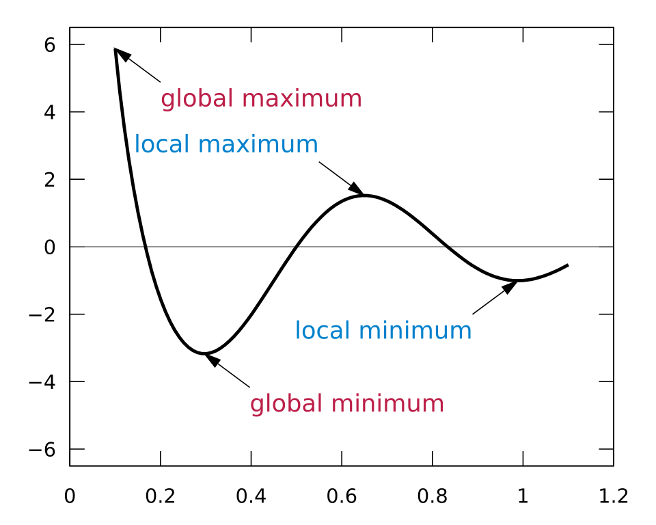
Face-to-face is a Local Maximum
https://en.wikipedia.org/wiki/Maxima_and_minima

Slide 12
Face-to-face is ephemeral

Slide 13
Meetings are ephemeral

Slide 14
Writing is forever

Slide 15
Rule 1: Be Deliberate

Slide 16
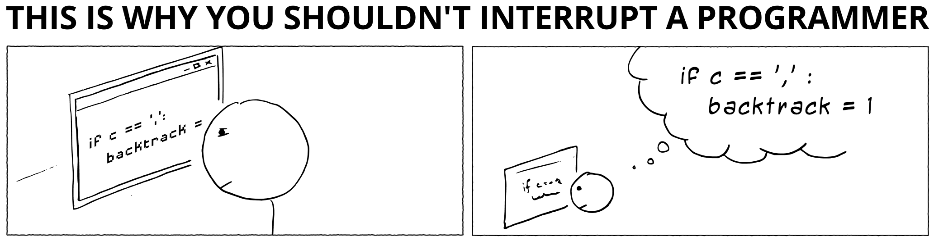
http://heeris.id.au/2013/this-is-why-you-shouldnt-interrupt-a-programmer/

Slide 17
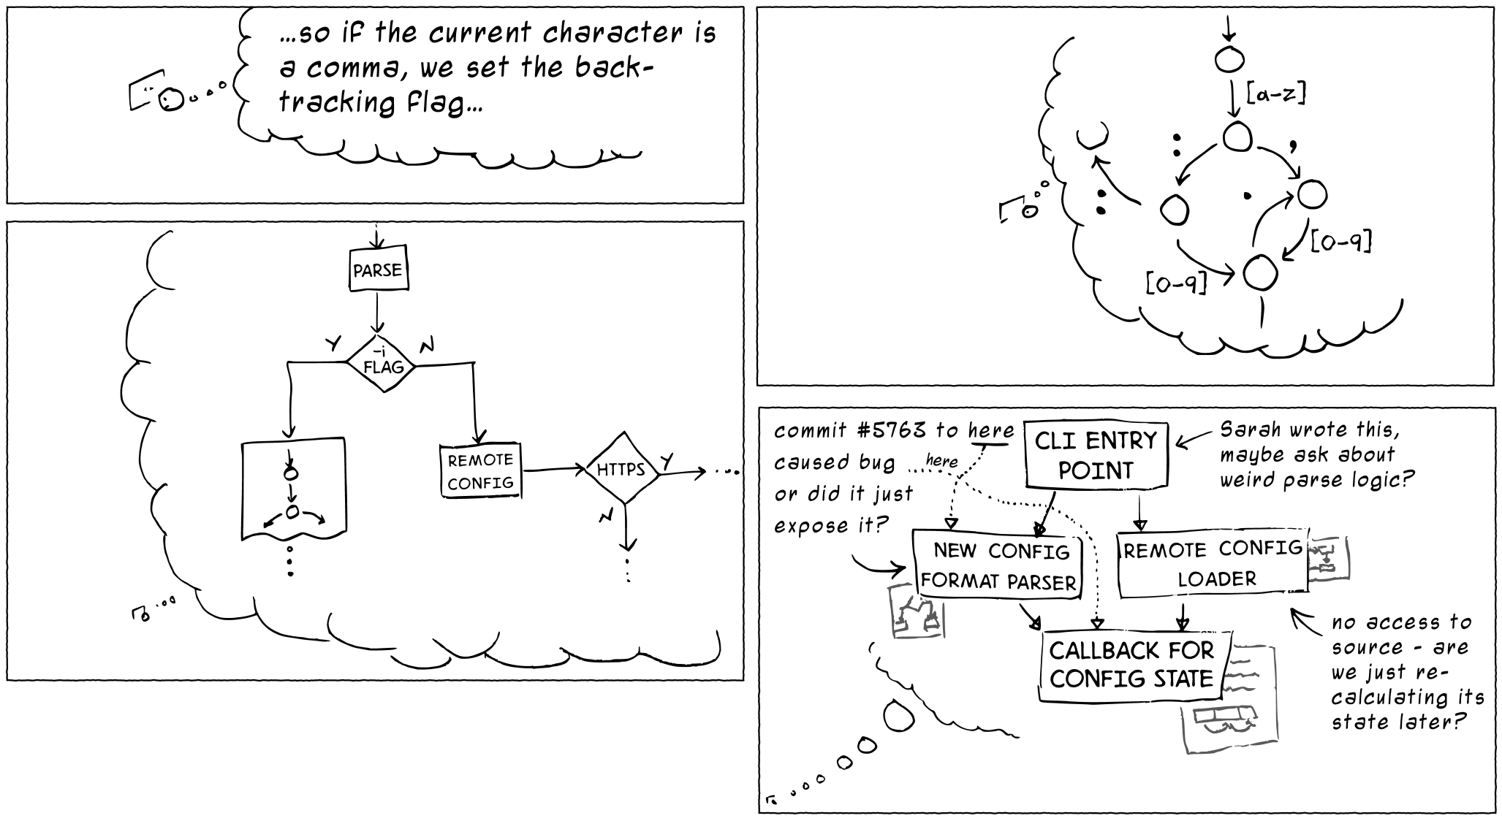
http://heeris.id.au/2013/this-is-why-you-shouldnt-interrupt-a-programmer/

Slide 18
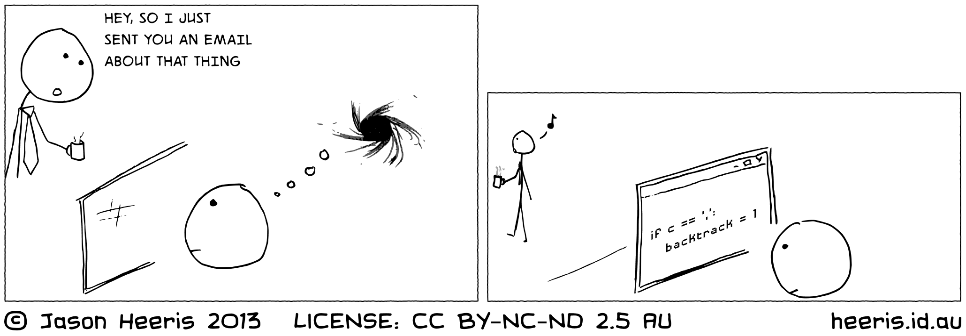
http://heeris.id.au/2013/this-is-why-you-shouldnt-interrupt-a-programmer/

Slide 19
Rule 2: Prefer Asynchronous

Slide 20
Rule 3: Public over Private

Slide 21
Visibility
Why public?
See available channels; choose when to join and leave
Share messages to other channels
Search even if not joined
Knowledge transfer
Why private?
Needs to be confidential

Slide 22
What goes where?
Goal 1: Receive Important Communication
Mention individuals/teams/@channel who need to know/respond now.
Goal 2: High Signal:Noise Ratio
Prefer most specific channel applicable, especially for @channel.

Slide 23
What goes where?
Goal 3: Transparency
“We discussed/decided in #channel” doesn’t work for private channels.
Goal 4: Celebration
Escalate big milestones so we can celebrate together.
Registration open! Keynote booked! Contract signed! Project finished! New hire! Award received! Big media mention! Another new hire!

Slide 24
Rule 4: Guard Attention

Slide 25
Organization
Separate Operations from Discussion
Operational messages are easily lost in the shuffle
Share milestones/decisions upward for visibility
Announce new channels…
But be stingy with invites, especially for shared staff
Doesn’t scale to be in nearly every channel

Slide 26
Rule 5: Avoid Assumptions

Slide 27
Rule 6: Seek Clarification

Slide 28
Rule 7: Everything Gets a Link

Slide 29
Rule 8: Version Control Matters

Slide 30
Rule 9: Continuous Deployment

Slide 31
Rule 10: Have Fun

Slide 32
Questions? Thoughts?
@dahlbyk
github.com/dahlbyk/Presentations
NewBo.Co

