Slide 1
All Teams Are Distributed
Keith Dahlby
@dahlbyk

Slide 2
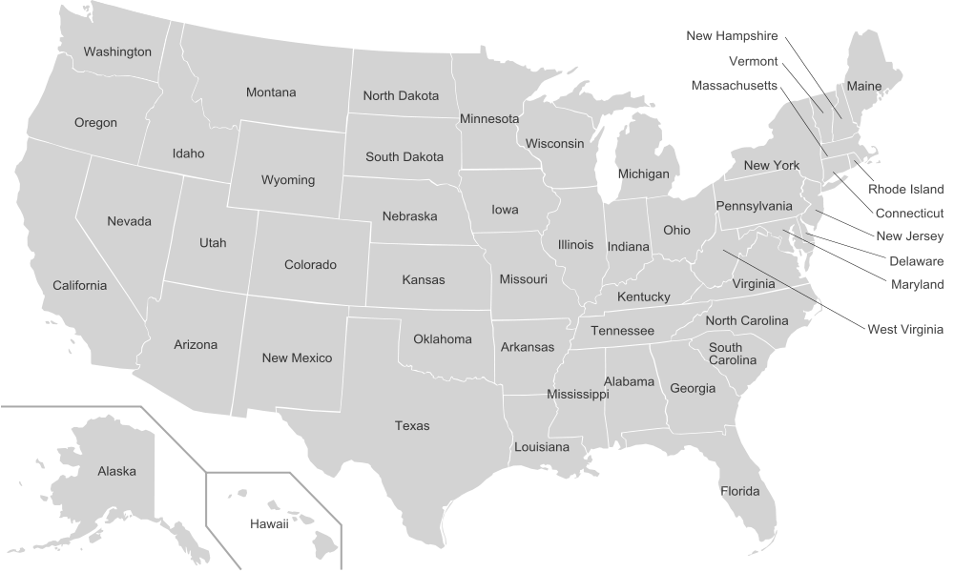







Slide 3
Teams of workers that labored together for several months in specially designed "war rooms" were twice as productive as their counterparts working in traditional office arrangements
University Of Michigan study
https://www.sciencedaily.com/releases/2000/12/001206144705.htm

Slide 4
Programmers work side by side in pairs, continually seeing and discussing each other’s code.
Extreme Programming Core Practice #7
http://www.computerworld.com/article/2585634/app-development/extreme-programming.html

Slide 5
The most efficient and effective method of conveying information to and within a development team is face-to-face conversation.
Principles behind the Agile Manifesto
http://agilemanifesto.org/principles.html

Slide 6
Is your team co-located?

Slide 7
Has anyone joined?

Slide 8
Will anyone join?

Slide 9
Has anyone left?

Slide 10
Will anyone leave?

Slide 11
In the whole organization?

Slide 12
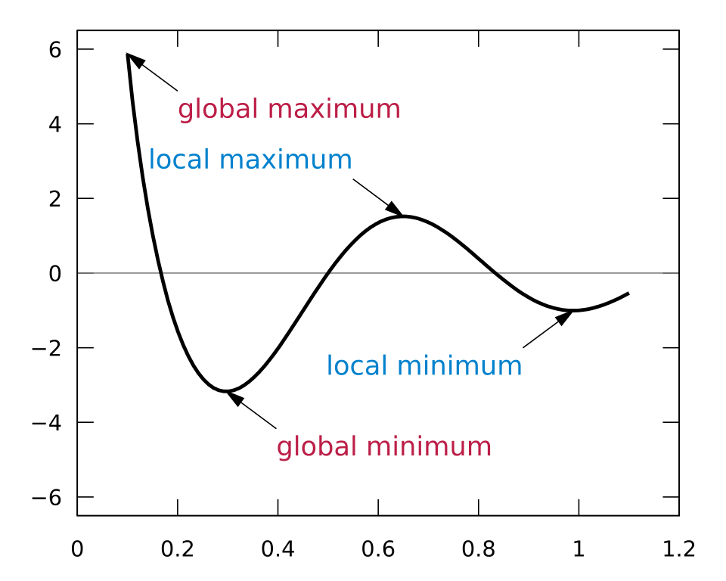
Face-to-face is a Local Maximum
https://en.wikipedia.org/wiki/Maxima_and_minima

Slide 13
Face-to-face is ephemeral

Slide 14
Meetings are ephemeral

Slide 15
Writing is forever

Slide 16
Rule 1: Be Deliberate

Slide 17
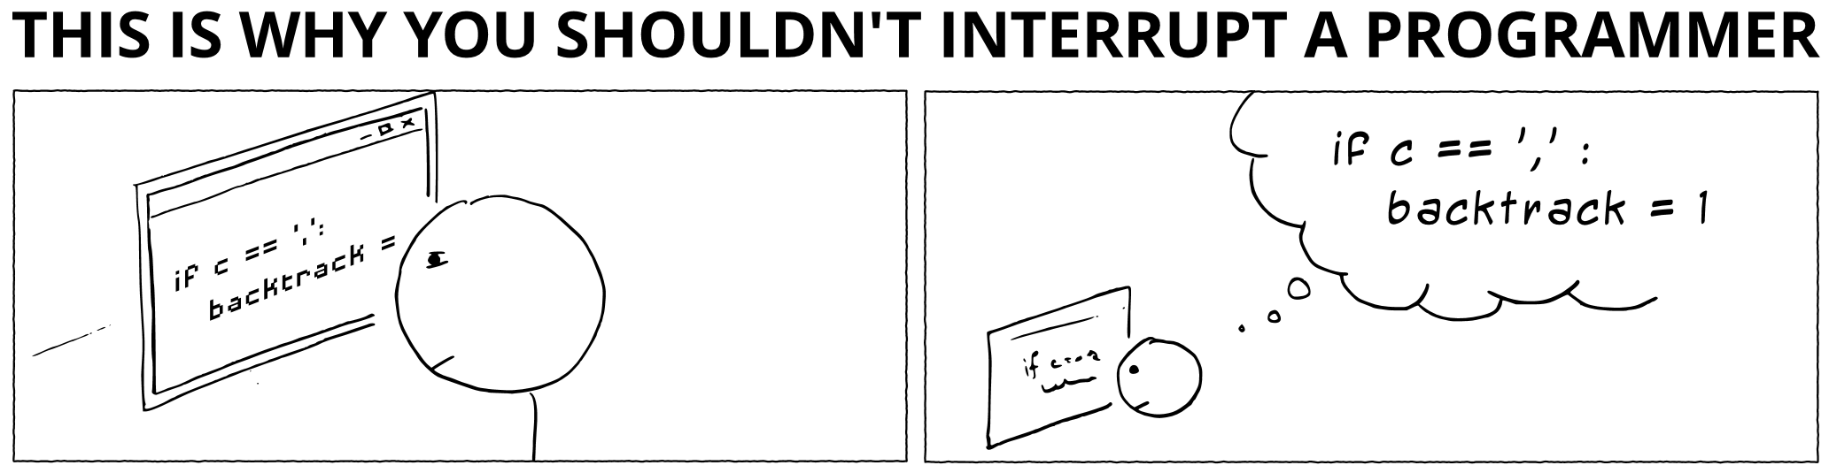
http://heeris.id.au/2013/this-is-why-you-shouldnt-interrupt-a-programmer/

Slide 18
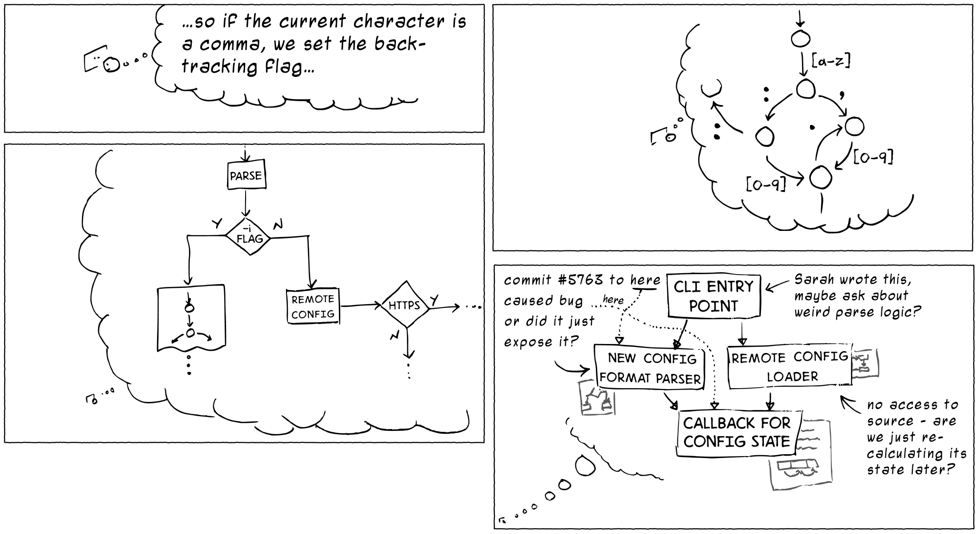
http://heeris.id.au/2013/this-is-why-you-shouldnt-interrupt-a-programmer/

Slide 19
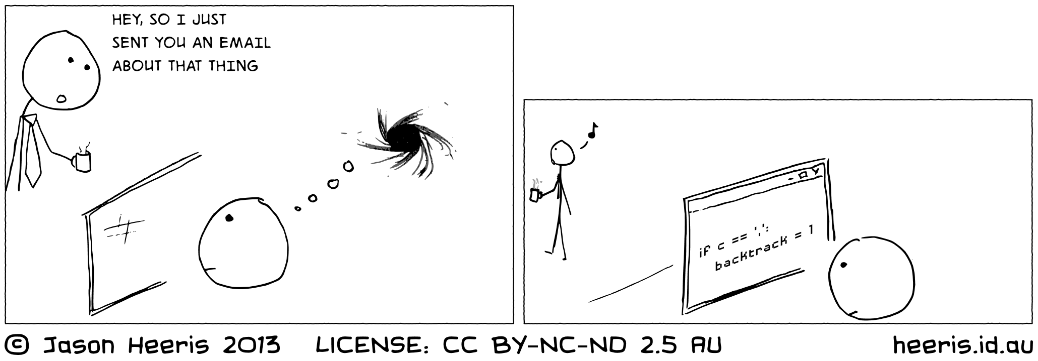
http://heeris.id.au/2013/this-is-why-you-shouldnt-interrupt-a-programmer/

Slide 20
Rule 2: Prefer Asynchronous

Slide 21
Rule 3: Public over Private

Slide 22
Rule 4: Avoid Assumptions

Slide 23
Rule 5: Seek Clarification

Slide 24
Rule 6: Everything Gets a Link

Slide 25
Rule 7: Create a Web

Slide 26
Rule 8: Version Control Matters

Slide 27
Rule 9: Continuous Deployment

Slide 28
Rule 10: Have Fun

Slide 29
Questions? Thoughts?
@dahlbyk
github.com/dahlbyk/Presentations
HuBoard.com
NewBo.Co

