Slide 1

Empowering Developers through Templates, Packages, and Starters
In this demo: ASP.NET Core Web API and Angular
Erik Dahl
@dahlsailrunner
knowyourtoolset.com
https://app.pluralsight.com/profile/author/erik-dahl

Slide 2

Motivations
Speed of Change
Developers should focus on business features
Monoliths are rampant
Breaking them into pieces is often better than rewrite
More important than ever to get certain things right
Security
Logging
Maintainability
Configurable applications to enable CD

Slide 3

Encapsulate Your Opinions
Security
Logging
Usage, Performance, Errors / Diagnostics
Exception Handling
Shielding, Wrapping
Data Access
Styles
Organization of Code
API Route Conventions
Preferred Tech Stacks

Slide 4
Tools
Templates
Can be used to create a new project from a CLI or wizard and gets names / etc updated automatically
Example: dotnet new tccc-api –o My.New.ProjectName
Packages
Shared packages (npm, Nuget, php Composer, etc) that can be added to projects from public or private repos
Example: Tccc2019.ApiBooster
Starters
Sample repository that is copied/pasted, then edited to be used as the starting point for some functionality
Example: tccc2019-angular-starter

Slide 5


Show Me!
https://github.com/dahlsailrunner/tccc2019-api-starter
https://github.com/dahlsailrunner/tccc2019-angular-starter

Slide 6
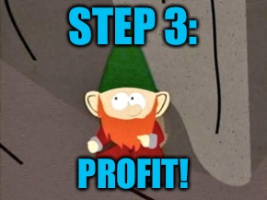
Go Forth and Conquer!
Expedite development
Create packages, templates, and starters
Document them in READMEs
Make them discoverable
Enable continuous delivery on them
Profit

