Slide 1


Weather forecast model using DBSCAN and Sepctral Clustering
Name of the Presenter: Danish Ahmad Ansari
Roll No of the Presenter:19CS4142
Name of the Guide/Supervisor: Dr Anirban Sarkar
May, 2021
This image will be replaced with the Graphical Abstract of the work, if any, otherwise skip it.
Department of Computer Science and Engineering
Notes:
NOTE:
To change the image on this slide, select the picture and delete it. Then click the Pictures icon in the placeholder to insert your own image.

Slide 2
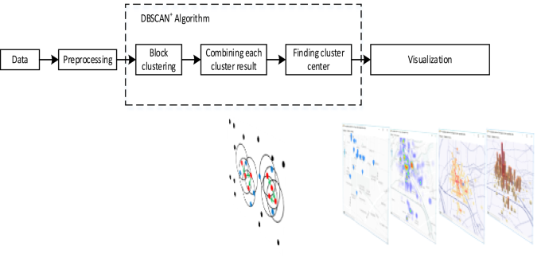
Contribution of your work: Algorithm/Methodology/Flowchart etc.

Slide 3
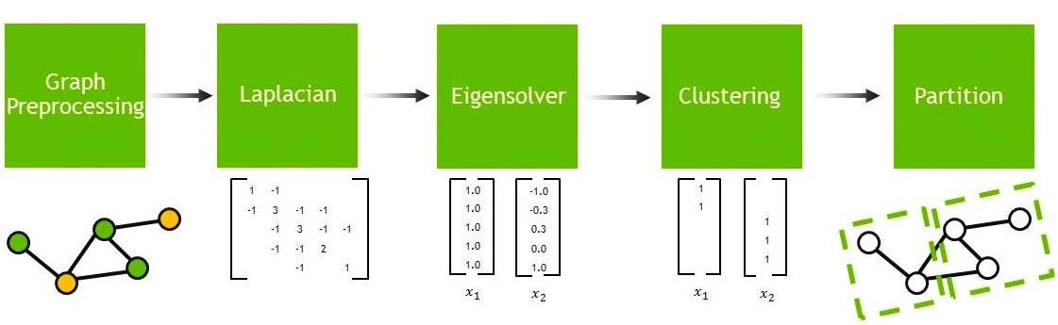
Methodology

Slide 4
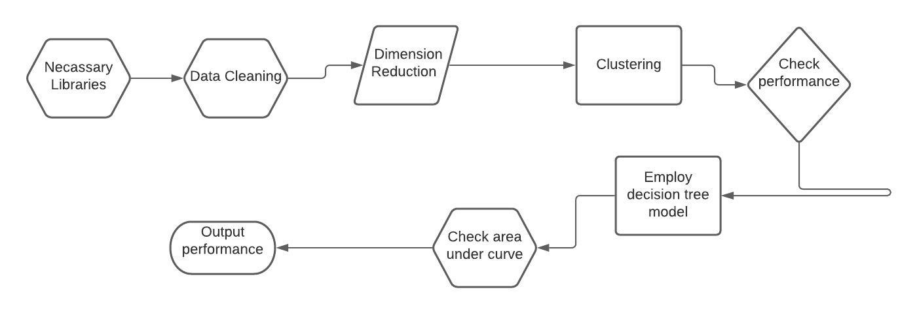
Methodology

Slide 5
Weather forecast model using clustering algorithm
To train model using decision tree after clustering data
Check whether which algorithm clusters the data efficiently
Compare recall score as performance metrics

Slide 6
Outcome of the work: Performance analysis, Comparative discussion, if any.
Performance score of DBSCAN
Performance score of Spectral
Spectral Clustering outperforms
Class | DBCSAN | Spectral
Accuracy | 0.59 | 0.76
Recall Score | 0.77 | 0.93

Slide 7
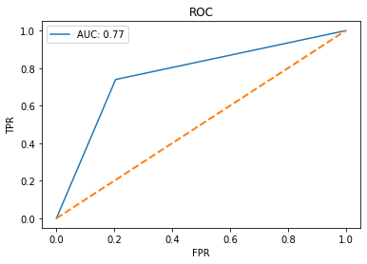
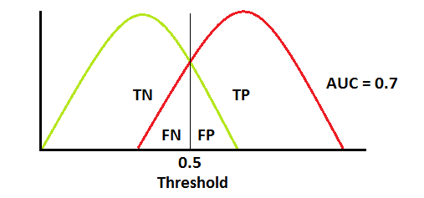
Outcome of the work: Performance analysis, Comparative discussion, if any.
When AUC is 0.7, it means there is a 70% chance that the model will be able to distinguish between positive class and negative class.

Slide 8
Conclusion:
Spectral Clustering Algorithm performs well in the dataset
DBSCAN performs lesser than spectral
Spectral Cluster performs well in large data sets.

