Slide 1

Javascript Course
Sylhet IT Academy 31 August 2020

Slide 2
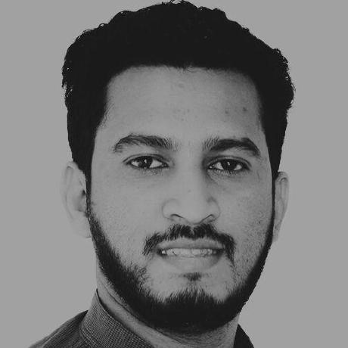
Ahmad Sharif
Javascript Developer, YoTech

Slide 3
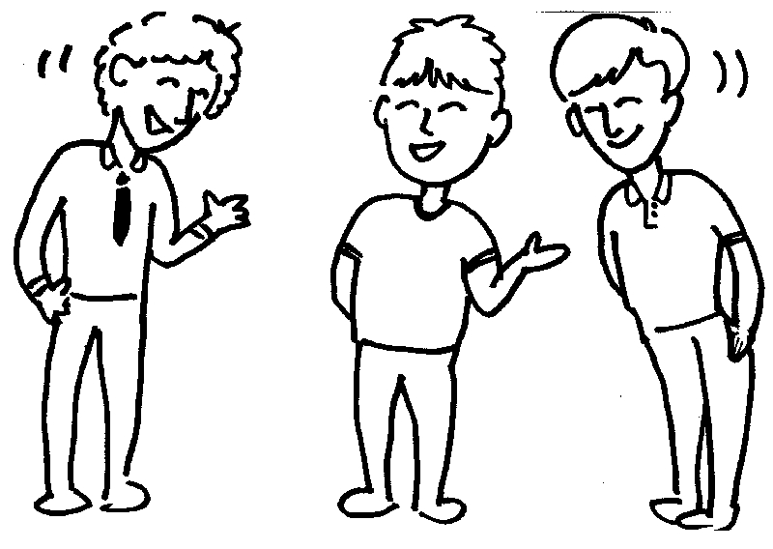
Introduce yourself
Name and Occupation
Home District
Future Plan
What do you expect, after completing JS course
Write down on a paper what you know about JS.

Slide 4

How much time does it takes to be a decent Javascript Developer.
10,000 hours takes to be a master on a specific field that takes minimum 10 years.
I ask to you to invest 100 hour at least.
100 Hours = just ok
150 hours = Decent
200 hours = excellent
*Hack your brain. Just sit down for 10 minutes.

Slide 5

How to learn something
Learn the concept first. Use analogy and learn how it works
Share and Teach only once concept each other.
Write on a white paper what you understand
Make something what you learn
Practise

Slide 6
Javascript Language Overview
JavaScript = ECMAScript + DOM + BOM.
ECMAScript® Language Specification defines all logic for creating and editing objects, arrays, numbers, etc...;
Brendan is the creator of JavaScript and the SpiderMonkey JS engine.

Slide 7
Javascript Language Overview
JavaScript = ECMAScript + DOM + BOM.
ECMAScript® Language Specification defines all logic for creating and editing objects, arrays, numbers, etc...;
Brendan is the creator of JavaScript and the SpiderMonkey JS engine.
Eich "wrote JavaScript in ten days" in 1995.

Slide 8

Javascript Creator
Brendan Eich

Slide 9
Javascript Engine
Google use V8 JavaScript engine.
Firefox use SpiderMonkey JavaScript engine.
Microsoft use Chakra JavaScript engine.

Slide 10
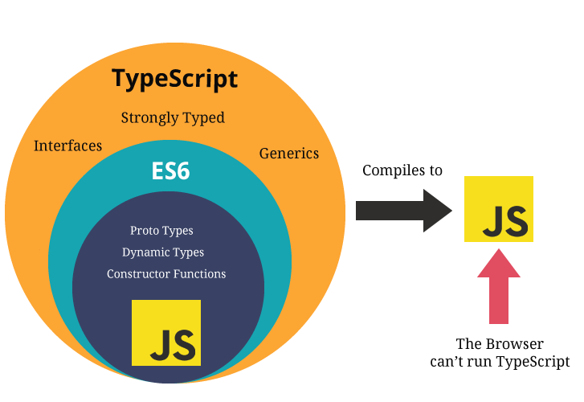
Difference between Typescript and Javascript
.

Slide 11
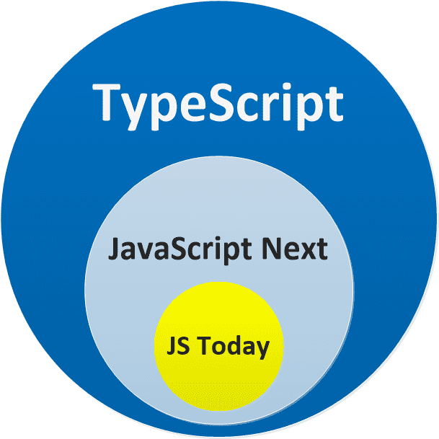
Difference between Typescript and Javascript
.

Slide 12
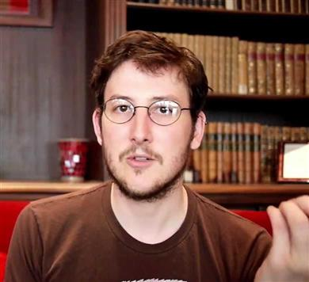
NodeJS
Ryan Dahl
Node.js is an open-source, cross-platform, JavaScript runtime environment that executes JavaScript code outside a web browser.

Slide 13

Environment
Git
git bash
visual studio code
Gh-page
Node

Slide 14

Resources
https://developer.mozilla.org/en-US/docs/Web/JavaScript
https://www.w3schools.com/js/default.asp

Slide 15
End
Describe what you understand in only 3 minutes.
Write down on a paper what you learn today.

