Slide 1




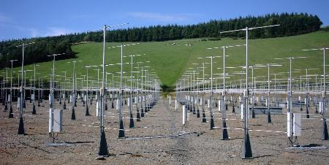
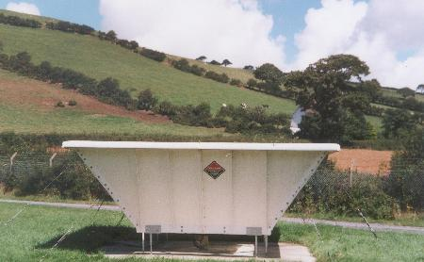
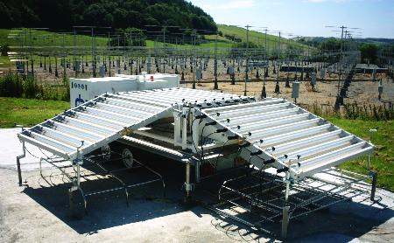
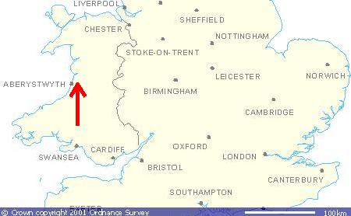
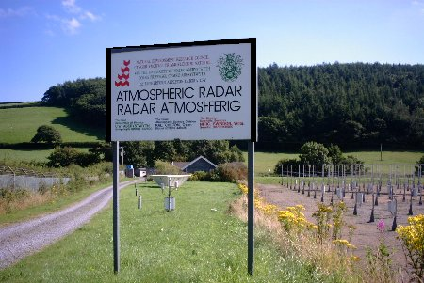
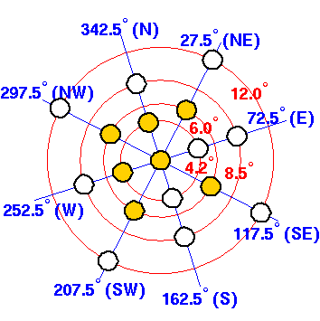
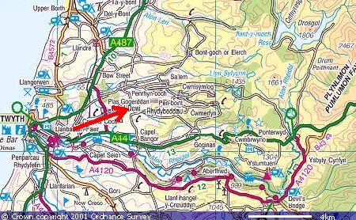
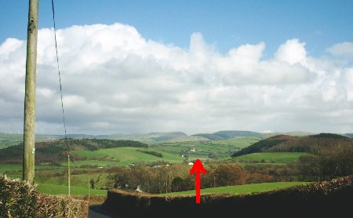
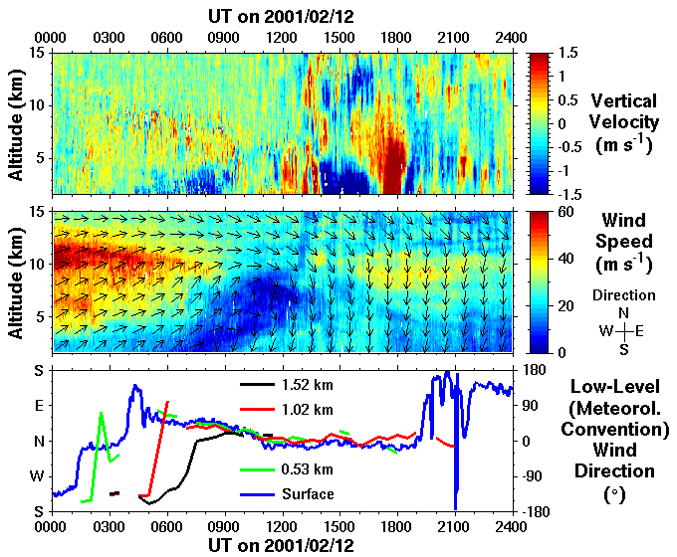
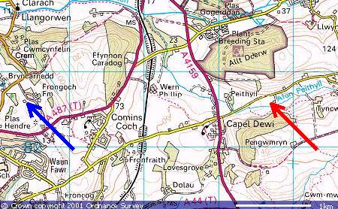
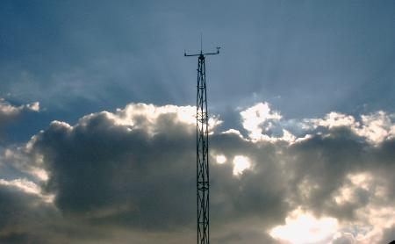

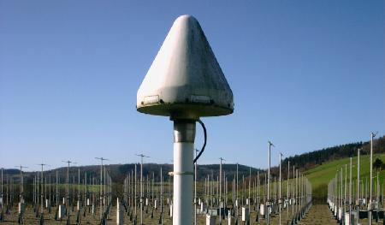
The NERC MST Radar Facility at Aberystwyth
David Hooper¹, Catherine Gaffard², Emily Norton³, Zbigniew Olewicz³, Dave Wareing³, and Stuart White¹
E-mail: D.A.Hooper@rl.ac.uk
¹Rutherford Appleton Laboratory
http://www.sstd.rl.ac.uk
²Met Office http://www.metoffice.com/
research/interproj/cwinde
³University of Wales Aberystwyth
http://www.aber.ac.uk/ozone
Maps produced from the Ordnance Survey Get-a-map service and reproduced with kind permission of Ordnance Survey and Ordnance Survey of Northern Ireland.
The 46.5 MHz NERC MST radar is operated on a quasi-continuous basis in the ST mode. It covers the altitude range 2 – 21 km at 300 m range resolution and with a cycle time of approximately 2½ minutes. Observations are made in the vertical direction, in two orthogonal azimuths at 4.2º off-vertical, and in four azimuths (each separated from the next by 90º) at 6.0º off-vertical.
Work is in progress to implement new signal processing software. A key feature will be the introduction of improved data reliability flagging based on the temporal continuity of horizontal velocity components. The redundancy in wind-profile information allows for an additional level of flagging based the variability between the different estimates.
The Met Office operated one of their boundary-layer wind-profilers, a Radian 915 MHz four-panel LAP3000 (shown above-left), at the radar site between November 1999 and March 2002. For more information about Met Office instruments at the MST radar site contact Tim Oakley, e-mail: tim.oakley@metoffice.com.
Since July 2002, the University of Wales Aberystwyth have operated a mobile Degreane 1290 MHz boundary-layer wind-profiler (shown above-right) at the site on an occasional basis. This instrument was purchased under UFAM (University Facilities for Atmospheric Measurement), a pool of equipment, distributed across 6 UK Universities, intended primarily for use in field campaigns. The University of Wales Aberystwyth also acquired a mobile ozone lidar under UFAM. Both instruments are operated at the MST radar site whilst not otherwise engaged. The University have also operated a static Rayleigh/ozone/aerosol/water-vapour lidar at the site for a number of years. For more information about UFAM instruments at the MST radar site contact Emily Norton, e-mail: egn@aber.ac.uk.
The NERC MST Radar site is located at Capel Dewi, 6 km to the east of Aberystwyth in West Wales (UK), at 52.42ºN, 4.01ºW. It is host to a number of instruments for atmospheric observations, some of which are owned and operated by the University of Wales Aberystwyth and the Met Office.
As can be seen from the 1:250 000 scale map above, the hills to the west of the radar site (which is 50 m above mean sea level) are rather gentle and generally no more than 150 m in altitude (note that the contours on this map represent the altitude in feet rather than in metres; 1 foot is equivalent to 0.305 m). However, owing to the proximity of the Cambrian Mountains (which run approximately north-south through Mid-Wales), the terrain to the east is much more dramatic. The above-right picture was taken from 80 m above mean sea level, and 2.5 km from the radar site, looking along the approximate direction of the arrow on the map. The peaks of the hills immediately to the left (north) and right (south) of the radar site (which are approximately 1 km apart) rise to over 140 m; the hills almost directly behind the radar site, at a distance of 8 km, rise to around 450 m; the snow-capped peak to the right is that of Plynlimon (Pumlumon Fawr in Welsh) which rises to 752 m approximately 15 km from the site. Mountain wave activity, which causes vertical velocity fluctuations of the order of 1 m s⁻¹, is often detected by the MST radar when the low-level wind direction is from between north and south through east.
The radar site (red arrow), at 50 m above mean sea level, is located in a valley which rises up to 140 m on the north and south sides. Since such terrain can have a significant effect on the low-level winds, surface wind measurements are made from Fongoch Farm (purple arrow) which is 140 m above mean sea level and 3 km to the west of the radar site. The wind-vane and anemometer are mounted on a 10 m mast.
The above plot gives a good demonstration of how data from the different instruments at the site can complement each other. It concerns a sharp rotation of the horizontal wind direction, from south-westerly to northerly/north-easterly, which is first seen around 0100 UT by the surface wind-sensors (bottom panel). Although the coverage from the Met Office’s boundary-layer wind-profiler is slightly discontinuous (bottom panel), the rotation clearly occurs at progressively later times (between 0200 and 0700 UT) with increasing altitude; the same pattern can be seen to continue between 0800 and 1200 UT in the MST radar coverage (middle panel). The rotation of the low-level wind direction gives rise to the onset of vertical-velocity/mountain-wave activity (top panel) early in the day. However, the presence of a sharp rotation of the wind vector at higher altitudes constitutes a critical layer and so it is not until 1200 UT that the waves can propagate freely into the lower stratosphere.
Data from all instruments associated with the Facility are due to be rewritten using self-descriptive file formats. This step will improve the current accessibility and ensure the long-term utility of the data.
The GPS water vapour receiver at the radar site is one of several owned and operated by the Met Office. The UK instruments form part of a wider European network under the framework of COST-716. The primary objective of this action is to assess the operational potential of a ground-based GPS system to provide near-real-time measurements of integrated water vapour.
http://badc.nerc.ac.uk
Initially use will be made of the (ASCII) NASA-Ames format. In the longer term the data may be written in (binary) NetCDF, making use of the Climate and Forecasts convention. The data are freely available to academic researchers through the British Atmospheric Data Centre. For more information see the BADC or MST websites or contact David Hooper, the Project Scientist for the Facility.

