Slide 1
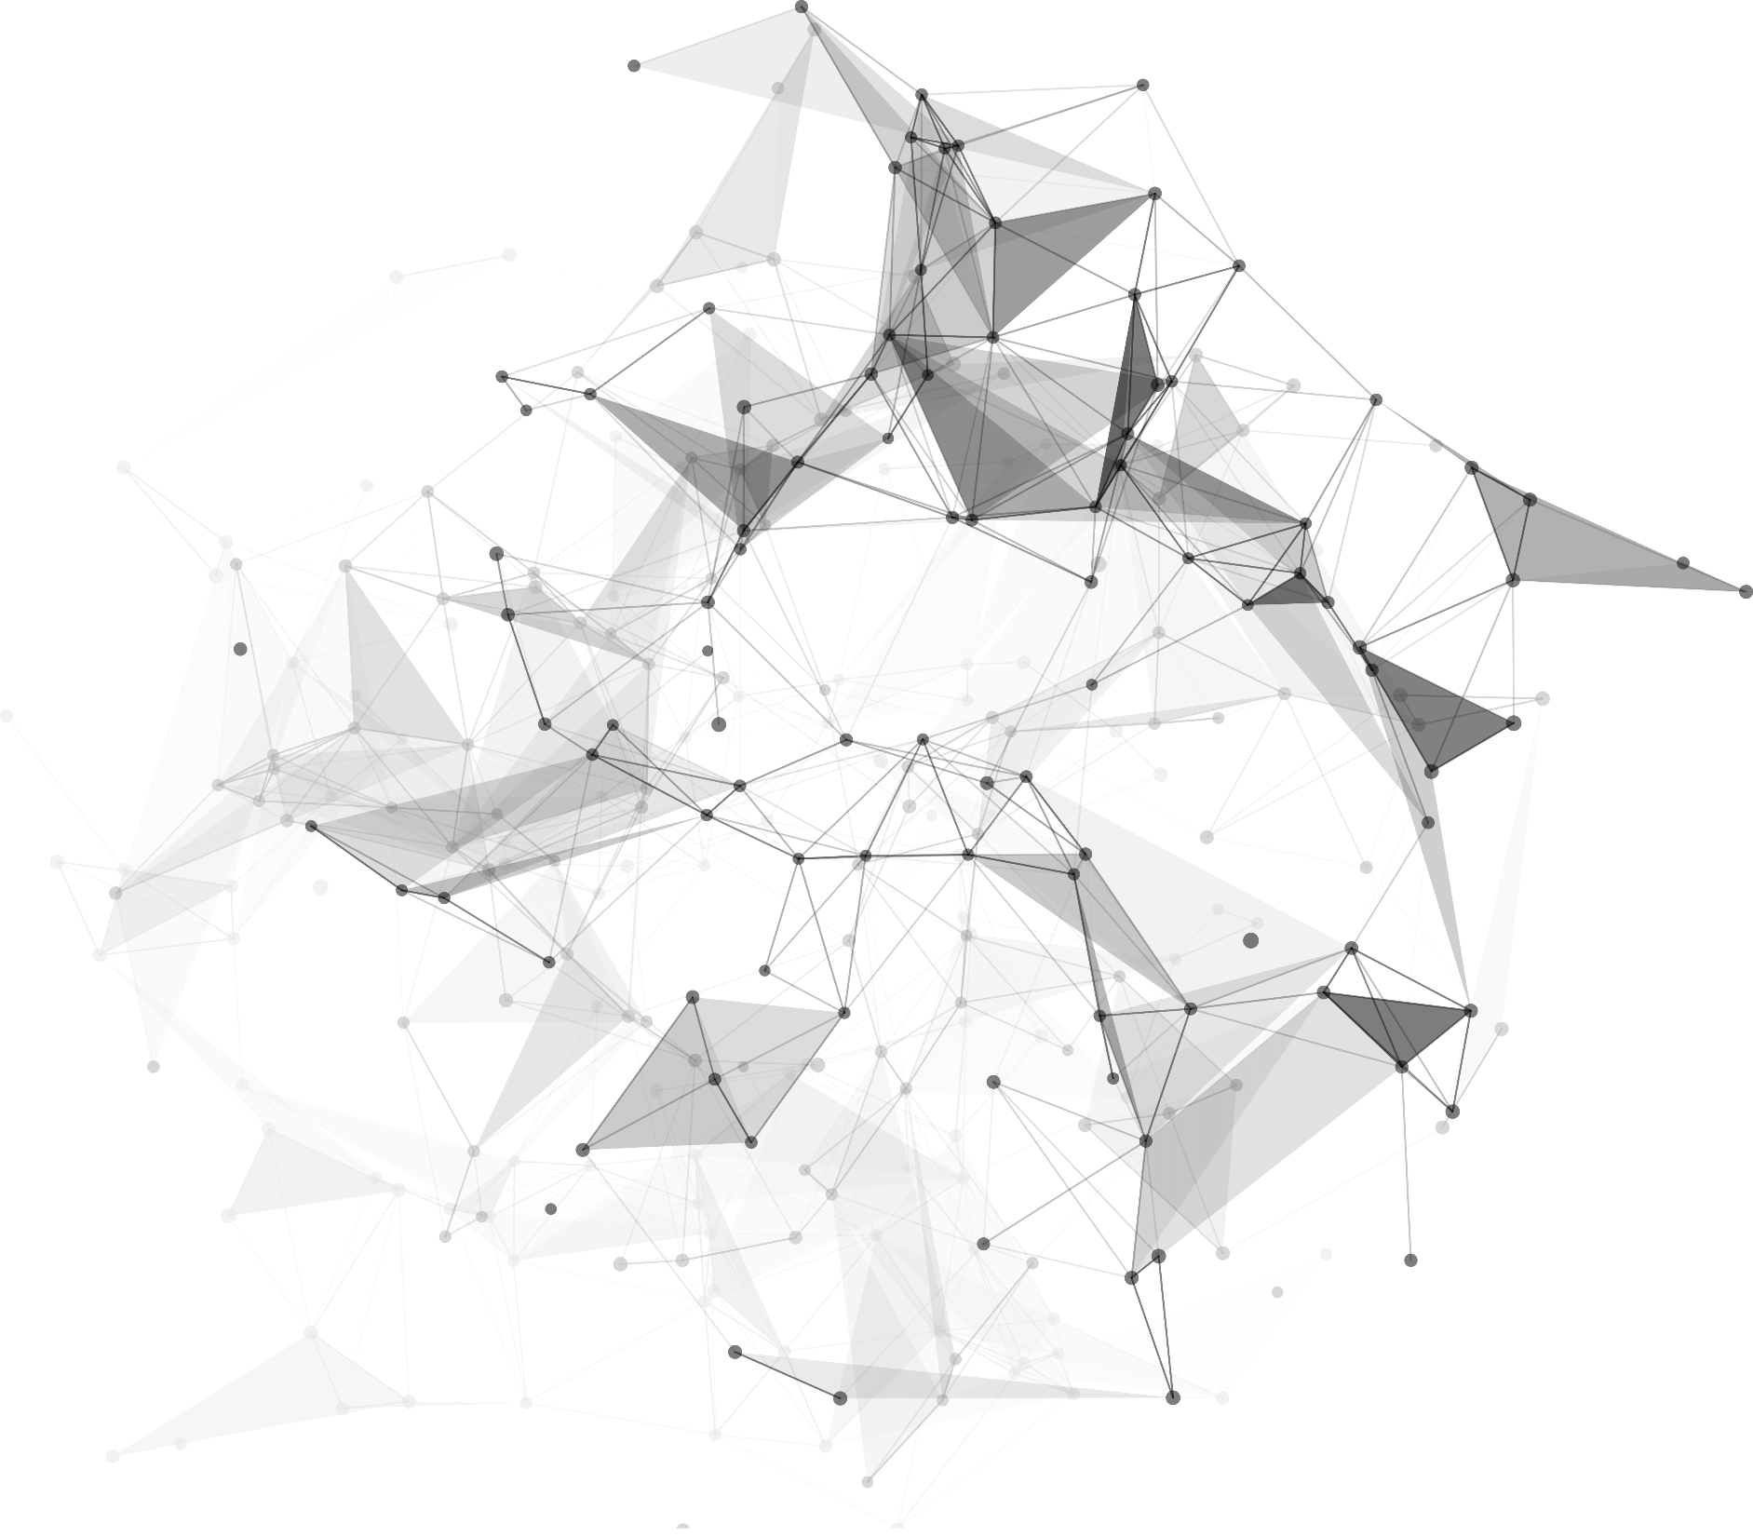
2
0
2
3
01.走进车载 Android 系统
作者 ：林栩link（昵称，并非实际姓名）
邮箱 ：linxu_link@foxmail.com
博客 ：https://juejin.cn/user/870468939434039/posts
github ：https://github.com/linxu-link

Slide 2
CONTENT
Take a piece of candy everyday
03
Take a piece of candy everyday
01
04
02
Take a piece of candy everyday
Take a piece of candy everyday

Slide 3
https://www.ypppt.com/
1
Part 01
Memories, beautiful very hurt, memories, memories of the past but can not go back.You can be happy to live just by yourself.

Slide 4
01
COMPANY
Those who adhere to the principles of wisdom, have right attitudes, and true to their words and discharge their duties with responsibility are loved by people.

Slide 5
01
2011
Knowledge can change your fate and English can accomplish future.
2014
Knowledge can change your fate and English can accomplish future.
2017
Knowledge can change your fate and English can accomplish future.

Slide 6
01
Dreamkiller
Waiting
The sun has begun to set and I hang up the smile I’ve worn all day
The sun has begun to set and I hang up the smile I’ve worn all day
Romantic
NIKI WU
The sun has begun to set and I hang up the smile I’ve worn all day
The sun has begun to set and I hang up the smile I’ve worn all day

Slide 7
01
Only things with which a man identifies himself are able to disturb his mind-only that which concern “ myself ”can give me grief.

Slide 8
01
Dreaming
If two past lovers can remain friends, it’s either they were never in love or they still are.
Knowledge
If two past lovers can remain friends, it’s either they were never in love or they still are.
Empathy
If two past lovers can remain friends, it’s either they were never in love or they still are.
Victory
If two past lovers can remain friends, it’s either they were never in love or they still are.

Slide 9
2
Part 02
Memories, beautiful very hurt, memories, memories of the past but can not go back.You can be happy to live just by yourself.

Slide 10
02
Pengyou
Tengxu
Wechat
Experience as your reference, prudence as your brother and hope as your sentry.
Experience as your reference, prudence as your brother and hope as your sentry.
Experience as your reference, prudence as your brother and hope as your sentry.

Slide 11
02
Dreaming
You can’t change the past，but you can ruin the present by worrying about
Empathy
You can’t change the past，but you can ruin the present by worrying
Giving
You can’t change the past，but you can ruin the present by

Slide 12
02
Click to add your text
Those who adhere to the principles of wisdom, have right attitudes, and true to their words and discharge their duties with responsibility are loved by people.
Click to add your text
Those who adhere to the principles of wisdom, have right attitudes, and true to their words and discharge their duties with responsibility are loved by people.

Slide 13


02
Dreaming
You can’t change the past，but you can ruin the present by worrying about
Empathy
You can’t change the past，but you can ruin the present by worrying
Giving
You can’t change the past，but you can ruin the present by
Notes:
https://www.ypppt.com/

Slide 14
02
Whatever
It is well worth of falling love in someone even

Slide 15
3
Part 3
Memories, beautiful very hurt, memories, memories of the past but can not go back.You can be happy to live just by yourself.

Slide 16
03
morning just in case it is “that day.” I want her to see me at my very best.
S
And then there are times I get that lump in my throat and that tight feeling in my chest,
W
O
It is well worth of falling love in someone even
T
It is well worth of falling love in someone，even can keep up with the unavoidable

Slide 17
03
Dreaming
Let's take steps to banish some of the most common negative thoughts many of us repeat to ourselves. Being in a negative space is harmful to our overall well-being, because what you dwell on can easily become self fulfilling if you don't change you r mindset.
Avecle
Waiting
Waiting
Then I ask myself, “Is this the day?” And the excitement rushes over me again. And then I ask myself, “Where’s it going to be?”
Soleil

Slide 18
03
Knowledge
Knowledge
I do the normal routine, eat dinner, clean the house
I do the normal routine, eat dinner, clean the house
Knowledge
Knowledge
Knowledge
I do the normal routine, eat dinner, clean the house
I do the normal routine, eat dinner, clean the house
I do the normal routine, eat dinner, clean the house

Slide 19

03
Knowledge
Knowledge
I do the normal routine, eat dinner, clean the house
I do the normal routine, eat dinner, clean the house
16344￥
45784￥
16344￥
45784￥
Knowledge
Knowledge
I do the normal routine, eat dinner, clean the house
I do the normal routine, eat dinner, clean the house

Slide 20

03
Temptation
Then I ask myself, “Is this the day?” And the excitement rushes over me again. And then I ask myself, “Where’s it going to be?” think about her. And sometimes I smile, and sometimes that urn into a burst of laughter.

Slide 21
4
Part 04
Memories, beautiful very hurt, memories, memories of the past but can not go back.You can be happy to live just by yourself.

Slide 22
04
13.3%
46.7%
78.2%
European
China
United States
8.6%
Australia
Business Template
Those who adhere to the principles of wisdom, have right attitudes, and true to their words and discharge their duties with responsibility are loved by people. Make haste in doing good, restrain your mind from evil. Whosoever is slow in doing well, his mind delights in evil?

Slide 23

04
Those who adhere to the principles of wisdom, have right attitudes, and true to their words and discharge their duties with responsibility are loved by people.
2014\09
2015\11
Those who adhere to the principles of wisdom, have right attitudes, and true to their words and discharge their duties with responsibility are loved by people.

Slide 24
04
18%
Bonds
57%
25%
Dream
Quiet
He who sees other’s faults is ever irritable, the corruptions of such as one grows. He is far from the destruction of the corruptions. Those who adhere to the principles of wisdom, have right attitudes, and true to their words and discharge their duties with

Slide 25
04
75.8%
Photoshop
Adobe Illustrator
You cannot improve your past, but you can improve your future. Once time is wasted, life is wasted.
Don't aim for success if you want it; just do what you love and believe in, and it will come naturally. Knowledge can change your fate and English can .
You cannot improve your past, but you can improve your future. Once time is wasted, life is wasted.

Slide 26
c
04
Those who adhere to the principles of wisdom, have right attitudes, and true to their words and discharge their duties with responsibility are
2
Those who adhere to the principles of wisdom, have right attitudes, and true to their words and discharge their duties with responsibility are
1
AIM AT

Slide 27
Thank You
.
.
.

Slide 28
更多精品PPT资源尽在—优品PPT！
www.ypppt.com
PPT模板下载：www.ypppt.com/moban/ 节日PPT模板：www.ypppt.com/jieri/
PPT背景图片：www.ypppt.com/beijing/ PPT图表下载：www.ypppt.com/tubiao/
PPT素材下载： www.ypppt.com/sucai/ PPT教程下载：www.ypppt.com/jiaocheng/
字体下载：www.ypppt.com/ziti/ 绘本故事PPT：www.ypppt.com/gushi/
PPT课件：www.ypppt.com/kejian/
Notes:
模板来自于 优品PPT https://www.ypppt.com/

