Slide 1
OpenResty（Nginx）+LuaJIT（Lua）高并发web服务实践教程

Slide 2
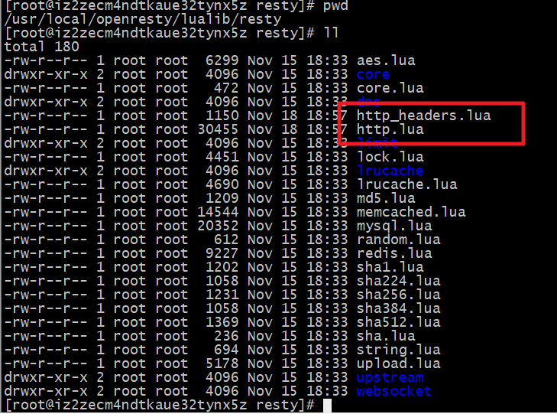
第八章：OpenResty的HTTP客户端安装与测试
Openresty没有提供默认的Http客户端，需要下载第三方的http客户端。
下载lua-resty-http到lualib目录下，使用以下的命令下载：
lua-resty-http模块的地址为https://github.com/pintsized/lua-resty-http
cd /usr/local/openresty/lualib/resty/
wget https://raw.githubusercontent.com/pintsized/lua-resty-http/master/lib/resty/http_headers.lua
wget https://raw.githubusercontent.com/pintsized/lua-resty-http/master/lib/resty/http.lua
Notes:
安装成功后，通过require(“resty.http”)引入 lua_http模块，它有以下的api方法：
syntax: httpc = http.new() 创建一个 http对象
syntax: res, err = httpc:request_uri(uri, params)根据参数获取内容，包括：
status 状态码
headers 响应头
body 响应体
=========================vim /usr/local/openresty/nginx/lua/test_http.lua，写以下代码： ==========================================
local http = require("resty.http")
local httpc = http.new()
local resp, err = httpc:request_uri("http://s.taobao.com", {
method = "GET",
path = "/search?q=hello",
headers = {
["User-Agent"] = "Mozilla/5.0 (Windows NT 6.1; WOW64) AppleWebKit/537.36 (KHTML, like Gecko) Chrome/40.0.2214.111 Safari/537.36"
}
})
if not resp then
ngx.say("request error :", err)
return
end
ngx.status = resp.status
for k, v in pairs(resp.headers) do
if k ~= "Transfer-Encoding" and k ~= "Connection" then
ngx.header[k] = v
end
end
ngx.say(resp.body)
httpc:close()
==================================vim /usr/local/openresty/nginx/conf 加上以下的配置：=============================================
location /lua_http {
resolver 8.8.8.8;
default_type 'text/html';
lua_code_cache on;
content_by_lua_file /usr/local/openresty/nginx/lua/test_http.lua;
}
注意事项：
在Nginx的配置文件nginx.conf的http部分，加上以下dns解析：
vim /usr/servers/nginx/conf/nginx.conf
resolver 8.8.8.8;
==================================浏览器访问：=============================================
http://116.196.177.123/lua_http
浏览器会显示淘宝的搜索页。

Slide 3
安装 lua_cjson模块
Json是一种常见的数据交换格式，常用于http通信协议和其他数据传输领域。在openresty默认内嵌了lua_cjson模块，用来序列化数据。
lua_cjson模块的地址：https://www.kyne.com.au/~mark/software/lua-cjson-manual.html
参考：https://www.cnblogs.com/ccmc/tag/openresty/
Notes:
它常用的API如下：
local cjson = require “cjson” 获取一个cjson对象
local str = cjson.encode(obj) obj转换成string
local obj = cjson.decode(str) 将string转obj
========================vim /usr/local/openresty/nginx/lua/test_cjson.lua，添加以下内容：==========================================
local cjson = require("cjson")
local obj = {
id = 1,
name = "zhangsan",
age = nil,
is_male = false,
hobby = {"film", "music", "read"}
}
local str = cjson.encode(obj)
ngx.say(str, "<br/>")
str = '{"hobby":["film","music","read"],"is_male":false,"name":"zhangsan","id":1,"age":null}'
local obj = cjson.decode(str)
ngx.say(obj.age, "<br/>")
ngx.say(obj.age == nil, "<br/>")
ngx.say(obj.age == cjson.null, "<br/>")
ngx.say(obj.hobby[1], "<br/>")
================================== vim /usr/local/openresty/nginx/conf/nginx.conf 加上以下的配置：=============================================
location ~ /lua_cjson {
default_type 'text/html';
lua_code_cache on;
content_by_lua_file /usr/example/lua/test_cjson.lua;
}
==================================在浏览器上访问http://IP:80/lua_cjson，浏览器显示以下内容：=============================================
{"hobby":["film","music","read"],"is_male":false,"name":"zhangsan","id":1}
null
false
true
film

