Slide 1
YoseLog
Real-time yoga pose classification, balance scoring, and automatic session logging
10-minute project defense
MediaPipe Pose
ML classifier
Stable hold detection
Web dashboard
Presenter: Dahyun Eom

Slide 2
Problem: most yoga apps assume the pose first
YoseLog
My goal was free-form session logging: let the user move naturally while the app detects and logs poses automatically.
Typical flow
My observation
Final product
User selects a target pose
App checks if the pose matches
Scoring/feedback is tied to that pre-selected pose
Hard-coded rules often drive pose-specific feedback
A real yoga session is not always pre-planned
The user may switch poses freely
Manual pose selection interrupts the session
Automatic logging would be more natural
Confirmed classifier result
Automatic session table
Pose durations + totals
Exportable CSV for review

Slide 3
System architecture
YoseLog
The frontend does not invent labels; it displays the same confirmed result from the live classifier loop.
Camera
Pose landmarks
Classifier
Session engine
Website
OpenCV VideoCapture
MediaPipe Pose 33 body points
66 x/y features scikit-learn model
stability + hold time balance score
Flask API + MJPEG browser dashboard
Design decision
The app was aligned back to classify_live.py after testing showed frontend-only gates changed pose results.
This made the web UI a presentation layer over the classifier, not a second classifier.

Slide 4
Why I chose an MLP
YoseLog
The input is already structured landmark data, so a small neural network is a practical classifier.
Input 66 features
Hidden 256
Hidden 128
Output 40 poses
Why MLP fits
Input is not raw pixels
MediaPipe already gives 66 numeric x/y features
MLP learns nonlinear joint relationships
Lighter than training a CNN
Easier than hand-coding angle rules for 40 poses
Each neuron combines weighted landmark features and learns nonlinear pose patterns.
Defense point: MediaPipe handles perception; the MLP handles classification from clean landmark features.

Slide 5
Classifier pipeline
YoseLog
I trained the pose classifier from downloaded Yoga-82 images using MediaPipe keypoints and an MLP model.
POSE CLASSES
SAMPLES
TRAIN / TEST
ACCURACY
40
11,566
9,252 / 2,314
86.9%
downloaded pose folders
keypoint rows extracted
stratified split
held-out test set
Training process
download images → original + flipped keypoint extraction → 66-feature keypoints.csv → train_model_mlp.py → pose_model.pkl
Accuracy key
Model
Horizontal flip augmentation doubled orientation coverage for left/right body views
MLPClassifier hidden layers (256, 128), trained on original + flipped landmarks

Slide 6
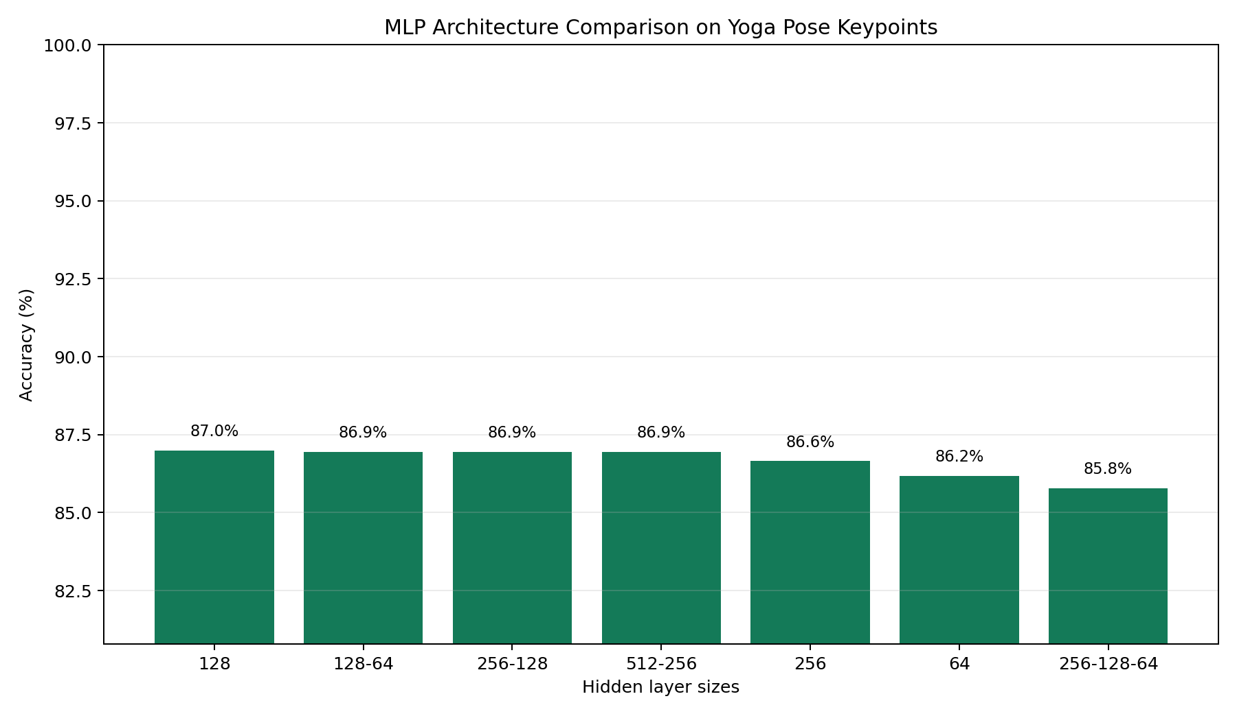
Model tuning experiment
YoseLog
Changing hidden-layer size changes accuracy, but most reasonable MLPs clustered near 86-87%.
What the graph shows
Best single result: (128,) at 87.0%
(256,128) reached 86.9%, nearly tied with the best
(256,128) had slightly stronger macro-F1 on the imbalanced 40-pose dataset
Very deep/wide is not automatically better
Defense point: I kept (256,128) because it balances accuracy, capacity, and per-class performance.

Slide 7
Session logging converts predictions into usable events
YoseLog
A pose is shown/logged only after it survives the stability rule.
Stability rule
Logging rule
Why it matters
Compare current smoothed keypoints to previous frame
Movement = mean absolute keypoint difference
If movement < 0.05 and label is unchanged, count stable frame
30 stable frames ≈ 1 second
Keep accumulating hold time for the same pose
When pose changes, log the previous pose
Only log if duration ≥ 1 second
Show recent entries in the UI
Reduces flicker
Prevents accidental one-frame logs
Turns recognition into a session summary
Makes export meaningful

Slide 8
Balance score estimates steadiness, not pose correctness
YoseLog
Balance is computed from body sway during a held pose.
What is measured
Defense distinction
Torso center movement over the hold
Shoulder tilt variation over the hold
Normalized by torso length so camera distance has less effect
It does not grade yoga form accuracy
It does not compare against an ideal pose template
It only measures how much the detected body landmarks wobble during a stable hold
score = 100 - sway penalty - tilt penalty
Higher score = steadier hold
This makes the feature honest: balance is a stability metric, not a coach.

Slide 9
Frontend integration
YoseLog
The website makes the classifier usable during a yoga session.
Live session dashboard
Key integration choice
The browser receives the same confirmed result as classify_live.py
The backend owns camera + model inference
The frontend polls session state and renders the stream
Port moved to 5001 to avoid macOS AirPlay conflict
Live camera stream
Confirmed classifier result
Hold timer + progress
Balance score
Session log + CSV export

Slide 10
My contribution
YoseLog
I moved the project from a classifier script to a usable session-logging product.
Training
Downloaded data for 40 yoga poses and extracted original + horizontally flipped keypoints
Model
Wrote train_model_mlp.py and trained an MLP classifier with 86.9% test accuracy
Product
Built Flask website, live stream, state API, dashboard, and CSV export
Reliability
Aligned frontend result to classify_live.py after debugging mismatches
Feature
Added balance scoring from held-pose landmark sway
Contribution claim: I contributed the dataset/model training path and the product layer that logs free-form sessions.

Slide 11
Limitations and defense answers
YoseLog
The system is honest about what it can and cannot claim.
Known limitations
How I defend it
Closed-set model can still confuse visually similar poses
No explicit no-pose/resting training class
Balance score measures steadiness, not correctness
Camera angle and body visibility affect landmarks
Separated raw classifier testing from web logging
Used stable-frame confirmation to reduce flicker
Kept frontend aligned with the trusted live classifier
Designed next steps: add no-pose data and pose-correctness scoring

Slide 12
Final takeaway
YoseLog
YoseLog turns pose detection into a session record a user can actually review.
What I built
Why it matters
Real-time yoga pose classification
Automatic duration logging
Balance scoring during stable holds
Browser dashboard and export
It reduces manual tracking
It makes model output understandable
It creates a foundation for future coaching features
Defense thesis: my main contribution was building the reliable session layer around the classifier.

