Slide 1
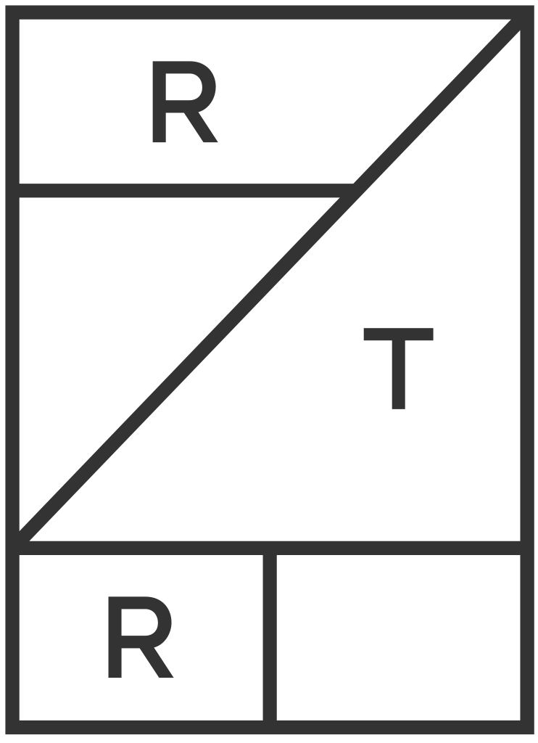
RENT THE RUNWAY RECOMMENDATIONS
ANNA DAI + SAWARI DAS + TIGRAN HARUTYUNYAN + SURABHI TRIVEDI

Slide 2
AGENDA
Business
Understanding
Clustering
Evaluation
Data
Recommendation
Engine
Implications & Future Work

Slide 3
BUSINESS UNDERSTANDING
Recommendation systems are key to the business
Businesses heavily rely recommenders
Rent the Runway is a clothing rental company where users browse through their website to find what clothes they want to rent
WE WANT TO UNDERSTAND IF BUILDING A RECOMMENDER
FOR SUBSETS OF USERS CAN BE MORE EFFICIENT THAN
A GENERAL ONE FOR ALL USERS

Slide 4
DATA
We have 190K rows of data on per user per item basis
Explicit feedback
User-related features
Body figure, height, weight
Users input these when they subscribe to the service
Transaction-related features
Fit, occasion, size
We process the data
TODO: insert diagram

Slide 5
CLUSTERING
We implement unsupervised learning to cluster our data in order to gain insight on the segmentation of users
TODO: INSERT VISUALIZATION

Slide 6
RECOMMENDATION ENGINE
METHODOLOGY
Tri-Fold
Cross
Validation
We leverage a supervised XGBoost model to build our recommender
We process the data
TODO: insert diagram

Slide 7
EVALUATION
General Model
Lift* = 1.074
AUC = 60.3%
Cluster
General
Cluster
Cluster
Cluster 1
Lift = 1.079
AUC = 60.5%
Cluster 2
Lift = 1.073
AUC = 59.9%
Cluster 3
Lift = 1.084
AUC = 61.7%
Cluster 3
Lift = 1.106
AUC = 64.5%
* Lift score measures the performance of a targeting model (accuracy/baseline)

Slide 8
IMPLICATIONS & FUTURE WORK
Conclusion:
1) We group people based off their clusters
2) Any new customers, we would first recommend them popular items to address our cold start problem
3) If they are in cluster #, #, we will run _ engine to recommend items we think they would like
3) As they click and purchase, we will continue to feed our data back into the engine to continue training
Limitations:
Future Work:
More robust recommendation engine

Slide 9
REFERENCES
GitHub Repo: https://github.com/dai-anna/RenttheRunwayRecommendations

Slide 10
CHOOSING A RECOMMENDATION SYSTEM
CONTENT-BASED FILTERING
COLLABORATIVE FILTERING

