Slide 1

Kanji reader
A Cross-Linguistic Phonetic Extension to master the Chinese characters
2026/ 06/26
Citation : Smithonian
NATIONAL MUSEUM OF ASIAN ART https://asia-archive.si.edu/learn/for-educators/teaching-china-with-the-smithsonian/lesson-plans/tea-culture-in-china/

Slide 2
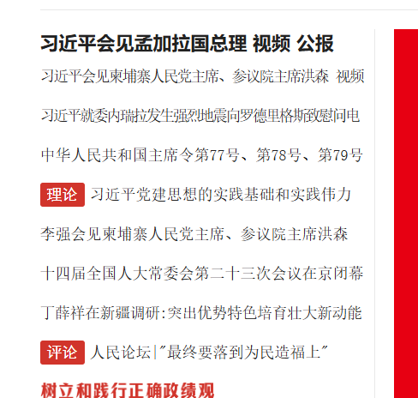
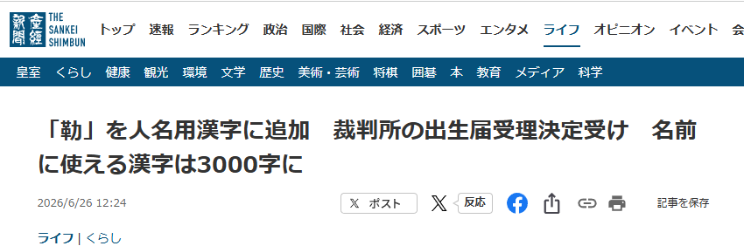
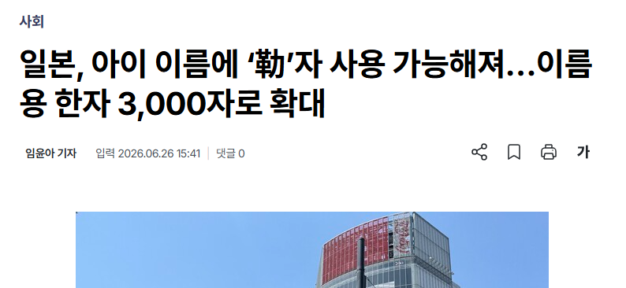
Necessity & Objective
Phonetic Divergence
・Japanese, Chinese, and Korean share the same character roots.
・Their pronunciations have diverged significantly over centuries.
・Language learners and researchers struggle to bridge these phonetic gaps.
Project Goal
・Kanji Reader was created to provide a unified data bridge.
・The goal is to build an extension tool on web content to show and to simultaneously compare
On-yomi (JP), Pinyin (CN) and Hangeul (KR).
Simplified Chinese
Japanese
Korean
Sankei news
https://www.sankei.com/article/20260626-ET3LTBEWGBGWVJKRKJU24T6JWI/
People’s daily
https://www.people.com.cn/
Japan Korea DAILY
https://www.jk-daily.co.kr/news/articleView.html?idxno=40639

Slide 3
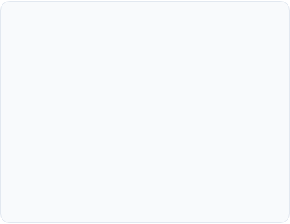
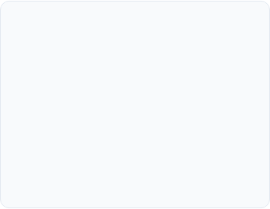
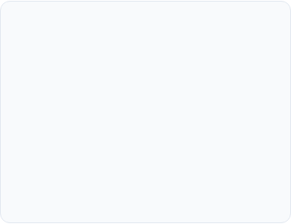



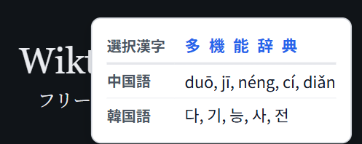
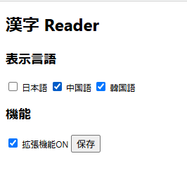
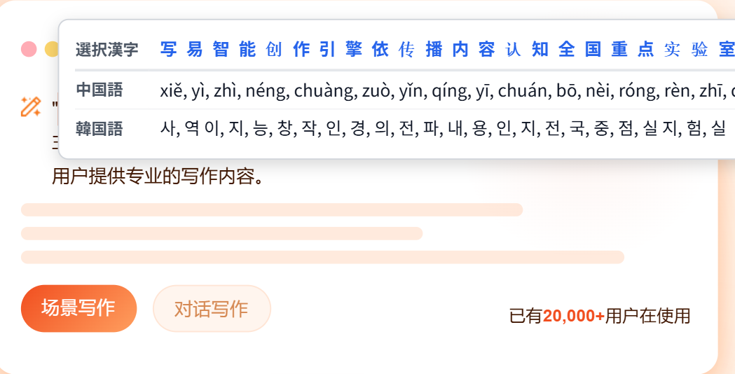
Software Overview
Instant Lookup
Trilingual Data
Customizable
Triggers phonetic display via high-speed selection change listeners or Ctrl-click interactions.
Integrated support for Japanese, Chinese, and Korean readings within a single view.
Flexible settings to toggle specific languages and enable/disable features per user needs.
https://xy.people.cn/user/login
https://www.wiktionary.org/

Slide 4
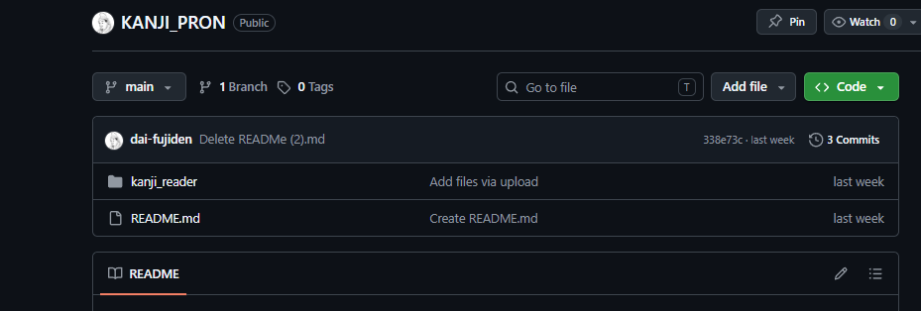
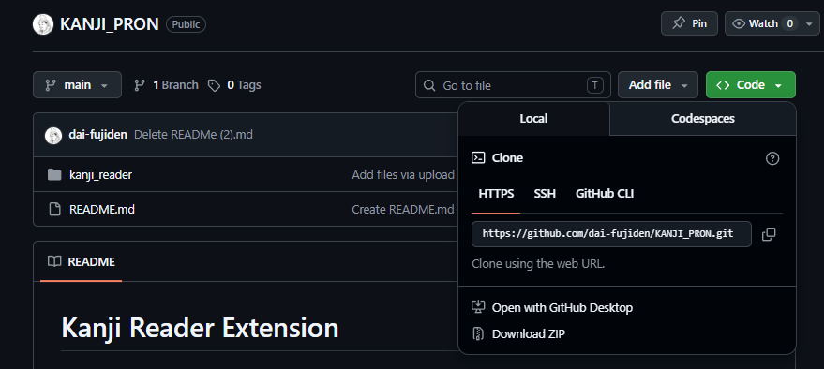
Install app
Please visit my Github account https://github.com/dai-fujiden/KANJI_PRON.git.
And download the zip folder
by clicking the botton shown in the picture.
Click Downloads Zip.
Please make sure the folder kanji_reader existing
in the Zip.

Slide 5
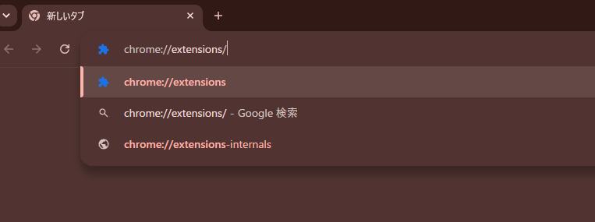
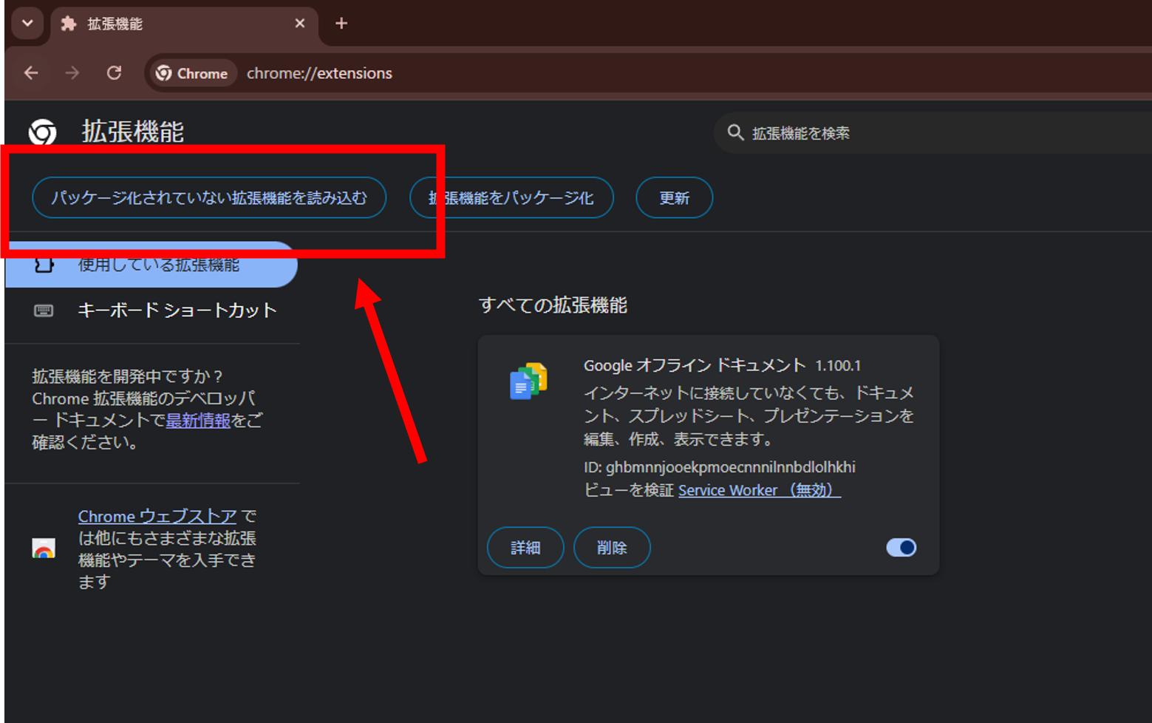
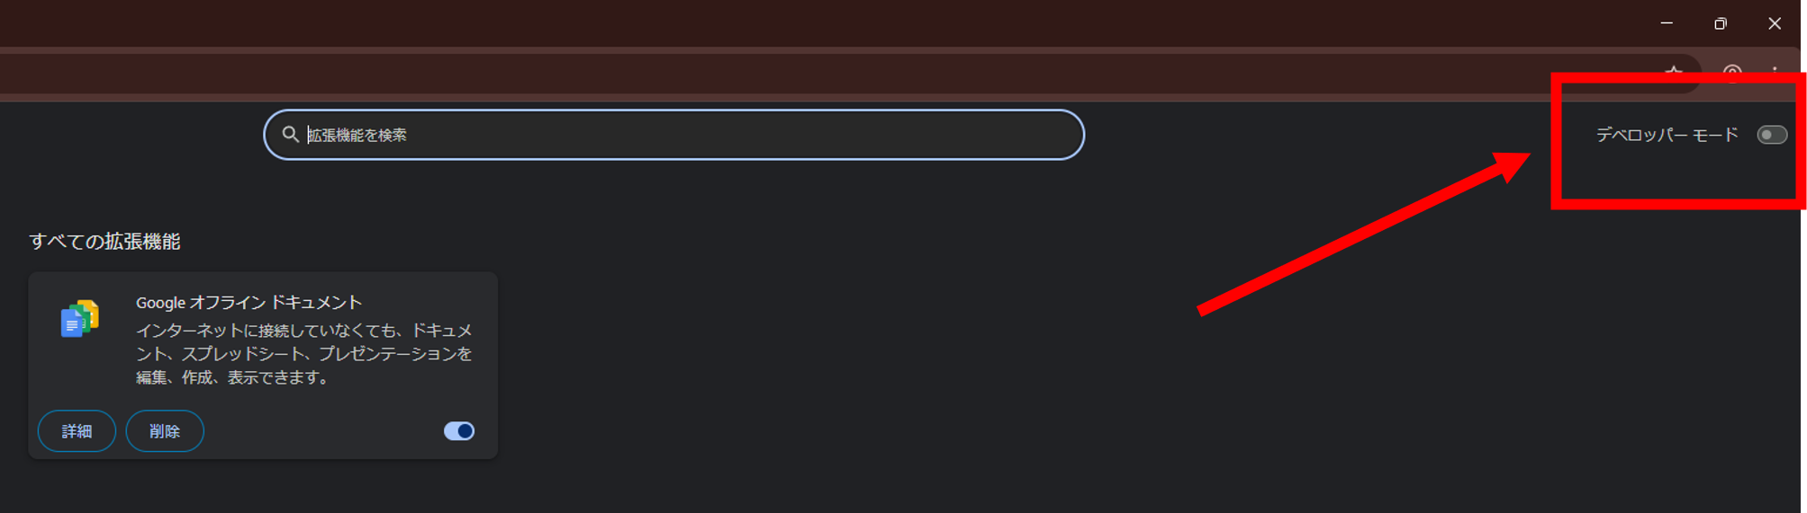
Preparation
1. Enter the extensions manage page
After downloads Zip from the Github,
launch Google Chrome and simply enter chrome://extensions/ in your address bar.
3. Activation of the Extension
Click the "Load unpacked" button on the top left.
Navigate your file explorer and select
the kanji_reader folder in the zip file KANJI_PRON.
2. Turning on the developer mode
Click the Developer Mode toggle in the top right corner, and turn it on.

Slide 6
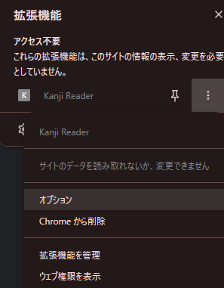
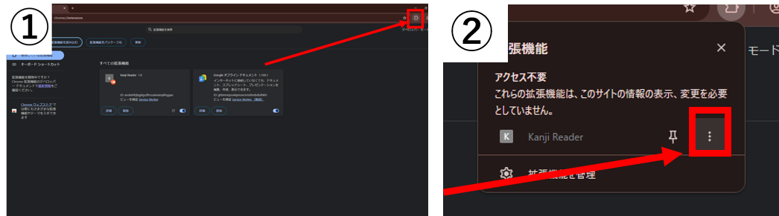
Usage - configure
0. Configure
Manage visible languages via the Options page.
2. Trigger
1. Select
3. View
① Click the puzzle icon in the browser toolbar.
② Click the three dots next to "Kanji Reader". And choose option.

Slide 7
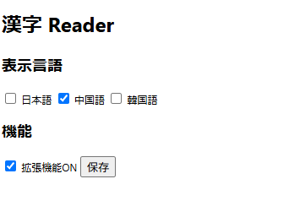
Usage - configure
0. Configure
Manage visible languages via the Options page.
2. Trigger
1. Select
3. View
③Select the phonetic systems you wish to see in your popups.
You can toggle these settings at any time to match your learning context.

Slide 8
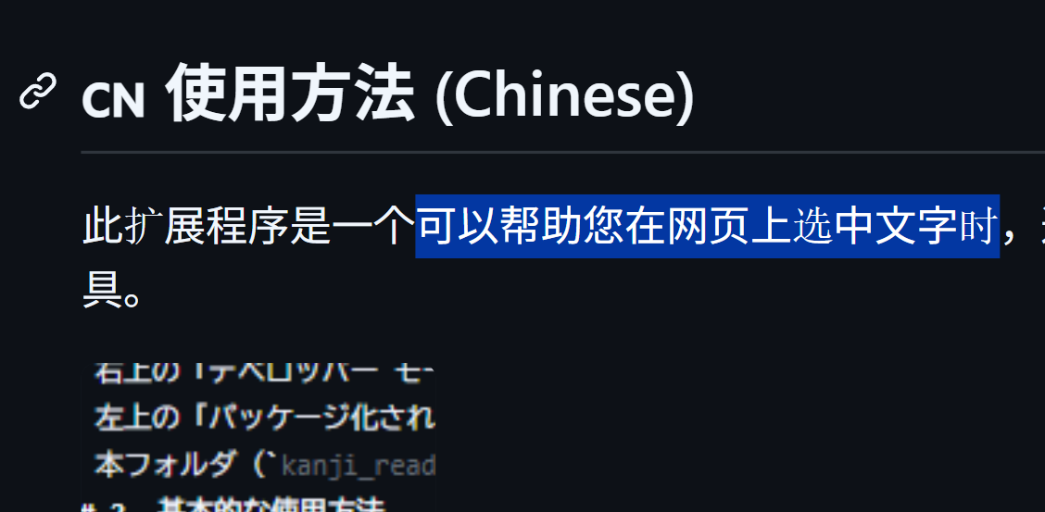
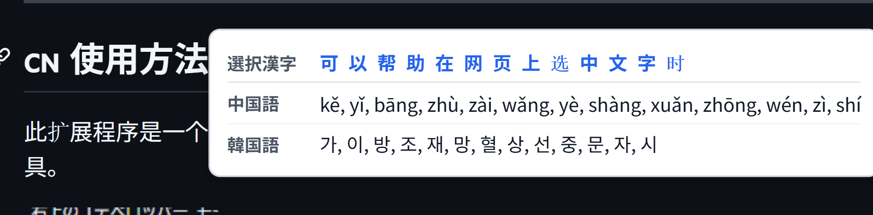
Usage - configure
2. Trigger
Hold the Ctrl Key on your keyboard. Select the characters with your mouse.
0. Configure
1. Select
3. View
Chose any Kanji/Hanzi text on any webpage.
Instantly view phonetic data in a floating panel.
1. Select
2. Trigger and 3. View

Slide 9
System structure
Module | File | Role
Core Engine | content.js | Selection tracking, Dictionary lookup, UI Rendering
Setting | options.js | Manages user settings for trilingual display
Persistence | manifest.js | Signifies the scripts to be used in each features.
Database | kanji_data.json | Mapped character keys to phonetic values
Data are borrowed from following dataset
Unihan reading and variants data
Latest Version:
https://www.unicode.org/Public/UCD/latest/ucd/Unihan.zip
Version 17.0.0:
https://www.unicode.org/Public/17.0.0/ucd/Unihan.zip
Explanations:
https://www.unicode.org/reports/tr38/

