Slide 1
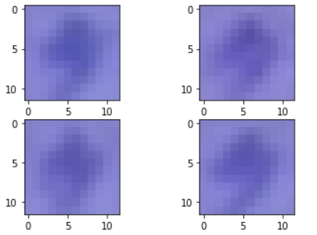
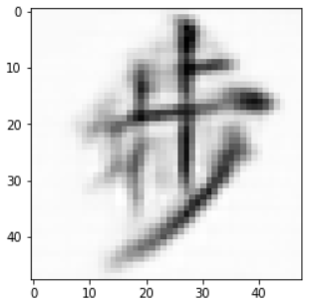
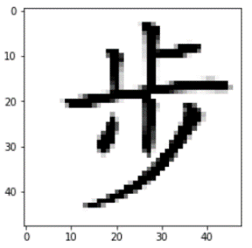



Massive Blurred
Snapshots
Complex Characters
Commercial Smartphone
Range: 1.8 / 6 m & 30°

Slide 2
Input
Prev.
Profile
H
H
H
Conv 1
Merge
Profile
Info.
H
Input
Conv 2
Conv 3
Output

Slide 3
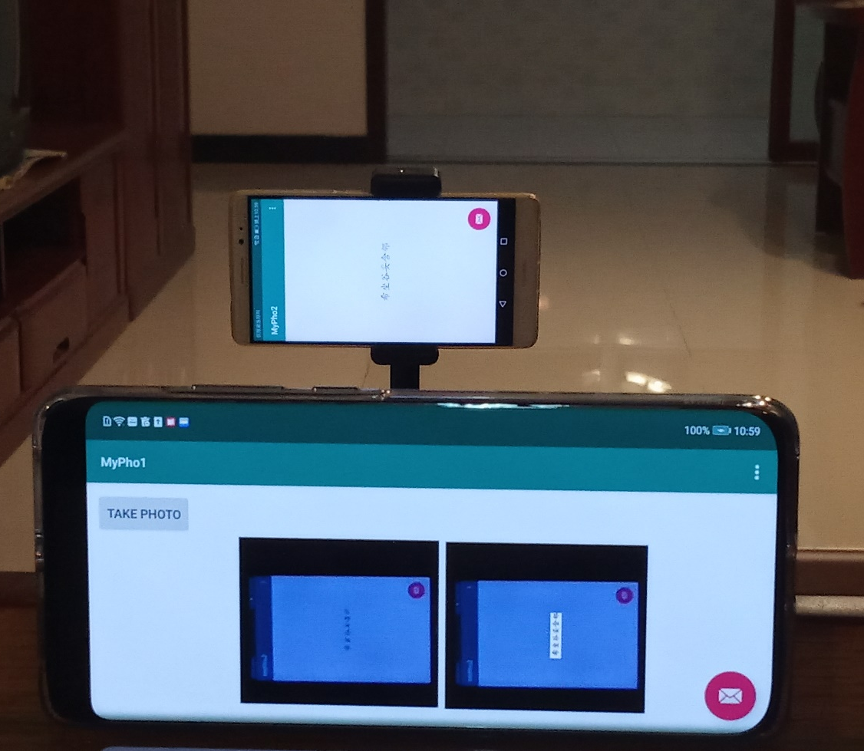

Victim
Result
Attacker

Slide 4
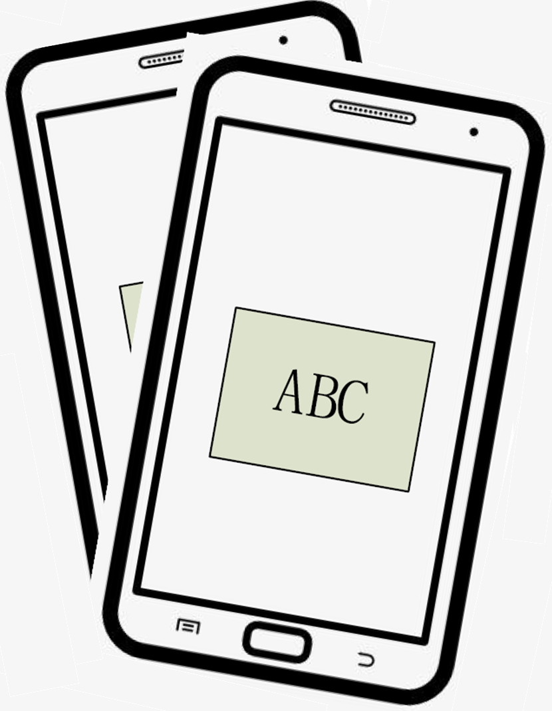
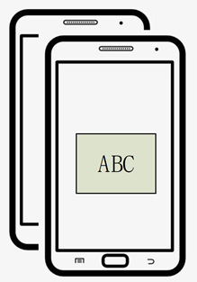
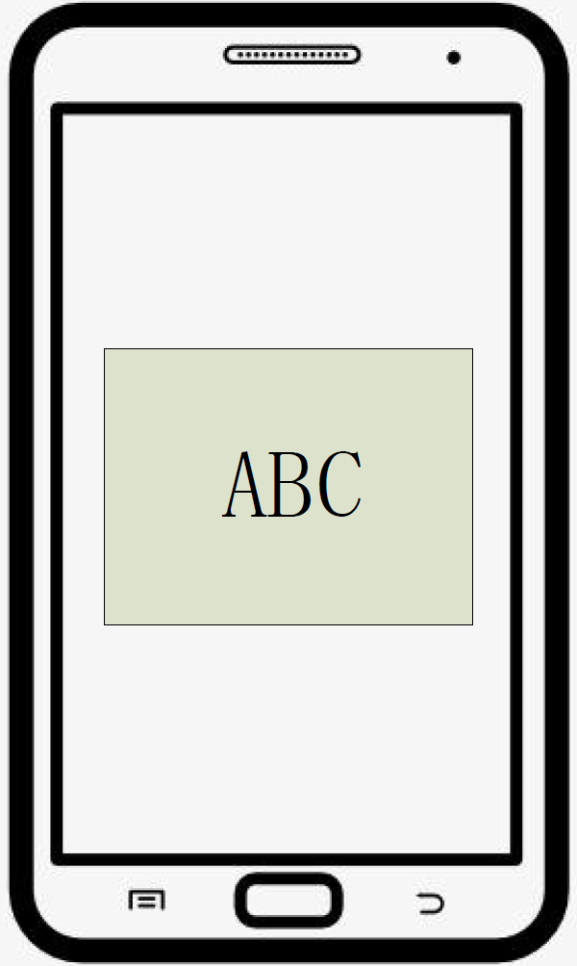
ABC
ABC
ABC
ABC
ABC
ABC
ABC
ABC
Input
Alignment
Adjustment
Processing
Output

Slide 5
