Slide 1

PeopleLedger
HR and Finance Review Platform
English edition
Project demonstration
20 slides with automatic English narration
01 / 20
Notes:
HR and Finance Review Platform
Project demonstration
English narration
Welcome to the PeopleLedger project demonstration. PeopleLedger brings human resources and finance records into a shared review process. The project focuses on a practical question: how can a reviewer understand a decision and find the records that supported it? During this presentation, we will follow a sample case from data preparation through checks, bank reconciliation, approval, and evidence export. We will also look at recruitment and the limits placed on AI assistance. All people and transactions in this demonstration are fictional. The product screenshots come from an isolated local demonstration. A cloud edition is now available on Vercel, with a PostgreSQL database and private file storage. This presentation explains the implemented behaviour, the evidence from testing, and the work still needed before an organisation could rely on it for operational use.
Sources
PeopleLedger-v2/README.md
PeopleLedger-v2/START_HERE.md

Slide 2
Gaps in cross-functional review
The business problem behind the project
01
Separate records
Payroll, ledger and bank data sit apart
02
Outdated reports
Source data can change after a report circulates
03
Unclear decisions
Reviewers need the evidence behind an approval
02 / 20
Notes:
Gaps in cross-functional review
The business problem behind the project
English narration
A review becomes difficult when each department maintains a different part of the evidence. Human resources may own the payroll spreadsheet. Finance may hold the ledger, while bank transactions arrive in a separate file. Even when each file is reasonable on its own, comparing them takes effort. A second problem appears when someone edits the underlying data after a report has circulated. The report may continue through approval without making that change obvious. A third problem concerns accountability. An approval message by itself does not explain which evidence the approver saw. PeopleLedger addresses these problems by organising records around a case, preserving source snapshots in reports, and recording the people who perform each review step. The intended benefit is a review that colleagues can follow and revisit. The project has not measured time savings in a real organisation.
Sources
DEMO_SCRIPT.md
PeopleLedger-v2/README.md

Slide 3
The maintained version
Changes since the earlier browser prototype
Capability | Earlier prototype | Current v2
Persistence | Browser storage | Server persistence
Access | Role simulation | Accounts and permissions
Inputs | Primarily payroll | Payroll, ledger and bank
Evidence | Reference numbers | Files, versions and ZIP export
03 / 20
Notes:
The maintained version
Changes since the earlier browser prototype
English narration
The maintained second version makes several changes to the earlier browser prototype. Data now belongs to a server application, so closing or refreshing a browser does not define the lifetime of the business records. The original local edition uses SQLite, and the deployed edition uses PostgreSQL. Access also changes from a simulated role selector to authenticated accounts with server permissions. The scope of the inputs expands beyond payroll to include ledger and bank records. Evidence develops from a reference number into an actual file with a version and a recorded hash. These changes matter because a demonstration becomes more useful when the server enforces the workflow. A browser can guide a user, but the server must decide whether an action is allowed. The rest of the presentation shows how these capabilities work together in one sample case.
Sources
hr-finance-compliance-mvp/README.md
PeopleLedger-v2/README.md

Slide 4
The review workflow
Four stages organise the case
01
Prepare records
Import source data and attach evidence
02
Check and reconcile
Review issues and compare bank transactions
03
Report and approve
Preserve the basis for separate review decisions
04
Seal and export
Package the approved report and its evidence
04 / 20
Notes:
The review workflow
Four stages organise the case
English narration
The workflow has four broad stages. First, a user prepares the case by importing the required records and attaching supporting evidence. The system validates the data before accepting the import. Second, checks identify issues and bank reconciliation compares the ledger with the bank statement. These results help a reviewer decide what still needs attention. Third, the report captures the relevant data and moves through separate review and approval stages. This is where the system records who made each decision and prevents users from skipping the required steps. Finally, an authorised user seals the approved report and exports its evidence package. Sealing creates a defined review outcome that can be revisited later. These stages provide the structure for the demonstration. Each screen has a specific place in the process, rather than acting as an unrelated collection of features.
Sources
PeopleLedger-v2/README.md
PeopleLedger-v2/server/services/reports.service.js
PeopleLedger-v2/server/services/export.service.js

Slide 5
The sample case
September 2026 demonstration data in Singapore dollars
6
Fictional employees
8 / 8
Ledger and bank rows matched
Synthetic data in SGD. Net bank movement does not establish profit.
05 / 20
Notes:
The sample case
September 2026 demonstration data in Singapore dollars
English narration
The sample case contains six fictional employees. The ledger has eight transactions, and the bank file also has eight. Six salary payments total thirty-five thousand one hundred Singapore dollars. A rental payment adds four thousand dollars to the outflow. A sales receipt contributes fifty thousand dollars of inflow. The chart therefore shows fifty thousand dollars of inflow, thirty-nine thousand one hundred dollars of outflow, and ten thousand nine hundred dollars of net bank movement. Net bank movement does not establish accounting profit. The payroll records also distinguish gross pay from net pay. Gross pay totals forty-three thousand eight hundred dollars, while expected and paid net salary both total thirty-five thousand one hundred dollars. Keeping those concepts separate avoids an incorrect comparison between gross payroll and the salary transactions that actually reach employees. All amounts here belong to synthetic demonstration data.
Sources
PeopleLedger-v2/examples/payroll-corrected.csv
PeopleLedger-v2/examples/ledger-demo.csv
PeopleLedger-v2/examples/bank-demo.csv
PeopleLedger-v2/tests/server.v2.test.cjs

Slide 6
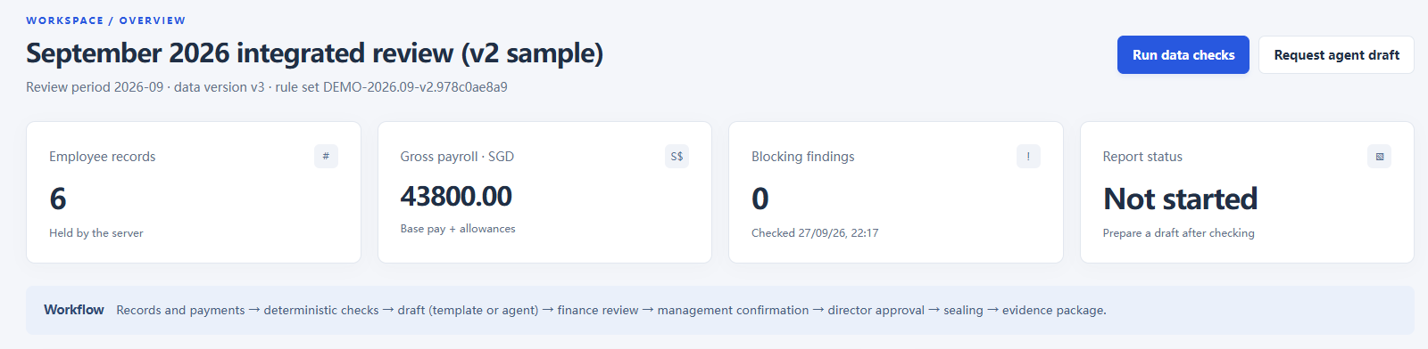
A shared case workspace
Actual application screen with fictional records
Case records
Review progress
Related inputs stay within the same case
The overview shows the current state
06 / 20
Notes:
A shared case workspace
Actual application screen with fictional records
English narration
The case overview provides an entry point for the reviewer. Instead of starting with several unrelated files, a user opens a case and can see the records and review status associated with it. The screenshot shows the actual application with fictional sample data. The overview helps answer basic questions: which case am I reviewing, what information has been prepared, and what remains to be done? The surrounding navigation leads to the detailed payroll, reconciliation, report, and evidence views. Access depends on both the user role and the case membership checked by the server. This matters when several teams share one application, because a person who can sign in should still see only the cases and actions permitted for that account. The overview supports navigation and coordination. The detailed evidence remains available in the relevant working screens.
Sources
PeopleLedger-v2/dist/workspace.html
PeopleLedger-v2/dist/workspace.js
PeopleLedger-v2/server/auth/access.js
Screenshot: original isolated demonstration using fictional sample data.

Slide 7
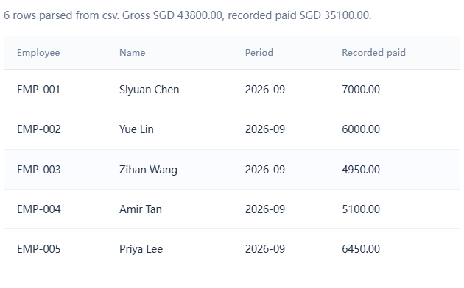
Import validation and payroll
Preview records before confirming an import
Validation before import
Review the preview and resolve invalid rows
Exact money handling
Amounts use integer cents and explicit SGD
07 / 20
Notes:
Import validation and payroll
Preview records before confirming an import
English narration
Importing a spreadsheet is a point where errors can enter the workflow, so the application checks the input before committing it. The preview lets the user examine the proposed records and resolve problems before confirming the import. The implementation supports the project’s CSV and spreadsheet input paths, validates required values, and rejects spreadsheet formulas in the supported import flow. It also treats an import as a complete operation, so invalid input should not leave a partly updated business dataset. Money uses integer cents inside the calculations. For example, one hundred dollars and twenty-five cents becomes ten thousand and twenty-five cents. This avoids the small rounding surprises that ordinary binary decimal calculations can introduce. The demonstration expects Singapore dollars explicitly. These choices support reliable comparisons when payroll totals later connect to ledger records and bank transactions.
Sources
PeopleLedger-v2/server/lib/money.js
PeopleLedger-v2/server/lib/xlsx.js
PeopleLedger-v2/server/services/payments.service.js
PeopleLedger-v2/server/services/reconciliation.service.js
Screenshot: original isolated demonstration using fictional sample data.

Slide 8
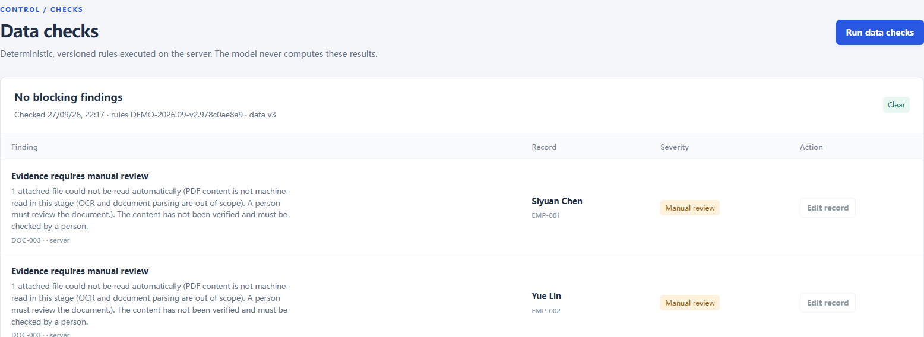
Checks and issue handling
Deterministic rules produce reviewable findings
14 demonstration rules
0 blockers, 6 manual reviews
The same inputs produce the same checks
Sample payroll PDFs still need human review
08 / 20
Notes:
Checks and issue handling
Deterministic rules produce reviewable findings
English narration
The checks screen applies fourteen default demonstration rules. These checks are deterministic, which means the same inputs and rule definitions produce the same findings. That makes the results easier to explain and test. In the corrected sample case, the results show zero blocking issues and six items that still need manual review. The six items concern the payroll PDF evidence. The application can store the files and record their identity, but it does not read and verify every statement inside those documents. A human reviewer still needs to inspect them. Zero blockers therefore does not mean that every business assertion has been independently proven. It means the implemented blocking checks did not find a blocking condition in this sample. The rules demonstrate a review framework and require professional validation before they could represent a real organisation’s compliance requirements.
Sources
PeopleLedger-v2/server/rules/registry.js
PeopleLedger-v2/server/services/checks.service.js
Screenshot: original isolated demonstration using fictional sample data.

Slide 9
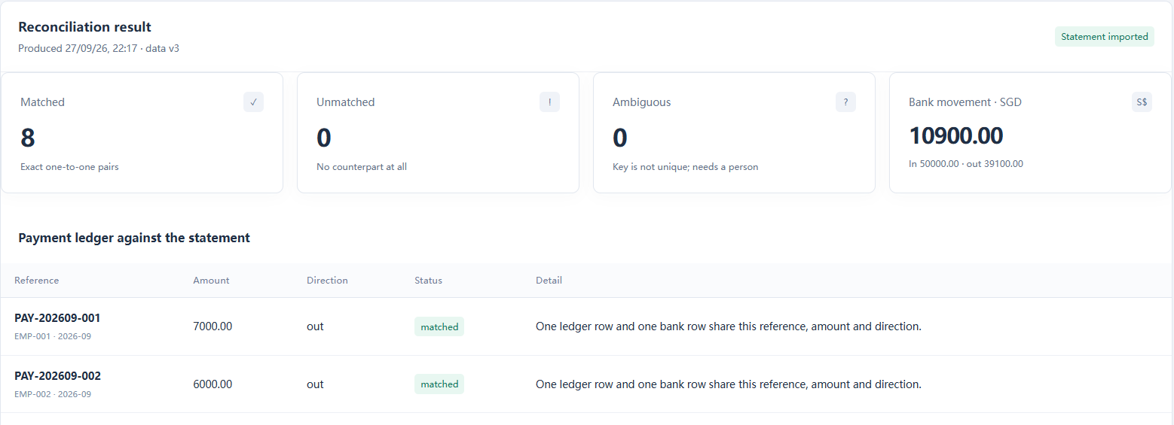
Bank reconciliation
One-to-one matching between ledger and bank records
Exact matching criteria
8 of 8 matched
Reference, amount and payment direction
The corrected sample has a complete match
09 / 20
Notes:
Bank reconciliation
One-to-one matching between ledger and bank records
English narration
Bank reconciliation connects the internal ledger to the external bank record supplied for the case. The matching logic uses the reference, the amount, and whether the transaction is an inflow or an outflow. It also enforces one-to-one matching. A single bank transaction should not satisfy several ledger entries simply because they share a similar description. In the corrected demonstration, all eight ledger transactions match the eight bank records. This is a useful result for the sample, but it is not a claim that every possible bank statement will reconcile automatically. The current implementation uses explicit matching criteria instead of fuzzy matching. When a reference differs, an amount is wrong, or a record is missing, the reviewer must resolve the discrepancy. This approach makes the reasons for a match easier to understand and makes unmatched records visible for follow-up.
Sources
PeopleLedger-v2/server/services/reconciliation.service.js
PeopleLedger-v2/tests/server.reconciliation.test.cjs
PeopleLedger-v2/tests/server.v2.test.cjs
Screenshot: original isolated demonstration using fictional sample data.

Slide 10
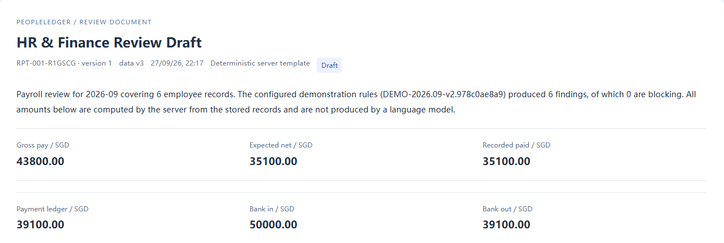
Report snapshots
The report preserves the records used in the review
Source snapshots
Version references
Payroll, ledger, bank and import context
Checks, rules and supporting evidence
10 / 20
Notes:
Report snapshots
The report preserves the records used in the review
English narration
A report is valuable only if a reviewer can understand what it represents. PeopleLedger therefore preserves the relevant source data when it creates the report. The snapshot includes payroll, ledger and bank records, as well as import context and reconciliation results. It also records the applicable rules and evidence references. If someone changes the working case later, an earlier report should continue to describe its original basis. This prevents a historical review from silently inheriting today’s numbers. The implementation also avoids filling a missing historical snapshot with current data as though that data had existed at the time. That distinction matters when investigating a difference between two versions. Reviewers can discuss a specific report and its supporting information, while new work can proceed in the case. The report becomes a defined record of a review stage.
Sources
PeopleLedger-v2/server/services/reports.service.js
PeopleLedger-v2/server/services/export.service.js
PeopleLedger-v2/tests/server.v2.test.cjs
Screenshot: original isolated demonstration using fictional sample data.

Slide 11
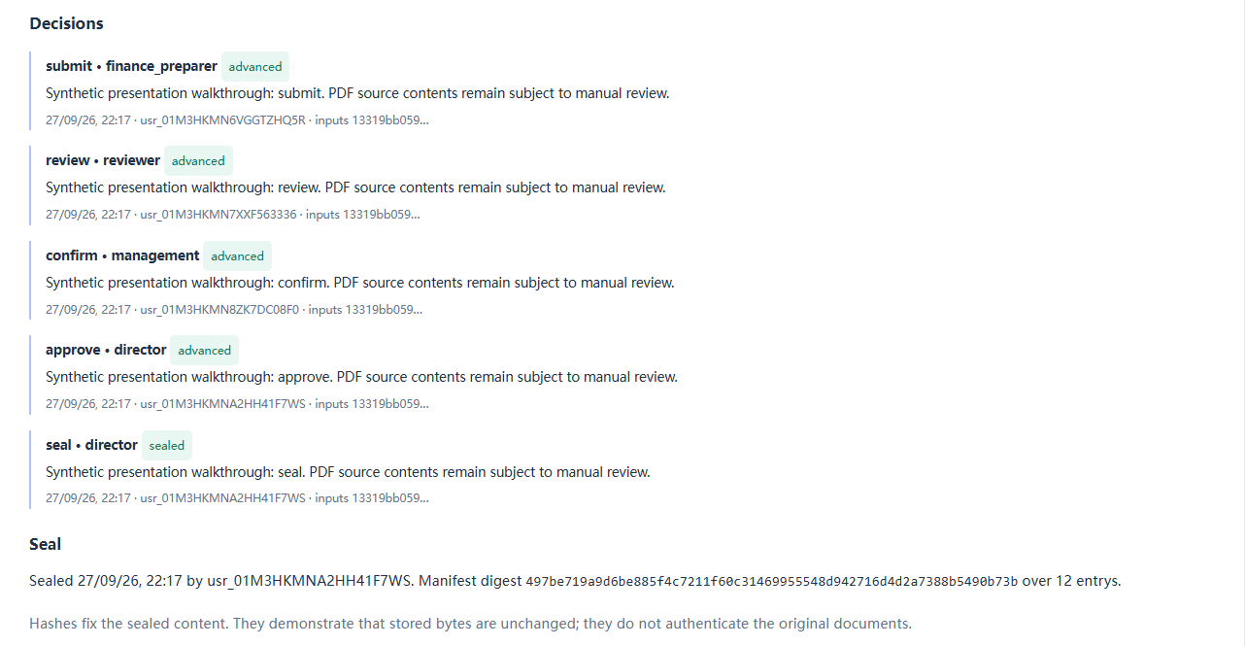
Separate review and approval
The server enforces the order and the actors
Four decision stages
Separation of duties
Submission, finance, management and director
Different actors review each required stage
11 / 20
Notes:
Separate review and approval
The server enforces the order and the actors
English narration
The approval process separates submission, finance review, management confirmation, and director approval. These stages require different actors, so one person cannot complete all of the decision steps for the same report. The server also rejects attempts to skip stages. For example, a director cannot approve a report that has not reached the required prior state. After approval, an authorised director can seal the report. The sealing action can belong to the same director who approved it, so the four-actor requirement concerns the four decision stages rather than five separate people. This distinction is useful when explaining the implementation. The workflow helps preserve responsibility and the sequence of decisions. It does not guarantee that an approver exercised good judgment. The reviewer must still inspect the available evidence and record a decision that the organisation can defend.
Sources
PeopleLedger-v2/server/auth/rbac.js
PeopleLedger-v2/server/services/reports.service.js
PeopleLedger-v2/tests/server.workflow.test.cjs
Screenshot: original isolated demonstration using fictional sample data.

Slide 12
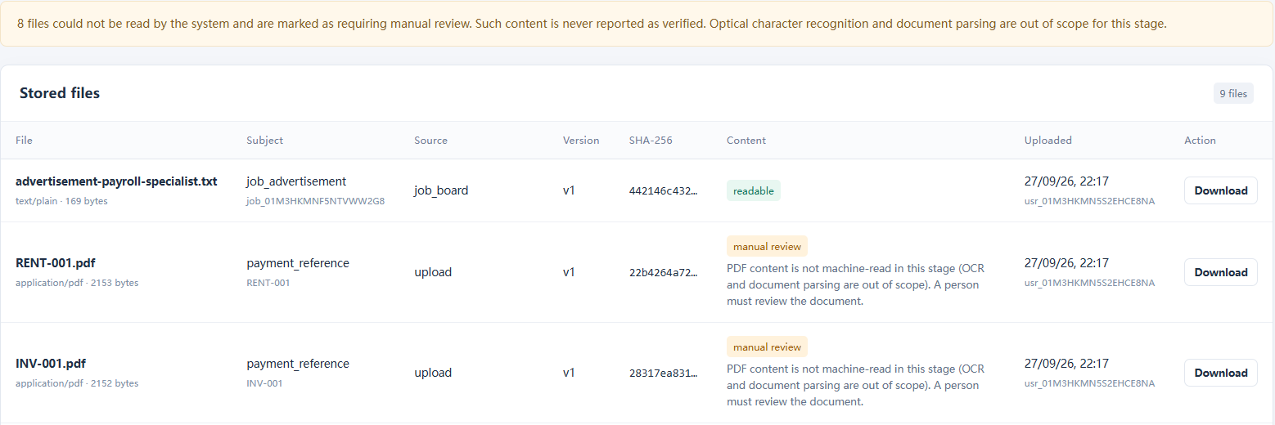
Evidence files and exports
Files retain their versions and recorded hashes
Evidence identity
Export package
Source, version and SHA-256 hash
The report travels with supporting records
12 / 20
Notes:
Evidence files and exports
Files retain their versions and recorded hashes
English narration
Evidence handling connects a report to actual files. The application records the source and version of an uploaded document and calculates a SHA-256 hash for its bytes. A later comparison can use that hash to detect whether those bytes differ. A matching hash does not prove that the statements in the document are true, or that the person who supplied it was authorised to make them. Those questions remain part of human review. The sample evidence inventory contains nine files, including eight PDFs requiring manual review and one readable advertisement. An export packages the report with the relevant supporting material so a reviewer can inspect them together. In the cloud edition, evidence resides in private Blob storage and the application checks access before serving it. The current serverless deployment also limits individual requests and uploads to four megabytes.
Sources
PeopleLedger-v2/server/services/evidence.service.js
PeopleLedger-v2/server/services/export.service.js
Screenshot: original isolated demonstration using fictional sample data.

Slide 13
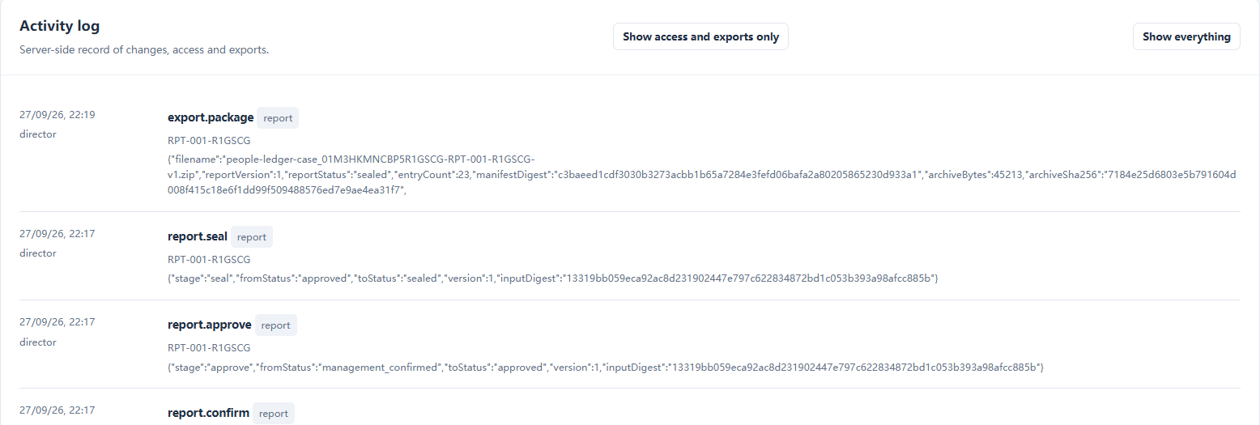
Activity and accountability
Actions remain connected to people and report versions
Who acted and when
Historical context
Review actions have an activity record
Earlier report versions remain traceable
13 / 20
Notes:
Activity and accountability
Actions remain connected to people and report versions
English narration
The activity trail helps a reviewer reconstruct how a case reached its current state. It records the actor and timing for relevant actions and connects those actions to the report or business operation. This is useful when someone asks why a report moved forward, who reviewed it, or which version existed at a particular point in the workflow. The server also records access-related activity and checks role permissions. Auditor access can have a limited duration, which supports a review assignment without assuming permanent access. These capabilities provide accountability within the application. They should not be described as an independently certified, tamper-proof archive. A production organisation would still need appropriate administration, retention policies, and operational controls. For this project, the main outcome is that review activity and historical report versions can be followed through the application instead of relying only on separate messages.
Sources
PeopleLedger-v2/server/auth/access.js
PeopleLedger-v2/server/services/audit.service.js
PeopleLedger-v2/server/services/reports.service.js
PeopleLedger-v2/tests/server.security.test.cjs
Screenshot: original isolated demonstration using fictional sample data.

Slide 14
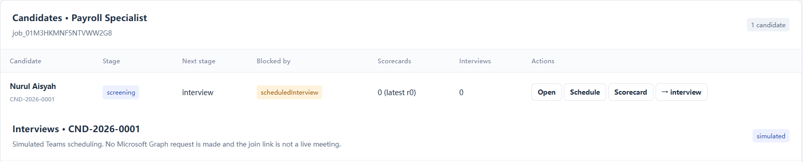
Recruitment and onboarding
Candidate progress connects to essential employee records
Recruitment stages
Onboarding handoff
Job requirements, candidates and scorecards
Create the employee information needed next
14 / 20
Notes:
Recruitment and onboarding
Candidate progress connects to essential employee records
English narration
The human resources side also includes recruitment. A case can hold job requirements and track candidates through the supported stages. The implementation checks the required conditions for transitions, rather than treating every stage as an unrestricted label. Candidate evaluation uses scorecard versions so that a later change to the assessment does not erase the context of an earlier decision. After the required hiring steps, the onboarding flow creates essential employee information for the next part of the process. This demonstrates the connection between recruitment records and downstream human resources work. The screenshot also includes interview scheduling actions. Those actions currently simulate the meeting workflow. They do not demonstrate a live Microsoft Teams invitation or a production Microsoft Graph connection. A real integration would need authorised access, failure handling, and tests that confirm meeting creation and changes in the external service.
Sources
PeopleLedger-v2/server/services/recruitment.service.js
PeopleLedger-v2/server/services/interviews.service.js
PeopleLedger-v2/tests/server.recruitment.test.cjs
Screenshot: original isolated demonstration using fictional sample data.

Slide 15
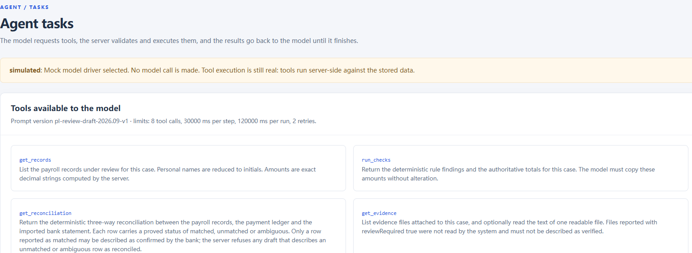
AI assistance and its limits
The default demonstration uses a Mock model
Allowed support
Restricted actions
Current model
Read evidence and save drafts
No payments or approvals
Mock output for demonstration
15 / 20
Notes:
AI assistance and its limits
The default demonstration uses a Mock model
English narration
The AI assistant supports the review process within explicit limits. It can read the information made available to its tools and save a draft for a person to examine. It cannot make payments, approve a report, or change the source records and rules that determine a review outcome. It also cannot grant itself permissions or delete the evidence. These restrictions keep the important decisions in the application workflow and with authorised people. The current default is a Mock model, which makes the demonstration predictable. The repository contains adapters for other model services, but their presence is not evidence that a live model has been evaluated in this deployment. A future rollout would need to test the chosen service with representative cases, including missing evidence and misleading instructions inside uploaded material. Human reviewers remain responsible for accepting, correcting, or rejecting a draft.
Sources
PeopleLedger-v2/server/config.js
PeopleLedger-v2/server/agent/tools.js
PeopleLedger-v2/server/agent/draft.js
PeopleLedger-v2/server/adapters/model/
Screenshot: original isolated demonstration using fictional sample data.

Slide 16
Implementation and cloud deployment
A local reference edition and a deployed cloud edition
Layer | Implementation
Browser | HTML, CSS and JavaScript workspace
Application | Node.js APIs, sessions and permissions
Business controls | Checks, reconciliation, approvals and snapshots
Persistence | Local: SQLite and files Cloud: Neon PostgreSQL and private Vercel Blob
The application and presentation website are now available on Vercel.
16 / 20
Notes:
Implementation and cloud deployment
A local reference edition and a deployed cloud edition
English narration
The browser workspace uses HTML, CSS, and JavaScript. A Node.js application exposes the APIs and checks sessions and permissions. The business services implement the rules, reconciliation, report snapshots, and approval transitions shown earlier. The original local edition stores records in SQLite and keeps evidence files locally. The cloud edition now runs on Vercel, uses a Neon PostgreSQL database in Singapore, and stores evidence in private Vercel Blob storage. These are distinct deployment arrangements for the same demonstrated business process. The cloud application and the presentation website have separate public addresses. Signing in to the application still requires the appropriate account. Credentials are not included in these presentation downloads. The project currently uses a manual deployment process. Saving a local file does not automatically update the live website. These details describe the delivered setup, rather than a promise of unlimited scale or enterprise readiness.
Sources
PeopleLedger-v2/package.json
PeopleLedger-v2/server/index.js
PeopleLedger-v2/server/config.js
PeopleLedger-v2/server/adapters/
deliverables/部署与使用说明.md
deployment/app/
Cloud deployment verification on 2026-09-27

Slide 17
Verification results
Local baseline and cloud deployment checks
116
131 automated tests
Deployment edition passed its test suite
Local baseline tests passed
24 live HTTP checks
Cloud behaviour and persistence verified
0 failures
Review coverage
Money, access, workflow and evidence
71 source files passed syntax checks
Checked 27 September 2026
17 / 20
Notes:
Verification results
Local baseline and cloud deployment checks
English narration
The original local project passed one hundred and sixteen automated tests, and seventy-one source files passed syntax checks. That is the baseline used for the application demonstration. The deployment edition subsequently passed one hundred and thirty-one automated tests and checks of seventy-eight JavaScript files. A further set of twenty-four live HTTP checks passed against the deployed application. Those live checks covered practical behaviour such as authentication, permissions, persistent records, and private evidence retrieval. The sample records remained available after redeployment, which helps confirm that the cloud application uses persistent storage. These different checks answer different questions. Automated tests cover defined behaviour in a controlled environment. Live checks confirm selected behaviour in the deployed environment. Neither result establishes complete security or statutory compliance. The next stage should add user acceptance and operational testing with appropriate business reviewers.
Sources
PeopleLedger-v2/package.json
PeopleLedger-v2/scripts/check.js
PeopleLedger-v2/tests/
Local verification on 2026-09-27: 116 tests passed, 71 files syntax checked
deliverables/部署与使用说明.md
deployment/app/
Cloud deployment verification on 2026-09-27

Slide 18
Current boundaries
Implemented behaviour and work still required
Area | Current state | Still required
Checks | 14 demonstration rules | Professional rule validation
AI | Mock model by default | Live model evaluation
Meetings | Simulated workflow | Microsoft Graph integration
Evidence | Files, versions and hashes | Human review, optional OCR
Cloud operation | Vercel, PostgreSQL and Blob | SSO, recovery and security review
18 / 20
Notes:
Current boundaries
Implemented behaviour and work still required
English narration
This table separates the implemented capabilities from the remaining work. The fourteen demonstration rules show how checks can operate, but specialists must validate the rules for a real business and jurisdiction. The assistant uses a Mock model, so a live service still needs evaluation. Interview scheduling demonstrates the process, while Microsoft Graph integration remains future work. Evidence files have versions and hashes, but document content still needs human review, and optical character recognition is an optional future addition. Cloud deployment is now complete for this demonstration, with PostgreSQL and private file storage. Organisational operation still needs decisions about single sign-on, backup and recovery, security review, and monitoring. The application’s four-megabyte request limit also constrains large evidence uploads and exports. Stating these boundaries helps an audience distinguish a working project demonstration from a service that has completed a full production readiness process.
Sources
PeopleLedger-v2/README.md
PeopleLedger-v2/server/config.js
PeopleLedger-v2/server/services/interviews.service.js
PeopleLedger-v2/server/services/evidence.service.js
deliverables/部署与使用说明.md
deployment/app/
Cloud deployment verification on 2026-09-27

Slide 19
The next stage
Recommended work before an operational pilot
01
Business acceptance
Review the rules and workflow with actual users
02
Operational readiness
Test identity, backup and recovery
03
External integrations
Connect and verify one service at a time
04
Pilot evaluation
Measure review quality and time with agreed criteria
19 / 20
Notes:
The next stage
Recommended work before an operational pilot
English narration
The recommended next stage begins with business acceptance. Human resources and finance reviewers should examine the sample workflow and confirm that the required fields, rules, and approval stages fit their actual responsibilities. The second priority is operational readiness. The team should test identity management and perform a recovery exercise, rather than assuming that a database backup alone guarantees restoration. External services should then be connected one at a time, with clear success and failure cases for each integration. A controlled pilot can assess whether the application improves the review process. Useful measures might include the time needed to locate supporting evidence, the number of unresolved reconciliation items, and the frequency of reports returned for correction. These are proposed evaluation measures, not results already achieved by the project. The pilot should use agreed criteria and appropriate data handling arrangements before any broader adoption.
Sources
PeopleLedger-v2/README.md
Recommendations based on verified current implementation boundaries

Slide 20
Project recap and discussion
PeopleLedger
A working review process
Preparation through approval and evidence export
Traceable review decisions
Reports retain their supporting records
A deployed demonstration
Application and narrated presentation on Vercel
20 / 20
Notes:
Project recap and discussion
PeopleLedger
English narration
PeopleLedger now demonstrates a complete review process using fictional human resources and finance data. The case connects imports with deterministic checks and bank reconciliation, then preserves the source records in a report that passes through separate approval stages. Evidence files and an activity trail help reviewers understand the decisions afterwards. Recruitment and the restricted assistant extend the demonstration while keeping their current integration limits visible. The application is available on Vercel with persistent database and private file storage, and this presentation provides an English explanation of the delivered work. The testing results support the specific behaviours that were checked. Further business and operational validation remains necessary before real organisational use. Thank you for watching. The presentation website provides the editable PowerPoint, the automatic slideshow, and the narration script. These materials can support a project assessment, a demonstration session, or a discussion of the next development stage.
Sources
PeopleLedger-v2/README.md
PeopleLedger-v2/tests/
deliverables/部署与使用说明.md
deployment/app/
Cloud deployment verification on 2026-09-27

