Slide 1

RAG for MS-ADS Website
GenAI Mid-term Project
Team: Nexus Intelligence
Daichi Ishikawa
Liang Gong
Haoran Zheng
Live UI Link: https://rag-uchicago-website.streamlit.app/
GitHub Link: https://github.com/daichi6/rag-uchicago-website
November 2024

Slide 2
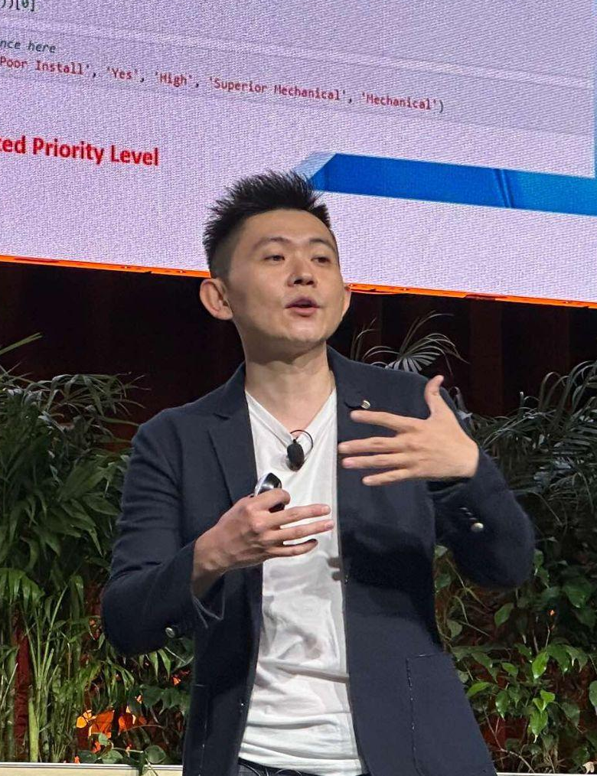

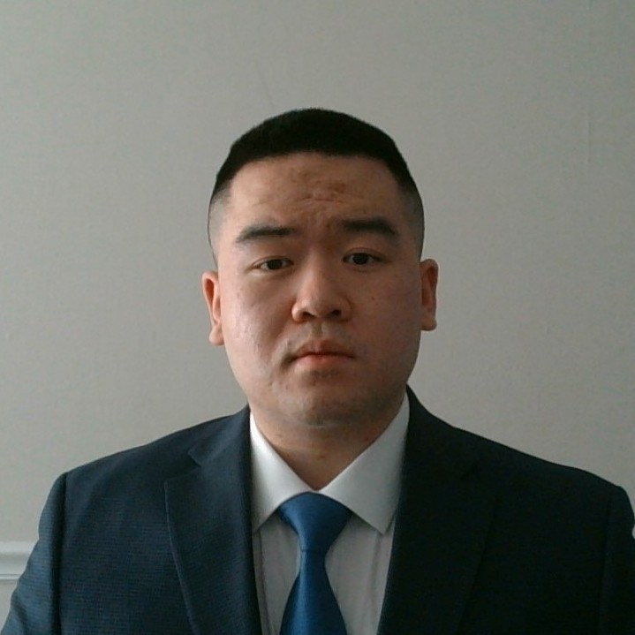
Our Team
Daichi Ishikawa
Liang Gong
Haoran Zheng

Slide 3
Agenda
Business Problem
Main Architecture
Implementation Process
1. Website Review
2. Data Collection and Cleaning
3. Document Creation and Chunking
4. Creating Vector Database
5. Finding Relevant Chunks and Generating Answer
6. Routing for further improvement
7. RAG Fusion for further improvement
Live Demo
Evaluation
Summary
Future Work
Appendix

Slide 4
Business Problem
Current Problem
Expected Outcome
Students interested in the MSADS program often spend a lot of time searching for relevant information on a cluttered website.
Chatbot to find answers accurately and quickly
No budget seems to be allocated for hiring an external development team to implement this tool.
Midterm project
for GenAI students

Slide 5







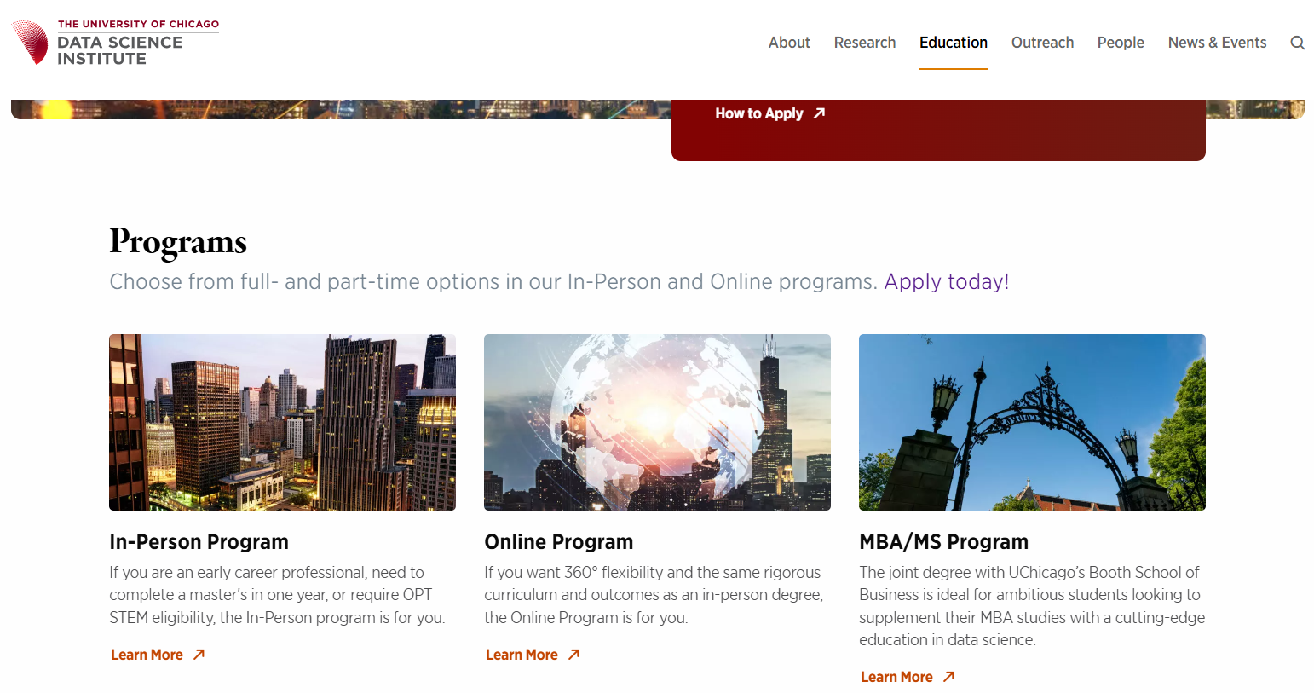
Main Architecture
OpenAI are used for LLM and embeddings, and FAISS as the vector database.
We achieved accuracy improvements through the use of routing and RAG fusion.
We also crafted prompts to avoid hallucination and ensure that original information sources are included in the response.
Additionally, our chatbot is designed to make effective use of conversation history within the LLM.
Main Architecture
Routing with Metadata
Avoid Hallucination
Include original links
User’s Query
Vector DB
Prompt
Answer
RAG Fusion (Query Rewriting)
RAG Fusion
(Re-Ranking)
Conversation History
Fetch&Cleaning
Metadata Extraction
Chunking
Embedding
MS-ADS Website

Slide 6
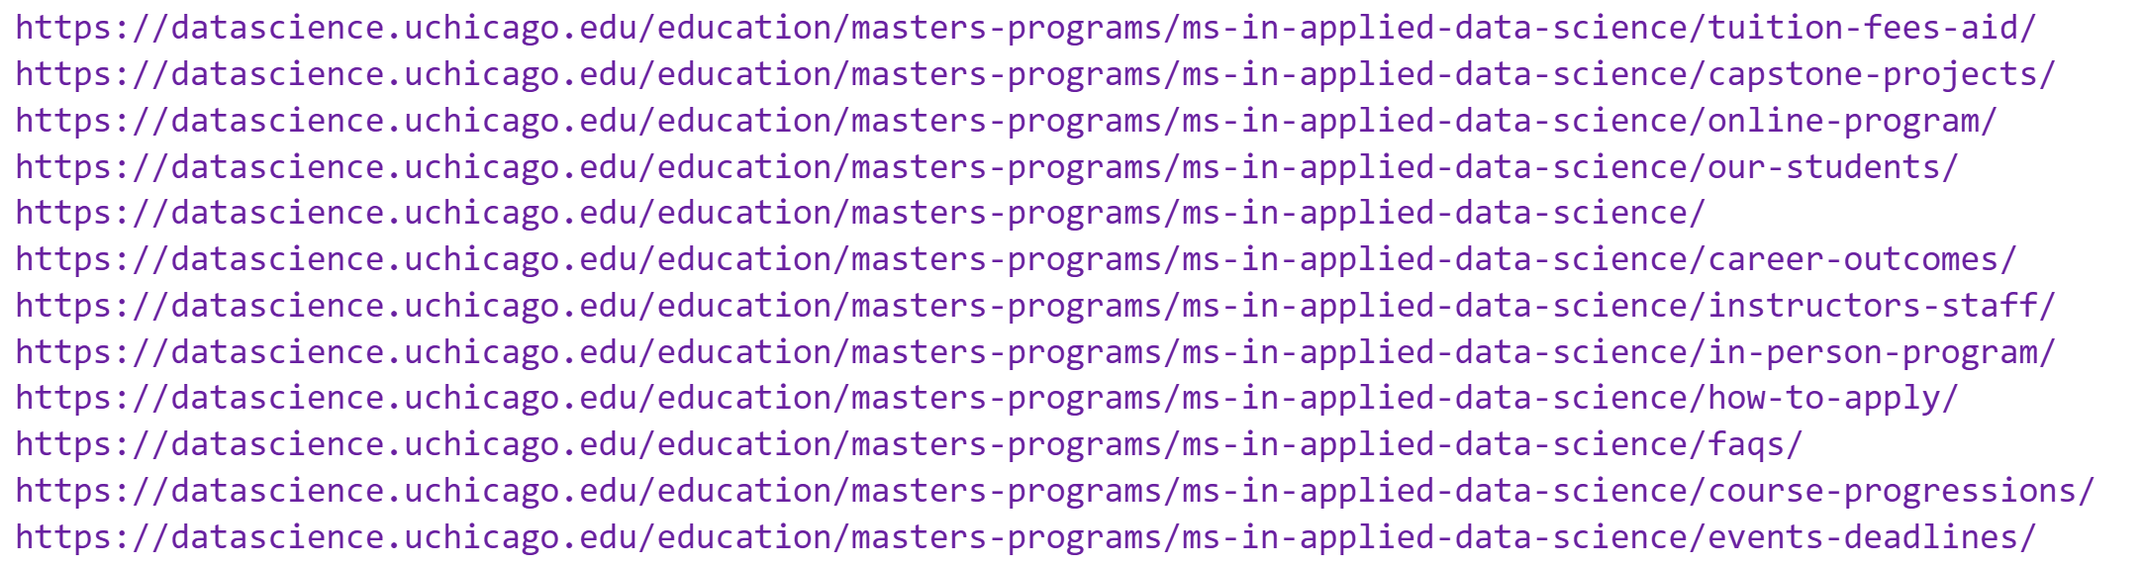
1. Website Review
The program includes a comprehensive curriculum covering machine learning, data engineering, and data visualization, along with a capstone project for practical experience. The program’s expert faculty, strong industry connections, and career support services equip graduates for successful careers across various industries.
The website provides information on the curriculum, faculty, admissions, career outcomes, and program formats (in-person and online).
Notes:
BeautifulSoup
get_subpage_links(url)

Slide 7
2. Data Collection and Cleaning
Fetching Web Content
Metadata Extraction
Content Cleaning
Retrieves raw HTML content from provided URLs using requests.
Handles SSL verification and timeouts for reliability.
Function: fetch_web_content
Extracts critical metadata such as: title, keywords, description, author, and the domain.
Utilizes BeautifulSoup to parse and extract metadata from HTML.
Includes the page's fetch date to track when the data was collected.
Function: extract_metadata
Cleans and extracts the main content from HTML using trafilatura.
Ensures only the essential, readable content is retained, removing unnecessary HTML tags.
Function: clean_content
Notes:
Extracted Metadata:
source: https://datascience.uchicago.edu/education/masters-programs/ms-in-applied-data-science/instructors-staff/
domain: datascience.uchicago.edu
fetch_date: 2024-11-01T19:01:06.677247
content_type: web_page
title: Faculty, Instructors, Staff – DSI

Slide 8
3. Document Creation and Chunking
Document Creation
Document Splitting
Add Metadata to Chunks
Combines metadata and cleaned content to create a structured Document object.
Stores URL, domain, and content type for further processing.
Function: create_document
RecursiveCharacterTextSplitter to split large documents into smaller, more manageable chunks (default 1000 characters, 200-character overlap).
Ensures that each chunk can be indexed and queried independently.
Function: split_document
Adds metadata to each chunk, including:
'page_type',
'primary_category',
'subcategory',
'title',
'chunk_index',
'total_chunks',
'source'
Notes:
Original metadata: {'source': 'https://datascience.uchicago.edu/education/masters-programs/ms-in-applied-data-science/instructors-staff/', 'domain': 'datascience.uchicago.edu', 'fetch_date': '2024-11-01T19:31:59.474593', 'content_type': 'web_page', 'title': 'Faculty, Instructors, Staff – DSI', 'chunk_index': 3, 'total_chunks': 62, 'chunk_size': 750}
Enhanced metadata: {'source': 'https://datascience.uchicago.edu/education/masters-programs/ms-in-applied-data-science/instructors-staff/', 'domain': 'datascience.uchicago.edu', 'fetch_date': '2024-11-01T19:31:59.474593', 'content_type': 'web_page', 'title': 'Faculty, Instructors, Staff – DSI', 'chunk_index': 3, 'total_chunks': 62, 'chunk_size': 750, 'primary_category': 'ms-in-applied-data-science', 'subcategory': 'instructors-staff', 'page_type': 'Ms In Applied Data Science - Instructors Staff'}
New fields added:
- subcategory: instructors-staff
- primary_category: ms-in-applied-data-science
- page_type: Ms In Applied Data Science - Instructors Staff

Slide 9
4. Creating Vector Database
Enhanced metadata: {'source': 'https://datascience.uchicago.edu/education/masters-programs/ms-in-applied-data-science/instructors-staff/', 'domain': 'datascience.uchicago.edu', 'fetch_date': '2024-11-01T19:31:59.474593', 'content_type': 'web_page', 'title': 'Faculty, Instructors, Staff – DSI', 'chunk_index': 3, 'total_chunks': 62, 'chunk_size': 750,
'primary_category': 'ms-in-applied-data-science', 'subcategory': 'instructors-staff', 'page_type': 'Ms In Applied Data Science - Instructors Staff'}
Enhancing Metadata
Embedding
Vector Database
Enhances document metadata by parsing URL paths (e.g., /how-to-apply/).
Extracts primary category and subcategory from URL to enrich metadata.
Adds human-readable page_type to indicate the document’s content type.
Function: enhance_metadata
Initializes OpenAI’s embedding model (text-embedding-3-small by default) to convert documents into vectors for similarity search.
Function: init_embeddings (model: str = "text-embedding-3-small")
Creates a FAISS vector database from the document embeddings.
Saves the FAISS vector store locally for efficient retrieval.
Benefits: Fast approximate nearest neighbor (ANN) search, ensuring quick document retrieval based on vector similarity.
Function: create_and_save_vectordb
Notes:
Original metadata: {'source': 'https://datascience.uchicago.edu/education/masters-programs/ms-in-applied-data-science/instructors-staff/', 'domain': 'datascience.uchicago.edu', 'fetch_date': '2024-11-01T19:31:59.474593', 'content_type': 'web_page', 'title': 'Faculty, Instructors, Staff – DSI', 'chunk_index': 3, 'total_chunks': 62, 'chunk_size': 750}
Enhanced metadata: {'source': 'https://datascience.uchicago.edu/education/masters-programs/ms-in-applied-data-science/instructors-staff/', 'domain': 'datascience.uchicago.edu', 'fetch_date': '2024-11-01T19:31:59.474593', 'content_type': 'web_page', 'title': 'Faculty, Instructors, Staff – DSI', 'chunk_index': 3, 'total_chunks': 62, 'chunk_size': 750, 'primary_category': 'ms-in-applied-data-science', 'subcategory': 'instructors-staff', 'page_type': 'Ms In Applied Data Science - Instructors Staff'}
New fields added:
- subcategory: instructors-staff
- primary_category: ms-in-applied-data-science
- page_type: Ms In Applied Data Science - Instructors Staff

Slide 10
5. Finding Relevant Chunks and Generating Answer
Loading the Vector Database
Performing Similarity Search
Generating answer
Purpose: Loads FAISS vector database for efficient access to document embeddings.
Embedding Initialization: Uses OpenAI’s text-embedding-3-small for semantic vector generation.
Error Handling: Catches and logs errors during loading for robust system operation.
Parameterization: Allows flexible model choice and database path.
Function: load_vectordb
Purpose: Retrieves top-k similar document chunks based on the user’s query.
Metadata Filtering: Optionally filters results by fields, enhancing relevance.
Output: Returns a list of Document objects with content and metadata.
Function: search_similar_chunks(vectorstore, query, k=5, filter_dict)
Use GPT-4o
Following adjustments to the prompt:
1) added phrasing to avoid hallucination
2) included original links in the response for validation and detailed information.

Slide 11
6. Routing for further improvement
The goal is to link user queries with metadata to search for the appropriate chunks.
Using an LLM enabled flexible classification of user queries.
Subcategories were determined using the final part of the URL.
tuition-fees-aid
Chunk
Chunk
## Subcategory Options ##
- in-person-program
- course-progressions
- online-program
- tuition-fees-aid
- capstone-projects
- instructors-staff
- how-to-apply
- our-students
- events-deadlines
- career-outcomes
- faqs
or “None”
Chunk
Chunk
capstone-projects
Chunk
User’s Query
Chunk
“How much is the tuition?”
career-outcomes
Chunk
Chunk
Chunk

Slide 12
7. RAG Fusion for further improvement
Through query rewriting, we were able to retrieve a wider variety of chunks, while re-ranking allowed us to successfully obtain chunks with the highest relevance to the query.
k = 10
User’s Query
(Original)
Vector
DB
Re-Ranking
(top_n = 5)
Query Rewriting
Q1
User’s Query
Q2
Q3

Slide 13
LIVE DEMO
http://209.97.145.117:8501
https://rag-uchicago-website.streamlit.app/

Slide 14
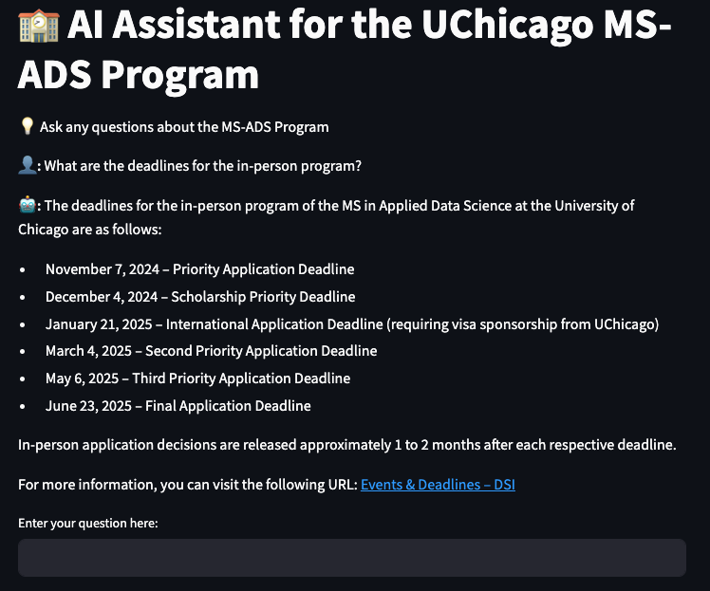

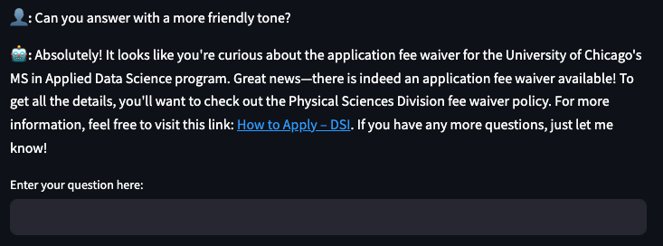
Evaluation

Slide 15
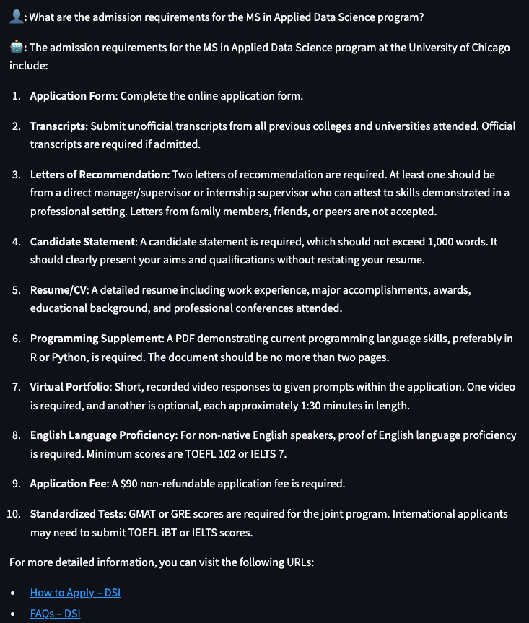
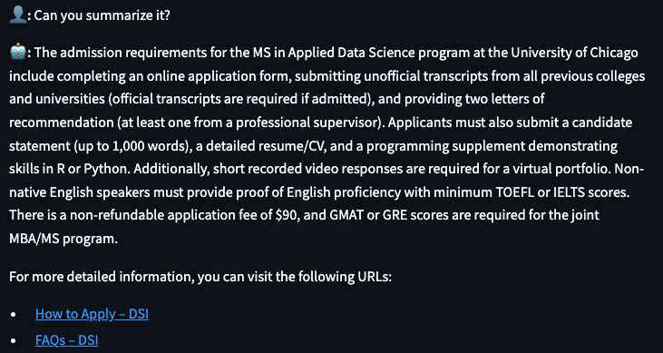
Evaluation - Conversation History

Slide 16
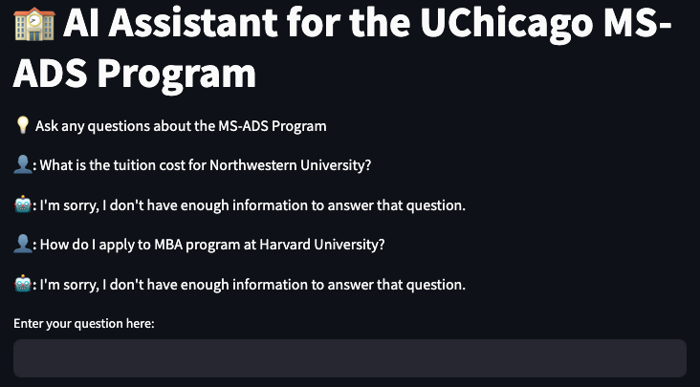
Evaluation - Hallucination

Slide 17
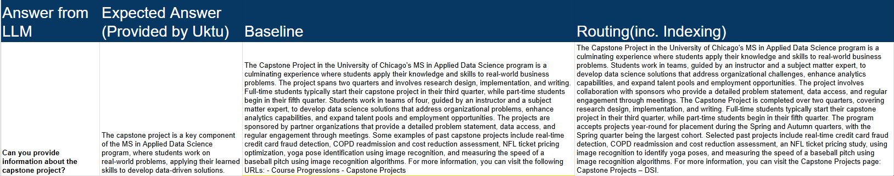

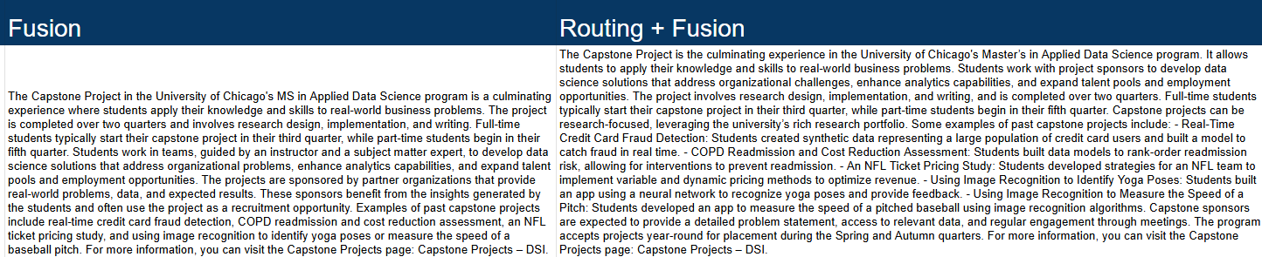
Evaluation - Routing + RAG Fusion
4 options here
routing=True, fusion=True | routing=True, fusion=False | routing=False, fusion=True | routing=False, fusion=False
Summary of Key Differences:
Baseline focuses on general project details and student benefits.
Routing emphasizes program logistics (timing of project acceptance and larger cohorts).
Fusion highlights sponsor benefits and the potential for recruitment.
Routing + Fusion combines all aspects, adding a research-focused angle and a broader appeal to both students and sponsors.

Slide 18
Summary
This RAG model architecture answers user queries about the MS-ADS website by combining several tools and techniques:
1. User Query: Routed with metadata and enhanced with query rewriting via OpenAI models.
2. Vector Database (FAISS): Central storage for embedded website content, processed through **fetching, cleaning, indexing, chunking, and embedding with tools like BeautifulSoup and Trafilatura.
3. Prompt & Answer Generation: Retrieved results are re-ranked (RAG Fusion) for relevance and compiled into responses that include original links to avoid hallucinations, with conversation history maintained for context.
4. Key Tools: LangChain manages operations, FAISS handles vector storage, and OpenAI models support embedding, routing, rewriting, and answer generation.
This setup ensures accurate, context-aware responses, grounded in the MS-ADS website data.

Slide 19
Future Work
Include both hyperlink text and URL in retrieve context:
Ideal result: "For questions regarding an application fee waiver, you can refer to the Physical Sciences Division fee waiver policy https://physicalsciences.uchicago.edu/academics/admissions/application-requirements/#FeeWaiver. (Source: https://datascience.uchicago.edu/education/masters-programs/ms-in-applied-data-science/how-to-apply/)“
Expanded Metadata and Contextual Cues: Include additional metadata fields (e.g., content freshness, user intent) to enhance filtering accuracy.
Automated Evaluation Metrics: Develop automated relevance scoring metrics to evaluate and monitor response quality over time.
User Personalization: Tailor responses based on user history or preferences to enhance engagement and relevance.
Upgrade or Fine-tune to More Advanced Embedding Models: Experiment with newer or more specialized embedding models as they become available to improve retrieval precision.

Slide 20
Appendix
http://209.97.145.117:8501

Slide 21

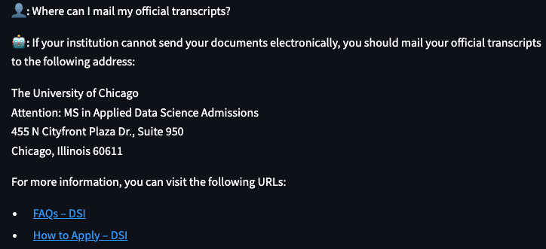
Appendix

Slide 22
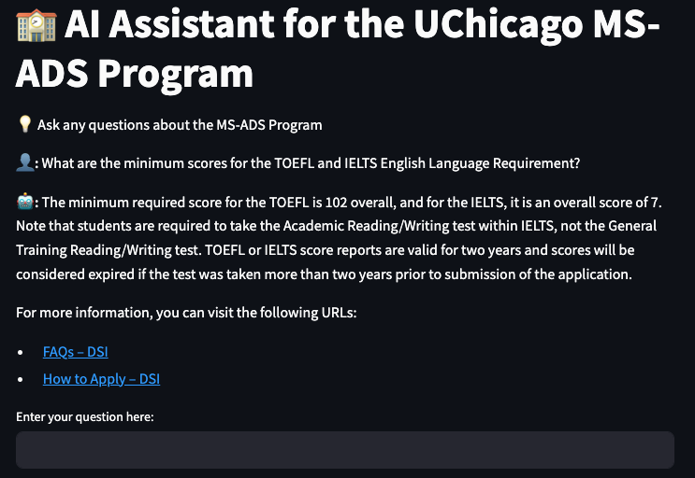
Appendix

Slide 23
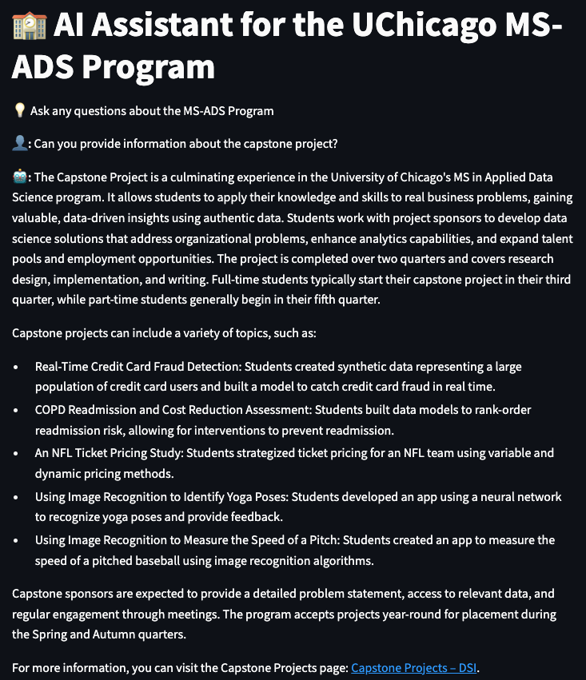
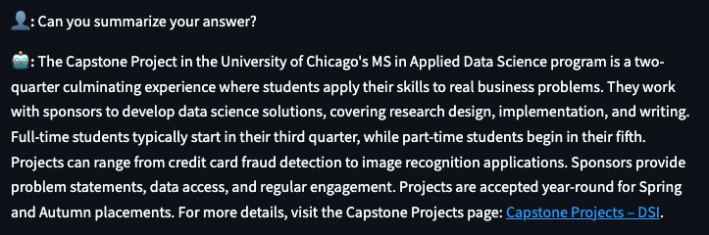
Appendix

Slide 24
Appendix
System Design - System Overview and Data Flow
System Overview:
Integrates several key components: data preprocessing, embedding and vector storage, query handling, response generation, and user interface.
Components interact seamlessly to create an AI-powered information retrieval chatbot focused on UChicago’s MS in Applied Data Science program.
Data Flow:
User Query Input:
User submits a question through the Streamlit interface (main_streamlit.py).
Query Preprocessing:
The query is preprocessed, rewritten, and expanded using functions like rewrite_queries in chat_utils.py to improve retrieval.
Document Retrieval:
FAISS vector database (vector_search.py) performs similarity-based retrieval to find relevant document chunks.
Response Generation:
Retrieved chunks and user query are passed to the GPT-4 model (create_chat_chain in chat_utils.py) to generate a final response.
Response Display:
The response is displayed in the Streamlit interface, with conversational history maintained for continuity.

Slide 25
Appendix
System Design - Core Components and Integration
1. Data Preprocessing and Vectorization:
Script: vectordb_creation.py
Key Functions:
fetch_web_content and extract_metadata for retrieving and processing data from UChicago’s website.
create_document and split_document to structure and chunk documents.
create_and_save_vectordb to generate and save the FAISS vector database with embeddings.
Purpose: Prepares data for efficient retrieval by structuring documents, enhancing metadata, and creating embeddings stored in FAISS.
2. Vector Database for Document Storage and Retrieval:
Library: FAISS (Facebook AI Similarity Search)
Script: vector_search.py
Functions:
load_vectordb loads the vector database with precomputed embeddings.
search_similar_chunks retrieves document chunks similar to the user query based on vector similarity.
Integration:
The vector database is structured to support fast similarity searches and metadata filtering, enabling targeted and efficient retrieval.
3. Language Model Chain for Response Generation:
Model: GPT-4, via OpenAI’s API
Script: chat_utils.py
Functions:
create_chat_chain initializes the model chain, with a structured prompt to integrate retrieved document chunks and query.
rewrite_queries and subcategory_finder improve the relevance of retrieved information.
Integration:
The language model chain takes the retrieved chunks and user question, using the context to generate a coherent and contextually accurate response.

Slide 26
Appendix
System Design - User Interaction and Additional Functionalities
1. User Interface (Streamlit):
Script: main_streamlit.py
Purpose: Provides a simple and interactive UI for users to ask questions and view responses.
Key Elements:
Session State Management: st.session_state is used to track chat history (chat_history) and maintain the conversation flow (llm_chat_history).
Dynamic Input and Response Display:
User inputs are managed with text_input, and responses are displayed with a typing effect for a natural experience.
Toggle Mechanism for Input Reset:
Clears the input box after each interaction using st.session_state.clear_input, making it easier for users to enter new queries.
2. Conversational Memory Management:
Class: ChatHistory in chat_utils.py
Functionality:
Maintains the conversation history, enabling context to persist across multiple turns.
add_interaction and get_history methods allow tracking of user queries and responses, which are integrated into subsequent interactions.
Purpose: Ensures a seamless user experience by preserving context across multiple exchanges.
3. Result Ranking and Filtering:
Reciprocal Rank Fusion:
Function: reciprocal_rank_fusion in chat_utils.py
Merges results from multiple rephrased queries, ranking documents based on their cumulative relevance.
Metadata-Based Filtering:
Function: search_similar_chunks in vector_search.py with filter_dict support.
Filters results based on metadata fields (e.g., primary_category, subcategory) to improve the precision of retrievals.
Purpose: Enhances response quality by prioritizing the most relevant content through ranking and filtering mechanisms.

