Slide 1
Database System Tutorial 1
Notes:
Welcome everyone, Thank you for joining this session.

Slide 2
Tutorial Structure
Covers additional material if needed
Questions that you can try
Answering questions
(Top-left corner: QR code of this slide)
Notes:
Before we dive in, let’s quickly cover some housekeeping items. First, here’s our tutorial structure: we’ll start with any extra material you might need, then I’ll share a set of questions for you to work on, and finally, we’ll go through the answers and discuss any challenges you encountered.
You’ll also notice there’s a QR code on the top-left corner of the slide. If you scan it, you can access this slide directly, including the multiple pages of questions, so you can follow along at your own pace or refer back to them later. Feel free to scan it now or anytime during the session, as the QR code is always there.

Slide 3
Compare SQL Joins
Cartesian Product (×)
Theta Join (⋈_{θ})
Natural Join (⋈)
Key Differences
Notes:
Today, we’re going to explore three types of relational operations often referred to as ‘joins’ in SQL and relational algebra: the Cartesian Product, the Theta Join, and the Natural Join. We’ll look at what each one does, how they differ from each other, and in which scenarios you might use them. By the end of this session, you’ll have a clear understanding of these fundamental concepts in database systems.

Slide 4
Cartesian Product (×)
Join with no condition
Yields every combination of values
All attributes concatenated
Notes:
“The Cartesian Product is the simplest form of combining two tables or relations. It’s denoted as r×sr \times sr×s in relational algebra. What it does is pair each row from the first table with each row from the second table—no conditions, no filters.

Slide 5
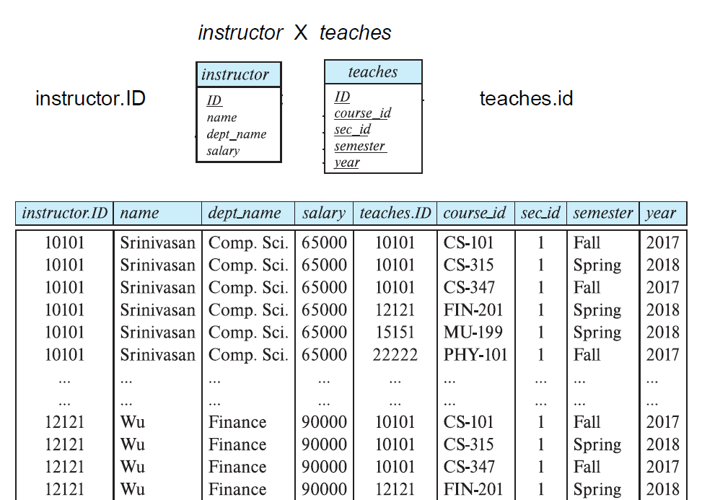
Notes:
If table A has m rows and table B has n rows, the result will have m × n rows. This can grow very large, so we typically don’t use the Cartesian Product by itself in real queries. Instead, it’s often the foundation for other join operations, where we add conditions to filter out rows.”

Slide 6
Theta Join (⋈_{θ})
Cartesian Product, but with extra predicate
r ⋈_{θ} s = σ _{θ}(r × s)
σ_{instructor.ID=teaches.ID}(instructor × teaches)
=
instructor ⋈_{instructor.ID=teaches.ID} teaches
Notes:
“A Theta Join is a Cartesian Product combined with a condition (often called a ‘theta’ condition). In relational algebra, we write it as r⋈θsr \bowtie_{\theta} sr⋈θ​s, which is the same as performing a Cartesian Product r×sr \times sr×s and then applying a selection σθ\sigma_{\theta}σθ​ that filters out rows not meeting the condition. The condition can use any relational operator—equality, inequality, greater than, etc. In typical SQL, the most common form is an equi-join, where we match on a specific column like instructor.ID = teaches.ID.”

Slide 7
Natural Join (⋈)
Cartesian Product, but automatically uses = for each column with the same name
instructor ⋈ teaches
=
σ_{building=303 ∧ year=2024} (instructor × teaches × department)
Notes:
“A Natural Join is another special kind of equi-join. It looks at all columns that share the same name in both tables and automatically creates equality conditions on those columns. This can simplify queries, because you don’t have to explicitly write each matching condition. However, you need to be cautious. If two tables share a column name that you don’t intend to match on, you could end up filtering rows incorrectly. That’s why Natural Joins can be convenient but should be used with an awareness of the schema design.”

Slide 8
Key differences
Features | Cartesian Product | Theta Join | Natural Join
Condition | None | General predicate (e.g., =, <, >) | Implicit equality on matching column names
Duplicate Columns | No removal | No removal | Removes duplicate columns
Symbol | R × S | R ⋈_{θ} S | R ⋈ S
Notes:
**“To wrap up, remember these key differences:
Cartesian Product: Just pairs every row from one table with every row from another. Usually needs filtering.
Theta Join: Allows any condition, including equality, inequality, or more complex predicates.
Natural Join: Automatically uses equality on all columns with the same name. Convenient, but be cautious of unintended matches. Always choose the type of join that best fits the relationship you need to express. This ensures both clarity and efficiency in your database queries.”**

Slide 9
Exercises
branch(branch name, branch city, assets)
customer (ID, customer name, customer street, customer city)
loan (loan number, branch name, amount)
borrower (ID, loan number)
account (account number, branch name, balance)
depositor (ID, account number)
1. Consider this bank database. Assume that branch names and customer names uniquely identify branches and customers, but loans and accounts can be associated with more than one customer.
What are the appropriate primary keys?
Given your choice of primary keys, identify appropriate foreign keys.

Slide 10
Exercises
branch(branch name, branch city, assets)
customer (ID, customer name, customer street, customer city)
loan (loan number, branch name, amount)
borrower (ID, loan number)
account (account number, branch name, balance)
depositor (ID, account number)
2. Consider this bank database. Give an expression in the relational algebra for each of the following:
Find each loan number with a loan amount greater than $10000.
Find the ID of each depositor who has an account with a balance greater than $6000.
Find the ID of each depositor who has an account with a balance greater than $6000 at the “Uptown” branch.

Slide 11
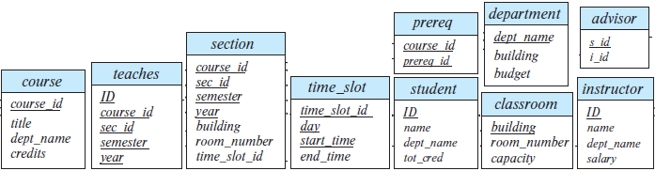
Exercises
3. Consider the university database as below.
Write the following queries in relational algebra:
Find the ID and name of each instructor in the Physics department.
Find the ID and name of each instructor in a department located in the building “Watson”.
Find the ID and name of each student who has taken at least one course in the “Comp. Sci.” department.
Find the ID and name of each student who has taken at least one course section in the year 2018.
Find the ID and name of each student who has not taken any course section in the year 2018.

Slide 12
Exercises
4. Consider the university database as below.
Write the following queries in SQL:
Find the titles of courses in the Comp. Sci. department that have 3 credits.
Find the IDs of all students who were taught by an instructor named Einstein; make sure there are no duplicates in the result.
Find the highest salary of any instructor.
Find all instructors earning the highest salary (there may be more than one with the same salary).
Find the enrollment of each section that was offered in Fall 2017.
Find the maximum enrollment, across all sections, in Fall 2017.
Find the sections that had the maximum enrollment in Fall 2017.
Notes:
We encourage you to use the online interpreter, which the link and the QR code can be found on Appendix (go to that page)

Slide 13
Appendix: University Database
classroom(building, room number, capacity)
department(dept_name, building, budget)
course(course_id, title, dept_name, credits)
instructor(ID, name, dept_name, salary)
section(course_id, sec_id, semester, year, building, room number, time_slot_id)
teaches(ID, course_id, sec_id, semester, year)
student(ID, name, dept_name, tot cred)
takes(ID, course_id, sec_id, semester, year, grade)
advisor(s_ID, i_ID)
time_slot(time_slot_id, day, start time, end time)
prereq(course_id, prereq_id)

Slide 14
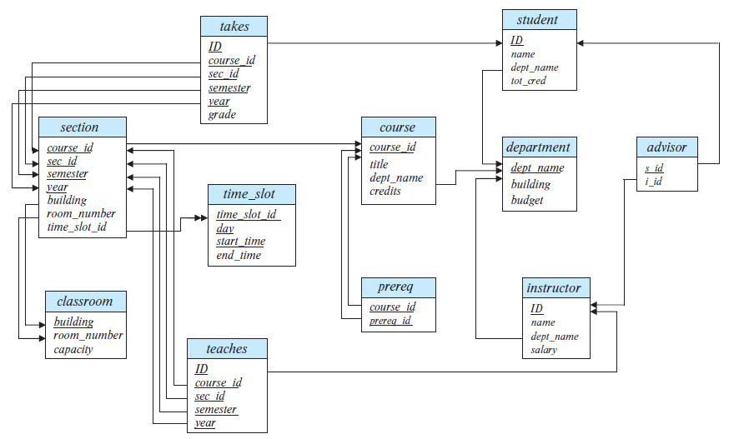
Appendix: University Database

Slide 15

Appendix: University Database
https://www.db-book.com/university-lab-dir/sqljs.html
<- Online SQL interpreter
University database loaded

Slide 16

FIN
Any questions?

