Slide 1
Database System Tutorial 1
Notes:
Welcome everyone, Thank you for joining this session.

Slide 2
Tutorial Structure
Additional Material: Brief overview or expansion of key topics
Exercises: Time to work through problems
Open Q&A: Discuss any questions
(Slide available on Canvas, Week Overview page)
Notes:
Before we dive into today’s tutorial, let’s take a quick moment to outline how things will run. First, I’ll present some additional material that complements what you’ve learned so far. Next, I’ll provide a set of exercises to help solidify your understanding. Finally, we’ll have an open Q&A session—feel free to ask about anything related to the material, the questions, or broader course topics.
You can find this slide, along with all the key information, on the Week Overview page in Canvas.

Slide 3
Differences Between Joins
Features | Cartesian Product | Theta Join | Natural Join
Condition | None | General predicate (e.g., =, <, >) | Implicit equality on matching column names
Duplicate Columns | No removal | No removal | Removes duplicate columns
Symbol | R × S | R ⋈_{θ} S | R ⋈ S
Notes:
On this slide, we have a table comparing the three main join types we’ve covered: Cartesian Product, Theta Join, and Natural Join. We’ll walk through each row—Condition, Duplicate Columns, and Symbol—to understand how these joins differ and when you might use each one.
First, let’s look at the Condition row. A Cartesian Product has no condition at all. It pairs every row in one relation (R) with every row in another (S), which can lead to a very large result if both tables are big. A Theta Join introduces a general predicate—this can be equality, inequality, or other operators—to control how rows match between R and S. Finally, a Natural Join automatically applies equality on all columns that share the same name in R and S, saving you from specifying each column explicitly. However, this can sometimes cause unintended matches if you’re not careful with naming.
Next, check out the Duplicate Columns row. With a Cartesian Product and a Theta Join, any columns that appear in both R and S will show up twice in the resulting table. This can be useful for certain operations but can also clutter your data if you don’t need those duplicate columns. On the other hand, a Natural Join automatically merges columns with the same name, effectively removing duplicates so that each matching attribute appears only once. This feature is convenient but demands consistent naming in your database design.
Finally, the Symbol row shows how we represent each join in relational algebra. A Cartesian Product is written as R × S, while a Theta Join is R ⋈θ S, indicating a specific condition (θ). The Natural Join is simply R ⋈ S, where the implicit condition is that all matching column names must be equal.
By comparing these three types side by side, we can see that each one serves a different purpose. The Cartesian Product is the broadest, creating all possible combinations; the Theta Join lets you tailor a condition to filter those combinations; and the Natural Join is a shortcut for equi-joins when tables share identically named columns. Keep these distinctions in mind, and you’ll be well-prepared to choose the right join for your data.”

Slide 4
Exercises
branch(branch name, branch city, assets)
customer (ID, customer name, customer street, customer city)
loan (loan number, branch name, amount)
borrower (ID, loan number)
account (account number, branch name, balance)
depositor (ID, account number)
1. Consider this bank database. Assume that branch names and customer names uniquely identify branches and customers, but loans and accounts can be associated with more than one customer.
1.1 What are the appropriate primary keys?
1.2 Given your choice of primary keys, identify appropriate foreign keys.

Slide 5
Exercises
branch(branch name, branch city, assets)
customer (ID, customer name, customer street, customer city)
loan (loan number, branch name, amount)
borrower (ID, loan number)
account (account number, branch name, balance)
depositor (ID, account number)
2. Consider this bank database. Give an expression in the relational algebra for each of the following:
2.1 Find each loan number with a loan amount greater than $10000.
2.2 Find the ID of each depositor who has an account with a balance greater than $6000.
2.3 Find the ID of each depositor who has an account with a balance greater than $6000 at the “Uptown” branch.

Slide 6
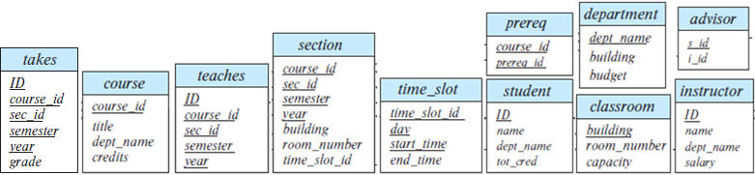
Exercises
3. Consider the university database as below.
Write the following queries in relational algebra:
3.1 Find the ID and name of each instructor in the Physics department.
3.2 Find the ID and name of each instructor in a department located in the building “Watson”.
3.3 Find the ID and name of each student who has taken at least one course in the “Comp. Sci.” department.
3.4 Find the ID and name of each student who has taken at least one course section in the year 2018.
3.5 Find the ID and name of each student who has not taken any course section in the year 2018.

Slide 7
Exercises
4. Consider the university database as below.
Write the following queries in SQL:
4.1 Find the titles of courses in the Comp. Sci. department that have 3 credits.
4.2 Find the IDs of all students who were taught by an instructor named Einstein; make sure there are no duplicates in the result.
Notes:
We encourage you to use the online interpreter, which the link and the QR code can be found on Appendix (go to that page)

Slide 8
Appendix: University Database
classroom(building, room number, capacity)
department(dept_name, building, budget)
course(course_id, title, dept_name, credits)
instructor(ID, name, dept_name, salary)
section(course_id, sec_id, semester, year, building, room number, time_slot_id)
teaches(ID, course_id, sec_id, semester, year)
student(ID, name, dept_name, tot cred)
takes(ID, course_id, sec_id, semester, year, grade)
advisor(s_ID, i_ID)
time_slot(time_slot_id, day, start time, end time)
prereq(course_id, prereq_id)

Slide 9
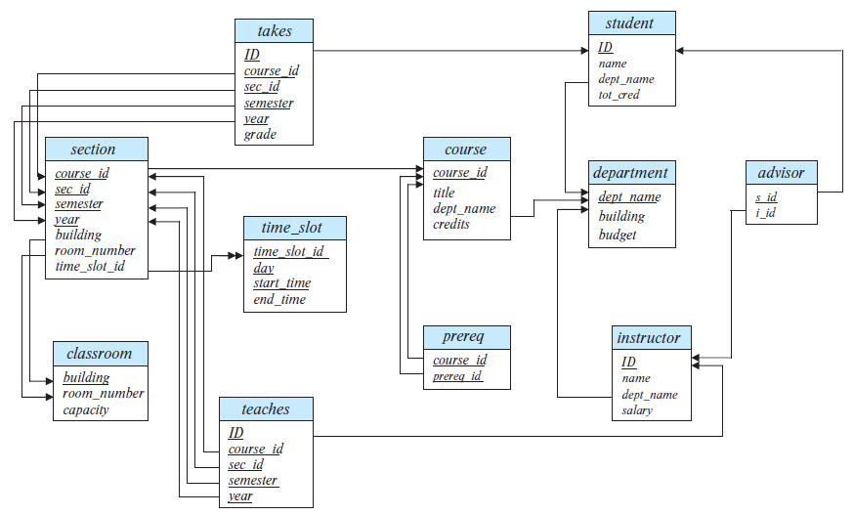
Appendix: University Database

Slide 10

Appendix: University Database
https://www.db-book.com/university-lab-dir/sqljs.html
<- Online SQL interpreter
University database loaded

Slide 11
Answers
1.1
branch(branch name, branch city, assets)
customer (ID, customer name, customer street, customer city)
loan (loan number, branch name, amount)
borrower (ID, loan number)
account (account number, branch name, balance)
depositor (ID, account number)

Slide 12
Answers
1.2
i. For loan: branch name referencing branch.
ii. For borrower: Attribute ID referencing customer and loan number referencing loan
iii. For account: branch name referencing branch.
iv. For depositor: Attribute ID referencing customer and account number referencing account

Slide 13
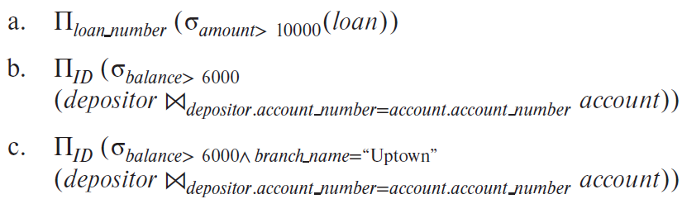
Answers
2.

Slide 14
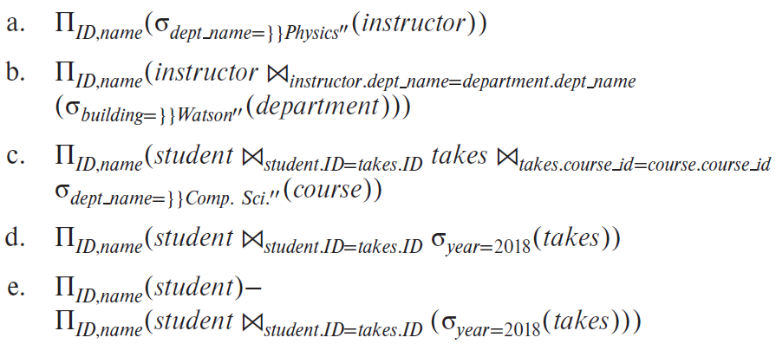
Answers
3.

Slide 15
Answers
4.
4.1 SELECT title FROM course WHERE credits = 3 AND dept_name="Comp. Sci."
4.2 SELECT DISTINCT student.ID FROM student, takes, teaches, instructor WHERE student.ID = takes.ID AND takes.course_id = teaches.course_id AND takes.sec_id = teaches.sec_id AND takes.semester = teaches.semester AND takes.year = teaches.year AND instructor.ID = teaches.ID AND instructor.name = "Einstein"

Slide 16

FIN
Any questions?
Cache test update 03151500

