Slide 1
Database System Tutorial 3
Notes:
Welcome everyone, Thank you for joining this session.

Slide 2
Tutorial Structure
Additional Material: Additional content that extends the lecture material.
Exercises: Time for students to work through assigned problems independently or in groups.
Open Q&A: Feel free to ask questions and discuss any challenges encountered.
(Slide available on Canvas, Week Overview page)
Notes:
Welcome to today’s tutorial session! Here’s what we will cover:
First, I will go over some additional material to add to the lecture content.
Then, just like in previous lab sessions, you will have time to work on exercises.
Feel free to ask any questions at any time!

Slide 3
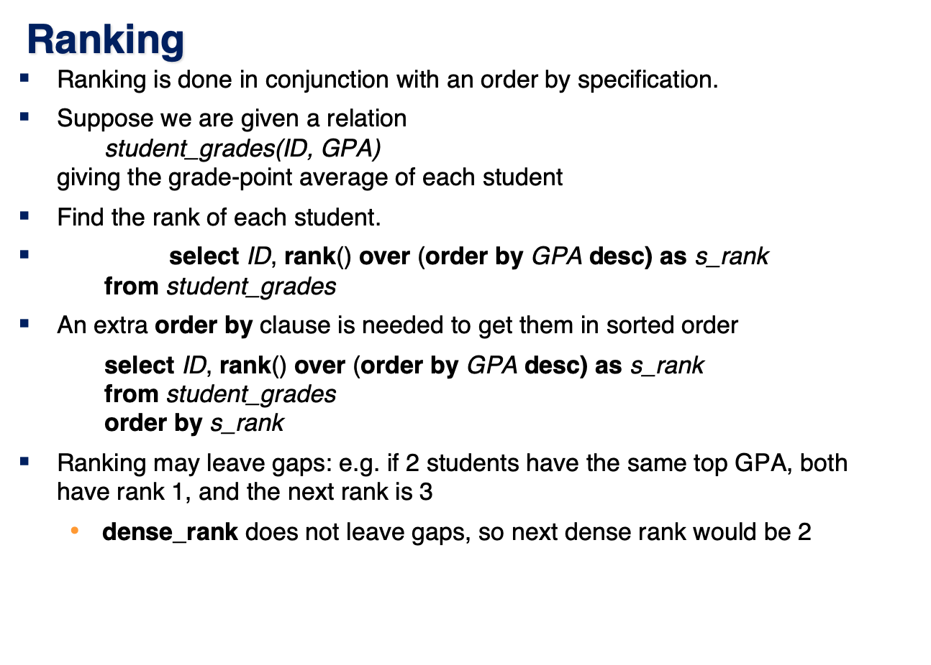
Notes:
Today, we will talk about RANK() in SQL.
Imagine we have a table called student_grades(ID, GPA) in our student database, which stores GPA of students.
Our goal is to rank students based on their GPA. Here is the SQL query to achieve this:
This query assigns a rank to each student based on their GPA, with higher GPAs receiving a better (lower-numbered) rank.
RANK() function assigns a rank to each row.
OVER (ORDER BY GPA DESC): It orders the students by GPA in descending order, meaning the highest GPA gets the first rank.
If we want to ensure that the results are displayed in the correct ranking order, we can add an external ORDER BY clause.
It is important to note the difference between RANK() and DENSE_RANK(). ranking may leave gaps...

Slide 4
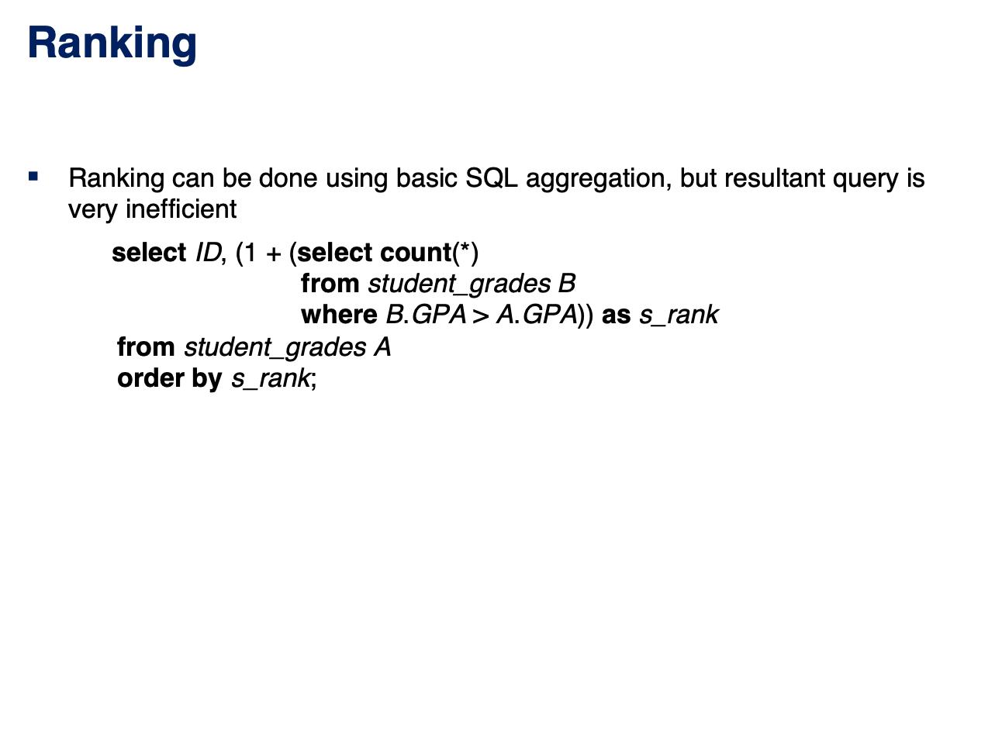
Notes:
Not using RANK() can still achieve a similar purpose.
We have an example here, but it requires a subquery to count the number of students with a higher GPA.
The subquery counts how many students have a higher GPA than the current student.
And then add to calculates the rank.
However, this method is inefficient, especially for large datasets, as it requires multiple subqueries and comparisons.

Slide 5
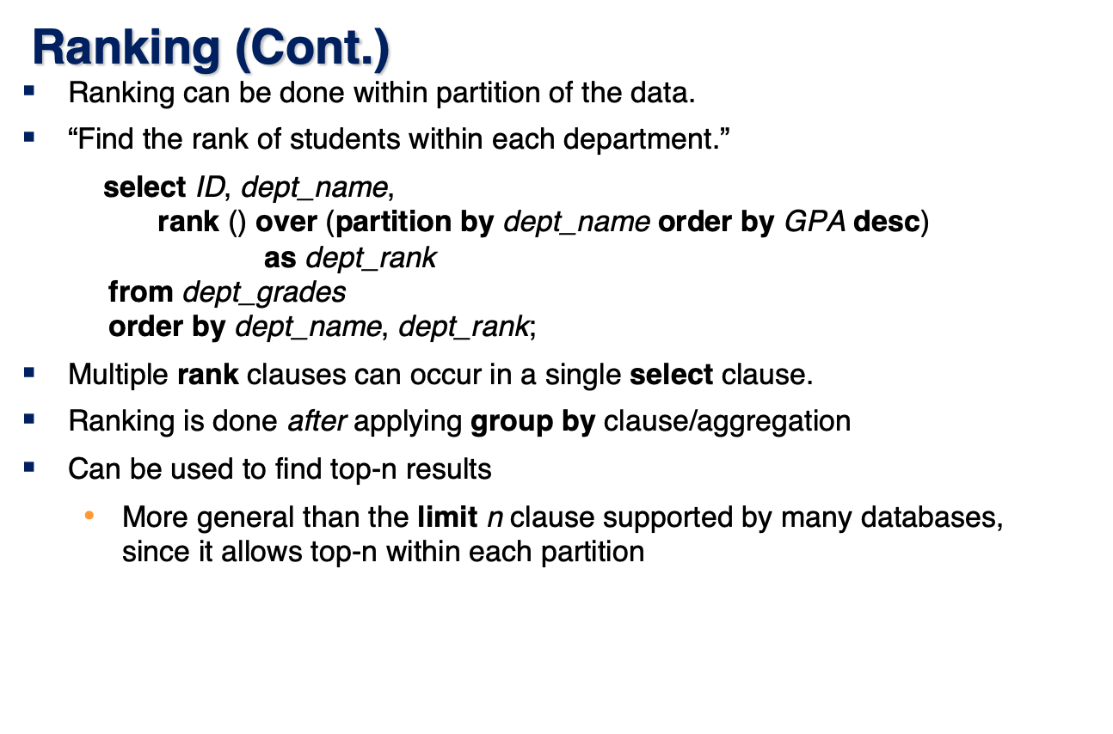
Notes:
Ranking can be done within partitions of the data.
For example, if we want to rank students within each department, we can use PARTITION BY like this.
This query ranks students within each department based on their GPA.

Slide 6
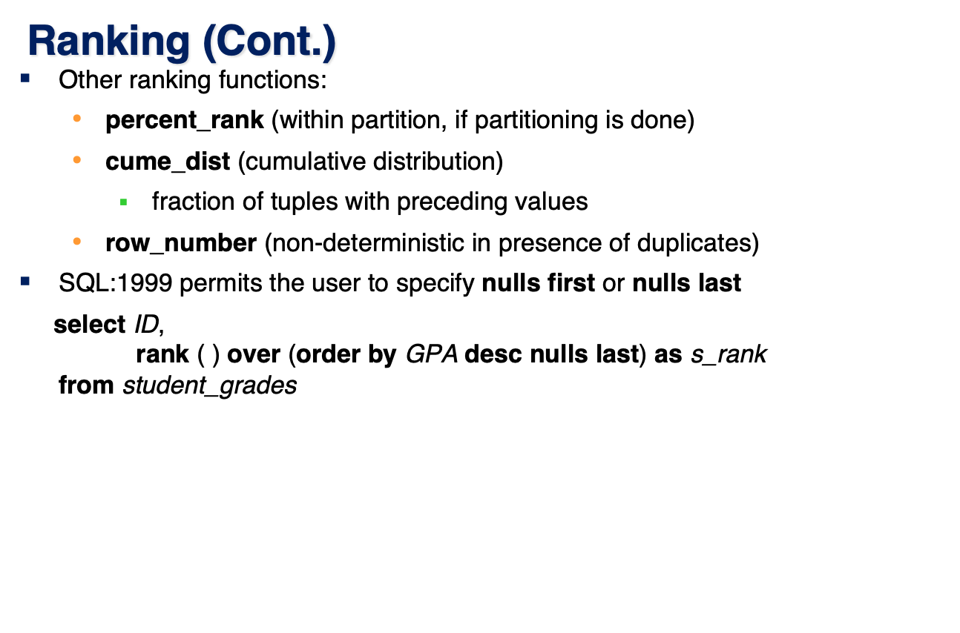
Notes:
Apart from RANK() and DENSE_RANK(), SQL provides additional ranking functions:
PERCENT_RANK(): Computes the percentage ranking within a partition.
CUME_DIST(): Determines the cumulative distribution by calculating the fraction of preceding values.
ROW_NUMBER(): Assigns a unique row number to each record, but it is non-deterministic when duplicates exist.
SQL also allows users to specify how NULL values are ranked using NULLS FIRST or NULLS LAST

Slide 7
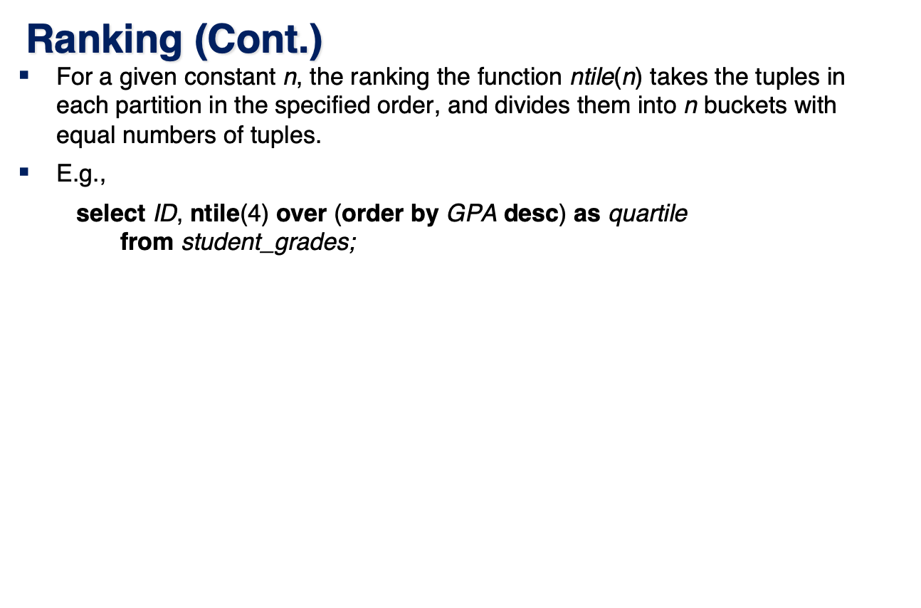
Notes:
Another useful ranking function is NTILE(n), which divides data into n equal parts.
For example, NTILE(4): This divides the dataset into 4 equal parts (quartiles).
ORDER BY GPA DESC: The division is based on GPA, ensuring higher GPAs are placed in higher quartiles.

Slide 8
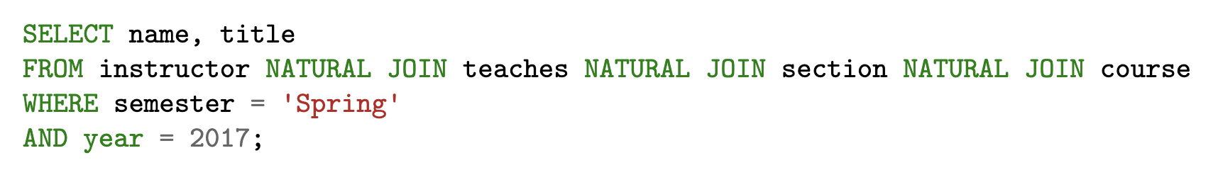
Exercises
1. Consider the following SQL query that seeks to find a list of titles of all courses taught in Spring 2017 along with the name of the instructor.
What is wrong with this query?

Slide 9
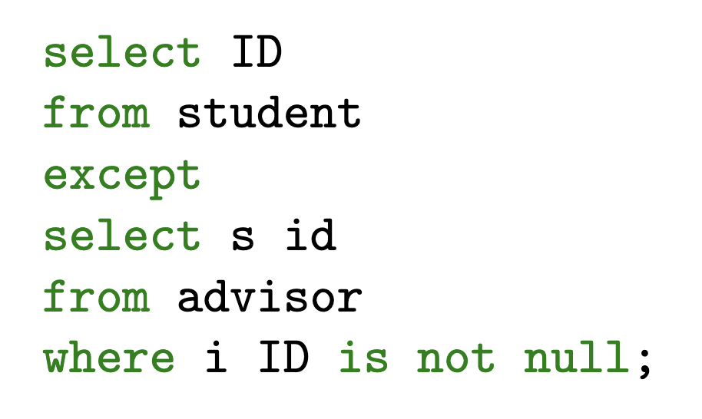
Exercises
2. Express the following query in SQL using no subqueries and no set operations.

Slide 10
Exercises
3. Show how to define a view tot_credits (year, num credits), giving the total number of credits taken in each year.

Slide 11
Exercises
4. Given a relation S(student, subject, marks), write a query to find the top 10 students by total marks, by using SQL ranking. Include all students tied for the final spot in the ranking, even if that results in more than 10 total students.

Slide 12

FIN
Any questions?

