Slide 1

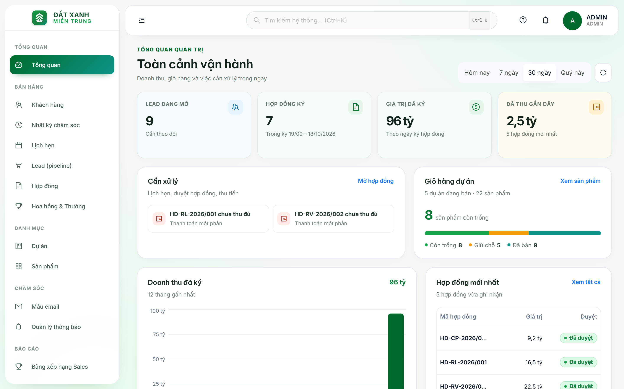
LIVE PLATFORM SHOWCASE
ENTERPRISE REAL ESTATE MANAGEMENT CRM
ĐẤT XANH MIỀN TRUNG
HIGH-END REAL ESTATE CRM SYSTEM REVIEW
Comprehensive digitization of property sales workflows, live project inventory, multi-channel customer care, and automated transactions for Regal Group.
• Frontend: React 19 + TypeScript + Ant Design 5 (Vercel)
• Backend: Spring Boot 3 Microservices (Render Blueprint)
• Database: 3 Supabase PostgreSQL DBs + Media Bucket
• Live URL: estate.daidev.me (fe-estate-system.vercel.app)
SYSTEM ARCHITECT & PRESENTER
Presented by Trần Anh Đài
Audience: Technical Evaluation Committee, Project Leads & Supervisory Board
Stack: Spring Boot 3 Java 17 Microservices, React 19 Frontend, Cloud Topology & RBAC
Production Status: Verified on Render & Vercel | Oct 2026

Slide 2
OVERVIEW
AGENDA & TABLE OF CONTENTS
Structured technical briefing across architecture, security, persona interfaces, and roadmap
PART 01 • Technical Core
PART 02 • UI & Workflows
PART 03 • Architecture & Flow
PART 04 • Roadmap & Demo
Architecture & Foundation
Role Interfaces & Operations
Engineering Deep-Dive
Future AI & Business Value
• System Purpose & Role-Based Access Control (RBAC)
• Cloud Deployment Topology (Vercel, Render, Supabase, Resend)
• Security Architecture: 2FA TOTP, Email OTP & Stateless JWT
• Admin Portal: User Provisioning & System Audits
• Manager Portal: Project Inventory & Booking Approval
• Sales Portal: Lead Pipeline & Site-Visit Appointments
• Multi-Channel Customer Care: 360° Interaction Logs
• End-to-End Real Estate Transaction Lifecycle (Booking to Deed)
• Cloud Free Tier Constraints: In-Memory vs Kafka/Redis Trade-offs
• Cold-Start Mitigation & SMTP Network Port Solutions
• Lightweight AI Assistant on Render (Spring AI + Gemini + pgvector)
• Quantifiable Business Impact & SaaS Cost Elimination
• Conclusion, Live System Demonstration & Committee Q&A
ĐẤT XANH MIỀN TRUNG • REGAL GROUP | ENTERPRISE CRM SYSTEM REVIEW
Slide 2 of 14

Slide 3
SYSTEM ROLES
SYSTEM OVERVIEW & ROLE-BASED ACCESS CONTROL (RBAC)
Securing high-value real estate transaction data through enterprise role separation and Spring Security filters
ADMIN (System Superuser)
MANAGER (Sales Director)
SALES (Property Consultant)
Scope: System-wide governance & data integrity
Scope: Sales division & project branch oversight
Scope: Personal customer portfolio & daily outreach
• User & Employee Provisioning: Creation, department assignment, and instant credential revocation.
• Role Assignment: Assigning ADMIN, MANAGER, or SALES authorities via Spring Security.
• Global Security Auditing: Enforcing mandatory 2FA TOTP, review of authentication logs.
• Macro Revenue Analytics: High-level financial oversight across all Regal Group projects.
• Live Inventory Management: Unlocking & monitoring property baskets (Regal Legend, Complex, Victoria).
• Lead Allocation: Dynamic distribution of marketing leads to consultants based on capacity.
• Transaction Approval: Authorizing reservation bookings (50M-100M VND) and approving official deposits.
• Team KPI Supervision: Monitoring conversion velocity from inquiry to signed contract.
• 360° Customer Dossier: Managing client profiles, budget tiers (3B - 20B+ VND), and preferred orientations.
• Multi-Channel Interaction Log: Timestamped recording of phone calls, site tours, and emails.
• Showroom Appointments: Scheduling physical site visits and virtual reality model tours.
• Deal Progression: Generating booking tickets and initiating deposit vouchers for manager lock.
Security Rule: Enforced via @PreAuthorize("MASTER CONTROL")
Security Rule: Enforced via @PreAuthorize("APPROVAL AUTHORITY")
Security Rule: Enforced via @PreAuthorize("CLIENT EXECUTION")
ĐẤT XANH MIỀN TRUNG • REGAL GROUP | ENTERPRISE CRM SYSTEM REVIEW
Slide 3 of 14

Slide 4
CLOUD INFRASTRUCTURE
PRODUCTION CLOUD TOPOLOGY & THIRD-PARTY SERVICES
Zero-infrastructure-cost architecture orchestrating Vercel Edge, Render Microservices, Supabase & Resend API
01 • Vercel Cloud
02 • Render Cloud
03 • Supabase Cloud
04 • Resend API
Frontend Edge Hosting
Backend Microservices
Multi-Database PostgreSQL
Transactional Email Engine
estate.daidev.me
crm-gateway-9dj8.onrender.com
aws-0-ap-southeast-1.pooler.supabase.com
api.resend.com (HTTPS Port 443)
• React 19 + TypeScript + Vite build pipeline with zero configuration.
• Global Edge Network delivering sub-20ms initial asset latency.
• Automatic continuous deployment (CI/CD) hooked directly to GitHub repo.
• Multi-tenant route guards & Web Locks token refresh synchronization.
• Spring Boot 3 API Gateway (:8080) running Adoptium Temurin 17.
• Internal microservices network hosting 5 isolated business services.
• Automatic health recovery (Auto-restart) and native SSL/TLS encryption.
• Optimized non-Docker JVM process consuming <300MB RAM per instance.
• Physical isolation across 3 PostgreSQL DBs: USER_DB, CUSTOMER_DB, CRM_DB.
• Row-Level Security (RLS) enabled across all 16 production entity tables.
• Supabase Storage (estate-media) hosting high-res property floorplans.
• Logical UUID foreign keys ensuring autonomous service scalability.
• Immediate dispatch of 6-digit cryptographic authentication OTPs.
• Automated transactional emails for reservation booking & deposit receipts.
• Pure REST HTTP communication eliminating ISP / cloud SMTP port blocks.
• DKIM & SPF verified domain ensuring 99.8% inbox deliverability.
ĐẤT XANH MIỀN TRUNG • REGAL GROUP | ENTERPRISE CRM SYSTEM REVIEW
Slide 4 of 14

Slide 5
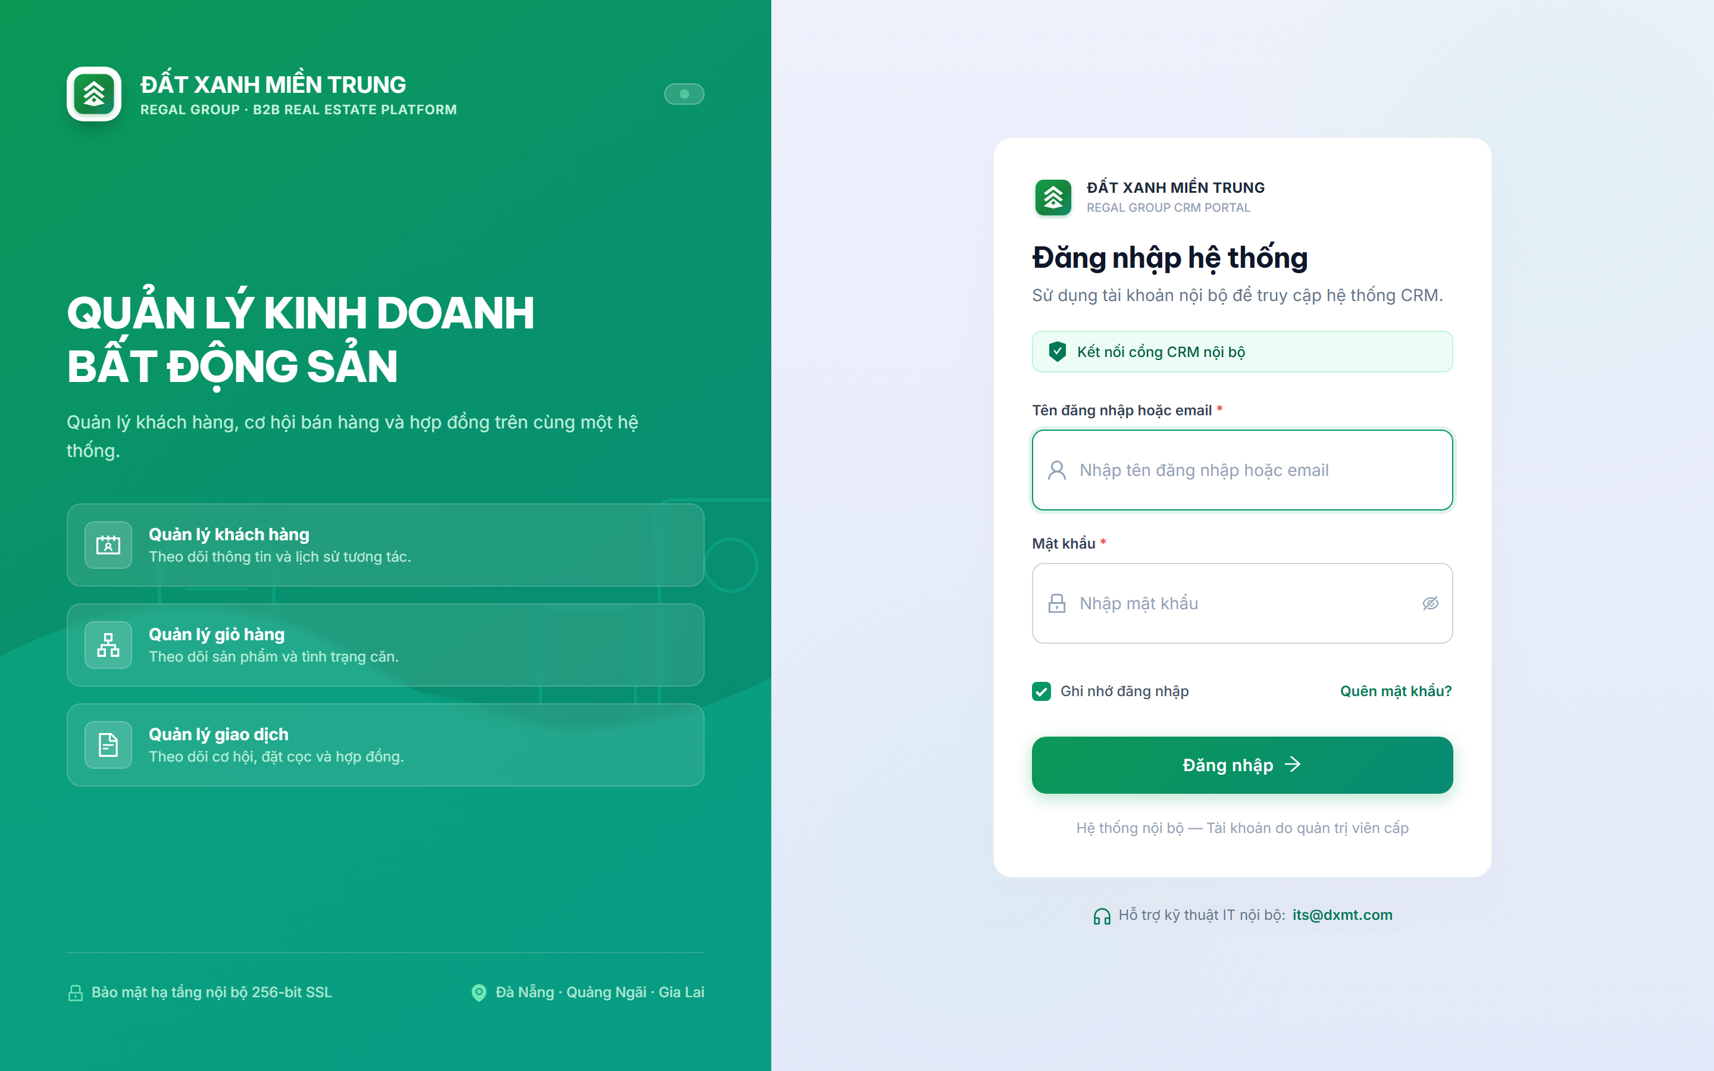
SECURITY & AUTH
SECURITY & AUTHENTICATION ARCHITECTURE
Multi-tiered identity verification: HMAC-SHA256 JWT, TOTP 2FA, Email OTP, and Bcrypt rate limiting
https://estate.daidev.me/login
ZERO-TRUST GATEWAY
1
Stateless JWT Lifecycle & Claims
HMAC-SHA256 signed tokens containing identity and roles. 15-minute access token paired with 30-day refresh token. Web Locks API (dxmt.refresh) prevents multi-tab token race conditions.
2
Two-Factor Authentication (2FA TOTP)
RFC 6238 Time-based One-Time Password with 30-second rotation. Users scan QR code with Google Authenticator or Microsoft Authenticator, eliminating credential stuffing vulnerabilities.
1
3
Cryptographic Email OTP & Bcrypt Hashing
Dynamic 6-digit OTP generated via SHA-256 and sent via Resend API for new devices. All passwords hashed with Bcrypt (10 salt rounds) with in-memory IP brute-force throttling.
2
3
⚡ END-TO-END AUTHENTICATION FLOW:
1
User submits username & password -> Bcrypt hashes verified -> Rate limiter checks IP attempts.
2
If 2FA is active, server challenges with TOTP; alternatively dispatches 6-digit OTP via Resend.
3
Gateway issues access token (15m) + refresh token (30d); client stores securely in local storage.
ĐẤT XANH MIỀN TRUNG • REGAL GROUP | ENTERPRISE CRM SYSTEM REVIEW
Slide 5 of 14

Slide 6
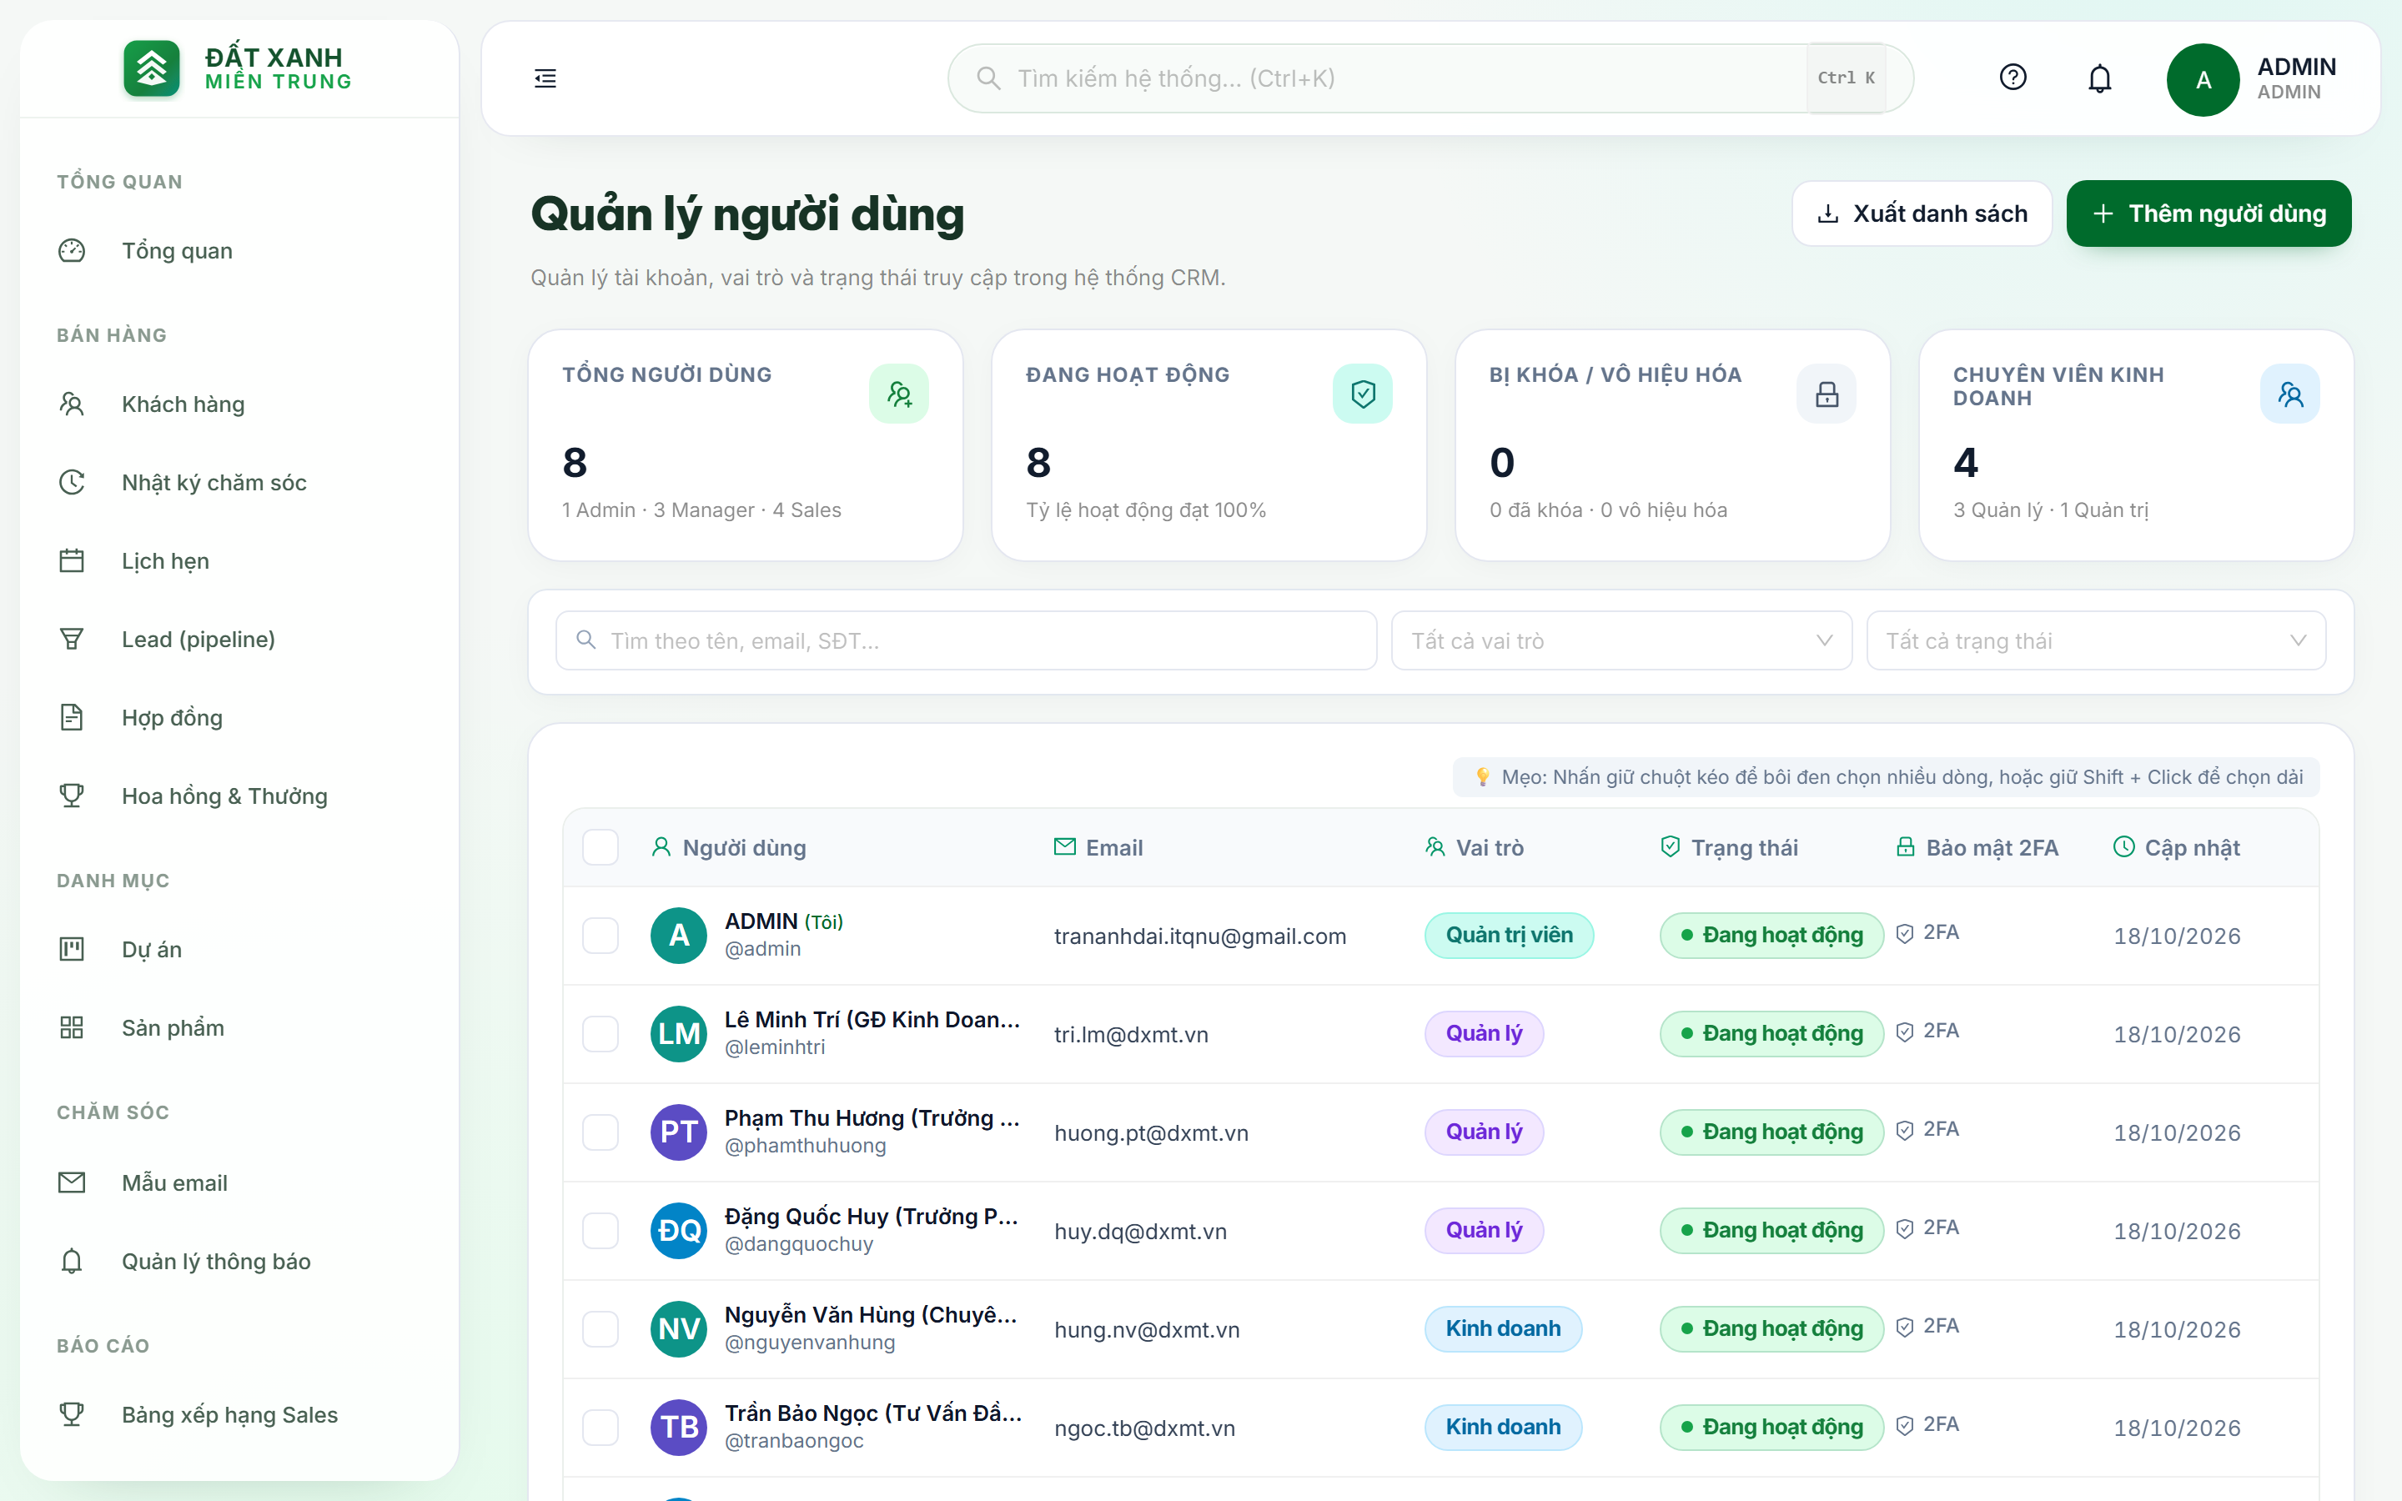
ADMIN PORTAL
ADMIN WORKSPACE: SYSTEM GOVERNANCE & PROVISIONING
Centralized control over personnel accounts, dynamic role assignment, security status, and system audit logs
https://estate.daidev.me/users
SUPERUSER PRIVILEGE
1
Dynamic Role-Based Navigation Menu
Sidebar dynamically renders Admin-exclusive modules: User Management (/users), System Logs, and Global Reports, strictly filtered by user authorities.
2
2
Staff Onboarding & Role Granting Button
1
Initiates employee creation modal to assign roles (ADMIN, MANAGER, SALES), bind branch departments, and trigger automatic welcome invite emails via Resend.
3
Employee Registry & Security Audit Table
3
Displays active 2FA status, last login timestamps, assigned branch, and instant lock/unlock switch to freeze accounts upon suspicious activity.
⚡ STANDARD ADMIN OPERATIONAL WORKFLOW:
1
Login via master admin credentials (admin / Anhdaidtr04@) with mandatory 2FA security validation.
2
Navigate to User Management (/users) -> Provision new real estate consultant & assign branch.
3
Review aggregated sales analytics & inspect system audit logs for unauthorized data modifications.
ĐẤT XANH MIỀN TRUNG • REGAL GROUP | ENTERPRISE CRM SYSTEM REVIEW
Slide 6 of 14

Slide 7
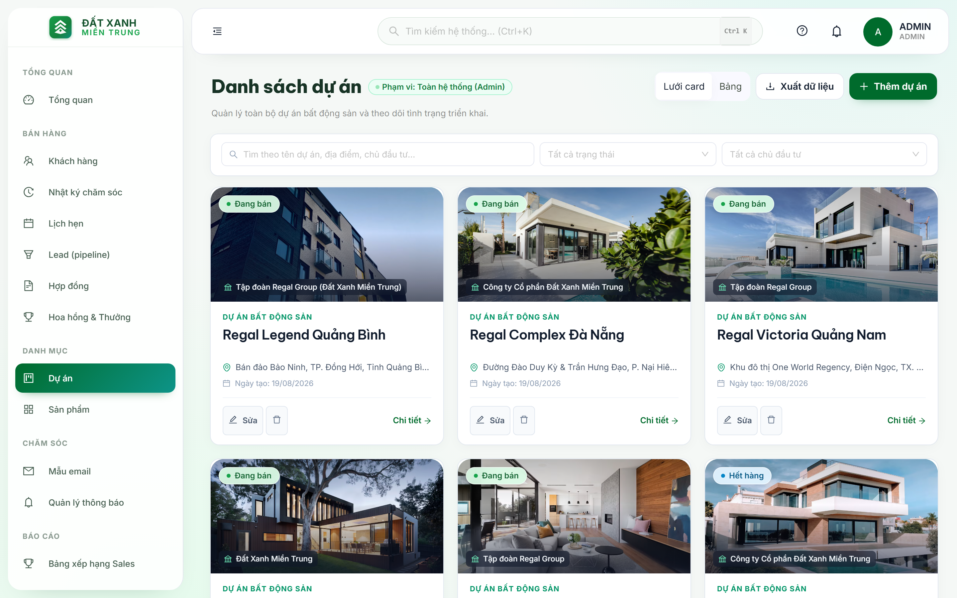
MANAGER PORTAL
MANAGER WORKSPACE: PROJECT INVENTORY & APPROVALS
Supervising Regal Group project baskets, locking apartment inventory, and validating reservation deposits
https://estate.daidev.me/projects
INVENTORY & DEAL CONTROL
1
Regal Group Mega-Project Catalog
Central overview of 6 key enterprise projects: Regal Legend Quang Binh, Regal Complex Da Nang, Regal Victoria, and Regal Maison Phu Yen with real-time sales progress.
2
Real-Time Apartment Inventory Matrix
Color-coded unit status: Available (Green), Priority Booking (Amber), Deposited (Blue), and Contract Signed (Gray). Completely prevents double-booking across agencies.
1
2
3
Booking & Deposit Approval Center
Inspects and authorizes 50M-100M VND reservation vouchers submitted by sales consultants, locking units and progressing deals to formal SPA signing.
⚡ STANDARD MANAGER OPERATIONAL WORKFLOW:
3
1
Authenticate as Sales Supervisor (leminhtri / Anhdaidtr04@) to access division command center.
2
Review incoming customer leads and assign to sales consultants based on territory quotas.
3
Inspect project inventory table -> Verify deposit bank receipt -> Approve official unit locking.
ĐẤT XANH MIỀN TRUNG • REGAL GROUP | ENTERPRISE CRM SYSTEM REVIEW
Slide 7 of 14

Slide 8
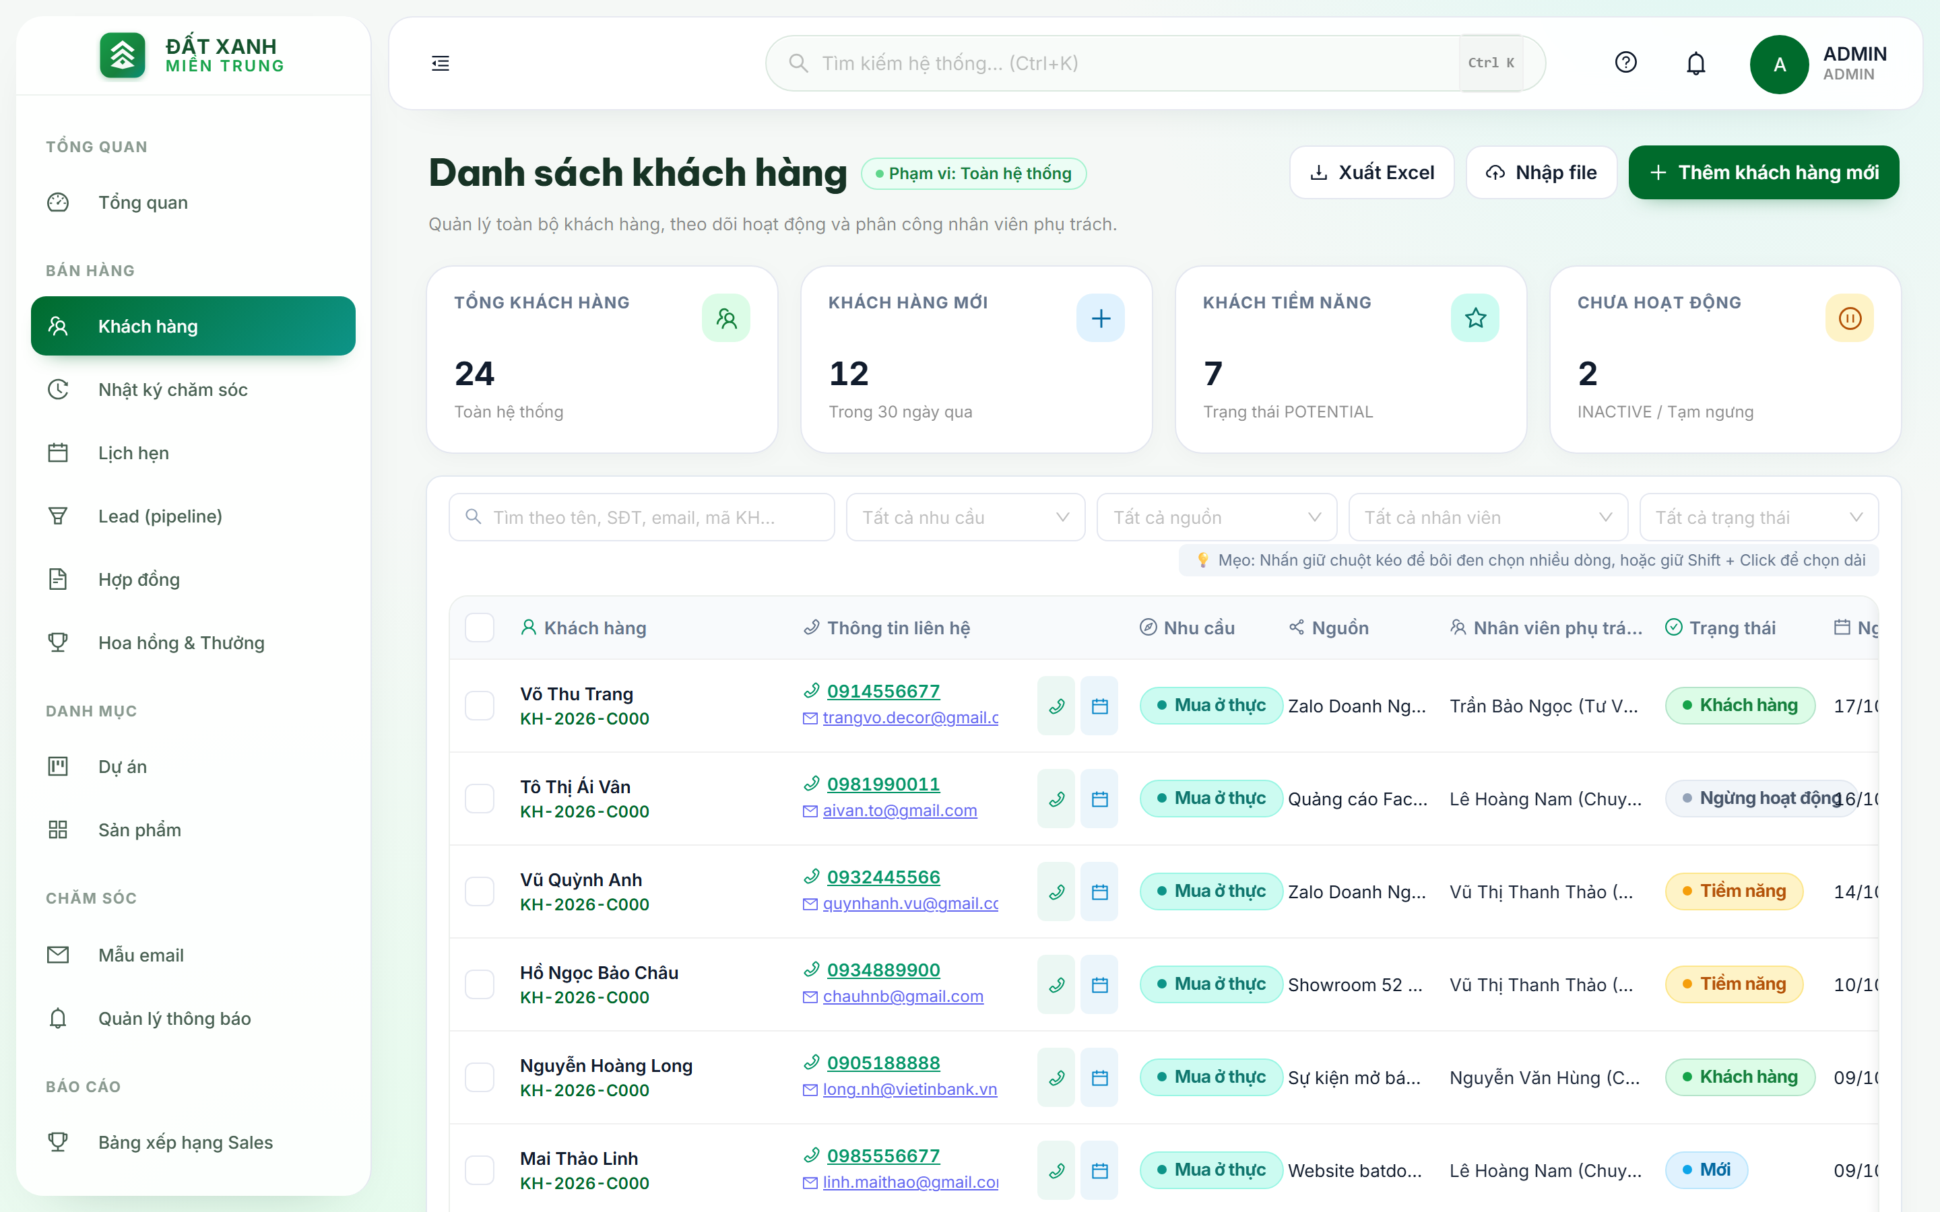
SALES WORKSPACE
SALES WORKSPACE: LEAD PIPELINE & CLIENT CONVERSION
Personal client portfolio, smart property matching, site-visit appointment scheduling, and deal creation
https://estate.daidev.me/customers
LEAD FUNNEL AUTOMATION
1
Smart Customer Segmentation Filters
Quickly filters leads by criteria: VIP Investors, Residential Buyers, Speculative Flippers, and budget tiers from 3B VND up to over 20B VND.
1
2
Project Model & Site-Visit Appointments
Schedules physical tours to Regal Legend / Regal Victoria construction sites. Automatically triggers calendar invites and email reminders via Resend API.
2
3
Deal Generation & Financial Amortization
3
Generates real estate booking tickets with instant payment milestone schedules, 0% interest bank subsidies, and commission calculation projections.
⚡ STANDARD SALES OPERATIONAL WORKFLOW:
1
Login as Property Consultant (tranbaongoc / Anhdaidtr04@) to inspect personal daily lead queue.
2
Conduct initial discovery phone call within 15 minutes of assignment; record notes in dossier.
3
Schedule project showroom visit -> Select preferred unit -> Submit booking ticket for manager approval.
ĐẤT XANH MIỀN TRUNG • REGAL GROUP | ENTERPRISE CRM SYSTEM REVIEW
Slide 8 of 14

Slide 9
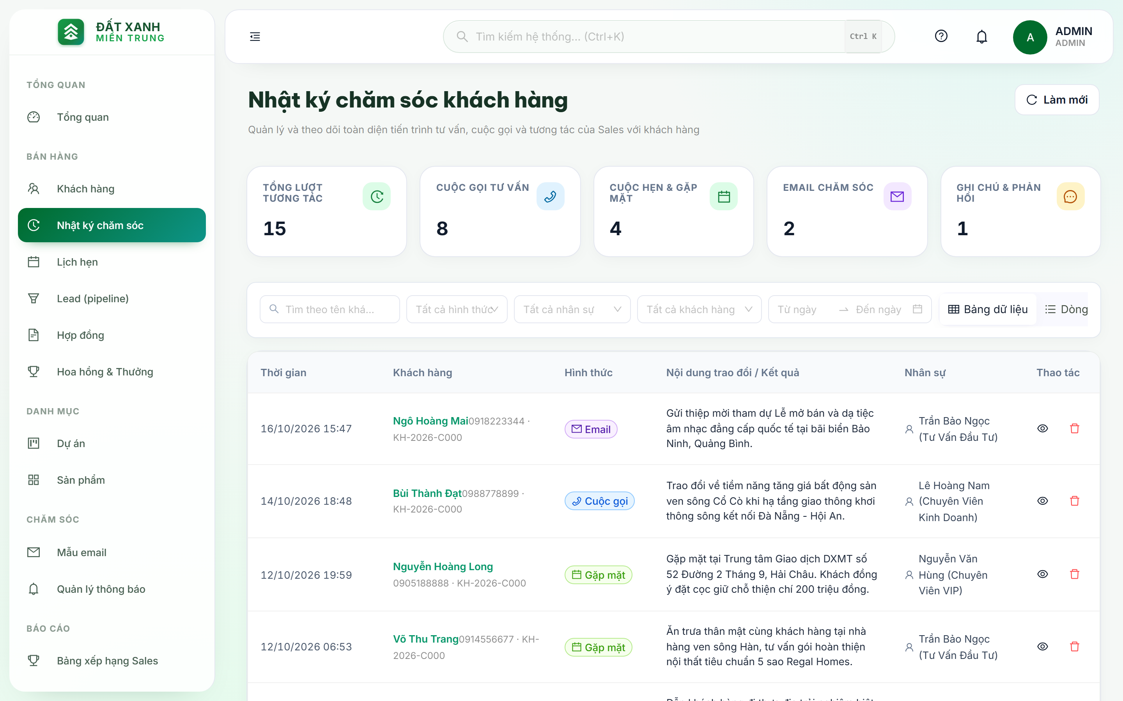
CUSTOMER CARE
CUSTOMER CARE: 360° MULTI-CHANNEL INTERACTION LOGS
Visualizing 5 stretched KPI metrics (100% full width) and maintaining unalterable chronological interaction records
https://estate.daidev.me/customer-cares
360° AUDIT TRAIL
1
5 Stretched KPI Cards (100% Full Width)
Modern CSS Grid (repeat(5, minmax(0, 1fr))) balancing metrics: Total Care Activities, Phone Calls, In-Person Meetings, Sent Emails, and Internal Notes without clipping.
1
2
360-Degree Multi-Channel Care Timeline
Every phone consultation, office meeting, sent quotation, or customer feedback note is timestamped in real-time, guaranteeing seamless handover when consultants rotate.
3
Client Sentiment & Engagement Rating
2
Categorizes client engagement: Highly enthusiastic for lake-view shophouse, hesitant on installment speed, enabling timely manager policy interventions.
⚡ ENTERPRISE CUSTOMER CARE BENEFIT:
3
1
Consultant logs interaction details immediately following calls, meetings, or site tours.
2
System links notes directly to customer UUID in customer_db with UTC timestamps.
3
When staff leaves or reassigns, 100% of relationship history remains intact for the successor.
ĐẤT XANH MIỀN TRUNG • REGAL GROUP | ENTERPRISE CRM SYSTEM REVIEW
Slide 9 of 14

Slide 10
TRANSACTION PIPELINE
END-TO-END REAL ESTATE TRANSACTION LIFECYCLE
Standardized 5-stage pipeline from marketing lead qualification to SPA contract execution and commission settlement
01
Stage 1: Lead
02
Stage 2: Hold
03
Stage 3: Deposit
04
Stage 4: Legal SPA
05
Stage 5: Settlement
Lead Capture & Qualification
Priority Unit Booking
Official Deposit Confirmation
SPA Contract Execution
Commission & Title Handover
• Ingestion from Landing Page, Ads, Showroom
• 15-minute SLA consultant phone outreach
• Budget qualification (3B - 20B+ VND)
• Preferred project & view selection
• Client selects specific villa/shophouse
• 50M - 100M VND refundable hold deposit
• Unit temporarily locked on inventory
• Prevents simultaneous external agency booking
• Goodwill hold converted to formal deposit
• Sales Manager verifies banking receipt
• Unit permanently transitioned to DEPOSITED
• Deposit contract dispatched via Resend
• Sales & Purchase Agreement signed
• 7 - 10 installment milestone schedules
• Bank partnership 0% interest loan bind
• Automated overdue payment notifications
• System auto-calculates 1.5% - 2.5% commission
• Manager override compensation calculated
• Villa physical inspection & snagging
• Official Pink Book (title deed) handover
ĐẤT XANH MIỀN TRUNG • REGAL GROUP | ENTERPRISE CRM SYSTEM REVIEW
Slide 10 of 14

Slide 11
SYSTEM ARCHITECTURE
CLOUD INFRASTRUCTURE CONSTRAINTS & ENGINEERING SOLUTIONS
Transparent technical audit of Render Free Tier boundaries and production-grade engineering trade-offs
HARD CONSTRAINTS OF RENDER FREE PLAN
PROVEN ENGINEERING WORKAROUNDS IMPLEMENTED
• No Managed Kafka / RabbitMQ: Distributed Kafka brokers demand KRaft/Zookeeper and 2-4GB RAM, exceeding Render free 512MB RAM cap.
• No Persistent Redis Cluster: Managed cloud Redis services require paid credit card tiers and incur ongoing maintenance costs.
• Free Tier Cold-Start Inactivity: Services spin down into sleep mode after 15 minutes of idle time, introducing ~40-45s wake-up latency on first request.
• Render SMTP Port Blocking: Outbound ports 25, 465, and 587 are blocked at network firewall level to prevent automated spam abuse.
• Internal Event-Driven Spring Engine: Replaced external Kafka broker with native ApplicationEventPublisher and asynchronous @Async thread pools.
• In-Memory Caffeine Cache: High-speed JVM caching providing sub-millisecond lookups for login attempts without external Redis dependencies.
• Frontend Axios Cold-Start Absorber: Client-side retry interceptor automatically retries HTTP 502/503/504 errors up to 6×10s without dropping state.
• Resend HTTP REST API Integration: Operates strictly over HTTPS Port 443 REST calls, completely impervious to SMTP network port blocks.
ĐẤT XANH MIỀN TRUNG • REGAL GROUP | ENTERPRISE CRM SYSTEM REVIEW
Slide 11 of 14

Slide 12
AI EXPANSION
FUTURE EXPANSION: LIGHTWEIGHT AI ASSISTANT ON RENDER
Architecture blueprint: Lightweight Spring AI REST client running on Render without RAM overflow (OOM)
01 • Serverless LLM Client via REST API
02 • RAG on Supabase pgvector
03 • Automated Care Drafts & Workflow Bot
Architecture: Zero JVM RAM Bloat
Architecture: Accurate Property Data
Architecture: Sales Productivity
• Lightweight Spring HTTP REST client invoking Google Gemini 1.5 Flash or OpenAI API.
• Zero heavy neural model weights loaded into Java memory; RAM usage remains safely under 280MB.
• Streaming response tokens via Server-Sent Events (SSE) directly to React 19 UI.
• 100% compliant with Render Free Tier (512MB RAM cap) with zero OOM crash risks.
• Regal Group project master plans, zoning permits, and price lists stored as vector embeddings in Supabase.
• Natural language inquiries ("Which ocean-view villa is available under 15 billion VND?") query pgvector.
• RAG provides verified context to LLM, completely preventing real estate hallucination.
• Zero additional database costs by leveraging existing Supabase PostgreSQL instance.
• Automated synthesis of customer follow-up email drafts based on past customer_cares logs.
• Instant Telegram Bot notifications alerting managers when high-intent VIP investors register.
• Predictive lead scoring algorithms ranking conversion probability from customer interaction frequency.
• Frees up 60% of sales consultants routine administrative paperwork time.
ĐẤT XANH MIỀN TRUNG • REGAL GROUP | ENTERPRISE CRM SYSTEM REVIEW
Slide 12 of 14

Slide 13
BUSINESS VALUE
ENTERPRISE BUSINESS IMPACT & VALUE DELIVERY
Quantifiable operational efficiency, revenue acceleration, and customer relationship asset protection
+45%
100%
80%
100%
Transaction Velocity
Inventory Transparency
Risk Reduction
SaaS Cost Elimination
Accelerated Booking Cycle
Zero Double-Selling
Client Data Asset Protection
Zero Software License Fees
Reduces property hold and deposit confirmation cycle from several hours down to under 3 minutes via real-time inventory matrix and online payment verification.
Centralized live property baskets eliminate accidental double-booking of prime shophouses/villas across both internal sales teams and external brokerage partners.
Centralizes customer dossiers and conversation logs in company-owned encrypted databases, completely preventing client data loss when brokers resign.
Eliminates expensive monthly SaaS licensing fees (e.g. Salesforce / HubSpot at $150/user/month), saving over $18,000 annually while owning 100% of custom code IP.
ĐẤT XANH MIỀN TRUNG • REGAL GROUP | ENTERPRISE CRM SYSTEM REVIEW
Slide 13 of 14

Slide 14
CONCLUSION
THANK YOU & LIVE DEMONSTRATION
Open discussion, committee Q&A, and live end-to-end system walkthrough across all 3 user roles
TECHNICAL PROGRESS REVIEW COMPLETE
THANK YOU!
Q&A & LIVE SYSTEM DEMONSTRATION
LIVE DEMONSTRATION ACCESS: estate.daidev.me (fe-estate-system.vercel.app)
ADMIN ACCOUNT
MANAGER ACCOUNT
SALES ACCOUNT
User: admin | Pass: Anhdaidtr04@
User: leminhtri | Pass: Anhdaidtr04@
User: tranbaongoc | Pass: Anhdaidtr04@
Full system control, employee provisioning, security audits
Project inventory lock, booking approvals, lead distribution
Client dossiers, 360° care logs, showroom appointments
Presented by Trần Anh Đài | Đất Xanh Miền Trung (Regal Group) CRM Engineering Team
ĐẤT XANH MIỀN TRUNG • REGAL GROUP | ENTERPRISE CRM SYSTEM REVIEW
Slide 14 of 14

