Slide 1
POSTER: Understand the Overheads of Storage DataStructures on Persistent Memory
Abdullah Al Raqibul Islam, Dong Dai
[aislam6,ddai]@uncc.edu
University of North Carolina at Charlotte
Charlotte, NC

Slide 2
Abstract
New opportunities for building high-performance storage system with byte-addressable persistent memory (PMEM) devices
Challenges
Read-write latency asymmetry
PMEM programming overhead
Limited understanding of the actual performance characteristic among different persistent mode
Our work
YCSB based benchmark suite to help developers better understand the overhead of various commonly used storage data structures implemented using PMDK (persistent memory develop kit) under different persistent and consistency requirements

Slide 3
PMEM Programming Overheads
Communication with the volatile components of the systems (caches and registers)
CPUs reordering in memory accesses
CPUs limitation in atomic write (e.g., 8-byte for Intel Cascade Lake CPUs)
Asymmetric physical performance of persistent memory on reads and writes
We categorize the PMEM data consistency overheads into two parts:
Persistence Overhead
Transaction Overhead

Slide 4
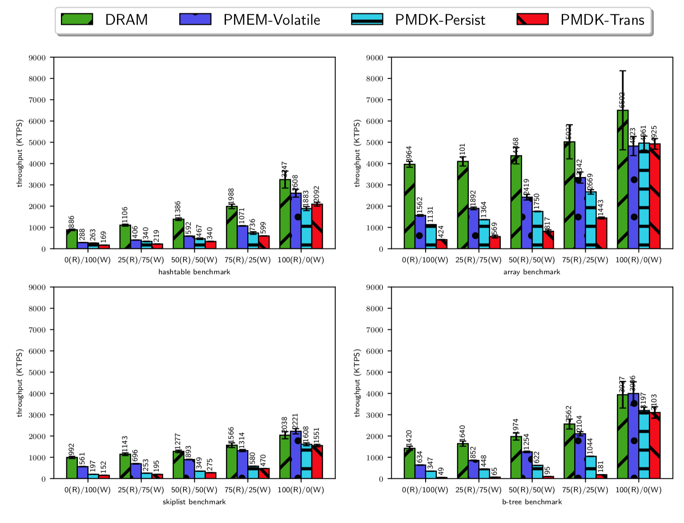
Implementation and Initial Results
We implemented four different versions for each storage data structure: DRAM, PMEM-Volatile, PMDK-Persist, PMDK-Trans
Our observations from the experiment:
PMEM persistence and transaction do have negative impacts on write performance. For instance, b-tree PMEM-Trans version performs 29x worse than its DRAM counterpart on write-dominated workload.
PMEM devices have much less overhead on read-dominate workload
PMEM has different impacts on different data structures on a read-dominated workload
a data structure that performs better in DRAM may perform worse in PMEM.

Slide 5
Thank You

