Slide 1
Yiğit At – 20016900014 Unveil The Places - Native Android App

Slide 2
Content
Introduction
System Overview
Human Interface Design
Functional Requirements
Nonfunctional Requirements
Technologies Used During The Development

Slide 3
Introduction
Project definition denotes that individuals frequently step outside from where they reside and go someplaces.
However, there might be issue about the places which are hard to go or complicated to locate.
Therefore, this proposed app offers to optimal solution to tackle that specific issue.
How to tackle is that consists of using pre-defined solution which is utilizing of FourSquare API and GoogleMaps
If client tends to keep track of where they have been before, app will offer check-in operation or no idea of
where he/she is, app will demonstrate the current location using GoogleMaps

Slide 4
System Overview
App is fundamentally using RESTful architecture which is operated by FourSquare API.
For instance, https://api.foursquare.com/v2/venues/Your_Access_Token that will return location-based
venues in JSON format.
Moreover, client can merely log in or sign up with social media account which is Facebook. Therefore,
app is secured with OAuth.
Whether client is unregistered, app does have built-in sign-up option that enables to clients do sign up operation.
Besides, app is using PHP as back-end and database as MySQL.

Slide 5
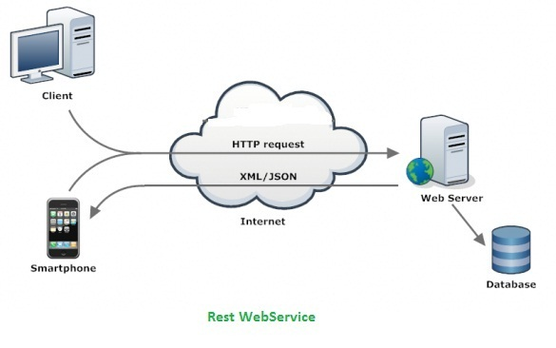
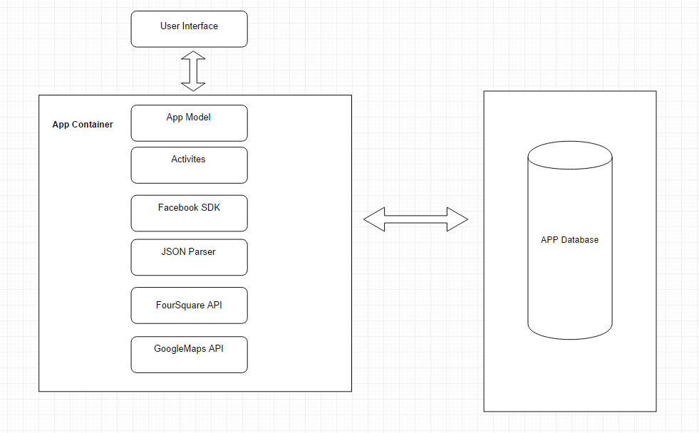
System Overview – Cont.
Restful Architecture
System Architecture

Slide 6
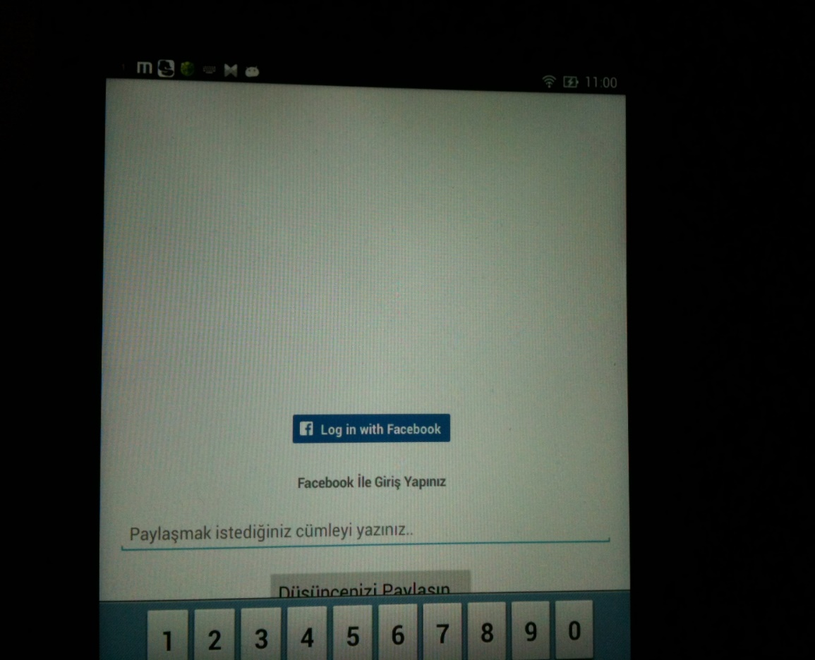
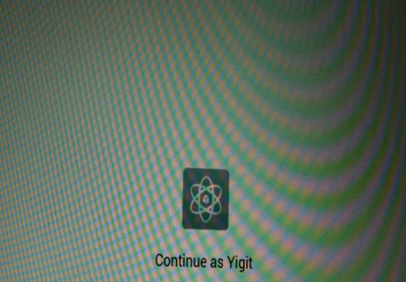
Human Interface Design
Login Activity
Login Activity – Cont.

Slide 7
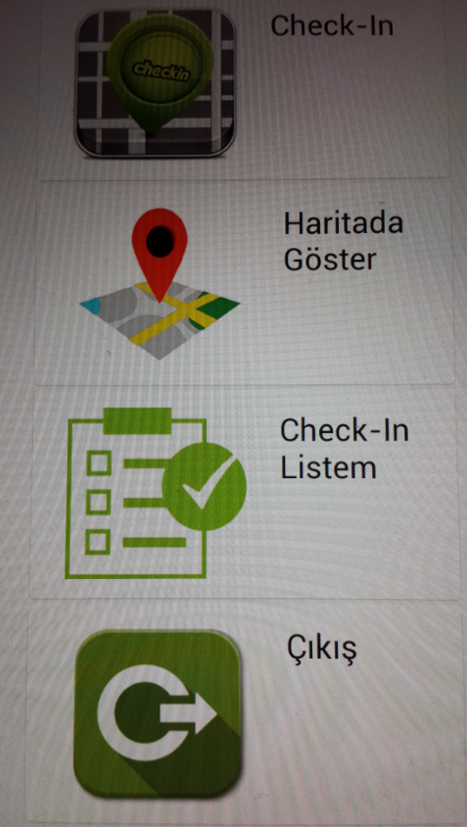
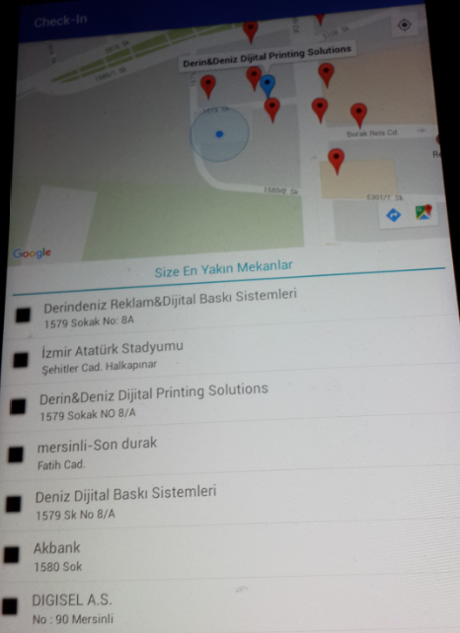
Human Interface Design – Cont.
Menu Activity
Nearby Located Places Activity

Slide 8
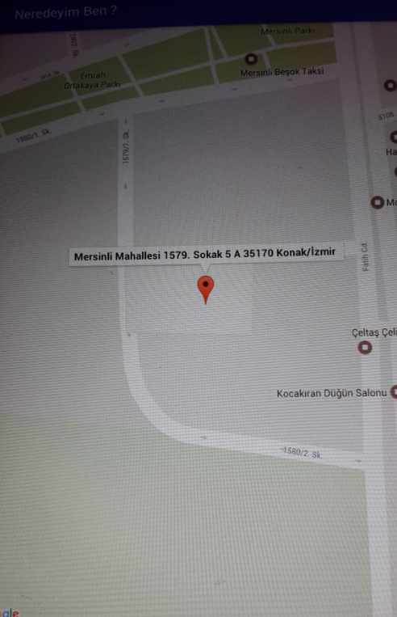
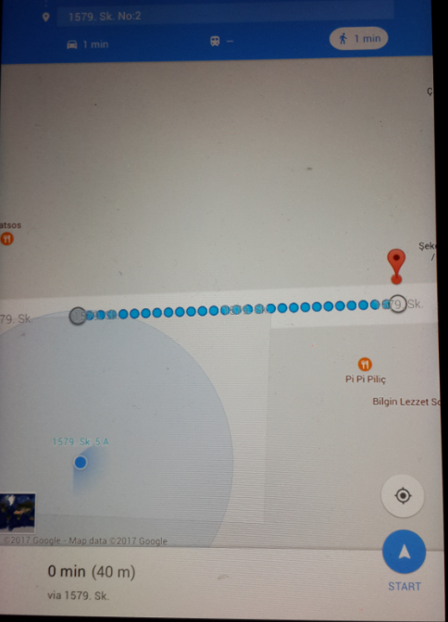
Human Interface Design – Cont.
Nearby Located Places Activity – Cont.
Show Me Where I’m Activity

Slide 9
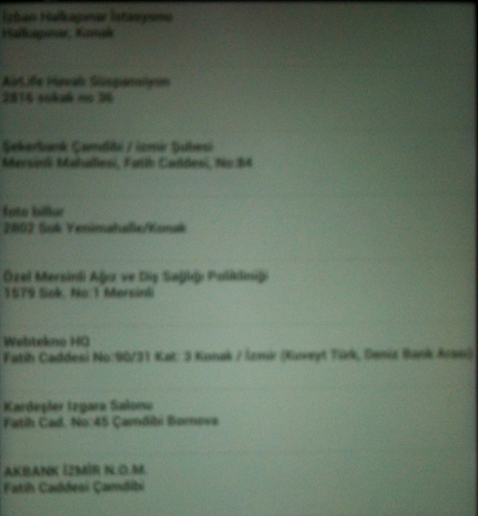
Human Interface Design – Cont.
Check-Ins Activity

Slide 10
Functional Requirements
When client selects any place which is fetched via FourSquare API, app will demonstrate where it is located in and
a way to go via GoogleMaps.
When client hits Where I’m link in Menu Activity, app will demonstrate where he/she is.
When client tends to use that app, client is required to complete log-in with social media account constrain.
When client tends to keep track previously visited place, client is required to complete check-in option

Slide 11
Nonfunctional Requirements
Portability : App is written in Java language so it is runnable wherever JVM is installed which enables app to be
platform independent.
Extensibility : App is open to make any feature when it is required.
Privacy : Client is anticipated to agree with facebook login so ,fields for database operation such as email
address ,telephone number, name and so forth.
Usability : App is merely run in Android devices.
Response Time : Render of map with places is viable thru FourSquare API and GoogleMaps. Callback operation
will be coped with FourSquare which makes app so rapid.

Slide 12
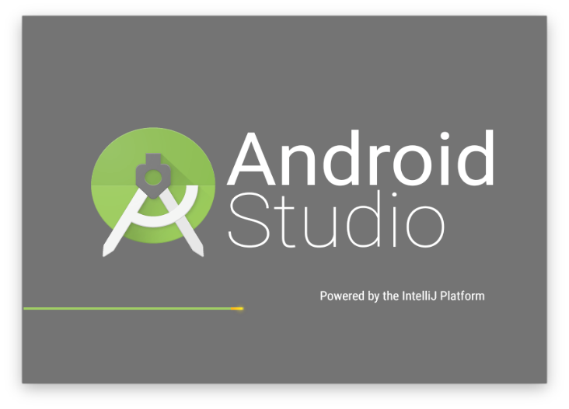




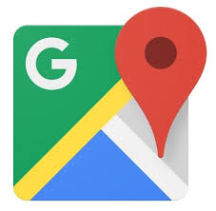
Technologies Used During The Development

