Slide 1
Github

Slide 2
What is Version Control System
Version control is a system that records changes to a file or set of files over time so that you can recall specific versions later.
In Version Control System, below data of project will be stored
Source code
Documentation
Reports
Etc…
There are two types of VCS
Centralized VCS – old approach – CVS, perforce
Distributed VCS – new approach - git

Slide 3
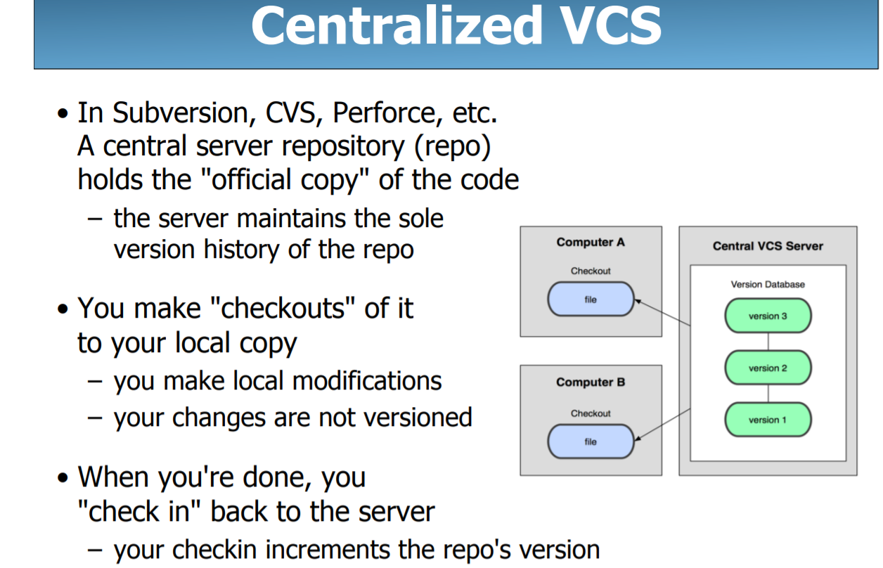

Slide 4
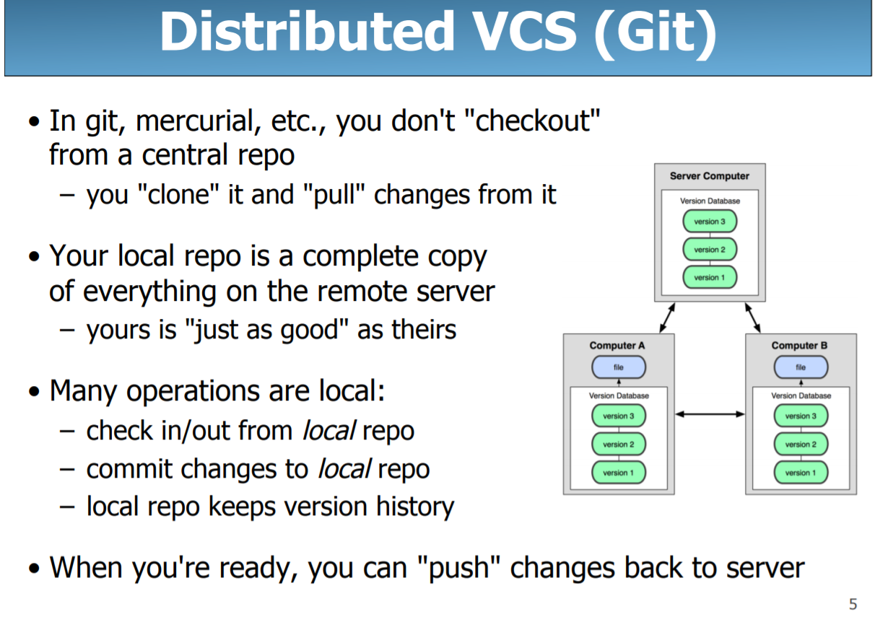

Slide 5
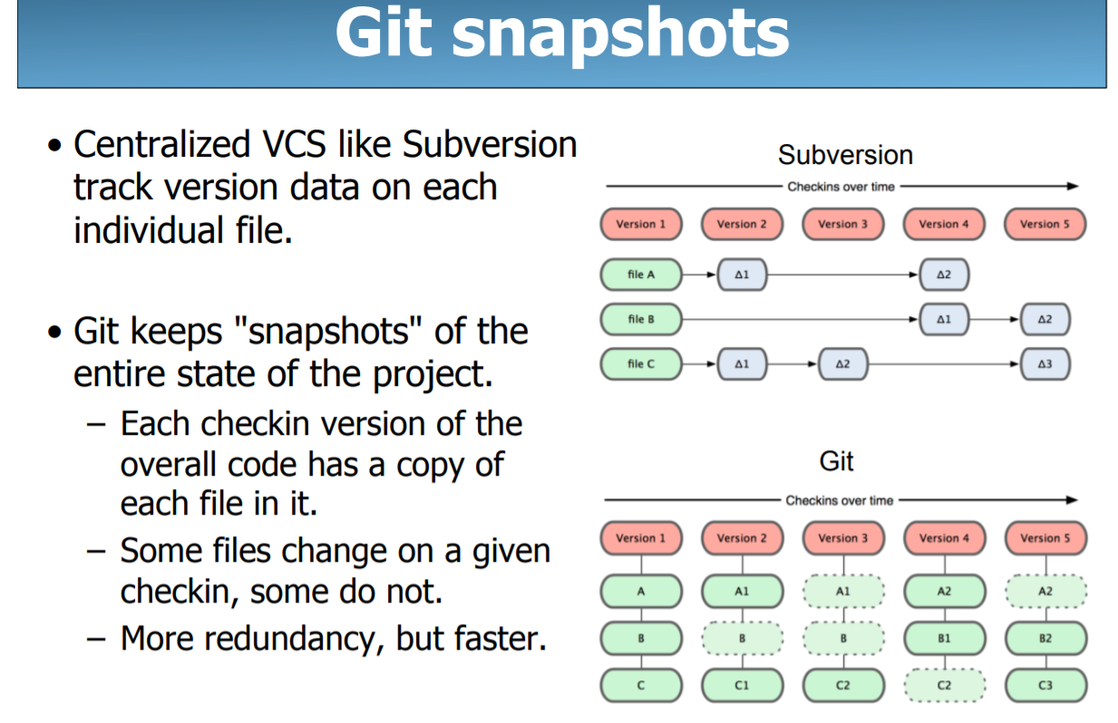

Slide 6
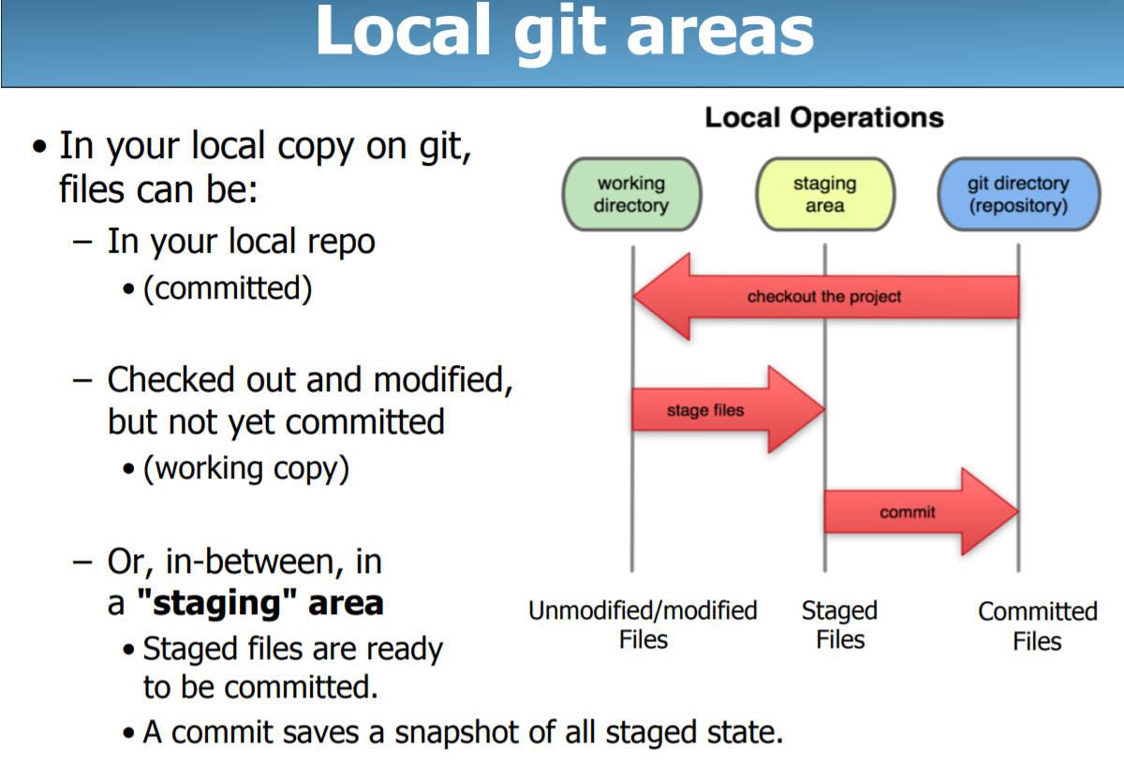

Slide 7
How to install Git
To install Git Client on windows visit below URL
https://git-scm.com/download/win
Download and complete installation
After installation ensure that the above installation path is added to PATH environment variable

Slide 8
How to add a project to GitRepository
Create account by visiting https://github.com
Now, login to above Account and create a repository with a name sampledb
On your System identify the project which you want to check in to above repository. See that the root path of above project is current directory

Slide 9
How to add a project to GitRepository
git init //this creates .git folder in the folder
git add .
git add myfile.txt – to add a specific file
git commit -m "second commit“
git remote add origin https://github.com/iihtsba/secondrepo.git
git push -u origin master
Now it asks for username and password of your Github account, provide the same to complete the Push
Once pushed, you can visit https://github.com/vskreddy652/ and check if the above pushed code exists.

Slide 10
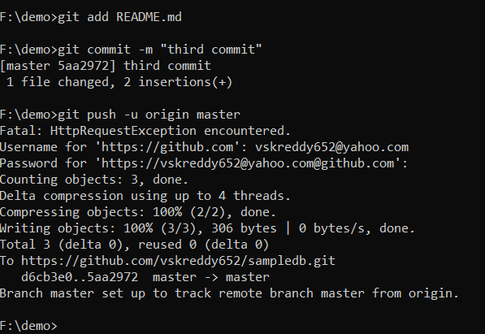
How to Check in Changes in a file?
Below we are checking in README.md after it got changed locally. As shown below, git add, commit & push commands need to be repeated
Multiple files can be added at a time
git add A.java B.java C.java
Repeat above steps even to commit & push changes of an existing file

Slide 11
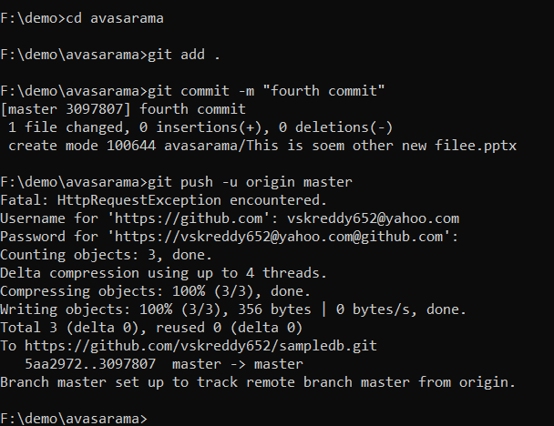
How to Check in Changes in a folder?
Sometimes new files may get added to local folders, and content of existing files may be updated, below are steps to be followed to checkin the same to Github public repository.
See that you are in current directory, whose changes need to be checked in(Assuming that this folder was already checked in initially, and here we are focusing only on changes)

Slide 12
Tracked and Untracked Files
git add .
//to track all files/folders in current directory, recursively
git add Abcd.java
//to track a specific file
git add folder
//to recursively track a folder

Slide 13
.git Folder
As known .git folder gets created once the “git init” command is invoked. This folder maintains locally all information related to Version Management.

Slide 14
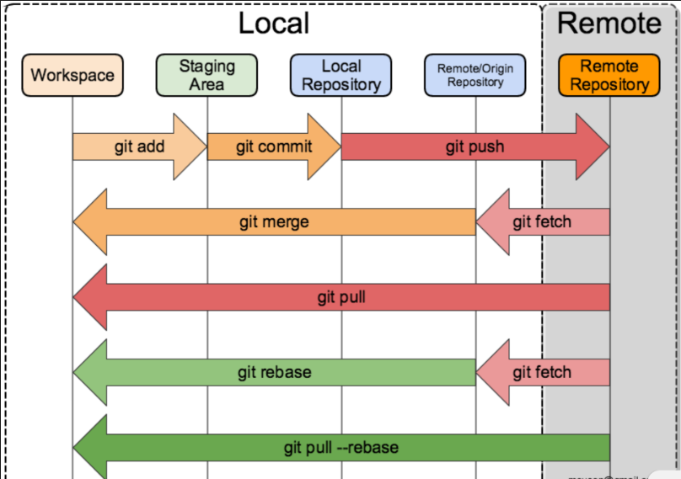
Pictorial representation of Commands
Various commands which make changes to local, remote repository

Slide 15
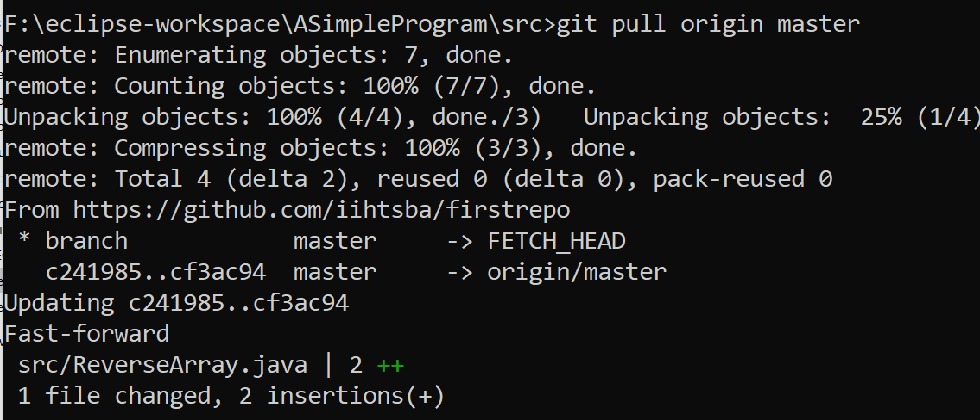
What is Git Pull?
git pull command is used to fetch and download content from a remote repository and immediately update the local repository to match that content.
On Github, in our repository, select some file, Click Edit and Make some changes to the file.
Commit that file, by pressing Commit button on github
Now run, git pull origin master

Slide 16
What is Git Cloning?
"clone" command downloads an existing Git repository to your local computer.
You will then have a full-blown, local version of that Git repo and can start working on the project
Use below command to clone a Public repository to your local system
git clone https://github.com/vskreddy652/sampledb.git
git clone url [dir]
Note: To clone a specific Tag refer next Topics

Slide 17
Git Checkout
If a file is changed locally, and these changes need to be ignored, you may checkout the file, to get the latest version of the file, so your local file changes will be lost
git checkout <file>
git checkout is to checkout your desired status of your repository (like branches or particular files).
E.g., you are currently on master branch and you want to switch into develop branch.
git checkout develop_branch
E.g., you want to checkout to a particular status of a particular file
git checkout commit_point_A -- <filename>

Slide 18
How to create Tag
Like most VCSs, Git has the ability to tag specific points in history as being important. Typically people use this functionality to mark release points (v1.0, and so on).
Below is command for the same
git tag <tagname>
If you want to include a description with your tag, add -a to create an annotated tag:
git tag <tagname> -a
To Push Tag to remote repository
git push origin <tagname>
//generally each release is considered as a tag
Now verify in online repository that a tag/releases is created. Now anyone can
push the commits in the local branch named master to the remote named origin". Once this is executed, all the stuff that you last synchronised with origin will be sent to the remote repository and other people will be able to see them there.

Slide 19
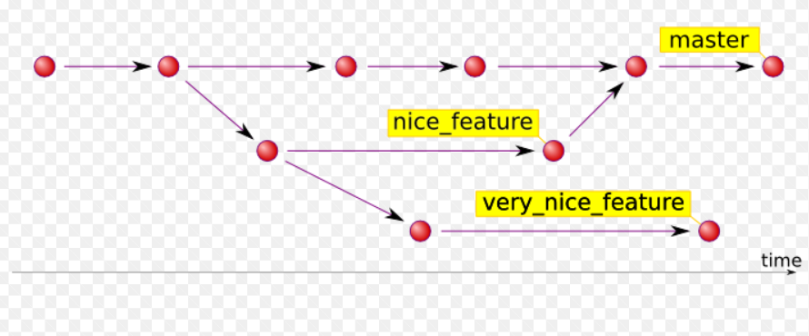
How a Tag looks like

Slide 20
How to List Tags
List all the available Tags
git tag
List all the Tags of specific Pattern
git tag -l “v1.3*”
Tags can also include a more descriptive tag-message or annotation
git tag -a v1.0.0
Executing this command you will create a new annotated tag identified with version v1.0.0
Lightweight tags are the simplest way to add a tag to your Git repository because they store only the hash of the commit they refer to. They are created with the absence of the -a, or -m options and do not contain any extra information. Below is an example
git tag v1.0.0

Slide 21
How to checkout a Tag
$ git clone
will give you the whole repository.
After the clone, you can list the tags with
$ git tag -l and then checkout a specific tag:
$ git checkout tags/<tag_name>
Even better, checkout and create a branch (otherwise you will be on a branch named after the revision number of tag):
$ git checkout tags/<tag_name> -b <branch_name>

Slide 22
Update a Tag Name
Step 1: Create a new tag on the same commit point of old tag and push it,
git tag new_tag old_tag
git push --tags
Step 2: Delete the old tag from local repo.
git tag -d old_tag
Step 3: Delete the old tag from remote repo.
git push origin :refs/tags/old_tag
You can verify the changes made, by executing the below command. It shows all remote tags:
git ls-remote --tags origin

Slide 23
Update a Tag
To update reference of a Tag:
if your remote is called origin and you're working on master branch:
git tag -d <tagname>
git push origin :refs/tags/<tagname>
git tag <tagname> <commitId>
git push origin <tagname>
Line 1 removes the tag in local env.
Line 2 removes the tag in remote env.
Line 3 adds the tag to different commit
Line 4 pushes the change to the remote

Slide 24
Tag - Difference
git diff tag1 tag2
or show log between them:
git log tag1..tag2
to see only the list of files that were changed:
git diff tag1 tag2 --stat
and then look at the differences for some particular file:
git diff tag1 tag2 -- some/file/name

Slide 25
Tag a specific commit id
git tag V2.0 048cd4c
V2.0 is tag name
048cd4c is commit id, for which tag is created

Slide 26
How to create a Branch
Use the branch command with a name to create a new branch with that name.
//Create a new branch named issue1.
$ git branch issue1
If you do not specify any parameters, the branch command will list all branches that correspond to this repository. The asterisk indicates the current active branch.
$ git branch issue1 * master
$ git checkout issue1
//checkout is used to switch between repositories
---make changes to the file(s), add & commit the file
$ git checkout master
$ git merge issue1
//issue1 changes are merged to master branch
$ git push origin master
//changes are pushed to live repository
To delete a branch:
git branch -d somebranch //to delete the branch
To create and select it as current branch:
git branch -b somebranch
List of Branches

Slide 27
What is a Conflict
Conflict can arise when Multiple branches are used.
A ‘conflict’ arises when the commit that has to be merged has some change in a line N, and the current commit also has a change in the same line.
Git will not be able to predict which change should take precedence.
We need to manually solve the conflict.
Conflict can also occur when a change is done to a file on one branch, and the same file is deleted by other branch, and when these changes are commited.

Slide 28
Steps to create a Merge Conflict
G:\git_removeme9\secondrepo>git branch
* master
G:\git_removeme9\secondrepo>git branch brnch11
G:\git_removeme9\secondrepo>git branch
brnch11
* master
G:\git_removeme9\secondrepo>git checkout brnch11
Switched to branch 'brnch11'
G:\git_removeme9\secondrepo>git checkout master
M src/com/abc/Login.java
Switched to branch 'master'
Your branch is up-to-date with 'origin/master'.
G:\git_removeme9\secondrepo>git checkout brnch11
M src/com/abc/Login.java
Switched to branch 'brnch11'
G:\git_removeme9\secondrepo>git add src/com/abc/Login.java
CHange a line in file Login.java

Slide 29
Steps to create a Merge Conflict
G:\git_removeme9\secondrepo>git commit -m "commented import"
[brnch11 cfd9f37] commented import
1 file changed, 1 insertion(+), 1 deletion(-)
G:\git_removeme9\secondrepo>git checkout master
Switched to branch 'master'
Your branch is up-to-date with 'origin/master'.
G:\git_removeme9\secondrepo>git add src/com/abc/Login.java
G:\git_removeme9\secondrepo>git commit -m "changed import package"
[master f766996] changed import package
1 file changed, 1 insertion(+), 1 deletion(-)
G:\git_removeme9\secondrepo>git merge brnch11
Auto-merging src/com/abc/Login.java
CONFLICT (content): Merge conflict in src/com/abc/Login.java
Automatic merge failed; fix conflicts and then commit the result.
G:\git_removeme9\secondrepo>
Make some other change to same line or delete the line

Slide 30
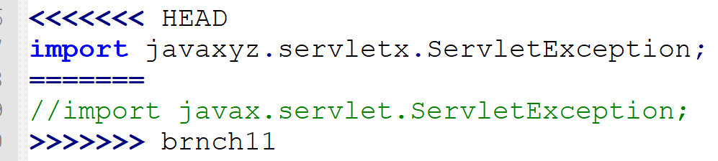
Merge Conflict File
Make changes to the file accordingly, again add/commit the file, and perform merge & push accordingly.
If you do not need branch further, you can delete it using git branch –d “branch_name”

Slide 31
Merge Conflict during pull
remove a line in a file locally
git add, commit & push
Make change to above line on github
Now pull latest changes from github using below command
git pull origin master

Slide 32
Multiple Users
Try to commit/push changes from other users, and explore on how to collaborate on a Single Repository

Slide 33
How to delete files
Remove a file
git rm <file_name>
For remvoal to take effect in Remote Repository, you need to commit & push as usual
To forcible remove a file, i..e to delete even though the changes in it is pending in the stage
git rm –f <file_name>
To remove multiple files
git rm <file1> <file2> <file3>
To recursively delete files in a folder
git rm -r folder-name
To undo the changes you have done in your working directory
Git checkout <file_name>

Slide 34
Git status
The git status command displays the state of the working directory and the staging area.
It lets you see which changes have been staged, which haven't, and which files aren't being tracked by Git.
Status output does not show you any information regarding the committed project history.
Check the status after
Creating an untracked file
Use git add on above file
Make changes to above file, add again
Remove file
Etc…

Slide 35
Git reset
Roll back changes, undo a local commit and restore the development environment to an earlier and possibly more stable state. For traversing the commit history and rolling back to a previous state, you'll need the git reset hard command.
git reset --hard ebbbca3
https://www.theserverside.com/video/How-to-use-the-git-reset-hard-command-to-change-a-commit-history

Slide 36
Git rebase
Rebasing is a common way to integrate upstream changes into your local repository. Pulling in upstream changes with Git merge results in a superfluous merge commit every time you want to see how the project has progressed. On the other hand, rebasing is like saying, “I want to base my changes on what everybody has already done.”

Slide 37
Git log
To see the history of commits, use the command git log. It provides a list of all of the commits made on our branch with the most recent commit first.
Type git log
Press q. You can press the up or down arrows or press enter to view additional log entries. Type q to quit viewing the log and return to the command prompt.
Type git log -5 to only see the last 5 commits.
Type git log --oneline
Type git log --oneline --graph
Type git log --oneline --graph --decorate
Type git log --oneline --graph --decorate --all
Type git log --stat
Type git log --patch

Slide 38
Git diff
This command is used to find difference between files.
git diff
git diff HEAD // compare the working directory with local repository.
git diff [filename] // compare the working directory with index.
git diff --cached [filename] // compare the index with local repository.
You can also compare files between two different commits. Every commit in Git has a commit id which you can get when you give git log. Then you can use the commit id if diff command like this.
git diff 7eb2..e03 812...a3f35

Slide 39
Git Config related
Below commands can be used when you want to clean up config which has username/password, and when you need to be force asked username/password for commands such as “git push” etc..
git config --system --unset credential.helper
git config --global --unset credential.helper
git config --local --unset credential.helper
git config --local credential.helper ""

Slide 40
Git mv
Git mv is used to rename or move a file, below is the sequence of steps to make these changes in Remote Repository
git mv -v ServletLifeCycleEg.java Qrst.java
git commit -m "fdfdf“
git push -u origin master

Slide 41
Git Stash
In Git, the stash operation takes your modified tracked files, stages changes, and saves them on a stack of unfinished changes that you can reapply at any later point of time.
How to Stash
#1. Making a change to one or more tracked files
#2. Use below command to stash above changes
git stash
Once stashed, all the changes made to the files, are removed, now open and observe the file, whose content you have changed.
Can we stash multiple times
Yes. After above stashing is done, now make some other changes to one or more files. Again run “git stash”

Slide 42
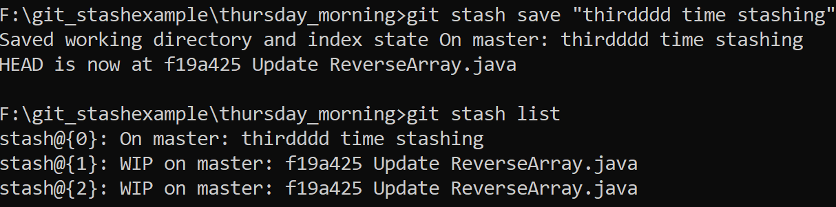
Git Stash
How to Apply contents of the last stash?
Below command can be used for the same
git stash pop
When multiple stashes are done, how to view list ?
git stash list
How stash list be made more descriptive?
It is possible by annotating the Stash

Slide 43
Git Stash Pop
By default, git stash pop will re-apply the most recently created stash: stash@{0}
You can choose which stash to re-apply by passing its identifier as the last argument, for example:
$ git stash pop stash@{2}
To view diff between Stashes
git stash show -p
To view contents of file as per a specific stash
git show stash@{0}:src/MainApp.java

Slide 44
Git Stash Pop - Conflict
Steps:
Edit File Abcd.java
git stash
Edit File Abcd.java
git stash
git stash pop
//Again if “git stash pop” is executed, conflict occurs
git add Abc.pop, commit it
git stash pop //Now this will work fine

Slide 45
Partial Stashes
You can also choose to stash just a single file, a collection of files.
If you pass the -p option (or --patch) to git stash, it will iterate through each changed "hunk" in your working copy and ask whether you wish to stash it:
To interactively select the changes that you want to stash use below command:
git stash -p

Slide 46
Create Branch From Stash
This checks out a new branch based on the commit that you created your stash from, and then pops your stashed changes onto it.
$ git stash branch add-stylesheet stash@{1} Switched to a new branch 'add-stylesheet' On branch add-stylesheet Changes to be committed: new file: style.css Changes not staged for commit: modified: index.html Dropped refs/stash@{1} (32b3aa1d185dfe6d57b3c3cc3b32cbf3e380cc6a)
Clean up Stash: Incase you do not need a stash
git stash drop stash@{1}
To delete all Stashes:
git stash clear

Slide 47
Stash untracked files
It is possible to stash untracked files as well. Follow below steps to see this working.
#1. In local repo make some changes to a file.
#2. Create a file and do not make it tracked file
#3. Use below command to
git stash --include-untracked
Now go and check the folder in which we have create new file. observe that file doesn’t exist
Now. pop it up
git stash pop
NOw check if that newly created file exists

Slide 48
Git Clean & gc
TBD

Slide 49
Misc
grep Print lines matching a pattern
log Show commit logs
show Show various types of objects
status Show the working tree status

