Slide 2
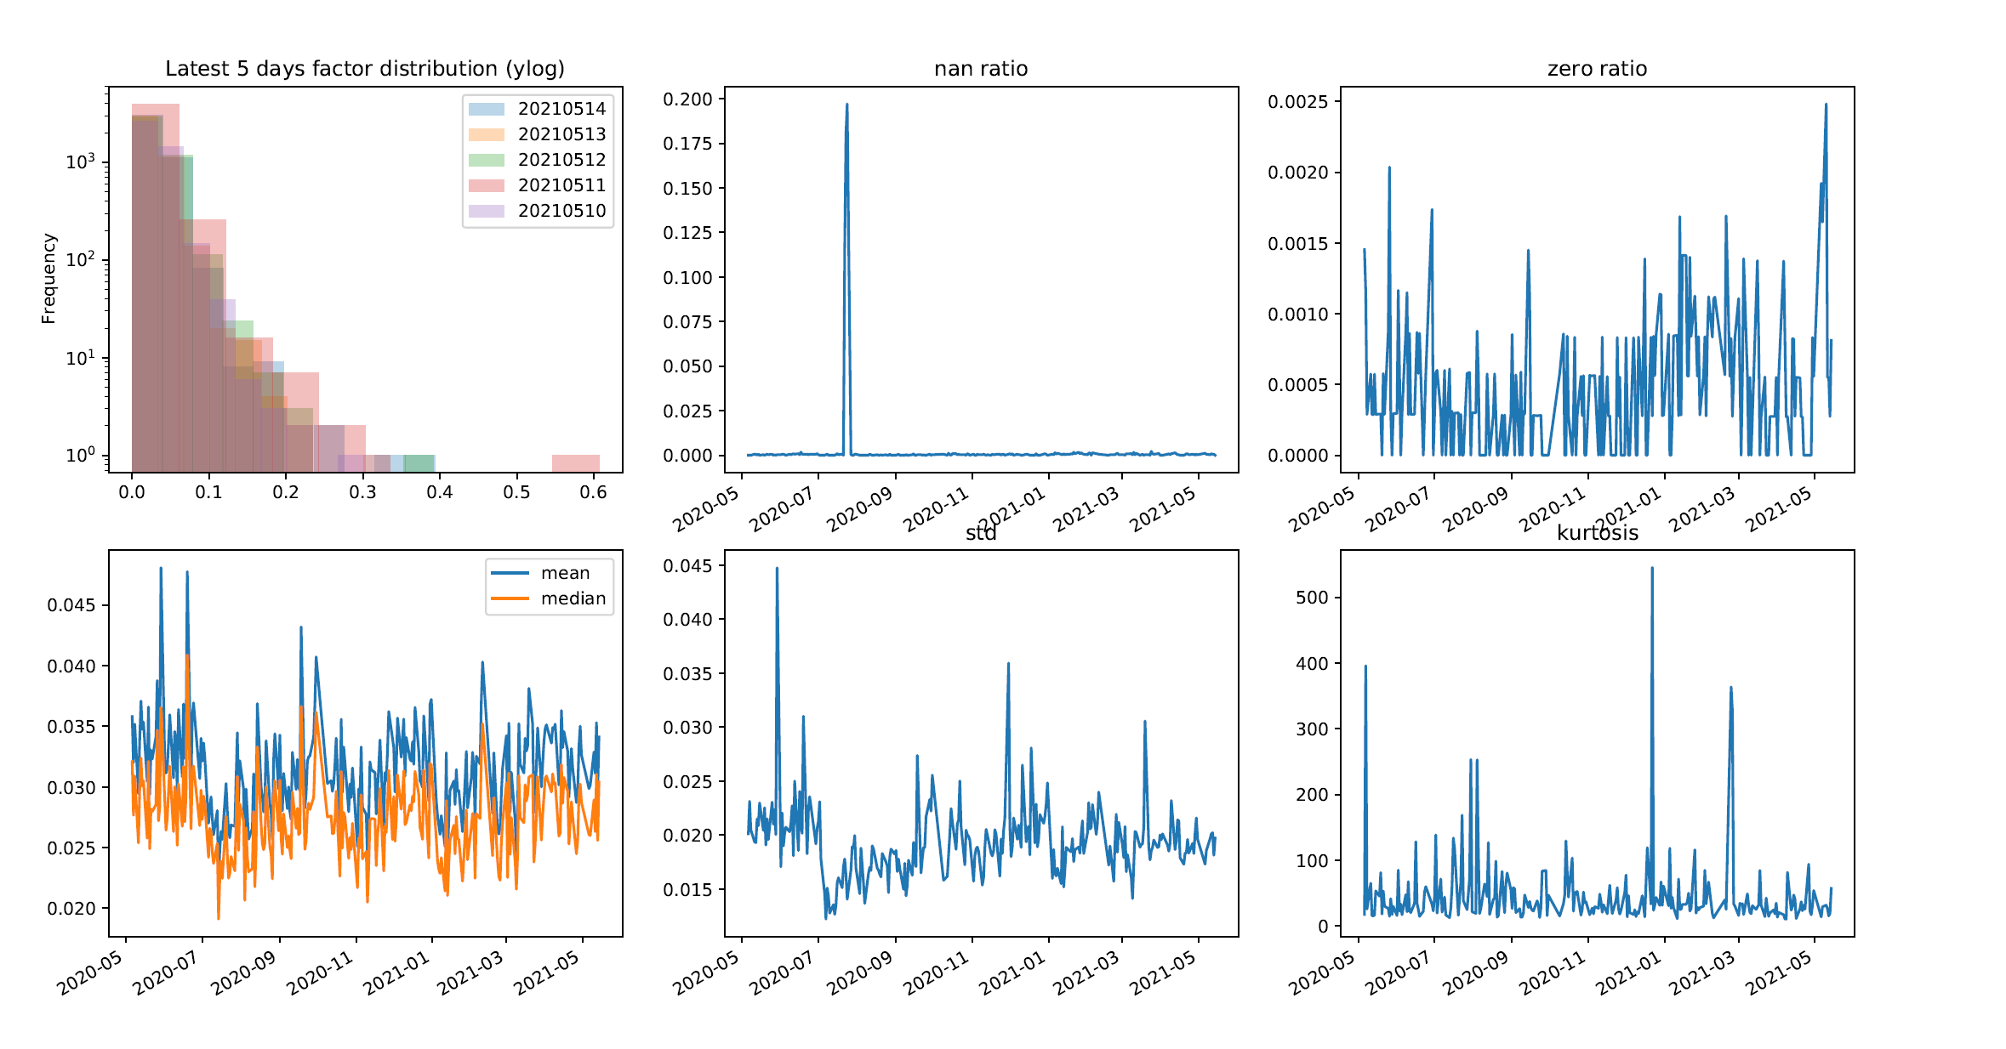
Back Test Result Preview factor distribution

Slide 3
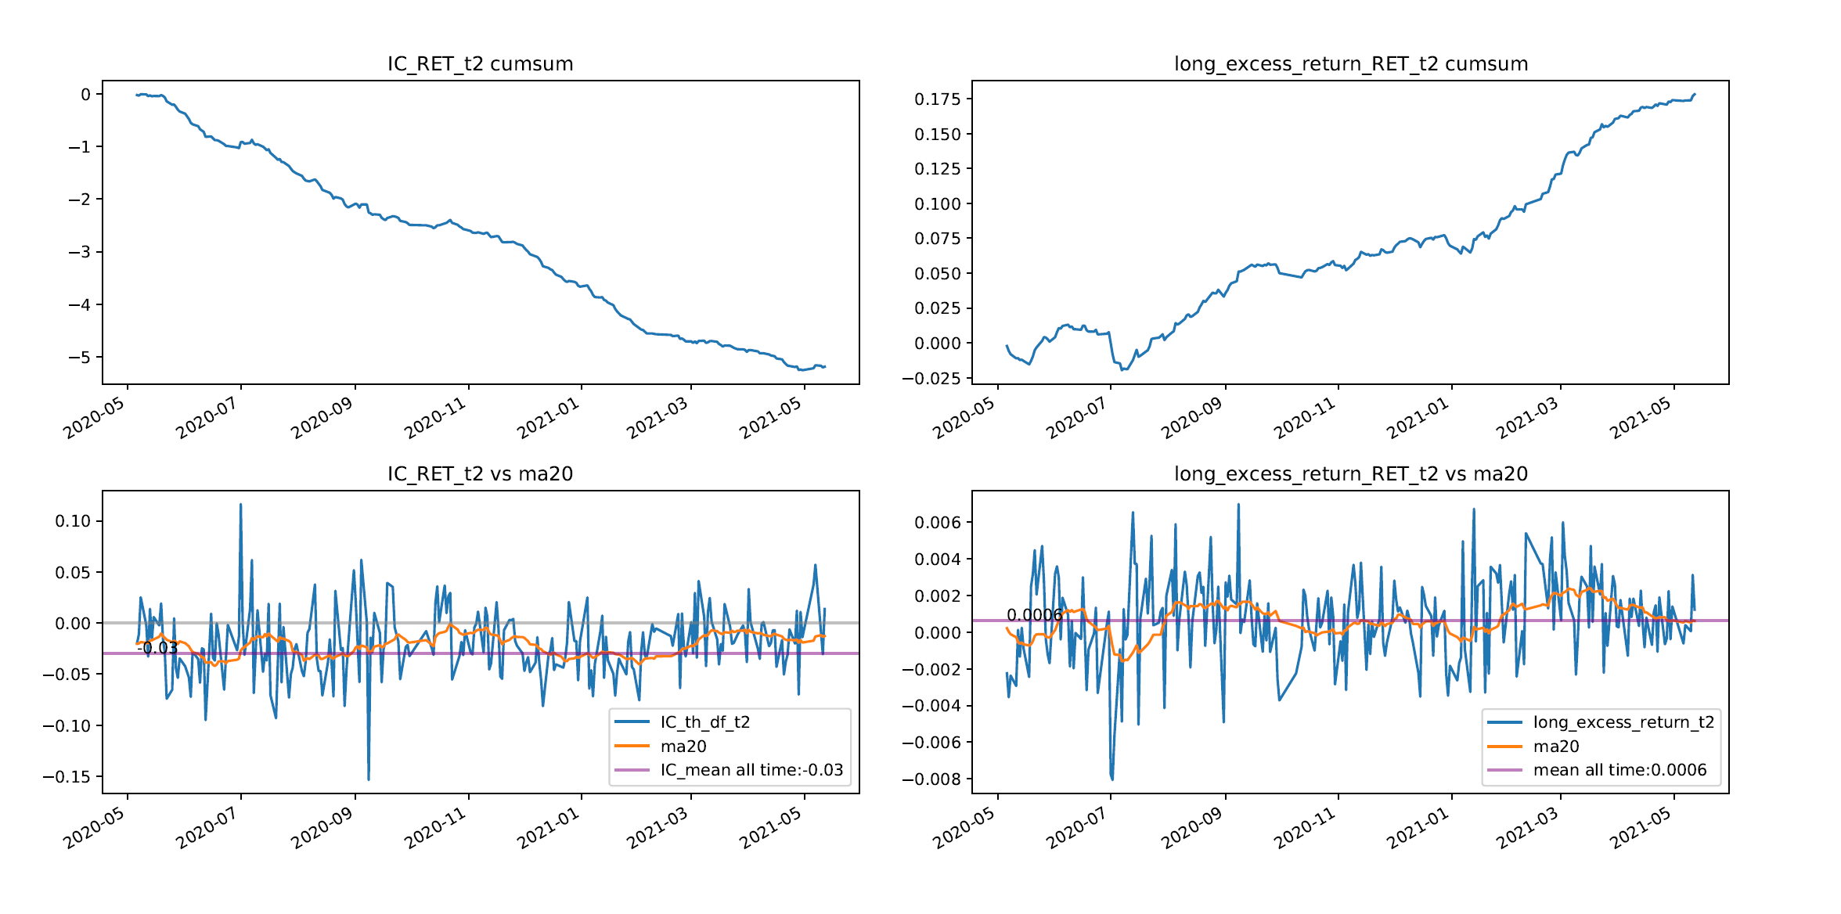
Back Test Result Preview IC & excess return

Slide 4
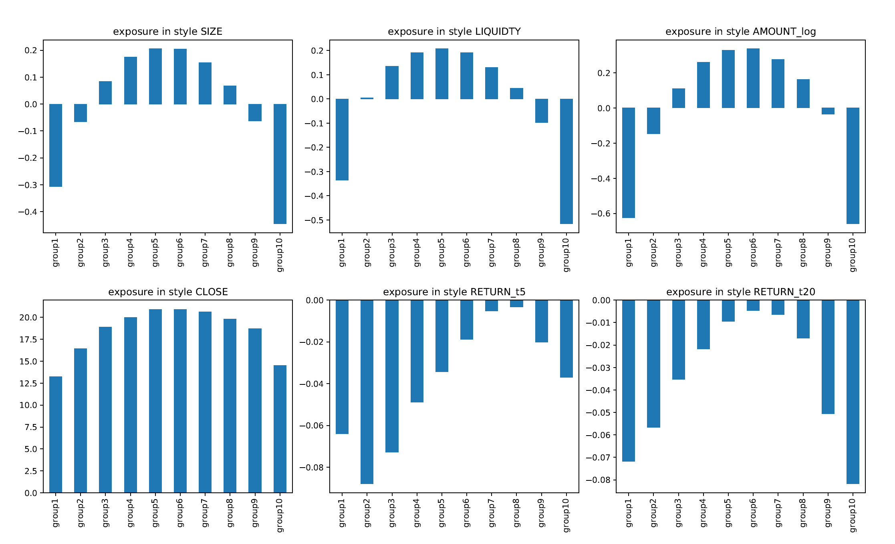
Back Test Result Preview style exposure analysis

Slide 5
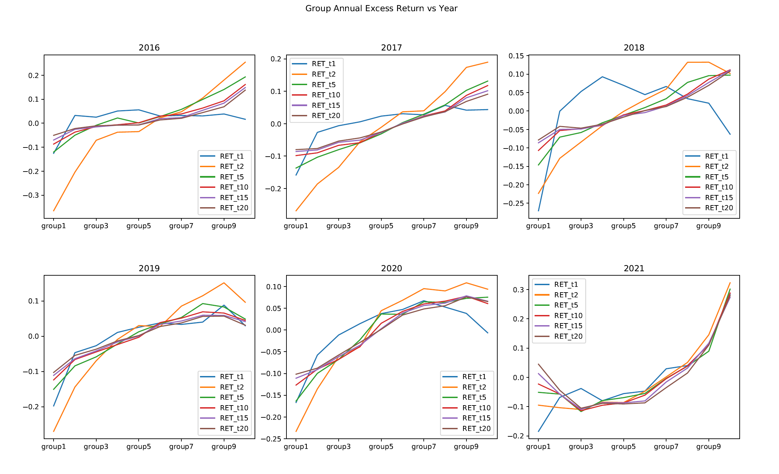
Back Test Result Preview group excess return

