Slide 1
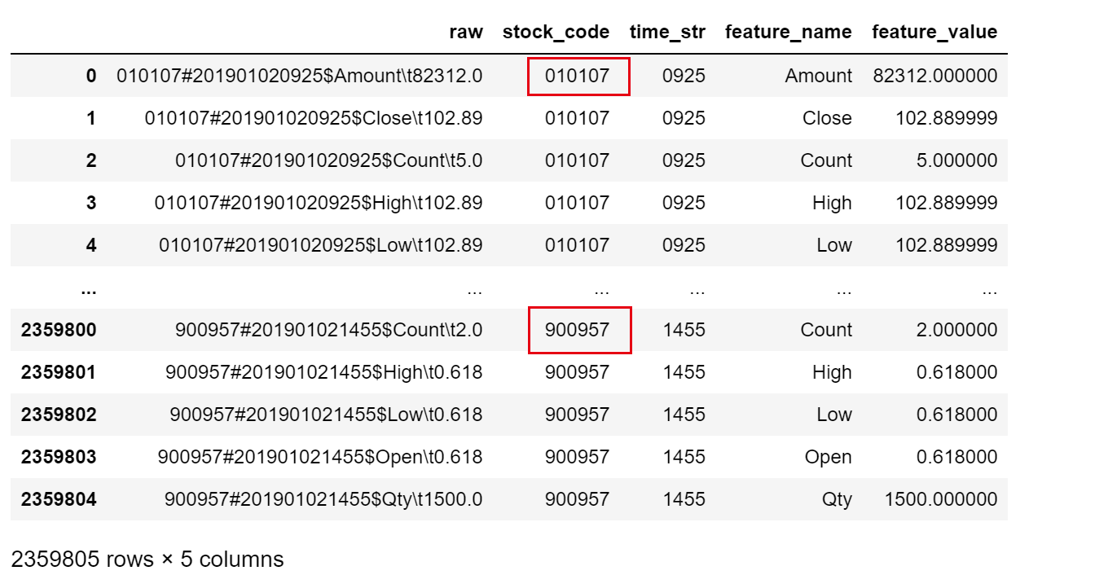
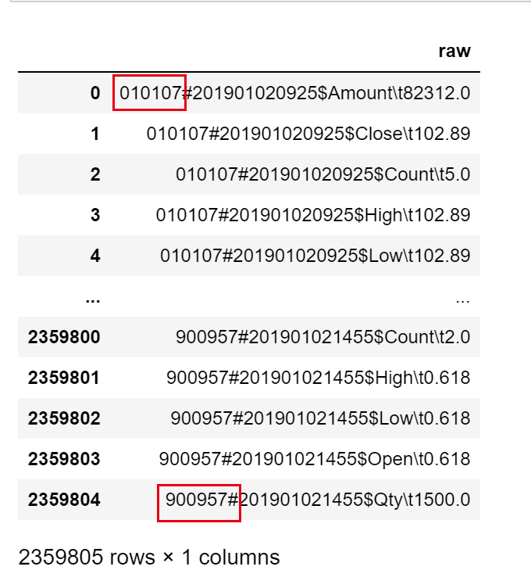
Data Preprocessing Map reduce output to 1min data
Raw data contains bonds information
We only use stock information
Drop useless row

Slide 2
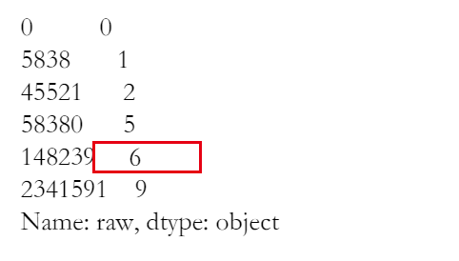
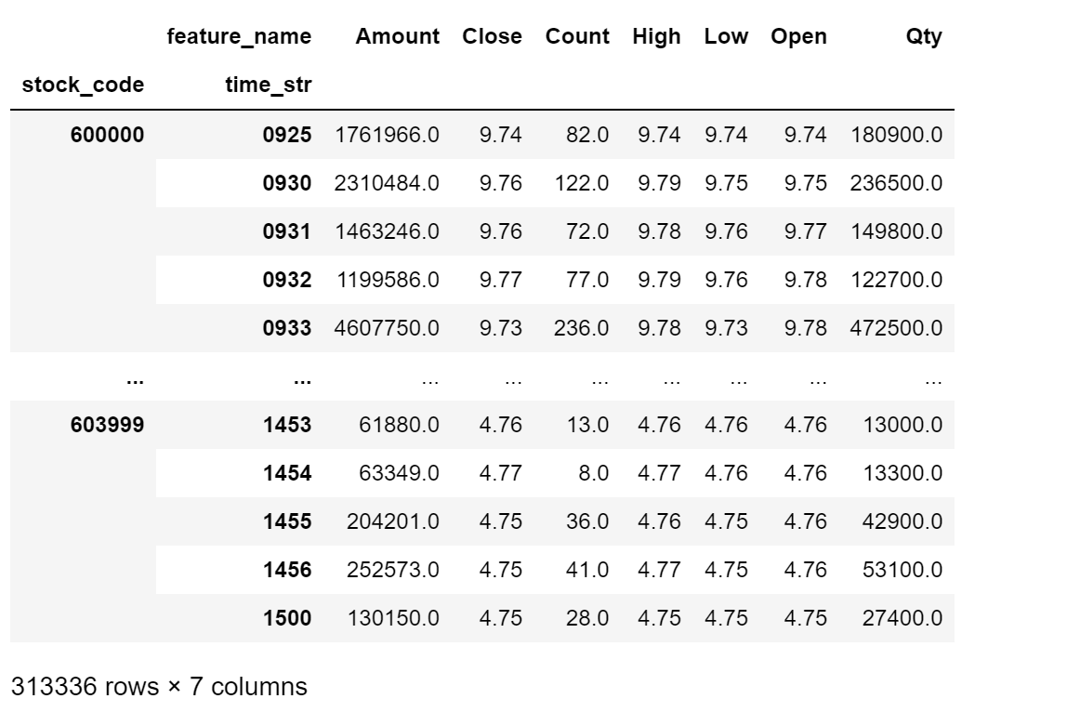
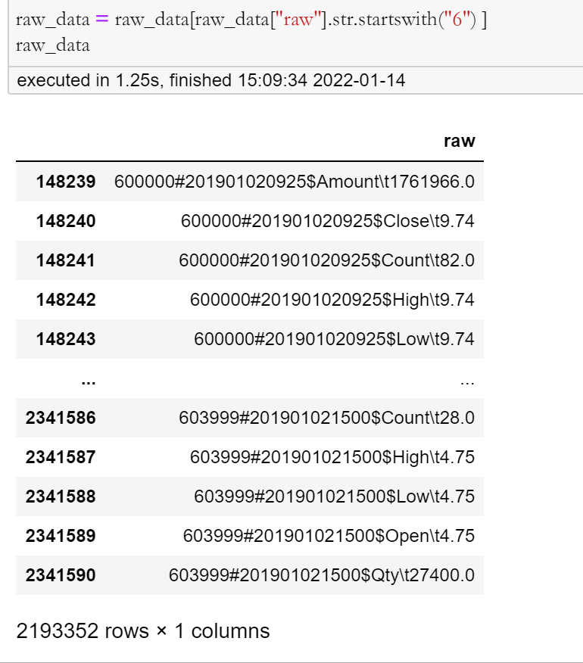
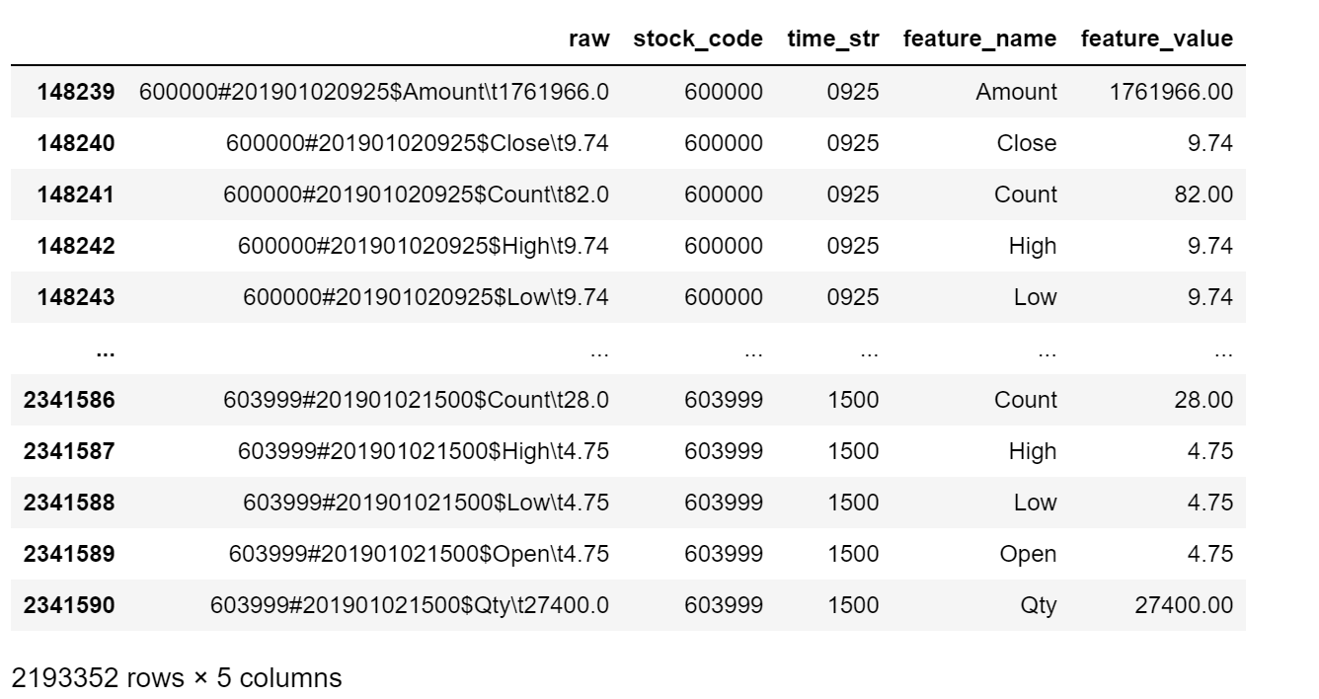
Data Preprocessing Map reduce output to 1min data
unique_code_str[0]

Slide 3
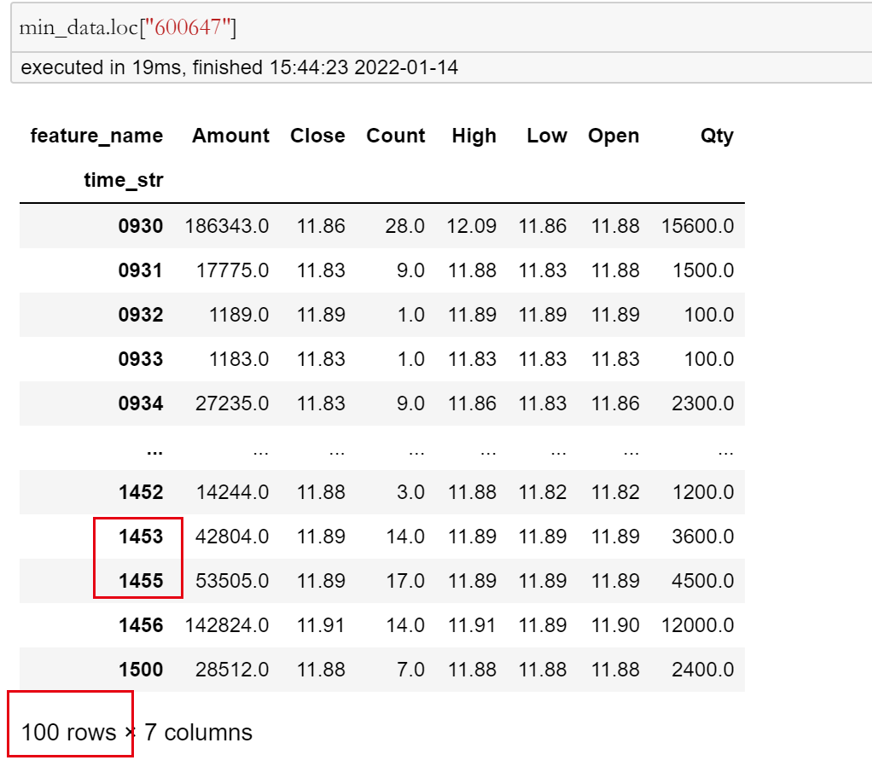
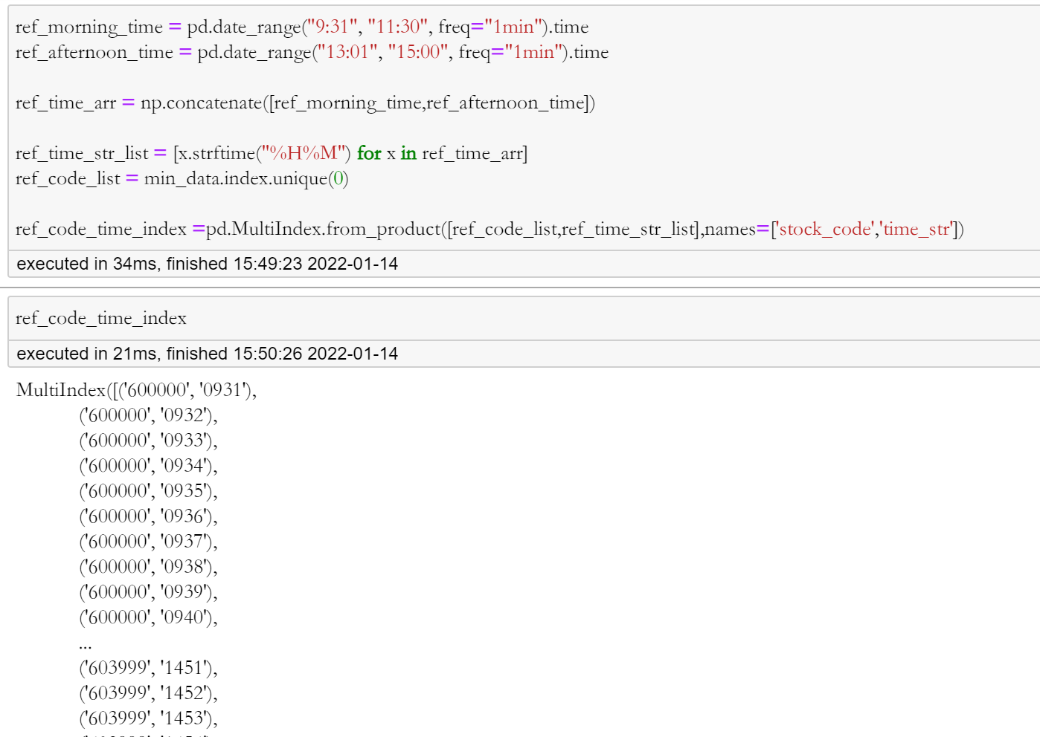
Data Preprocessing 1min data missing value
240 min per day
Need to fill the missing data
1. Prepare multiIndex for (stock_code,time_str)

Slide 4
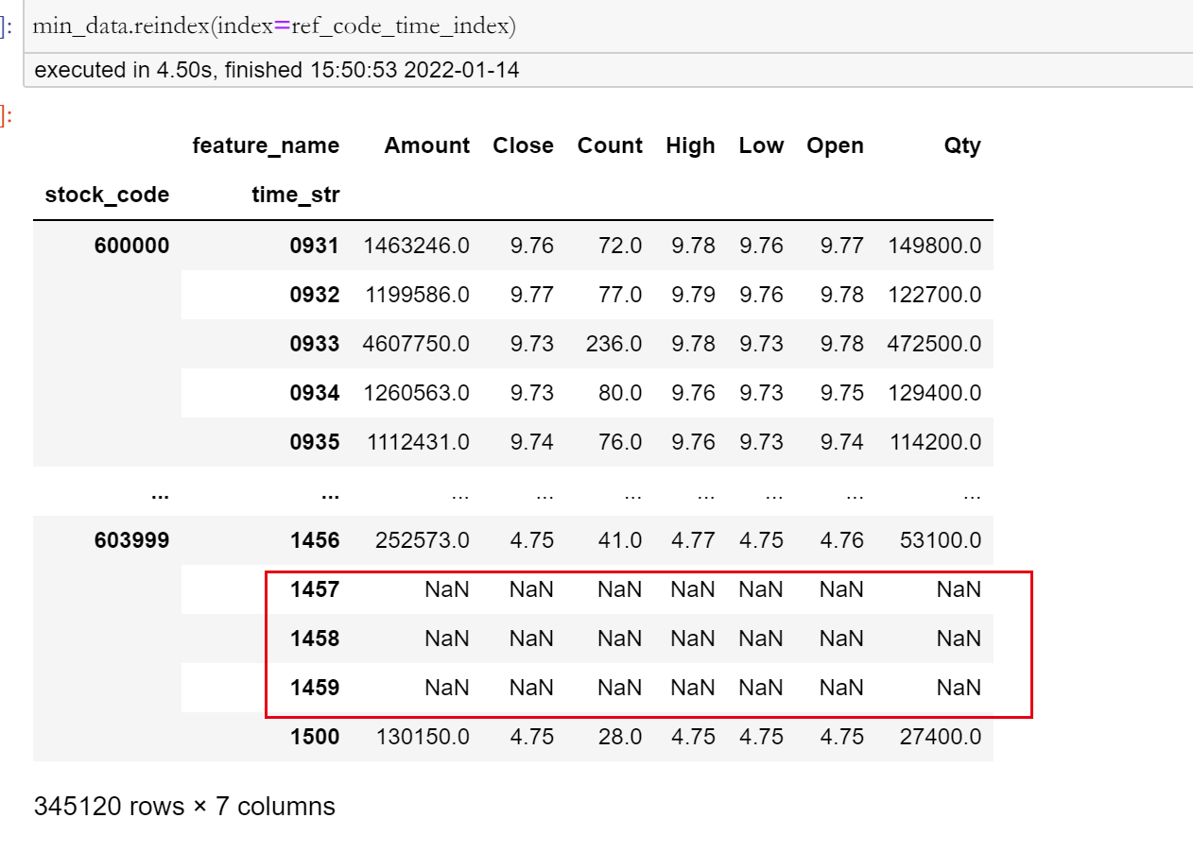
Data Preprocessing 1min data missing value
2, reindex data and get some nan rows

Slide 5
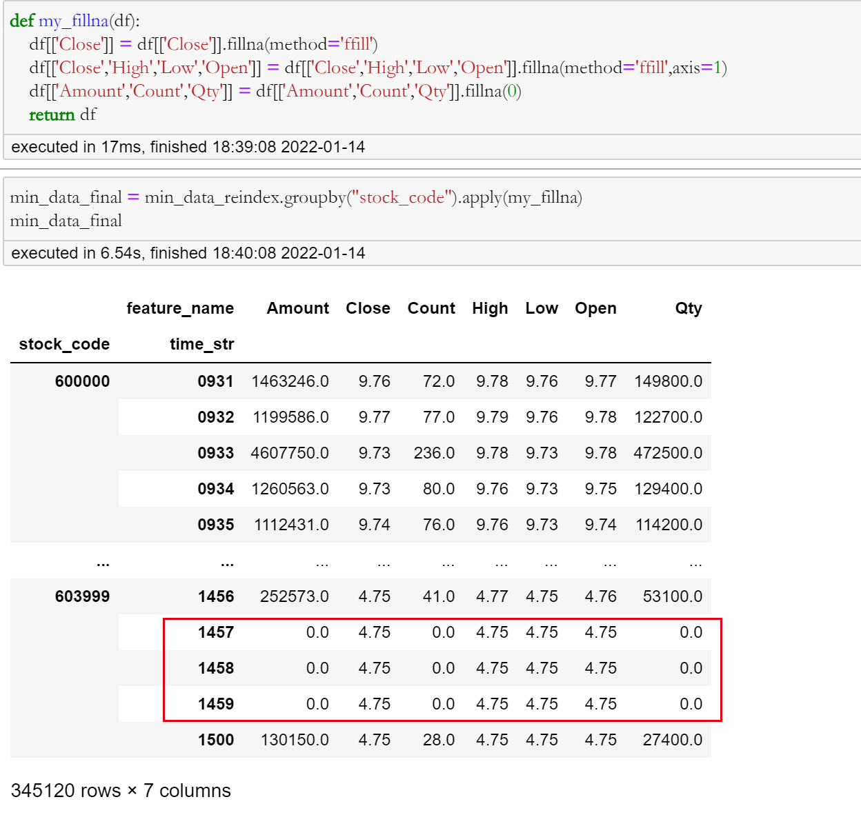
Data Preprocessing 1min data missing value
3, fillnan method:
amount: 0
Count: 0
Qty: 0
close high low open: preclose

Slide 6
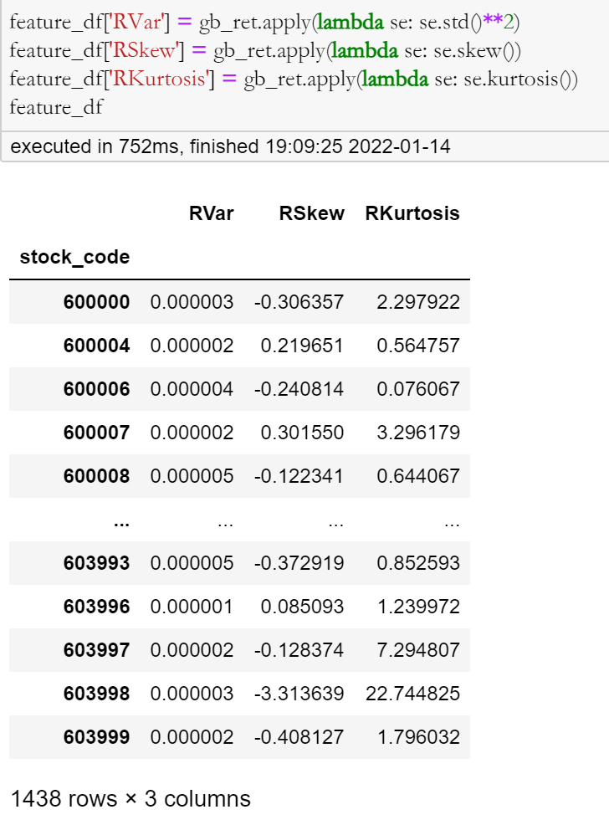
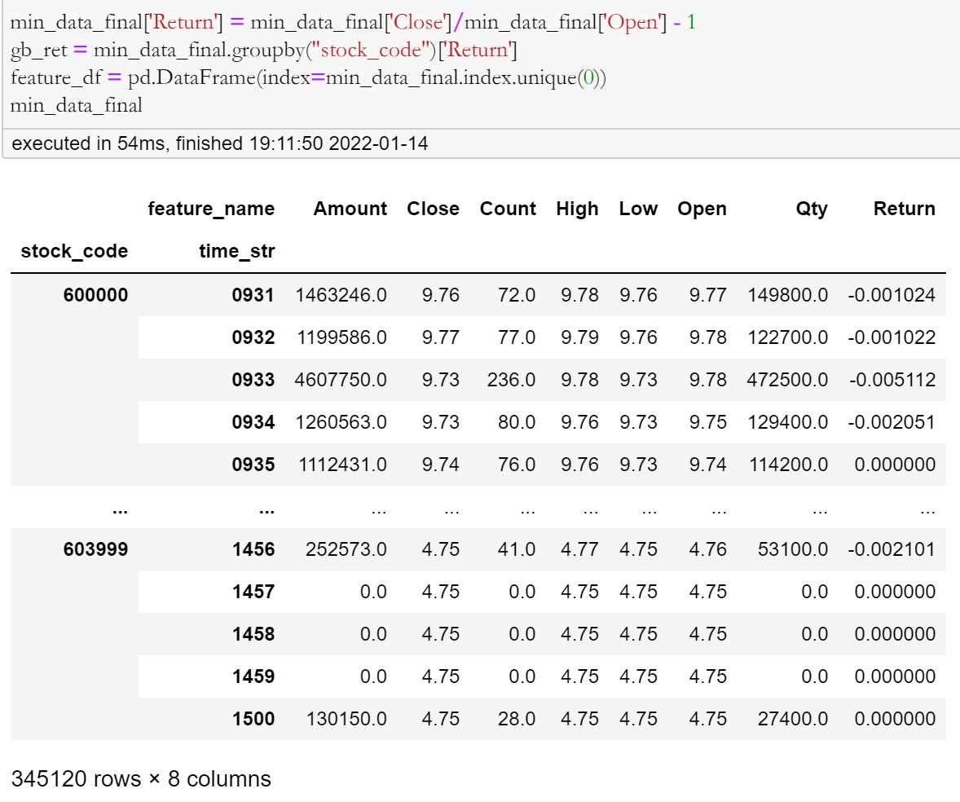
Feature Construction Demo

