Slide 1
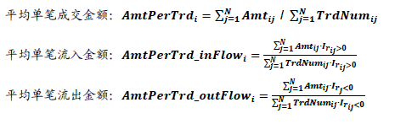
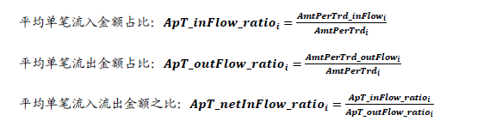
Average single transaction amount factor (平均单笔成交金额类因子)
Factor logic
There is a strong positive correlation between single transaction amount and stock market value
Rij：stock i return series in minute frequency
Amtij: trading volumn series
TrdNumij: trading number series
Irij: indicator of whether the return of stock is positive
Factor Construction:
Factor Expectation:
AmtPerTrdi is Positively correlated with the future return
AmtperTrd_inFlowi is Positively correlated with the future return
AmtPerTrd_outflow is Negatively correlated with the future return
ApT_netInFlow_ratioi is Positively correlated with the future return
Reference:(海通证券)选股因子系列研究——日内分时成交中的玄机

Slide 2
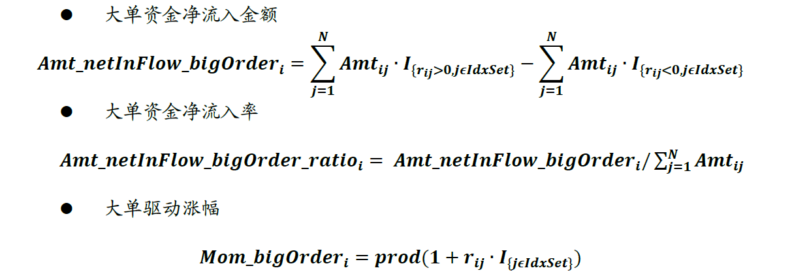
Large order capital flow factor(大单资金流向类因子)
Factor logic
Refer to the previous PPT for variable definition.
The minute K line is sorted by 𝑨𝒎𝒕𝑷𝒆𝒓𝑻𝒓𝒅𝒊𝒋 from high to low, and the first N (N=10%, 20%, 30%) K line is selected as a large order sample, the corresponding k-line serial number is 𝑰𝒅𝒙𝑺𝒆𝒕
Factor Construction:
Factor Expectation:
𝑨𝒎𝒕_𝒏𝒆𝒕𝑰𝒏𝑭𝒍𝒐𝒘_𝒃𝒊𝒈𝑶𝒓𝒅𝒆𝒓_𝒓𝒂𝒕𝒊𝒐𝒊 is Positively correlated with the future return
𝑴𝒐𝒎_𝒃𝒊𝒈𝑶𝒓𝒅𝒆𝒓𝒊 is Positively correlated with the future return
Reference:(海通证券)选股因子系列研究——日内分时成交中的玄机

Slide 3
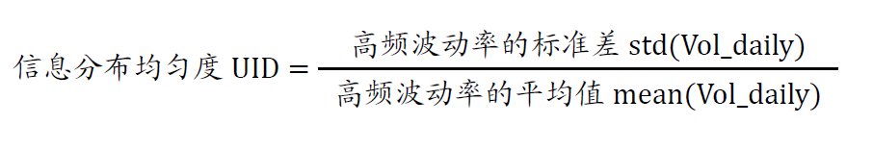
UID (the Uniformity of Information Distribution) Factor
Factor logic
Ross and Andersen found through theoretical and empirical studies that the fluctuation of stock prices is directly related to the information flow into stocks.
Vol_daily: For each trading day, minute data are used to calculate the standard deviation of intraday minute gains and losses, which are recorded as daily high-frequency volatility.
std（Vol_daily）: Calculate the standard deviation of Vol_daily for all trading days
mean（Vol_daily）: Calculate the standard deviation of Vol_daily for all trading days
Factor Construction:
Factor Expectation:
UID is Positively correlated with the future return
Reference:(东吴证券)信息分布均匀度，基于高频波动率的选股因子

Slide 4
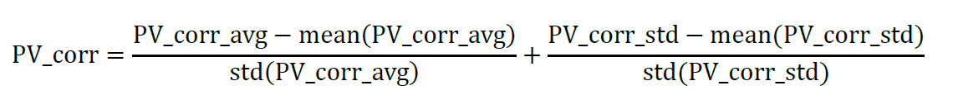
correlation coefficient between price and volume —— Type 1(不错位的价量互动相关系数)
Factor logic
price volume correlation coefficient without considering Mismatch
Factor Construction:
Step 1 : Calculate the correlation coefficient between closing price Pt and the corresponding minute trading volume Vt within minutes per day;
Step 2: calculate the average value of the correlation coefficient of each stock(after neutral treatment), and get the factor PV_corr_avg
Step 3 : calculate the standard deviation of the correlation coefficient of each stock(after neutral treatment), and get the factor PV_corr_std
Step 4：combine the factors obtained above and get new factor P V_corr
Factor Expectation:
PV_corr_avg is Negatively correlated with the future return
PV_corr_avg is Negatively correlated with the future return
PV_corr is Negatively correlated with the future return
Reference:(东吴证券) CPV因子移位版，价量自相关性中蕴藏的选股信息

Slide 5
correlation coefficient between price and volume——type 2 (错位的价量互动相关系数)
Factor logic
price volume correlation coefficient with considering Mismatch
Factor Construction:
Price first
Step 1 : Calculate the correlation coefficient between closing price Pt and the trading volume in Vt+1 next minute per day;
Step 2: calculate the average value of the correlation coefficient of each stock(after neutral treatment), and get the factor PV_Corr_P
volumn first
Step 1 : Calculate the correlation coefficient between closing price Pt and the trading volume Vt-1 in previous minute per day;
Step 2: calculate the average value of the correlation coefficient of each stock(after neutral treatment), and get the factor PV_Corr_V
Factor Expectation:
PV_Corr_P is Negatively correlated with the future return
PV_Corr_V is Negatively correlated with the future return
Reference:(东吴证券) CPV因子移位版，价量自相关性中蕴藏的选股信息

Slide 6
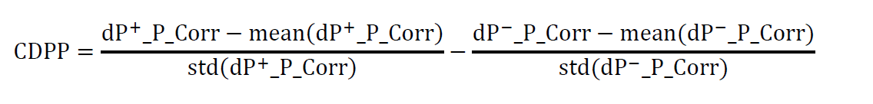
Single sequence difference (单序列差分)
Factor logic
Autocorrelation coefficient of stock price
ΔPt=Pt−Pt-1
Factor Construction:
Type 1
Step 1 : In each trading day, closing price series of the stock within minutes is made a first order difference, and then the correlation coefficient between Δ Pt series and Pt+1 series is calculated.
Step 2: Take the average of the correlation coefficient of each stock, do the cross-sectional market value neutral processing, get the price autocorrelation factor dP_P_Corr
Type 2
Step 1 : In each trading day, closing price series of the stock within minutes is made a first order difference, and then the correlation coefficient between Δ Pt series and Pt+1 series is calculated.
Step 2: fllow type1, but we separate the series into ΔPt >0 part and ΔPt <0 and get two correlation coefficient 𝐝𝐏+_𝐏_𝐂𝐨𝐫𝐫、𝐝𝐏−_𝐏_𝐂𝐨𝐫𝐫
Type 3
Factor Expectation:
dP_P_Corr is Negatively correlated with the future return
𝐝𝐏+_𝐏_𝐂𝐨𝐫𝐫 is Negatively correlated with the future return
𝐝𝐏−_𝐏_𝐂𝐨𝐫𝐫 is positively correlated with the future return
CDPP is Negatively correlated with the future return
Reference:(东吴证券) CPV因子移位版，价量自相关性中蕴藏的选股信息

Slide 7
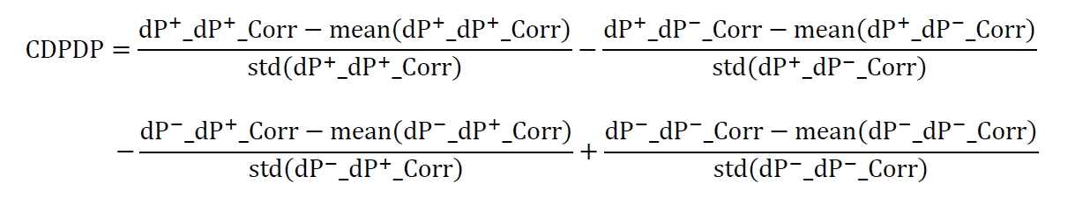
Double sequence difference (双序列差分)
Factor logic
Autocorrelation coefficient of stock price
ΔPt=Pt−Pt-1
Factor Construction:
Type 1
Step 1 : In each trading day, take the first order difference of closing price sequence of the stock and get two sequences Δ Pt and Δ Pt+1
Step 2: The correlation coefficients between δ Pt sequence and δ Pt+1 sequence were calculated daily and take average within n day getting factor dP_dP_Corr
Step 3
separate the two series into ΔPt >0 part and ΔPt <0 part and get four correlation coefficients 𝐝𝐏+_𝐝𝐏+_𝐂𝐨𝐫𝐫,𝐝𝐏−_𝐝𝐏−_𝐂𝐨𝐫𝐫,𝐝𝐏+_𝐝𝐏−_𝐂𝐨𝐫𝐫,𝐝𝐏−_𝐝𝐏+_𝐂𝐨𝐫𝐫
Step 4
Combine the factor gotten form step 3 and get new factor CDPDP
Factor Expectation:
dP_dP_Corr is Negatively correlated with the future return
𝐝𝐏+_𝐝𝐏+_𝐂𝐨𝐫𝐫 is Negatively correlated with the future return
𝐝𝐏+_𝐝𝐏−_𝐂𝐨𝐫𝐫 is positively correlated with the future return
𝐝𝐏−_𝐝𝐏+_𝐂𝐨𝐫𝐫 is positively correlated with the future return
𝐝𝐏−_𝐝𝐏−_𝐂𝐨𝐫𝐫 is Negatively correlated with the future return
CDPDP is Negatively correlated with the future return
Reference:(东吴证券) CPV因子移位版，价量自相关性中蕴藏的选股信息

