Slide 1
RETAIL PERFORMANCE / DASHBOARD DECK
What the data is, how it flows,
and what is working
Every slide is a visual from the Streamlit dashboard, captured as the audience sees it.
Profit means gross profit on standard cost (pack-adjusted), not net profit.
Source: dbt marts in retail.duckdb | App: http://localhost:8501

Slide 2
Agenda: one tab per audience
01
Solution map
3 visuals
02
Data & model
3 visuals
03
Row flow
2 visuals
04
Management
5 visuals
05
Finance
5 visuals
06
AP / Ops
5 visuals
07
Sales
5 visuals
08
Stores
3 visuals
09
Analysis
11 visuals
10
Roadmap & AI
2 visuals
Generated from the dashboard; re-run scripts/export_dashboard_deck.py after any change.

Slide 3
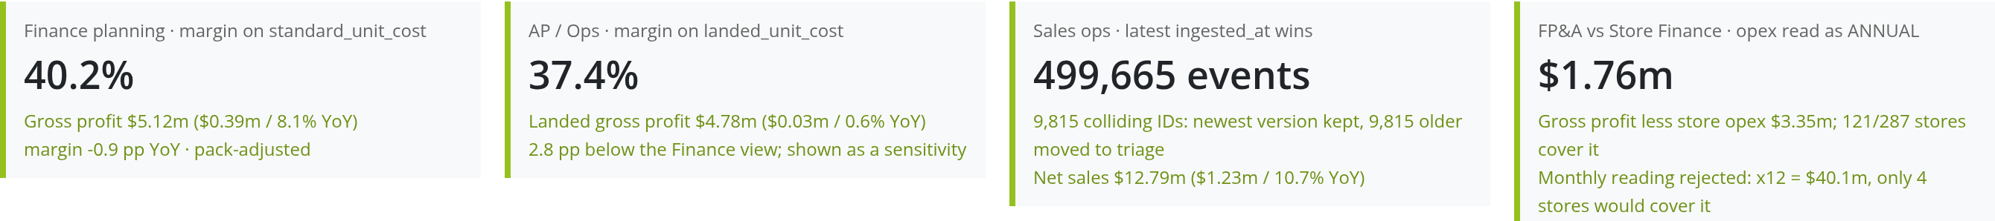
One tile per stakeholder note
Headline | dashboard capture | gross profit, not net profit

Slide 4
01
Solution map

Slide 5
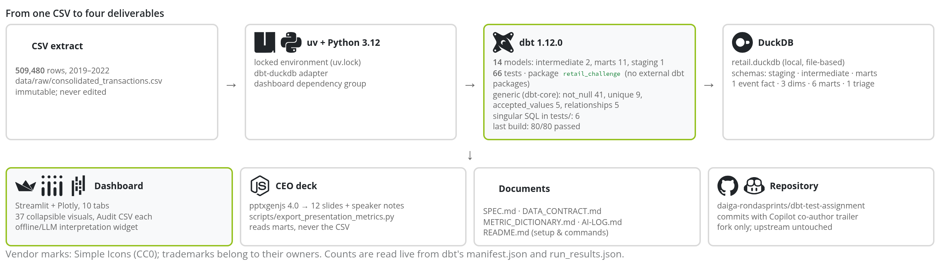
From one CSV to four deliverables
Solution map | dashboard capture | gross profit, not net profit

Slide 6
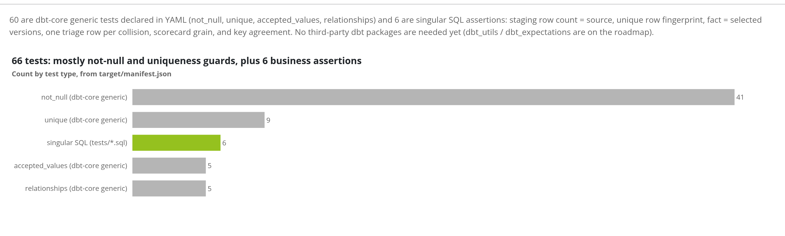
What do the 66 dbt tests check?
Solution map | dashboard capture | gross profit, not net profit

Slide 7
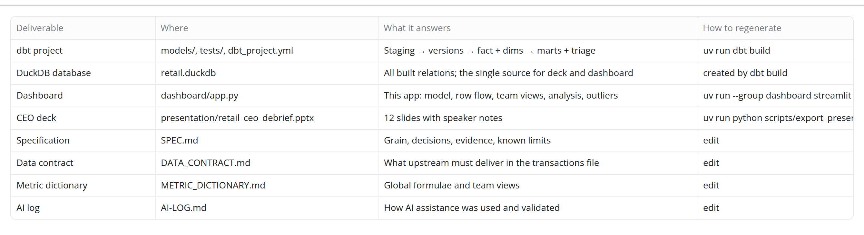
Deliverables list
Solution map | dashboard capture | gross profit, not net profit

Slide 8
02
Data & model

Slide 9
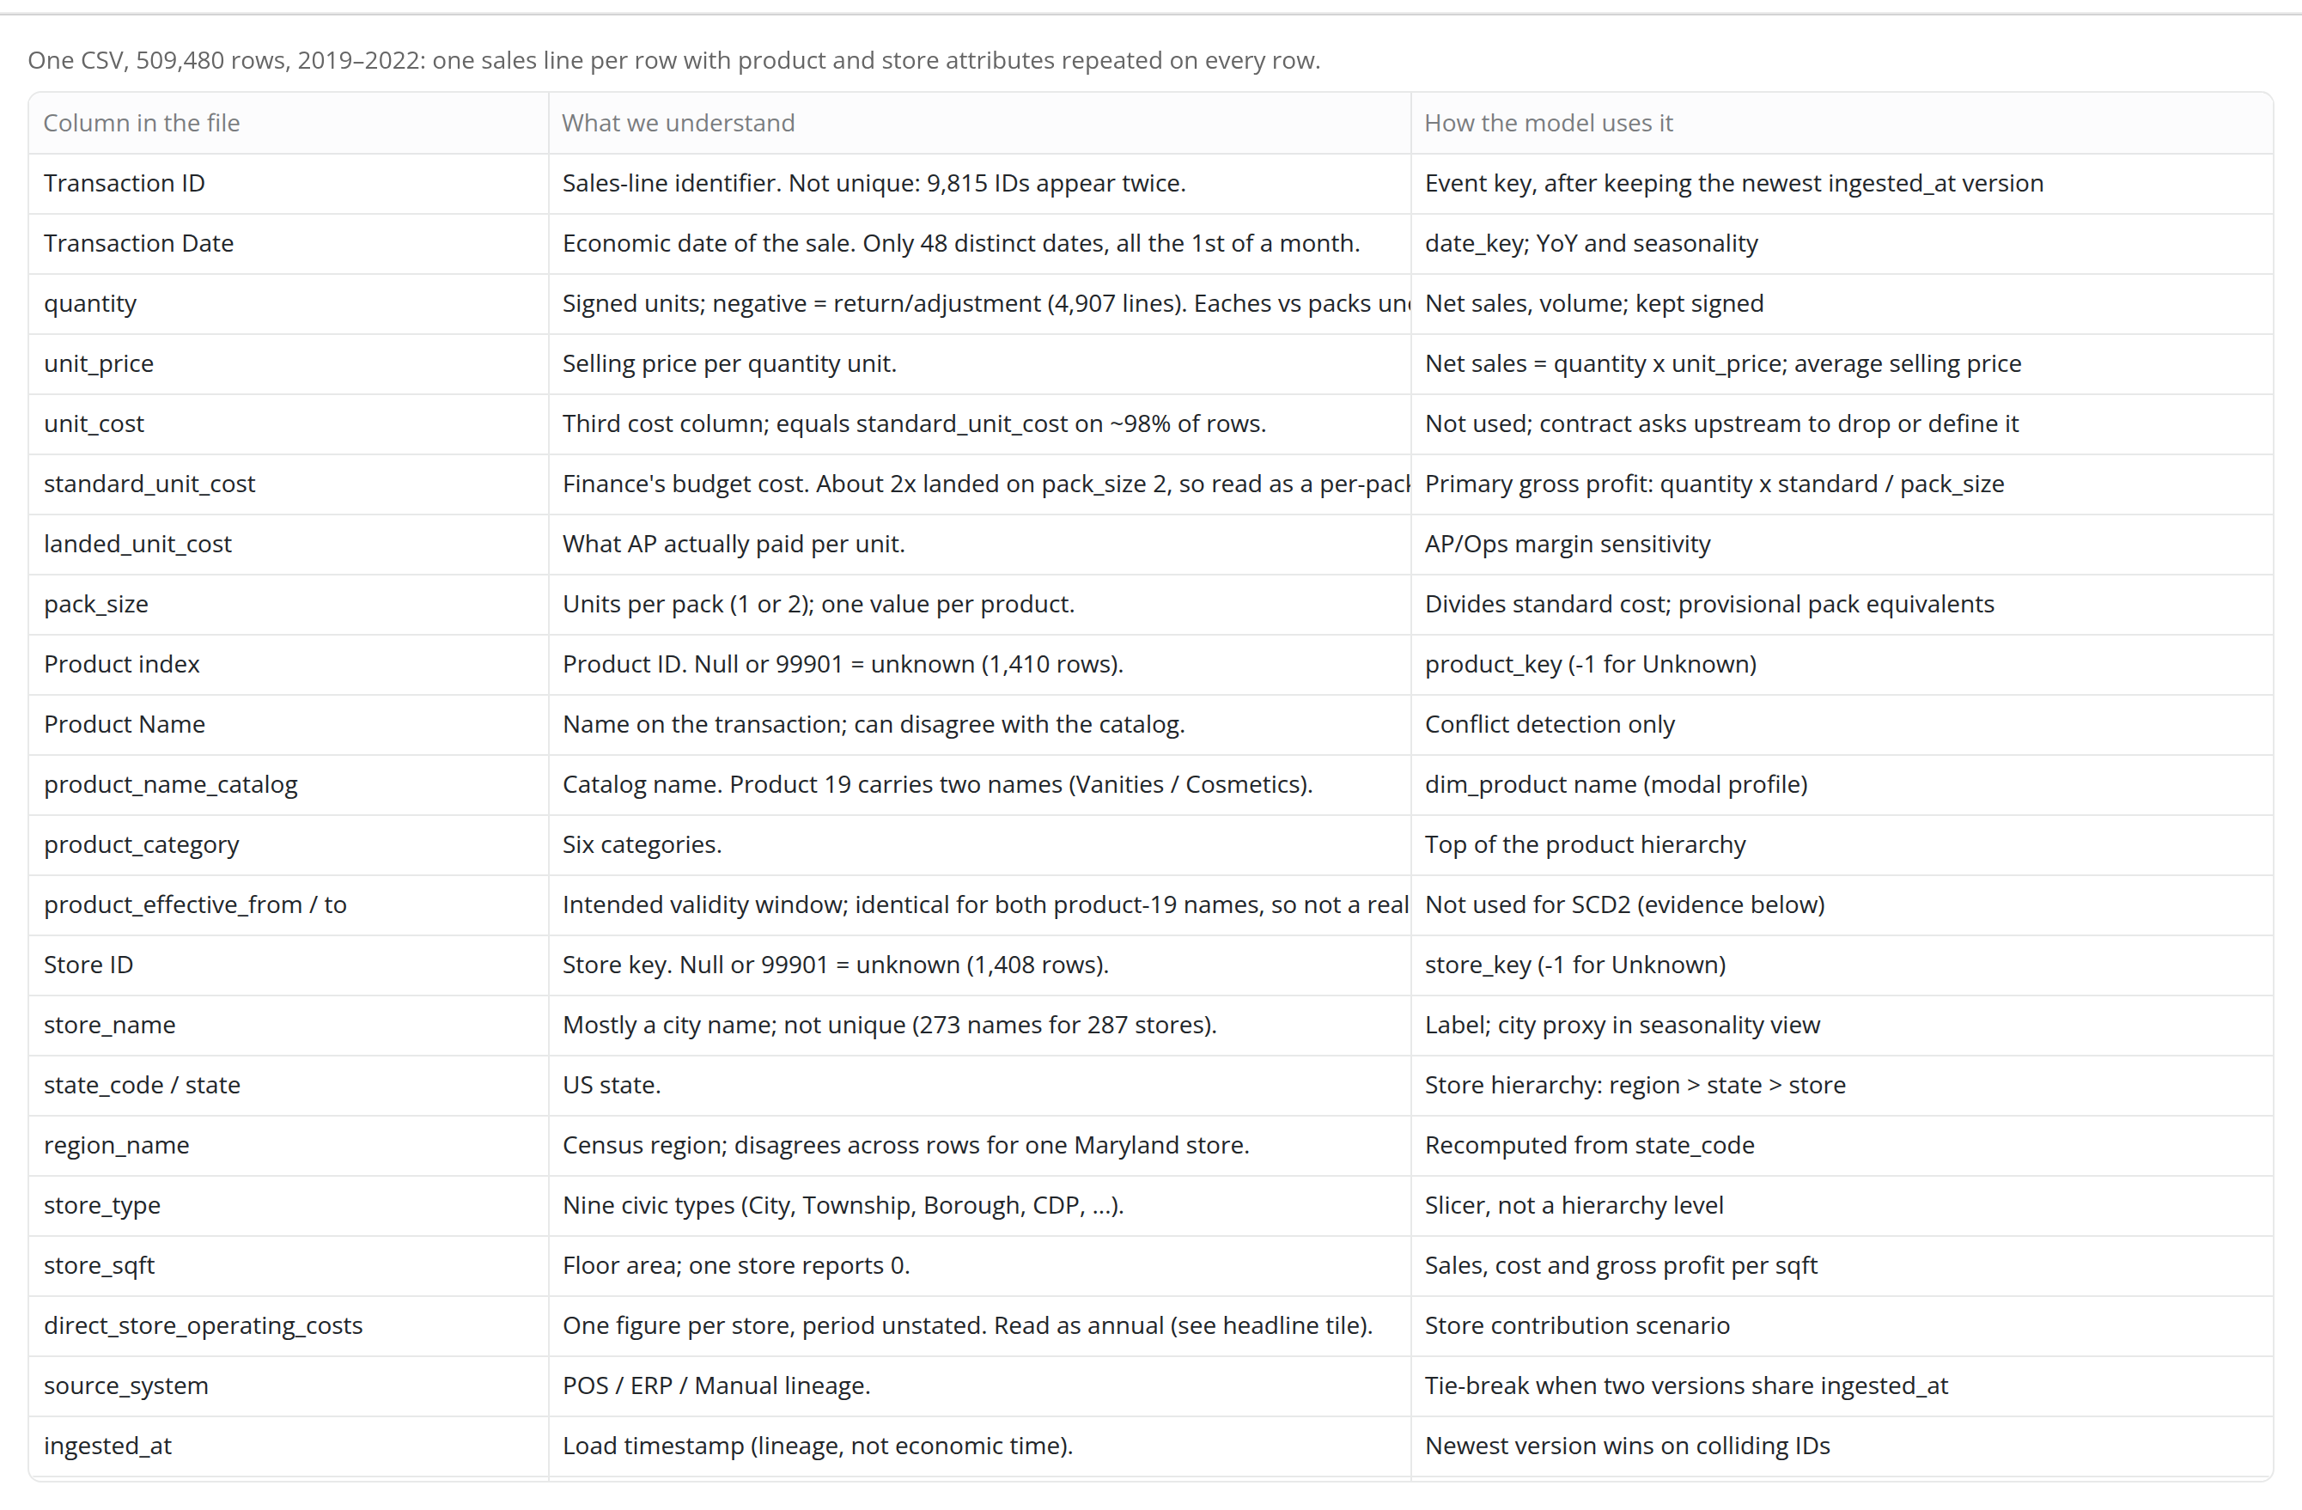
What is in the file?
Data & model | dashboard capture | gross profit, not net profit

Slide 10
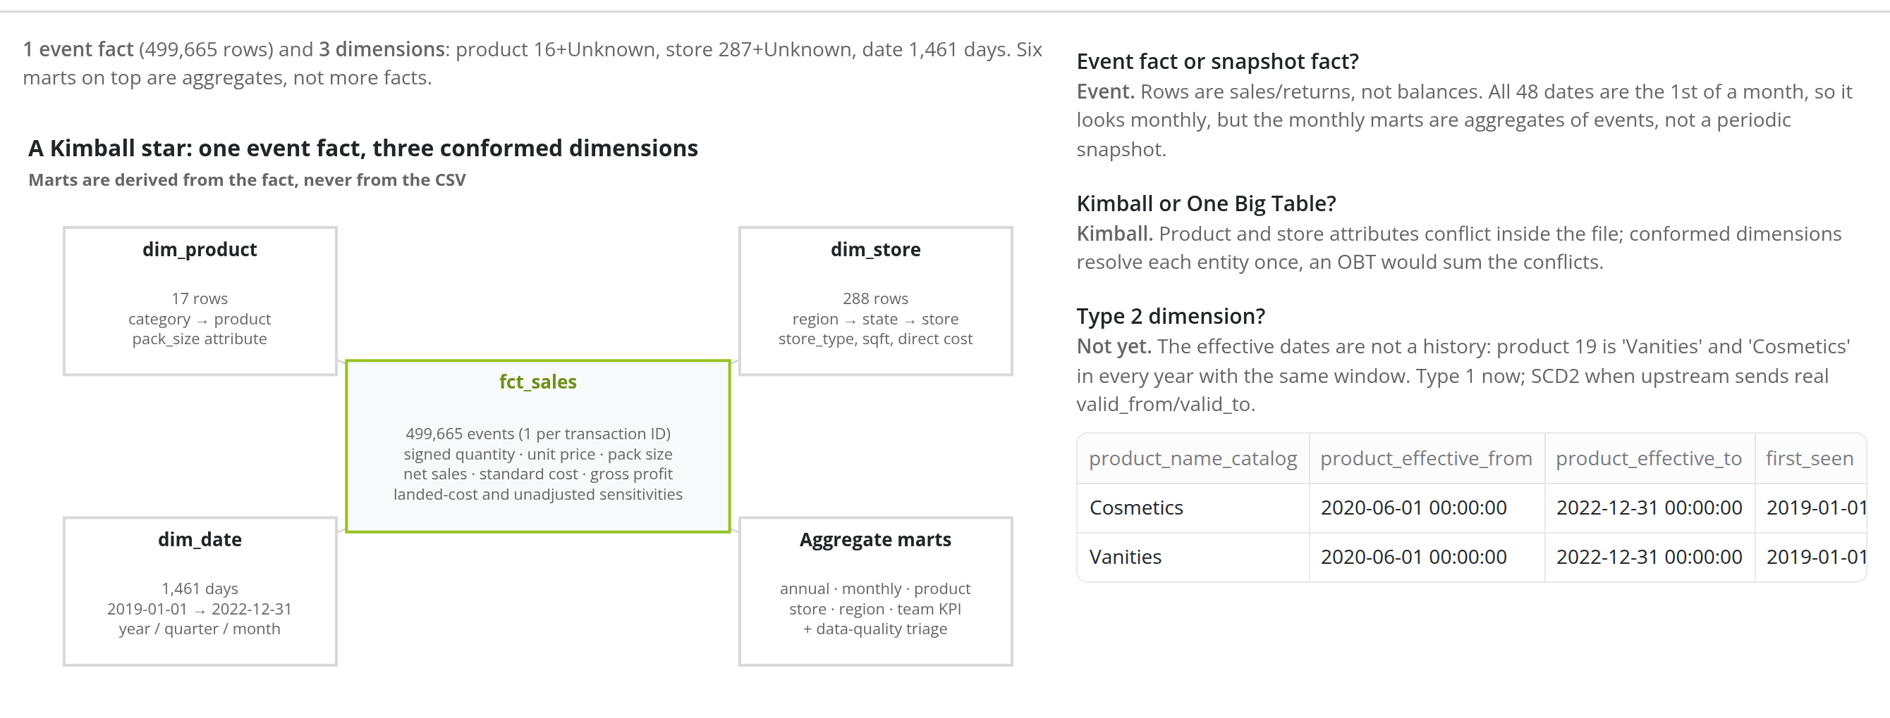
How many facts and dimensions? Event or snapshot? Kimball or OBT? Type 2?
Data & model | dashboard capture | gross profit, not net profit

Slide 11
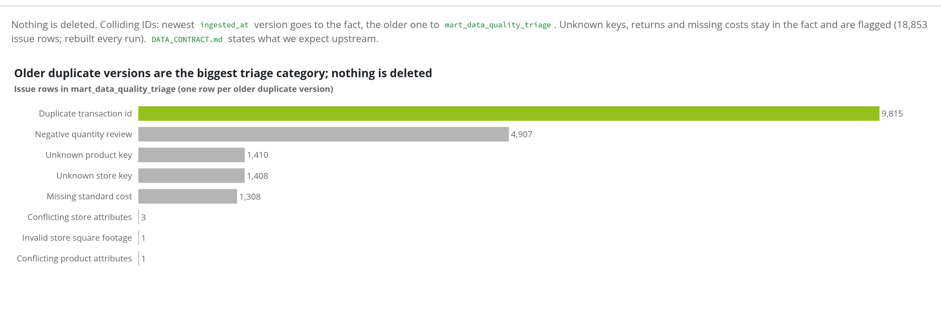
What happens to dirty data?
Data & model | dashboard capture | gross profit, not net profit

Slide 12
03
Row flow

Slide 13
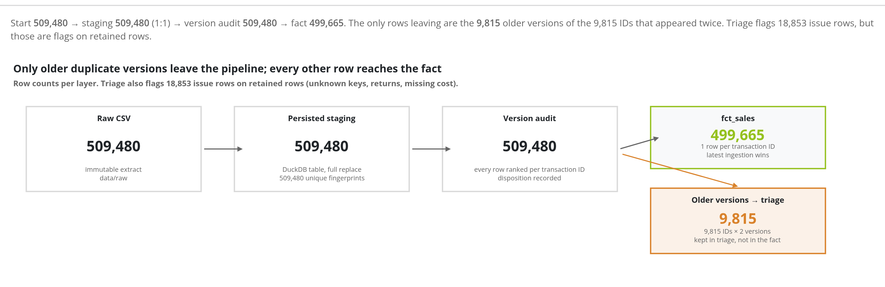
How many rows did we start with, and how many were de-duplicated or sent to triage?
Row flow | dashboard capture | gross profit, not net profit

Slide 14
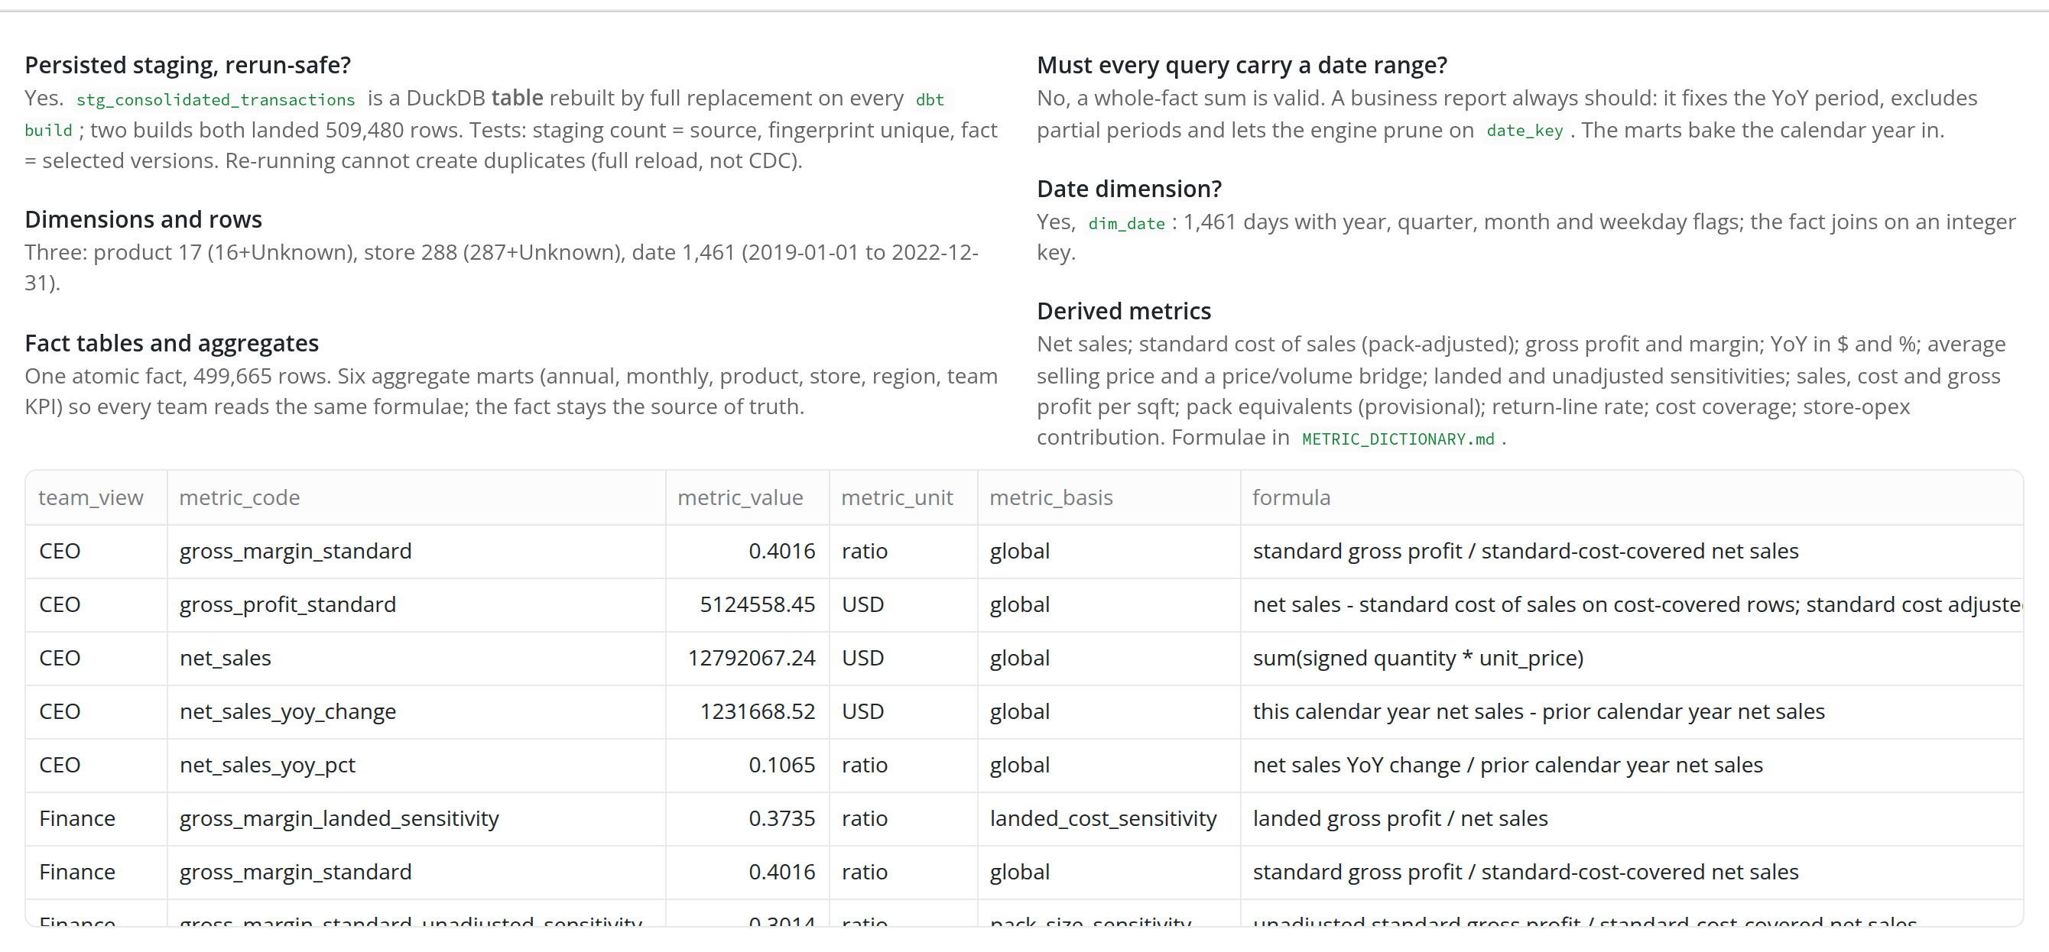
Is staging persisted and rerun-safe? Dimensions, facts, aggregates, date range, date dimension, derived metrics
Row flow | dashboard capture | gross profit, not net profit

Slide 15
04
Management

Slide 16
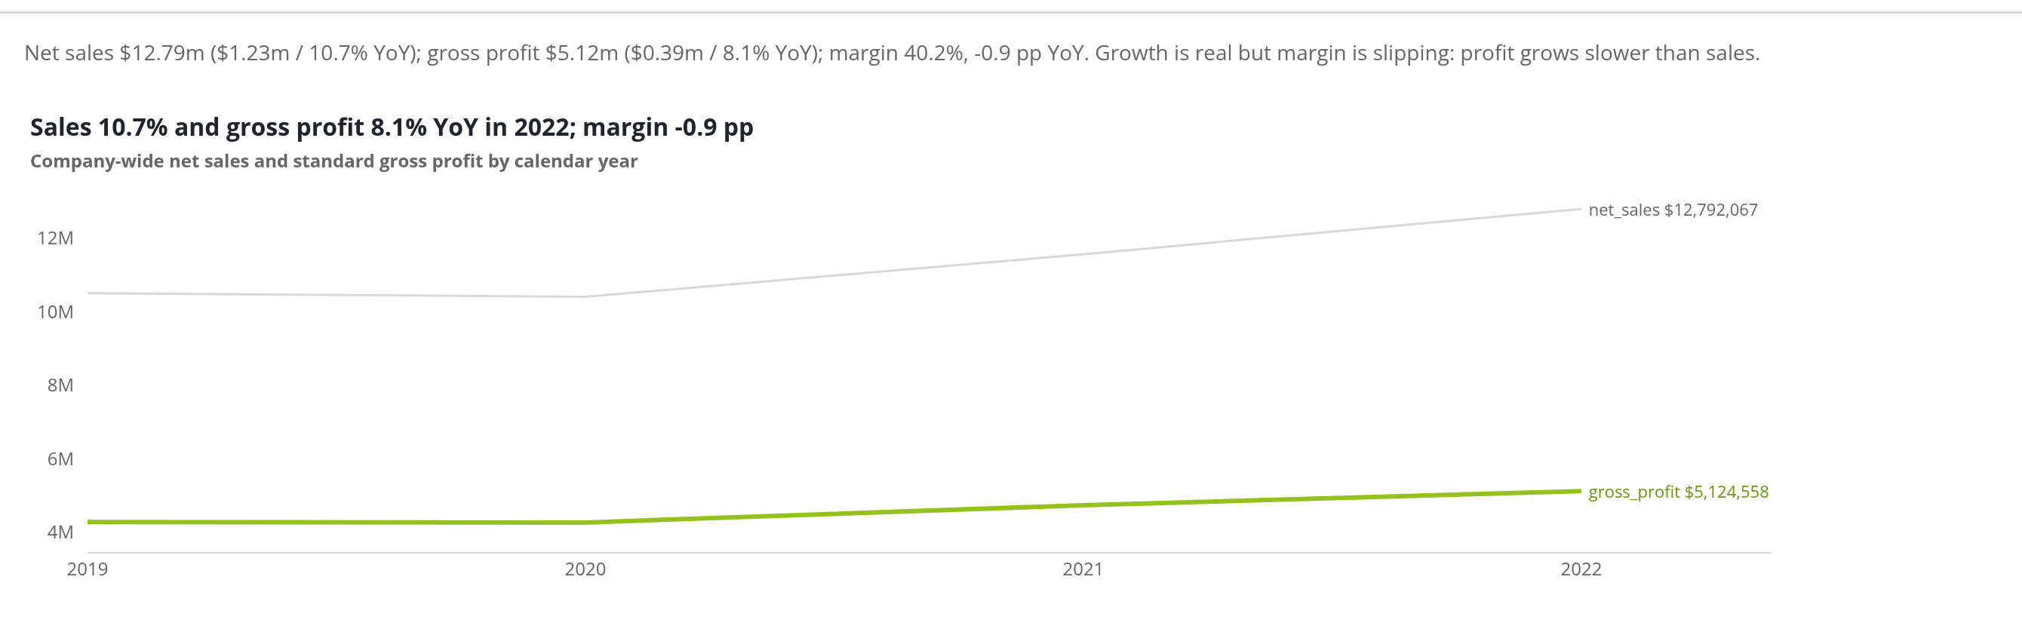
Are we growing profitably?
Management | dashboard capture | gross profit, not net profit

Slide 17
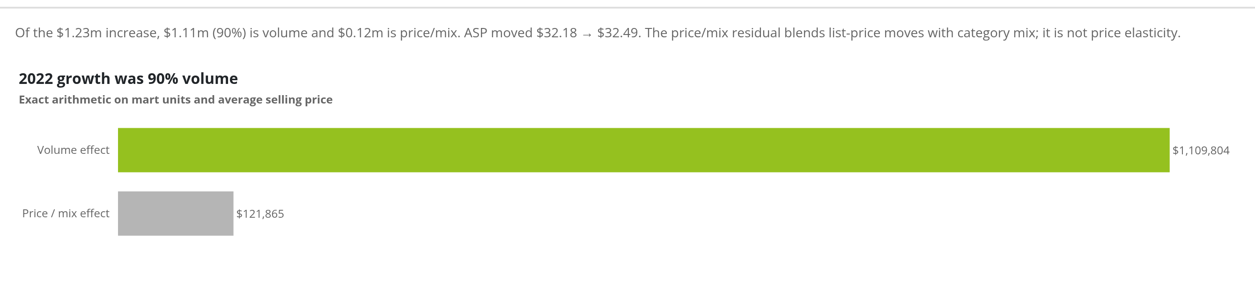
Where did the growth come from: price or volume?
Management | dashboard capture | gross profit, not net profit

Slide 18
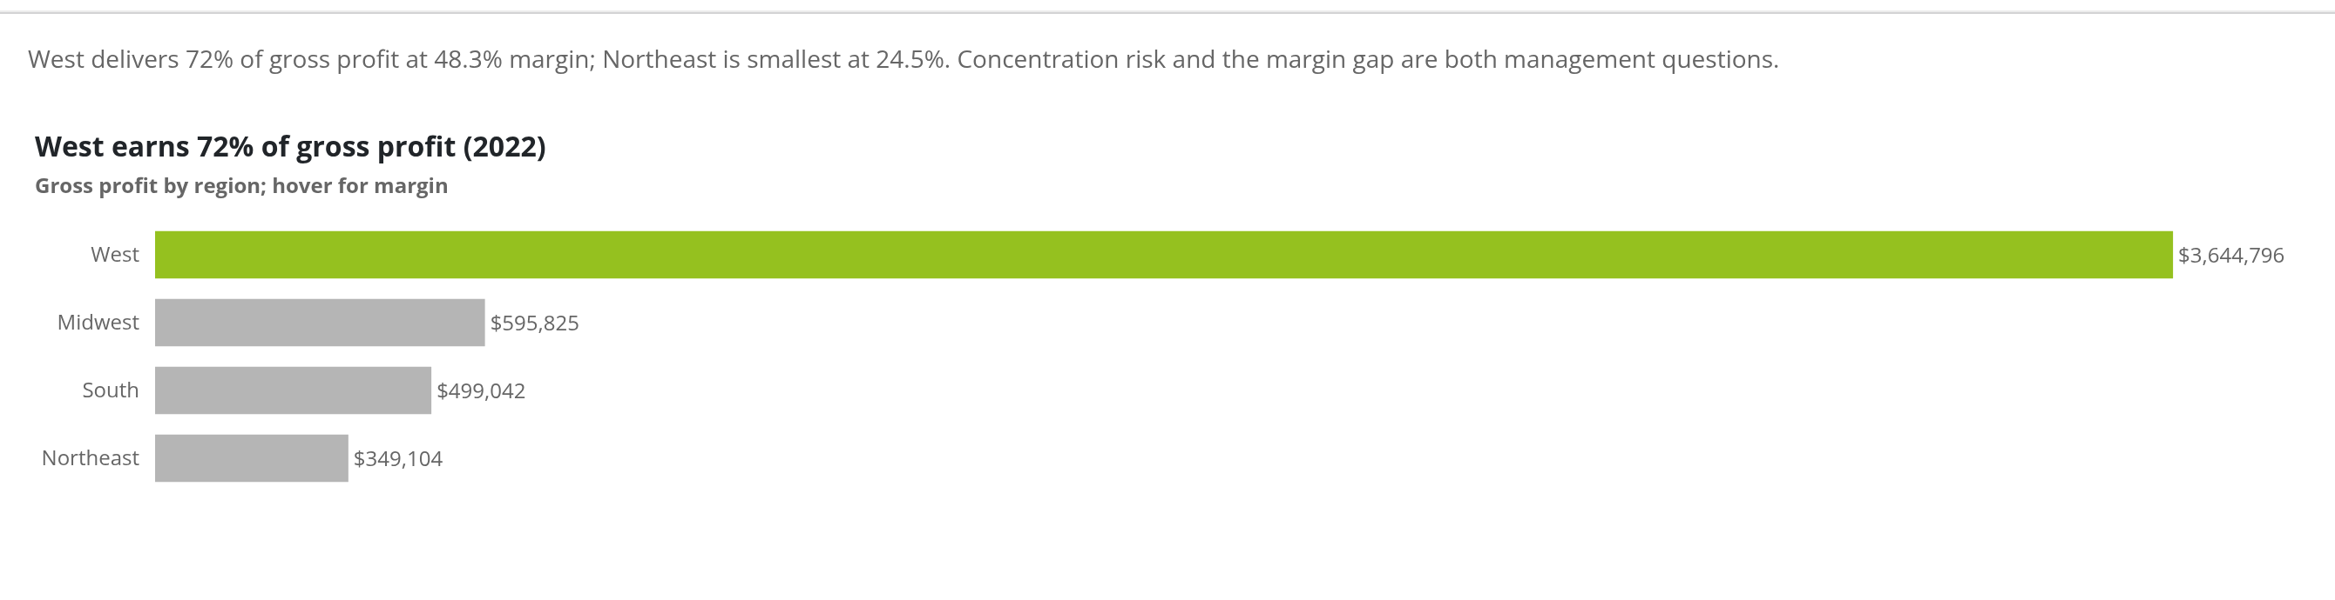
Which regions carry the company?
Management | dashboard capture | gross profit, not net profit

Slide 19
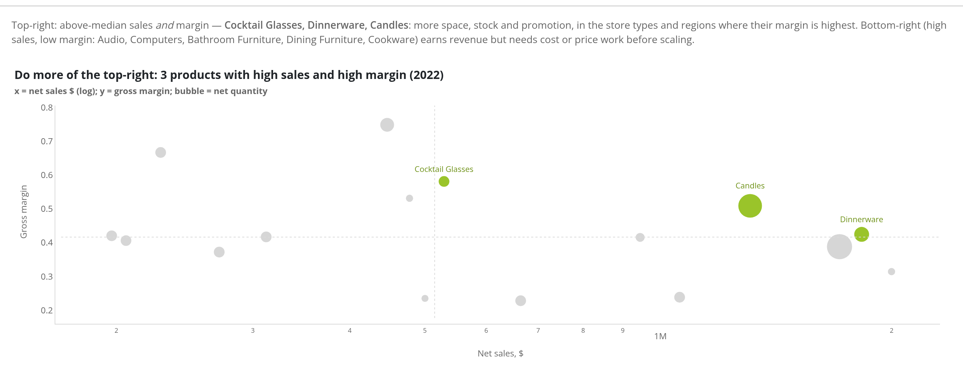
What is working, and what should we do more of?
Management | dashboard capture | gross profit, not net profit

Slide 20
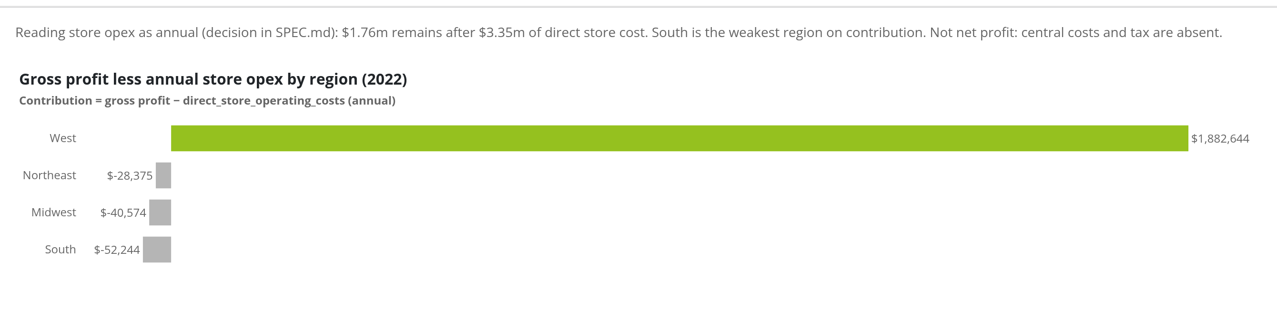
After store operating cost, what is left?
Management | dashboard capture | gross profit, not net profit

Slide 21
05
Finance

Slide 22
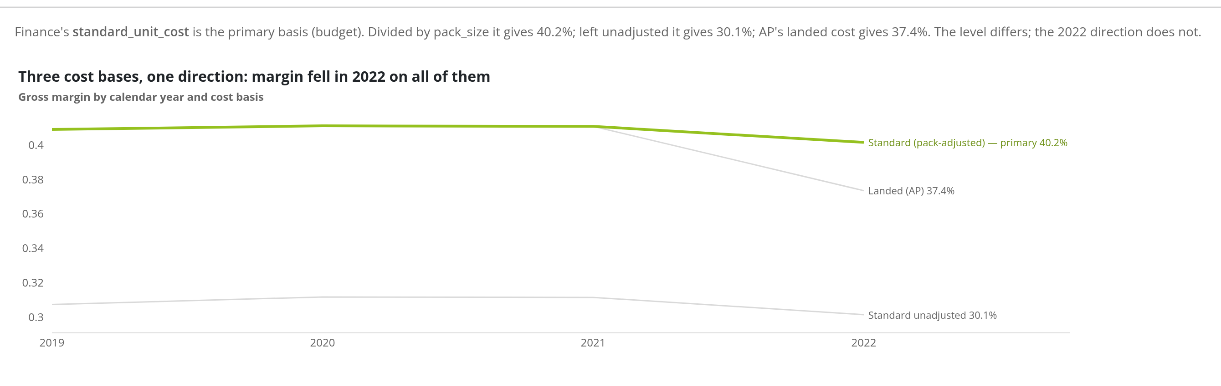
Which cost basis, and does the answer change with it?
Finance | dashboard capture | gross profit, not net profit

Slide 23
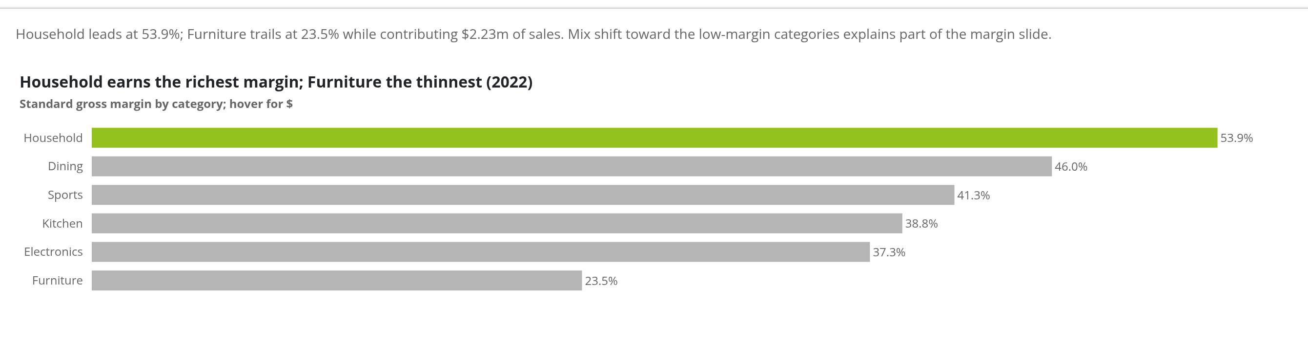
Which categories make the margin?
Finance | dashboard capture | gross profit, not net profit

Slide 24
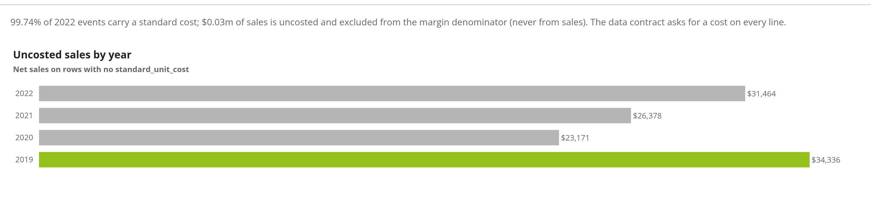
How much of sales has no standard cost?
Finance | dashboard capture | gross profit, not net profit

Slide 25
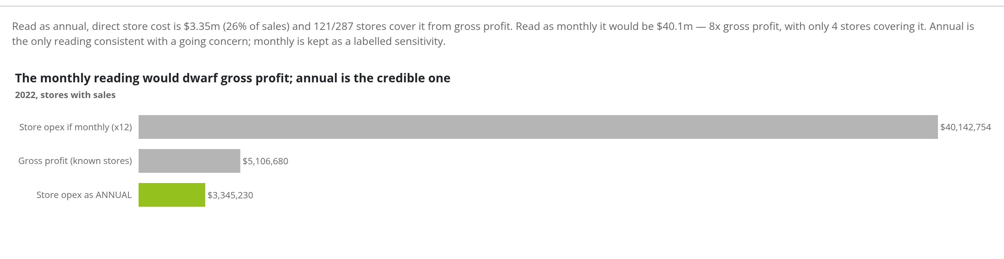
Store opex: annual or monthly? We say annual.
Finance | dashboard capture | gross profit, not net profit

Slide 26
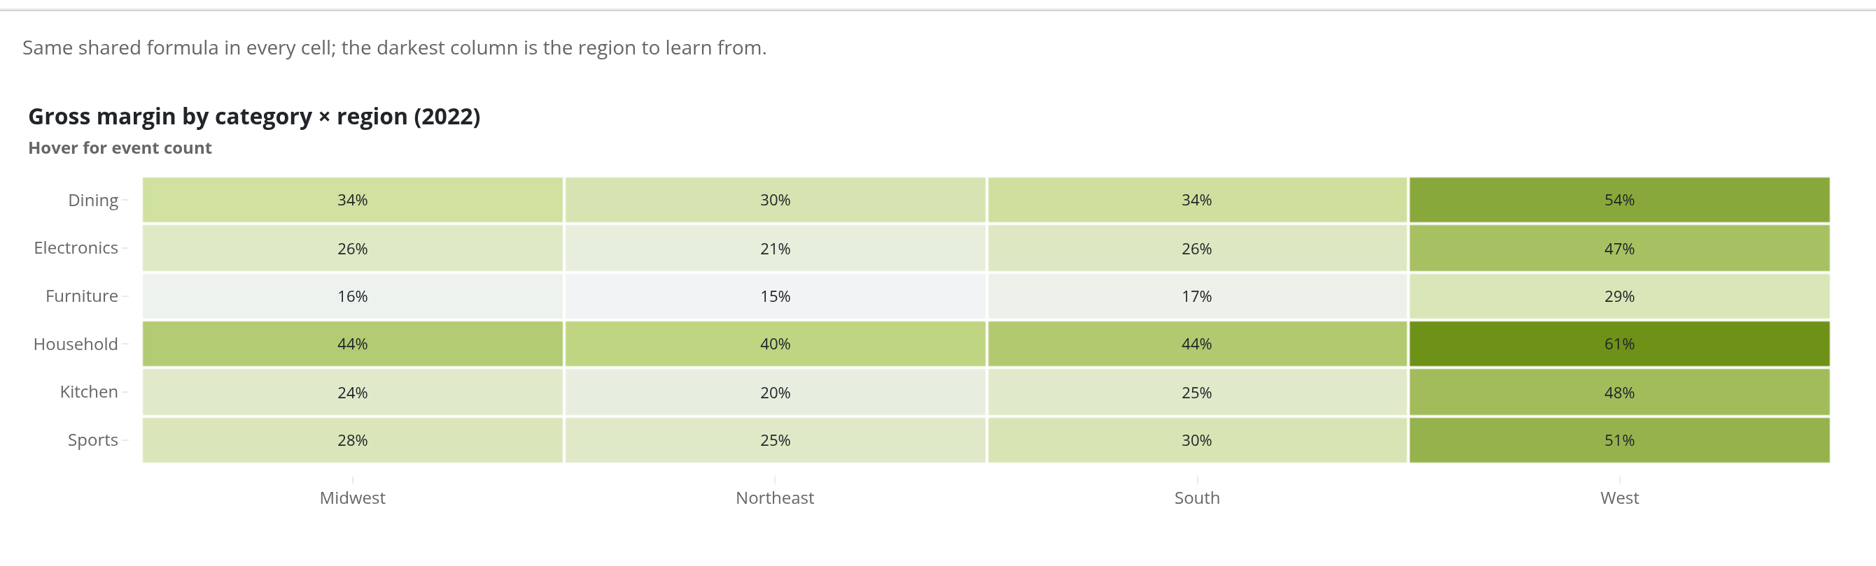
Where is margin made: category × region
Finance | dashboard capture | gross profit, not net profit

Slide 27
06
AP / Ops

Slide 28
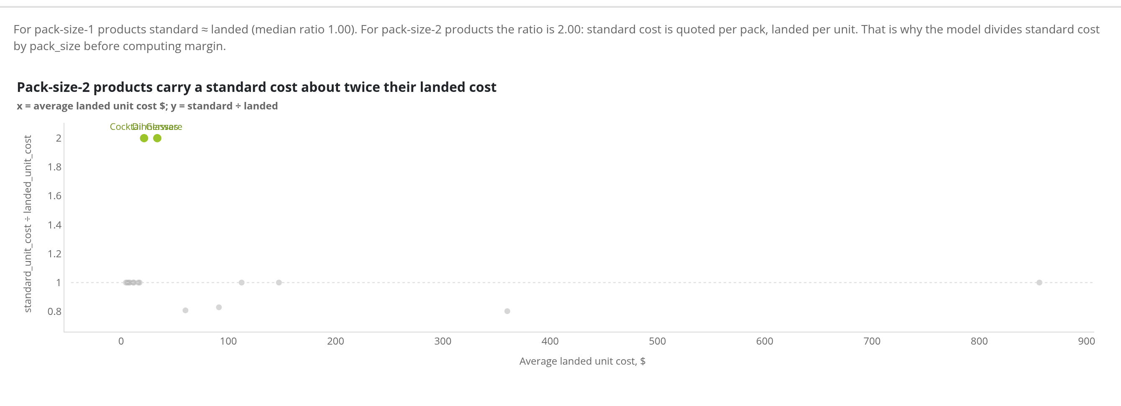
How does what we paid (landed) compare with the budget cost (standard)?
AP / Ops | dashboard capture | gross profit, not net profit

Slide 29
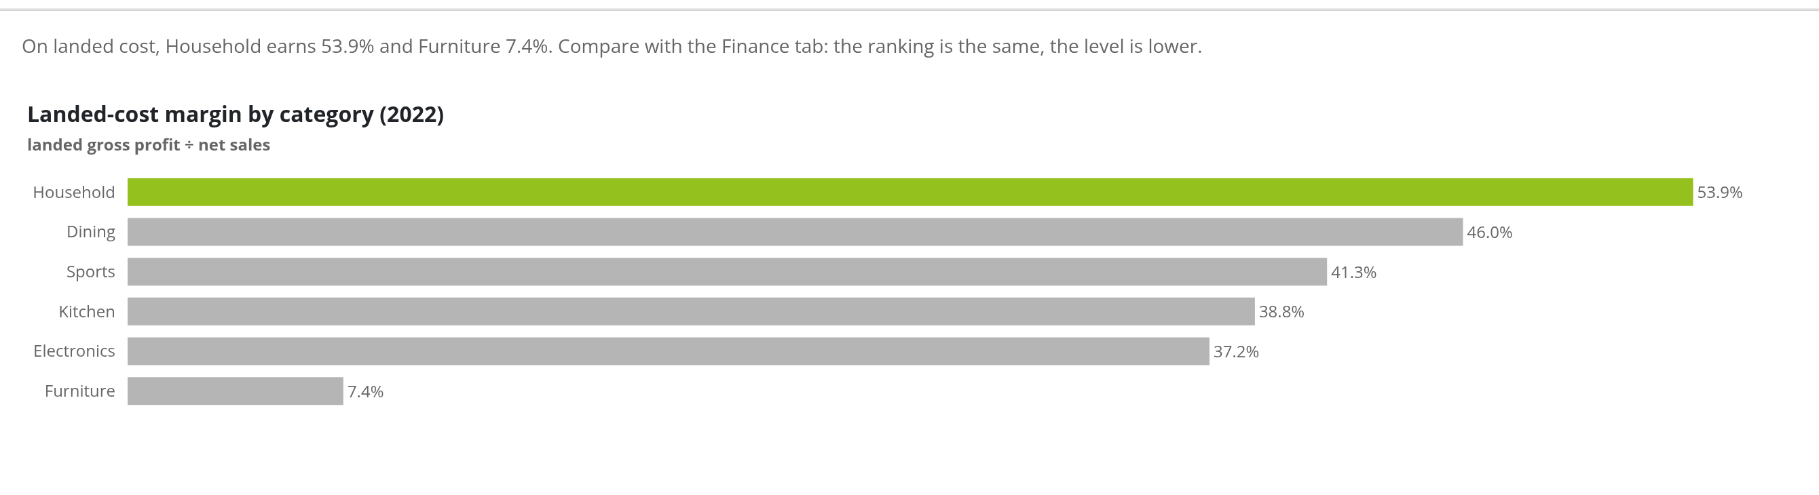
Margin on what we actually paid, by category
AP / Ops | dashboard capture | gross profit, not net profit

Slide 30
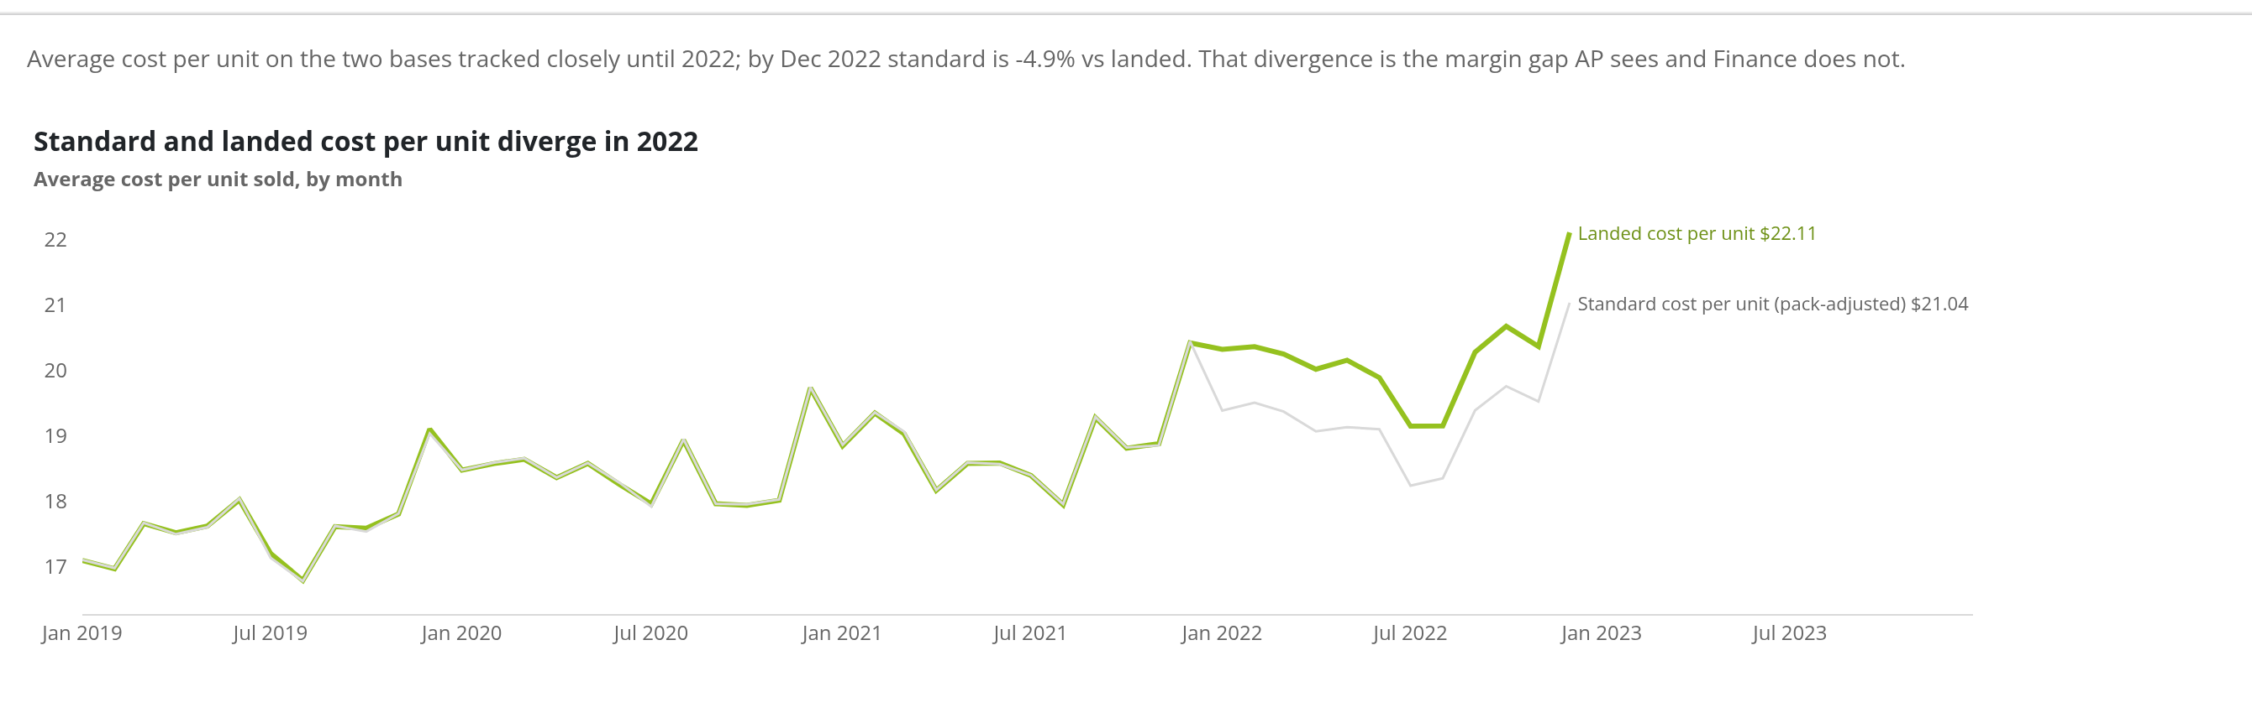
Did landed cost move away from standard in 2022?
AP / Ops | dashboard capture | gross profit, not net profit

Slide 31
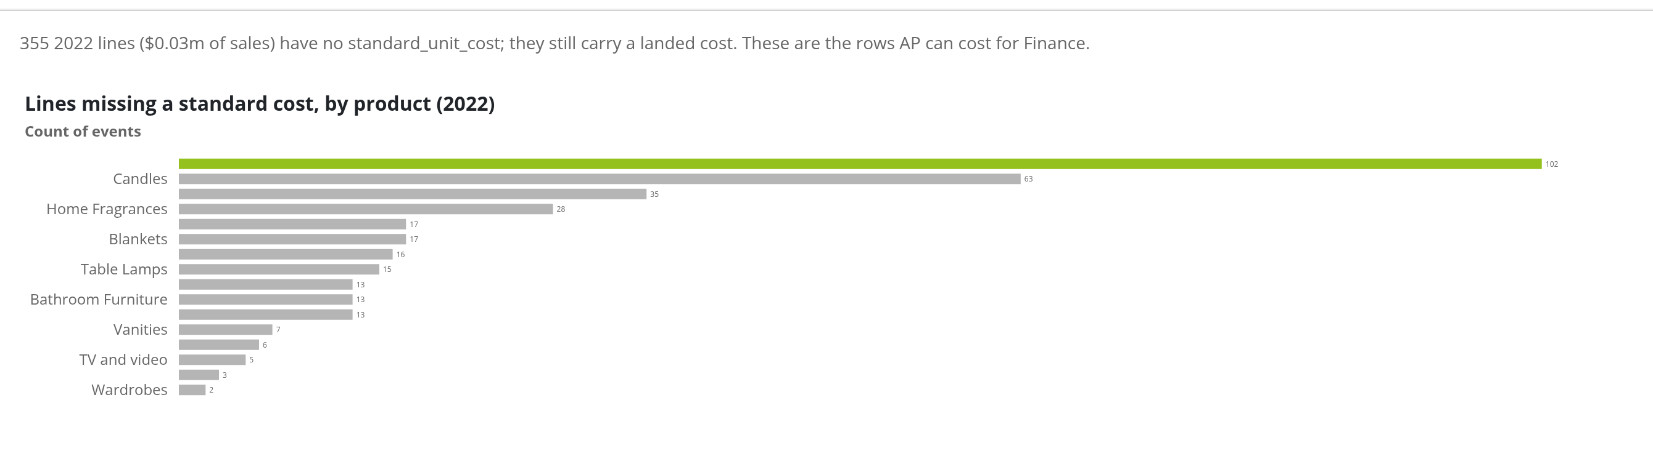
Which lines have no standard cost at all?
AP / Ops | dashboard capture | gross profit, not net profit

Slide 32
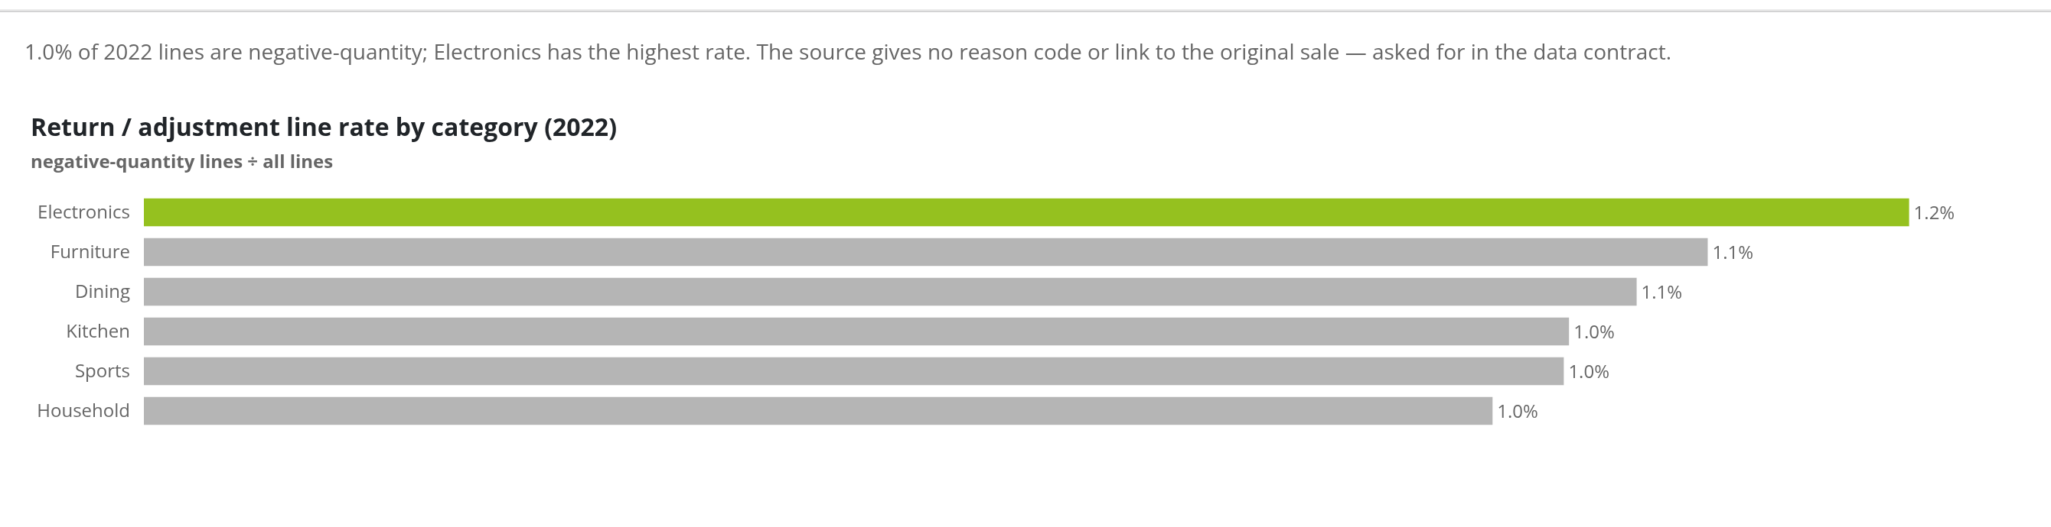
Where are returns and adjustments concentrated?
AP / Ops | dashboard capture | gross profit, not net profit

Slide 33
07
Sales

Slide 34
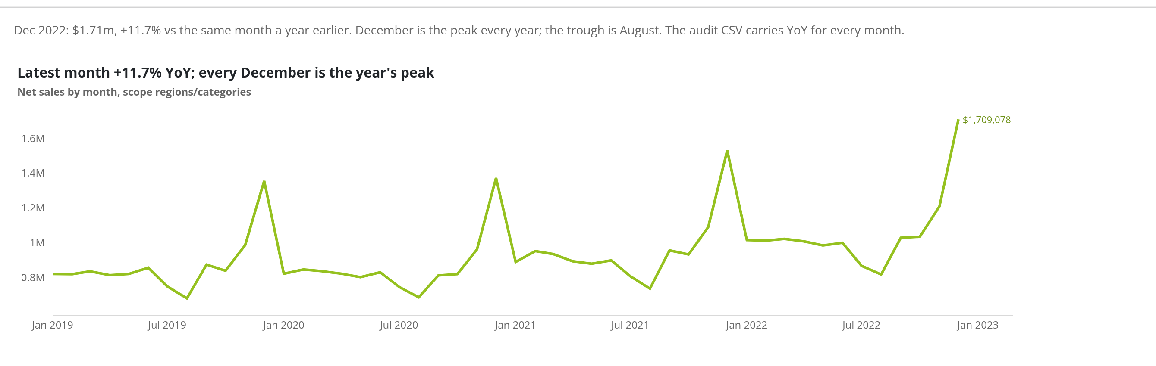
How are monthly sales trending, and what is the YoY?
Sales | dashboard capture | gross profit, not net profit

Slide 35
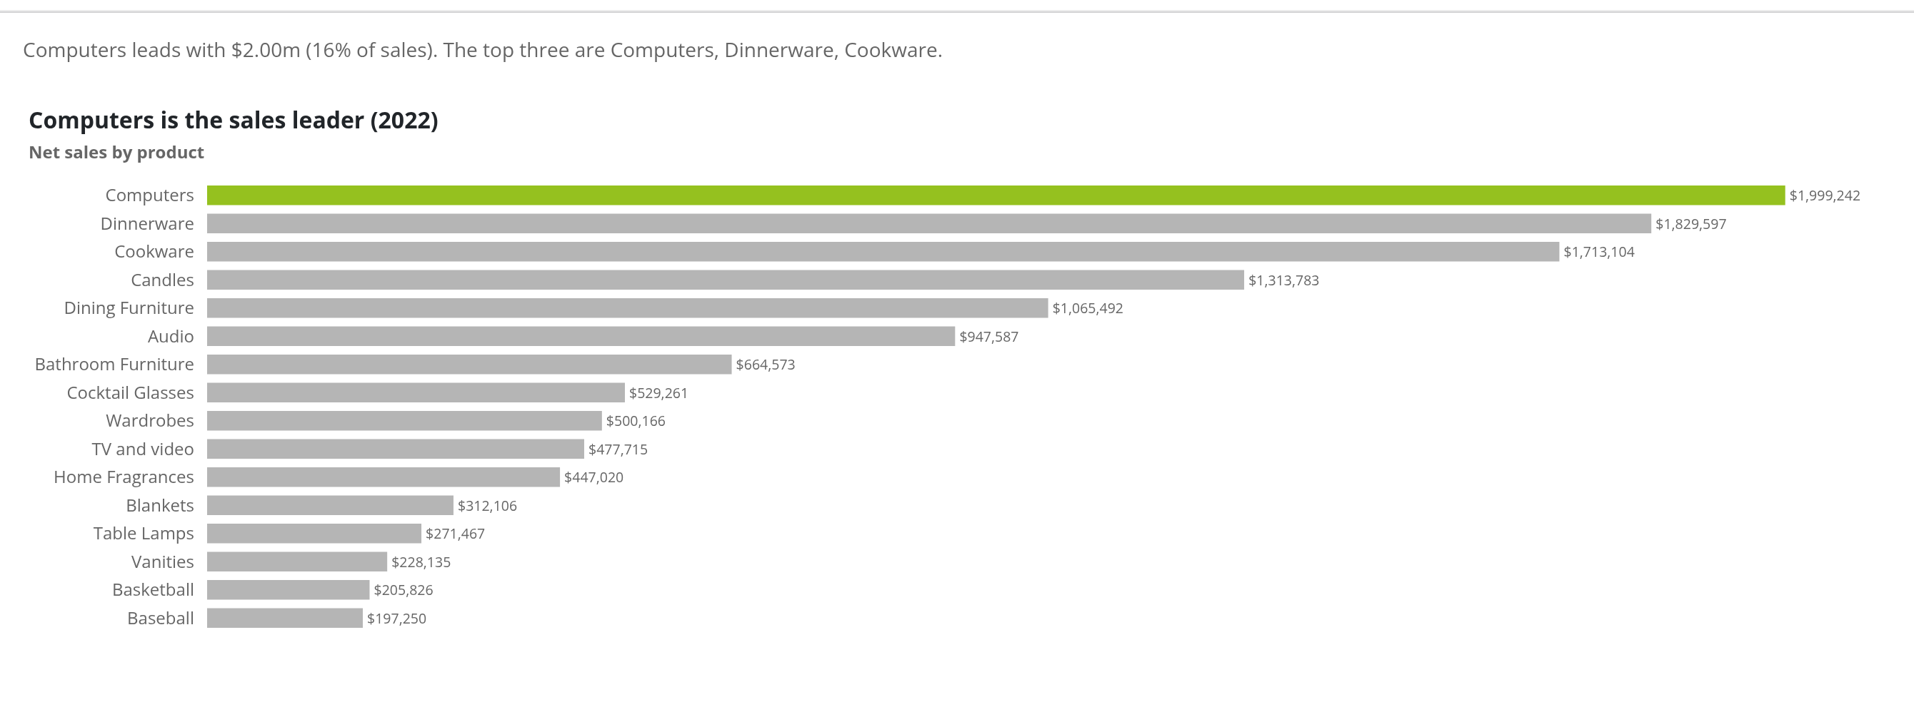
Which products sell the most?
Sales | dashboard capture | gross profit, not net profit

Slide 36
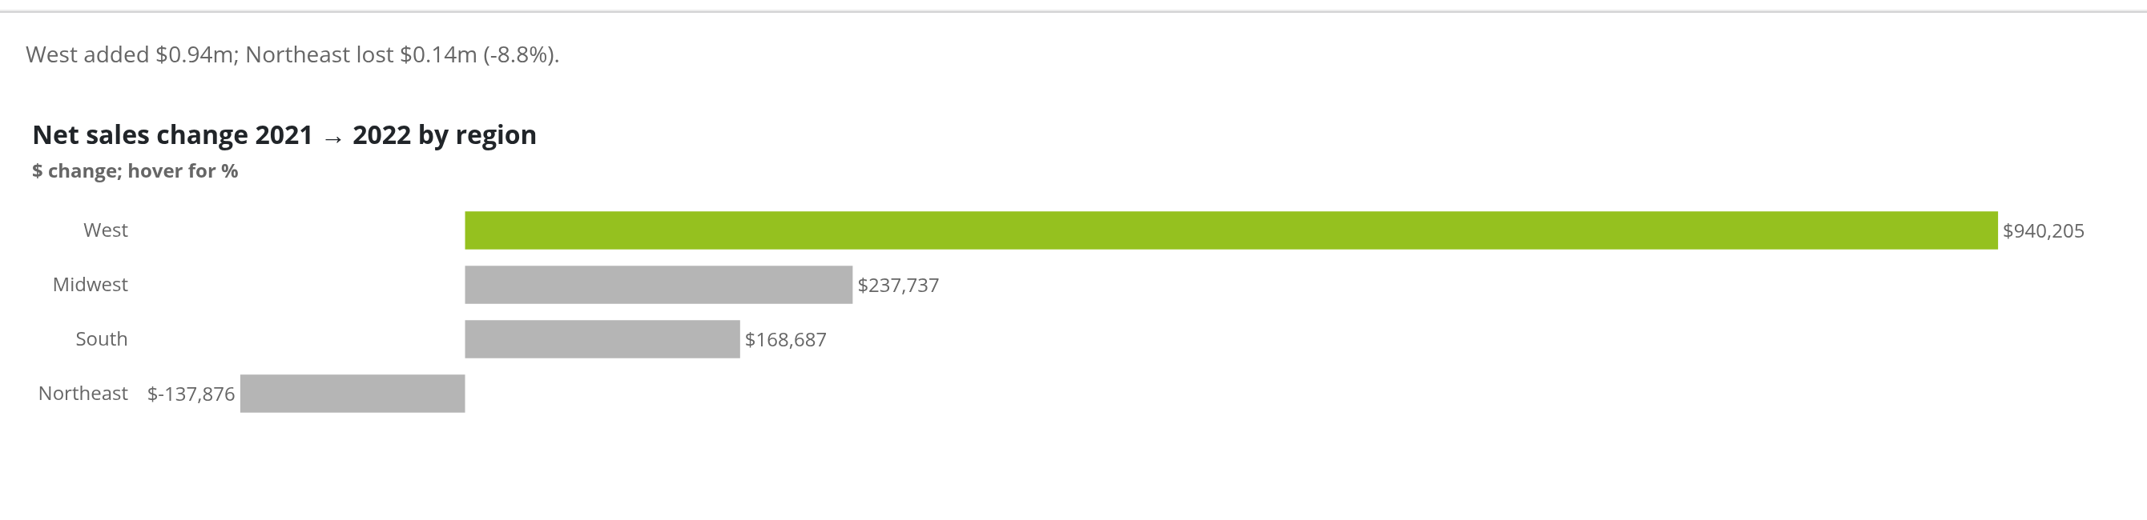
Which regions grew, and which shrank?
Sales | dashboard capture | gross profit, not net profit

Slide 37
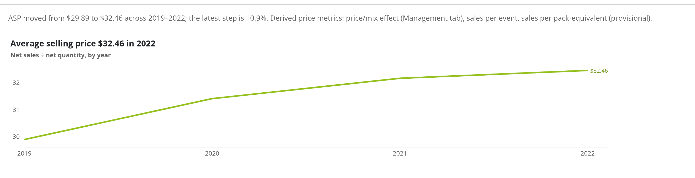
Talk about price: what is happening to the average selling price?
Sales | dashboard capture | gross profit, not net profit

Slide 38
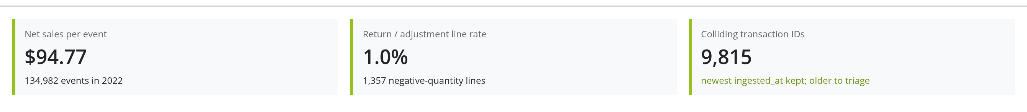
Sales-ops hygiene: sales per event, returns, collisions
Sales | dashboard capture | gross profit, not net profit

Slide 39
08
Stores

Slide 40
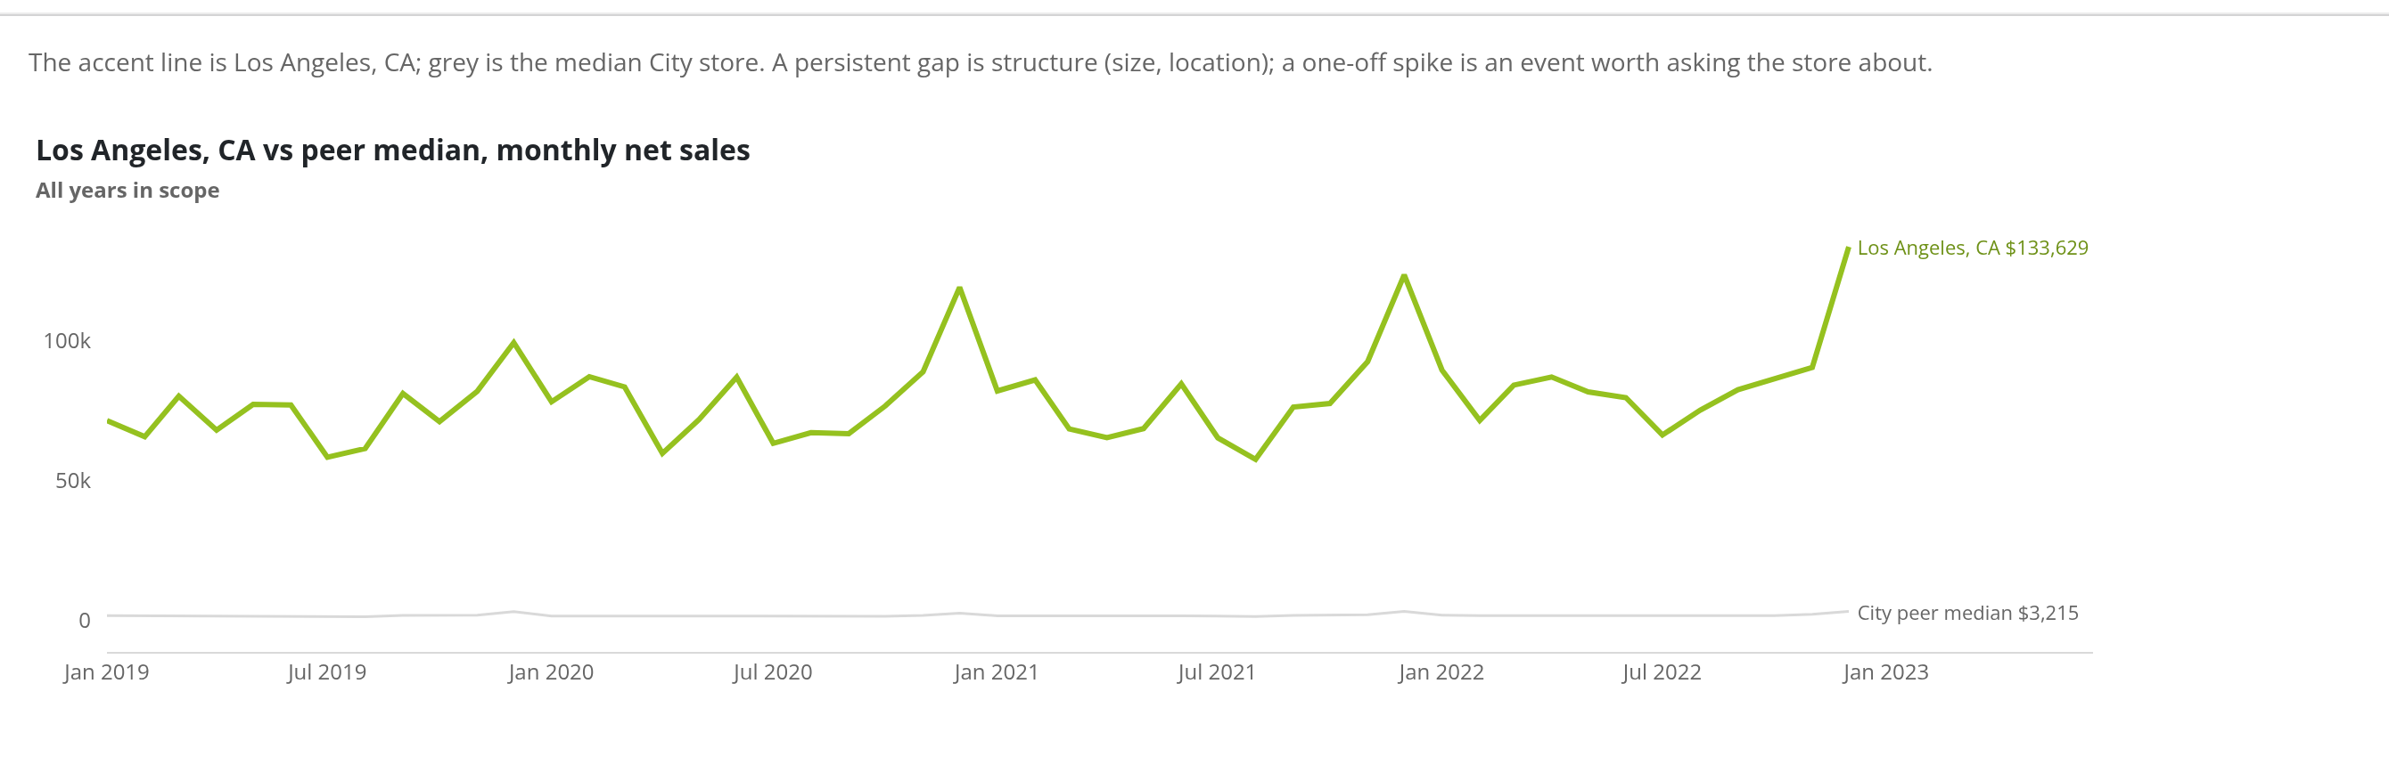
How does this store track against its peers month by month?
Stores | dashboard capture | gross profit, not net profit

Slide 41
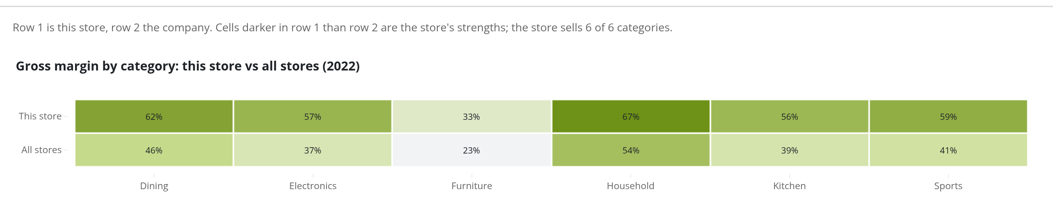
Which categories does this store do better or worse than the company?
Stores | dashboard capture | gross profit, not net profit

Slide 42
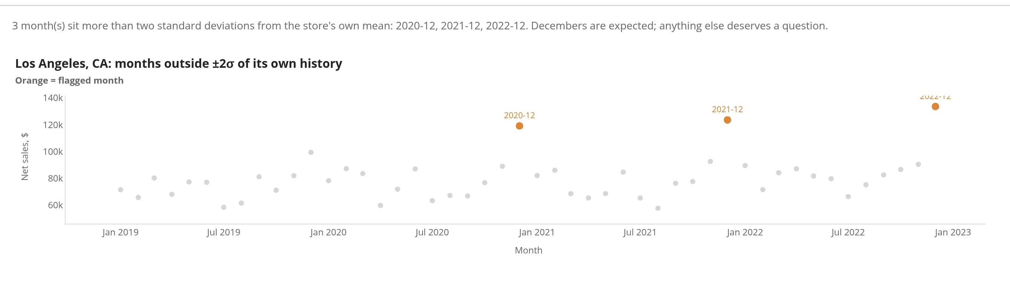
Which months broke this store's own pattern?
Stores | dashboard capture | gross profit, not net profit

Slide 43
09
Analysis

Slide 44
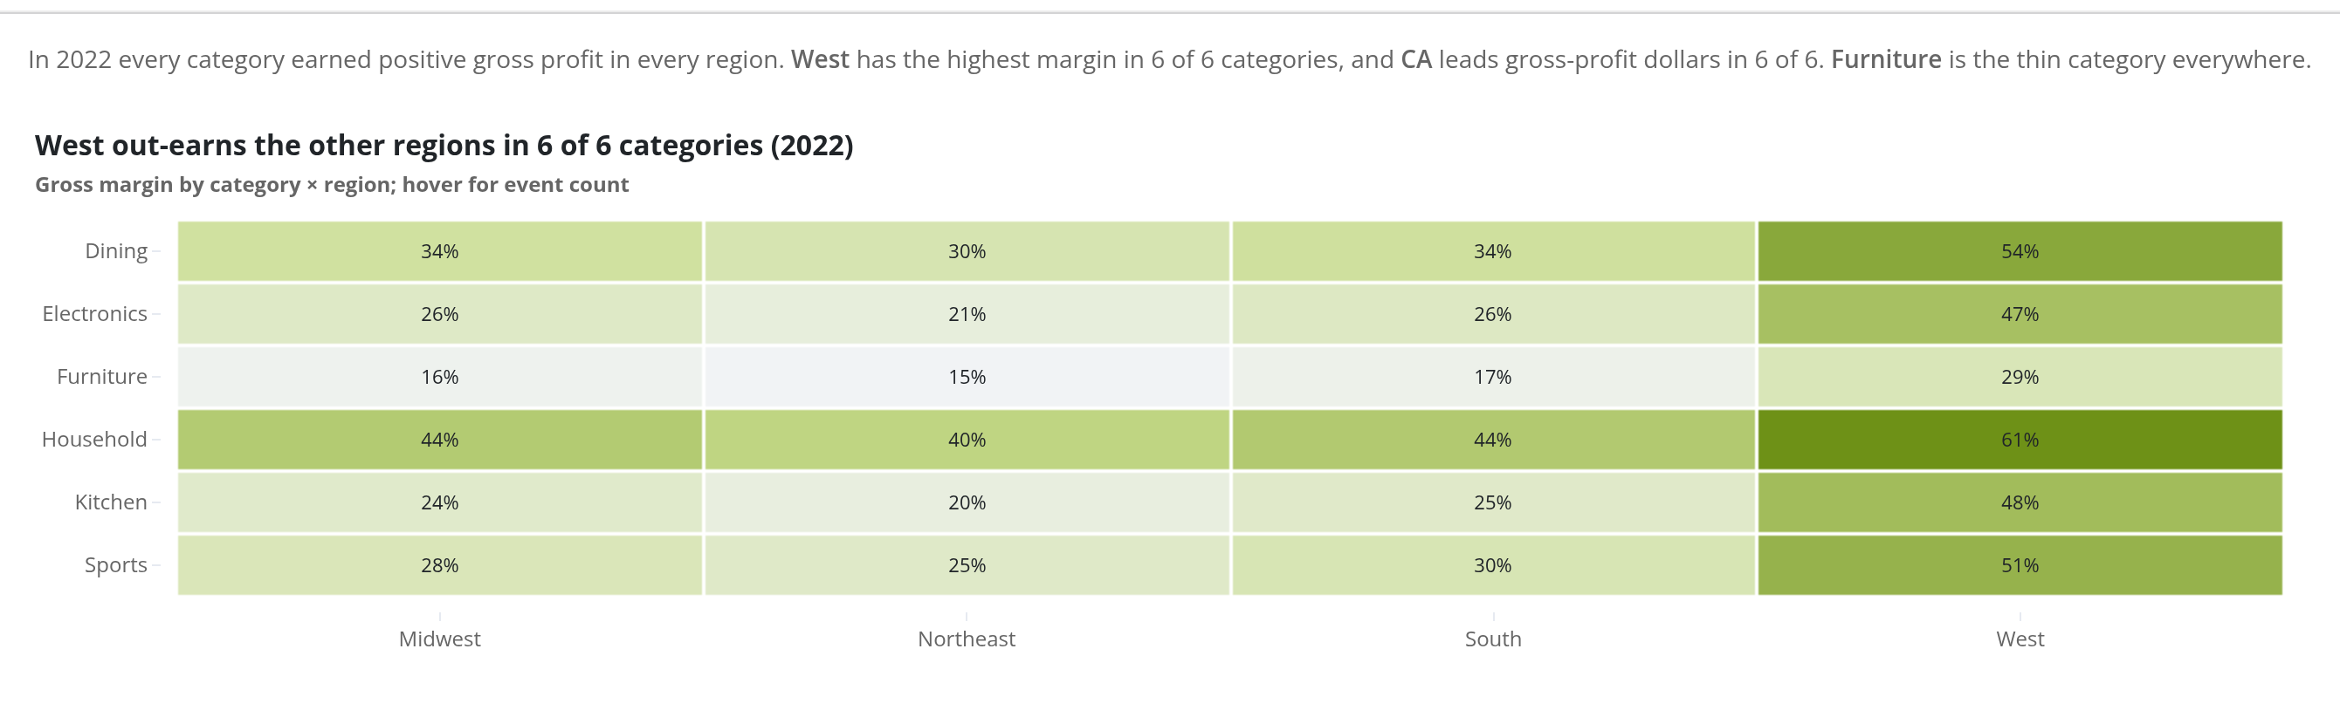
Which product category is profitable where?
Analysis | dashboard capture | gross profit, not net profit

Slide 45
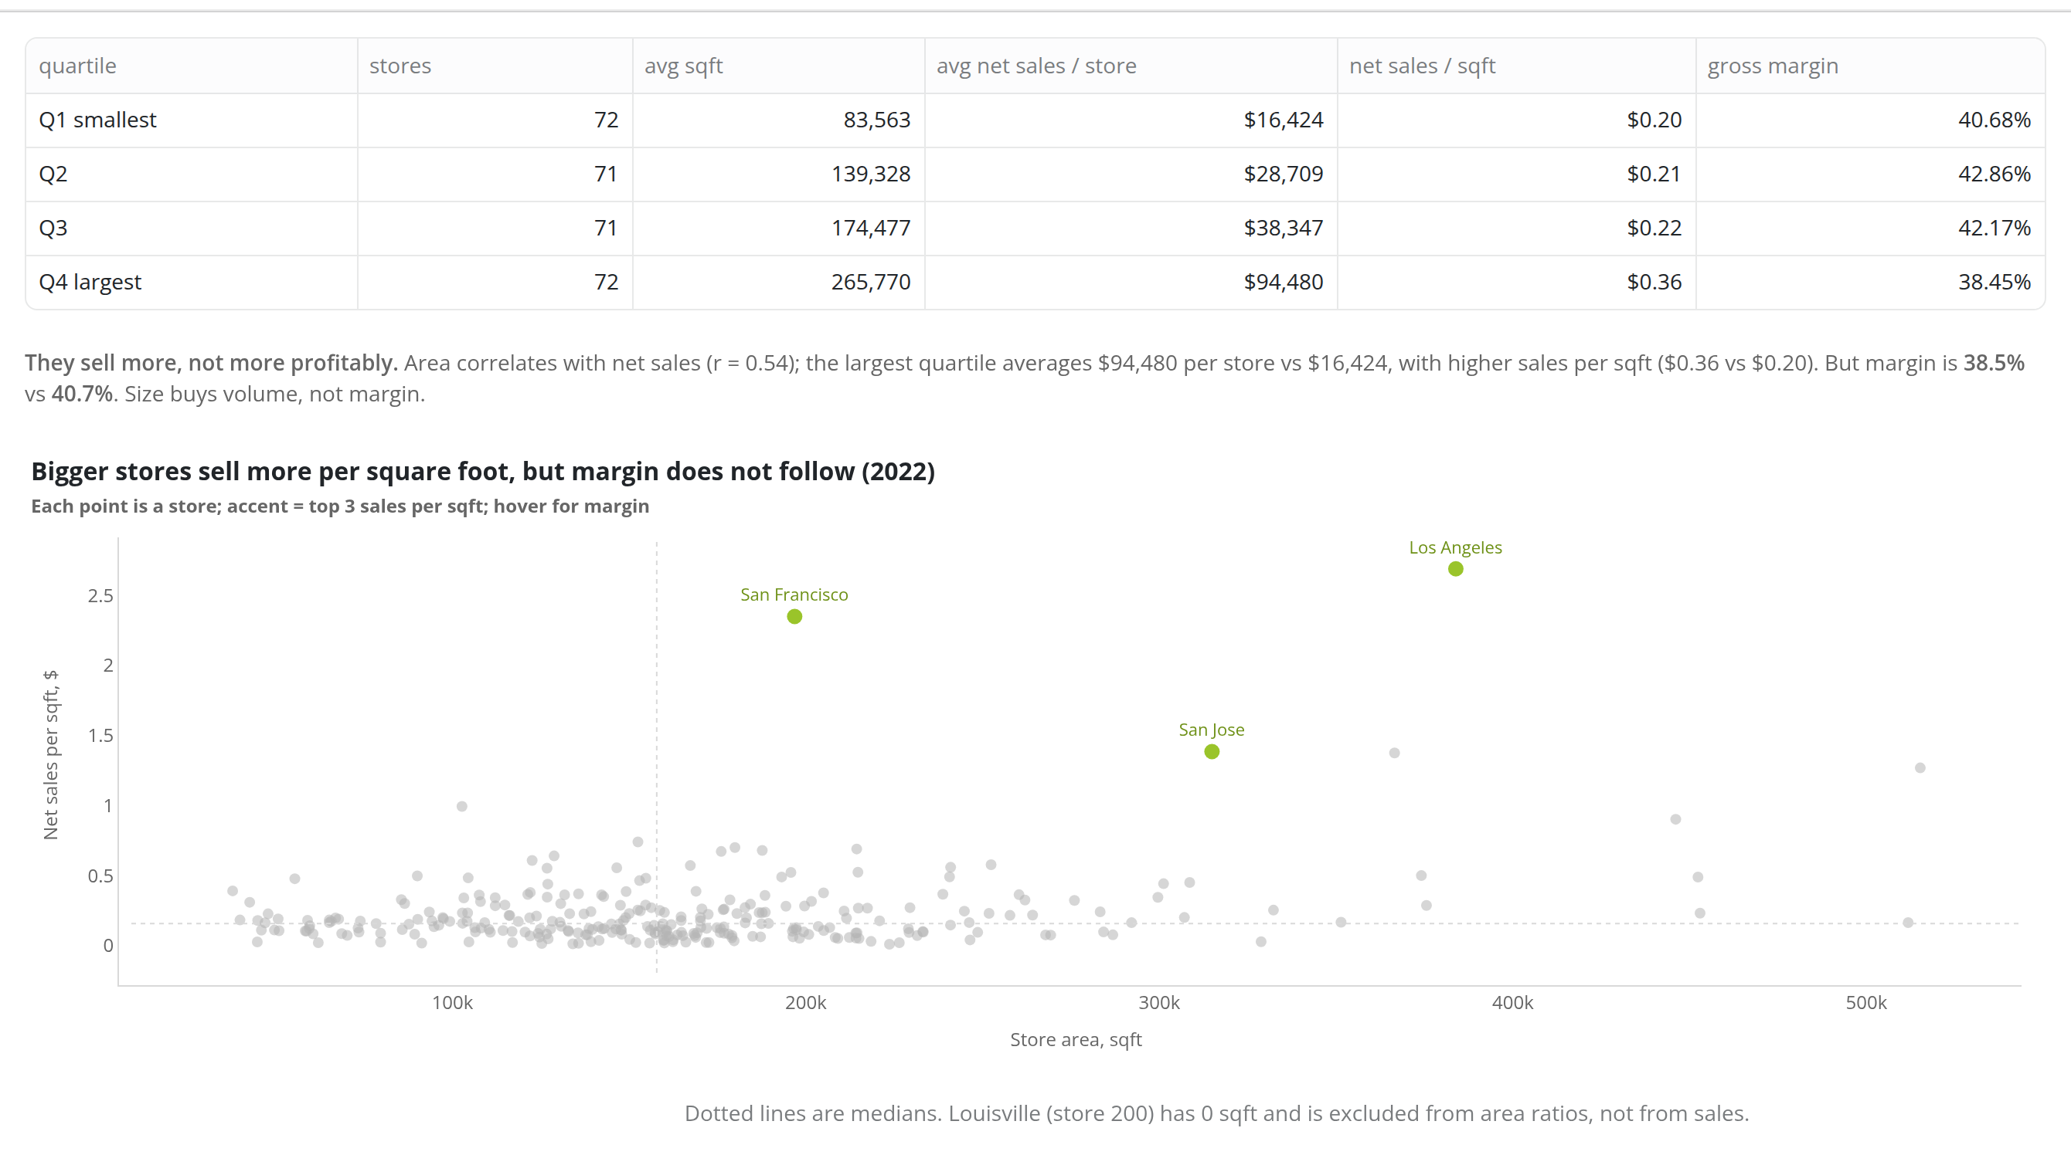
Are larger stores performing better than smaller stores?
Analysis | dashboard capture | gross profit, not net profit

Slide 46
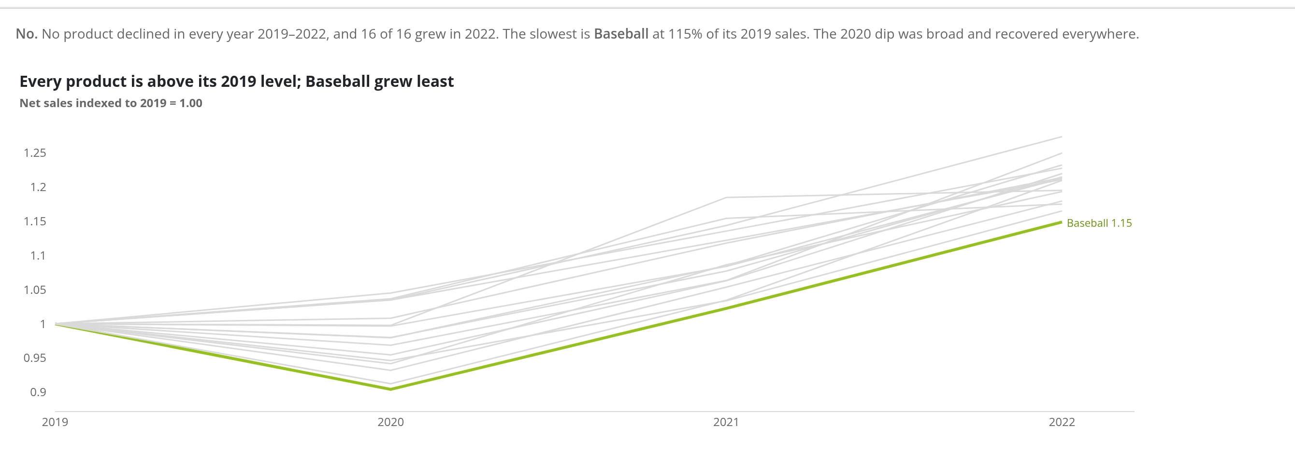
Has any product fallen out of favour so that we lose sales consistently?
Analysis | dashboard capture | gross profit, not net profit

Slide 47
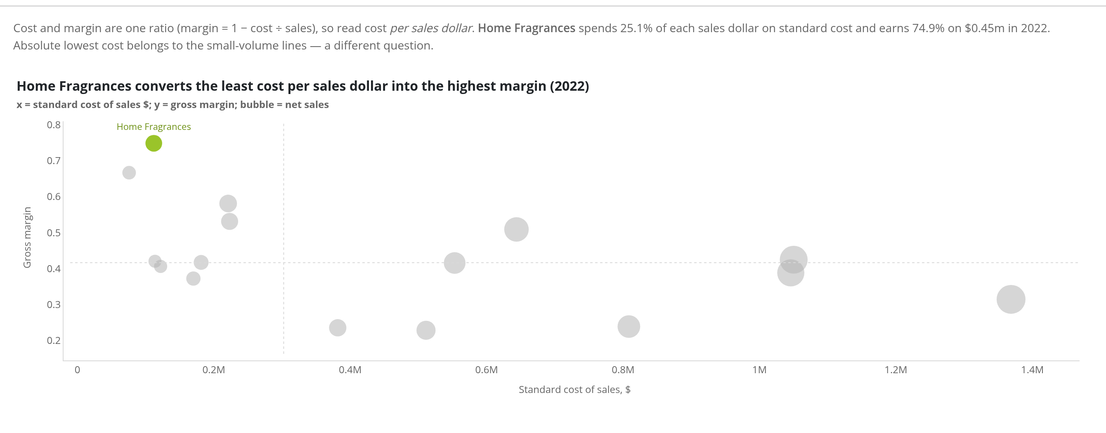
Where has our cost been lowest but margin highest?
Analysis | dashboard capture | gross profit, not net profit

Slide 48
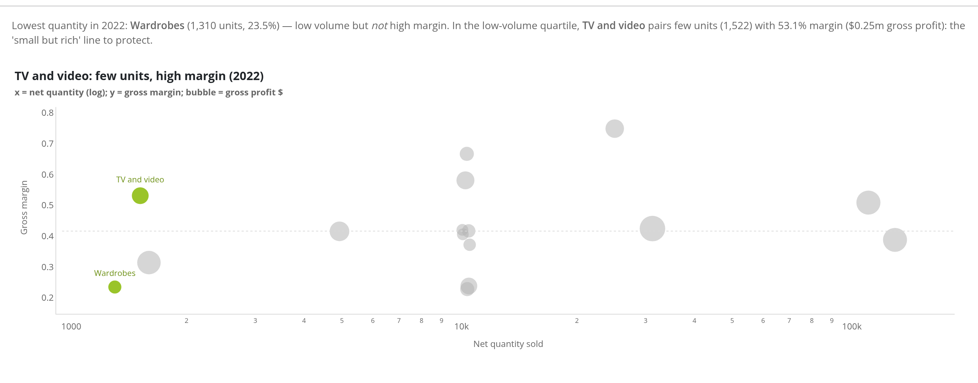
Which product sold the lowest quantity but gave us the highest margin?
Analysis | dashboard capture | gross profit, not net profit

Slide 49
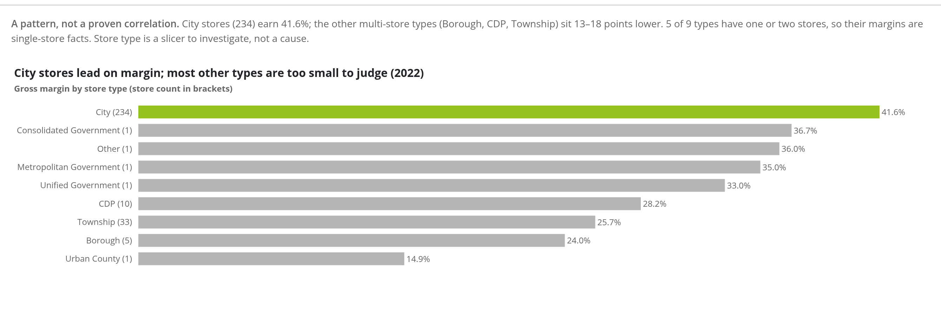
Is there a correlation between store type and profitability in general?
Analysis | dashboard capture | gross profit, not net profit

Slide 50
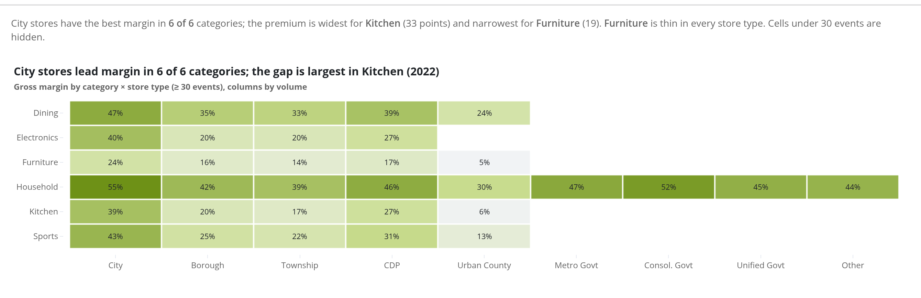
Is there a correlation between store type and profitability for each product category?
Analysis | dashboard capture | gross profit, not net profit

Slide 51
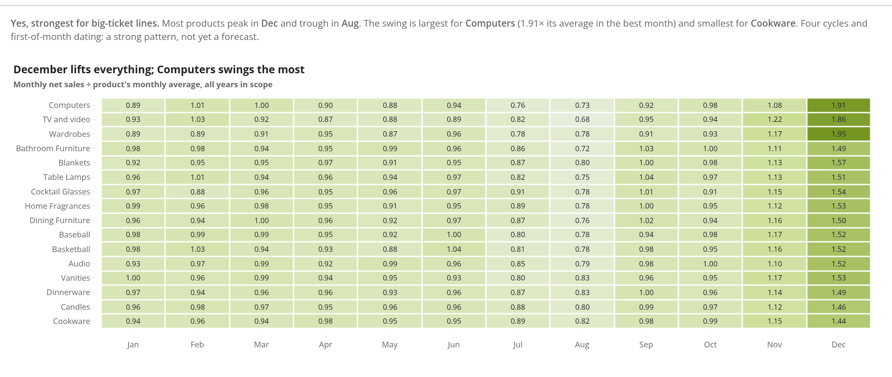
Is there a correlation between time of year and certain products' sales?
Analysis | dashboard capture | gross profit, not net profit

Slide 52
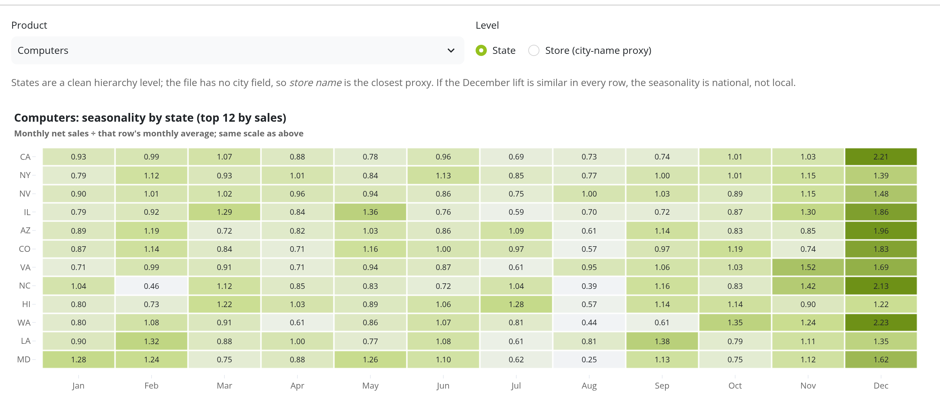
Is there a correlation between time of year and a product's sales in certain states or cities?
Analysis | dashboard capture | gross profit, not net profit

Slide 53
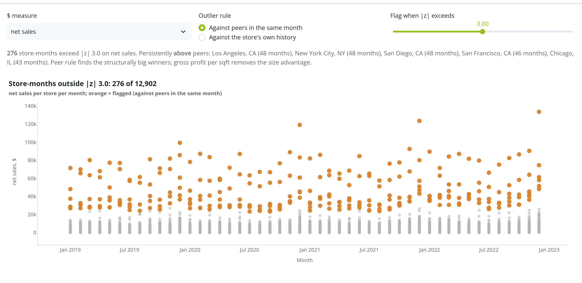
Scatter: $ by time for each store — which stores are outliers?
Analysis | dashboard capture | gross profit, not net profit

Slide 54
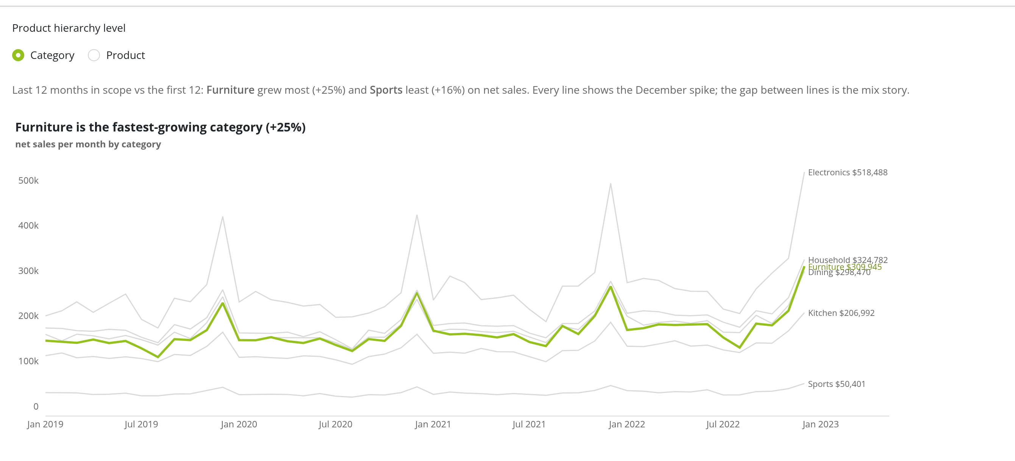
Scatter by product hierarchy: which categories or products are pulling ahead over time?
Analysis | dashboard capture | gross profit, not net profit

Slide 55
10
Roadmap & AI

Slide 56
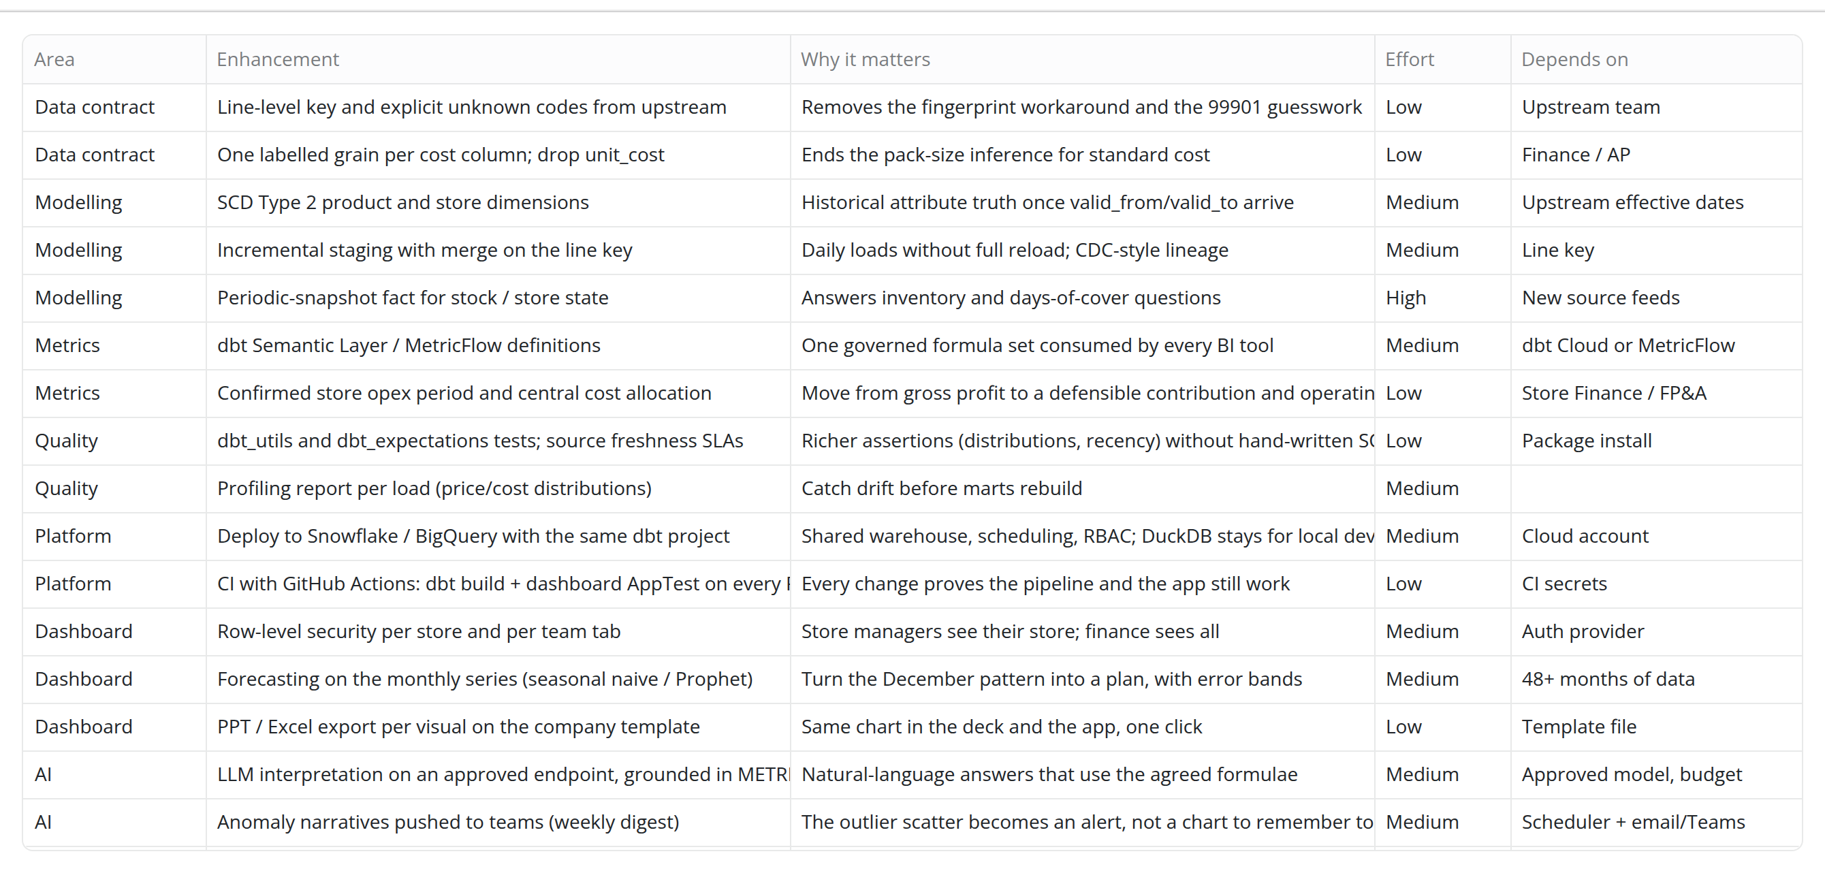
Future enhancements
Roadmap & AI | dashboard capture | gross profit, not net profit

Slide 57
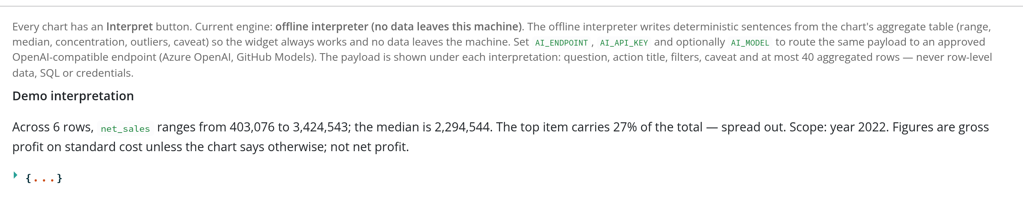
Is there an AI inference widget? Yes — the Interpret button under every visual
Roadmap & AI | dashboard capture | gross profit, not net profit

