Slide 1
STAT 390 CAPSTONE · AUTONOMOUS RESEARCH LOOP
AutoResearch for Spatio-Temporal
Traffic Forecasting on METR-LA
When the agent loop changed the question, not just the answer
The claim: 16 agent iterations cut test RMSE from 15.00 → 11.87 mph — but 94% of the gain came from a per-node temporal encoder, only ~5% from the graph.
Daigo Moriwake · branch autoresearch/may7-gnn · 6-minute talk
Notes:
[~30s] The task is to predict freeway speeds in Los Angeles one hour ahead, across two hundred and seven sensors, using only the previous hour of speeds. Over sixteen iterations of experiments, test error dropped from fifteen miles per hour at the baseline to about eleven point nine. The more important result, which I'll walk through, is that around ninety-four percent of that improvement came from a change that has nothing to do with the graph structure itself.

Slide 2
TOPIC → AUTORESEARCH FORMULATION
From “does a GNN win?” to “where does the gain come from?”
WEEK 1 · ORIGINAL QUESTION
WEEK 5 · REVISED QUESTION (a product of the loop)
“Can a spatio-temporal GNN beat a temporal-only LSTM baseline on METR-LA?”
“Where does the gain come from — temporal encoder, graph topology, or operator — and how much is real vs. seed noise?”
Implicit assumption: the gains come from the spatial model.
The loop itself forced this reframing.
THE AUTORESEARCH CONTRACT
INPUTS
LOOP
OUTPUT
Fixed dataset + fixed eval protocol; one mutable sandbox file (train.py).
Read → Hypothesize → Hack → Commit → Run → Parse → Logic-gate → Log.
A defensible decomposition of where gains come from — not one best number.
Notes:
[~40s] My initial research question was the standard one: can a spatio-temporal graph network outperform a temporal-only LSTM on this dataset? Implicit in that framing is the assumption that any improvement comes from the spatial component. A few weeks in, the question I was actually able to answer was different. It became: where does the improvement come from — the temporal encoder, the graph topology, or the graph operator — and how much of each effect is statistically real, versus seed noise. The setup that made this possible: a fixed dataset and evaluation protocol, one mutable file, and a deliverable that decomposes contributions rather than reporting a single best number.

Slide 3
DATA, METRIC & BASELINE
One honest temporal floor, measured in mph
BASELINE · Vanilla LSTM
THE SUBSTRATE (held constant on every run)
1 layer, hidden 64, treats 207 sensors as features
Dataset
METR-LA freeway speeds · tensor [34272, 207, 1] · 5-min resolution
15.00
Test RMSE (mph)
Task window
12 steps in (1 hour) → 12 steps out (1 hour ahead)
Split
70 / 10 / 20 chronological · no leakage across time
8.91
Test MAE (mph)
Normalization
Per-sensor z-score, statistics fit on train split only
Optimization
Adam + MSE in normalized space · lr 1e-3 · batch 64 · CPU
0.567
Test R²
Evaluation
Denormalized to mph — RMSE / MAE / R² are interpretable
Intentionally simple — the floor against which we measure what graph structure actually adds.
Notes:
[~45s] A short grounding in the data. Everything on the left is held constant across every run, which is what makes the results comparable from one iteration to the next. The dataset is METR-LA freeway speeds — thirty-four thousand timesteps across two hundred and seven sensors, at five-minute resolution. The forecasting window is one hour of input, predicting one hour ahead. One detail worth noting is normalization. I compute the z-score statistics from the training split only, which prevents temporal leakage. Evaluation is denormalized back to miles per hour, so all the metrics on later slides are directly interpretable. The baseline is a one-layer LSTM that treats the sensors as features. It scores fifteen RMSE, around nine MAE, and an R-squared of zero point five-seven. It's a deliberately simple temporal floor — every later number in the project is measured against it.

Slide 4
AGENT LOOP DESIGN
The logic gate is the forcing function
1
2
3
4
5
6
7
8
Read
Hypothesize
Hack
Commit
Run
Parse
Logic-gate
Log
MULTI-METRIC LOGIC GATE
TIER SYSTEM (order is enforced)
KEEP
Tier 1
Methodological controls — ablations & multi-seed reruns. Always committed, never reset. These are measurements.
test_rmse < best AND MAE didn’t rise > 0.3 mph
DISCARD
Tier 2
Structural changes — new operators / topologies. Subject to the multi-metric gate.
otherwise → git reset --hard HEAD~1
Tier 3
Revisits of prior discards under new substrate. Require written justification.
KEEP-MARGINAL
ΔRMSE < 0.1 AND runtime > 1.5× best (flagged, not promoted)
Hard rule: no Tier 2/3 runs while a Tier 1 deliverable is still open.
Notes:
[~60s] This is the structure of the loop. I want to spend a little time on it because the attribution claims later depend on it. The design is intentionally minimal — one file, one metric, and fast iterations. Each change has to defend itself on its own commit, which prevents two improvements from being quietly bundled together. The cycle is: read previous results, write down a hypothesis, edit the code, commit, run, parse the log, and evaluate against the logic gate. The gate has two conditions: a change is kept only if RMSE improves and mean absolute error doesn't rise by more than three tenths of a mile per hour. The MAE guard catches calibration regressions — that's the failure mode that ended iteration five. A separate simplicity gate flags changes that improve accuracy only marginally but increase runtime substantially. On the right is the tier system. Tier one runs are methodological controls — ablations and multi-seed reruns — and these are never discarded. Tier two and three are optimization runs, subject to the gate. The rule is that no architecture experiment runs while a Tier-one measurement is still open, because the value of any architectural change depends on the spatial contribution being real.

Slide 5
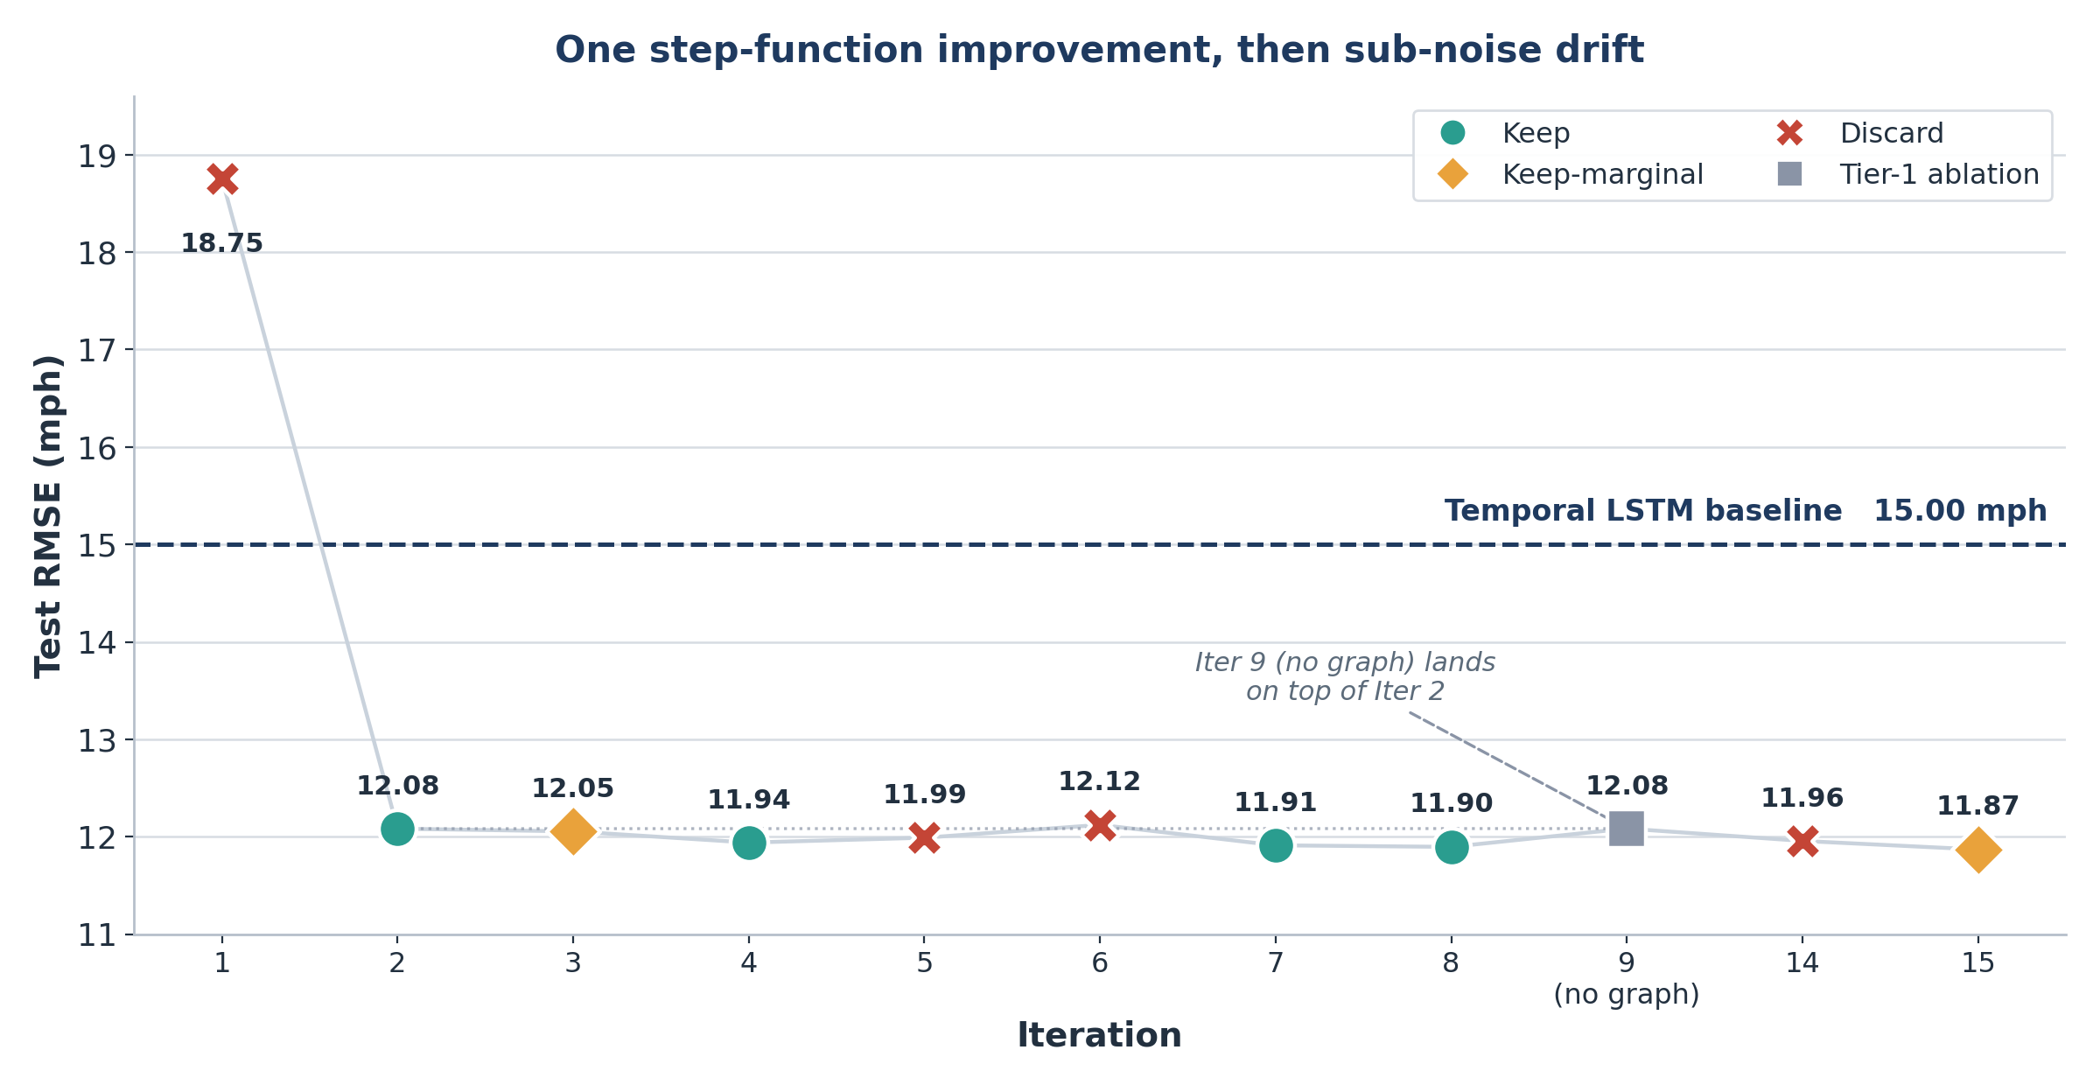
EXPERIMENT TRACE
One step-function win; everything after is decimal noise
Iter | Change | RMSE
1 | Broken broadcast arch | 18.76
2 | Per-node LSTM + GCN skip | 12.08
4 | Correlation adjacency | 11.94
7 | 10 epochs (best 3-seed) | 11.91
9 | Tier-1: no graph at all | 12.08
15 | ChebConv K=2 (marginal) | 11.87
Iter 1 → 2: −6.67 RMSE. The single biggest jump in the project. Every other change moves RMSE by < 0.2.
Notes:
[~45s] This is the experiment trace. Each point is one completed iteration plotted at its test RMSE, color-coded by the decision made. Iteration one used a flawed architecture and scored worse than the baseline, at eighteen point eight. Iteration two corrected the architecture and dropped to twelve point one. That single transition accounts for nearly all of the improvement in the project. Every subsequent iteration moves the metric by less than two tenths of a point. The grey point at iteration nine is the one to flag. That was an ablation using the same per-node temporal encoder but no graph layer at all. It lands almost exactly at iteration two's score, which sets up the result on the next slide.

Slide 6
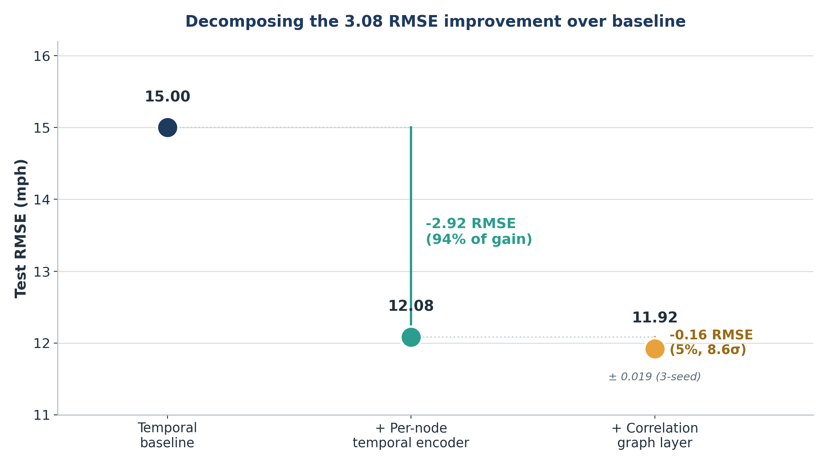
FINAL RESULT & STABILITY
94% of the gain is the encoder, not the graph
DECOMPOSITION, WITH ERROR BARS
Stage | Δ RMSE | Verdict
Per-node encoder | −2.92 | Real — 94%
Correlation graph | −0.16 | Real, 8.6σ — 5%
Longer training | −0.03 | Borderline p≈0.07
2nd GAT layer | −0.02 | Unproven, 1-seed
Iter 8 MAE “win” | — | Refuted (noise)
SEED NOISE FLOOR
Iter 7 (3-seed): RMSE 11.920 ± 0.019, MAE ± 0.27 Any single-seed claim below ±0.02 RMSE / ±0.27 MAE is uninterpretable. The Iter 8 “calibration win” sat entirely inside that band.
Notes:
[~60s] This slide presents the main result. Iteration nine — the ablation with no graph layer — scored twelve point zero eight. That means the graph layer, added on top of the temporal encoder, accounts only for the difference between twelve point zero eight and eleven point nine two. Decomposed against the baseline: about ninety-four percent of the three-point-one improvement comes from the per-node temporal encoder, and roughly five percent from the correlation graph. The five-percent contribution is statistically real — about eight point six sigma across seeds — but it's a small effect, and the original framing of the project did not correctly identify where the improvement was coming from. I can make that decomposition with confidence because the seed-noise floor is about two-hundredths of a point of RMSE and a quarter point of MAE. The iteration-eight result that initially looked like an MAE improvement was within that noise band on a single seed.

Slide 7
WHAT WORKED VS. WHAT FAILED
Two real wins, five named failure modes
WHAT WORKED
FAILURE TAXONOMY
Per-node temporal encoding −6.67 RMSE
T1
Representation collapse
Reshape (B,T,N)→(B·N,T,1) gave each sensor its own embedding. The only step-function win.
Iter 1 — shared embedding broadcast to all nodes; GNN has nothing to say.
T2
Optimization instability
Iter 5 — 2-layer LSTM on T=12; MAE +0.74 while RMSE looked flat.
Correlation > physical adjacency −0.12 RMSE
Pearson-K5 neighbors (train-split) beat physical neighbors — free, and 4× the GCN→GAT gain. Topology > operator.
T3
Capacity overshoot
Iter 6 — hidden 96 overfits in last epochs at fixed budget.
T4
Topology misspecification
The logic gate as forcing function procedural
Iter 3 — GAT on the wrong graph; switching adjacency gave 4× more.
Auto-discarded Iter 5 & 6. This is what made the attribution defensible.
T5
Compute-quality mismatch
Iter 3 & 15 — small gain bought at 1.6–2.5× runtime.
Notes:
[~55s] Two changes produced most of the improvement. The first is per-node temporal encoding. In the original architecture, every sensor was passed through one shared LSTM and a single embedding was broadcast across all of them, which meant the graph layer was averaging two hundred near-identical vectors. Giving each sensor its own pass through the LSTM produced the only step-function improvement in the project. The second is correlation-based adjacency — choosing neighbors that behave similarly outperformed using physically adjacent ones, at no additional computational cost. On the right are five named failure modes, each grounded in a specific iteration: representation collapse, optimization instability, capacity overshoot, topology misspecification, and compute-quality mismatch. I'll also note two procedural issues: single-seed evaluation early on, and a logging bug that re-ran the same configuration multiple times.

Slide 8
REFLECTION · WHAT THIS TAUGHT US ABOUT AGENT-ASSISTED RESEARCH
The discipline that mattered was not the architecture search
1
The loop changed the question.
2
The gate is necessary, not sufficient.
A Tier-1 ablation collapsed “GNNs help” into “the encoder is the lever.” Pure optimization never surfaces this.
It catches catastrophic regressions, but selection on one seed manufactures significance. Require ≥3 seeds for ΔRMSE < 0.05.
3
Watch every metric.
4
Compute-quality needs its own gate.
RMSE alone nearly missed Iter 5’s calibration failure. Squared error quietly accepts MAE regressions.
Gains that pass an accuracy gate can still fail a cost-aware reading. The simplicity gate flags them.
THE PUNCHLINE
Agents run experiments faster than humans — but the value came from wiring the loop to ask “is this real?” alongside “is this better?”. Half the budget went to putting error bars on the loop’s own claims.
Best defensible: 11.92 ± 0.019 (3-seed) Real effects: encoder −2.92 · graph −0.16 Caveat: Iter 15 best (11.87) still single-seed
Notes:
[~55s] To close, four methodological lessons. First, the research question changed during the project — an ablation, rather than an optimization step, was what reframed it. Second, the keep-discard gate is necessary but not sufficient; selection on a single seed produces apparent statistical significance, which is why I now require at least three seeds for small claims. Third, monitoring a single metric is risky — RMSE alone nearly missed a calibration failure in iteration five. Fourth, compute-quality tradeoffs need an explicit gate of their own. The broader takeaway is that a logic-gated experimental loop can still be misled if the gate isn't designed to ask whether a result is real, in addition to whether it's better. On limitations: the defensible final number is eleven point nine two RMSE. The project uses one dataset, a fixed window, and CPU compute only. Thank you.

