Slide 1
Font Generation Using zi2zi with Self-Attention Mechanism

Slide 2
Outline
Architecture
Loss
Dataset
Results
Conclusion
Reference

Slide 3
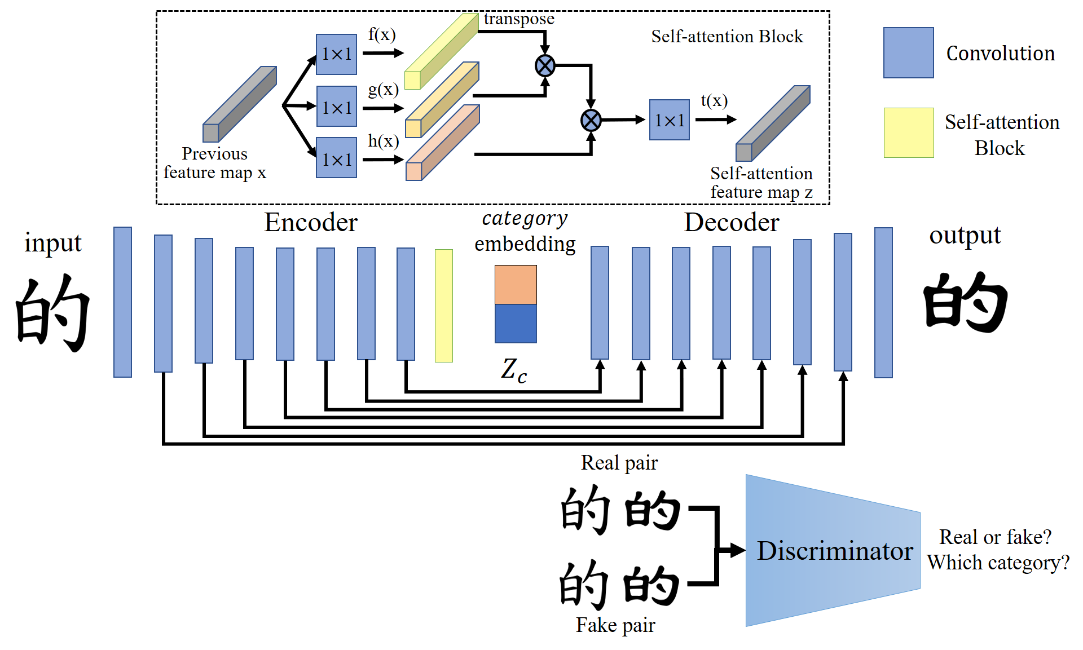
Architecture

Slide 4
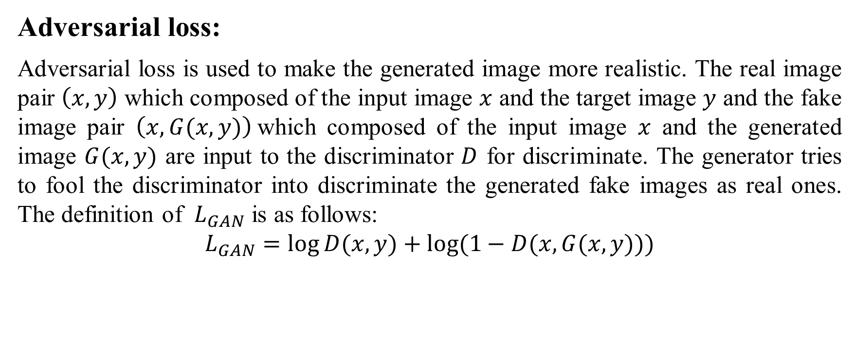
Loss
Adversarial loss:
Adversarial loss is used to make the generated image more realistic. The real image pair $\left(x,y\right)$ which composed of the input image $x$ and the target image $y$ and the fake image pair $\left(x,G(x, y)\right)$which composed of the input image $x$ and the generated image $G(x, y)$ are input to the discriminator $D$ for discriminate. The generator tries to fool the discriminator into discriminate the generated fake images as real ones. The definition of $L_{GAN}$ is as follows:
$$L_{GAN}=log⁡D(x,y)+log⁡(1−D(x,G(x,y)))$$

Slide 5

Loss
Pixel wise loss :
In order to make the generated image more similar to the target image, use pixel wise loss $L_{p}$ to compare the target image $y$ with the generated image $G(x,y)$. $L_{p}$ is defined as follows:
$$L_{p}={\left\|y−G(x,y)\right\|}_{1}$$

Slide 6
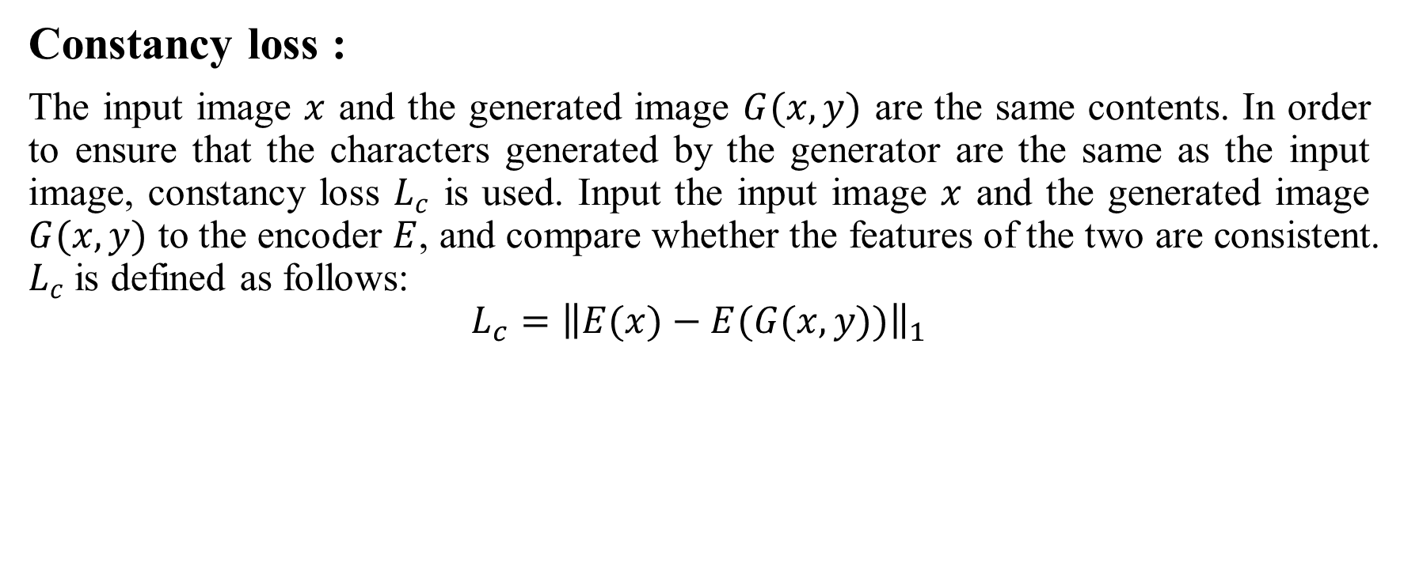
Loss
Constancy loss :
The input image $x$ and the generated image $G(x,y)$ are the same contents. In order to ensure that the characters generated by the generator are the same as the input image, constancy loss $L_{c}$ is used. Input the input image $x$ and the generated image $G(x,y)$ to the encoder $E$, and compare whether the features of the two are consistent. $L_{c}$ is defined as follows:
$$L_{c}={\left\|E(x)−E(G(x,y))\right\|}_{1}$$

Slide 7
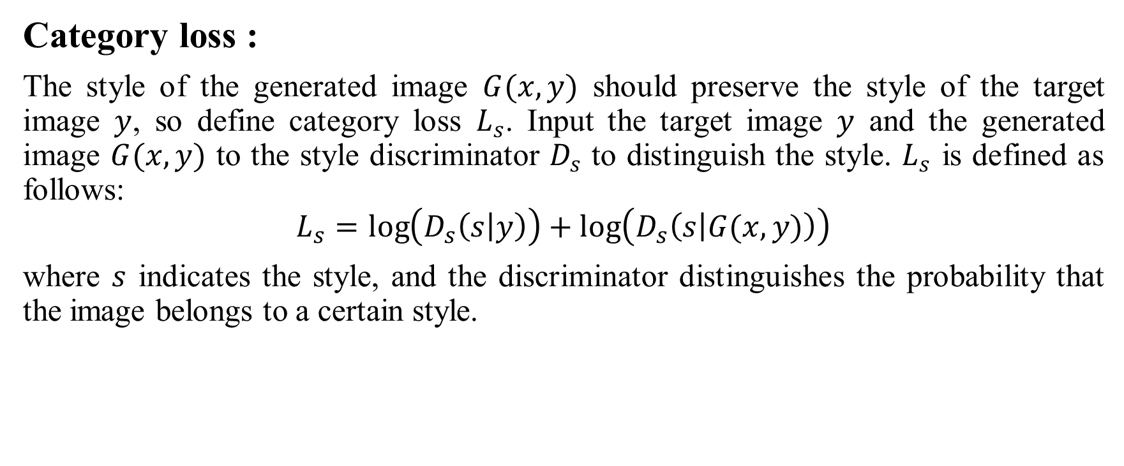
Loss
Category loss :
The style of the generated image $G(x,y)$ should preserve the style of the target image $y$, so define category loss $L_{s}$. Input the target image $y$ and the generated image $G(x,y)$ to the style discriminator $D_{s}$ to distinguish the style. $L_{s}$ is defined as follows:
$$L_{s}=\log\left(D_{s}\left(s | y\right)\right)+\log\left(D_{s}\left(s | G(x,y)\right)\right)$$
where $s$ indicates the style, and the discriminator distinguishes the probability that the image belongs to a certain style.

Slide 8

Loss
Objective function:
Combining all the losses mentioned above, the overall objective function of our GAN is defined as follows:
$$L=L_{GAN}+{λ_{p}L}_{p}+{λ_{c}L}_{c}+{λ_{s}L}_{s}$$
where $λ_{p}$, $λ_{c}$and $λ_{s}$ are the weights that control the importance of each loss.

Slide 9
Dataset
Font style: kai, lisu, yoazai and 2 handwriting.
3,000 characters for each style.
2,700 characters for training, and 300 for testing.
Yoazai and 2 handwriting font style transfer to kai and lisu font style for training.

Slide 10


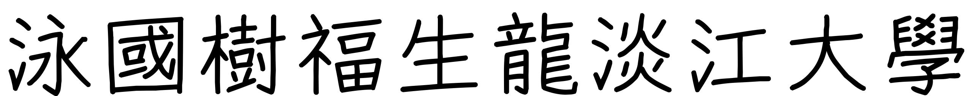
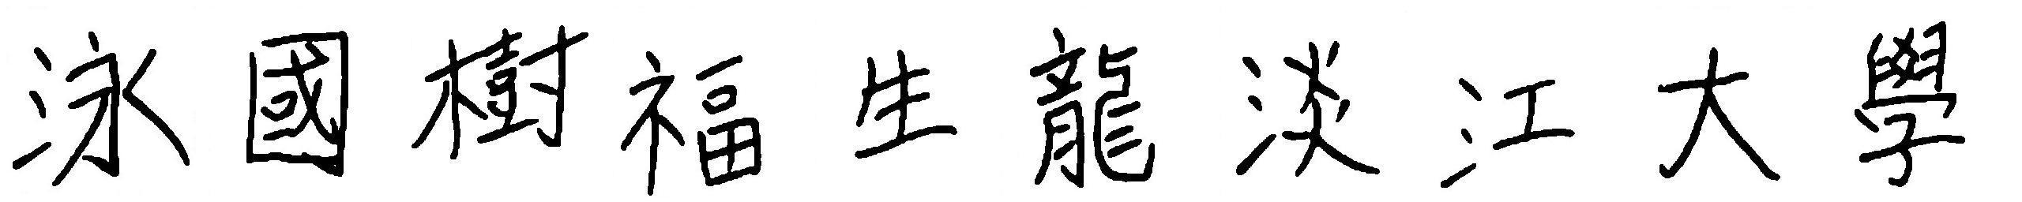
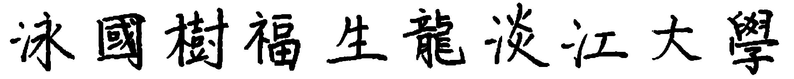
Dataset
kai:
lisu:
yoazai:
handwrting1
handwrting2

Slide 11

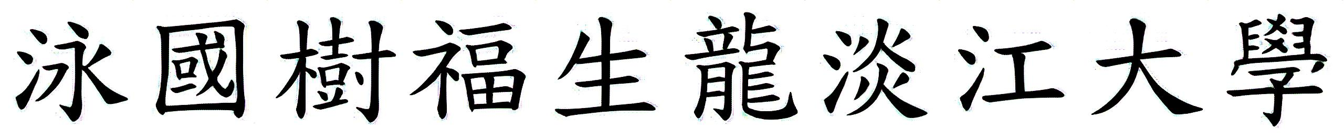
Results
Source
Zi2zi
zi2zi+attn
Target
Yoazai to kai

Slide 12

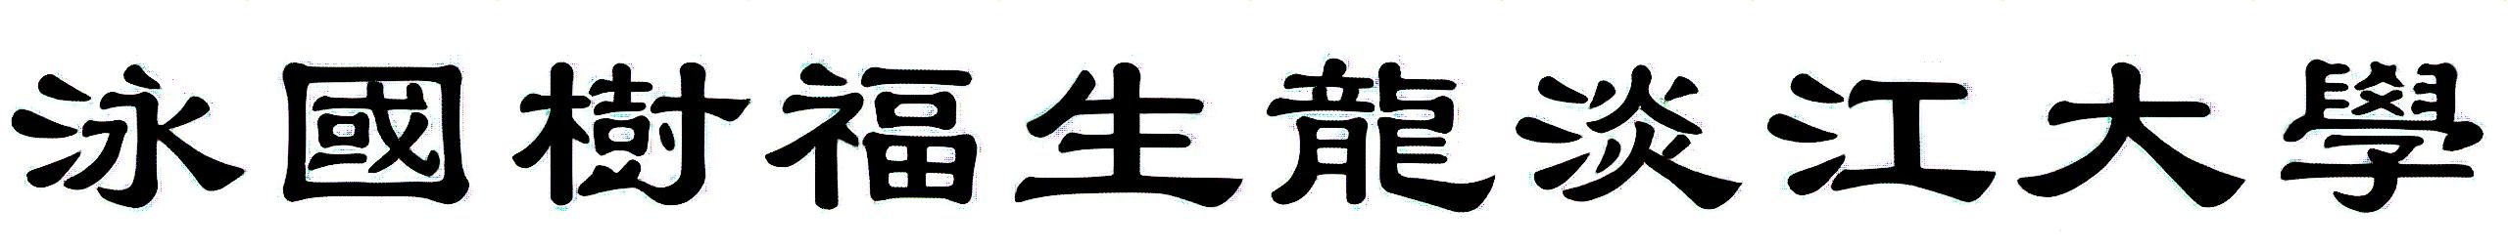
Results
Source
Zi2zi
zi2zi+attn
Target
Yoazai to lisu

Slide 13
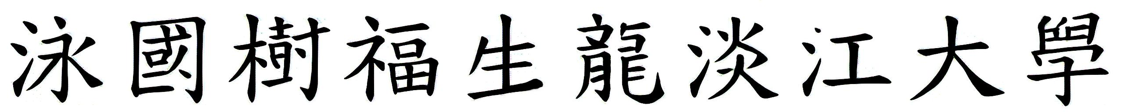
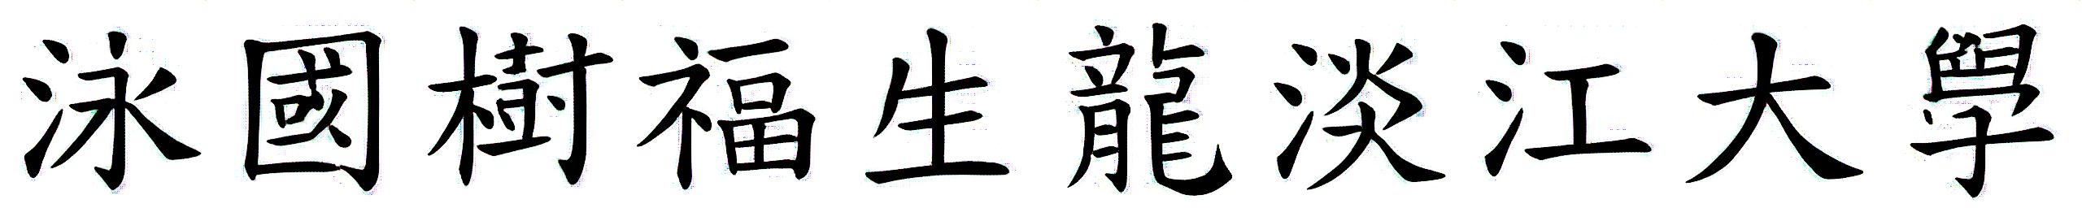
Results
Source
Zi2zi
zi2zi+attn
Target
Handwrting1 to kai

Slide 14

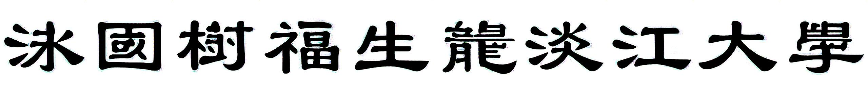
Results
Source
Zi2zi
zi2zi+attn
Target
Handwrting1 to lisu

Slide 15
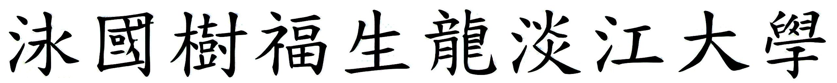
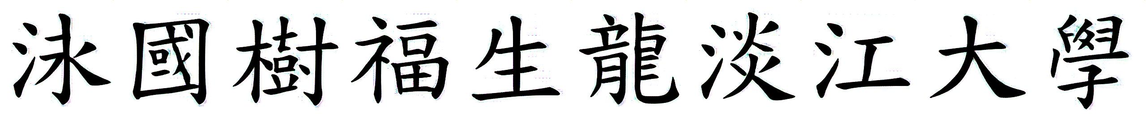
Results
Source
Zi2zi
zi2zi+attn
Target
Handwrting2 to kai

Slide 16
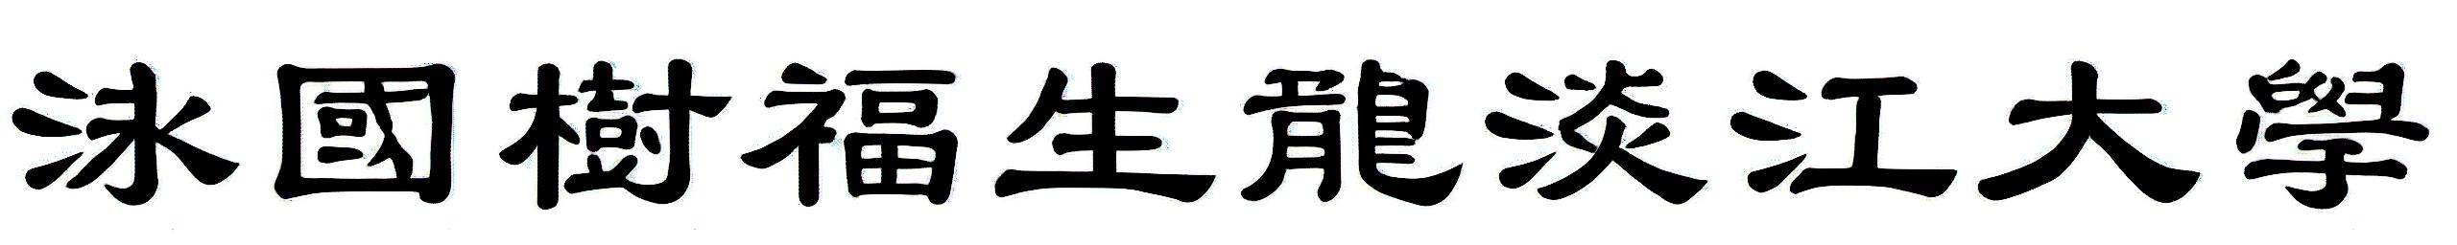
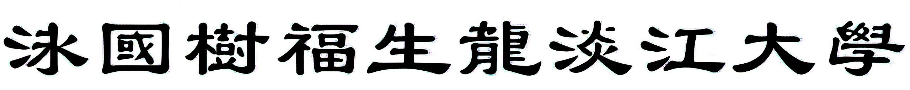
Results
Source
Zi2zi
zi2zi+attn
Target
Handwrting1 to lisu

Slide 17
Results
Similarity compare:
 | MSE | SSIM
zi2zi | 4870.7300 | 0.7470
zi2zi+attn | 4718.9024 | 0.7411

Slide 18
Conclusion
Training zi2zi with self-attention mechanism.
Comparing the generation results of models.
Adding a self-attention block can help the model generate better results in some strokes or areas.

Slide 19
References
[1] Yuchen Tian, “zi2zi: Master chinese calligraphy with conditional adversarial networks.,” https://github.com/kaonashi-tyc/zi2zi, 2017.
[2] Euphoria Yan, “zi2zi: Master chinese calligraphy with conditional adversarial networks.,” https://github.com/EuphoriaYan/zi2zi-pytorch, 2020.
[3] Zhang, Han, et al. “Self-attention generative adversarial networks,” International conference on machine learning. PMLR, 2019.

