Slide 1
Linear regression : Model
For conciseness, define
Define

Slide 2
Linear regression : Cost Function
Cost function:
——ith training example
When we choose parameters ,we minimize our cost function

Slide 3
Gradient Descent for Linear Regression
Linear regression:
hypothesis
cost function
Gradient descent:
repeat until converge

Slide 4
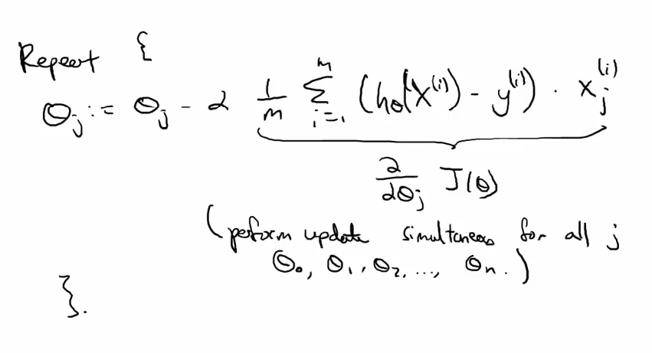

Slide 5
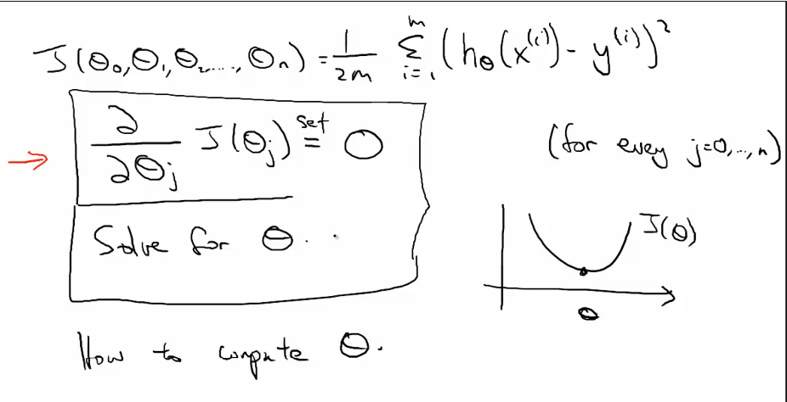
Normal equation

Slide 6
假设我们有m个examples（训练样本），
n个features（特征）
首先计算design matrix

Slide 7
当n=1时，
The solution of

Slide 8
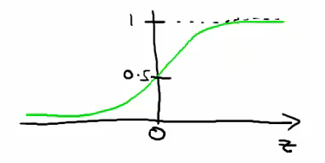
Logistic regression : Model
We have class labels , we want a classifier, and How to represent the hypothesis?
In particular
the output value between 0 and 1
called sigmoid function or logistic function

Slide 9
Logistic Regression : Optimization Objective II
Assume y always equals 0 or 1.

Slide 10
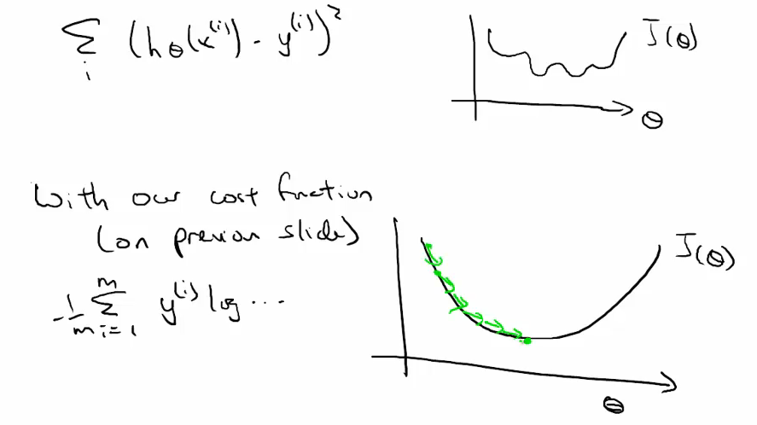

Slide 11
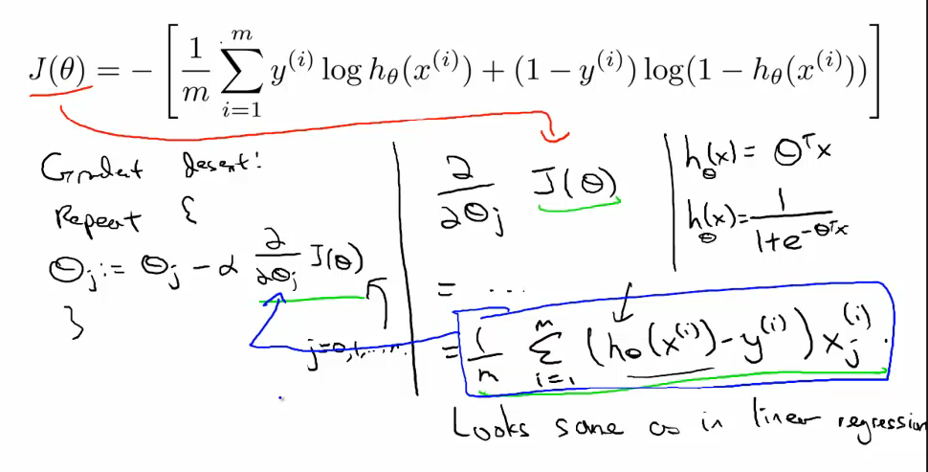
Logistic Regression : Gradient Descent

Slide 12
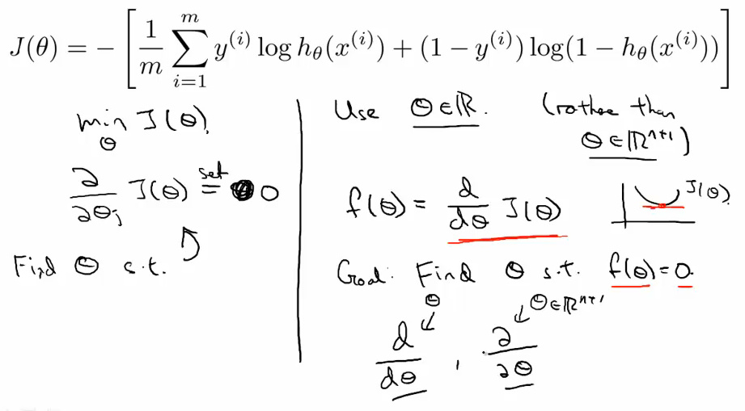
Logistic Regression : Newton’s Method

Slide 13
Logistic Regression : Newton’s Method II
When θ is a raw number
When θ is a vector of parameter
H is called Hessian matrix of J

Slide 14
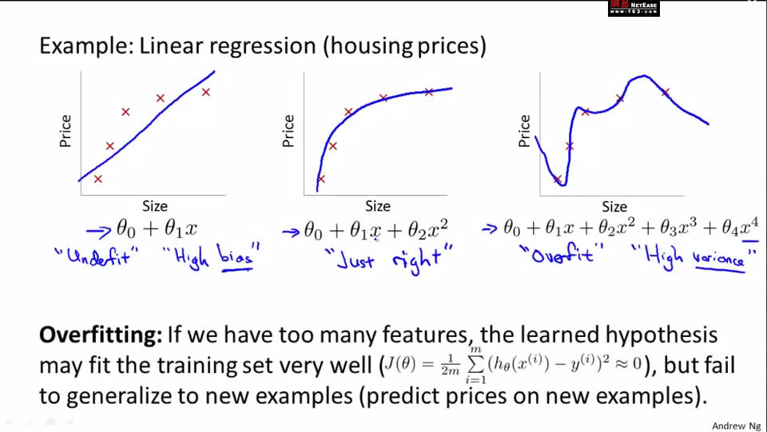
Regularization : The problem of overfitting
What is overfitting?

Slide 15
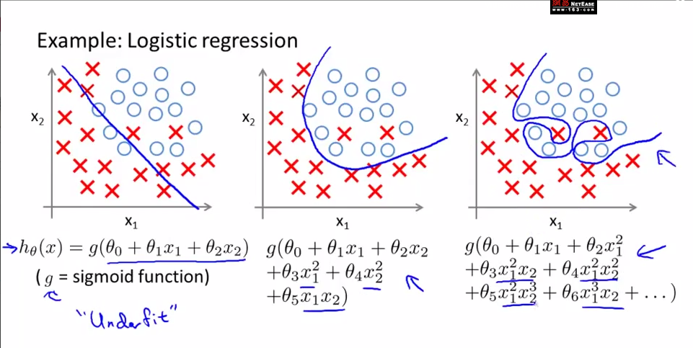

Slide 16
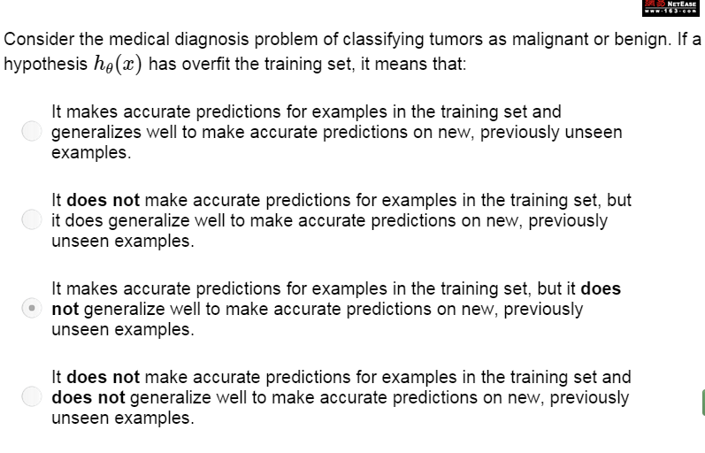

Slide 17
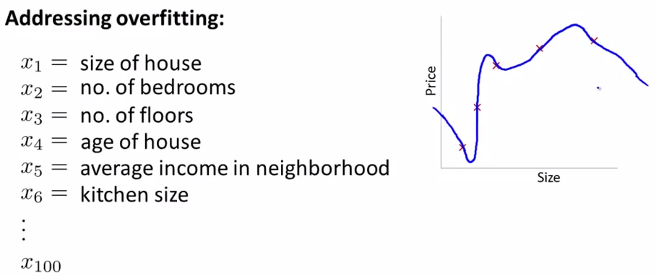

Slide 18
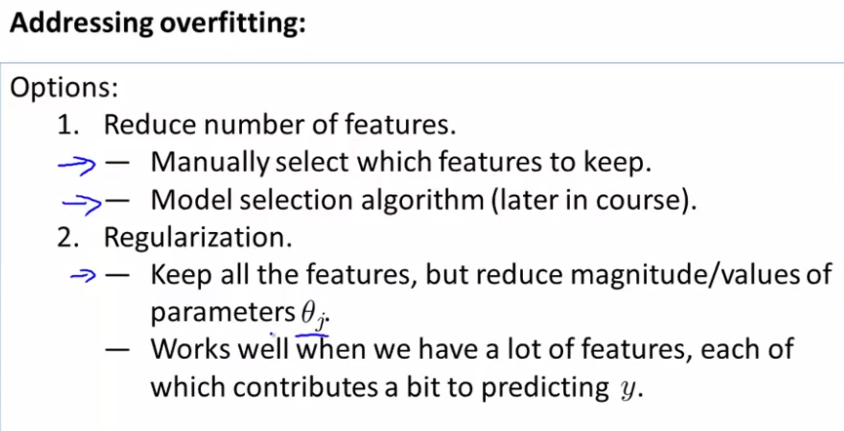
Model selection algorithm : automatically deciding which features keep, which features throw out.

Slide 19
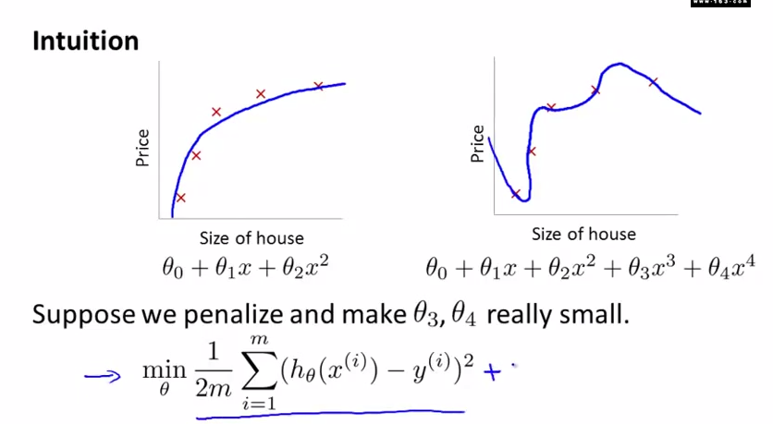
Regularization : Cost function

Slide 20
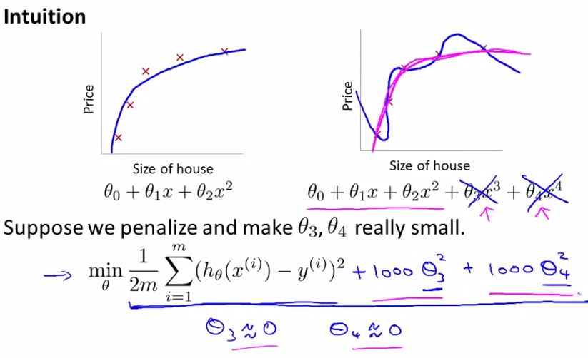

Slide 21
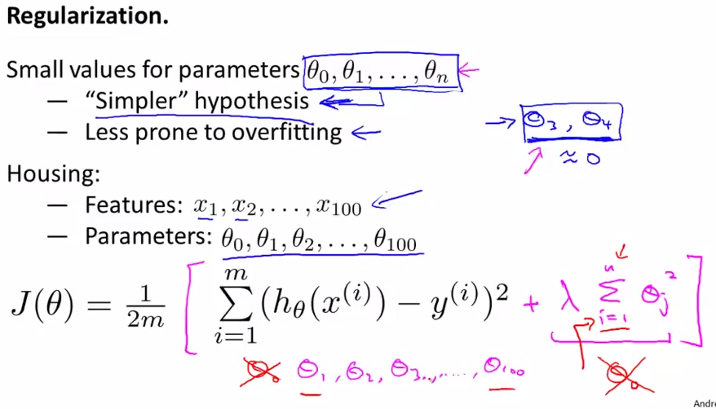

Slide 22
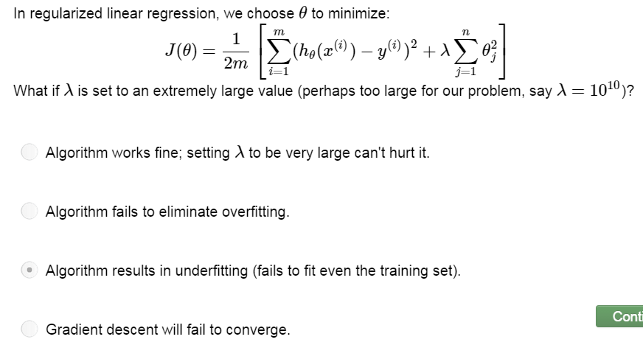

Slide 23
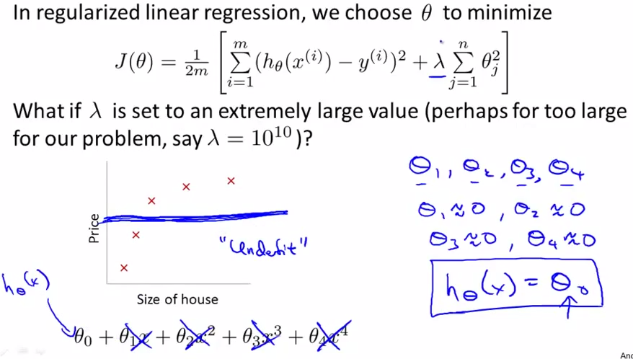

Slide 24
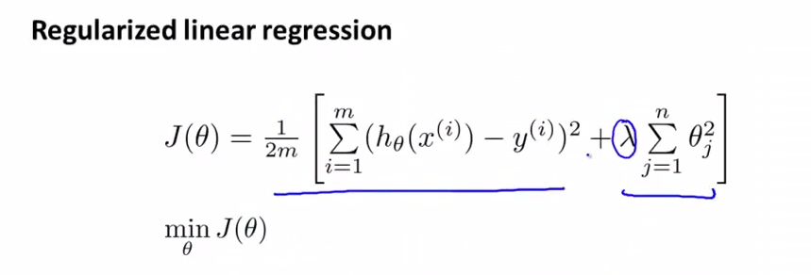
Regularized linear regression
usual objective for linear regression
additional regularization term
regularization parameter

Slide 25
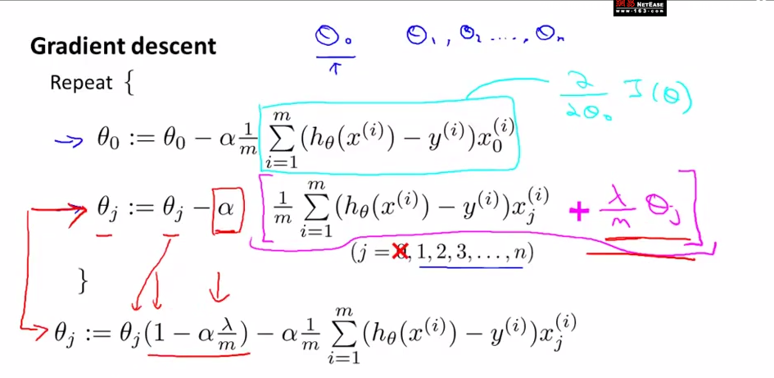

Slide 26
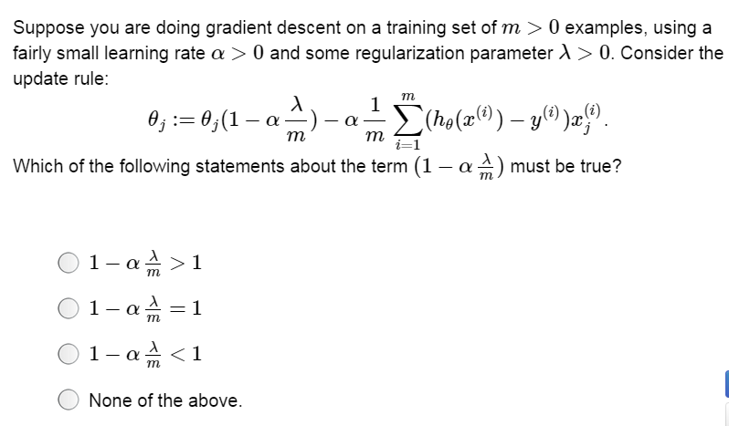

Slide 27
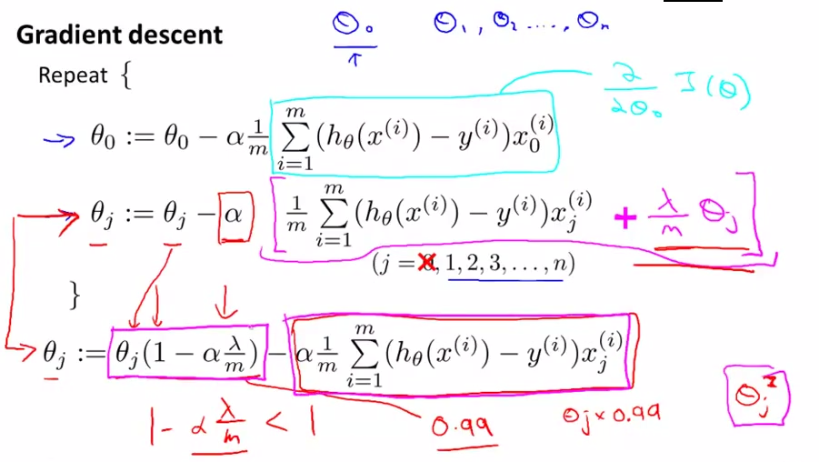

Slide 28
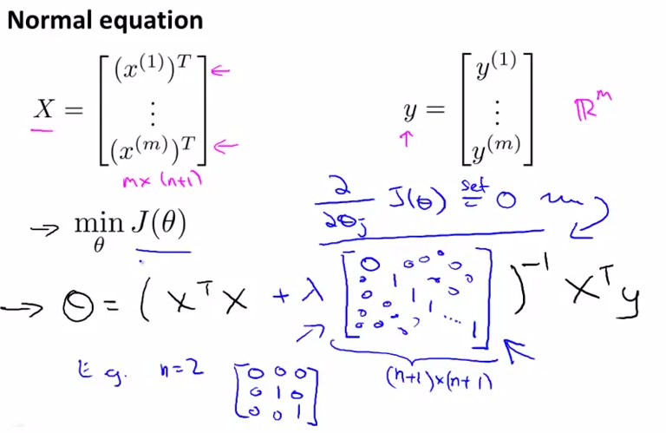

Slide 29
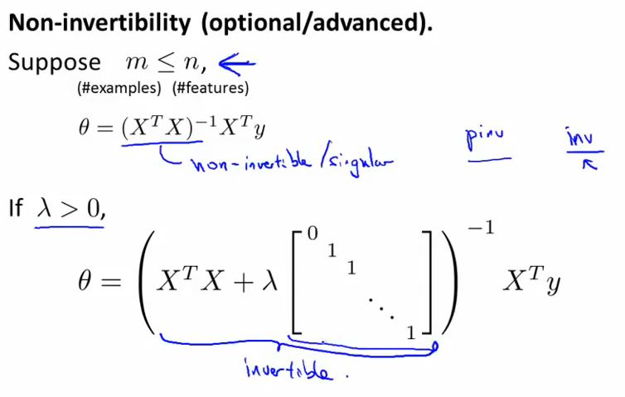

Slide 30
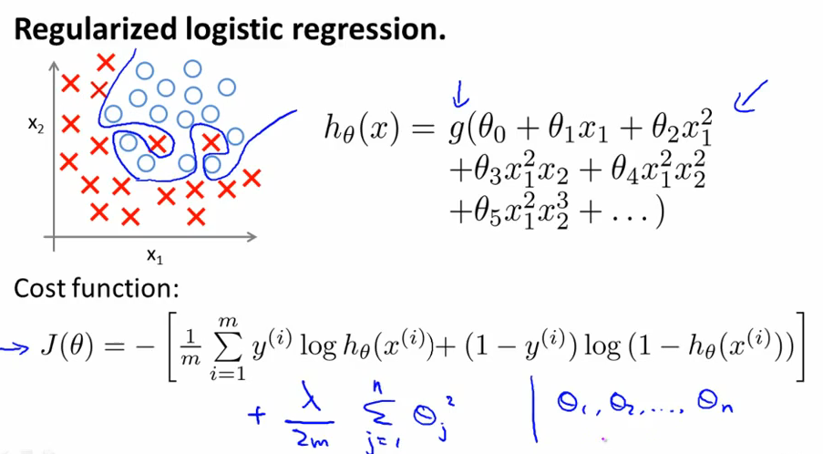
When using regularization, even you have a lot of features, the regularization can care of the overfitting problem.

Slide 31
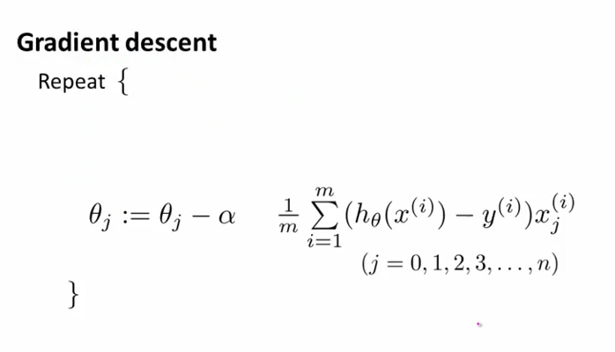

Slide 32
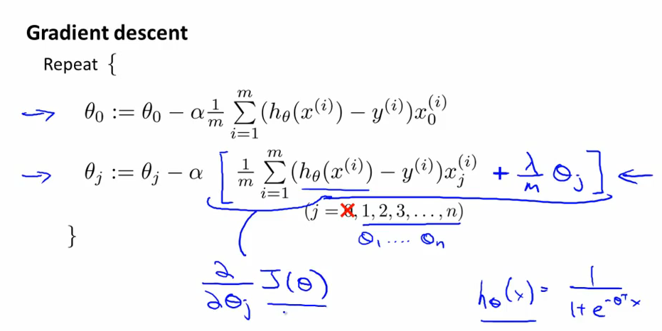

Slide 33
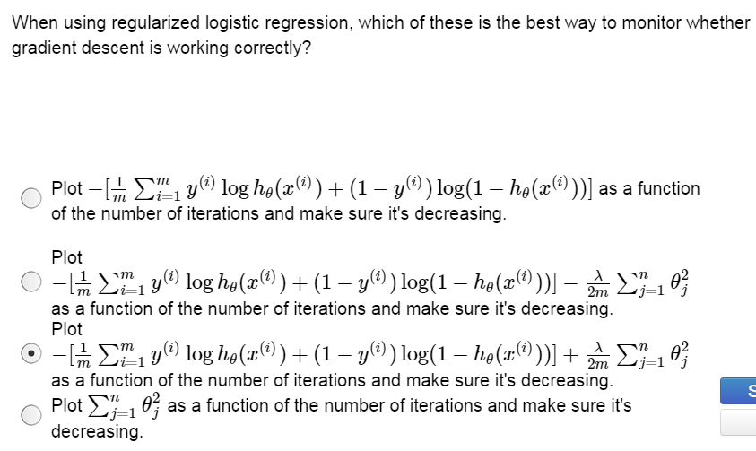

Slide 34
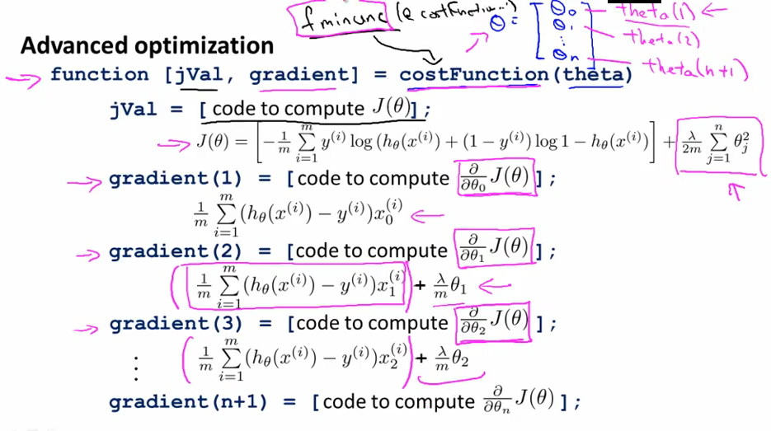

Slide 35
so if you implement this cost function and pass this into fminunc or to one of those advanced optimization techniques, that will minimize the new regularized cost function J of θ, and parameters you get out will be the ones that correspond to the logistic regression with regularization. So, you know how to implement the logistic regression with regularization.

