Slide 1
Detecting Human Body Parts and Building Skeleton Models using Deep Convolutional Neural Networks

Slide 2
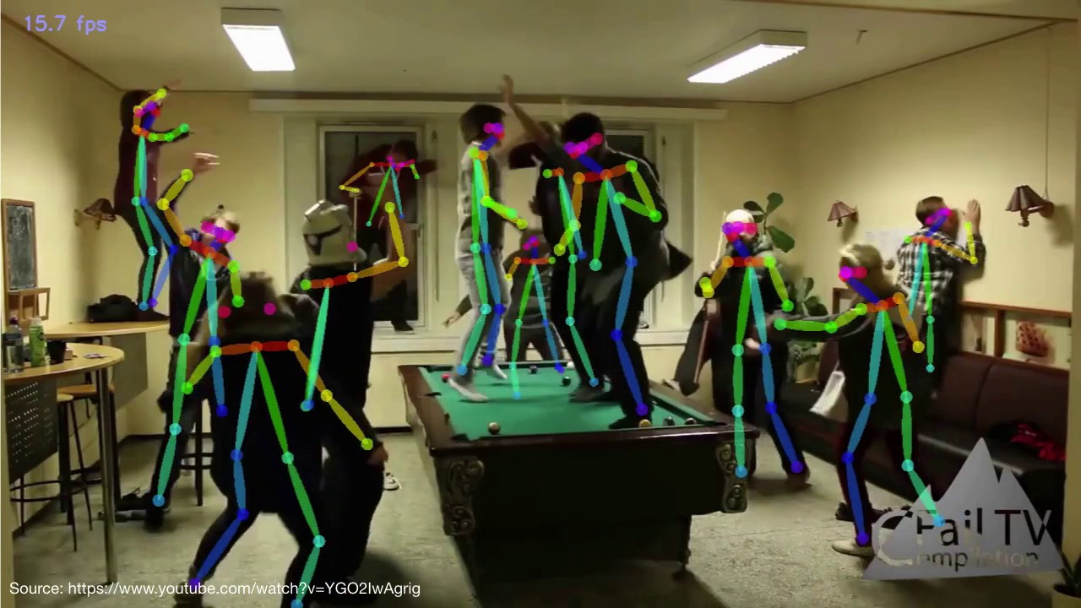
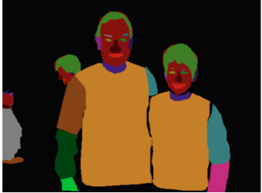
Project objectives
Detect every person in the image
For each person segment the body parts and detect key points
Make it process in real time

Slide 3
What I did
Read many articles
Tested multiple models and searched databases for training
Implemented a fully convolutional neural network for segmentation
Learned how to import pretrained models such as VGG, ResNet
Studied for a few weeks FasterRCNN, FastMaskRCNN and drew their schematics
Trained FastMaskRCNN for instance segmentation on COCO dataset
Trained FastMaskRCNN for body parts detection and segmentation
Modifying FastMaskRCNN for human detection and body parts segmentation

Slide 4
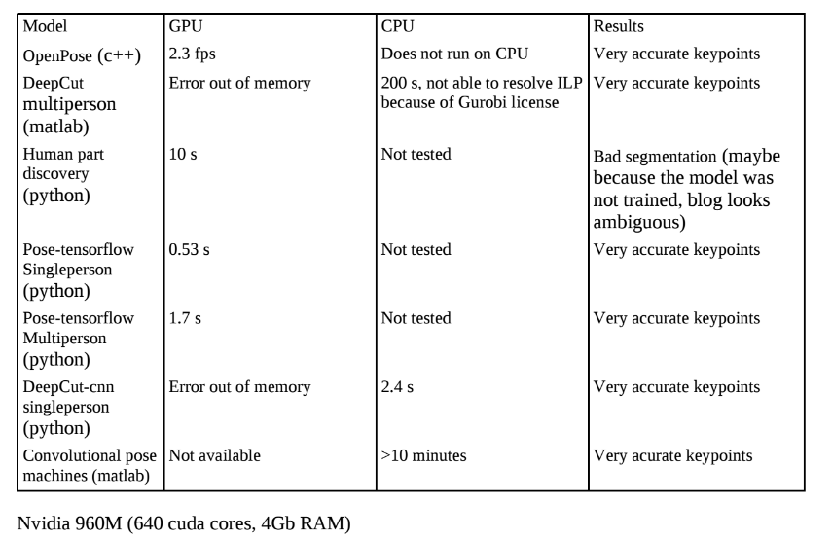
Articles, models
There are many articles for both body parts segmentation and key points estimation and joint objectives
There are open source projects only for key points estimation
Best model: OpenPose

Slide 5
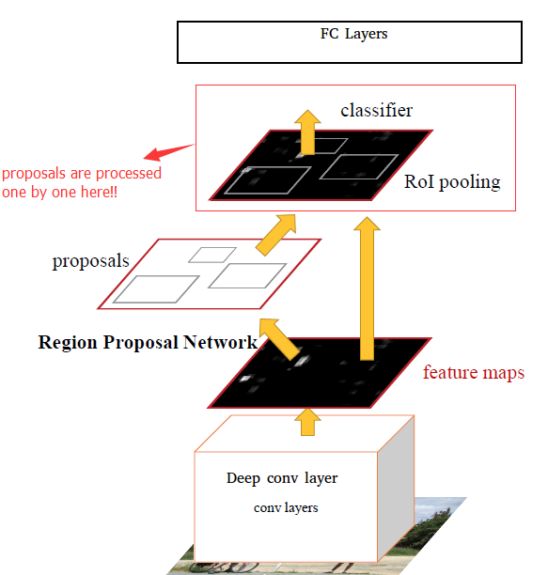
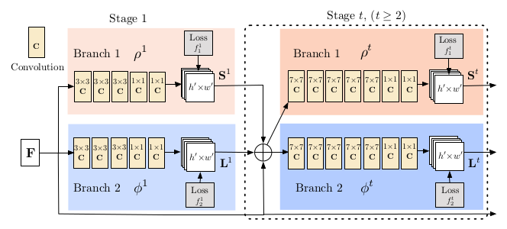
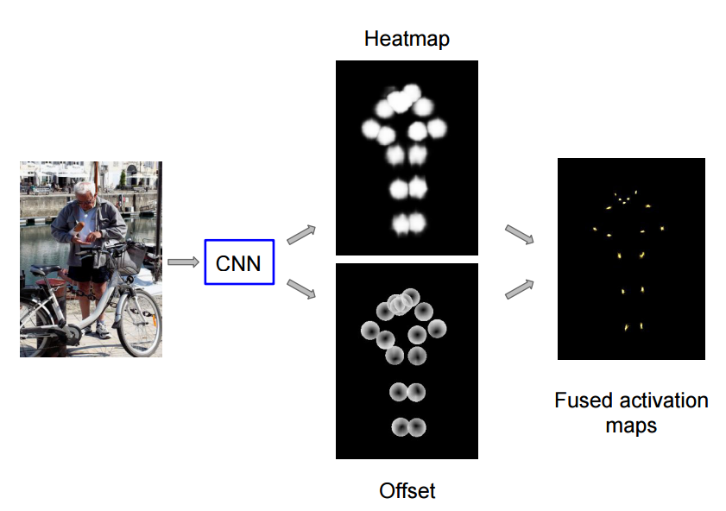
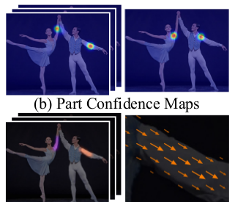
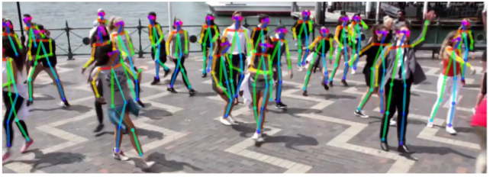
There are two model approaches
Top down
    Detect each person
    For each person detect body parts / key points
    Generally based on Faster RCNN
Bottom up
    Detect all body parts / key points
    Propose a method for grouping them into persons

Slide 6
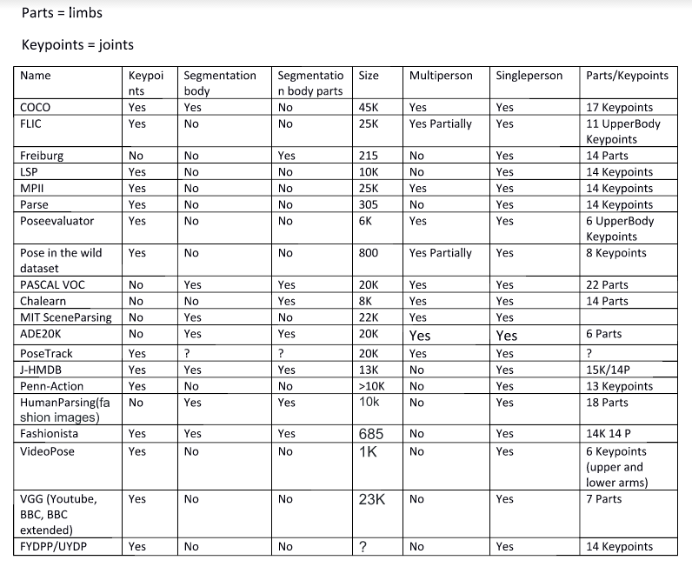
Databases
So far I trained on only Pascal VOC
It contains 22 parts such as nose, eyes, ears, but I grouped them into 6 parts as it is the minimum number of body parts found in all datasets.

Slide 7
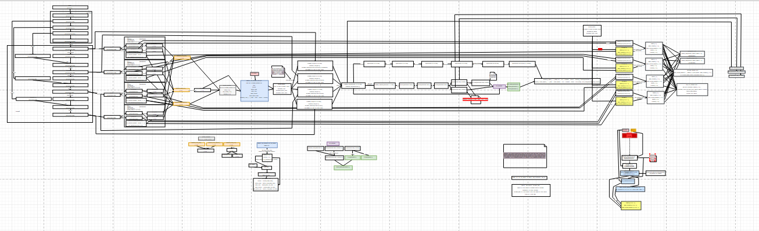
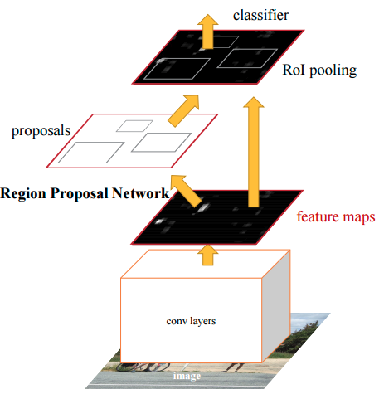
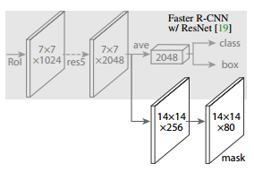
Studied for a few weeks FasterRCNN, FastMaskRCNN and drew their schematics given the Tensorflow code
FastMaskRCNN has an additional segmentation layer to FasterRCNN
The code-based schematics is more complicated

Slide 8
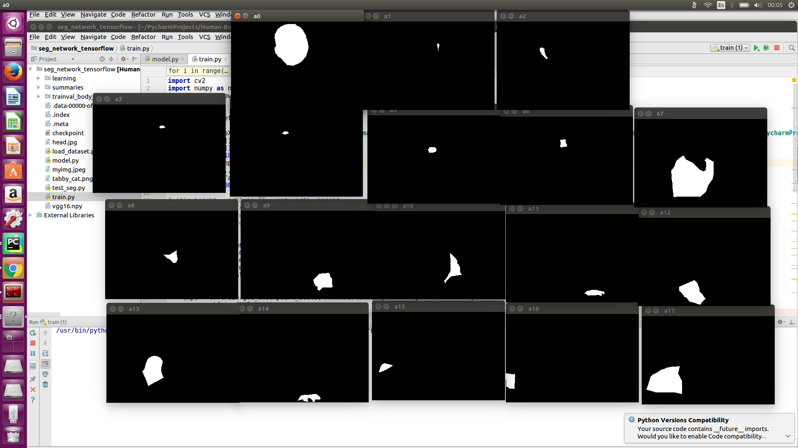
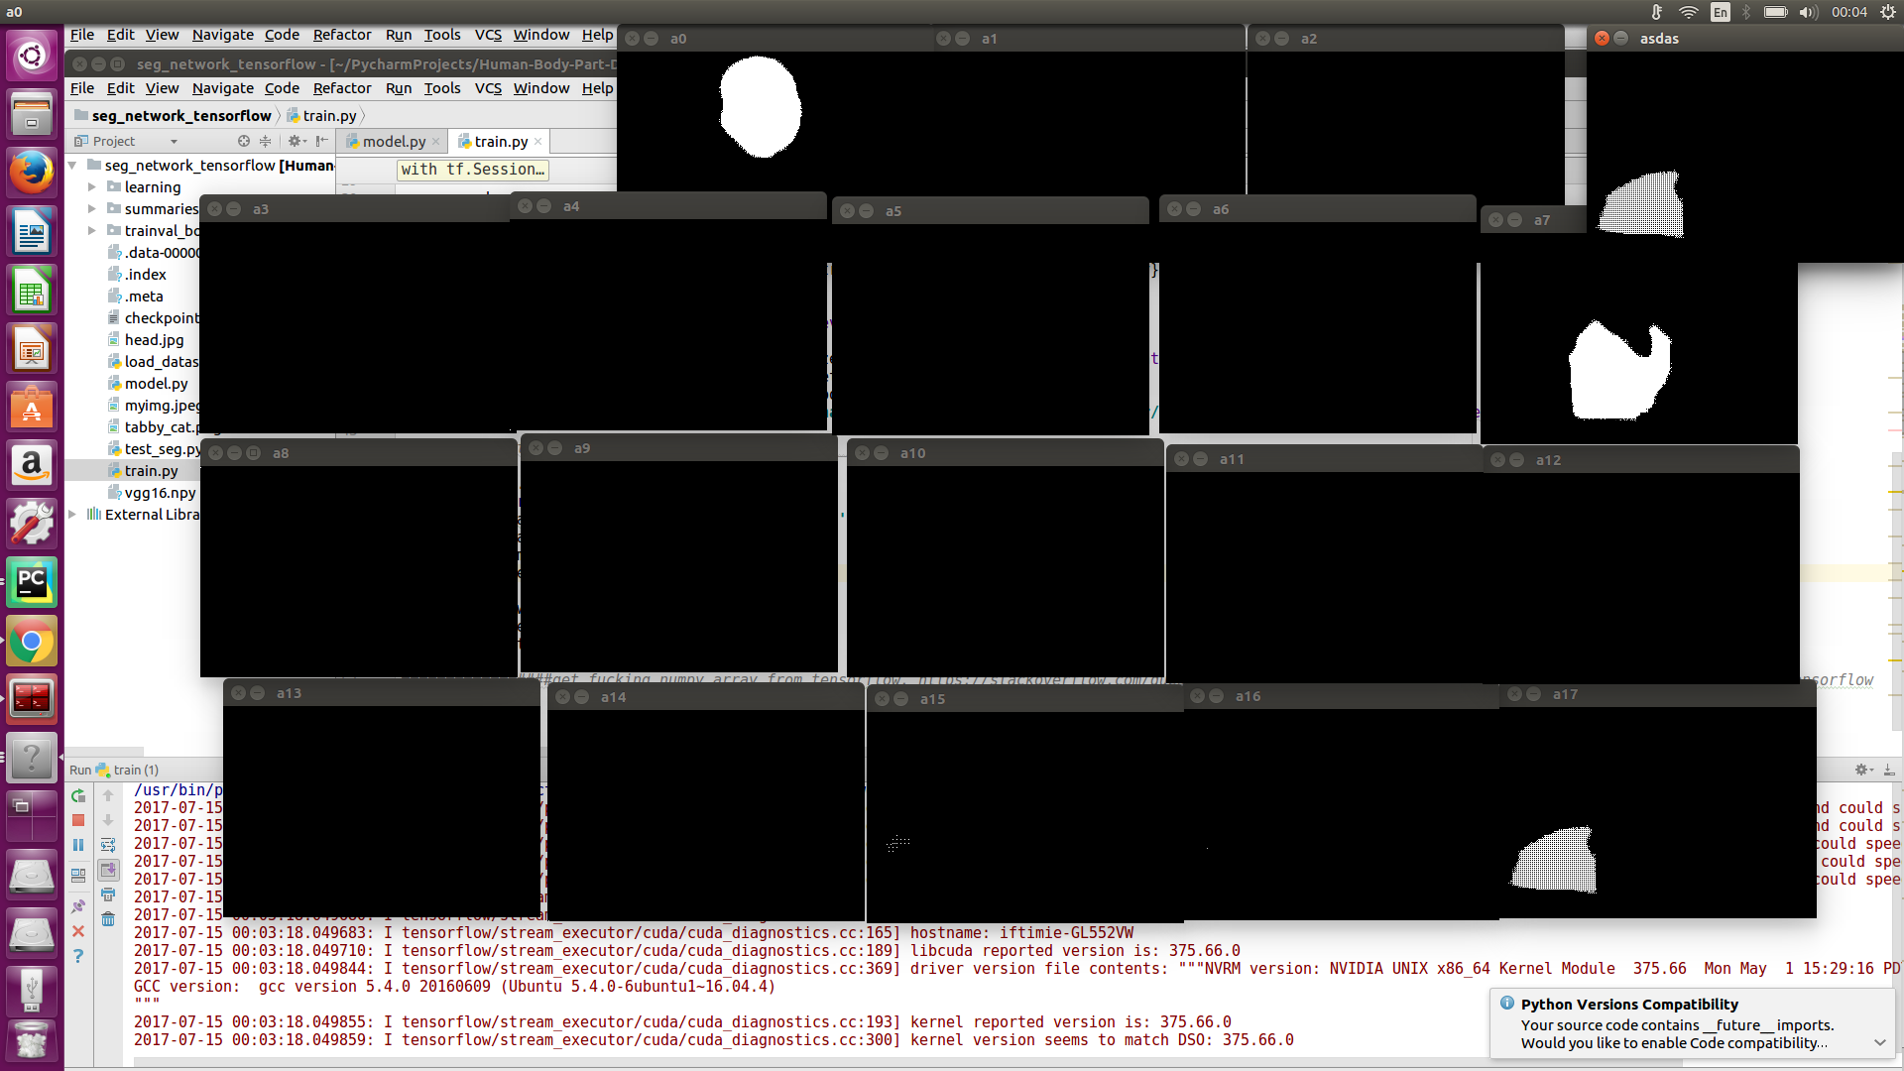
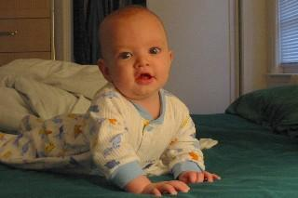
Implemented a fully convolutional neural network
Ground truth
Segmented
Overfitted the model on a single image
It was a good exercise for understanding the FCN
Discarded it quickly in order to have time to understand other concepts

Slide 9
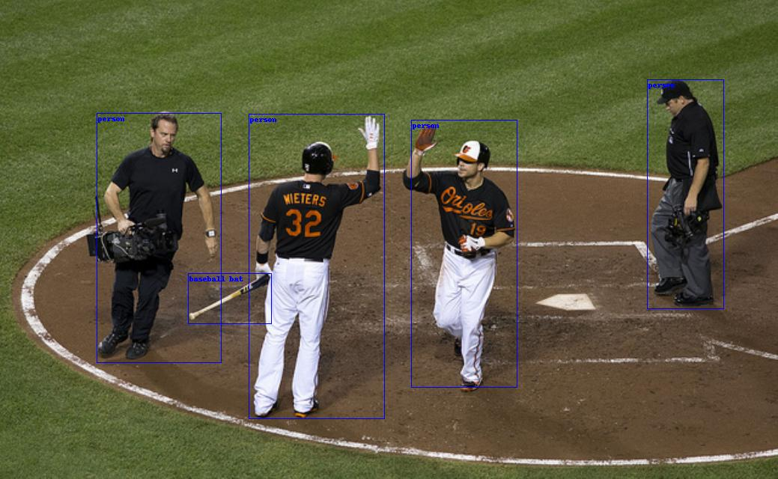
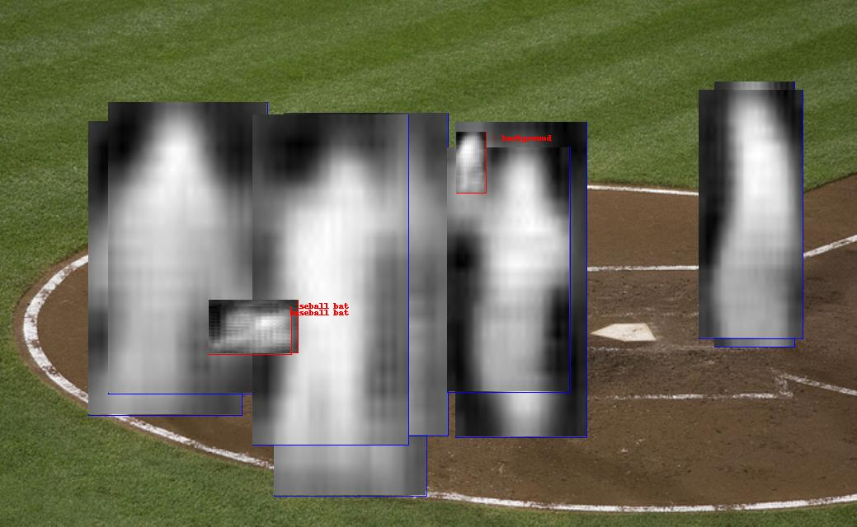
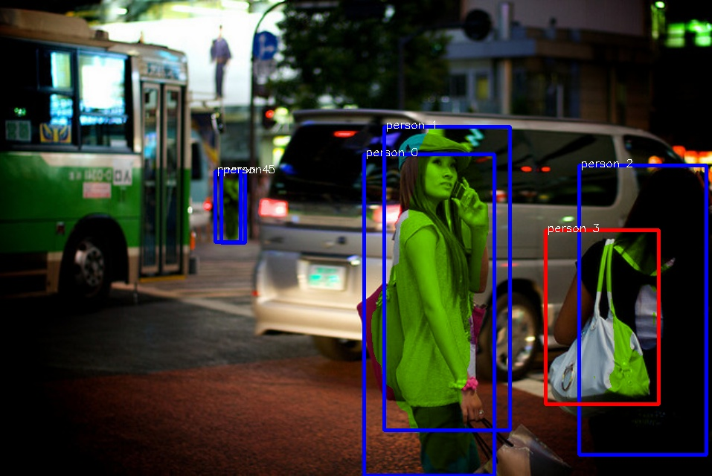
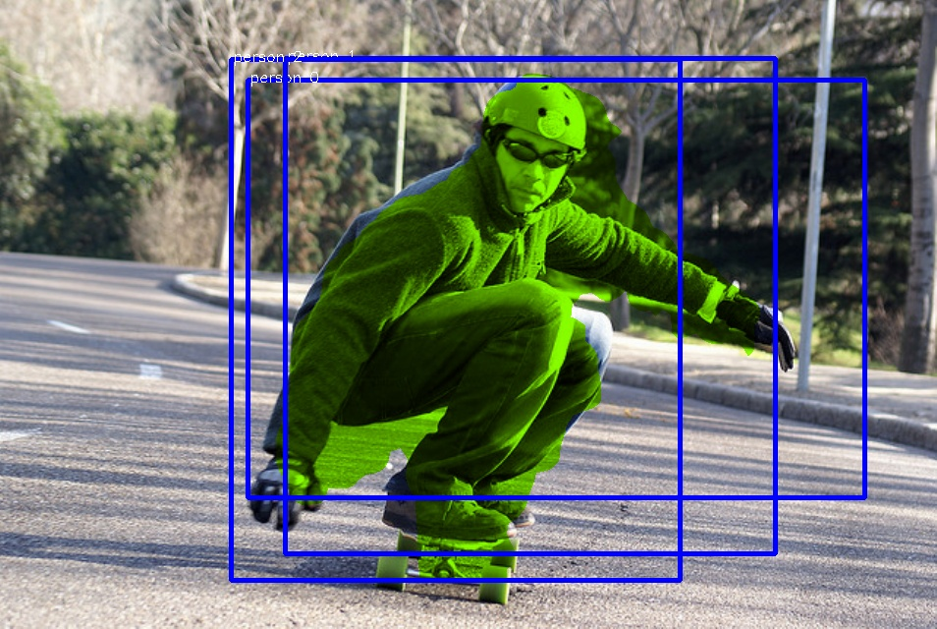

Trained FastMaskRCNN for instance segmentation on COCO dataset
The TensorFlow implementation did not have code for visualization
This is how I started colouring the segmentation
Based on the discussion on GitHub, I thought that the sigmoid layer for segmentation was missing. It was actually included in sigmoid_cross_entropy_loss

Slide 10
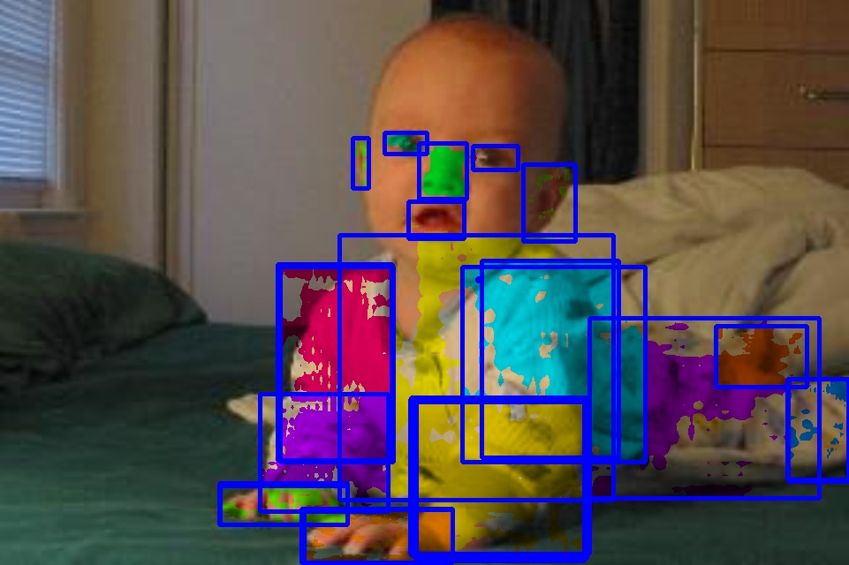
Trained FastMaskRCNN for body parts detection and segmentation
Took Pascal VOC with 22 body parts annotations
Adapted the input of MaskRCNN for body parts
Overfitted on a single image
This is where I realized that I did a mistake with the extra sigmoid layer

Slide 11
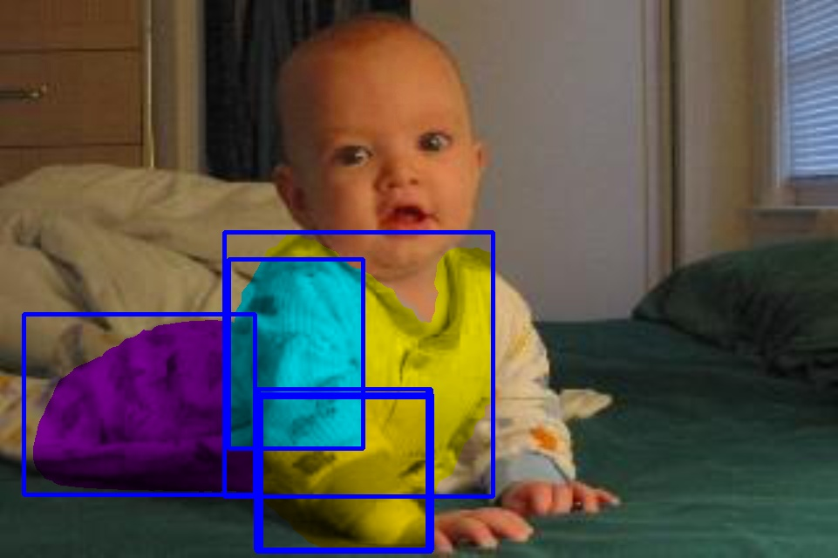
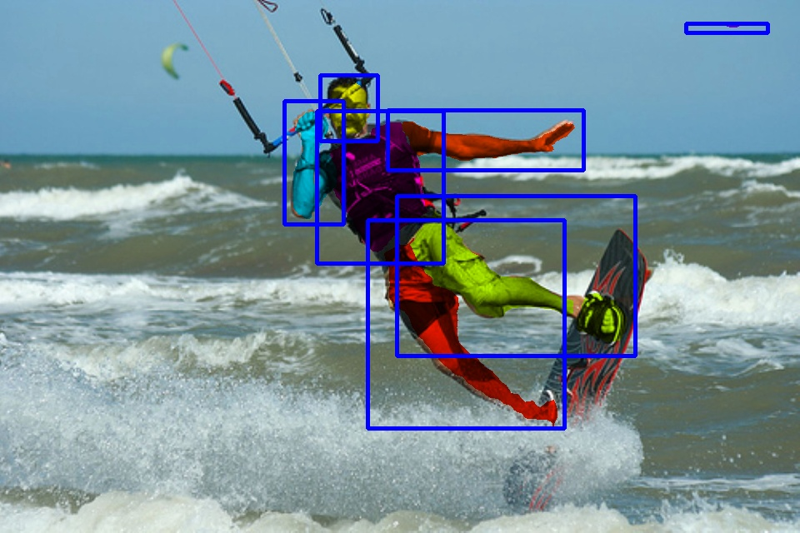
Trained FastMaskRCNN for body parts detection and segmentation
Played around with the number of parts and their sizes in order to see how the model reacts

Slide 12
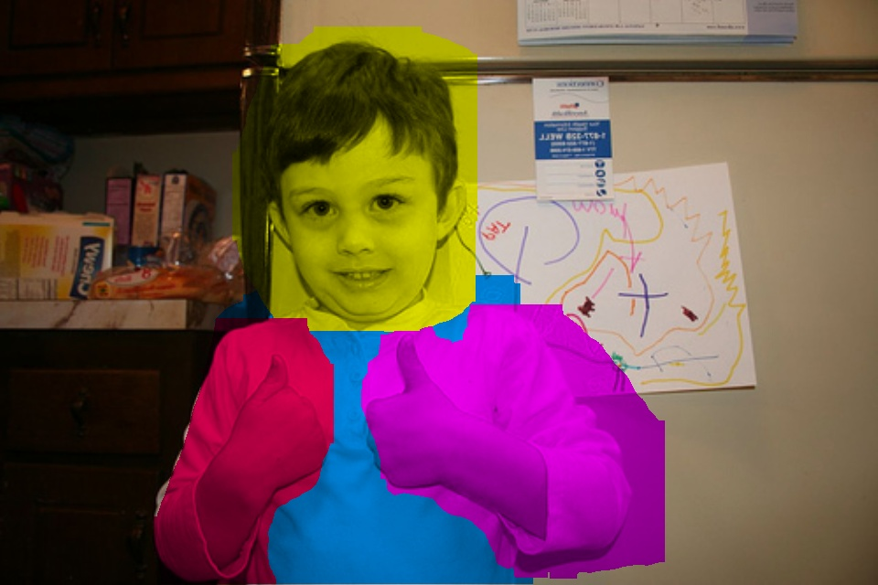
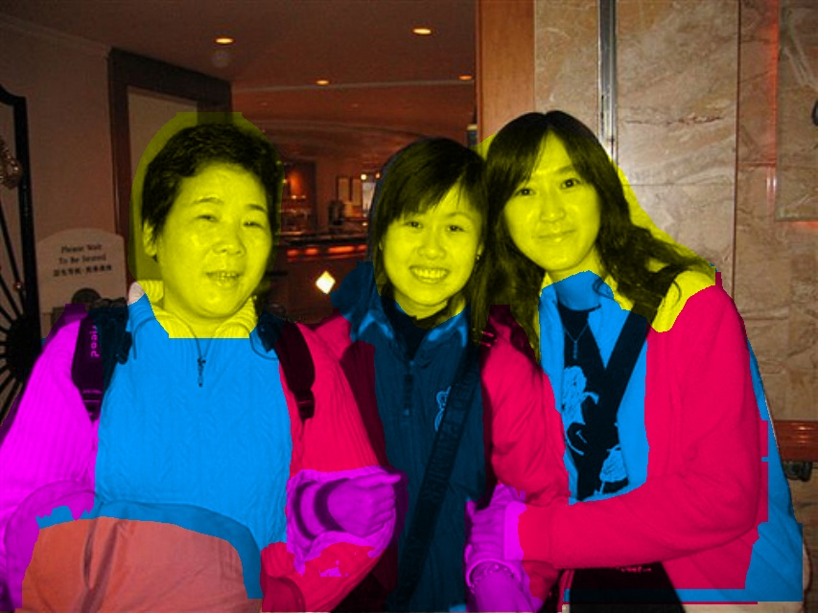
Fresh results
Adapted Pascal VOC body parts dataset as input for FastMaskRCNN
Train iterations:2 days->180K(actually images not epochs)
Not shown, but there are actually more bounding boxes
We do not know which parts belong to which person

Slide 13
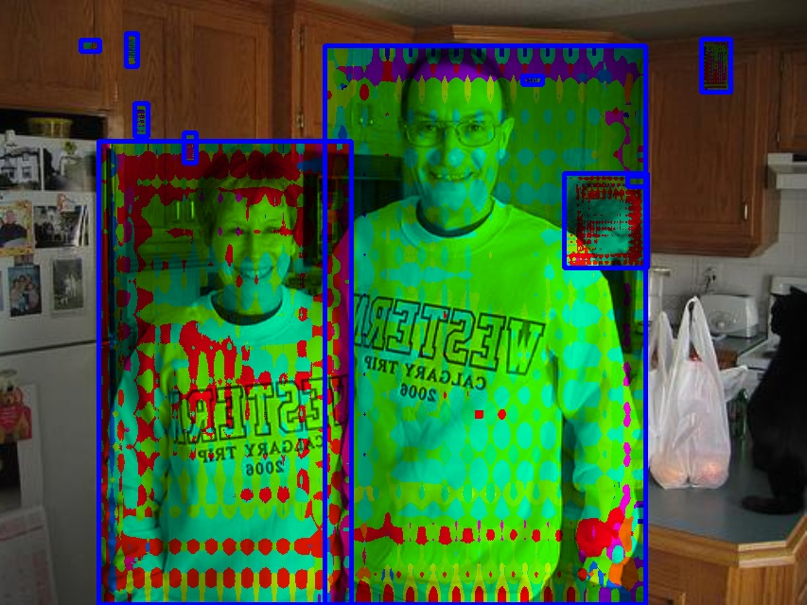
Trained FastMaskRCNN for human detection and body parts segmentation
Top down approach
I tried to modify MaskRCNN for person detection, and for each person to segment the body parts like in FCN
Obviously I did something wrong

Slide 14
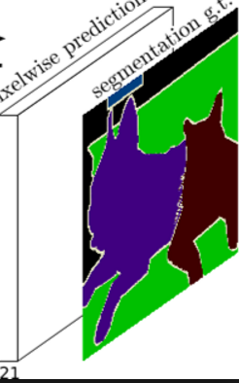
What I intend to do next
Remove the classification branch of MaskRCNN
The Region Proposal Network(RPN) branch already has objectness score
Adapt the segmentation branch as in FCN
Classification
ResNet
RPN
Objectness:human/non-human
Segmentation

Slide 15
Thank you

