Slide 1
How to use SVM_Light

Slide 2



ANN
SVM
Naïve Bayes
KNN

Slide 3
SVM Site
http://svmlight.joachims.org/
Preparation of train data and test data
→ remember TF-IDF
→ Feature Vector
Let’s look at the data in the example directory

Slide 4
Run the SVM
% svm_learn example1/train.dat example1/model
% svm_classify example1/test.dat example1/model example1/predictions
How to read / evaluate the result!

Slide 5

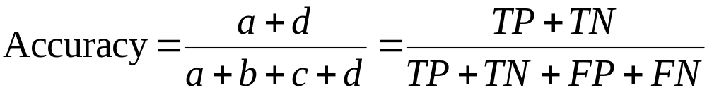
Most widely-used metric:
 | PREDICTED CLASS
ACTUAL CLASS |  | Class=Yes | Class=No
 | Class=Yes | a (TP) | b (FN)
 | Class=No | c (FP) | d (TN)

Slide 6

Consider a 2-class problem
  Number of Class 0 examples = 9990
  Number of Class 1 examples = 10
If model predicts everything to be class 0, accuracy is 9990/10000 = 99.9 %
  Accuracy is misleading because model does not detect any class 1 example

Slide 7

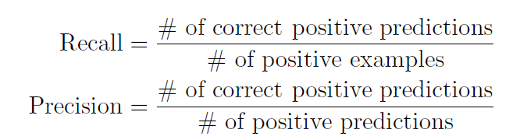
Compare a system that locates 100 documents, 40 of which are relevant. With another that locates 400 documents, 80 of which are relevant. Which is better? It depends on the relative cost of false positives, documents that are returned that are not relevant, and false negatives, documents that are relevant that are not returned.
number of documents retrieved that are relevant
Recall =
total number of documents that are relevant
number of documents retrieved that are relevant
Precision =
total number of documents that are retrieved

Slide 8
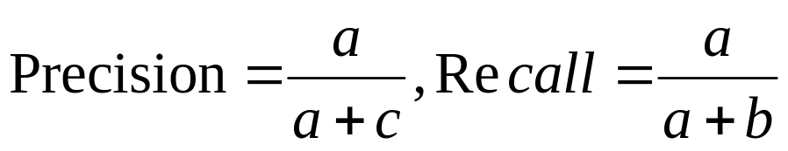
Precision and Recall
 | PREDICTED CLASS
ACTUAL CLASS |  | Class=Yes | Class=No
 | Class=Yes | a (TP) | b (FN)
 | Class=No | c (FP) | d (TN)

