Slide 1
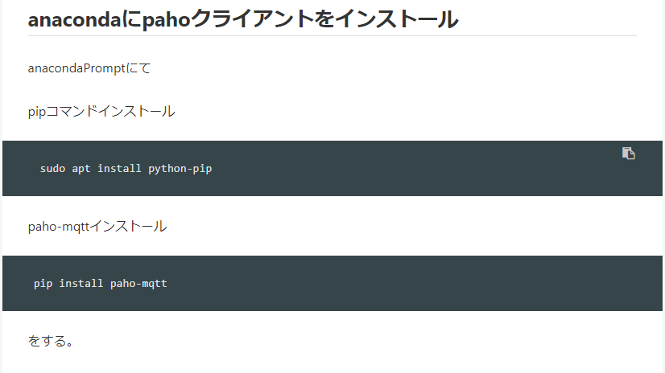
https://qiita.com/rui0930/items/1d139248b440650dc952

Slide 2
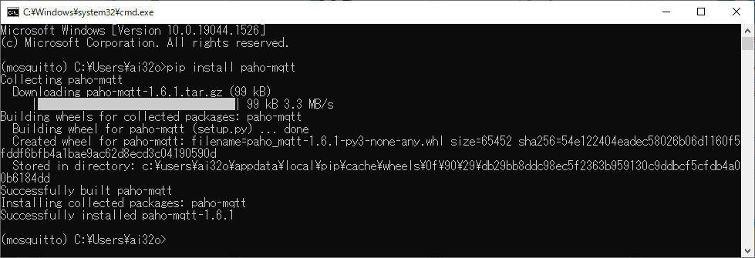

Slide 3
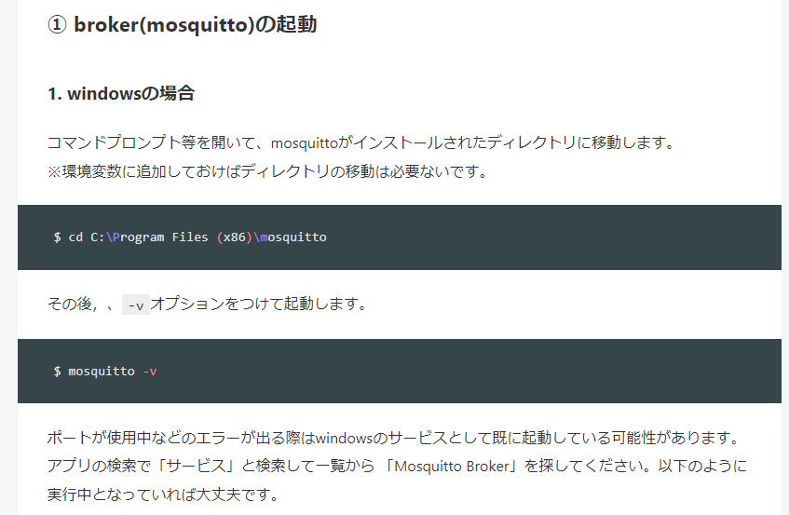
mosquitto -v
https://qiita.com/koichi_baseball/items/8fa9e0bdbe6d0aebe57d

Slide 4
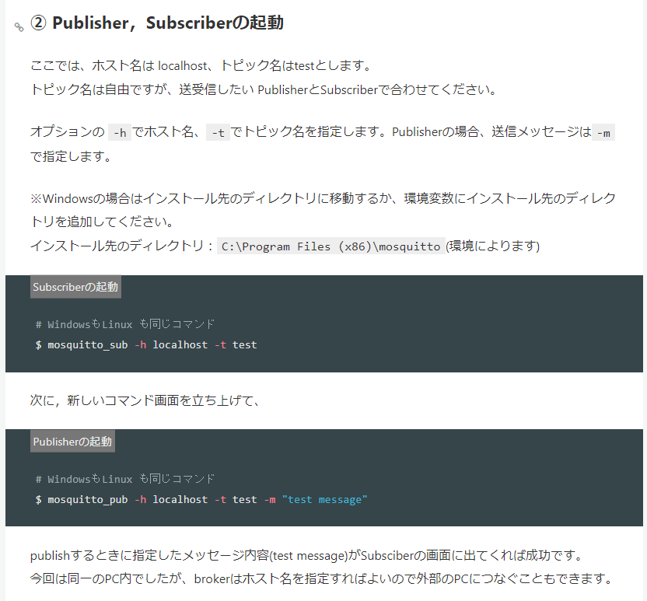
mosquitto_sub –h localhost -t /pub/M5StickCPlus

Slide 5
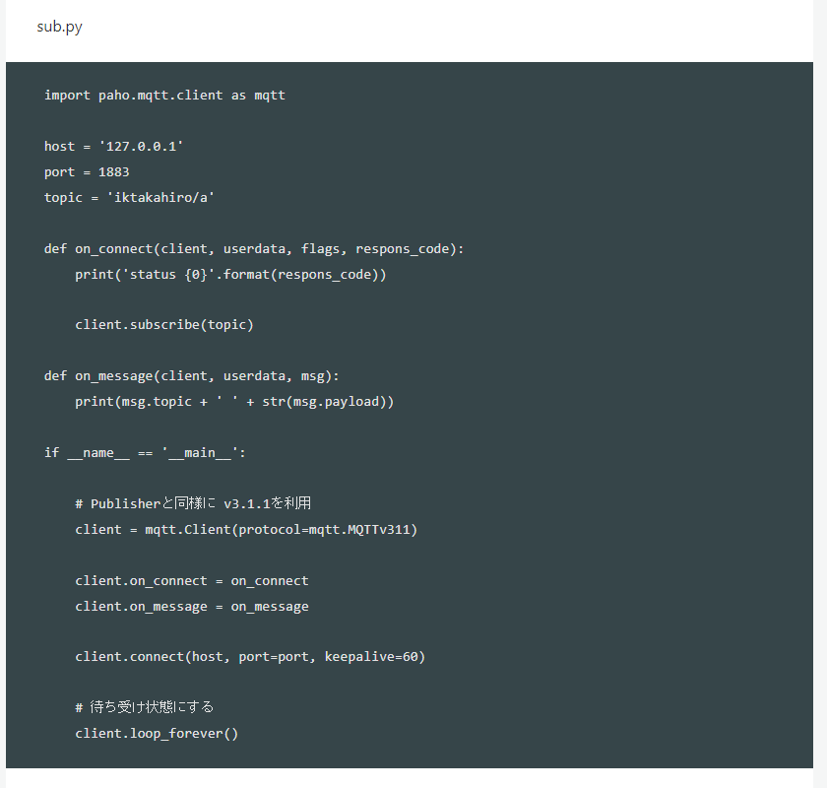
https://qiita.com/rui0930/items/1d139248b440650dc952
Python subscribe参考

