Slide 1
Intro to R Project Workflows, Git, & GitHub
Cody Dailey

Slide 2


Slide 3
Overview
Git*
Project Workflow
Interactive Demo

Slide 4
Context – Where will this info be useful?
Data analysis → Manuscript preparation
Collaboration
Organization & Reproducibility

Slide 5
Git and GitHub
“Git is an Open-source, Distributed Version Control System.”
Aditya Sridhar
https://www.freecodecamp.org/news/what-is-git-and-how-to-use-it-c341b049ae61/
“GitHub is in some sense the interface and Git the underlying engine (a bit like RStudio and R).”
Andreas Handel
“You do not need GitHub to use git, but you cannot use GitHub without using git. [GitHub is] referred to in git-speak as [a] remote.”
HubSpot Product Team
https://product.hubspot.com/blog/git-and-github-tutorial-for-beginners

Slide 6
Git and GitHub, cont’d
Git/GitHub ≈ Dropbox, OneDrive, Google Drive, …
But, mainly used for code
What kind of code?

Slide 7
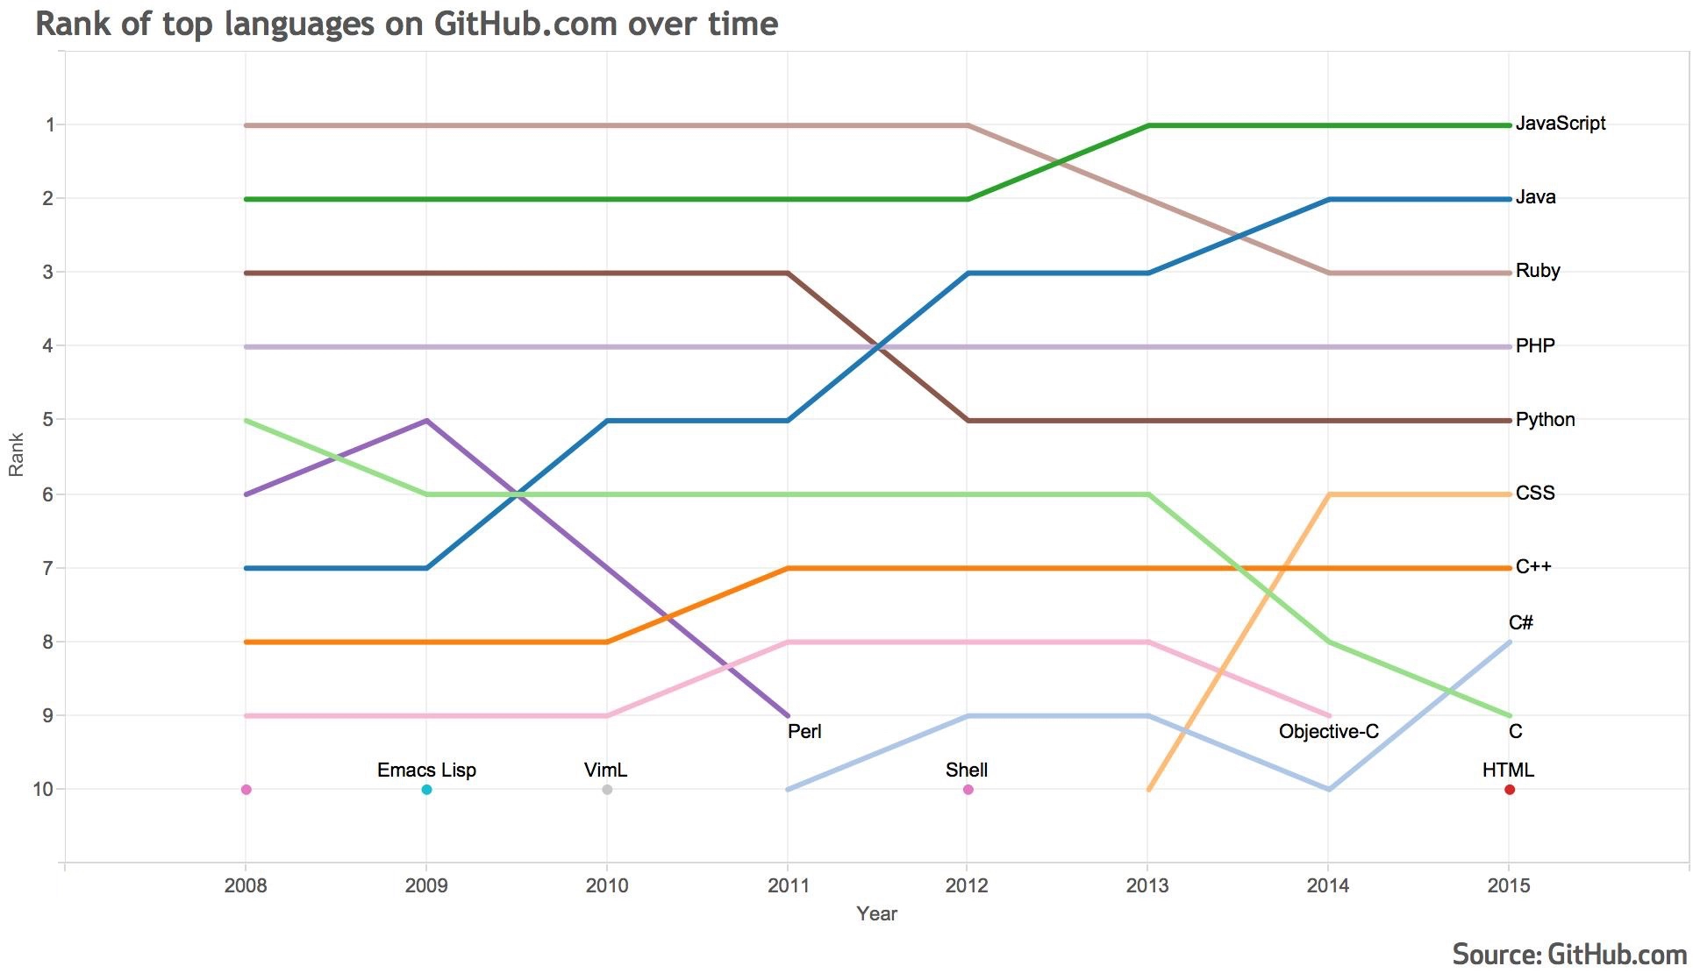
Git and GitHub, cont’d
Git/GitHub ~= DropBox, OneDrive, GoogleDrive, …
But, mainly used for code
Notes:
https://github.blog/2015-08-19-language-trends-on-github/

Slide 8
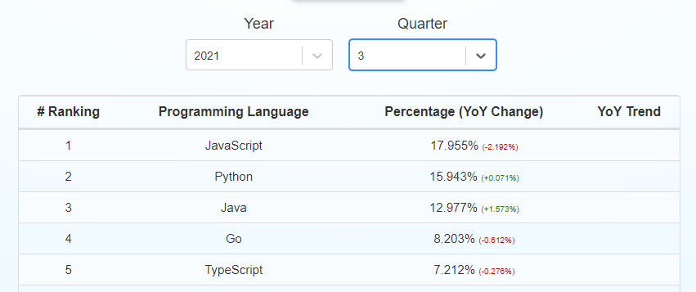
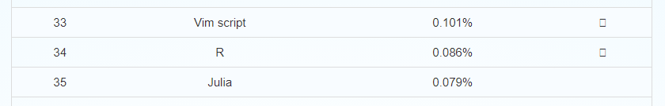
Git and GitHub, cont’d
Git/GitHub ≈ Dropbox, OneDrive, Google Drive, …
But, mainly used for code
What kind of code?

Slide 9
Git and GitHub, cont’d
Git/GitHub ≈ Dropbox, OneDrive, Google Drive, …
But, mainly used for code
Folks can work in parallel on a project (think Google Docs / Slides / …)
But, mainly where each project/team member is working on a separate part

Slide 10
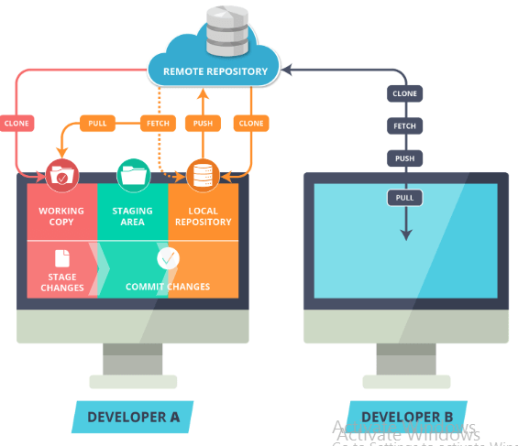
Git and GitHub, cont’d
Notes:
https://www.c-sharpcorner.com/article/git-and-github-version-control-local-and-remote-repository/

Slide 11
Some Git / GitHub Terminology
Repository ≈ Director or Folder
Commit ≈ Save my [local] version
Stage ≈ Prepare these files for a commit
Push ≈ Update version in [remote] repo to match my [local] version
Pull ≈ Update my [local] version with changes on [remote] repo
Pull request ≈ I made some changes that I think you should incorporate

Slide 12
Some Git / GitHub Terminology, cont’d
Branch ≈ alternate “version” of all files within repo
Fork ≈ alternate “version” of the repo
Clone ≈ copy that repo

Slide 13
Some Git / GitHub Terminology, cont’d
Merge ≈ Bring your changes and my changes together into one version
Merge conflict ≈ we both changed the same thing but differently
#@?$!!!!
Rebase ≈ make my version like that one
Fast-forward ≈ get all new files from there

Slide 14
Using Git and GitHub
Designed to work from command line
CMD for Windows
Terminal for Linux/Mac
Many Graphical User Interfaces have been developed
GitHub Desktop
GitKraken

Slide 15
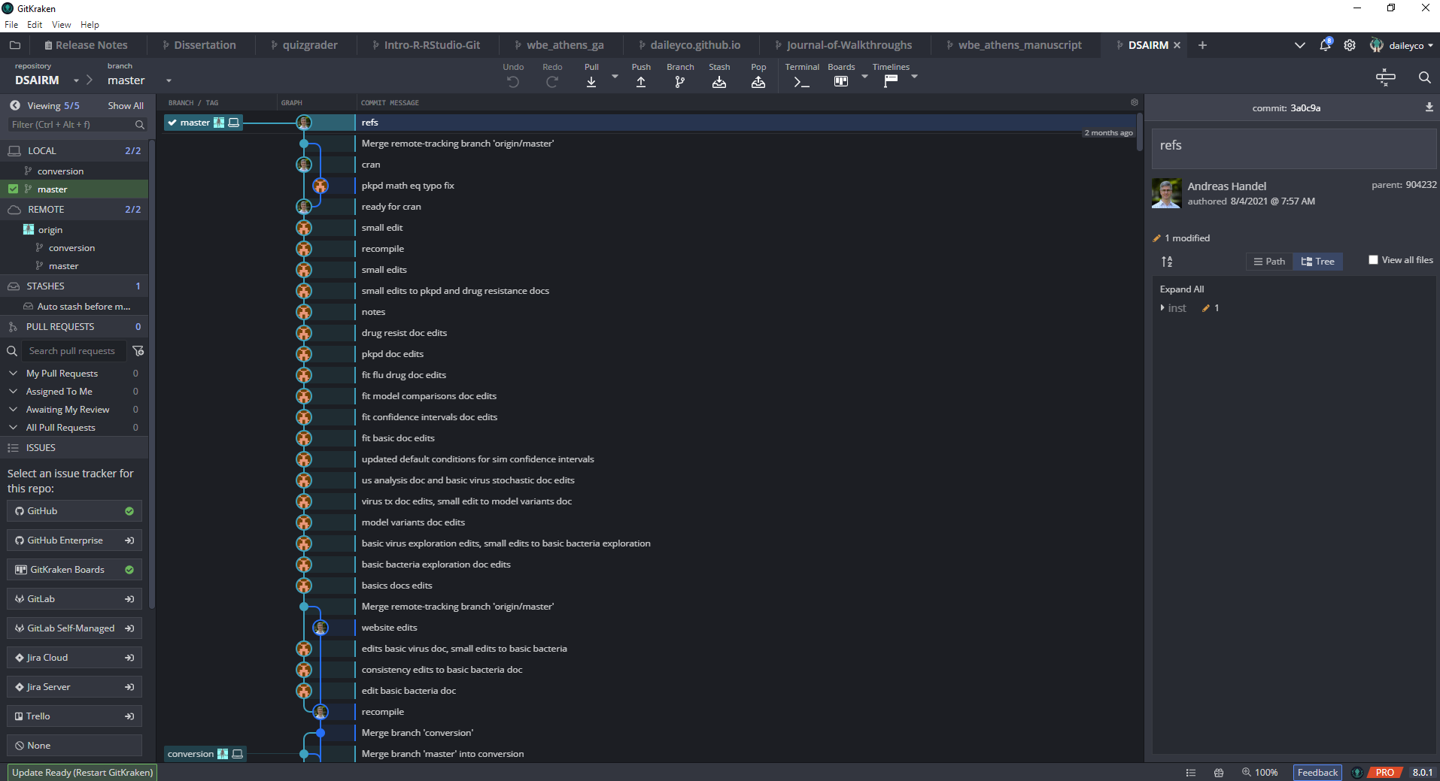
GitKracken

Slide 16
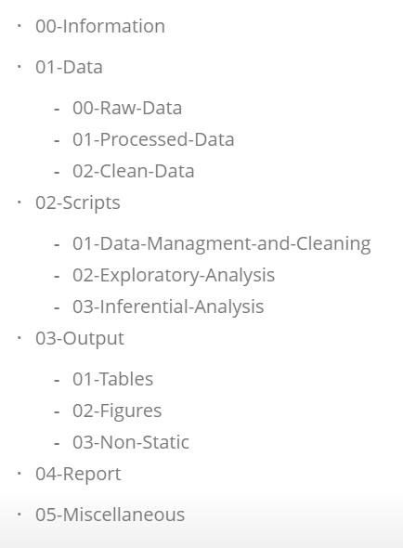
Project Workflow
Create GitHub repo
Clone it locally using GitKraken
Create R Project
Set up directory structure
Stage, Commit, Push, and Pull frequently

Slide 17
Some Useful (Maybe) Tips
As a student, you get free upgrades for “Student Developer Pack” for GitHub
Free private repos
GitKraken
Free Pro version as student
1 repo per “project”
R Projects
Name repo something informative
Don’t store local “repo” within other version control folders/apps
Use relative paths to data and scripts
Learn how to use RMarkdown effectively
Zotero is pretty great and is well integrated with Rstudio
ZotFile, Better BibTeX, Zotero Connector

Slide 18
Other Cool Things R Can Do
Intro to R

Slide 19
What can I use R / RStudio / RMarkdown for?
Data analysis
Scientific communication (w/ citations)
Reports (HWs, presentations, papers)
Reproducible research
Books
Personal website
Other
Browser Automation
Writing Scripts in Other Languages
…

Slide 20
Example of Workflow
Let’s create a repo for this presentation ☺

