Slide 1
Intro to GitHub & Other Cool Things R Can Do
Cody Dailey

Slide 2


Slide 3
Intro to GitHub
Intro to R

Slide 4
Git and GitHub
“Git is an Open Source Distributed Version Control System.”
Aditya Sridhar
https://www.freecodecamp.org/news/what-is-git-and-how-to-use-it-c341b049ae61/
“Github is in some sense the interface and Git the underlying engine (a bit like RStudio and R).”
Andreas Handel
https://andreashandel.github.io/MADAcourse/1d_Github.html

Slide 5
Git and GitHub, cont’d
Git/GitHub ~= DropBox, OneDrive, GoogleDrive, …
But, mainly used for code
What kind of code?

Slide 6
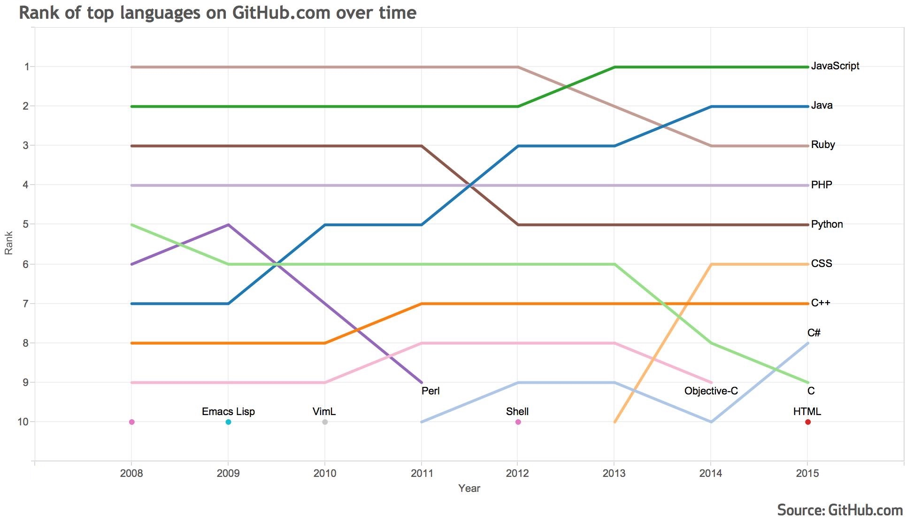
Git and GitHub, cont’d
Git/GitHub ~= DropBox, OneDrive, GoogleDrive, …
But, mainly used for code
Notes:
https://github.blog/2015-08-19-language-trends-on-github/

Slide 7
Git and GitHub, cont’d
Git/GitHub ~= DropBox, OneDrive, GoogleDrive, …
But, mainly used for code
What kind of code?

Slide 8
Git and GitHub, cont’d
Git/GitHub ~= DropBox, OneDrive, GoogleDrive, …
But, mainly used for code
Folks can work in parallel on a project (think Google Docs / Slides / …)
But, mainly where each project/team member is working on a separate part and not as simultaneous

Slide 9
Some Git / GitHub Terminology
Repository ~= Folder
Commit ~= Save my version
Stage ~= Prepare these files for a commit
Push ~= Save / update version in repo to match my version
Pull ~= Update my version with changes saved to repo
Pull request ~= I made some changes that I think you should incorporate

Slide 10
Some Git / GitHub Terminology, cont’d
Branch ~= alternate “version” of all files within repo
Fork ~= alternate “version” of the repo
Clone ~= copy that repo

Slide 11
Some Git / GitHub Terminology, cont’d
Merge ~= Bring your changes and my changes together into one version
Merge conflict ~= we both changed the same thing but differently
#@?$!!!!
Rebase ~= make my version like that one
Fast-forward ~= get all new files from there

Slide 12
Some Useful (Maybe) Tips
As a student, you get free upgrades for “Student Developer Pack” for GitHub
Free private repos
User Interface
GitHub Desktop
GitKraken
Free Pro version as student
1 repo per “project”
R Projects
Name repo something informative
Don’t store local “repo” within other version control folders/apps

Slide 13
Using Git/GitHub in Your Workflow
Create an account
Create a repo
Name it
Public or Private
Add README file
Settings
Options
GitHub Pages
Manage access
Notifications
Work
(Pull if needed), create or update some files, stage, commit, push (repeat)

Slide 14
Example of Workflow
Let’s create a repo for this presentation ☺

Slide 15
Other Cool Things R Can Do
Intro to R

Slide 16
What can I use R / RStudio / RMarkdown for?
Data analysis
Scientific communication (w/ citations)
Reports (HWs, presentations, papers)
Reproducible research
Books
Personal website
Other
Browser Automation
Writing Scripts in Other Languages
…

Slide 17
Examples

