Slide 1
Credit Card Default Prediction Using Data Science & Machine Learning
Cody Dailey
Ishaan Dave
Yang Ge
Vipul Shinde

Slide 2

Summary
Introduction
Exploratory Data Analysis
Classification
Logistic Regression
Random Forest Classifier
Predictions
Conclusions

Slide 3
Introduction
Credit risk plays a major role in the banking industry business. Banks main activities involve granting loan, credit card, investment, mortgage, and others.
Credit card has been one of the most booming financial services by banks over the past years. However, with the growing number of credit card users, banks have been facing an escalating credit card default rate.
As such data science and machine learning can provide solutions to tackle the current phenomenon and management credit risks.
Thus, Logistic Regression and Random Forest Classifier models are used to predict if the applicants for the credit card will default or not soon based on the given input data.

Slide 4
Exploratory Data Analysis
3 datasets
Training – used to create model
Validation – qualify performance
Test – evaluate final model performance

Slide 5
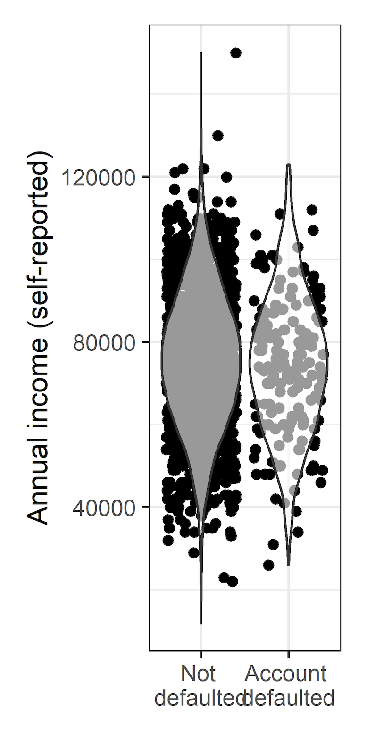
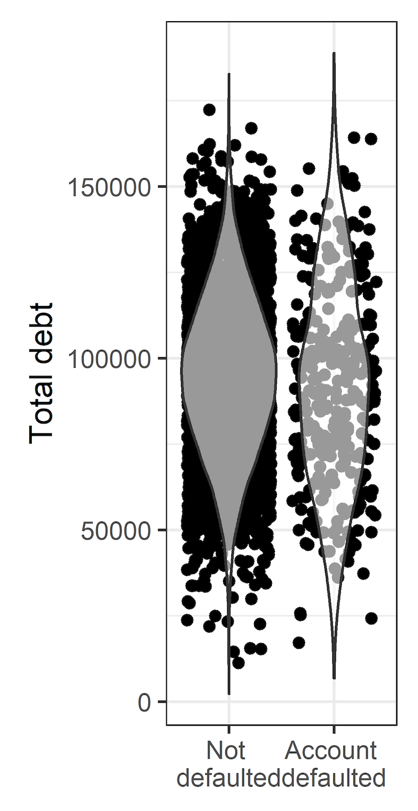
Exploratory Data Analysis
Univariate Statistics
Mean +/- SD and normality for continuous
N (%) for categorical
Median [IQR] for discrete counts
N missing for each variable
Compared between outcome groups (Did / did not default)

Slide 6
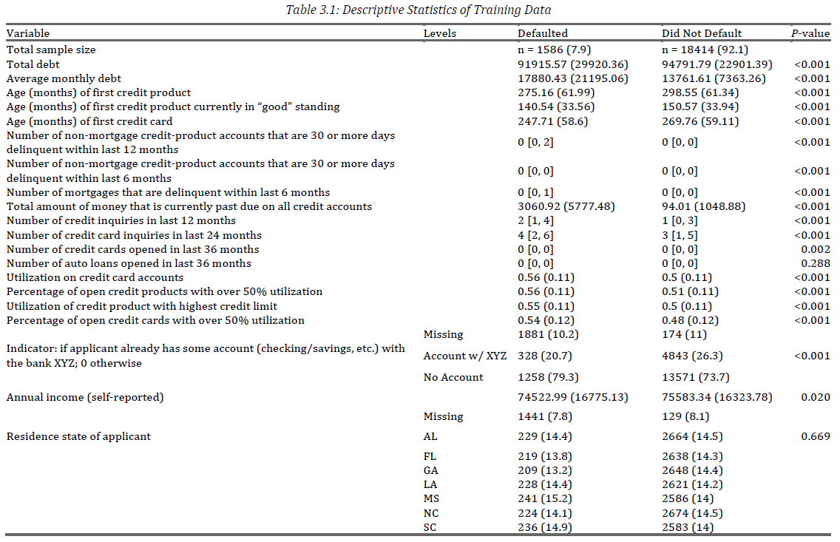

Slide 7
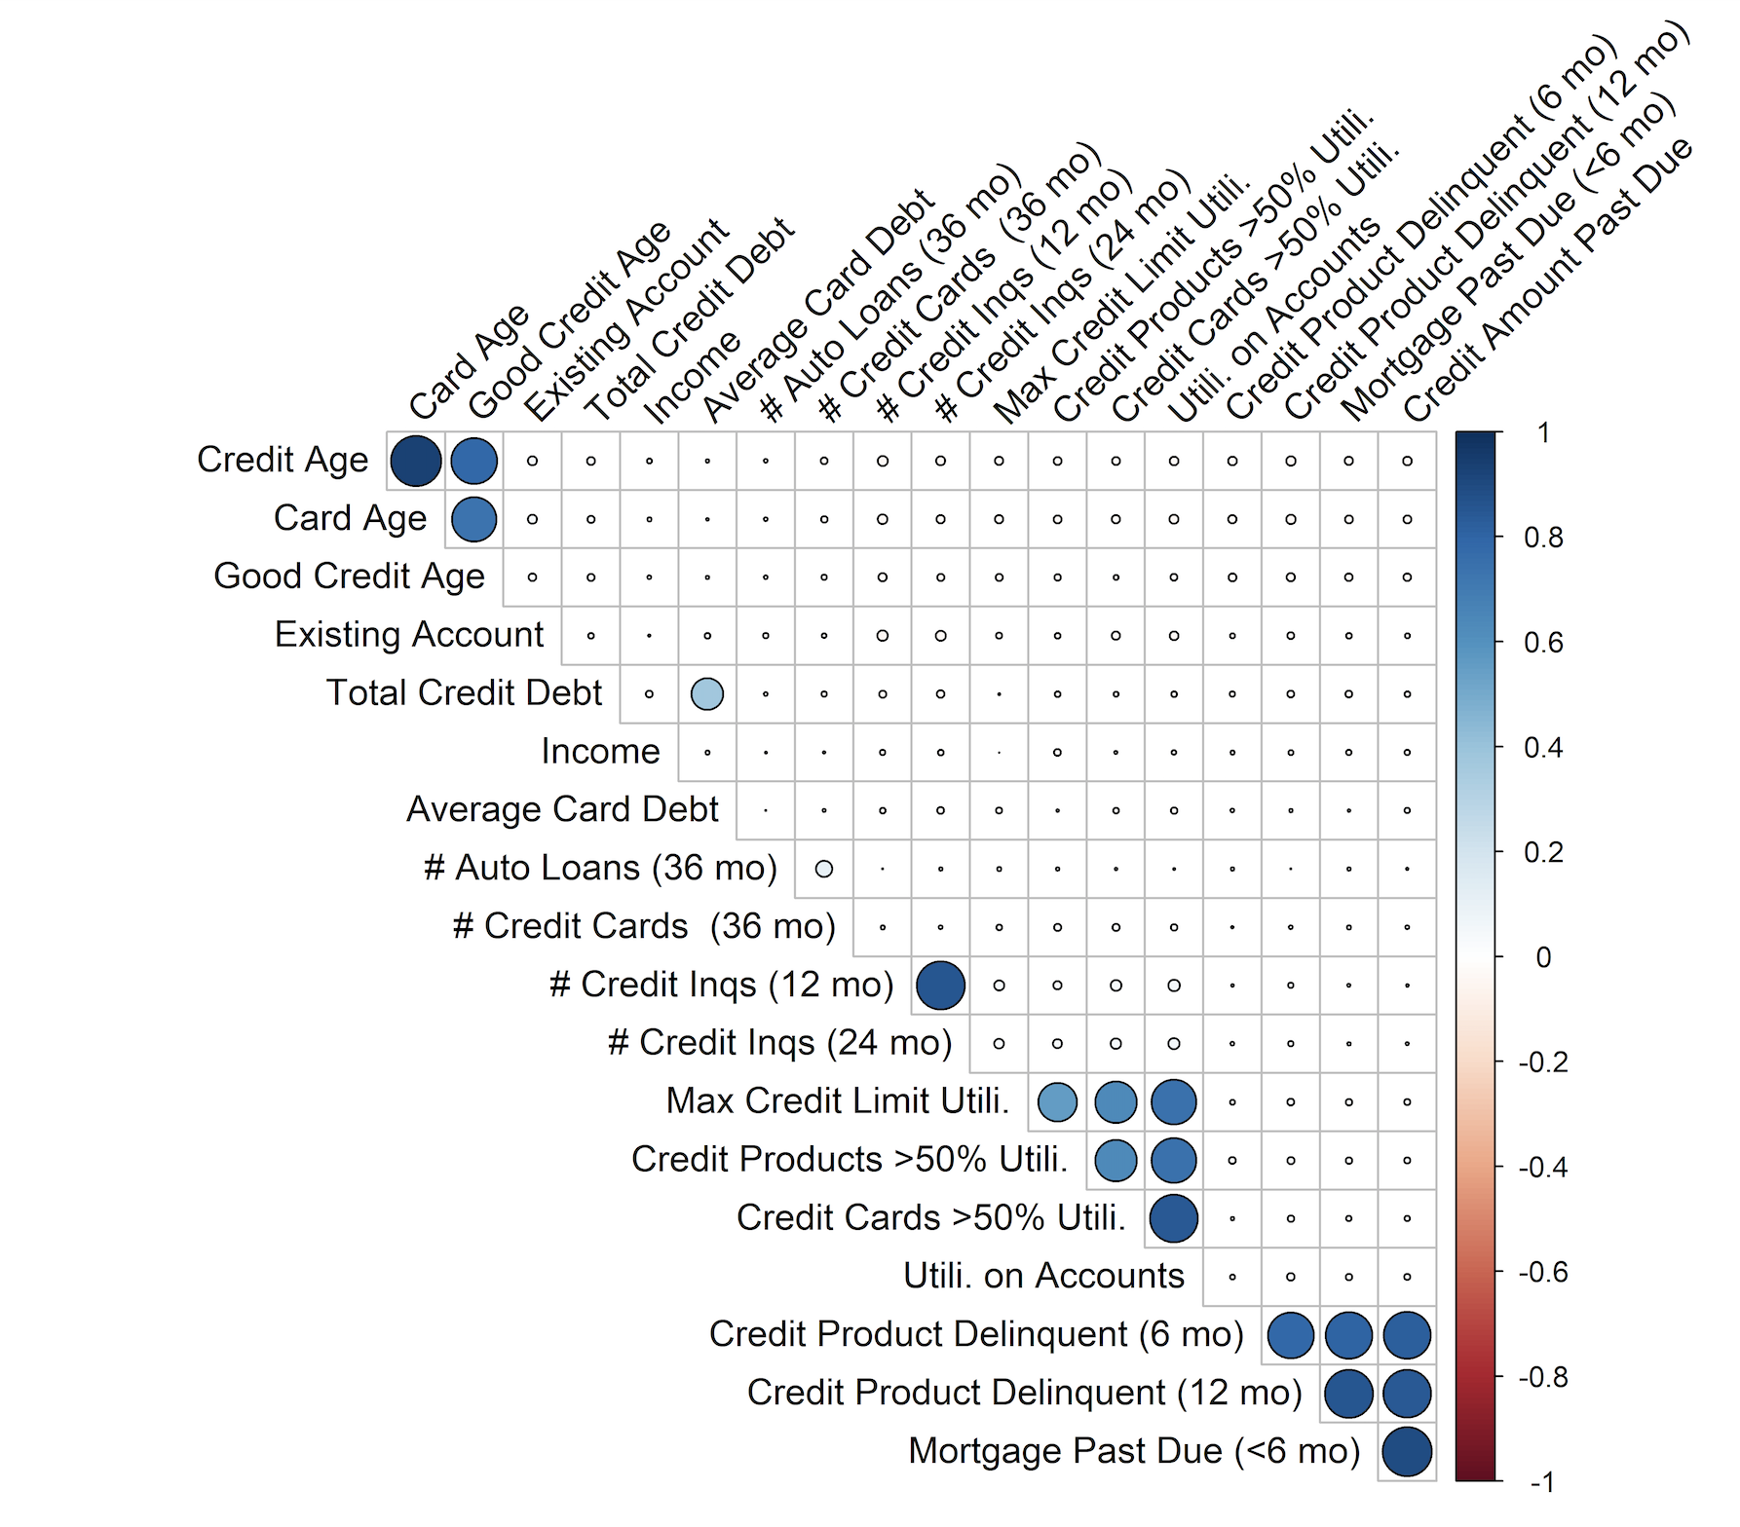
Exploratory Data Analysis
Correlations between variables
20 potential predictors
Suspected multicollinearity
Correlation matrix to examine what variables may vary together

Slide 8

Feature Selection
We want to select covariates that are important in predicting whether or an individual will default or not and “penalize” (shrink) those that are not important
Adaptive Least Absolute Shrinkage and Selection Operator (LASSO) Logistic Regression was performed to select covariates and predict binary outcome
$logit(E\left(Y | X\right)=β^{T}(X)$,
Y is the binary outcome (whether or not an individual defaulted)
X = $(1, X_{1}, …, X_{p})$ is the vector of covariate values
$β$ = $\left(β_{0},β_{1},…, β_{p}\right)$ vector of regression parameters we want to estimate
Estimation is an optimization problem in the form L$\left(β\right)−λ∗pen(β)$, where $pen(β)$ is the “penalty” and $λ$ is the “tuning parameter” (amount of shrinkage)

Slide 9


Classification
Adaptive LASSO is conducted in 2 steps
First is ridge regression: penalty is proportional to sum of squares of coefficients
Use the coefficients from ridge and calculate weights (usually reciprocal of ridge coefficients) to shrink coefficients
Predictive performance was assessed after selecting optimal tuning and penalty parameters
Cost associated with correctly classifying individuals was also optimized for bank’s benefit

Slide 10
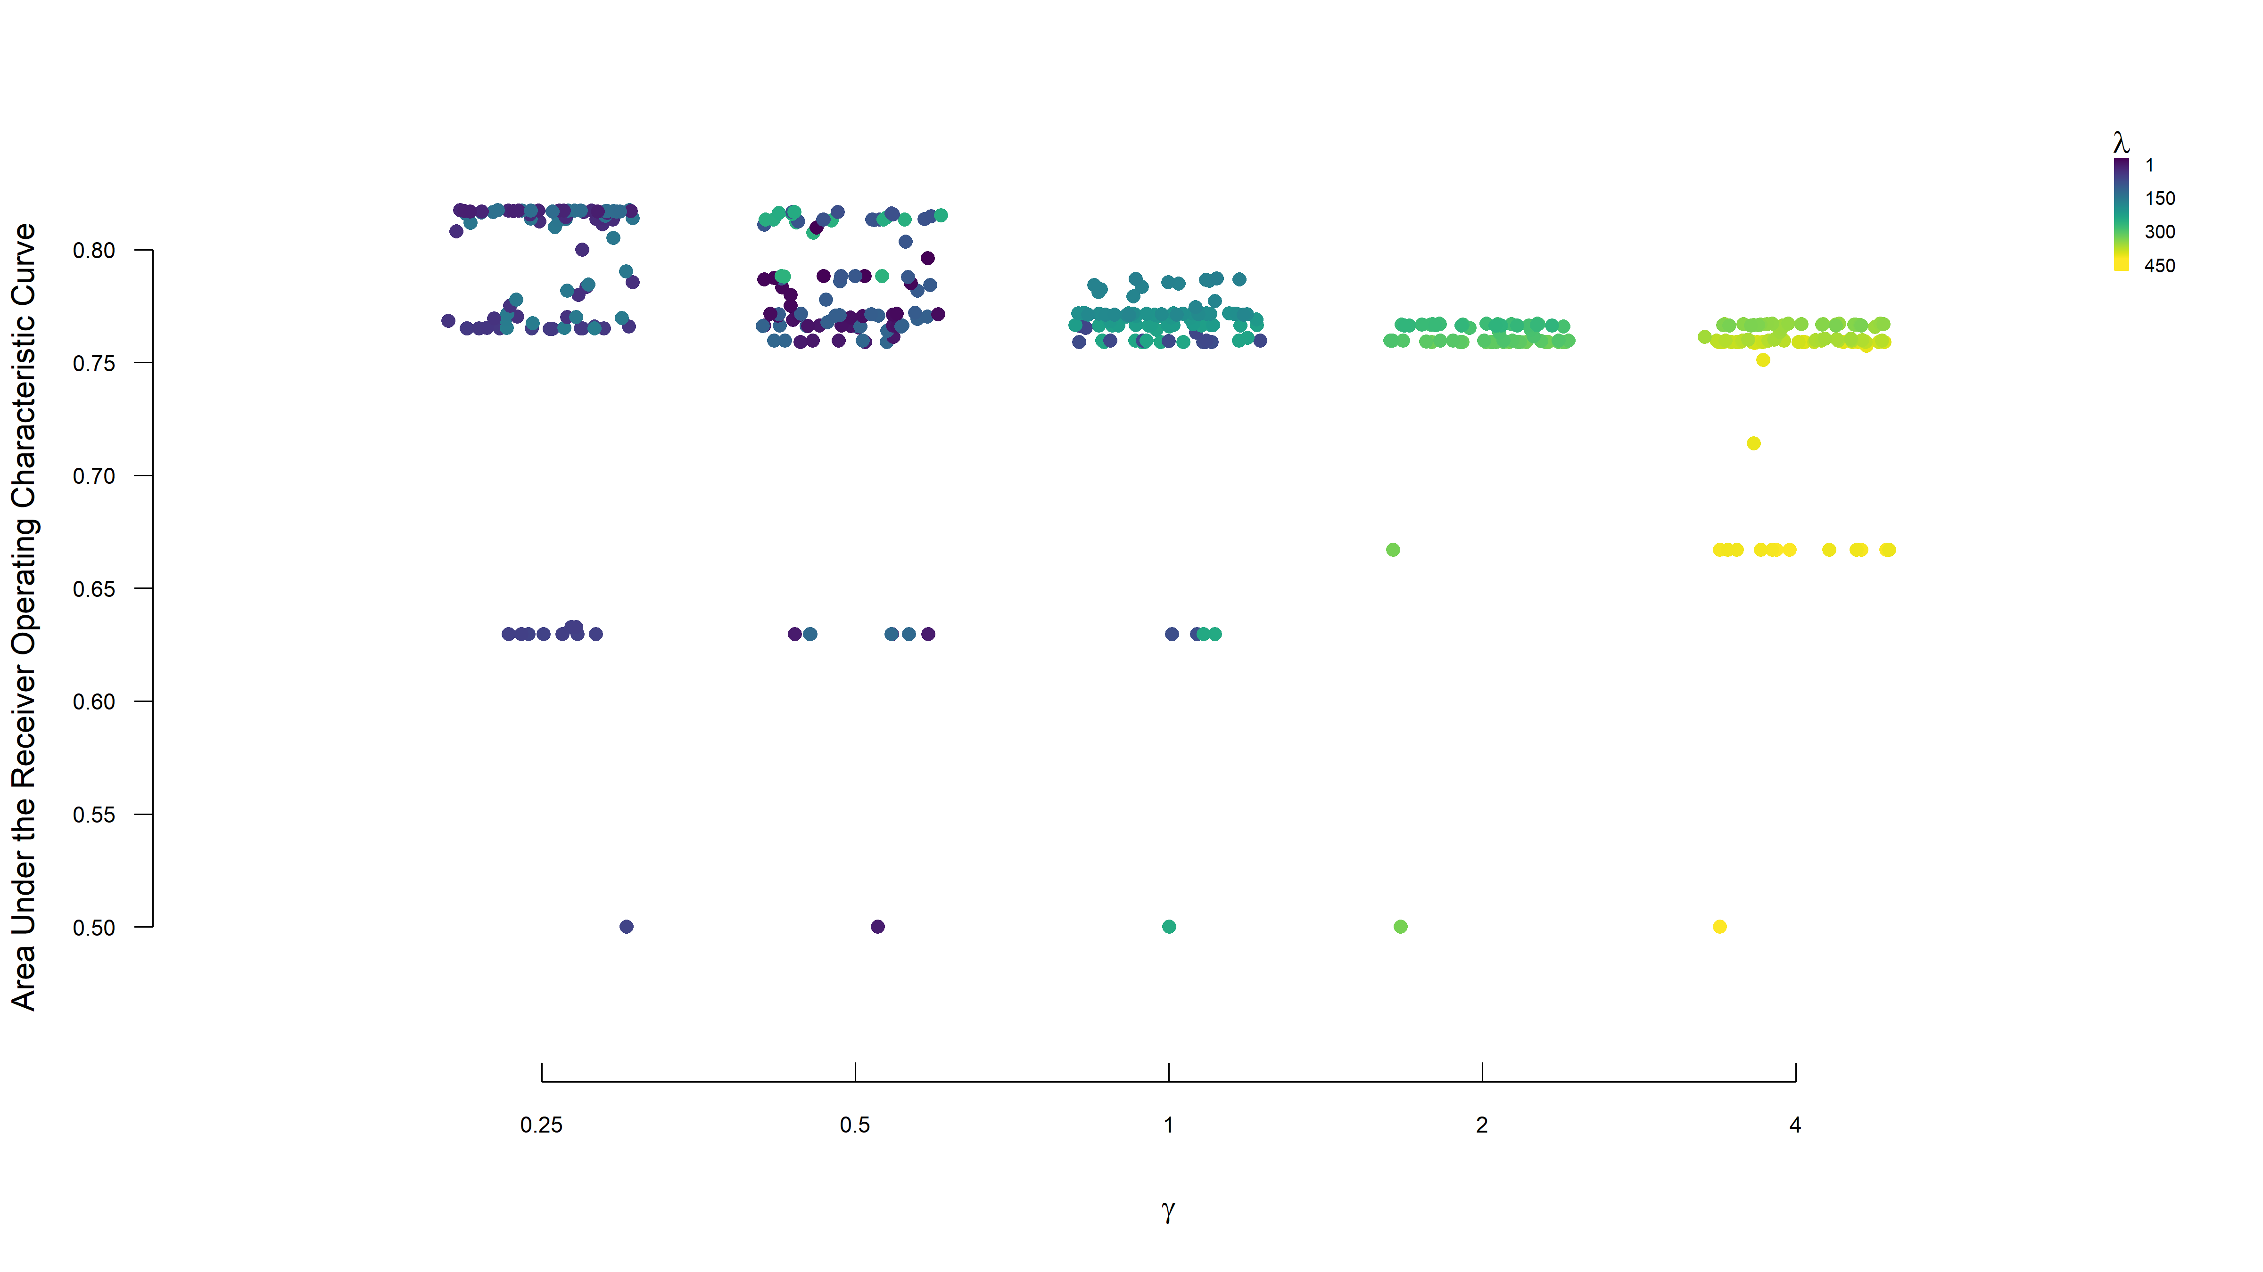

Slide 11
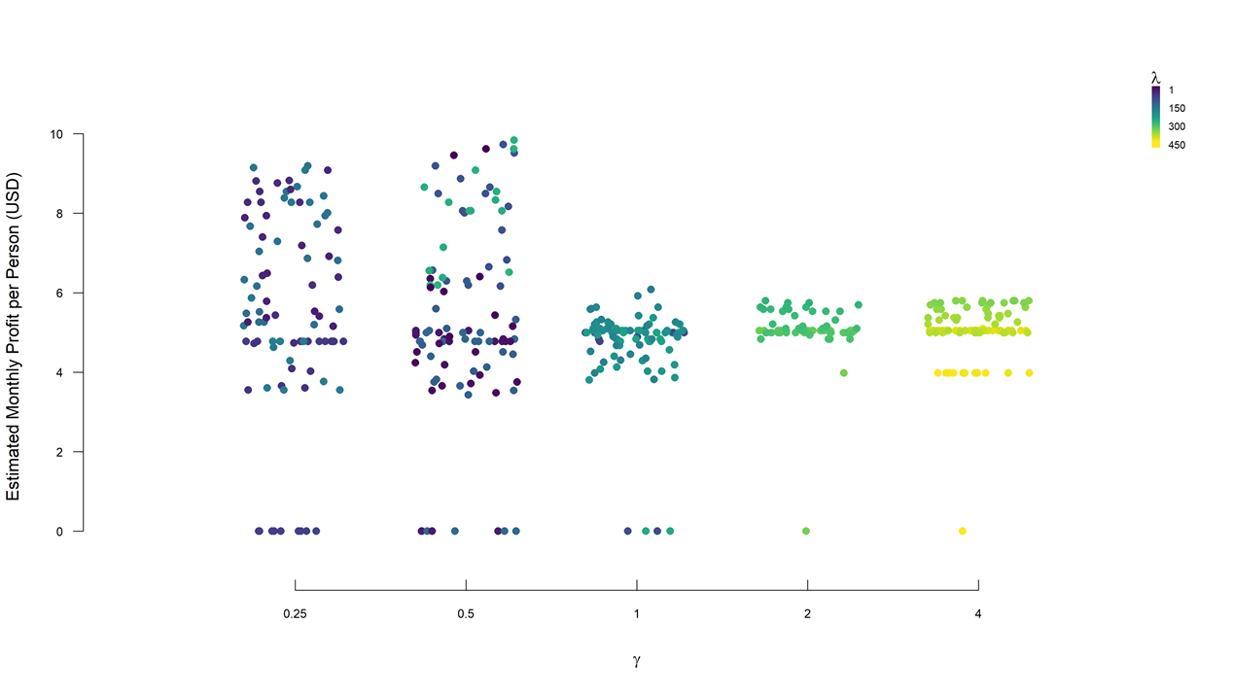

Slide 12
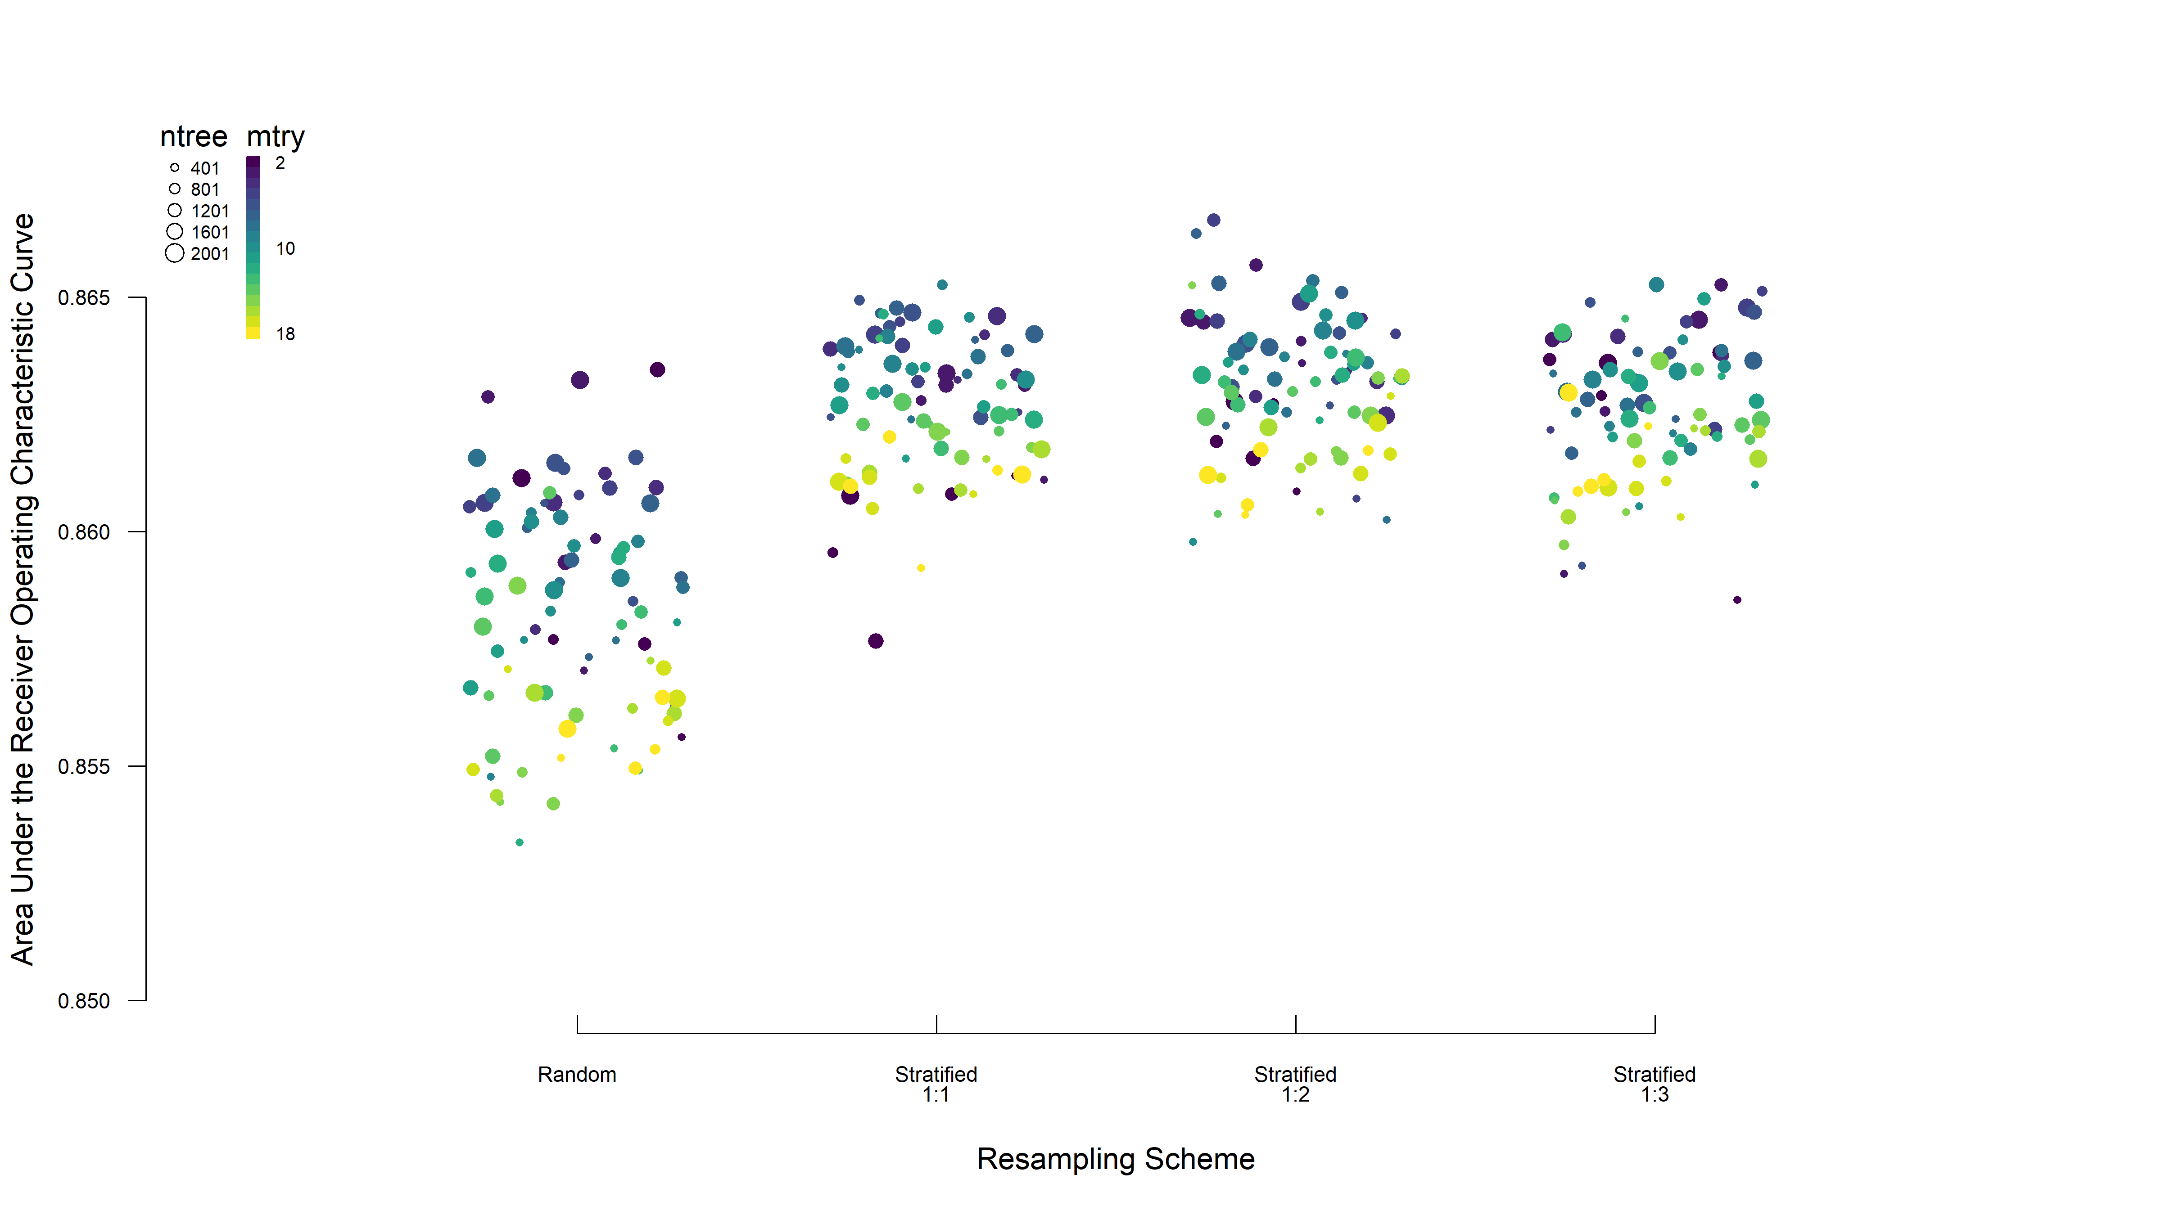
Classification
Random Forest

Slide 13
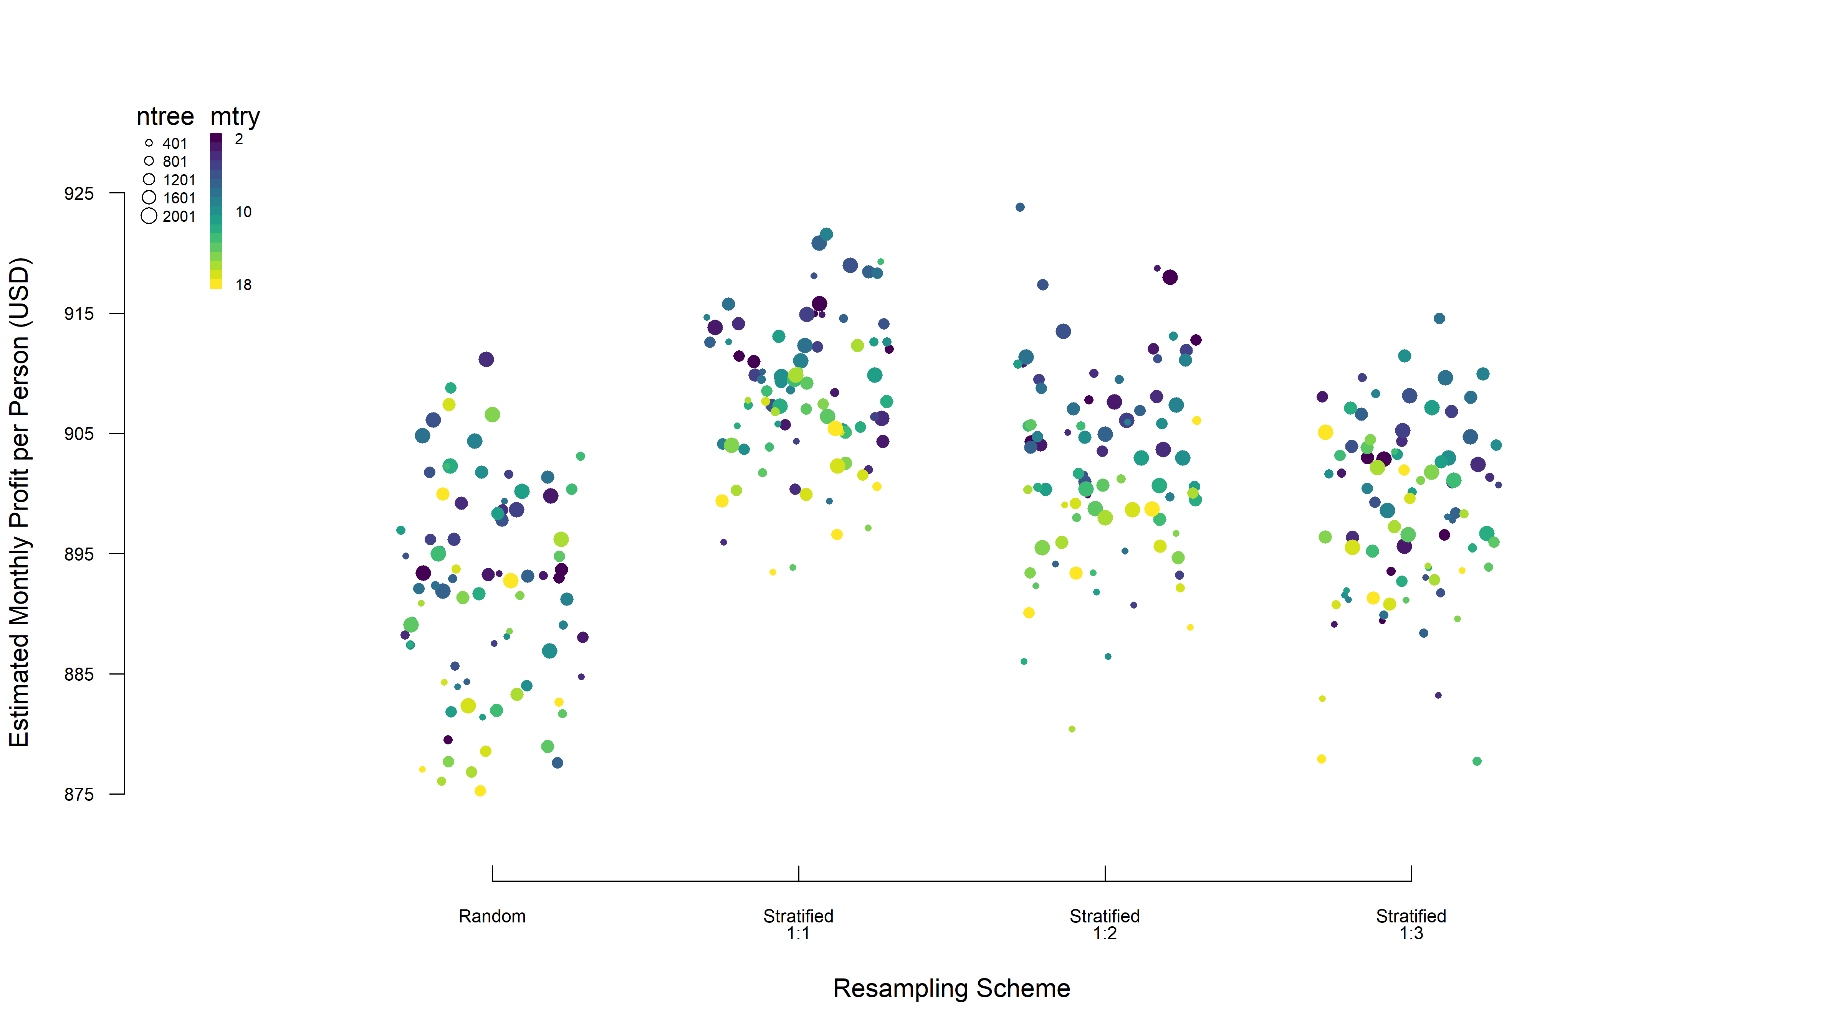
Classification
Random Forest

Slide 14
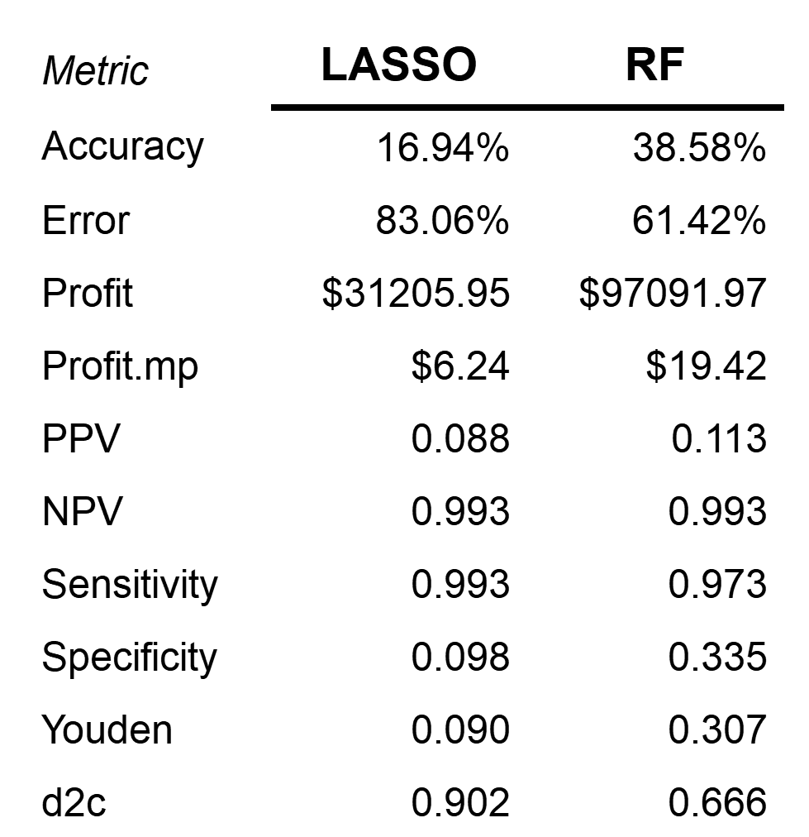
Predictions and Comparisons
Logistic Regression
 |  | Truth
 |  | Defaulted | Did Not Default
Prediction | Defaulted | 398 | 4,150 | 4,548
 | Did Not Default | 3 | 449 | 452
 |  | 401 | 4,599 | 5,000
Random Forest
 |  | Truth
 |  | Defaulted | Did Not Default
Prediction | Defaulted | 390 | 3,060 | 3,450
 | Did Not Default | 11 | 1,539 | 1,550
 |  | 401 | 4,599 | 5,000

Slide 15
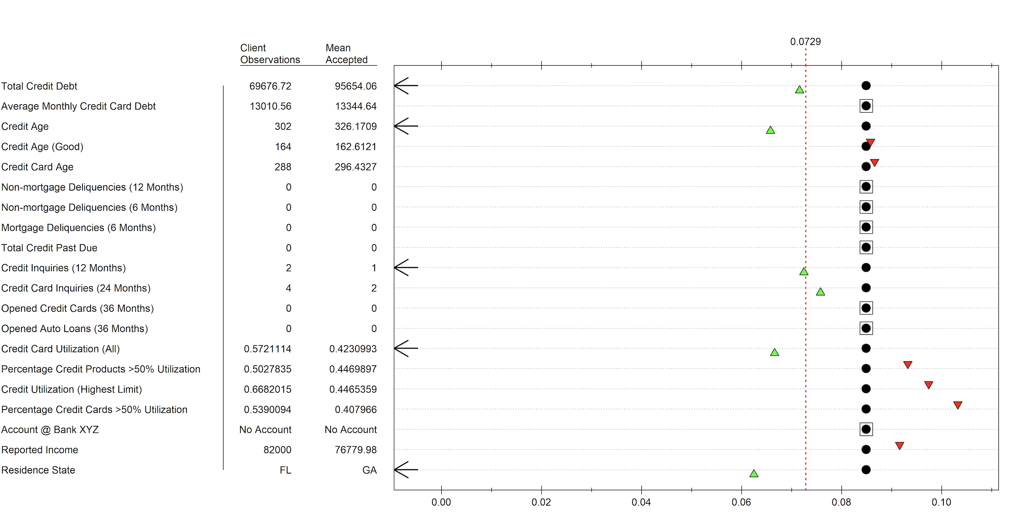
Conclusions
Rejection example based on Random Forest that shows how a change in a variable impacts model performance.
As seen in figure to the right, those who already have an account with bank XYZ do not receive favorable treatment

Slide 16
Thank you!

