Slide 1
Wastewater-based Epidemiological Surveillance for SARS-CoV-2
Athens-Clarke County, Georgia, USA
30 June 2020 – 03 February 2021
Megan Lott, William Norfolk, Cody Dailey,
Amelia Foley, Carolina Melendez Declet, Megan Robertson, Taylor Maddalene,
Stephen L. Rathbun, Erin K. Lipp
Presented by Cody Dailey

Slide 2
Can the pandemic be monitored through wastewater surveillance?

Slide 3
SARS-CoV-2 Quantities in Wastewater
Coronavirus Disease 2019 (COVID-19) Incidence
Can the pandemic be monitored through wastewater surveillance?

Slide 4
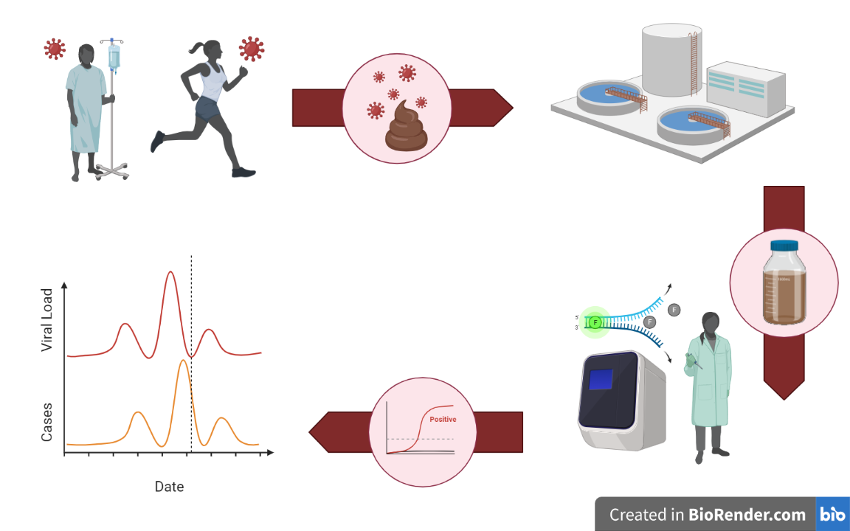
Wastewater-based Surveillance
for SARS-CoV-2

Slide 5
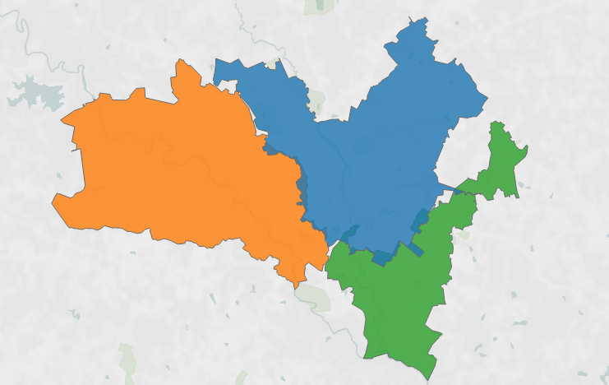

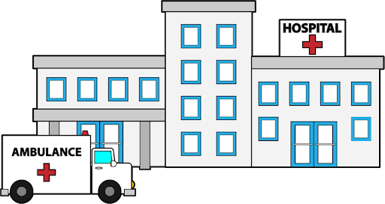

Catchment A
5.32 MGD
Catchment B
4.80 MGD
Catchment C
1.99 MGD
Notes:
Needs to be changed!!! Add in sewer map + emojis of the different contributions to each catchment area
+ highly residential + hospital +
Tell the story of this slide
Here is Athens.
We started by sampling three water treatment facilities in Athens.
Within each catchment area, there are different contributions that lead to different wastewater – catching different scopes of our community
Wasteater information highway

Slide 6
SARS-CoV-2 Quantities in Wastewater
Coronavirus Disease 2019 (COVID-19) Incidence
Raw (Sewage) Data
RT-qPCR Results
Reaction Calibrations
Wastewater Reclamation Facilities
COVID-19 Surveillance Reports

Slide 7
SARS-CoV-2 Quantities in Wastewater
Coronavirus Disease 2019 (COVID-19) Incidence
Plunging into Data Interrogation
Sampling Frequencies and Observations
“Missingness” Evaluation
Exploring Limits of Detection and Quantification

Slide 8
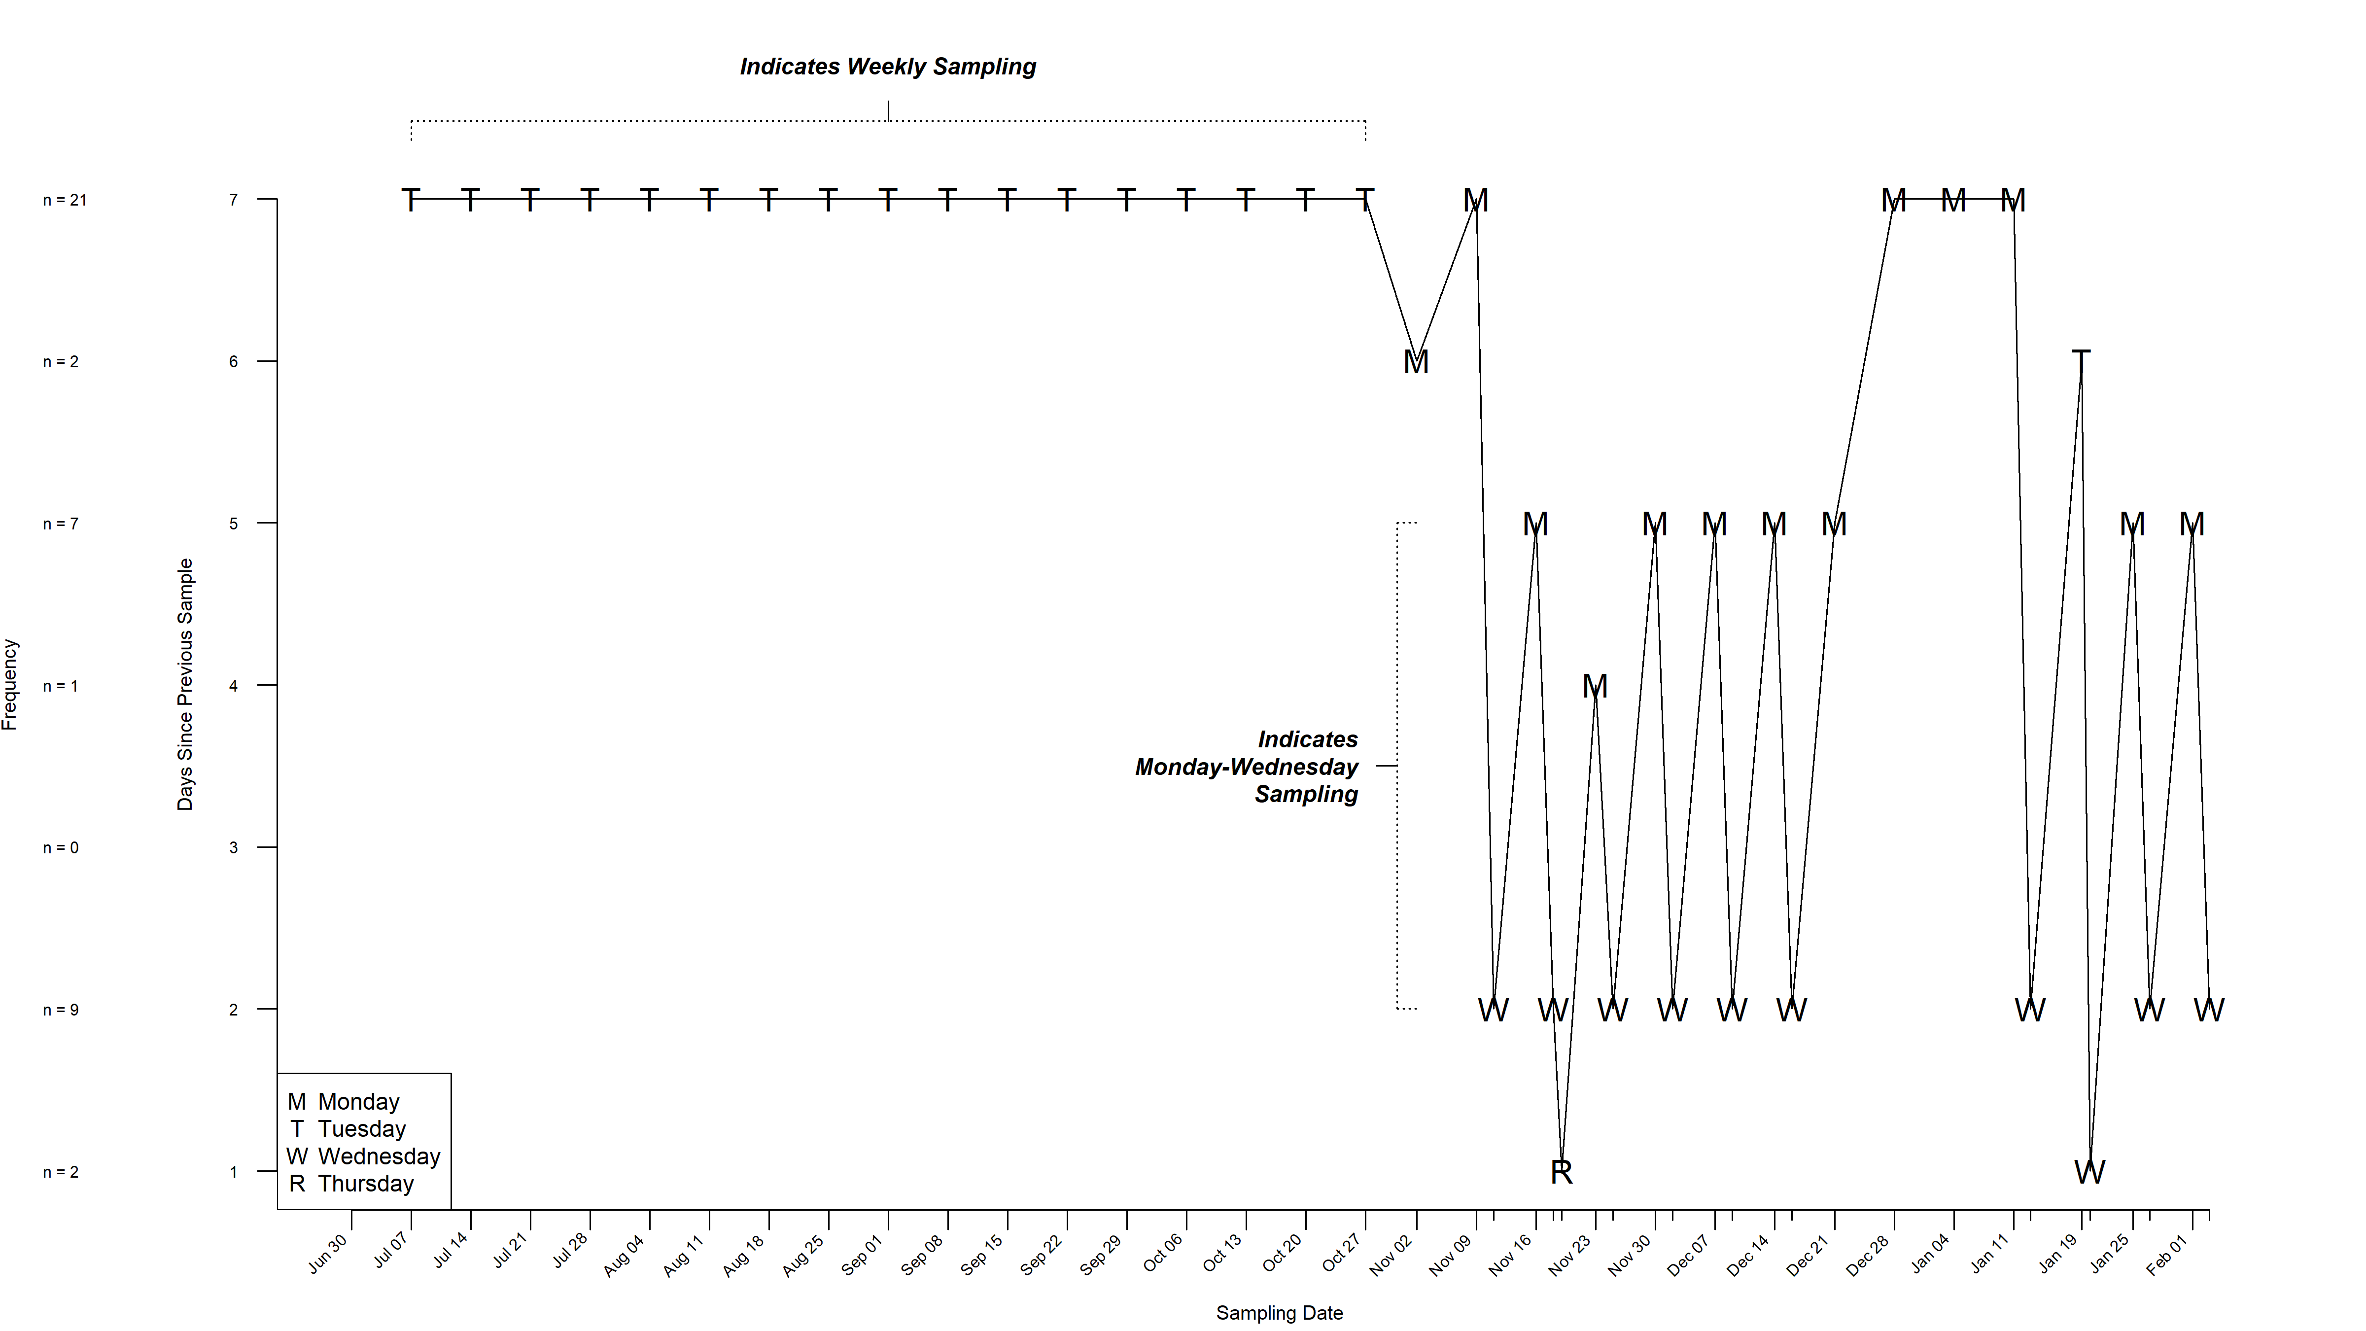

Slide 9
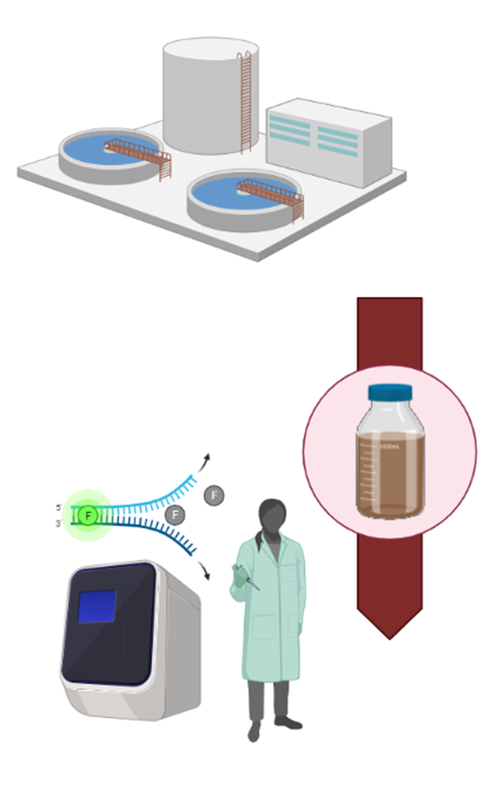
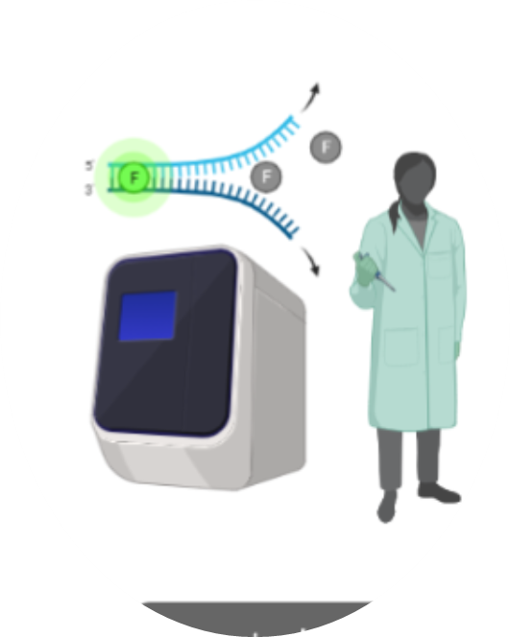
3 WRF
3 24-hour composite samples
2 viral sequence targets
3 technical replicates
~54 RT-qPCR results per sampling date

Slide 10
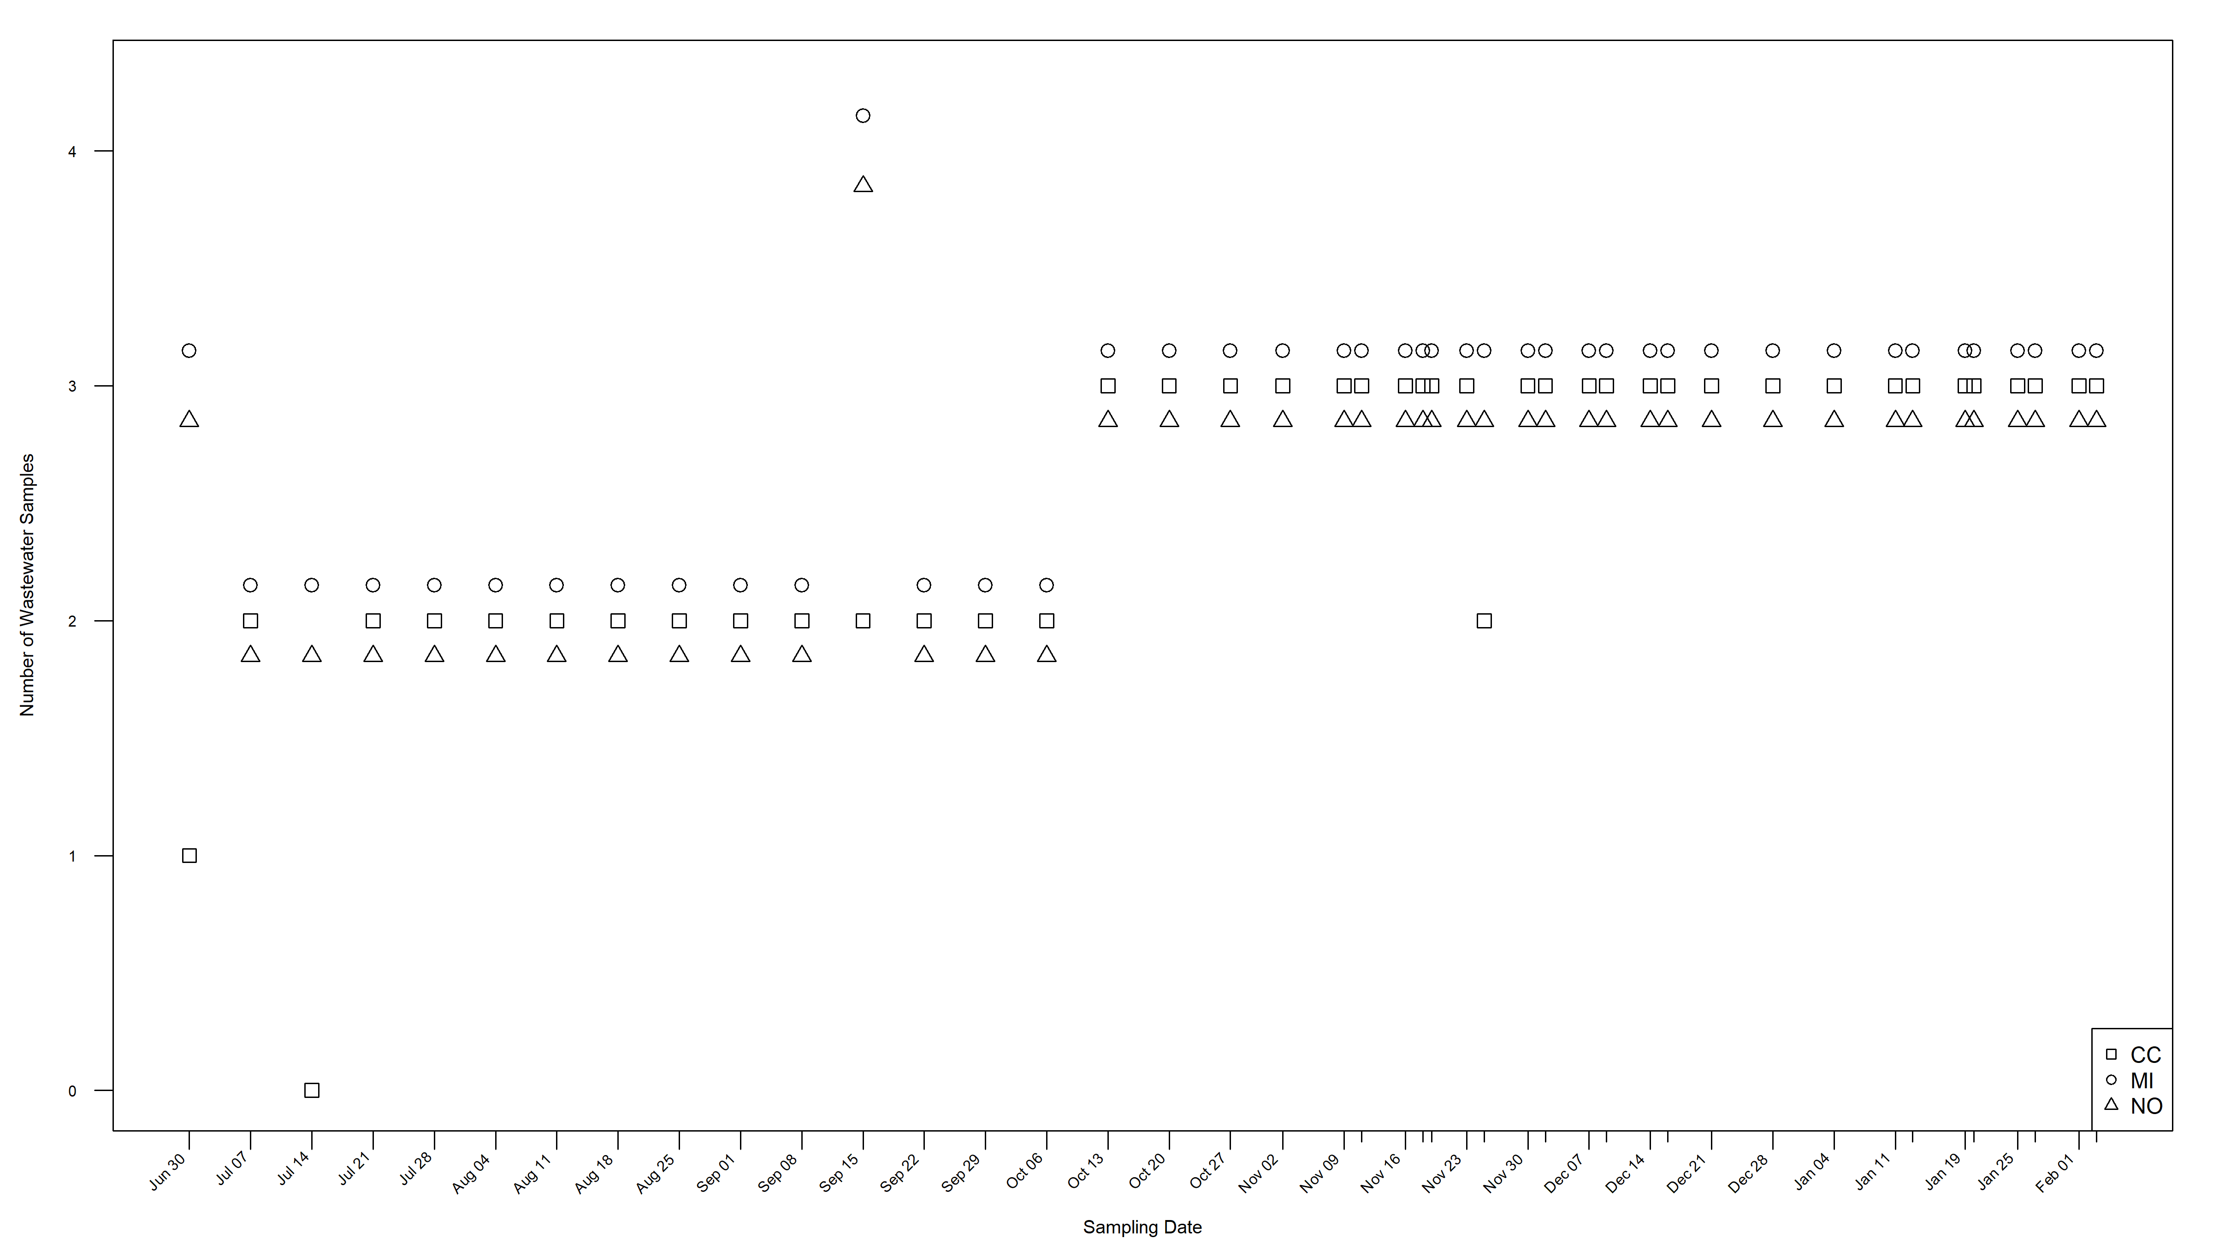

Slide 11
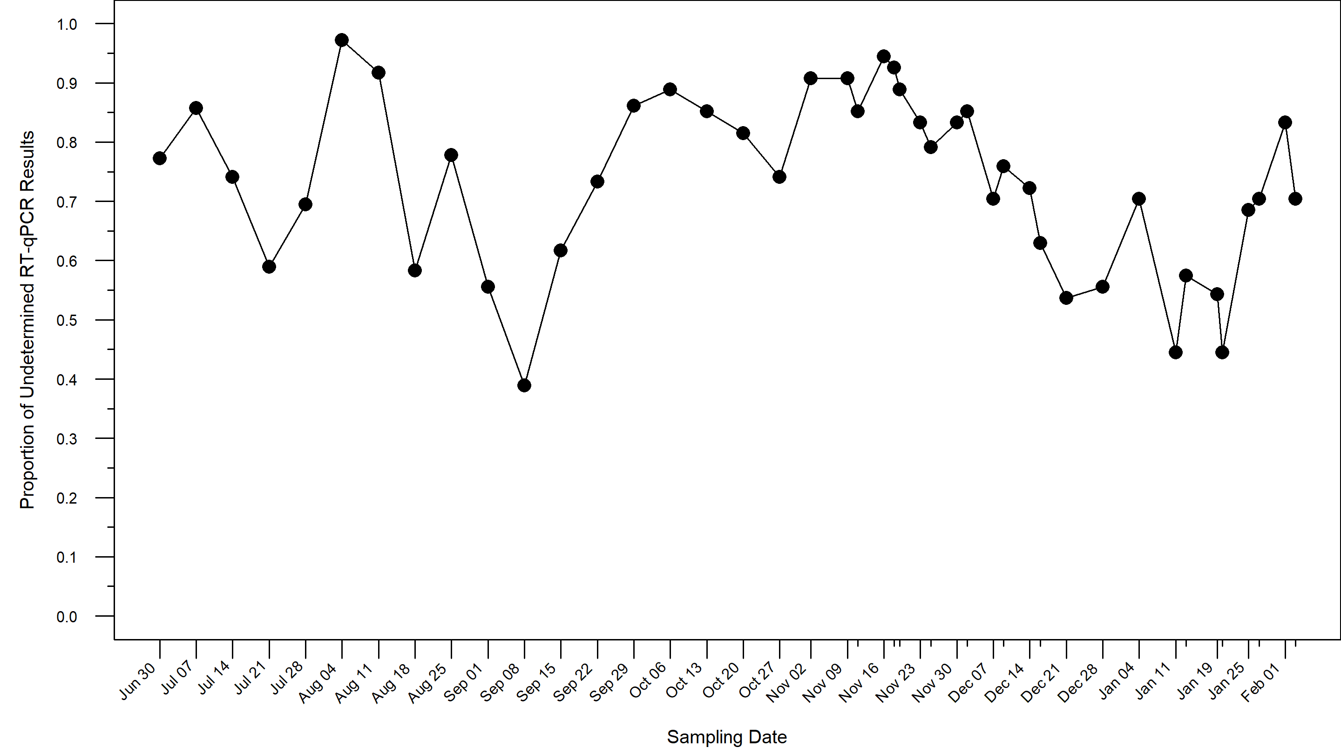
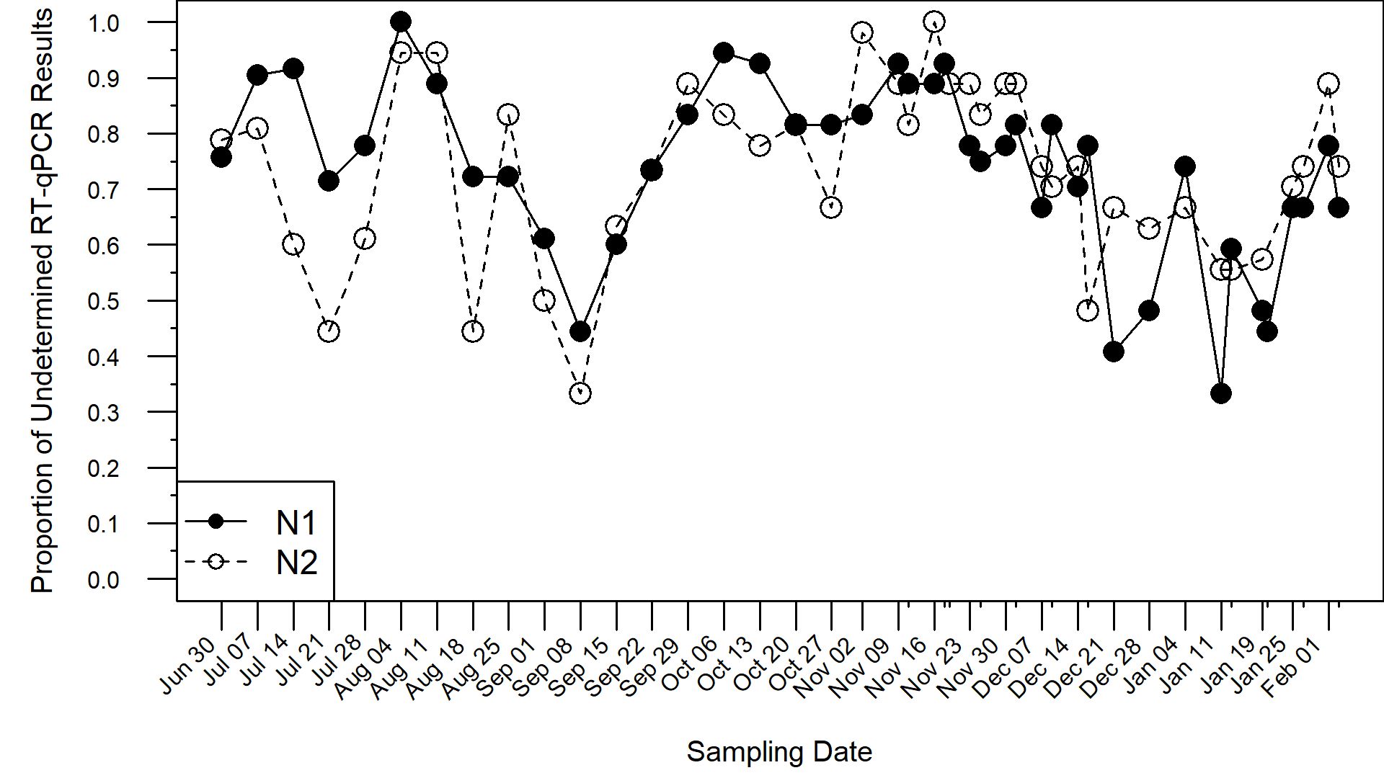
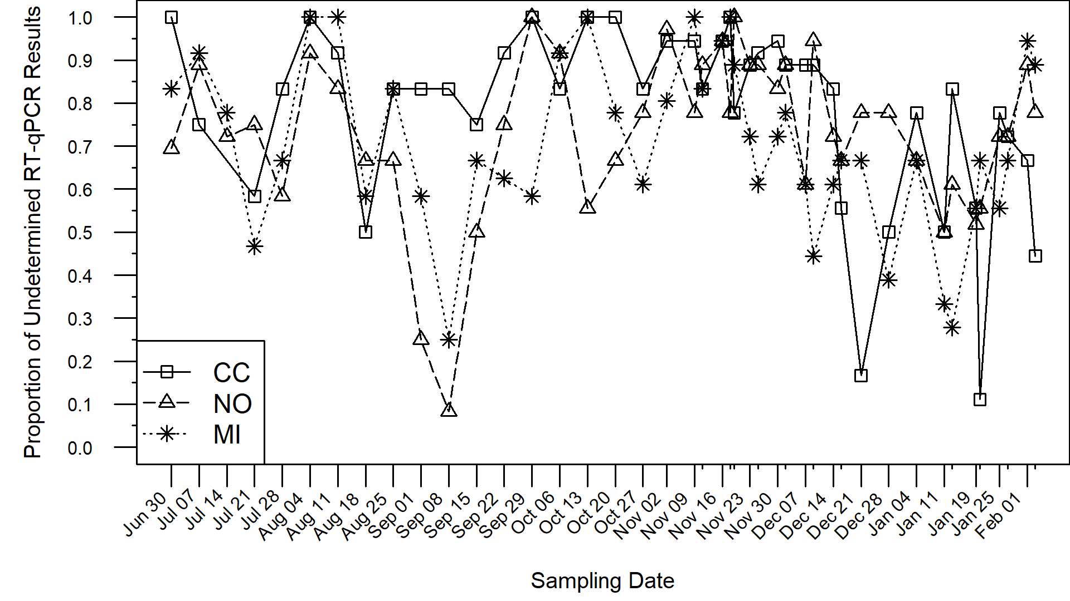
1567 of 2124 (73.7%) undetermined
Average of 13 positive results for each day
Over 80% of sampling dates have more than 6 positive results
At technical and biological replicate levels, significant facility differences in probabilities of undetermined results (p = 0.004 and p = 0.003, respectively) after controlling for sequence target.
Cedar Creek samples were more likely undetermined
No significant differences at sampling date level, nor for viral sequence target at any levels (multiple logistic regression* with both target and facility included)

Slide 12
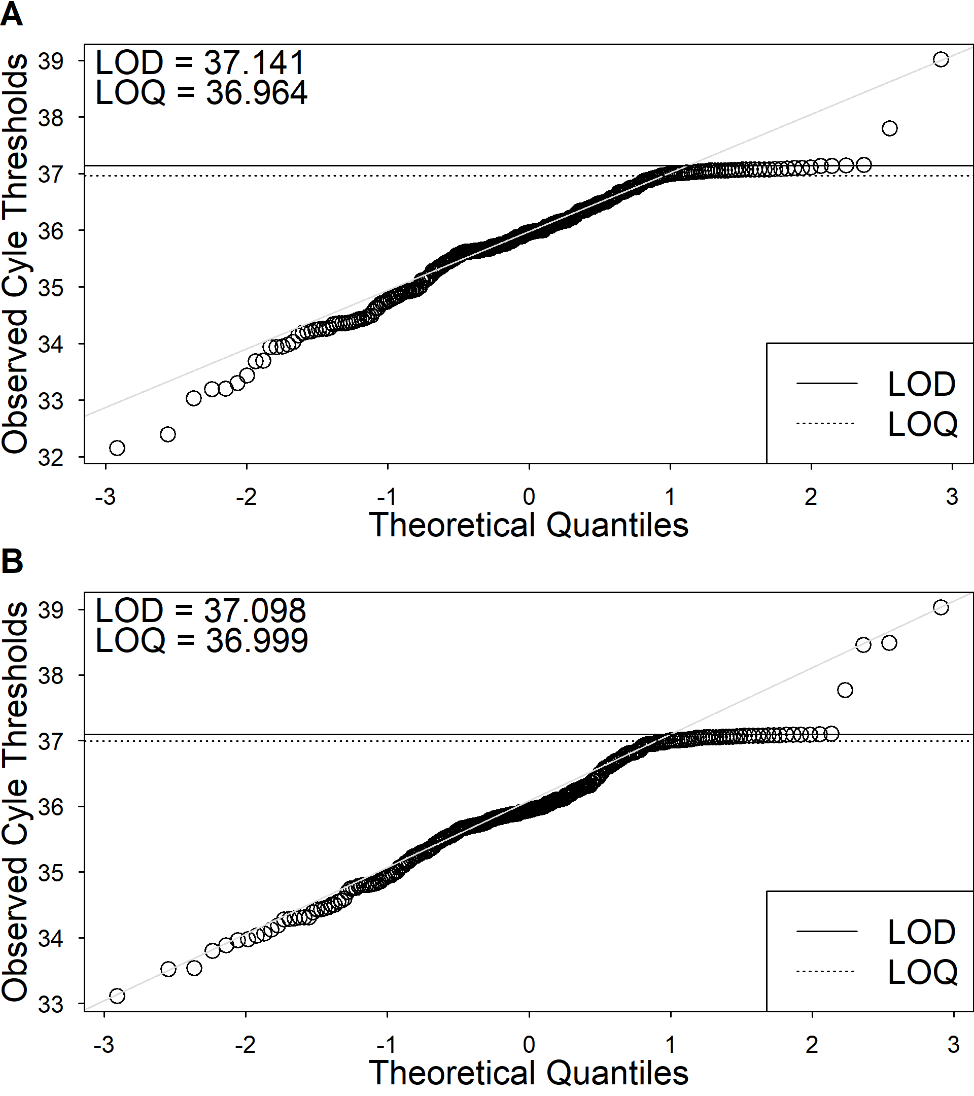
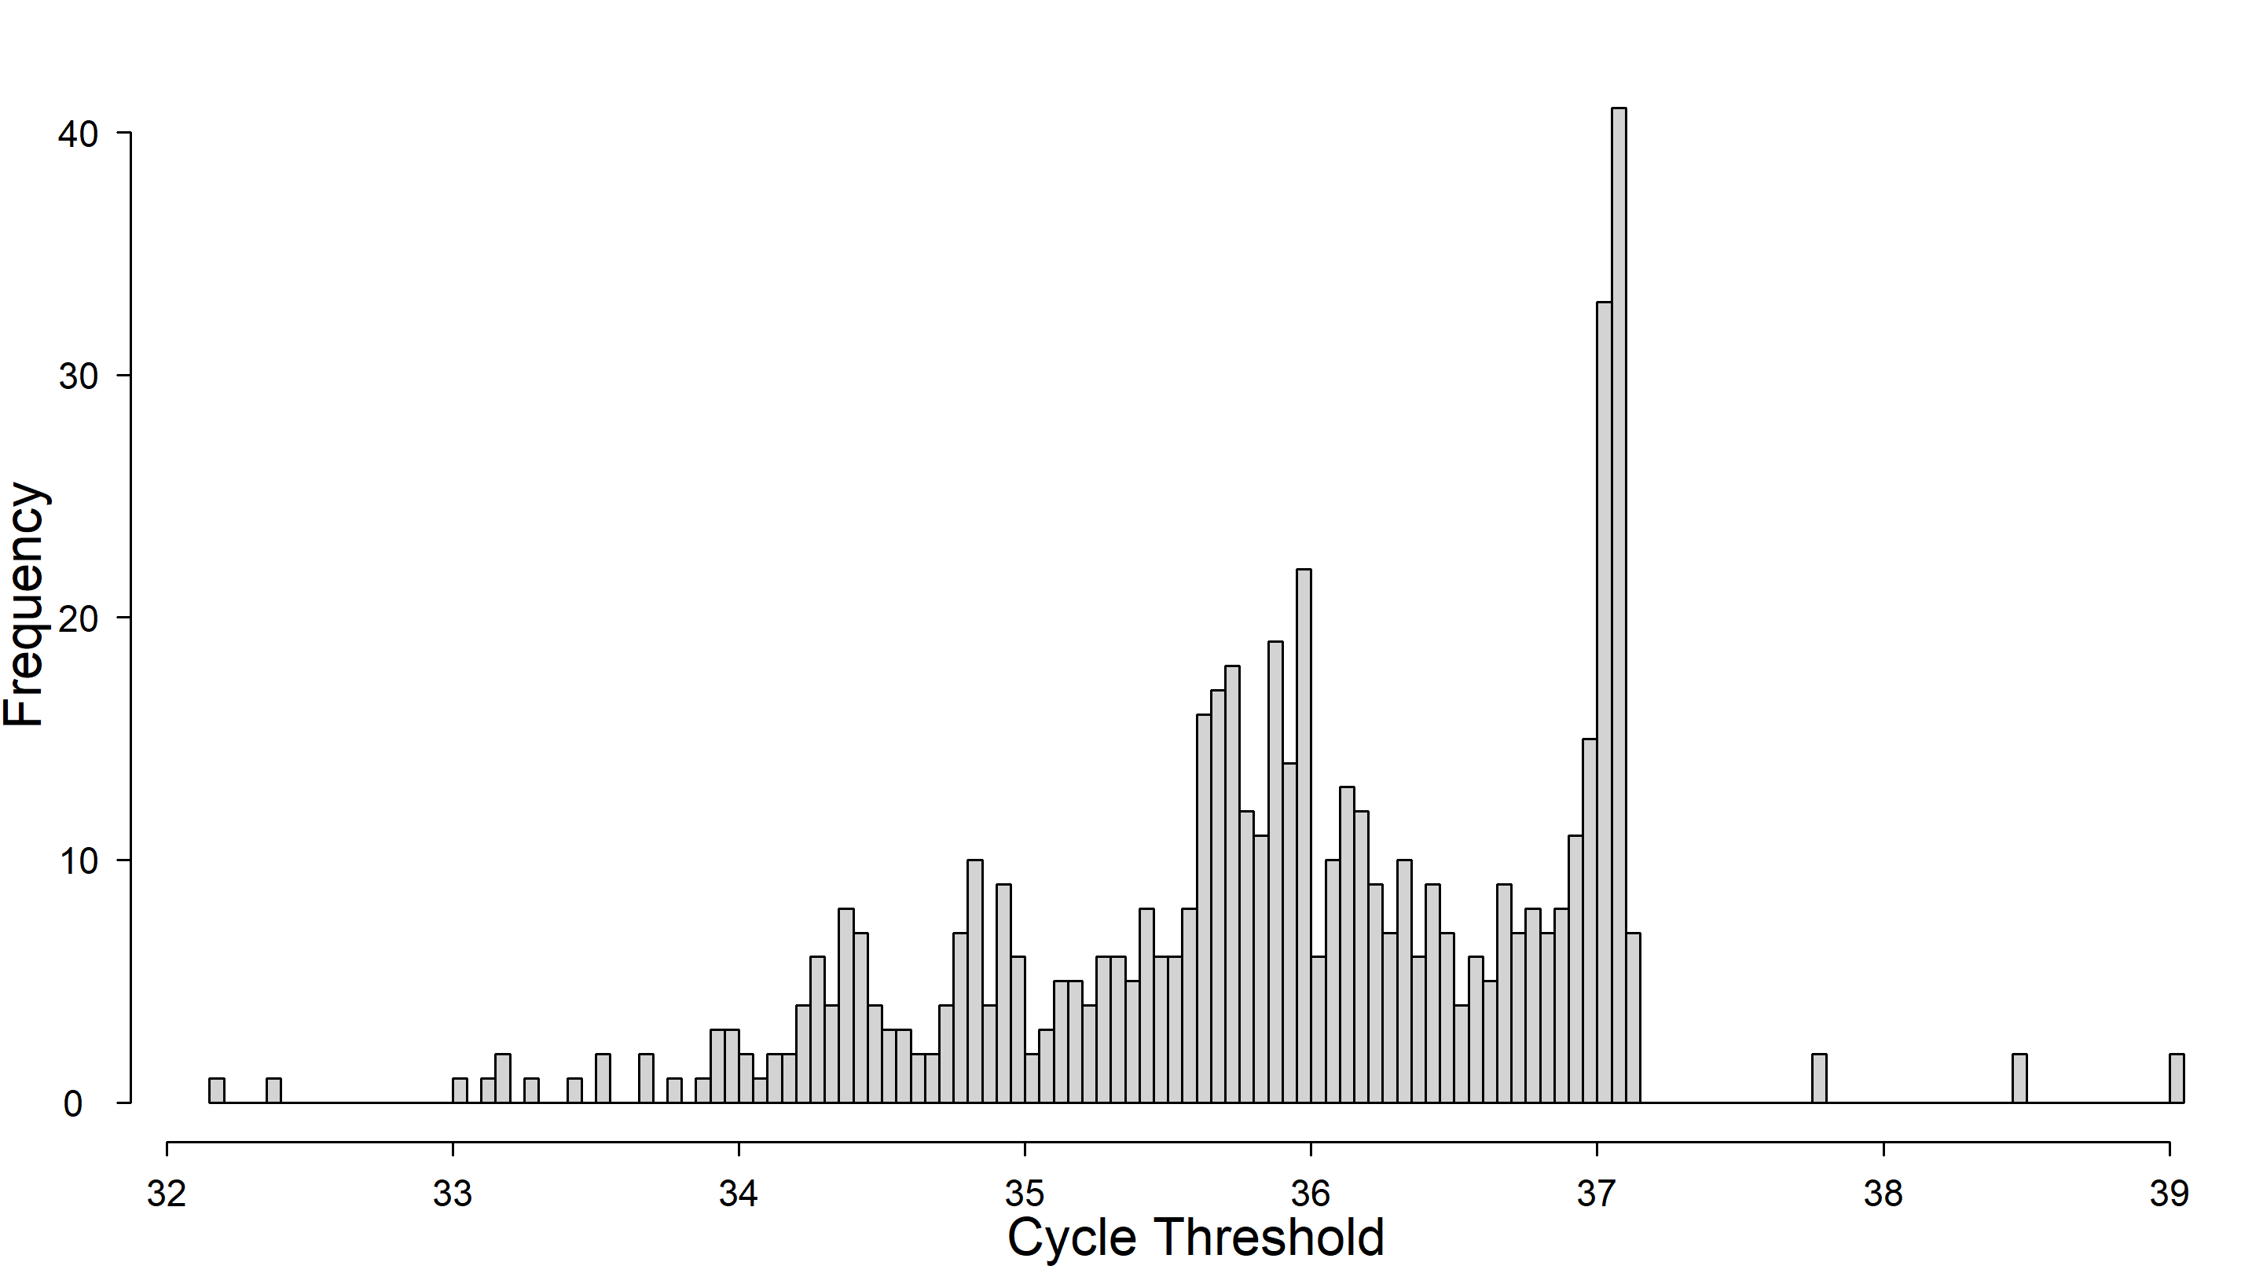

Slide 13
SARS-CoV-2 Quantities in Wastewater
Coronavirus Disease 2019 (COVID-19) Incidence
Waste (Data) Management
Standard Curves and Reaction Efficiency
Data Adjustment using Limits of Detection and Quantification

Slide 14
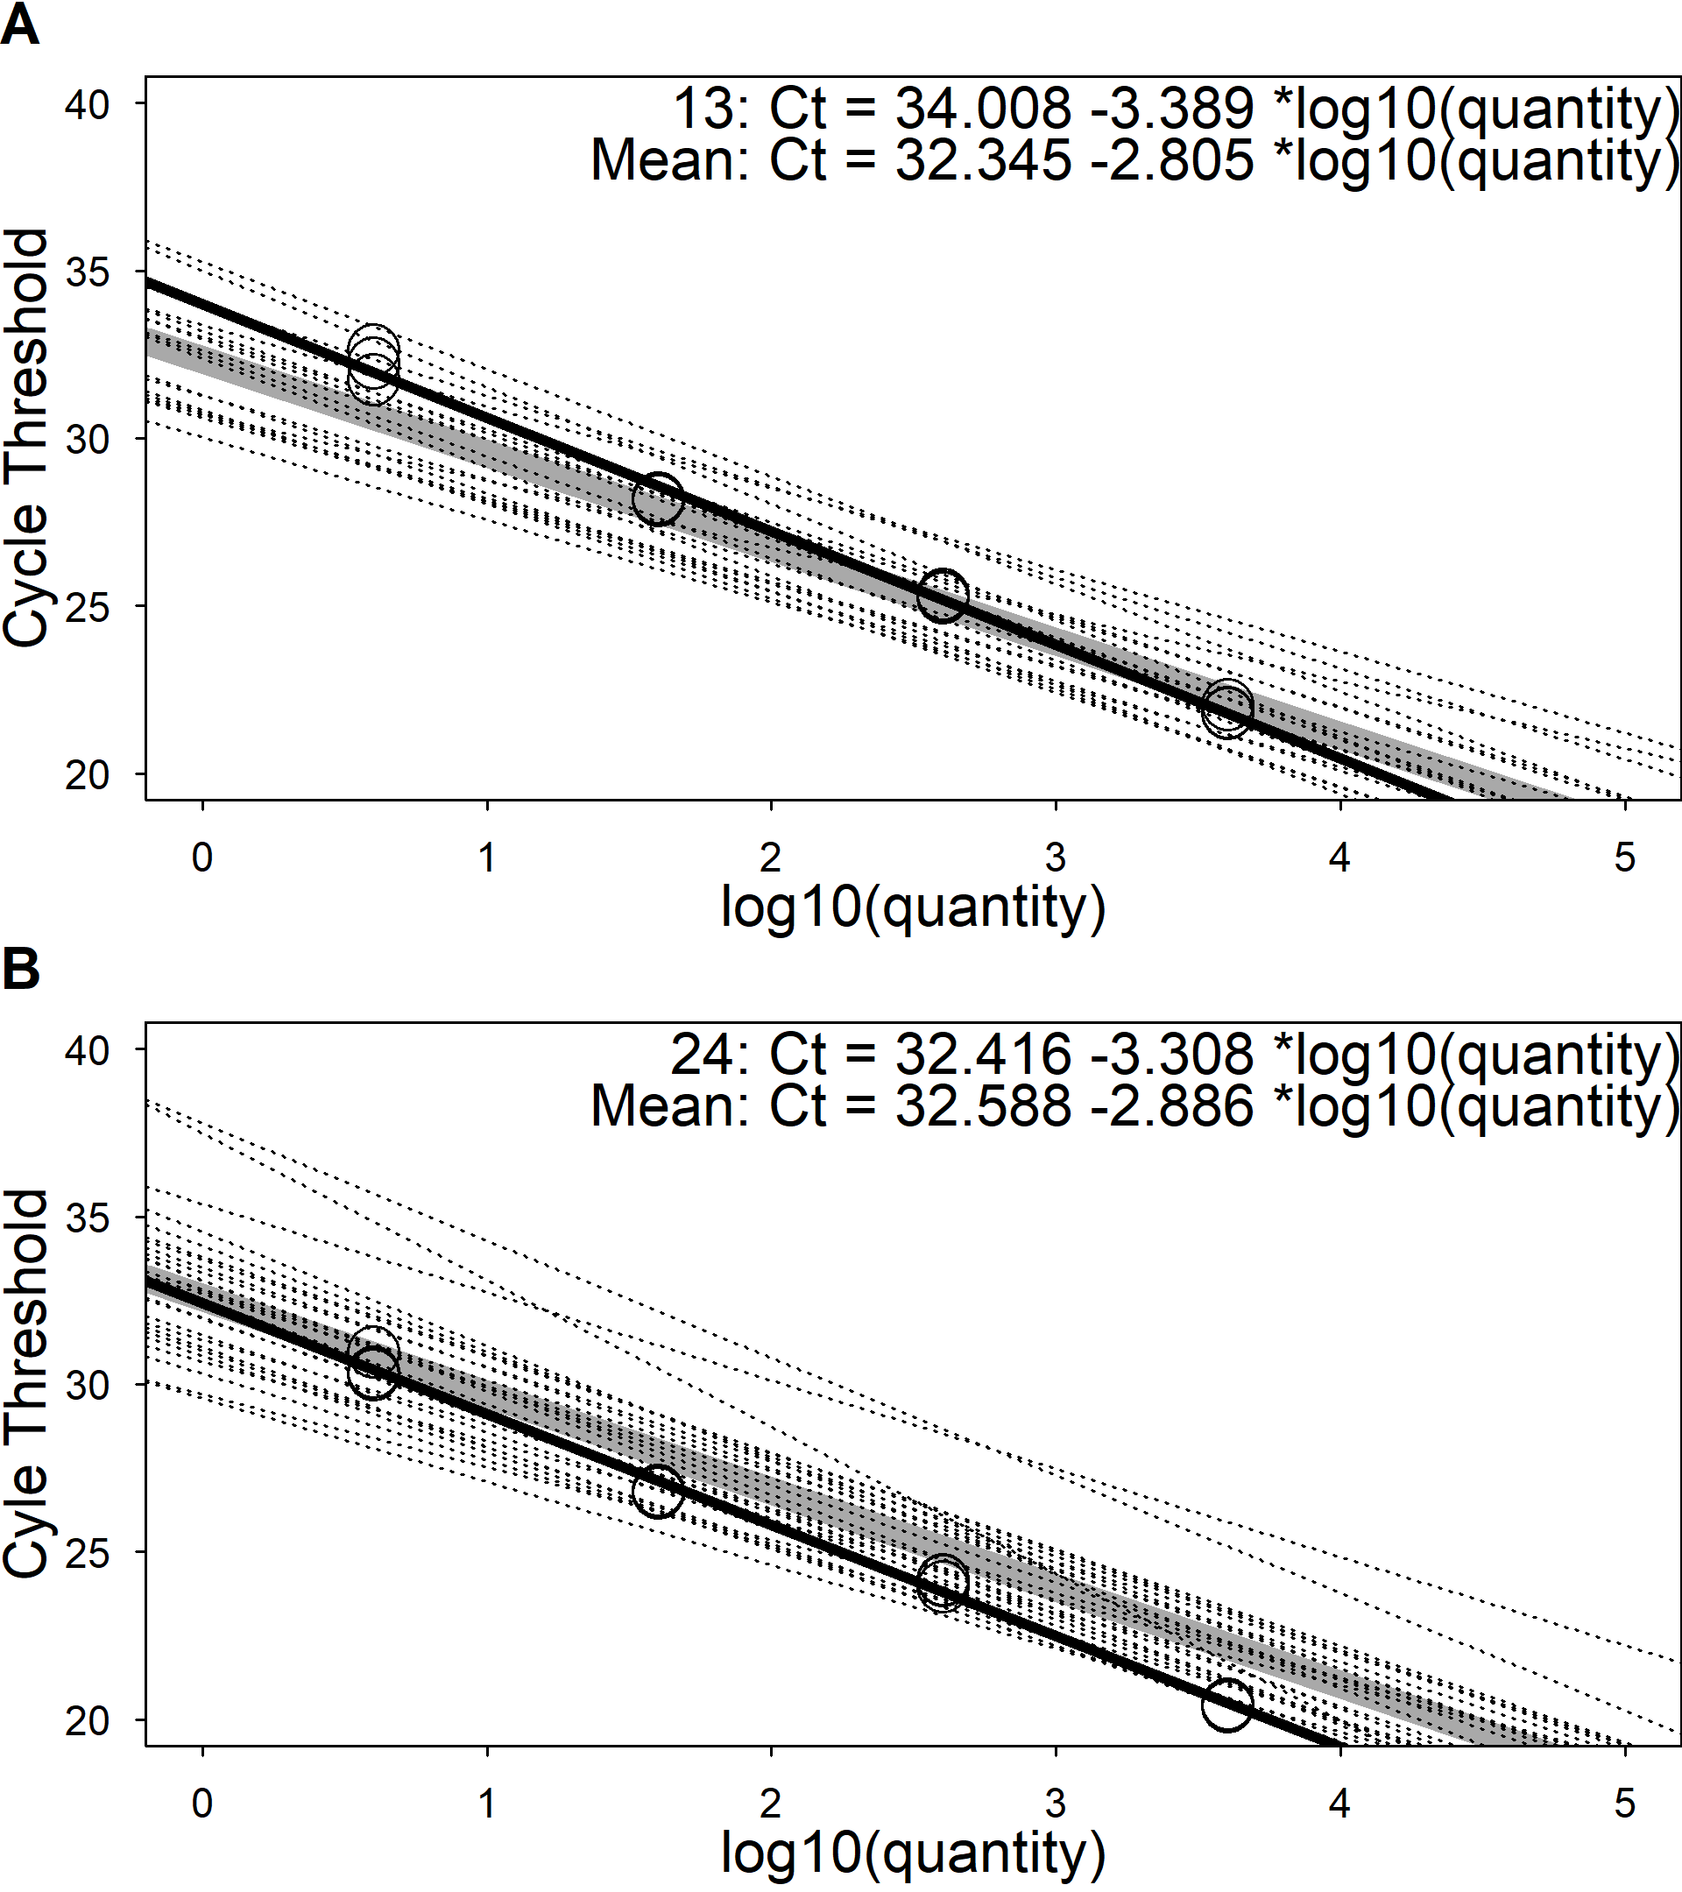

$$\begin{matrix} & Quantity_{N1}={10}^{−\frac{Ct−34.008}{−3.3890}} \\ & Quantity_{N2}={10}^{−\frac{Ct−32.416}{−3.3084}}\end{matrix} \left(5.8\right)$$

Slide 15
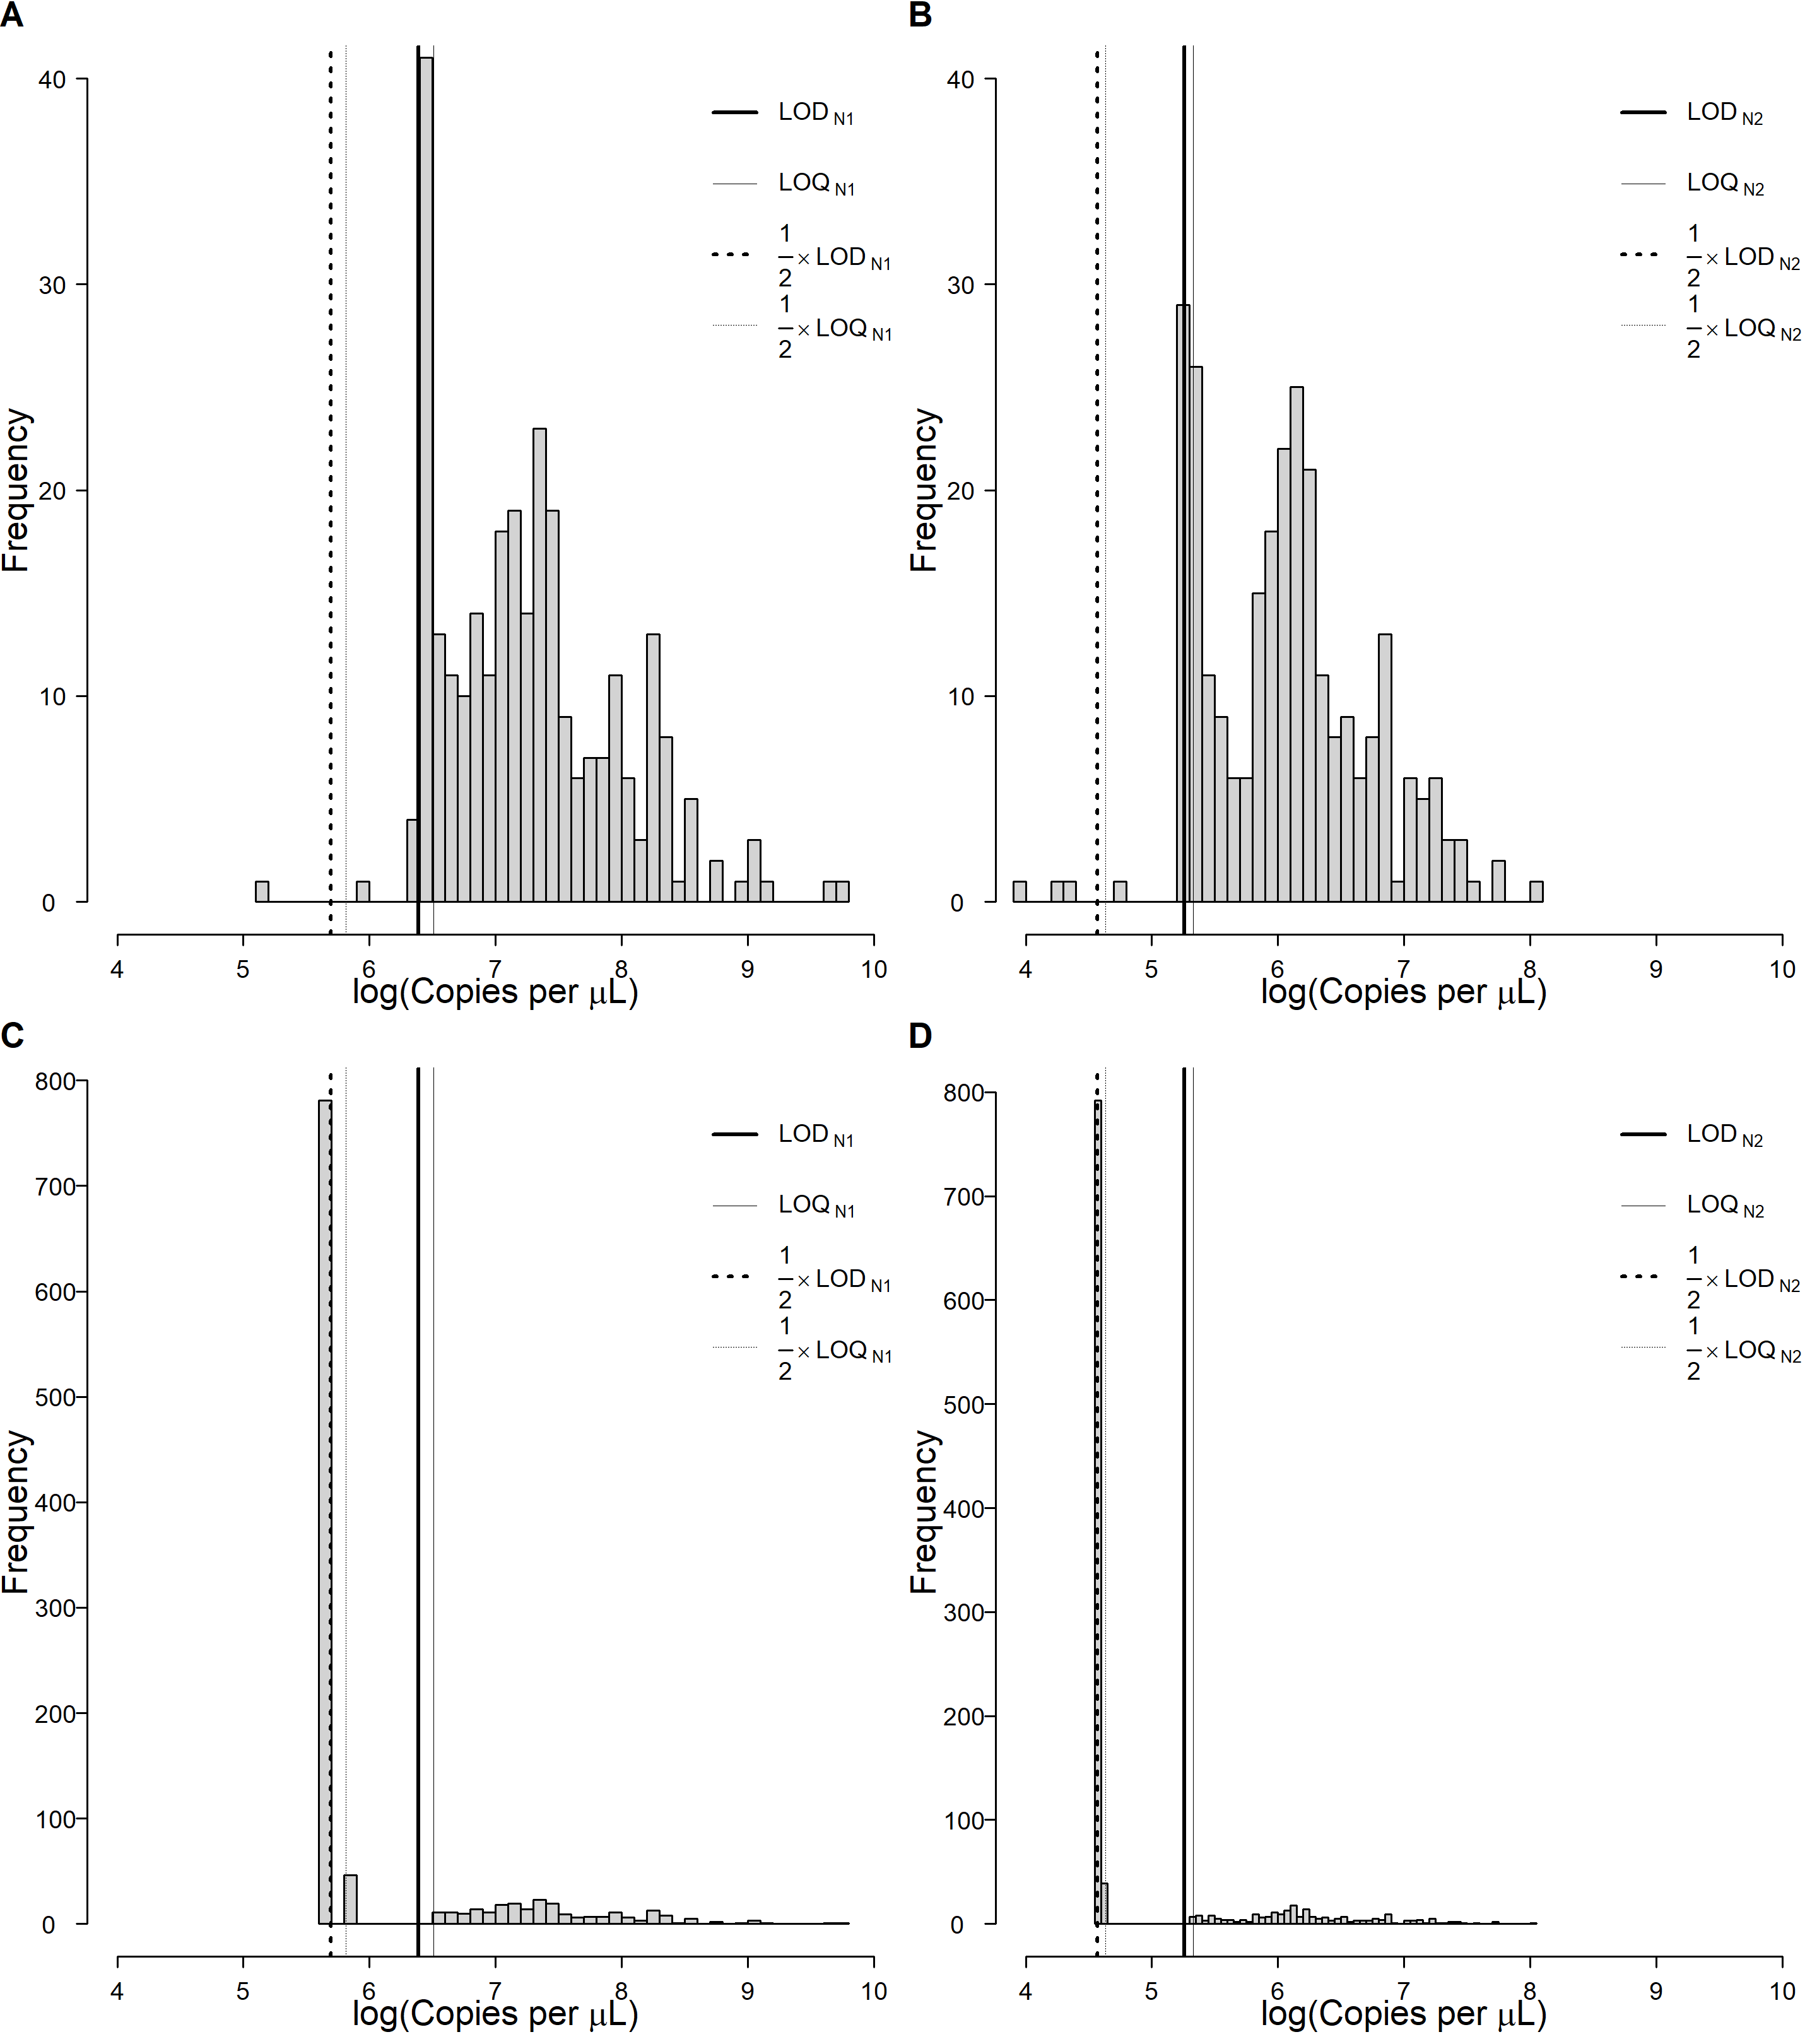
Facility | Target | Undetermined | Above LOD | Between the LOQ and LOD | Below LOQ
CC | N1 | 254 (77.0) | 2 (0.61) | 10 (3) | 64 (19.4)
 | N2 | 259 (78.5) | 2 (0.61) | 8 (2.4) | 61 (18.5)
MI | N1 | 243 (67.5) | 0 (0) | 26 (7.2) | 91 (25.3)
 | N2 | 260 (72.2) | 2 (0.56) | 15 (4.2) | 83 (23.1)
NO | N1 | 281 (75.5) | 1 (0.27) | 10 (2.7) | 80 (21.5)
 | N2 | 268 (72) | 1 (0.27) | 16 (4.3) | 87 (23.4)
 | Limit of Detection | Limit of Quantification
N1 | 595 | 671
N2 | 192 | 206

Slide 16
SARS-CoV-2 Quantities in Wastewater
Coronavirus Disease 2019 (COVID-19) Incidence
Wiping away Convolution
Epidemic Curves
Deconvolution

Slide 17
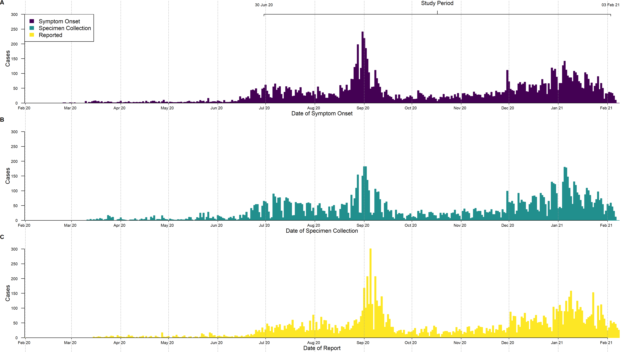

Slide 18
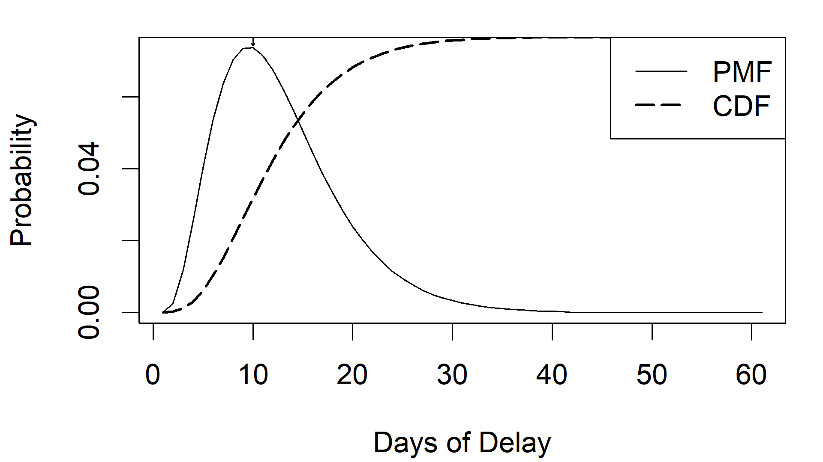
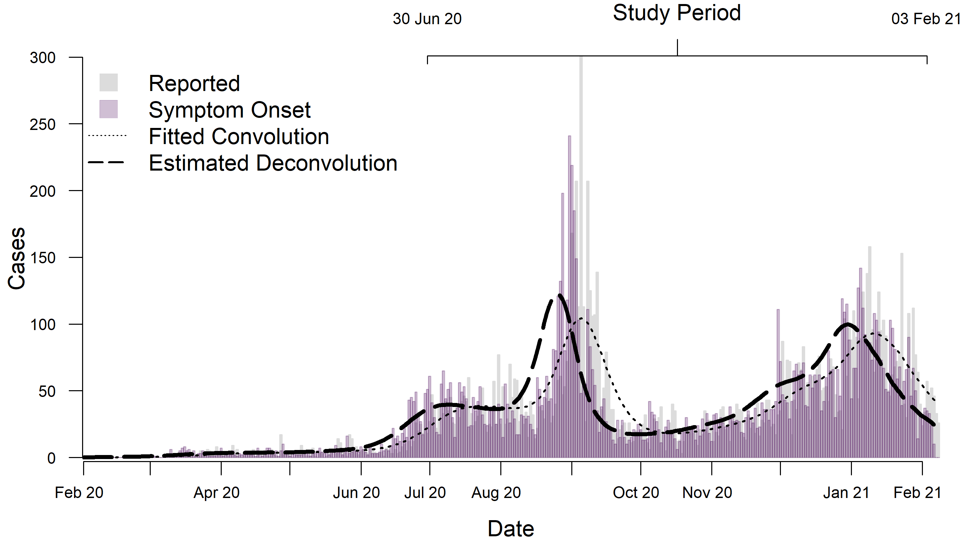
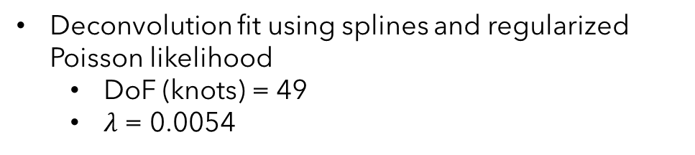
Delay distribution inferred from incubation period and time for a positive test to be reported
Peak @ 10 days, max @ 41 days
Deconvolution fit using splines and regularized Poisson likelihood
DoF (knots) = 49
$λ$ = 0.0054

Slide 19
SARS-CoV-2 Quantities in Wastewater
Coronavirus Disease 2019 (COVID-19) Incidence
It’s All Clumping Together…
Data Alignment
Cross-correlations

Slide 20
3 WRF
3 24-hour composite samples
2 viral sequence targets
3 technical replicates
~54 RT-qPCR results per sampling date
Wastewater reclamation facilities reported total influent volumes
Geometric means used to summarize the results to facility level
A sum combined all 3 WRF for each sampling date

Slide 21
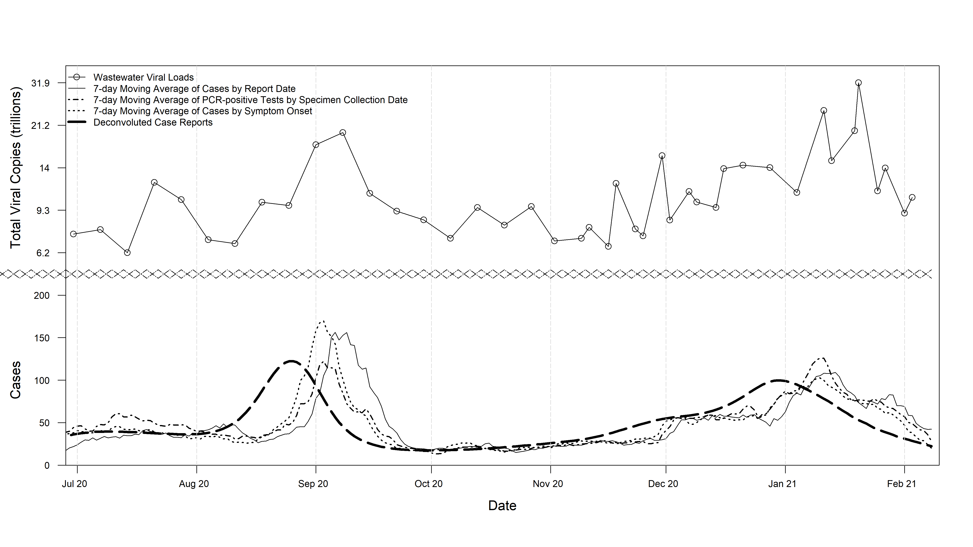

Slide 22
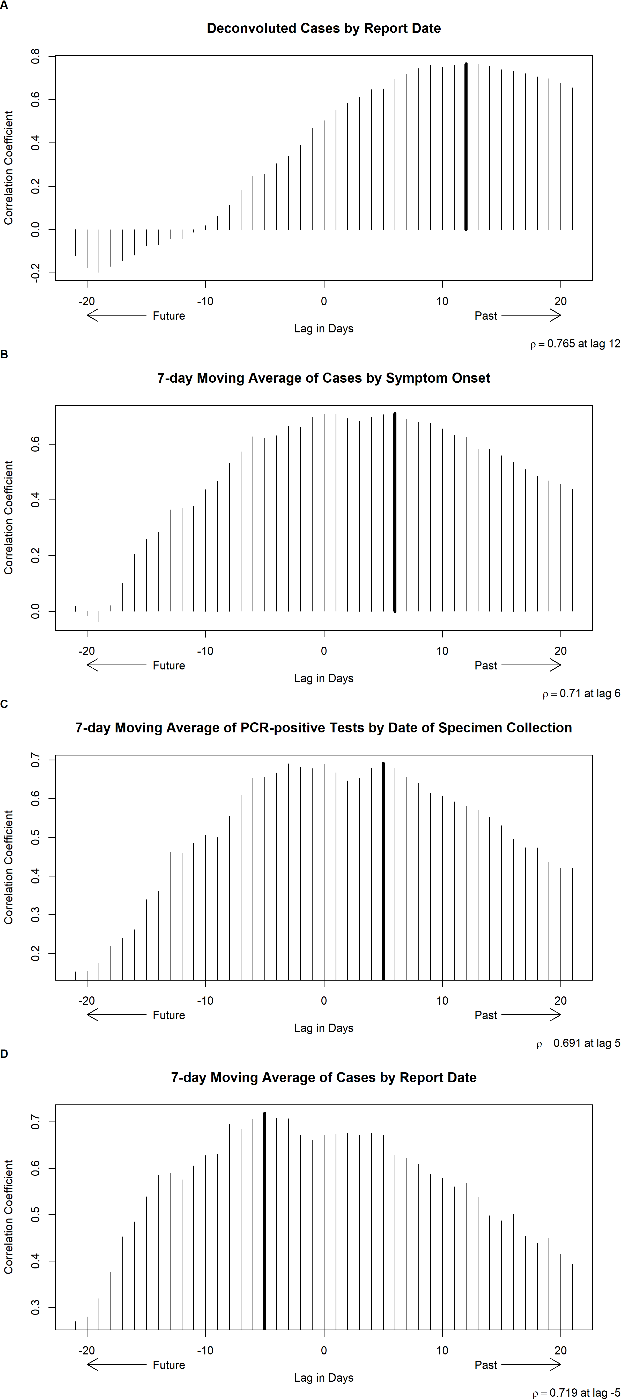

Slide 23
Can the pandemic be monitored through wastewater surveillance?

Slide 24
Conclusions
8-14-day lag behind “true” incidence
~1-day lead of to 6-day lag behind reported symptoms
~3-day lead of to 5-day lag behind date of specimen collection
~3 to 8-day lead ahead of time of reported cases
Further attention to…
Standard curves
Summarization schemes
Predictions / forecasting

Slide 25
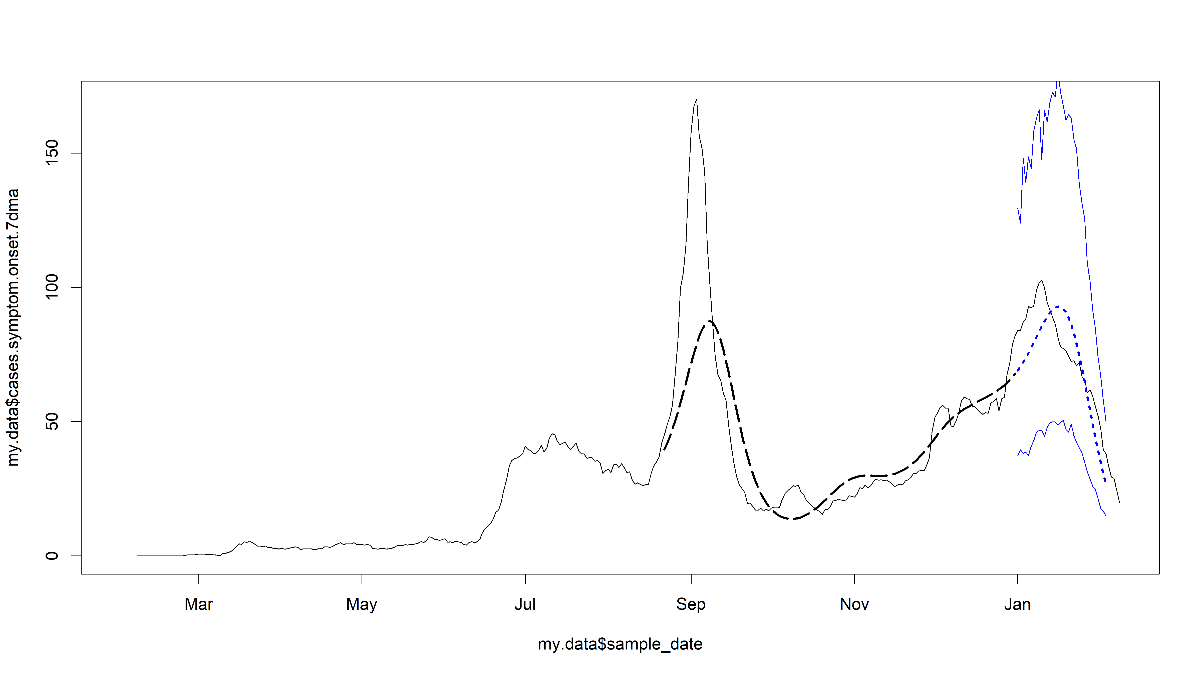

Slide 26
Acknowledgements
Megan Lott
Dr. Erin Lipp
Lipp Lab
Dr. Stephen Rathbun
Nicholas Mallis
Amanda Skarlupka
Morgan Taylor
Adrianna Westbrook

