Slide 1
Mining Rising Star in Academic Graph
Yao Lu
July, 2016

Slide 2
Contribution
We construct a dataset with less noise than previous publications because we focus more on the famous venues
We propose a more convincing evaluation metrics
Our Algorithm taken the community into consideration

Slide 3
Dataset
ACL Dataset

Slide 4
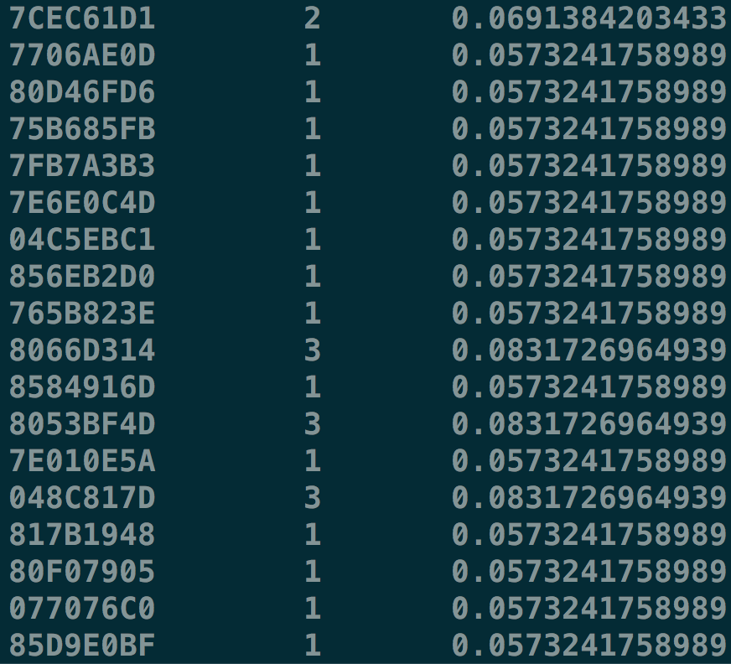
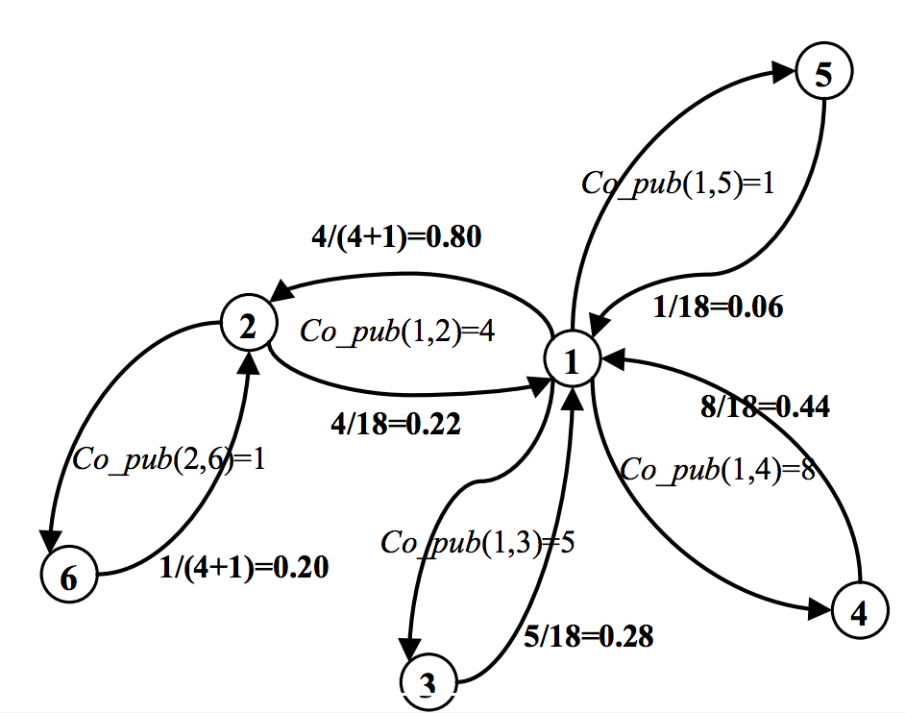
Features
Publication Number
Edge weight in a directed graph
Citation Number

Slide 5
Algorithm
The same as the previous method
Using PageRank
Community Detection in subgraph(NLP can be divided into MT, QA,etc)

Slide 6
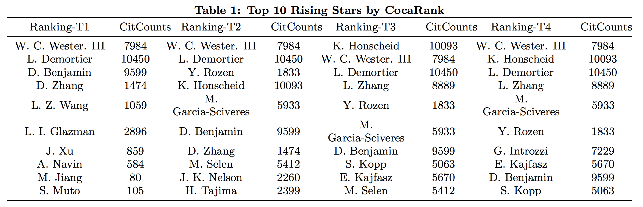
Previous Evaluation Metrics
WWW 16’[1] For the ranking of rising stars, there is no ground truth of it currently. Therefore, we adopt the scholar’s future citation counts as the ground truth to validate whether these rising stars have achieved their expectations.
[1] Zhang, Jun, et al. "Who are the Rising Stars in Academia?." Proceedings of the 16th ACM/IEEE-CS on Joint Conference on Digital Libraries. ACM, 2016.

Slide 7
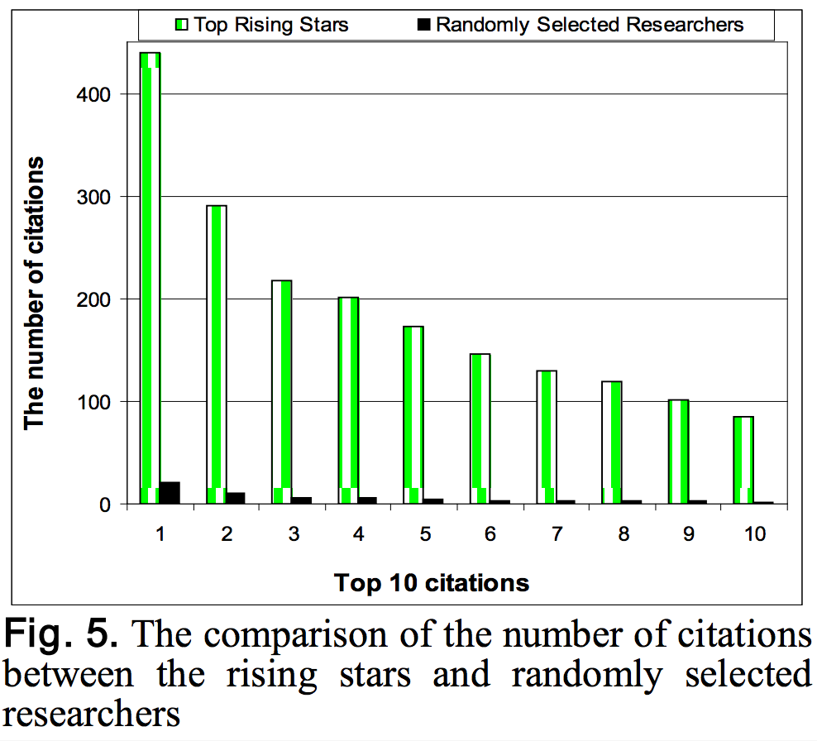
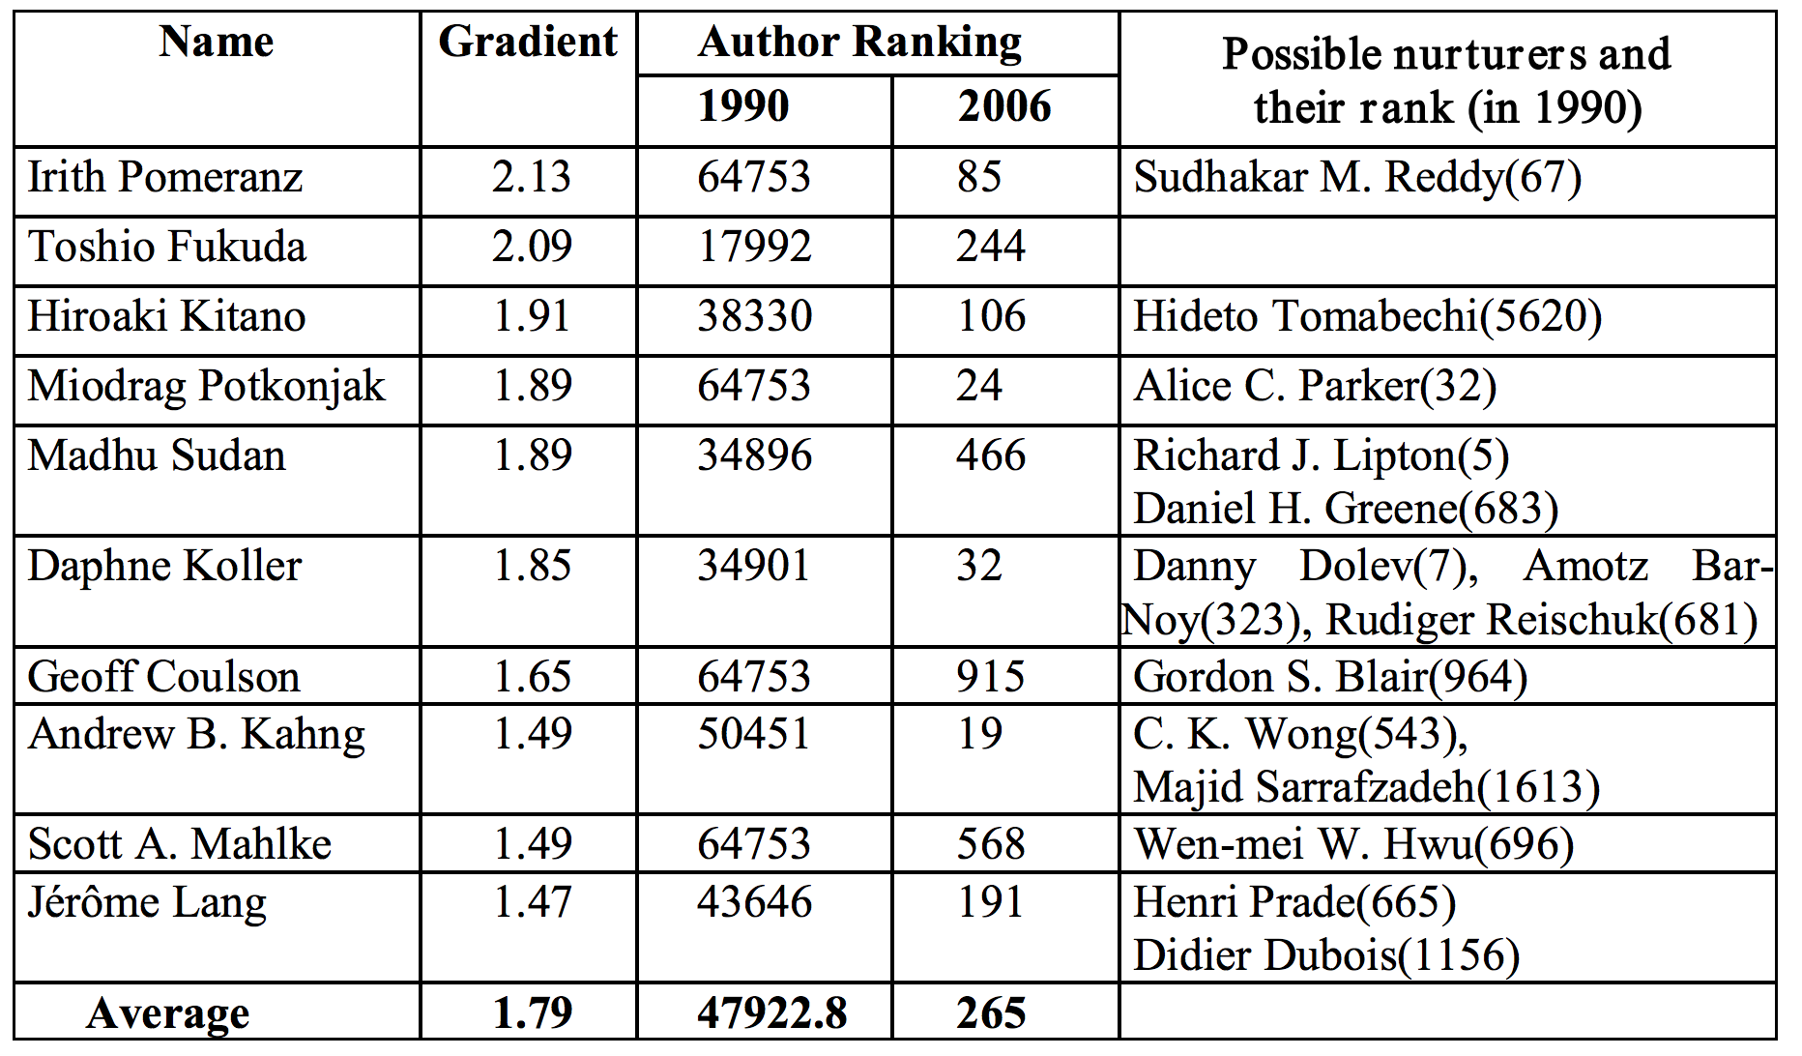
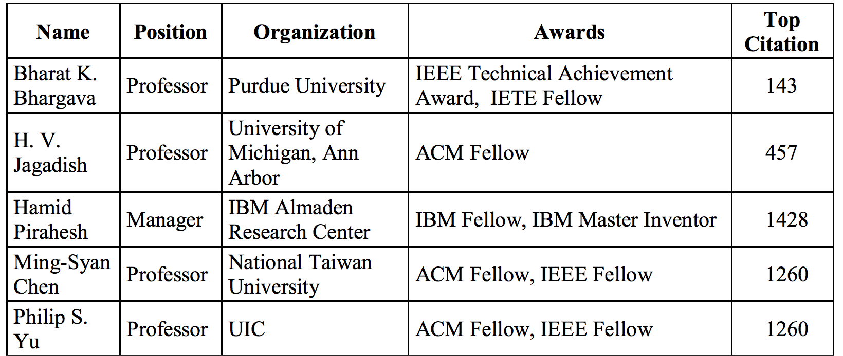
Li, Xiao-Li, et al. "Searching for rising stars in bibliography networks."International Conference on Database Systems for Advanced Applications. Springer Berlin Heidelberg, 2009.

Slide 8
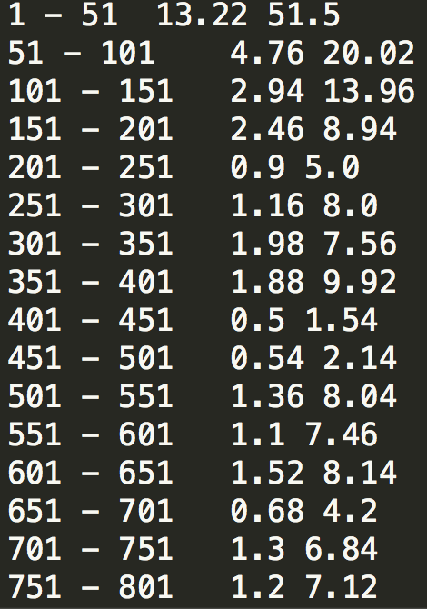
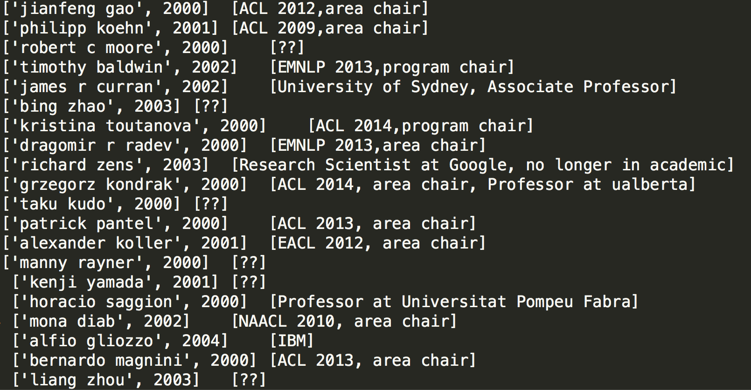
Our Evaluation Metrics
Using Average Citation Number
Area Chair For Ground Truth

