Slide 1
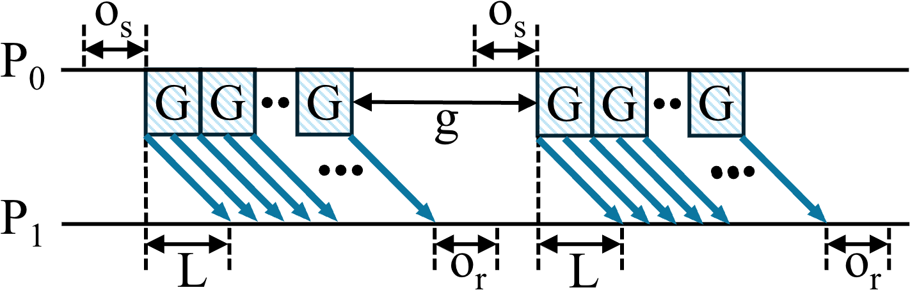
Communication Model (LogGP)
L: upper bound on message latency between processors;
o (o_{s}, o_{r}): overhead time during transmission or reception;
g: minimum gap between consecutive messages;
P: number of processors;
G: gap per byte for long messages.

Slide 2
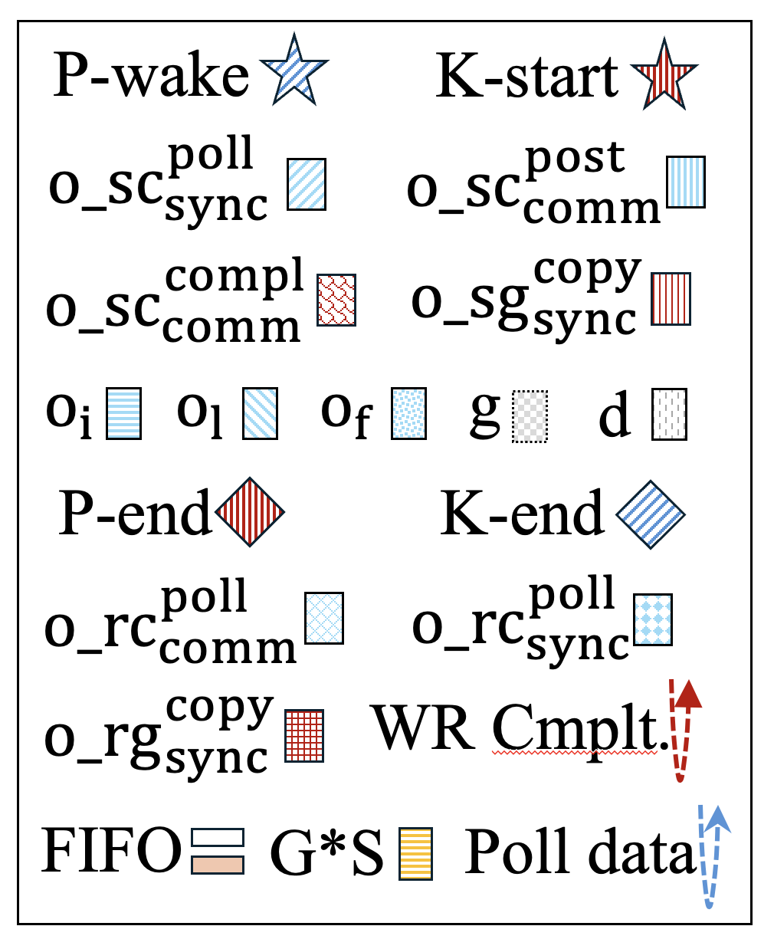







Usually, we call this Proxy-initiated GDR in CCLs
6. The sending GPU completes the data transfer
4. Recv: CPU proxy polls the NIC and forwards the data to the receiving GPU’s FIFO
What Does Comm. In NCCL Look Like?
7. The receiving GPU transfers the data from the FIFO to its destination buffer
CPU
GPU
NIC
NIC
GPU
CPU
1. GPU kernel is launched to compute and prepare data
2. CPU proxy begins polling the GPU to detect when the data in the FIFO;
Notify NIC
3. The NIC retrieves data from the FIFO via DMA; sends it to network.
5. The CPU proxy polls for the completion event, updates FIFO

Slide 3
LogGP Parameters in NCCL
L: time of proxy polled the data in the FIFO and post the isend (step 2) to proxy polled the complete event, updata the FIFO (step 5), data size should be very small, ie. 4 B.
G*s: NIC send data (size: s) to network (step 3).
CPU
GPU
NIC
NIC
GPU
CPU

Slide 4
o_{s}
o_{r}
GPU
CPU
G*s
L
NIC
NIC
CPU
GPU
Notes:
Nvidia:
https://developer.nvidia.com/blog/accelerating-hpc-applications-with-nsight-compute-roofline-analysis/
HPL (High Performance LINPACK): https://arxiv.org/pdf/2011.02617
Simulation: https://arxiv.org/html/2503.19050v1 https://1week.tistory.com/82

