Slide 1
硬币收集问题
Coin-collecting problem
小组成员：李艾欣、杨凯心、项孙寰、童奕寒
汇报日期：2022.07.05

Slide 2
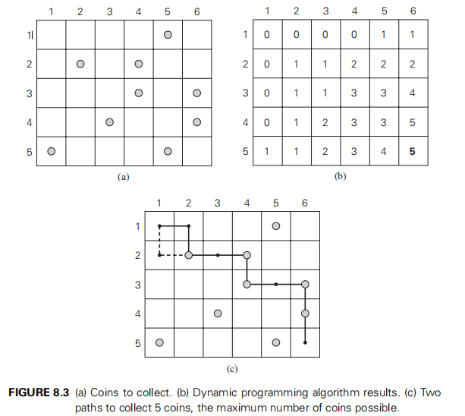
Coin-collecting problem
Several coins are placed in cells of an n × m board, no more than one coin per cell.
A robot, whose position is marked as (i , j), located in the upper left cell of the board and the start position (0 , 0).
The robot needs to collect as many of the coins as possible and bring them to the bottom right cell (n , m).
On each step, the robot can move either one cell to the right or one cell down from its current location.（No backward move！）
When the robot visits a cell with a coin, it always picks up that coin. （No drop！）
Design an algorithm to find the maximum number of coins the robot can collect and a path it needs to follow to do this.
Notes:
近似解：退火算法, Several coins are placed in cells of an n × m board, no more than one coin per cell.
A robot, whose position is marked as (i , j), located in the upper left cell of the board and the start position (0 , 0).
The robot needs to collect as many of the coins as possible and bring them to the bottom right cell (n , m).
On each step, the robot can move either one cell to the right or one cell down from its current location.（No backward move！）
When the robot visits a cell with a coin, it always picks up that coin. （No drop！）
Design an algorithm to find the maximum number of coins the robot can collect and a path it needs to follow to do this.

Slide 3
How to solve this problem？
The solution of coin collecting problem belongs to Dynamic Programming (DP)
Brief intro to DP:
set up a recurrence relating a solution to a larger instance to solutions of some smaller instances
solve smaller instances once
record solutions in a table
extract solution to the initial instance from that table
Dynamic programming can be interpreted as a special variety of space-and-time tradeoff (store the results of smaller instances and solve a larger instance more quickly rather than repeatedly solving the smaller instances more than once).
Example: Fibonacci series 0, 1, 1, 2, 3, 5, 8, 13, 21, 34, 55
F(n) = F(n-1) + F(n-2), for n > 1. F(0)=0; F(1) = 1
– F(6) = F(5) + F(4).
– F(5) = F(4) + F(3). Note that we do not solve F(4) twice. We find F(4) only

Slide 4
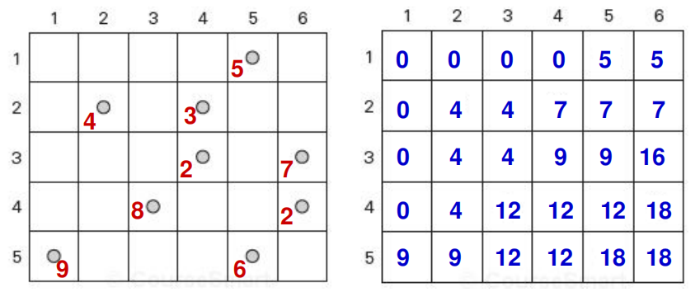
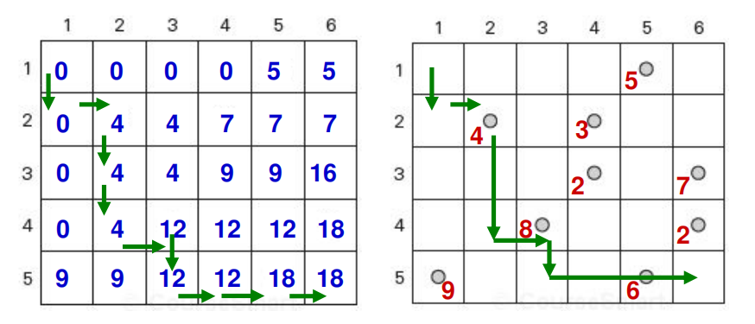
How to solve this problem？
Exact & approximate solutions

Slide 5
1【LAX】.解释问题——初始化条件、限制性条件、描述问题、规定符号，属于Dynamic Programming，为什么属于动态规划问题？
2.【LAX】精确解（2）、近似解（2，退火算法）的区别
3.【YKX】设计算法
4.【YKX】证明
5.【XSH】分析时间复杂度（）
6.【XSH】编程

Slide 6
自行补充

Slide 7
Coin-collecting problem
讲伪代码
The algorithm is illustrated in Figure 8.3b for the coin setup in Figure 8.3a. Since computing the value of F (i, j ) by formula (8.5) for each cell of the table takes constant time, the time efficiency of the algorithm is Θ (nm). Its space efficiency is, obviously, also Θ (nm).
Tracing the computations backward makes it possible to get an optimal path: if F (i − 1, j ) > F (i, j − 1), an optimal path to cell (i, j ) must come down from the adjacent cell above it; if F (i− 1, j ) < F (i, j − 1), an optimal path to cell (i, j ) must come from the adjacent cell on the left; and if F (i −1, j) = F (i, j −1), it can reach cell (i, j ) from either direction. This yields two optimal paths for the instance in Figure 8.3a, which are shown in Figure 8.3c. If ties are ignored, one optimal path can be obtained in Θ (n + m)

