Slide 1

Clustering and classification to characterize
Korean daily electricity demand
Dain Park* and Sanghoo Yoon
Daegu university
master’s course, Department of Statistics
Notes:
Hello? I’m Park Dain belong to Department of Statistics, Daegu University. The topic I will present today is 'Clustering and classification to characterize Korea's daily electricity demand'

Slide 2

1
Research Background
Clustering method
2
(K-means, Gaussian mixture model, functional clustering)
Classification method
3
Contents
(classification: Decision Tree, Random forest, Naïve Bayes, SVM)
4
Data
5
Results
6
Conclusion
Notes:
Contents are as follows.

Slide 3
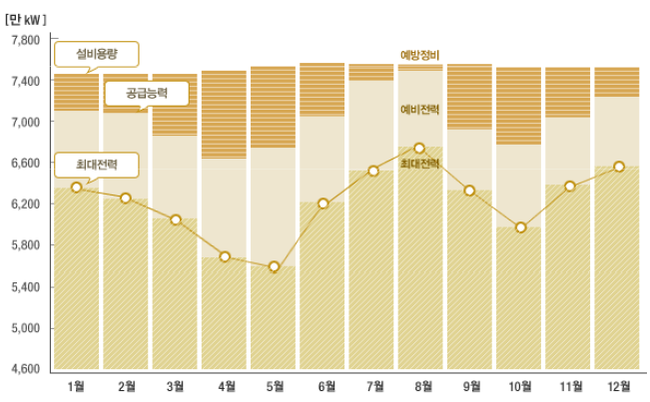
1
Background
Electricity demand forecasting is essential for stable and efficient operation of the electricity system.
This is because electricity can not be stored.
Notes:
Electricity demand forecasting is essential for stable and efficient operation of the electricity system.
This is because electricity can not be stored.

Slide 4
1
Background
Many electricity forecasting technique have been proposed.
There are three types of electricity demand forecasting methods
  Time series model (ex, exponential smoothing, ARIMA,… etc)
  Identify relationships with external variables (ex, ANN, LM,... etc)
  Simplifying the electricity pattern by clustering method
    Because time decomposed the complicated pattern into smooth curves and eliminated the periodic changes.
There are several clustering methods for clustering electricity demand.
  K-means, Gaussian mixture, functional, … and so on
Notes:
Many electricity forecasting technique have been proposed.
In statistic method, There are three types of electricity demand forecasting methods
One is using a time series model , another is Identify relationships with external variables the other is Simplifying the electricity pattern by clustering method
In this study, We chose the clustering method.
There are several clustering methods for clustering electricity demand.
These are K-means, Gaussian mixture model , functional and so on

Slide 5
1
Background
Several clustering analysis used to profile daily electricity demand pattern.
Then, classification was used with external variables for finding suitable clustering number.
  External variables : temperature, humidity ,day type, and so on.
Purpose of research
Find the best clustering methods for daily electricity pattern
Suggest the way to choose the optimal number of cluster using classification.
Notes:
In this study we performed clustering analysis as k-means, Gaussian mixture model and functional clustering.
Then, classification was used with external variables for finding suitable clustering number.
External variables are temperature, electricity demand, day type, and so on.
The purpose of this reseaerch is to Find the best clustering methods for daily electricity pattern and to suggest the way to choose the optimal number of cluster using classification.

Slide 6
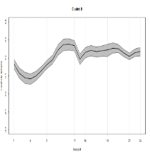
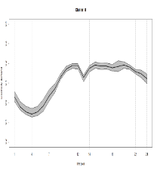
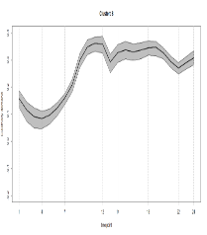
2
Flow chart
electricity load data
Data manipulating
Eliminate time trend
Log transformation
Clustering method
K means clustering
Gaussian Mixture model
Functional clustering
External variables
(weather, holidays, weekday, et al)
Classification method
Decision Tree
Random Forest
Support Vector Machine
Naïve Bayes
Evaluating
Accuracy
Kappa statistics
Profiling
Notes:
This is the flow chart for characterize Korea daily electricity demand.
AT first. We manipulate the data to Eliminated time trend by Log transformation.
And then we perform clustering analysis the manipulated data. We consider k-means, Gaussian mixture model , functional clustering as a clustering methods.
And we perform classification analysis using external variables such as weather , holiday and Day of the week and so on.
As classification methods, We used decision tree, random forest, svm and naïve bayes.
And we evaluate the clustering and classification by prediction accuracy and kappa statistics to suggest the best method and number of clustering
Lastly, we profile about the best cluster.

Slide 7
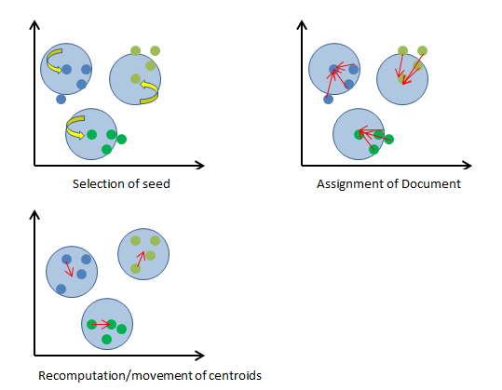
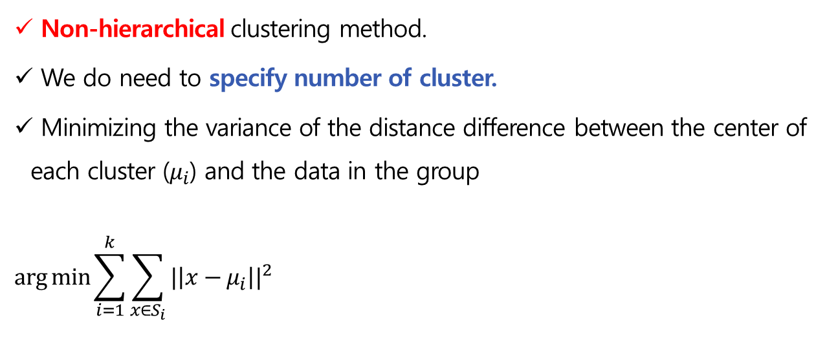
2
Methodology (Clustering)
K-means clustering
Non-hierarchical clustering method.
We do need to specify number of cluster.
Minimizing the variance of the distance difference between the center of each cluster ($μ_{i}$) and the data in the group
$$arg min{\sum_{i=1}^{k}{\sum_{x∈S_{i}}{{|\left|x−μ_{i}\right||}^{2}}}}$$
Notes:
K-means clustering is Non-hierarchical clustering method.
We do need to specify number of cluster.
The algorithm repeats until minimizing the variance of the distance difference between the center of each cluster ($μ_{i}$) and the data in the group

Slide 8
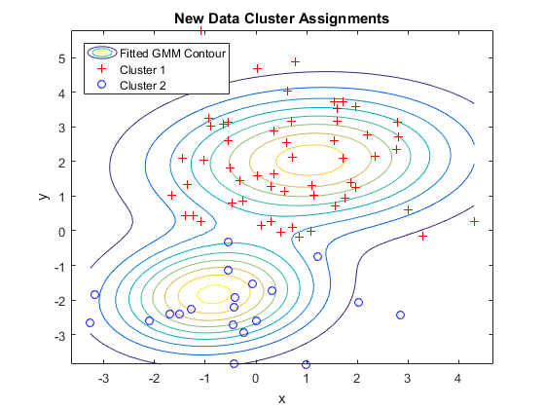
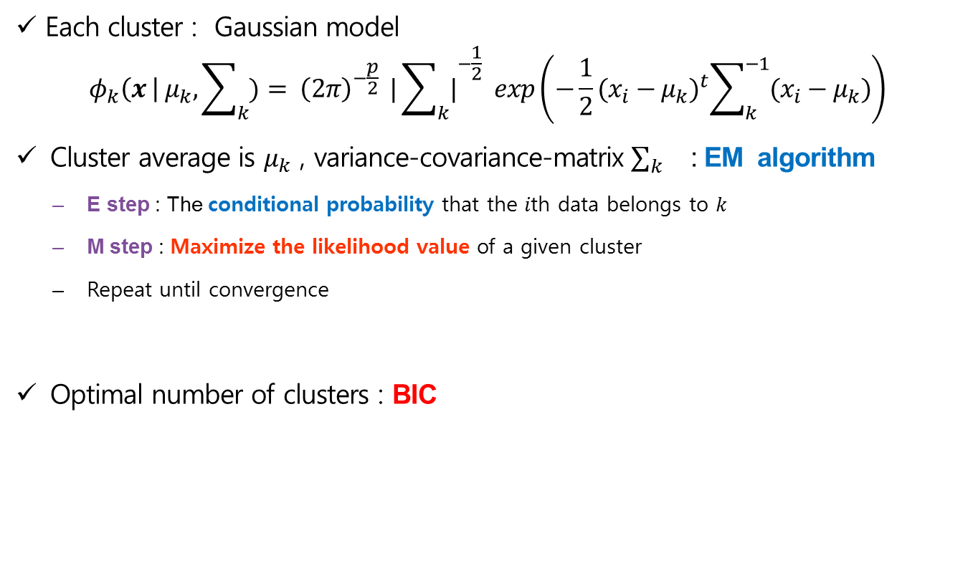
2
Methodology (Clustering)
Gaussian mixture model clustering
Each cluster : Gaussian model
$$φ_{k}\left(x \right| μ_{k},\sum_{k}{)}= {\left(2π\right)}^{−\frac{p}{2}}{ |\sum_{k}{|}}^{−\frac{1}{2}} exp\left(−\frac{1}{2}{(x_{i}−μ_{k})}^{t}\sum_{k}^{−1}{(x_{i}−μ_{k})}\right)$$
Cluster average is $μ_{k}$ , variance-covariance-matrix $\sum_{k}{}$: EM algorithm
  E step : The conditional probability that the 𝑖th data belongs to 𝑘
  M step : Maximize the likelihood value of a given cluster
  Repeat until convergence
Optimal number of clusters : BIC
Fraley, C., Raftery, A., & Scrucca, L. (1999). mclust: Normal Mixture Modeling for Model-Based Clustering, Classification, and Density Estimation. R Package, URL http://cran. rproject. org/package= mclust.
Notes:
This is a parametric method. But In this algorithm, it is difficult to find the mean and variance covariance matrix. So we use the EM algorithm to find them.
In this method, We can determine the optimum number of clusters with BIC.

Slide 9
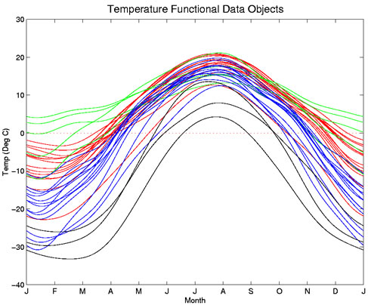

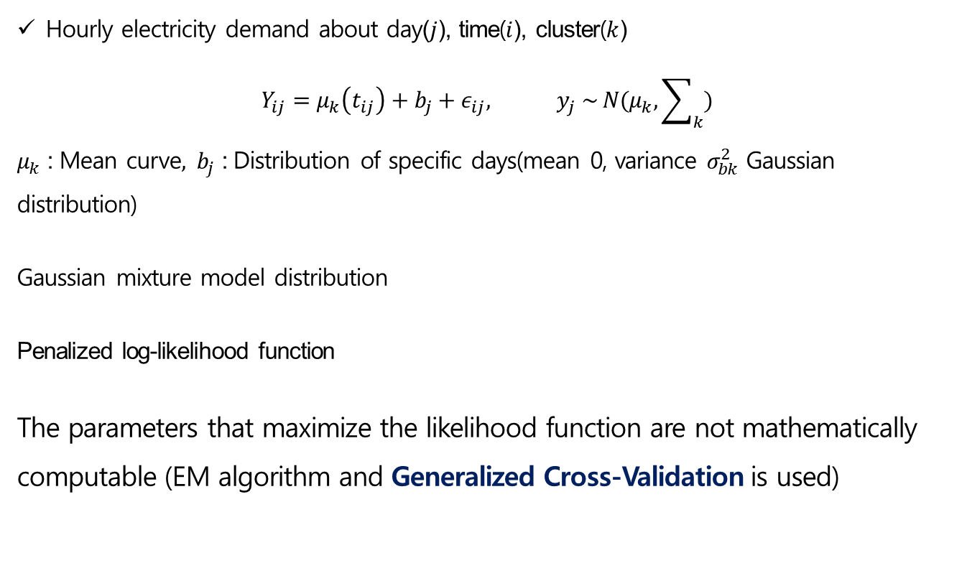
2
Methodology (Clustering)
Functional clustering
Hourly electricity demand about day($j$), time($i$), cluster($k$)
$$Y_{ij}=μ_{k}\left(t_{ij}\right)+b_{j}+ε_{ij}, y_{j} \sim N(μ_{k}, \sum_{k}{)}$$
$μ_{k}$ : Mean curve$,$ $b_{j}$ : Distribution of specific days(mean 0, variance $σ_{bk}^{2}$ Gaussian distribution)
Gaussian mixture model distribution
Penalized log-likelihood function
The parameters that maximize the likelihood function are not mathematically computable (EM algorithm and Generalized Cross-Validation is used)
Functional data
Notes:
The feature of the functional clustering is that a linear was considered as a data.
This is the hourly electricity demand equation for day, time, cluster.
The Mu_k is mean curve about day and time. and b_j is Distribution of specific days
The parameters that maximize the likelihood function are not mathematically computable. Using EM algorithm, Generalized Cross-Validation, It can be solved.

Slide 10
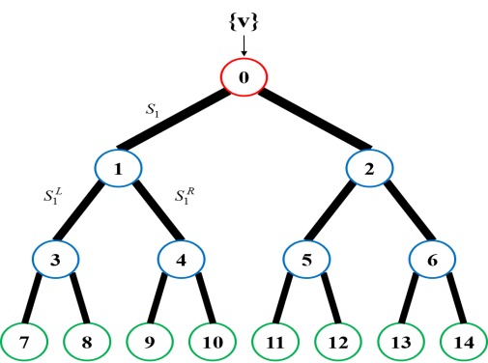
3
Methodology (Classification)
Decision Tree
  Process : Growth, Pruning, feasibility assessment, Prediction.
  Growth steps: Grow trees by finding the appropriate optimal separation rules at each node.
  Pruning steps: Eliminates branches that have a high risk to increase error or inadequate reason.
  Feasibility Assessment steps: Evaluate the decision tree using a gain chart, risk diagram, or test data
  Impurity measure
  determining the optimal separation at growth step
  Criteria : Chi squared(χ²), Gini coefficient, Entropy
Notes:
from here, I will explain the classification methods .
Decision tree process consists of growth, pruning, feasibility assessment, interpretation and prediction.
The growth steps are gorw the trees by finding the appropriate optimal separation rules at each node.
And at the Pruning steps , Eliminating some branches that have a high risk to increase error or inadequate reason.
And Feasibility Assessment steps are Evaluating the decision tree using a gain chart, risk diagram, or test data
Decision trees use Chi squared, Gini coefficients and entropy index for impurity measures.
카이제곱이 최대가 되는 통계량
지니계수가 최소가 되는 분리
엔트로피가 가장 작은 예측변수와 그때의 최적분리에 의해 마디를 생성한다

Slide 11
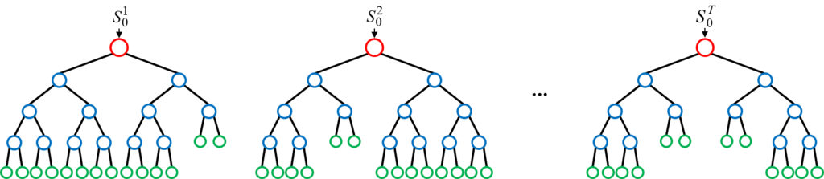
3
Methodology (Classification)
Random Forest
  An ensemble classifier using many decision tree models obtained through bagging. (bootstrap aggregating)
  It produces a highly accurate classifier and learning is fast.
  It can handle thousands of input variables without variable elimination.
  Variable importance information is provided with the results.
Notes:
Rnadom Forest is an ensemble classifier using many decision tree models obtained through bagging.
It produces a highly accurate classifier and learning is fast
Randomforest can handle thousands of input variables without variable elimination.
Variable importance information is provided with the results.

Slide 12
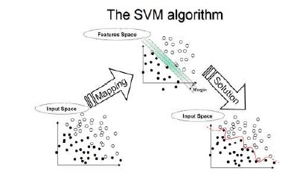
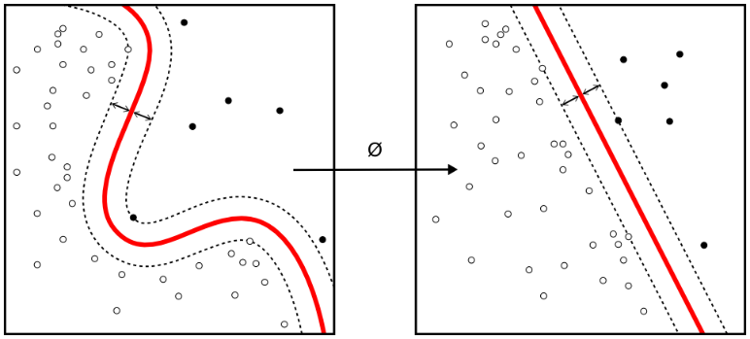
3
Methodology (Classification)
SVM (Support Vector Machine)
  Proposed that the original finite-dimensional space be mapped into a much higher-dimensional space
  The mappings used by SVM schemes are designed
  A kernel function is needed to solve the problem
  The hyperplanes in the higher-dimensional space are defined as the set of points
  The vectors defining the hyperplanes can be chosen to be linear combinations with parameters
A kernel function

Slide 13
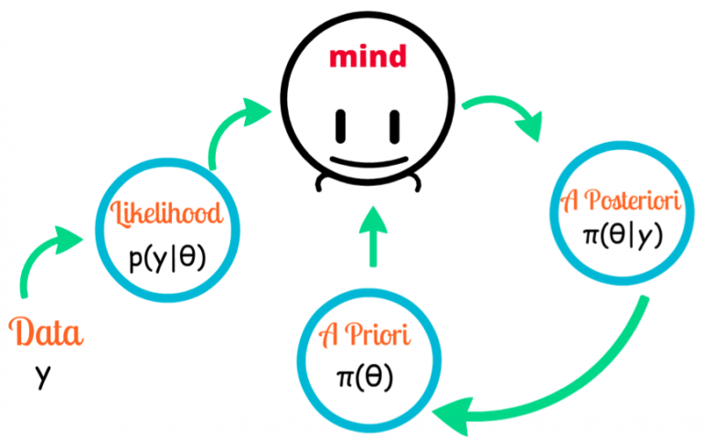
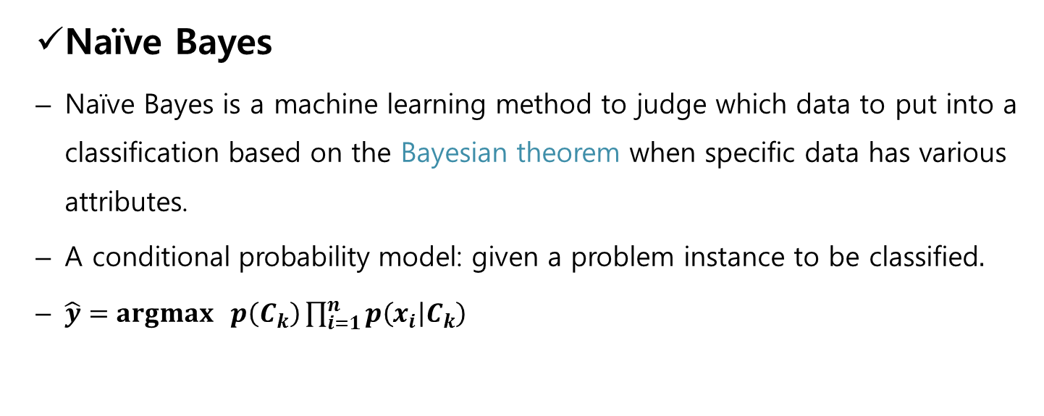
3
Methodology (Classification)
  Naïve Bayes
  Naïve Bayes is a machine learning method to judge which data to put into a classification based on the Bayesian theorem when specific data has various attributes.
  A conditional probability model: given a problem instance to be classified$.$
  $\hat{y}=argmax p\left(C_{k}\right)\prod_{i=1}^{n}{p\left(x_{i} | C_{k}\right)}$
Notes:
Naïve Bayes is a machine learning method to judge which data to put into a classification based on the Bayesian theorem when specific data has various attributes.

Slide 14
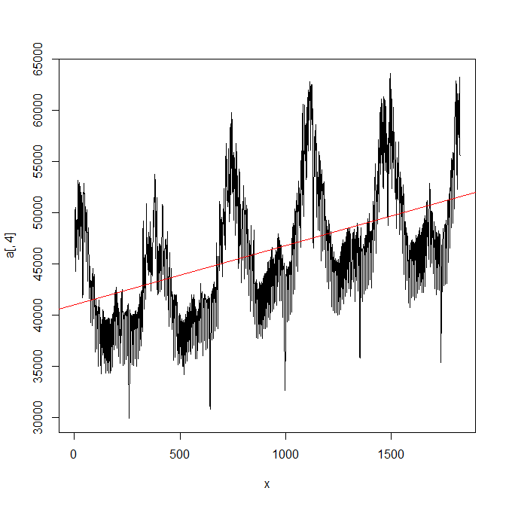
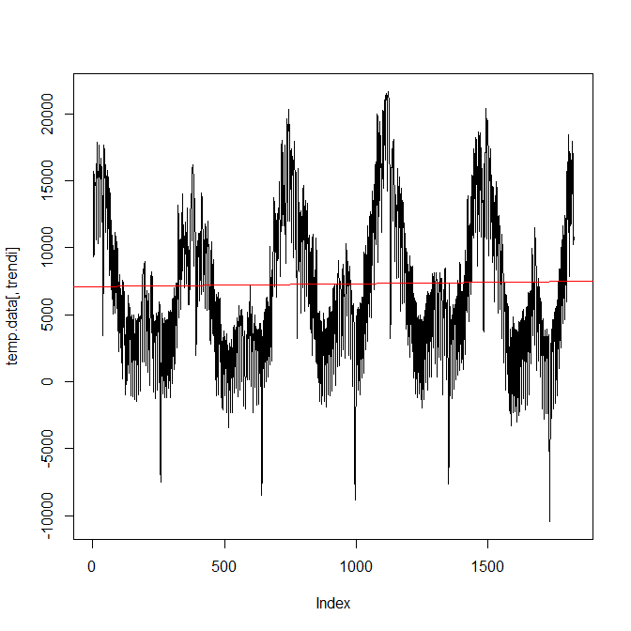
4
Data
Data Manipulating
Source : Korea electricity exchange (KPX)
Period : 2008.1.1~2012.12.31.
Data : hourly electricity load demand (Time series data)
- trend, Seasonal, periodic factor (eliminate time trend)
- Increasing in fluctuation over time (Log tranformation)
electricity load data
Data manipulating
before
after
Notes:
The electricity demand data was received from the Korea electricity Exchange from January 1.2008 to December 31, 2012.
Data is time series data with time trend, seasonal, periodic factor.
For the stability of the time series data, the trend is removed by log transformation.
The left figure is raw data plot, and the right figure is eliminated time trend by the log transformation.

Slide 15
4
Data
 | Factor 1 | Factor 2
MW01 | 0.221 | 0.962
MW02 | 0.220 | 0.961
MW03 | 0.227 | 0.961
MW04 | 0.227 | 0.968
MW05 | 0.220 | 0.975
MW06 | 0.230 | 0.967
MW07 | 0.364 | 0.914
MW08 | 0.619 | 0.760
MW09 | 0.826 | 0.526
MW10 | 0.905 | 0.389
MW11 | 0.930 | 0.340
MW12 | 0.945 | 0.300
MW13 | 0.944 | 0.274
MW17 | 0.983 | 0.168
MW18 | 0.957 | 0.253
MW19 | 0.916 | 0.351
MW20 | 0.928 | 0.328
MW21 | 0.939 | 0.292
MW22 | 0.896 | 0.395
MW23 | 0.694 | 0.672
MW24 | 0.557 | 0.784
Exploratory Factor Analysis
Reducing dimension of variables from 24 to 2.
Varimax rotation is used.
Explaining 97.2% of the total variance.
Factors can assumed to be independent.
Factor 1 : 09:00~23:00, (Day time, 57.9%)
Factor 2 : 24:00~08:00, (Night time, 39.3%)
 | factor1 | factor2
ss loadings | 13.892 | 9.440
Proportion Var | 0.579 | 0.393
Cumulative Var | 0.579 | 0.972
Notes:
And after remove time trend the data, we perform factor analysis to reduce two factors the 24 hour data and equalize the weights of each variables.
varimax rotation was used in factor analysis.
.
Factor 1 is the electricity demand during the daytime from 9:00 to 23:00 and Factor 2 is the electricity load during night time from 24:00 to 8:00.
Two independent factors account for about 97.2% of the total variance.

Slide 16
5
Results
Clustering method
K means clustering
Gaussian Mixture clustering
Functional clustering
Factor 1 and Factor 2 is input variables for clustering.
It is important to choose the number of cluster.
Actually, optimal cluster number is suggested by BIC
in Gaussian mixture clustering and Functional clustering.
Suggested cluster number might not be the best. because we want to forecasting the daily pattern using external variables.
We set the number of cluster between 7 and 10.
Notes:
We used factor 1 and factor 2 were used as input variables.
It is important to choose the number of cluster.
Actually, optimal cluster number is suggested by BIC
in Gaussian mixture clustering and Functional clustering.
However suggested cluster number might not be the best. because we want to forecasting the daily pattern using external variables.
In this study, We set the number of cluster between 7 and 10.

Slide 17
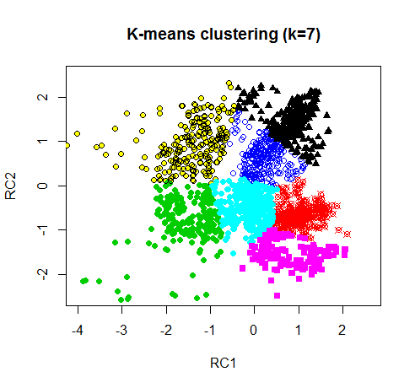
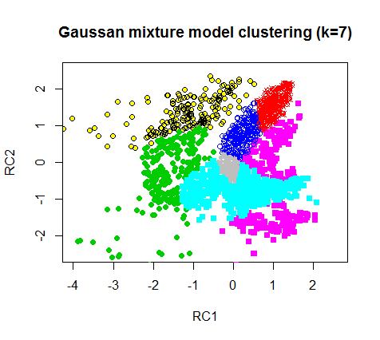
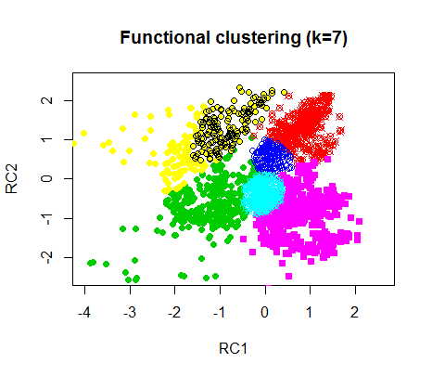
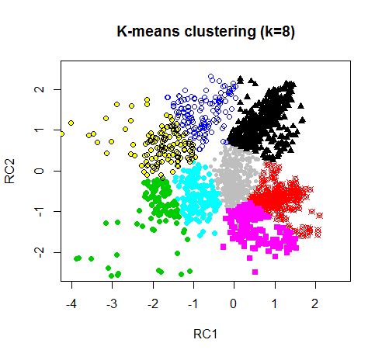
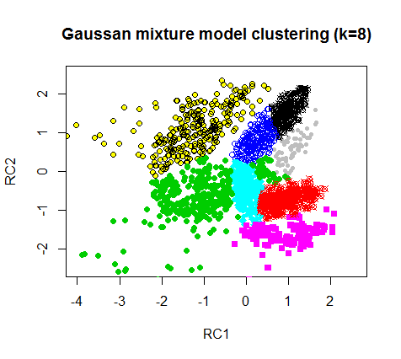
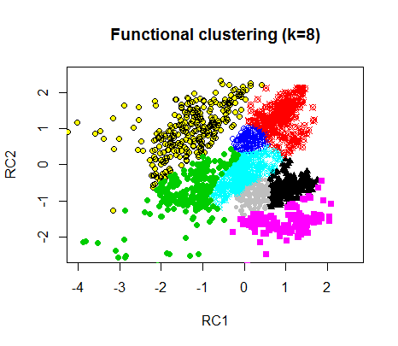
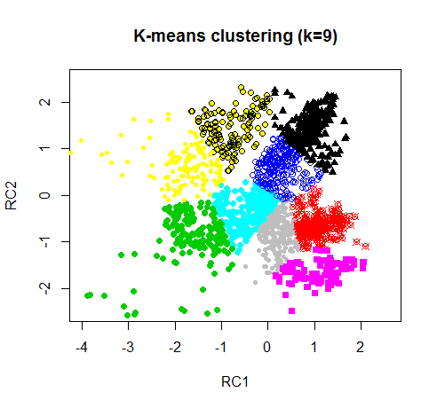
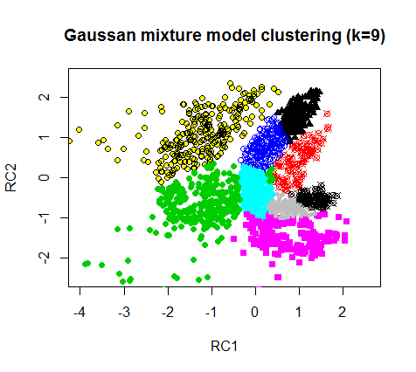
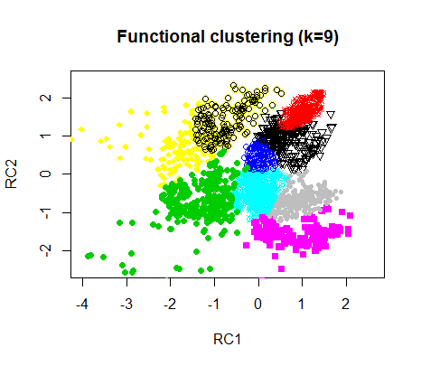
5
Results of Clustering
K-means clustering
Classify objects in close proximity to the
center of the group into the same cluster.
Gaussian mixture model clustering
Based on the mixed Gaussian distribution, it classify the objects at the center distance of the distribution into the same cluster.
Functional clustering
It appears that K-means clustering and Gaussian mixture models are mixed.
Notes:
This is the results of clustering.
In the case of the k-means clustering, we can see that the data are clustered in a circle based on the center point of each cluster.
In the case of Gaussian mixture model, the data was clustered in an elliptical shape.
Functional clustering considers 24 - hour data as one.
both k-means method and the Gaussian mixture model method are mixed form in the functional clustering result.

Slide 18
5
Results of Clustering
High demand
High demand
Factor 2 : Night time
Low demand
Factor 1 : Day time
High demand
Notes:
At the result of clustering, the data on the right side is more electricity demand in day time, And the more up, the more electricity demand data in night time.

Slide 19
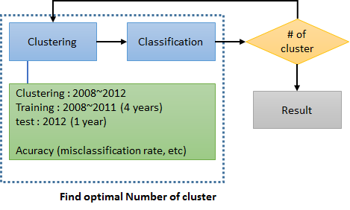
5
Classification
Daily electricity demand forecasting through classification
External variables
(weather, holidays, weekday, et al)
Notes:
Classification analysis was performed using result of cluster and external variables such as weather holidays, weekday and so on.

Slide 20
5
Classification
Clustering : 2008 – 2012 (observed cluster)
Training dataset : 2008~ 2011
Test dataset : 2012 (predicted cluster)
External variables
  Meteorological factors: daily maximum temperature, daily minimum temperature, precipitation, relative humidity, daylight hours.
  Day factor: Day of the week, holiday
Classification
  Decision Tree, Random Forest, Naïve Bayes, SVM
Notes:
In the classification analysis step, the data were divided into training data set and test data set.
Training dataset consist of clustered data 2008 to 2011
And test dataset consist of clustered data on 2012.

Slide 21
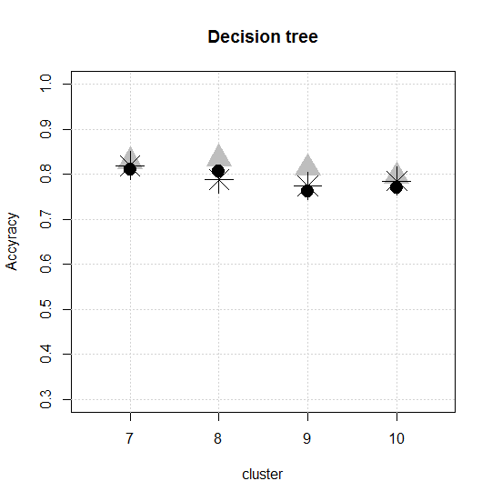
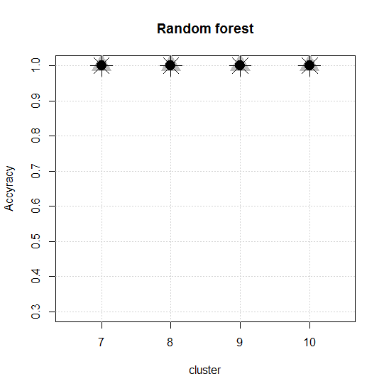
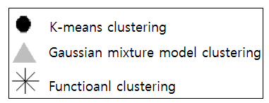
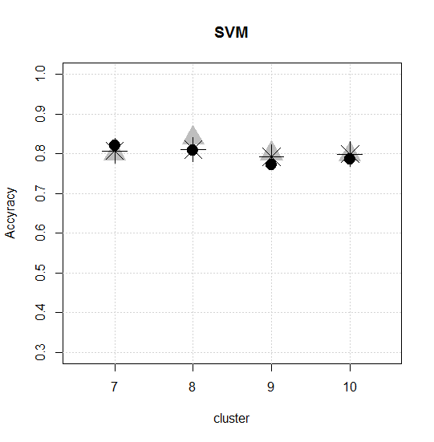
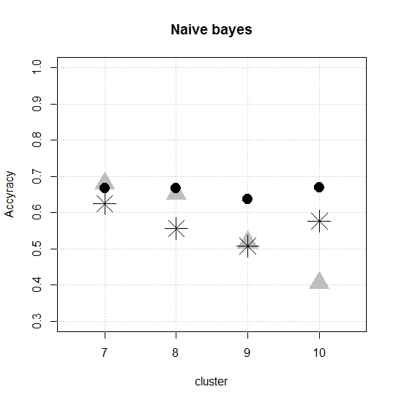
5
Results of Classification(modeling data)
All of the accuracy is 100% in Random Forest
Notes:
We compared the classification accuracy of modeling data and test data.
This figure shows the classification accuracy of modeling data.
All of the accuracy is 100% in Random Forest
So Random Forest is the best classification in modeling data.
And decision tree, svn and naïve bayes are followed

Slide 22
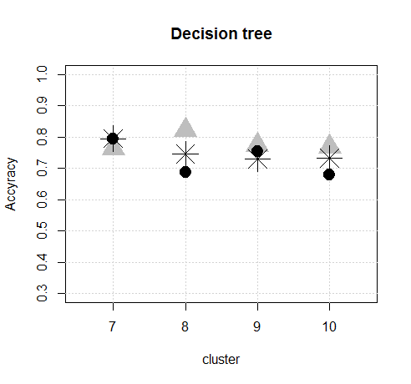
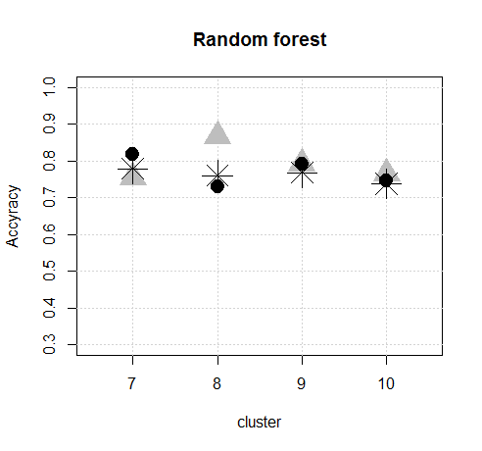
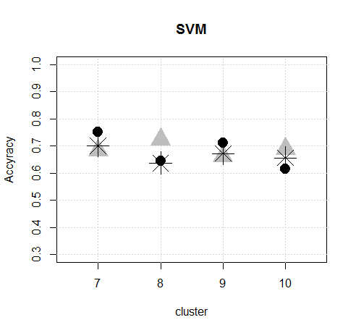
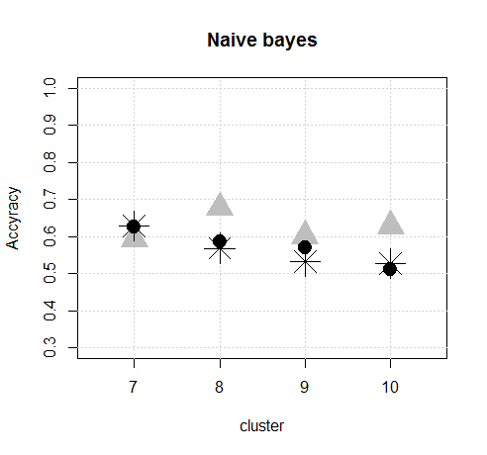
5
Results of Classification(test data)
Optimal number of cluster: 8
Classification : Random Forest
Notes:
This figure shows the classification accuracy of test data.
When the clustering method is Gaussian mixture model, the optimal cluster number is 8 and the classification method is random forest classification performance is best . Its classification accuracy is about 86%.

Slide 23
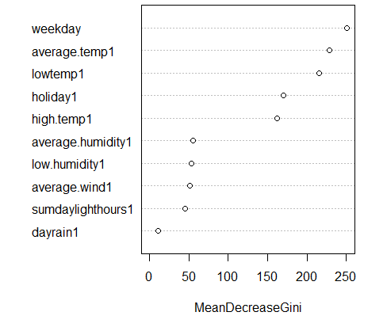
5
Results of Classification
Importance of variables
Random Forest (Cluster = 8)
The most important variable :
weekday
Average temperature,
minimum temperature,
Holiday,
Maximum temperature,
are followed
Notes:
This is variable importance plot.
The most important variable is weekday
and
Average temperature,
minimum temperature,
Holiday,
Maximum temperature,
are followed.

Slide 24
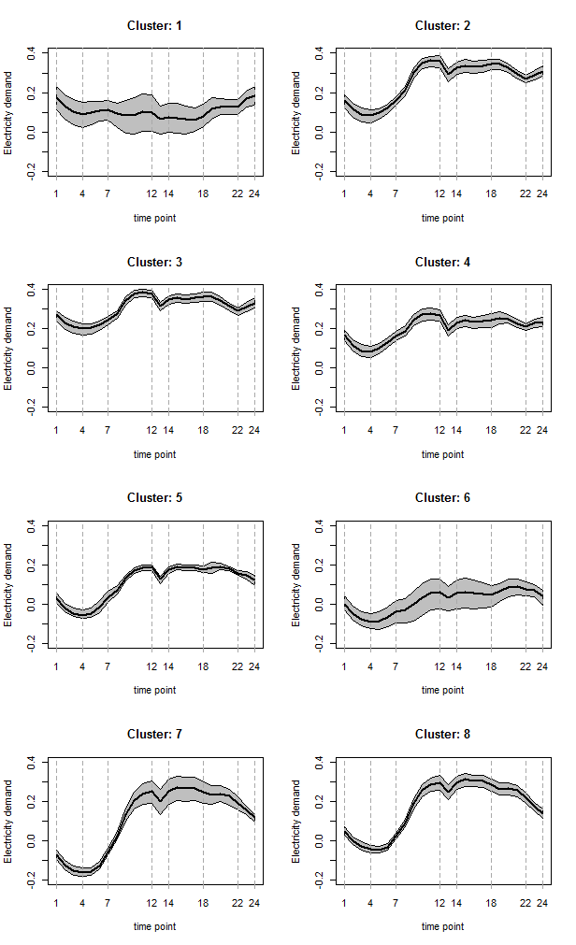
5
Results
3
1
4
2
6
5
8
7
Notes:
Left figure is clustering plot of Gaussian mixture model 8clusters. And the right plot is average patterns of each cluster.
1 cluster is a holiday or weekend in winter, 2 cluster is Monday in winter, 3 cluster is weekdays of winter, 4 cluster is weekdays of spring, early winter, 5 cluster is weekdays of spring and fall or weekends of summer, 6 cluster is holidays or weekends in spring, summer, fall, 7 cluster is Monday of summer and 8 cluster is weekdays of summer or Monday of spring and fall.

Slide 25
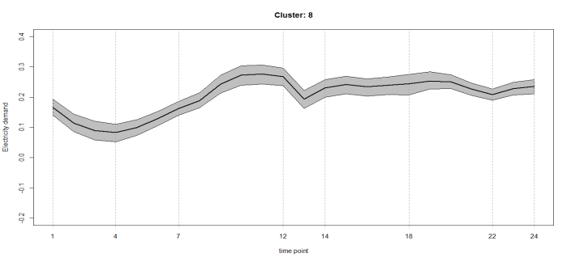
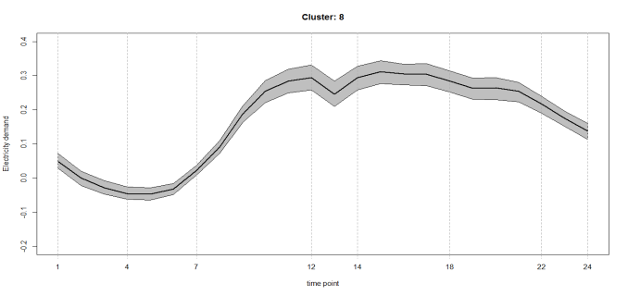
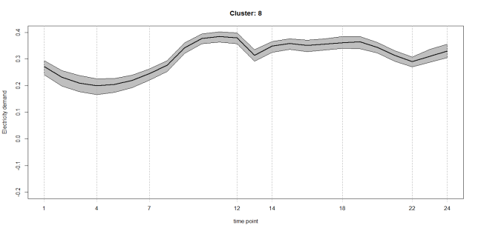

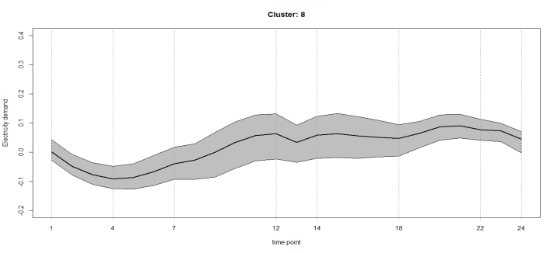
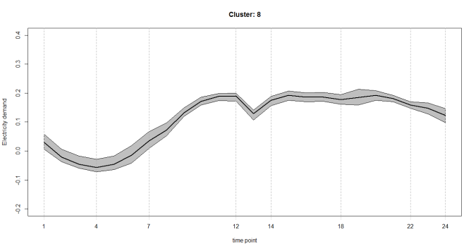
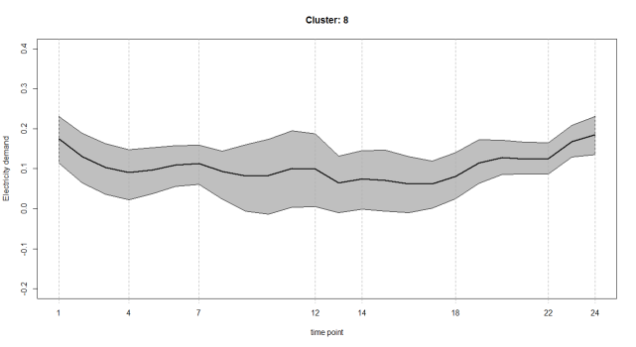

5
Profiling electricity load pattern
Spring and Autumn
  Summer
Winter
There is lower electricity demand due to warm weather in spring and autumn
During the daytime in summer, electricity demand is high due to the cooling system.
In winter, both daytime and nighttime electricity demand is high due to heating system.
Notes:
Let's compare the patterns of holidays and weekdays.
The electricity demand is lower on the holiday than on the weekdays.
And there is lower electricity demand due to warm weather in spring and fall.
During the daytime in summer, electricity demand is high due to the cooling system.
In winter, both daytime and nighttime electricity demand is high due to heating system at all day

Slide 26




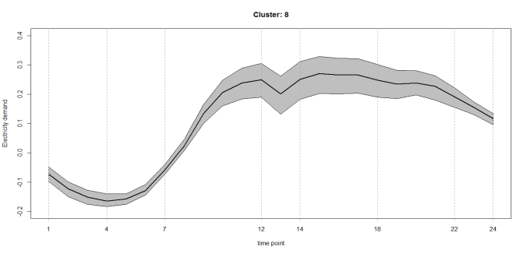
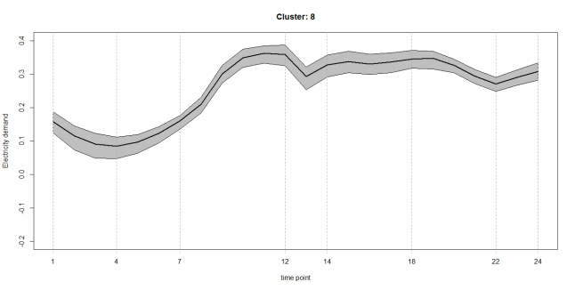
5
Profiling electricity load pattern
Spring /
Autumn
Monday effect
Summer
Monday effect
Winter
Monday effect
Notes:
On Monday morning ,electricity demand is low compared to other weekdays due to the effects of factory and company resting on weekends.
That is called, Monday effect

Slide 27
6
Conclusion
Characterize electricity demand pattern : clustering and classification.
External variables are used for Classification
Optimal number of clustering : 8
Best Clustering method : Gaussian mixture model
Best classification : Random Forest
  Important variables
    Weekday, Average temperature, minimum temperature, Holiday, Maximum temperature
Daily electricity demand of each cluster is profiled and explained.
  Season and day of week are used.
Notes:
We characterize the electricity demand pattern using clustering and classification analysis.
External variables are used for Classification such as weather and holiday and so on.
As a result Optimal number of clustering is 8 .
the best clustering method is Gaussian mixture model.
the best classification method is Random Forest.
Daily electricity demand of each cluster is profiled and explained.

Slide 28

Thanks for
Your attention

