Slide 1

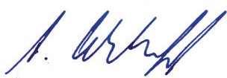
Sample taking ID: ISE-ST2025437 Inspection ID: ISE-IR20252501 Valuation ID: ISE-V202511468
SKR-20251032
ISE Furrengasse 21, 6004 Luzern Switzerland
Mercury Natural Resources GmbH Mr. Michael Schäfer
Ballindamm 13
20095 Hamburg
Lucerne, 23 June 2025
Analysis of copper powder for chemical purity and determination of particle shape and size. Your order dated 3 June 2025.
Analysis report No. ISE-A20258366
In accordance with the above-mentioned order, a sample of the customer’s goods was taken by an ISE inspector on 3 June 2025, for GD/MS purity analysis and determination of particle shape and size.
The sample was designated as:
Copper Powder
Sample taking ID: ISE-ST2025437 Sample: ISE-5262
Total Quantity: 600 kg
According to the attached analytical report, the chemical purity grade of the copper powder is:
Cu (Remainder) = 99,9999% according to TU 24.44.21-002-75815004-2022.
The particle shape is round and dendritic.
More than 50% of particle size varies in the range of 13-48 μm, less than 50% in the range of 0,6-1,2 μm.
The impurities contents of copper powder for prescribed impurities (page 3) are no more than 0,41 ppm. It was calculated as difference between 100% and sum of impurities. Тhе impurities list and grade have been determined according to the technical standard TU 24.44.21-002-75815004-2022.
The analytical reports are attached to this letter.
If you have questions about the results, please feel free to contact us.
Signed:
Institut for Rare Earths and Metals Arndt Uhlendorff
Customer: Mercury Natural Resources GmbH
1
Institut für Seltene Erden und Metalle AG
Furrengasse 21, Postfach
6000 Luzern 6, Schweiz
Email: Info@ise-ag.com
Phone: +41-41 5 11 11 20
Web: www.ise-ag.com
Handelsregisteramt Luzern
CHE-456.752.545
Verwaltungsrat: A. Uhlendorff

Slide 2
Sample taking ID: ISE-ST2025437 Inspection ID: ISE-IR20252501 Valuation ID: ISE-V202511468
SKR-20251032
Mercury Natural Resources GmbH Mr. Michael Schäfer
Ballindamm 13
20095 Hamburg
Dipl.-Ing. Peter Glörfeld
Dr. Myint Sein ISE Laboratory / Elmaspecs Willich, 11 June 2025
Analytic certificate No. ISE-A20258366
GD-MS Analysis according to ISO/TS 15338:2009
Your order of: 3 June 2025
Your order ID:
ISE-A20258366
Material according: to customer
Copper Powder 99.99x%
Your Sample ID:
ISE-ST2025437
Date of sample input:
3 June 2025
Elm-Laboratory ID:
1006010-2025
Results of the analysis on page 3
Customer: Mercury Natural Resources GmbH
2
Institut für Seltene Erden und Metalle AG
Furrengasse 21, Postfach
6000 Luzern 6, Schweiz
Email: Info@ise-ag.com
Phone: +41-41 5 11 11 20
Web: www.ise-ag.com
Handelsregisteramt Luzern
CHE-456.752.545
Verwaltungsrat: A. Uhlendorff

Slide 3
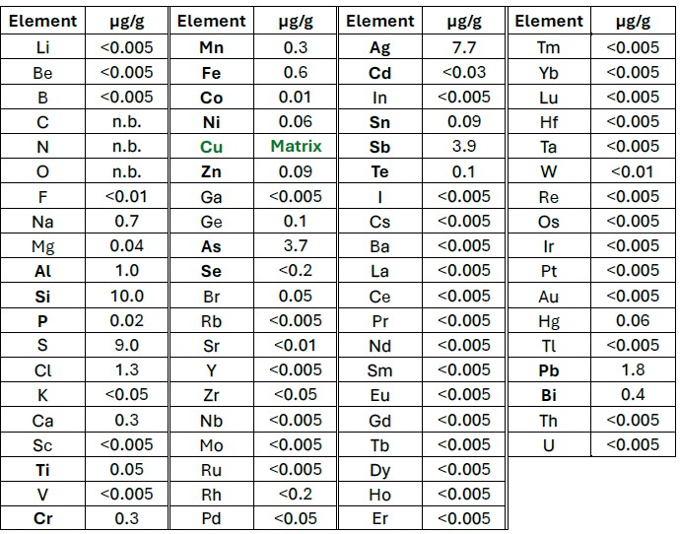
Sample taking ID: ISE-ST2025437 Inspection ID: ISE-IR20252501 Valuation ID: ISE-V202511468
SKR-20251032
GD/MS Analytical Report
Customer: Date:
Mercury Natural Resources GmbH
Analytic ID: Sample ID:
ISE-A20258366 ISE-ST2025437
11 June 2025
n.d. = not determined.
Bold elements: Calibrated measurement against certified reference samples. All other elements: Evaluation using standard RSFs (tolerance factor max. ± 2,5). Values below the detection limit are included at 50% in the sum calculation.
Sum of impurities of (Li, Be, Ti, V, Cr, Co, Cu, Cd, Rb, Mo, Pd) is 0,0041%
Cu (Remainder) = 99.9999% according to TU 24.44.21-002-75815004-2022.
The natural isotopic composition of copper is typically ⁶³Cu ≈ 69,2% and ⁶⁵Cu ≈ 30,8%.
The material is not radioactive.
Customer: Mercury Natural Resources GmbH
3
Institut für Seltene Erden und Metalle AG
Furrengasse 21, Postfach
6000 Luzern 6, Schweiz
Email: Info@ise-ag.com
Phone: +41-41 5 11 11 20
Web: www.ise-ag.com
Handelsregisteramt Luzern
CHE-456.752.545
Verwaltungsrat: A. Uhlendorff

Slide 4
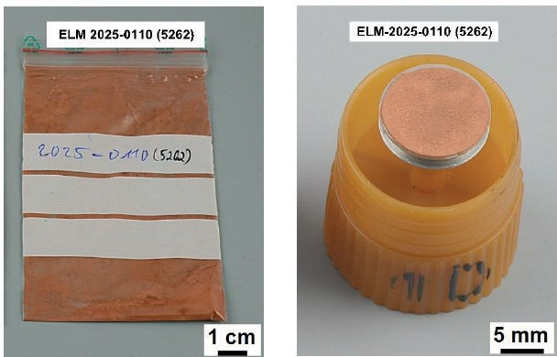
Sample taking ID: ISE-ST2025437 Inspection ID: ISE-IR20252501 Valuation ID: ISE-V202511468
SKR-20251032
Particle analysis by scanning electron microscopy (SEM)
The client submitted a sample of copper powder for semi-quantitative visualisation of the grain size and grain structure using a scanning electron microscope (SEM).
The sample has the following designation: ELM-2025-0110 (5262)
A portion of the copper powder from the sample bag was transferred to a carbon pad and examined in the SEM at magnifications of up to 3000x.
The grain size was analysed using circular radius measurements for round particles and distance measurements for elongated particles. The evaluation of grain size and grain structure is summarised in the following table:
 | roundish particles |  | elongated particles
 | round | rougher | dendritic structure
percentage | < 50% | 0% | > 50%
ELM-2025-0110 (5262) | 0,6 – 1,2 μm | ––– | 13- 48 μm
Conclusion
The powder sample exhibits a non-uniform particle size distribution. Over 50% of the particles possess a dendritic morphology, with sizes ranging from 13 to 48 μm, while the remaining particles (less than 50%) are predominantly round in shape, measuring between 0,6 and 1,2 μm.
Customer: Mercury Natural Resources GmbH
4
Institut für Seltene Erden und Metalle AG
Furrengasse 21, Postfach
6000 Luzern 6, Schweiz
Email: Info@ise-ag.com
Phone: +41-41 5 11 11 20
Web: www.ise-ag.com
Handelsregisteramt Luzern
CHE-456.752.545
Verwaltungsrat: A. Uhlendorff

Slide 5
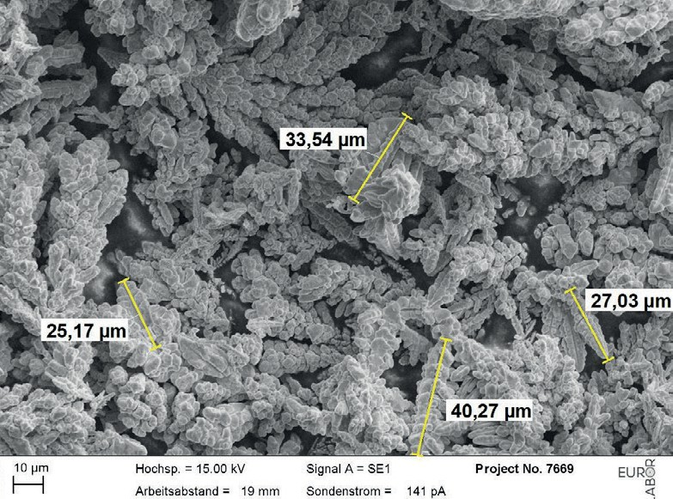
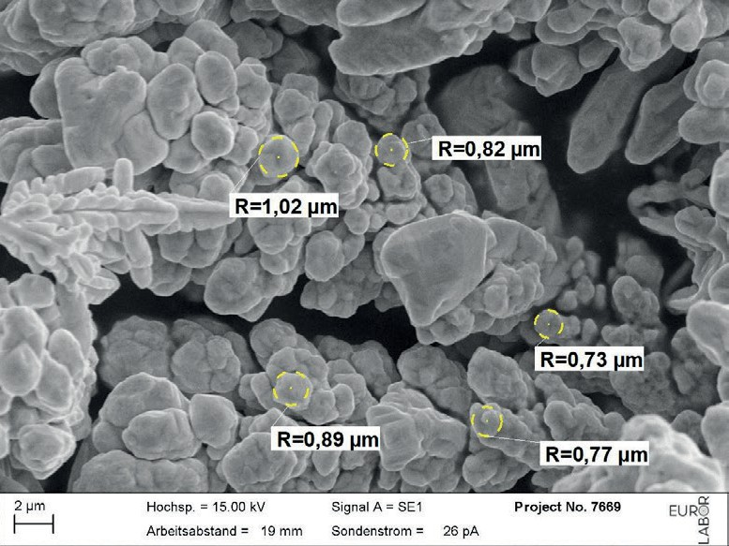
Sample taking ID: ISE-ST2025437 Inspection ID: ISE-IR20252501 Valuation ID: ISE-V202511468
SKR-20251032
Figure 1: ELM-2025-0110 (5262), overview of area 1 elongated dendritic struсtures, approx. 25- 40 µm.
Figure 2: ELM-2025-0110 (5262), detail from image 1
roundish particles, approx. 0,7- 1,0 μm.
Customer: Mercury Natural Resources GmbH
5
Institut für Seltene Erden und Metalle AG
Furrengasse 21, Postfach
6000 Luzern 6, Schweiz
Email: Info@ise-ag.com
Phone: +41-41 5 11 11 20
Web: www.ise-ag.com
Handelsregisteramt Luzern
CHE-456.752.545
Verwaltungsrat: A. Uhlendorff

Slide 6
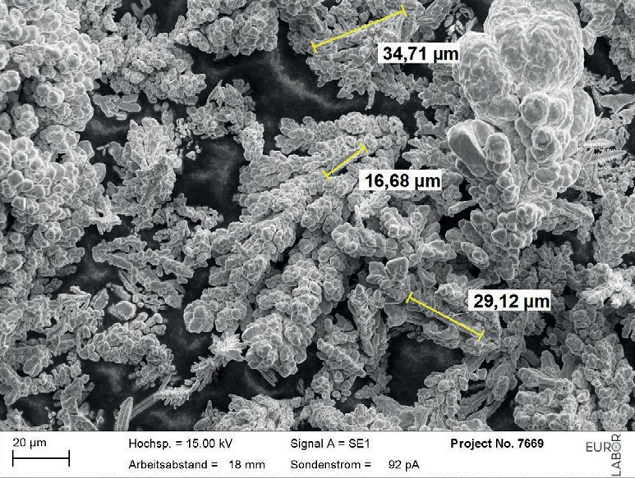
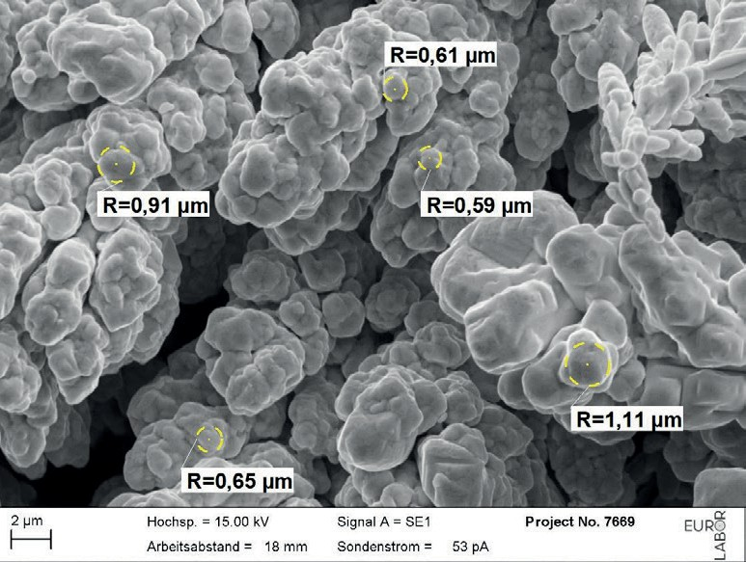
Sample taking ID: ISE-ST2025437 Inspection ID: ISE-IR20252501 Valuation ID: ISE-V202511468
SKR-20251032
Figure 3: ELM-2025-0110 (5262), overview of area 2, elongated dendritic structures, approx. 17- 35 µm.
Figure 4: ELM-2025-0110 (5262),detail from image 3 roundish particles, approx. 0,6 - 1,1 μm.
Customer: Mercury Natural Resources GmbH
6
Institut für Seltene Erden und Metalle AG
Furrengasse 21, Postfach
6000 Luzern 6, Schweiz
Email: Info@ise-ag.com
Phone: +41-41 5 11 11 20
Web: www.ise-ag.com
Handelsregisteramt Luzern
CHE-456.752.545
Verwaltungsrat: A. Uhlendorff

Slide 7
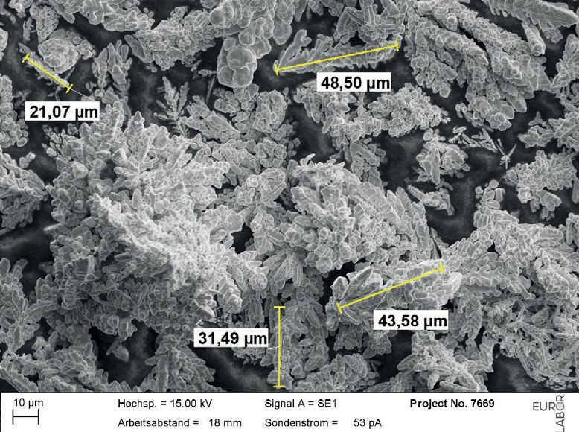
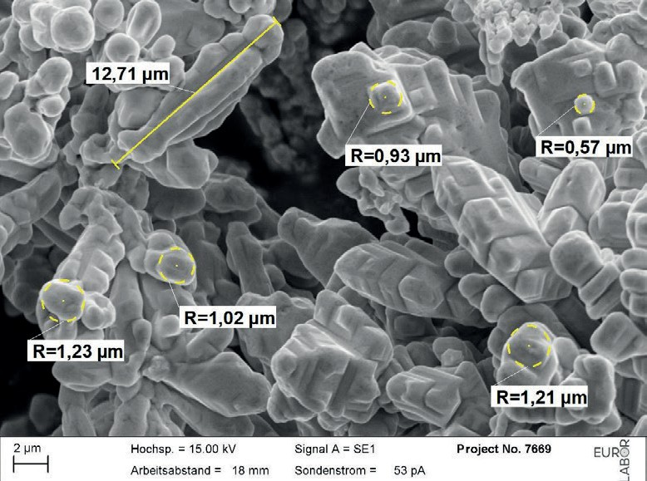
Sample taking ID: ISE-ST2025437 Inspection ID: ISE-IR20252501 Valuation ID: ISE-V202511468
SKR-20251032
Figure 5: ELM-2025-0110 (5262), overview of area 3 elongated dendritic structures, approx. 21 - 48 µm.
Figure 6: ELM-2025-0110 (5262), detail from image 5
roundish particles, approx. 0,6- 1,2 μm, elongated dendritic structures, approx. 13 µm.
Customer: Mercury Natural Resources GmbH
7
Institut für Seltene Erden und Metalle AG
Furrengasse 21, Postfach
6000 Luzern 6, Schweiz
Email: Info@ise-ag.com
Phone: +41-41 5 11 11 20
Web: www.ise-ag.com
Handelsregisteramt Luzern
CHE-456.752.545
Verwaltungsrat: A. Uhlendorff

